Slide 1



Long-acting antiretroviral therapy in sub-Saharan Africa
Dr Fiona Cresswell
NIHR Academic Clinical Lecturer, Brighton and Sussex Medical School, UK
Research Fellow, Clinical Research Department, LSHTM, UK
Research Associate Infectious Diseases Institute Uganda
Honorary Fellow MRC-UVRI-LSHTM Uganda Research Unit, Uganda
Notes:
Hello Harare, Hello MRC, I’m Fiona.
I recently completed my PhD in Uganda and I’m in my first year of a part-time NIHR ACL in Brighton.
I’m going to talk to you about the importance of long-acting antiretroviral therapy in Africa

Slide 2

What’s she doing in the TB session?
And without any of my own data to present?!
Notes:
What’s on earth is she doing in the TB session? And with none of my own data to present? Not a single p value!

Slide 3
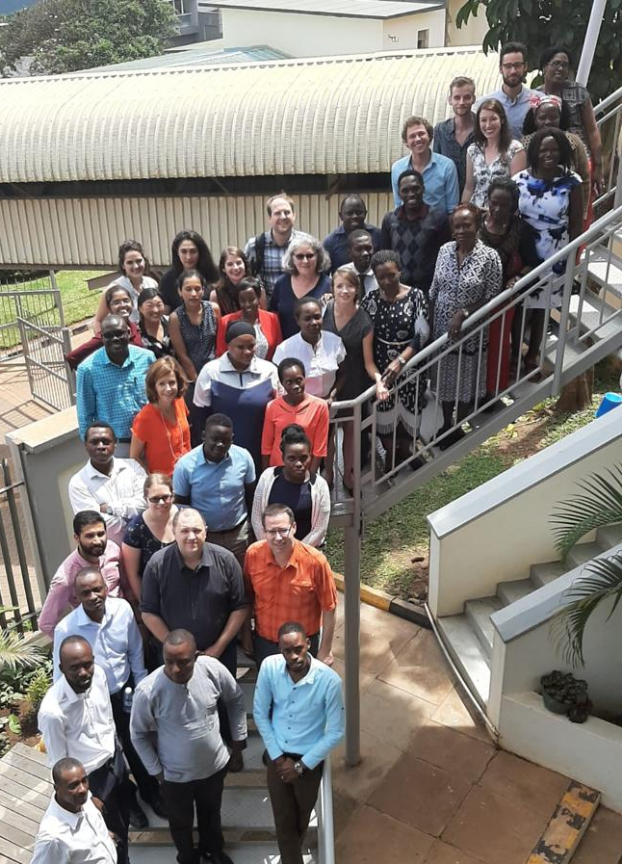

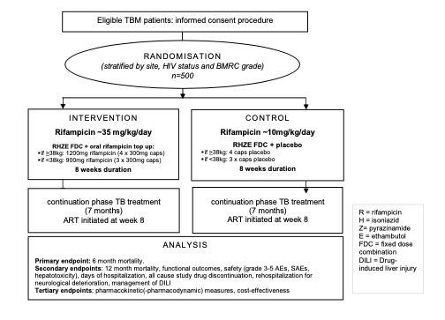
Initials, age, sex | HIV status ART | Clinical staus | CSF findings | Hospital outcome
NGX, 28, F | +, TDF/3TC/DTG 2 yrs, CD4 19 Poor adherence | GCS 10/15, Left hemiplegia Seizures | WBC <5 Ultra positive | RIP
MPZ, 34, M | +, TDF/3TC/EFV, CD4 24 Poor adherence | GCS 6/10, CNVII palsy Grade 4 pressure sores | WBC 125 (95% L) Ultra negative | Remains in hospital at 4 weeks
MLN, 22, F | +, ART naïve, CD4 87 | GCS 12/15 Paraplegia | WBC 320 (100% L) Ultra positive | RIP
Why is long-acting ART relevant to TB?
Notes:
Well, in an African setting where the HIV and TB epidemics are So inter-twined I believe LA ART is highly relevant to TB.
The interest in LA ART grew out of observing the drivers of TB meningitis in an ongoing phase III randomized clinical trial of high dose rifampicin that I’m involved with the people pictured.
This is an excerpt from the rounding sheet in Uganda– you’ll see our patients are young, over 90% are HIV positive, almost all with low CD4 counts, devastating neurological deficits at presentation, almost 50% die and half of survivors are left with life-altering disabilities.
The unifying driver in many is poor adherence to their oral ART regimen.
When outcomes are so dire, and healthcare systems so fragile, surely prevention of TBM is going to be better than cure!
Long-acting ART may be an important tool in this pursuit

Slide 4
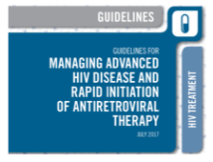
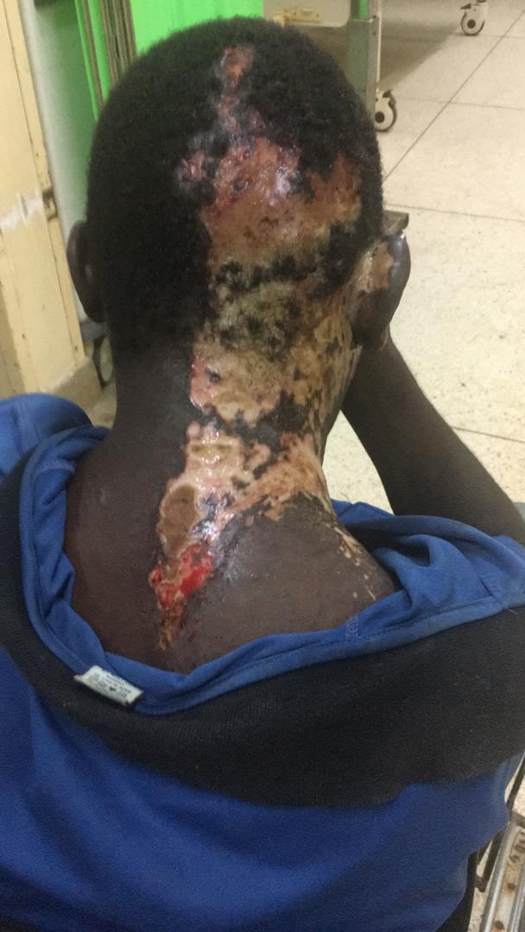
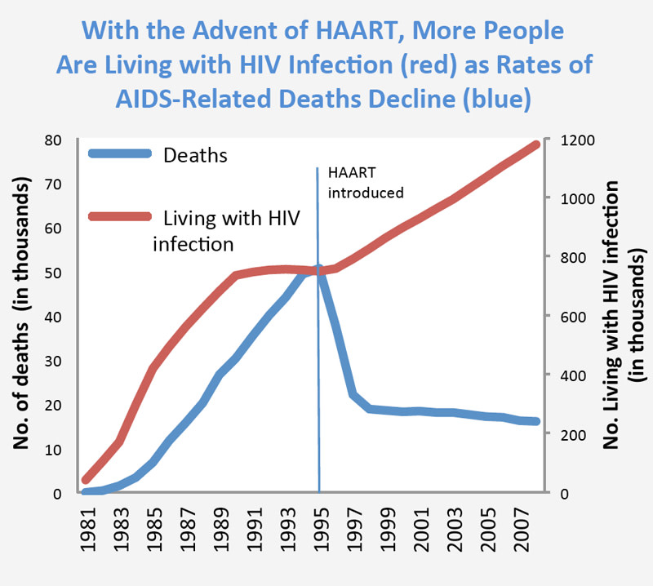
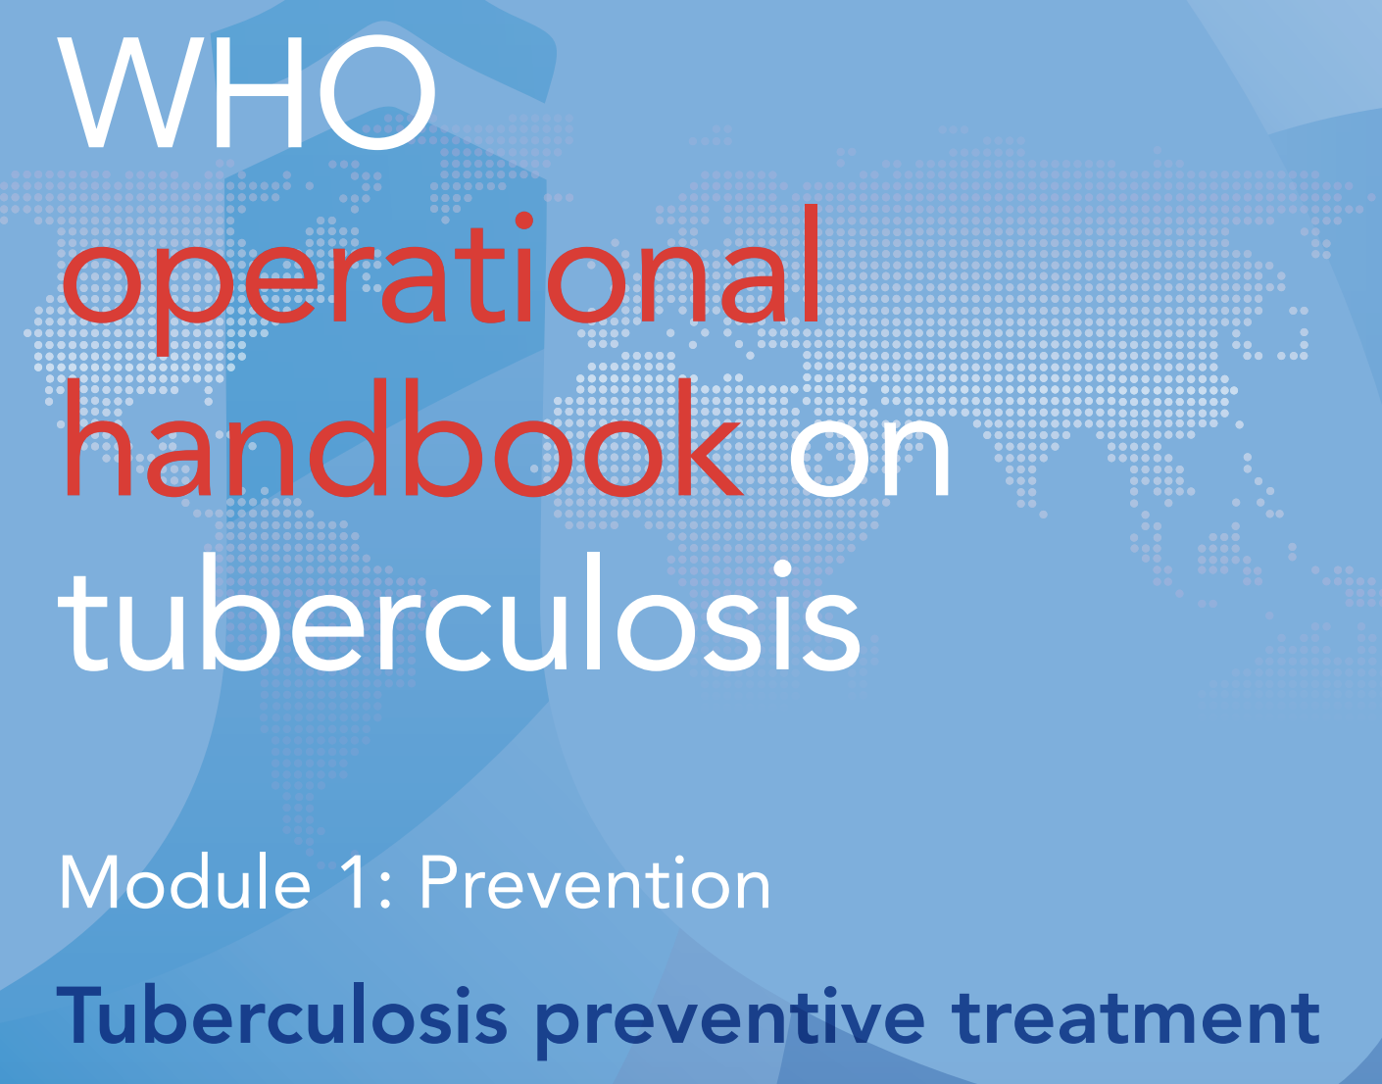
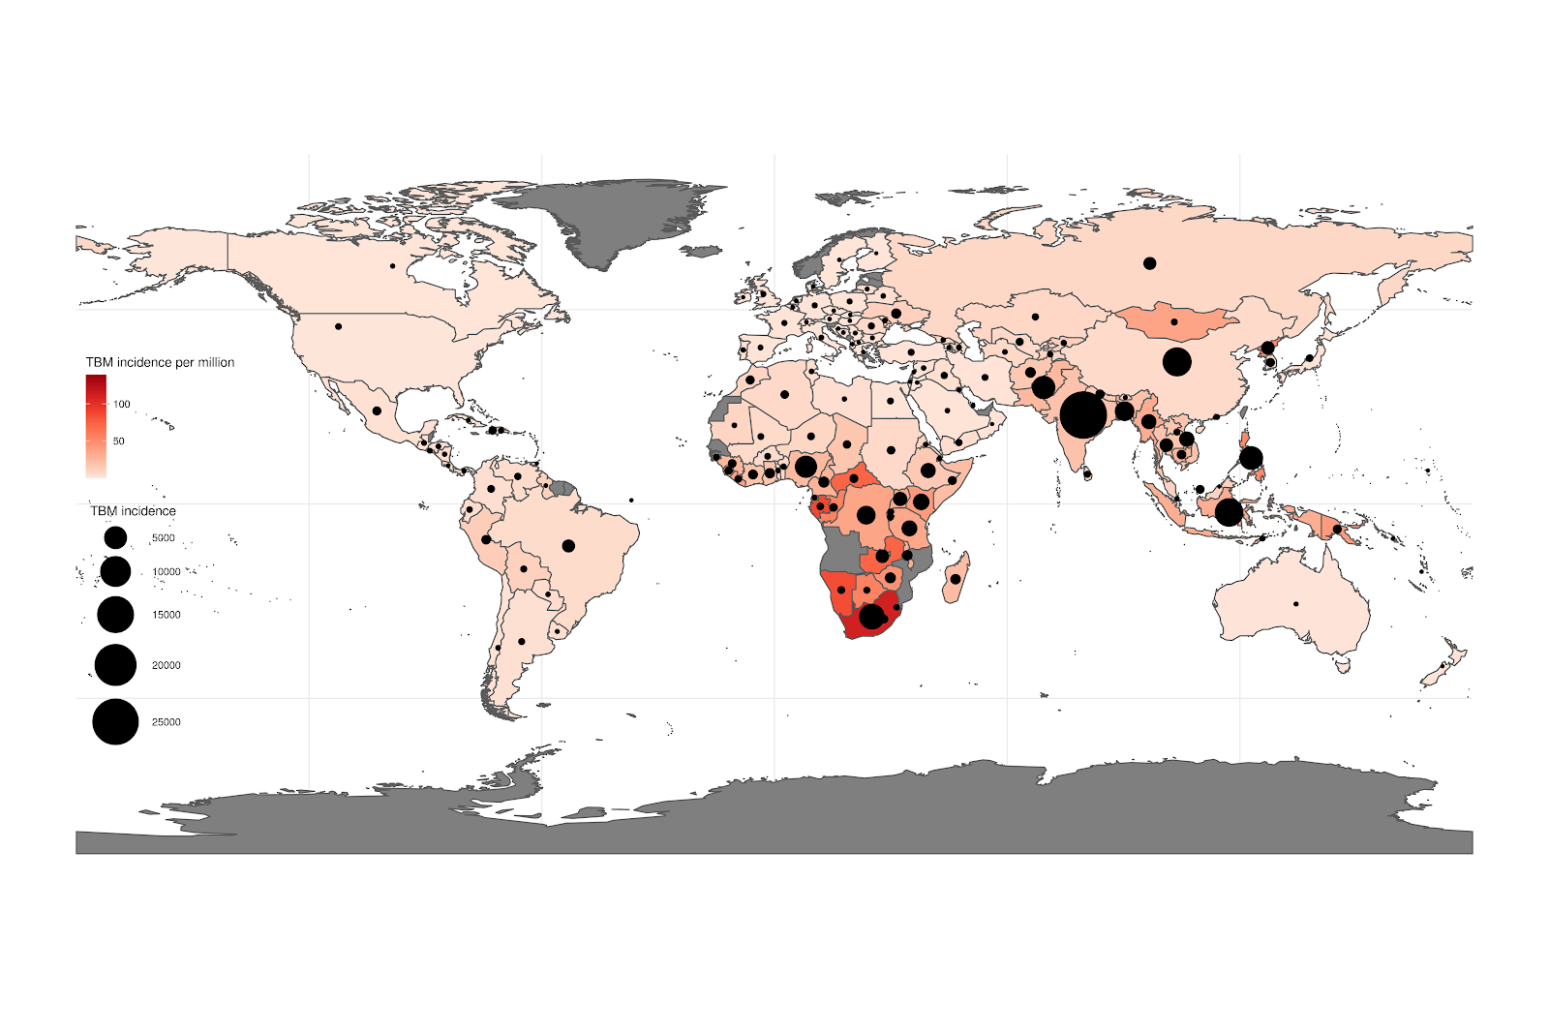
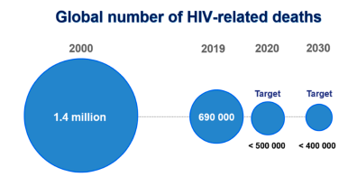
Deaths from advanced HIV disease are stuck
Mortality has plateaued, ~700,000 in 2020, >50% from advanced HIV
  TB (TBM contributes disproportionately to deaths)
  Bacterial infections
  Cryptococcal meningitis
  Viral infections
  PCP, Toxoplasmosis
  HIV-related cancers
TB meningitis:
164,000 cases in 2019
80,000 deaths
~5% of TB in PLHIV
CFR 27% overall
CFR 57% in HIV
1/3rd of advanced HIV are late diagnosis
  weak testing systems, linkage to care, stigma
2/3rd are ART-experienced
  Toxic drugs
  Drug resistance
  Imperfect adherence
  Disengagement from care,
  Stigma
UNAIDS Targets
Dodd PJ. Global burden of tuberculous meningitis. PLOS global public health. 2021.
Notes:
This doesn’t just apply to TB meningitis.
As Joe and Jayne so eloquently explained yesterday, the decline in deaths has flat-lined and we failed to reach the UNAIDS target of <500,000 HIV-related deaths
Improving diagnostics and treatment of OIs is really important
WHO have produced guidelines on management of AHD and it’s encouraging that TB preventative therapy is being scaled up.
What about turning off the tap on AHD in the first place?
Where are the key points to intervene in the HIV care cascade?
Late diagnosis due to weak testing systems makes up around a third of AHD diagnosis, so strengthening testing systems is important, you’re going to hear about HIV self testing shortly from Professor Corbett.
But, 2/3rd of people with AHD are ART-experienced.
The reason the drugs have failed them are multifactorial reasons and include- little choice in drug regimens, NNRTI resistance (the roll of DTG will help with this), the fastidious daily oral pill taking required to to maintain virological suppression, leading to disengagement in care.

Slide 5
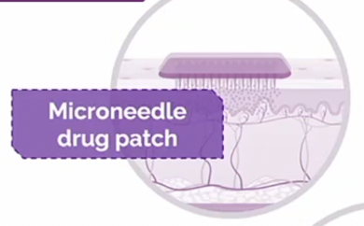
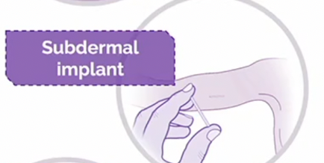
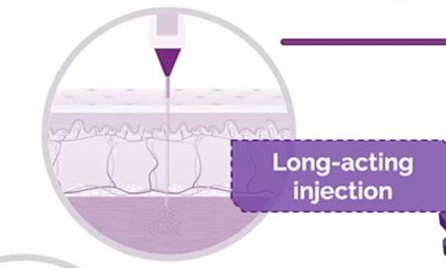

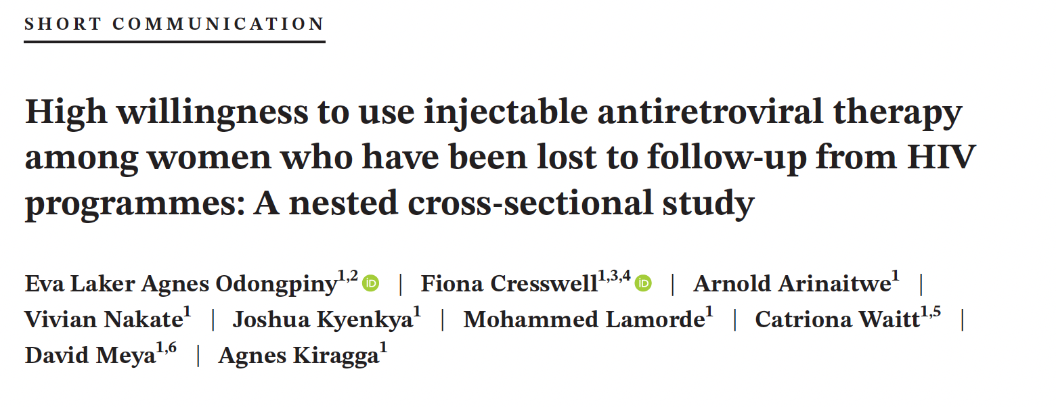
Would HIV outcomes be better if treatment was discreet and dosing intervals were longer?
Notes:
Many PLHIV do not like the daily reminder of their HIV status, fear of HIV status disclosure, through pill bottles being discovered in the home environment is a genuine concern.
The U=U message hasn’t really broken in most parts of Africa and stigma is constant burden to individuals.
We recently published some work from women who had become LTFU from PMTCT programmes, that showed a real interest in a discrete form of ART and high willingness to re-engage if they were offered LA ART.
What would HIV outcomes look better if treatment was invisible and dosing intervals were longer?
Monthly microneedle patches have been successfully used to deliver rilpivirine nanoparticles through the skin in animal models
Or two-monthly IM injections of cabotegravir and rilpivirine means there’s only 6-dosing intervals a year
Or perhaps in future drug-eluting implants will be available for HIV treatment – tenofovir eluting implants are already looking quite promising for HIV prevention.

Slide 6
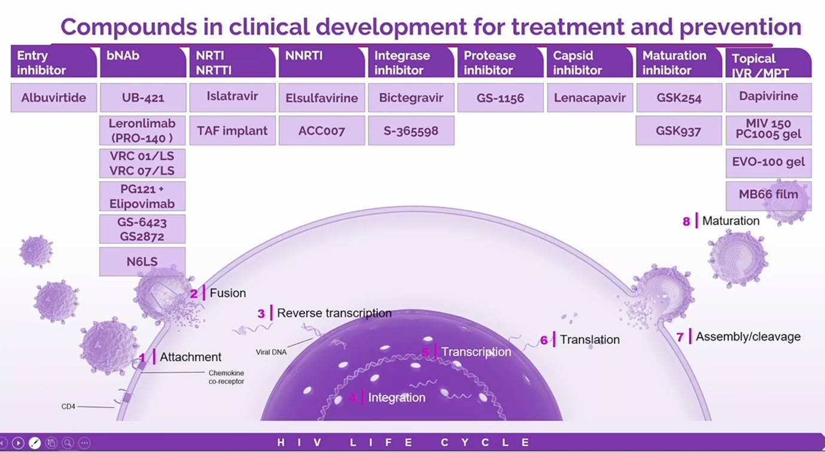
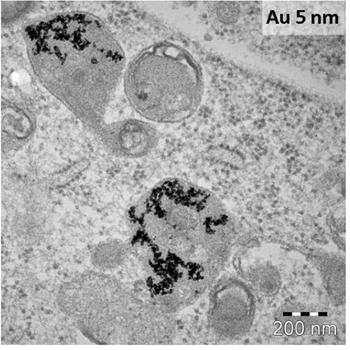
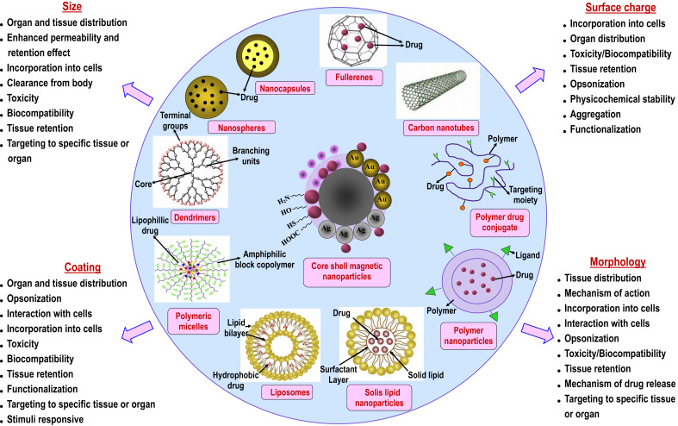
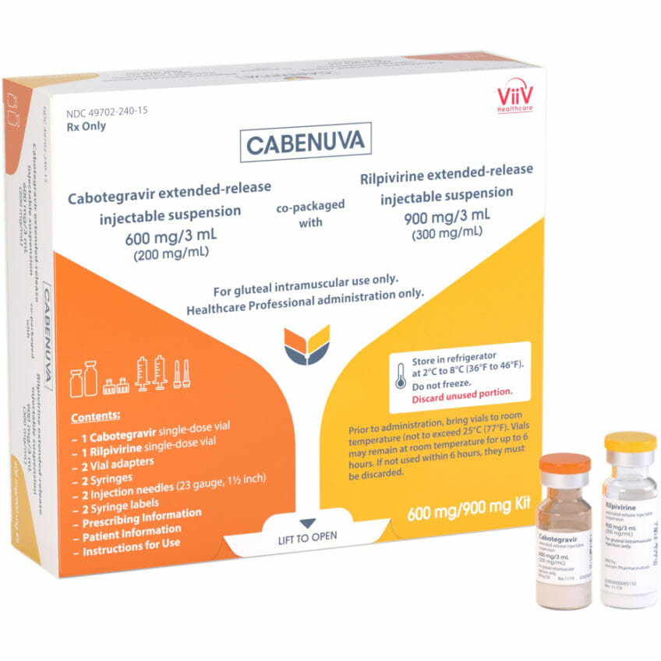
T1/2 ↑ ~50-fold
Slide from Prof Chloe Orkin. CROI plenary 2022.
Notes:
The future is looking bright on the long-acting front, lots of drug in the pipeline and nanotechnology is now being leveraged to change the pharmacokinetics of HIV drugs (and TB drugs for that matter!).
The front runner regimen of cabotegravir / rilpivirine is just being rolled out in select patients in the UK.
Nanocrystals form a depot at the injection site, from which drug is slowly released. Secondary depots form in the lymphatics, macrophages and lymphocytes.
This has increased the half-life almost 50-fold and means that drug is still detectable a year after a single injection.

Slide 7
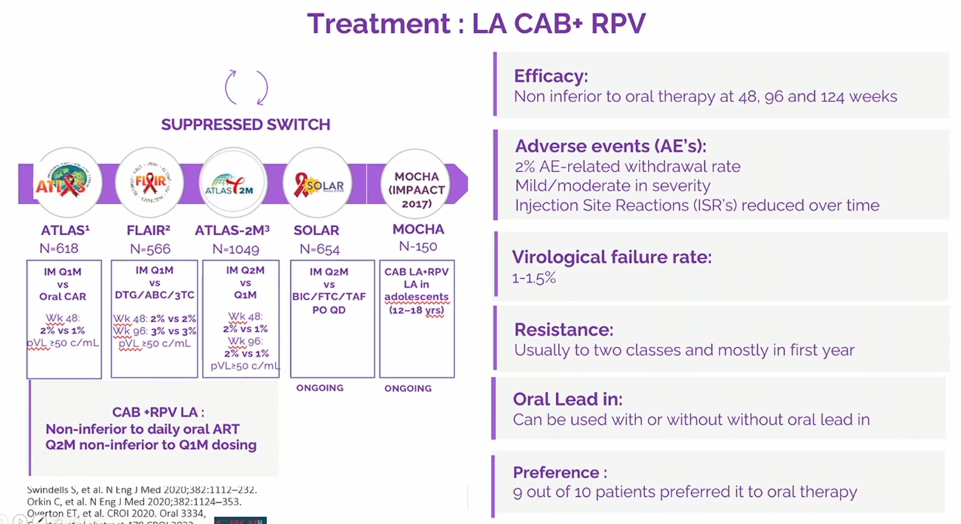
Efficacy: Q1M LA CAB+RPV is non-inferior to oral ART, Q2M non-inferior to Q1M
Safety: 2% withdrawal, Injection site reactions common but reduce over time
Virological failure rate: 1-2%
Resistance: usually NNRTI + INSTI, mostly in first year
OLI v’s DTI: equally safe but license mandates offering oral lead in
Satisfaction: 9/10 prefer it to oral therapy
2-monthly IM cabotegravir + rilpivirine
Notes:
There’s a fair amount of clinical trial data on CAB/RPV now, what we know so far is that.
It is non-inferior to oral ART
It is safe, the injections are very painful but become more tolerable over time
About 2% get virological failure, mostly with 2 class resistance, which is a concern
But – 9/10 people prefer it to oral therapy, that to me says a lot, and shows how important this could as a way of increasing treatment satisfaction and retaining people in care!

Slide 8
ADVANTAGES
Increases choice
Invisible / discreet / less stigmatising
High levels of satisfaction with LA CAB/RPV
Directly observed therapy
Less frequent dosing
Two drug regimens avoid NRTI toxicity
No requirement for dosing with meals
Fewer DDIs with parenteral formulations
Possibility of co-formulation or co-administration with other long-acting drugs e.g. contraception
DISADVATAGES
Long tail risks emergence of viral resistance (2 class)
Lower genetic barrier to resistance than DTG, PIs
Injectable drugs can’t be rapidly withdrawn if toxic
Injections visits are time consuming to clinics
Injections are painful, ISRs are common
Skills required for insertion / removal of implants
Need to offer oral lead-in with CAB/RPV and oral bridging
Higher cost than oral treatment
TDF & 3TC free LA regimens are not suitable for people co-infected with hepatitis B (what about prior infection?)
DDIs associated with drug metabolism - CAB/RPV can’t be used with TB treatment
Notes:
This option has multiple advantages, PLHIV community really want it, it will change many people’s lives for the better and it will stop some people progressing to AHD.
However, it will not be a panacea!
There are multiple concerns – the regimen has a lower barrier to resistance than dolutegravir even if all injection visits take place on schedule, people who get an injection then go AWOL will have long tail period of diminishing drug in their system which is the perfect setting for resistance to emerge.
Integrase inhibitors are the most important class of drug worldwide and we don’t want to compromise it
Importantly for SSA, the regimen cannot be given with TB treatment
And importantly for Africa – this regimen in free of tenofovir / 3TC so cannot be used in people with Hepatitis B co-infection. Can it be used in people with prior Hep B infection? We don’t know!

Slide 9


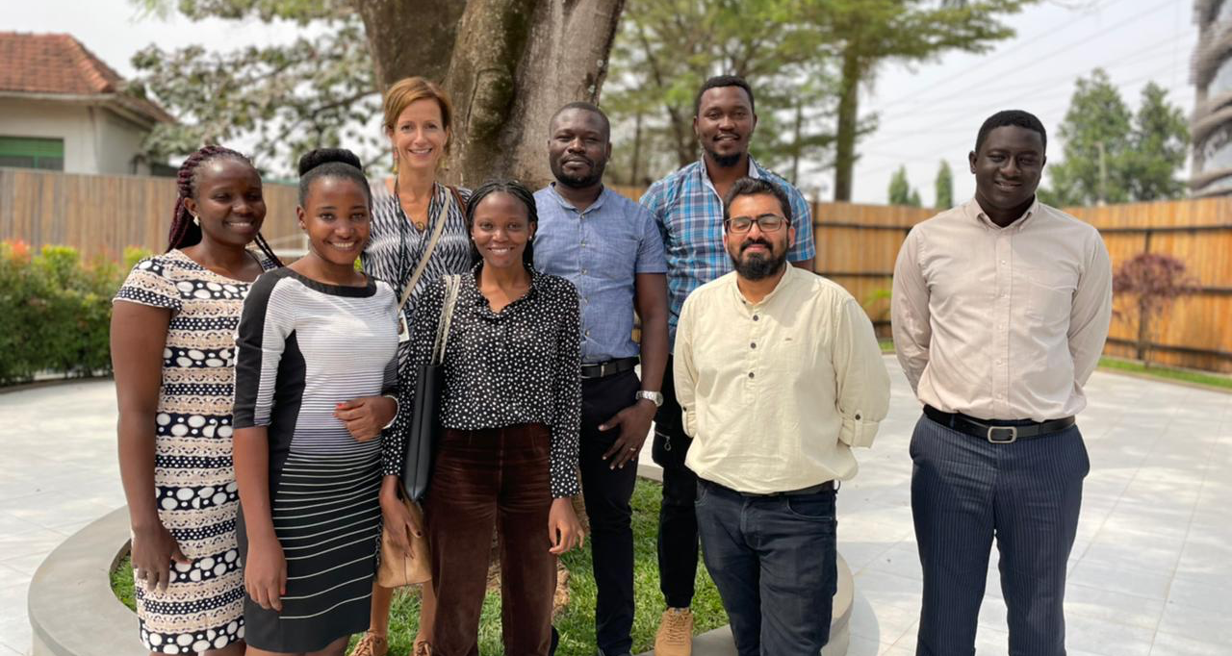
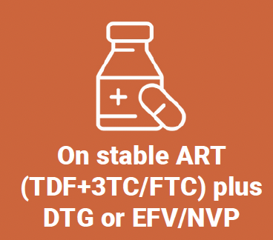
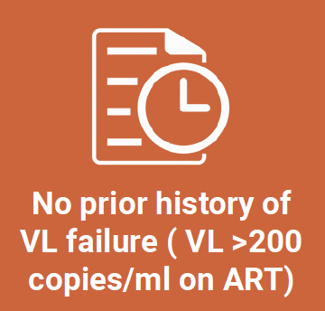
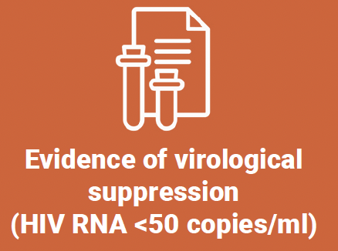
No
How generalizable are these trial results to African settings?
Trial | N | Age | Male | White | CD4 | Hep B | Pregnant
ATLAS | 616 | 42 (18-82) | 67% | 68% | 92% >350 | 0% | 0%
ATLAS2M | 1049 | 42 (34-51) | 73% | 73% | 642 (499-827) | <1% | 0%
FLAIR | 566 | 34 (18-68) | 78% | 74% | 93% >200 cells/ml | 0% | 0%
65% of PLHIV are in sub-Saharan Africa
103/2231 = 4.6% of participants from Africa (all S. Africa)
Frequency of VL and safety blood monitoring
Exclusion criteria
Baseline DRT in all: NNRTI or INSTI RAMs -> EXCLUDED
No baseline DRT, but….
Notes:
How generalizable is the trial data to an African context?
Well, the trial population were young, largely male, largely white, high CD4 counts, Hep B excluded, pregnancy/BF excluded,
Despite the fact that 65% of the PLHIV worldwide are in Africa.
In fact, only 5% were recruited from Africa, all from SA.
the list of exclusion criteria were as long as your arm.
Importantly, baseline resistance testing was done in all trial participants and anyone with RAMs was excluded.
Can these results be generalized to an African context? I would argue No!
The first RCT of this regimen is underway in Africa and we are a study site at IDI.
No DRT is being done and VL testing 6-monthly, which just about reflects programmatic care.
Individuals need to be on a stable first-line regimen, never had a viral load > 200 whilst on ART – by definition the EASY to treat population.
This is an important first step in getting African data but it doesn’t include the population who need this regimen the most – those who have had adherence challenges in the past.
Perhaps it’s too risky to test this relatively brittle regimen in that group? Something I agonized about.

Slide 10
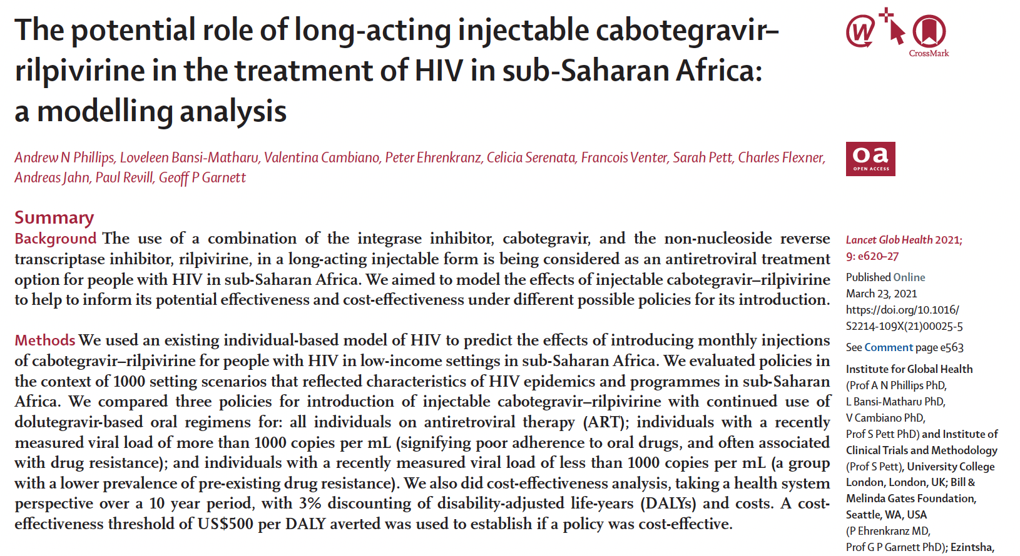
Individual-based simulation model, series of settings similar to sub-Saharan Africa.
Comparator DTG-based ART. If 2x VL >1000 c/mL switched to b-PI. Assumed that VL monitoring in place, but with varying levels of implementation across settings.
Outcomes: % on ART with viral suppression, AIDS-related deaths, DALYs, net DALYs (cost-effectiveness threshold of US$500 per DALY averted).
Modelling transition to LA CAB + RPV for three groups:
  ALL people on ART;
  Most recent VL >1000 c/mL (tendency for poorer adherence to oral drugs);
  Most recent VL of <1000 c/mL (lower prevalence of pre-existing drug resistance).
Introduction of LA CAB/RPV vs no introduction | All ART | VL >1000 | VL <1000
Diff in VL of <1000 c/mL, % | +5.3% | +4.1% | +3.0%
Diff in AIDS-related mortality, per 100 person-yrs | -0.19 | -0.17 | -0.05
Diff in integrase inhibitor resistance, % | +0.8% | -0.4% | +1.0%
Diff in NNRTI resistance, % | +4.3% | +1.5% | +3.4%
Median cost per DALY averted (90% range) | $1638 | $404 | $2808
US$120 per year
VL >1000 c/mL
Cost per DALY averted of $404 across all settings
Least contribution to resistance
Notes:
Thankfully modelling work from UCL published in Lancet HIV last year suggests that the benefits actually outweigh the risks in the harder to treat group.
Andrew Philips used an individual based simulation models across a series of programme settings similar those in SS-Africa, using a comparator of DTG-based ART.
They examined implementation of CAB/RPV in 3 different approaches:
ALL ART is switched
VL>1000, poorer adherence group
VL<1000, lower risk of resistance
The greatest benefit was seen in those with a viral load of more than 1000 c/m in terms of increase in virological suppression, least additional resistance and cost-effectiveness.
This modelling approach really helps to identify the population who stand to benefit the most.
But WHO are not going to recommend this regimen until we have some data from this population
And I hope that we can generate this data with an upcoming study called Impala

Slide 11

IMPALA: Improving HIV control in Africa with Long-Acting Antivirals
SCREENING, N=756
PLHIV with history, or high risk of, suboptimal adherence/engagement
Optional 1 month oral lead in
OPTIONAL
REAL WORLD EXTENSION
Long-term durability
LA ART CAB/RPV
IM Q8W
N=270
LA RPV / CAB IM
600 mg / 900mg
IM Q8W
SCREENING
PHASE
Virologically suppressed for >3 months at the end of screening
2NRTI + DTG
1. Documented detectable HIV1 VL >1000 c/ml in the prior 2 years despite being on oral ART for > 3 months
2. History of LTFU (>4 weeks elapsed since a scheduled clinic appointment / refill in prior 2 years
3. Unlinked to HIV care despite >3 months elapsing since HIV diagnosis
4. Key population (MSM, sex-worker, transgender, drug user, adolescent/young adult 18-25 y.o.)
N=270
2NRTI + DTG
OPTIONAL
REAL WORLD EXTENSION
Long-term durability
LA ART CAB/RPV
IM Q8W
Randomisation 1:1
-4 mths - 2 wks day 1 12 months 24 m 48m
Anyone on EFV or NVP will be required to switch to DTG prior to screening
Must have on DTG for >1 month prior to randomisation
Confirmation of total duration of virological suppression >3 months prior to randomisation
⇡
Primary endpoint – HIV VL<50
Secondary endpoints: engagement in care, VL >200, VL> 1000, HIV disease progression, drug resistance, safety, acceptability, cost-effectiveness
↑
Confirm VL <200
⇡
Termination
Storage of plasma and PBMCs @ randomisation
Exclusion criteria
Notes:
This trial seeks to recruit those with viral load >1000 despite being ART-experiences, people with a history of non-engagement in care, key populations, young adults 18-25 in 3 African countries.
So, all being well, the LSHTM Uganda research unit will be the coordinating centre of this Janssen funded study.
The list of exclusion criteria will fit on my hand

Slide 12



Pregnancy and breastfeeding?
HepBcAb positive individuals?
Liver experiences?
Can baseline factors predict whether LA CAB/RPV is going to be a successful regimen or not – prior regimens, BMI, geographical region, comorbidities?
Dose adjust to overcome rifampicin interaction?
Dose-adjust to overcome resistance?
What happens in the ‘real world / public health setting’?
Cost-effectiveness?
How to handle people missing injection visits?
Can clinics really manage cold chain?
How often to test viral load?
How to treat those who fail injectables?
Notes:
There are a number of other implementation-related questions – WRT to the individual, the service delivery and the drug itself, that I hope to address through this trial and parallel studies.

Slide 13

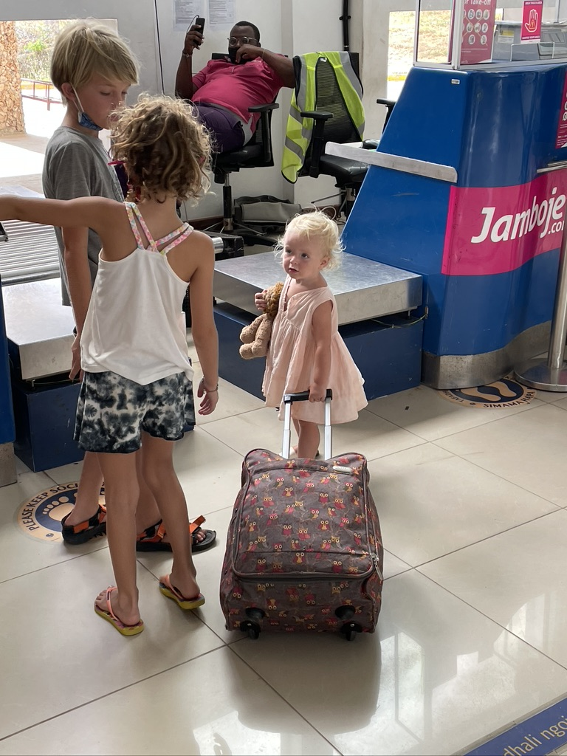


Eleanor Martins and others!
Professor Jaime Vera
Professor Shunmay Yeung
Professor Rashida Ferrand
Professor Alison Elliott
Professor David Meya
HARVEST study team
CARES study team
THANK YOU!
Notes:
I hope that by the time of the next meeting I’ll have some data to present

