Slide 1





COVID-19 vaccine uptake in Zimbabwe
Tinotenda Taruvinga
Global Health Department
Faculty of Public Health and Policy

Slide 2

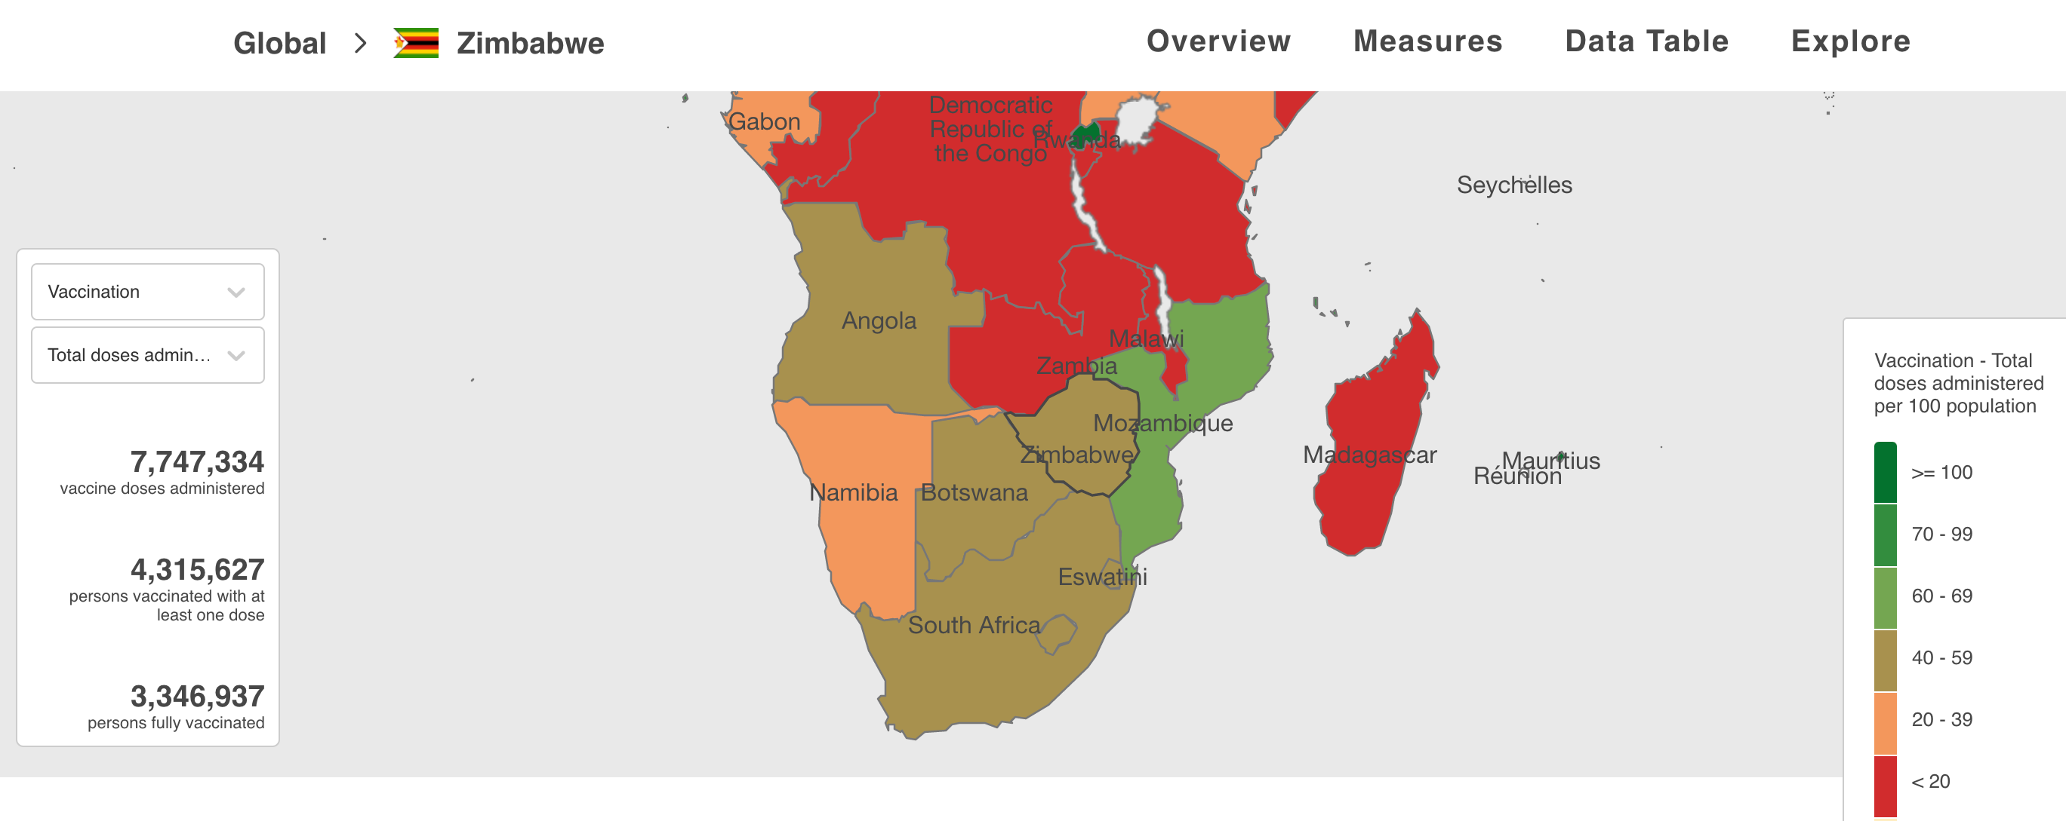
COVID-19 vaccination in SSA
3% of 8 billion doses given globally are in Africa
About 8% Africans are considered fully vaccinated (WHO 2021)

Slide 3
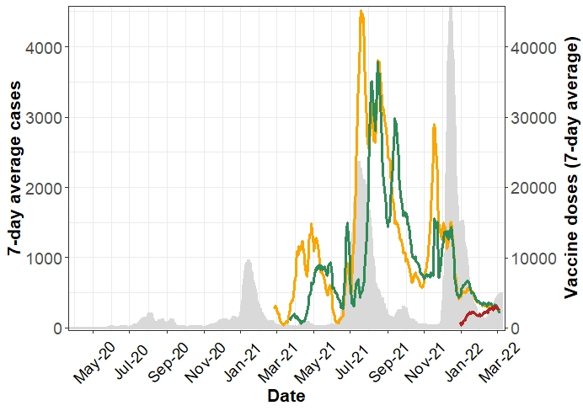
Vaccine uptake in Zimbabwe

Slide 4
Methods
Data collected across four studies
Quantitative data: health care workers (HCW), population
Qualitative data key informant and in-depth interviews (June-Dec 2021)

Slide 5
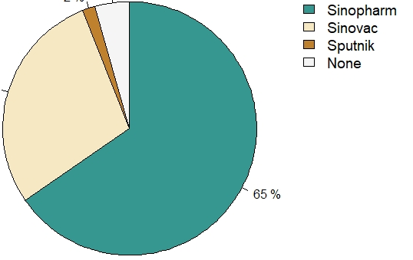
Vaccination - HCWs
96% self-reported having received at least one dose of COVID-19 vaccine
Most common reason (40%) for not getting vaccinated: pregnancy, breastfeeding or trying to conceive
29%
65%

Slide 6
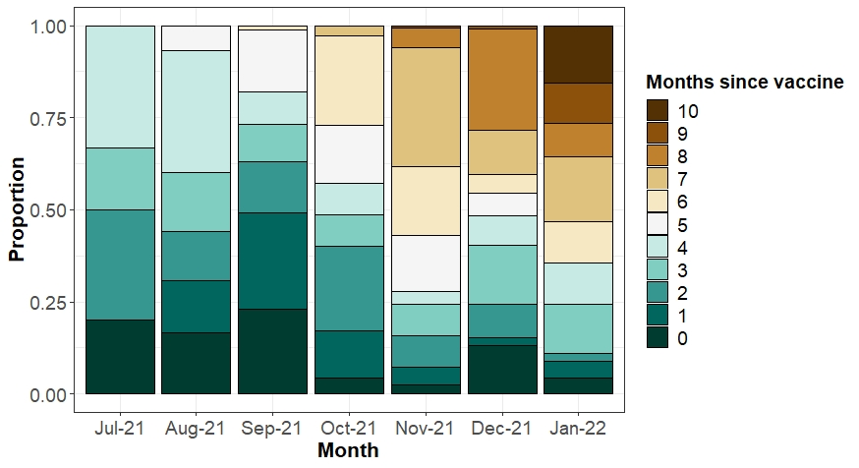
Time since vaccination - HCWs

Slide 7
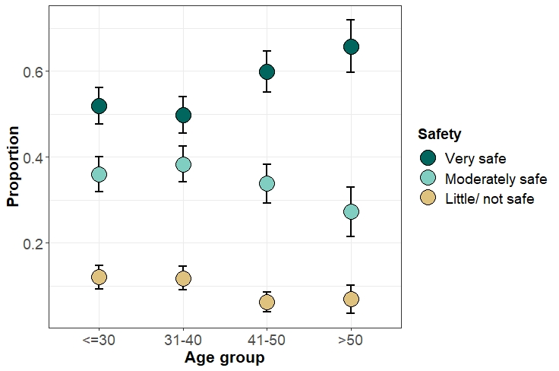
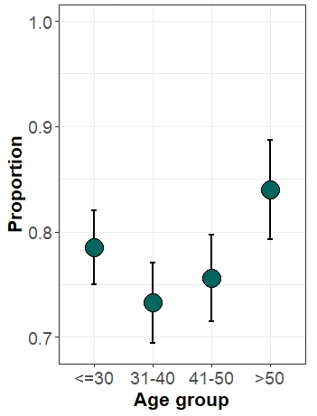
Perceptions - HCWs
HCWs perception of vaccine safety
HCWs reporting that their family members & friends have been vaccinated?

Slide 8
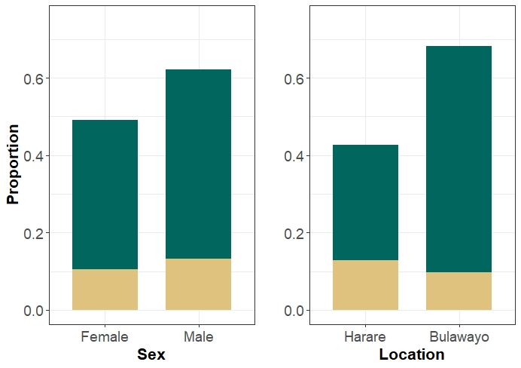
Vaccination uptake – general population
Reasons for not getting vaccinated:
22.3% Safety concerns
22.2% Worries about side effects (other than fertility)
19.2% Worries about dying 2 yrs after vaccination
15.7% Vaccine ineffectiveness
12.9% Concerns about fertility
green = 2 vaccines, yellow = 1 vaccine

Slide 9
HCWs vaccine uptake perceptions
Misinformation-fear of being dead after two years
“If you are injected then you will die after 2 years, and it was something that made me low. When I got vaccinated, I didn’t even tell anyone. Because I was afraid that if you tell them you were vaccinated, they will say you are dead already”[F41]
Vaccine mistrust based on origin
“Origin was the major issue, like China, USA, so that’s why people were worried, why is it that we are getting the vaccines from countries that are most affected” [M33]
Churches (religion) have a major influence on vaccine uptake
  “Well, there is a huge issue at churches especially at my church the pastors have not yet been vaccinated. They are saying the vaccine is satanism. They say we will be protected by the Holy Spirit. The archbishop told us not to get vaccinated” [F41]

Slide 10
Reasonable risk assessment
Fear of getting infected and dying of COVID-19
  “It is important because here at the hospital we meet a lot of people. Some come and they are sick of COVID. Some that come for treatment, so you see that you meet a lot of people at the hospital. So, the vaccine is important to us” [F41]
Other people’s stories as motivation to get vaccinated
  “When a lot of people where now getting vaccinated, people were now being encouraged to get vaccinated and they were even now pestering me that because you work at the hospital can you help me get vaccinated” [M33]

Slide 11
Vaccine as a requirement
Employment
  “I do not know exactly but people come here and say I have been told that if am not vaccinated then I should not come to work. So, they would have come because of work but I don’t know maybe with time they would realise that it is important” [M52]
Access social services and certain institutions
  “What is pushing people mostly it is because nowadays you cannot do anything without being vaccinated, everything you want to do, you have to be vaccinated that is what pushing a lot of people, for you to go to university, to go to work, you need to have a vaccination card, so people realise it is the only way out” [M33]

Slide 12
Conclusion
High vaccine uptake especially among healthcare workers
Recently vaccine uptake slowed down (might reflect eligible population)
Vaccine availability, trust and misinformation have been identified as barriers to COVID-19 vaccine uptake

Slide 13












Acknowledgements
Study Teams
Rudo S. Chingono
Vicky Simms
Ioana Olaru
ICAROZ team
MaCoCo team
TAZ team
CHIEDZA team
Sibusisiwe Sibanda
Data team
Tsitsi Bandason
Nicol Redzo
Supervisors
Justin Dixon
David McCoy
Katharina Kranzer
John Metcalf
Advisors
Lucy Gilson
Christian Bottomley
The study participants

