Slide 1




Acceptability and Effectiveness of Menstrual Health & Hygiene (MHH) Intervention Among Young Women in Zimbabwe
Mandi Tembo (PhD Research Fellow)
Global Health and Development Department
Faculty of Public Health and Policy
LSHTM/BRTI

Slide 2
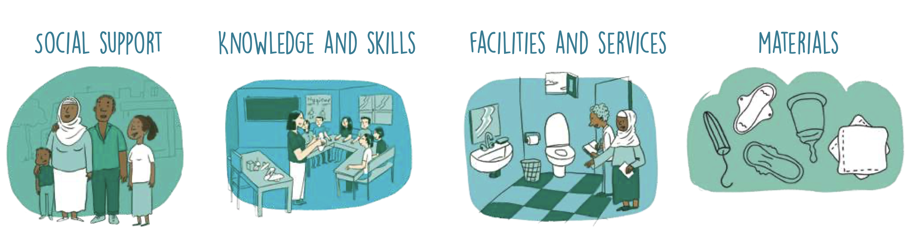
Defining MHH
… is menstrual hygiene management (MHM) and the broader systemic factors that inform menstruation and menstrual experiences
1. UNICEF. Guidance on Menstrual Health and Hygiene. www.unicef.org/wash: UNICEF, WASH; 2019 March. Report No.

Slide 3
Background
LACK OF ACCESS TO MHH EDUCATION, PRODUCTS, AND SUPPORT
MHH NOT A HEALTH OR RESEARCH PRIORITY
POOR PHYSICAL AND PYSCHOSOCIAL WELL-BEING
SCHOOL/WORK ABSENTEEISM
RESTRICTED MOBILITY
STIGMA AND SHAME
2. Ndlovu E, Bhala E. Menstrual hygiene - A salient hazard in rural schools: A case of Masvingo district of Zimbabwe. Jamba. 2016;8(2):204.

Slide 4
Study objectives
  Design a comprehensive MHH intervention within CHIEDZA
  To investigate the effect of the MHH intervention on MHH knowledge, practices, and perceptions
  To investigate the acceptability of the MHH intervention

Slide 5

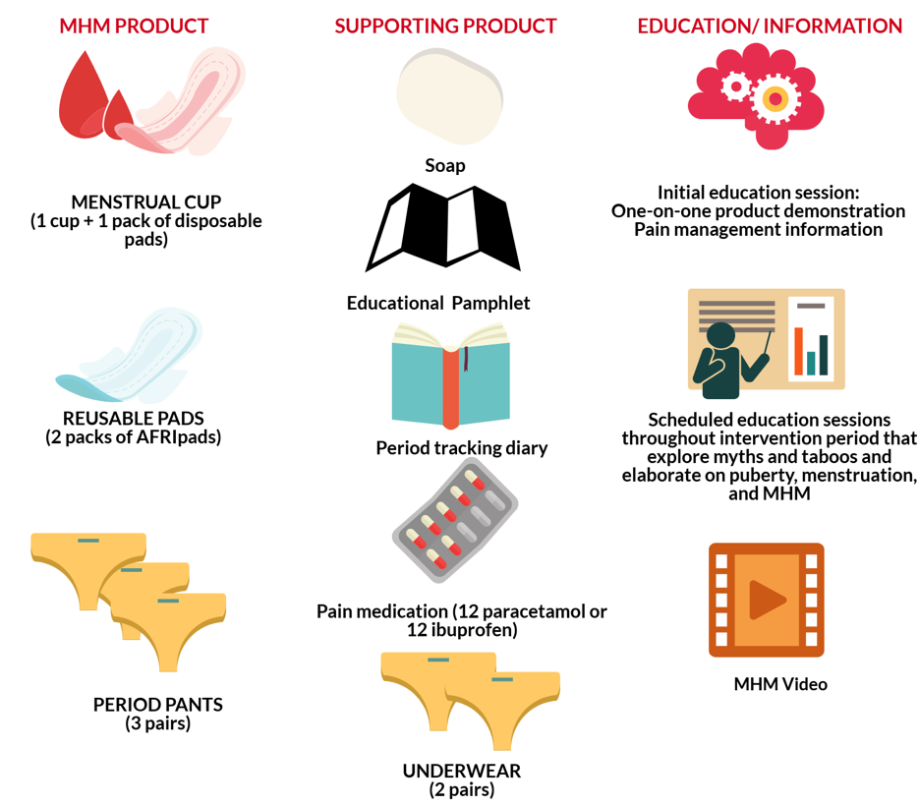

All eligible female CHIEDZA clients
Reusable pads or menstrual cup
(can swap after 3 months)
Supporting products
Education/information
MHH cohort of 300
reusable pads + menstrual cup + period pants
supporting products
Education/information
Ambassadors
Published – Tembo et al. “Menstrual product choice and uptake among young women in Zimbabwe: a pilot study. ”

Slide 6

Methods
Embedded within the CHIEDZA trial
MHH Intervention in CHIEDZA (mixed methods)
MHH service uptake and product choice using a biometric system
FGDs and IDIs with clients and providers
MHH Cohort (n=300, quarterly follow-up for 1 year)
FGDs and and IDIs
Quantitative questionnaire
Period tracking diary

Slide 7
MHH uptake and product choice
 | HARARE (N=9612) | BULAWAYO (N=8408) | MASH EAST (N=9455)
MHH Intervention (info only) | 94.1% | 96.7% | 94.9%
MHH Intervention (cup or pads) | 87.3% | 83.9% | 88.2%
Reusable Pads | 93.5% | 86.2% | 97.5%
Menstrual Cup | 6.5% | 13.8% | 2.5%

Slide 8
MHH uptake and product choice
 | HARARE (N=9612) | BULAWAYO (N=8408) | MASH EAST (N=9455)
MHH Intervention (info only) | 94.1% | 96.7% | 94.9%
MHH Intervention (cup or pads) | 87.3% | 83.9% | 88.2%
Reusable Pads | 93.5% | 86.2% | 97.5%
Menstrual Cup | 6.5% | 13.8% | 2.5%

Slide 9
Qualitative results
MHH intervention was acceptable
Provision of MHH products & community buy-in is important
Integration of MHH and SRH:
  Increased female engagement
  CHIEDZA as “service for women”
  Providers workload increased
“I will liken educating clients about the cup as one preaching a sermon, and then you feel like this word is for me, but on your way home you meet a friend who then diverts you from what was preached... When a client goes home with [a cup] she will hear another set of information and will be convinced to not use the cup based on the advice at home”- (Harare, FGD, CHW).
In press – BMC Health Service Research: “Integration of a menstrual health intervention in a community-based sexual and reproductive health service for young people in Zimbabwe: A qualitative acceptability study”

Slide 10
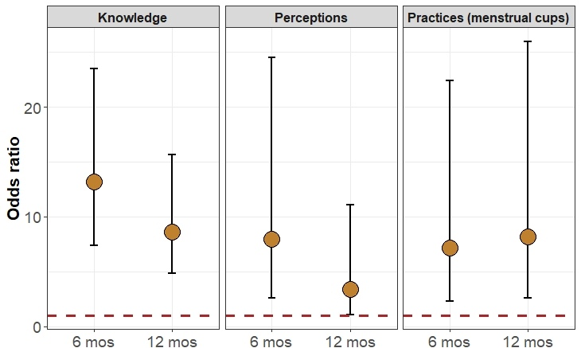
Effectiveness (cohort study)
Data Collection Tool:
Quantitative Questionnaire
*Compared to baseline

Slide 11
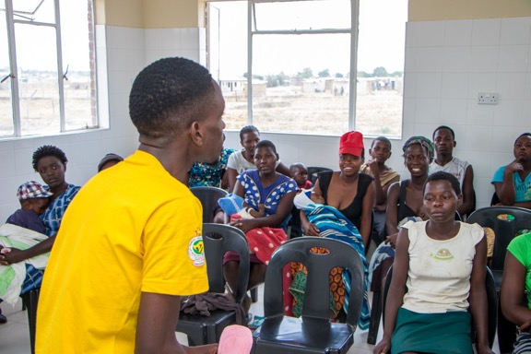
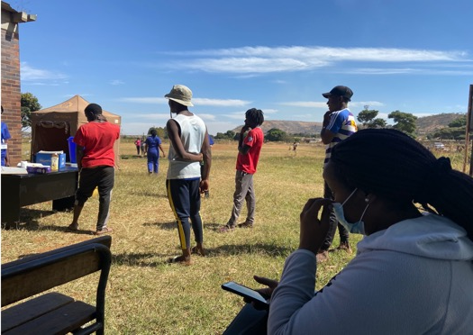
Strengths and challenges
Strengths
Inclusion of pain management
Multi-component intervention to improve MH
Inclusion of boys in MH health education sessions
Looking at MH among out-of-school young women
Challenges
COVID-19 restrictions and protocols
Delayed data collection and analysis
Loss to follow-up

Slide 12

Take-Aways
MHH is an acceptable SRH pathway
Community engagement KEY to sustainable change
Service integration important for female engagement
Comprehensive MHH must include:
  access to a CHOICE of MH products
  education and support
  pain management
Notes:
Talk about:
However, implementors need mitigate 1) overshadowing of other SRH services and 2) negatively informing male engagement

Slide 13
Acknowledgements
Study Team:
Tsitsi Bandason
Nicol Redzo
Ethel Dauya
Nancy Gweshe
Precious Ndlovu
Pauline Ishmael
Tafadzwa Nzazu
CHIEDZA Intervention Team
Collaborators:
Johnson and Johnson
The Butterfly Cup
AFRIpads
Days for Girls
East and Southern Africa Menstrual Health Research Network
Fellow PhD Students
Funding:
Fogarty TRENT Grant
Swiss Development Cooperation (SDC)
Wellcome Trust
Supervisors:
Dr Constance Mackworth-Young
Dr Suzanna Francis
Prof Helen Weiss
Dr Jenny Renju
Advisory Committee:
Prof Rashida Ferrand (CHIEDZA PI)
Institutions:
LSHTM
Biomedical Research and Training Institute
Ministry of Health and Child Care

