Slide 1






Musculoskeletal Health in Sub-Saharan Africa:
The Fractures-E³ Study
Epidemiology, Economic Impact and Ethnography
Prof Celia Gregson
Musculoskeletal Research Unit, Bristol Medial School
University of Bristol

Slide 2

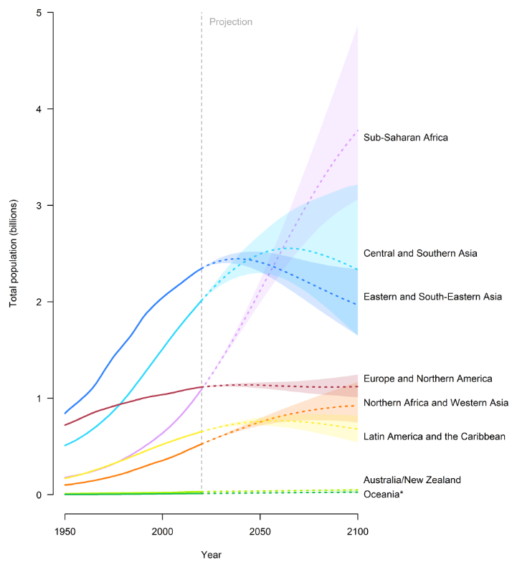
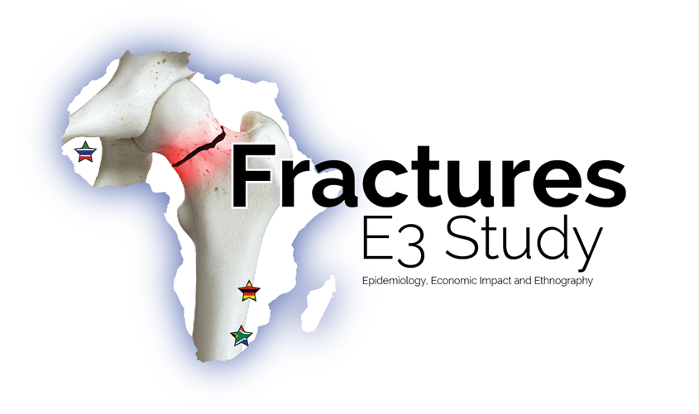
Population growth by region 1950-2020, and projections to 2100
2020
Sub-Saharan Africa
Of the 8 global regions, only sub-Saharan Africa is projected to sustain rapid population growth through to the end of the century
Total population (billions)
United Nations, Department of Economic and Social Affairs, Population Division
World Population Prospects 2019
1950
2000
2050
2100

Slide 3
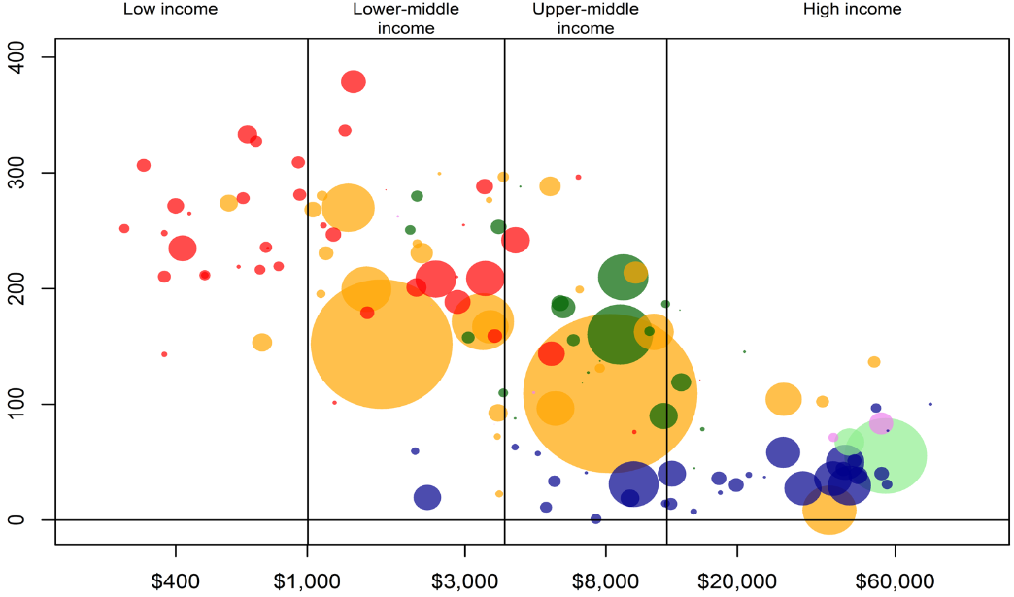
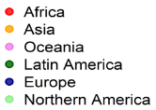
Projections for Population Ageing vs. National Income (2017-2050)
% change in population aged ≥60 years 2017-50
Greatest increase in people >60 years will be seen in Africa over the next 30 years
Gross National Income per capita (log scale)
UN, Dept Economic and Social Affairs, Population Division (2017). World Population Ageing 2017

Slide 4
2020-2030: WHO Decade of Healthy Ageing
“the process of developing and maintaining the functional ability that enables wellbeing in older age.”
Bones
Fractures
Osteoporosis
Musculoskeletal Health
Joints
Muscles
Arthritis
Back pain
Falls
Frailty
Immobility
Disability
Pain
Productivity loss
https://www.who.int/ageing/decade-of-healthy-ageing

Slide 5
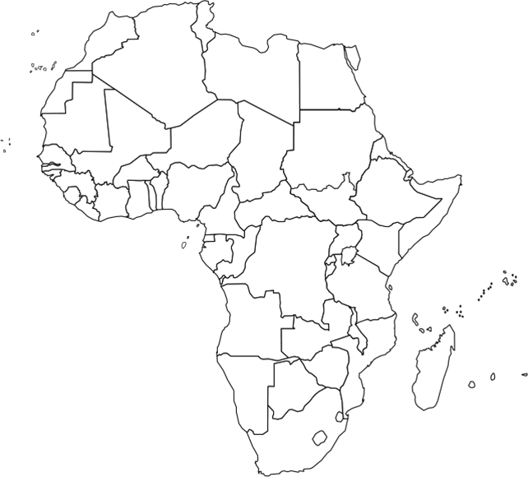








SAMSON; the Sub-Saharan African MuSculOskeletal Network
A network across West, East and Southern Africa
which aims to;
Build sustainable capacity in Musculoskeletal Health Research by creating a collaborative research platform to share learning
Inform health policy, promote training, knowledge transfer and public engagement
Provide guidance to standardise methods for Musculoskeletal assessment across SSA
www.theSAMSON.org
Notes:
SAMSON; the Sub-Saharan African MuSculOskeletal Network

Slide 6

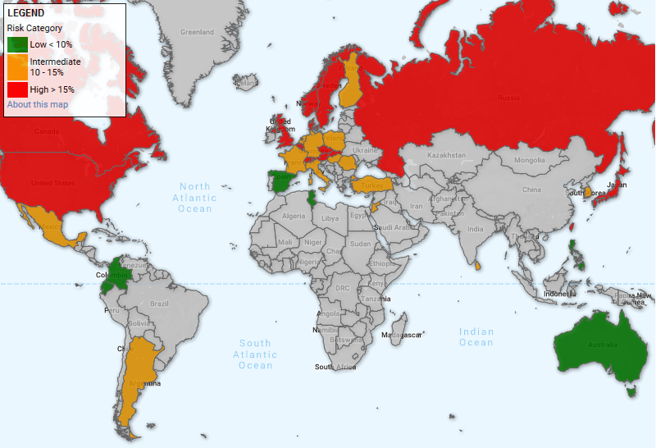
Fractures-E³ in sub-Saharan Africa:
Epidemiology, economic impact and ethnography
Rapid population ageing
Hip and Vertebral Fractures
The International Osteoporosis Foundation Fracture Risk Map of the World
High HIV prevalence
Pain
Disability
Increasing multi-morbidity
Quality of Life
Under and over nutrition
Death
High Trauma Rates
High demands on health care services
Chronic under resourced healthcare services
High health care costs
UNKNOWN
https://www.iofbonehealth.org/facts-and-statistics/frax-map
Data needed to inform health policy
Medical pluralism
Gregson CL, Cassim B, Ferrand RA, Ward KA et al. Lancet Global Health. 2019. 7 (1): e26

Slide 7
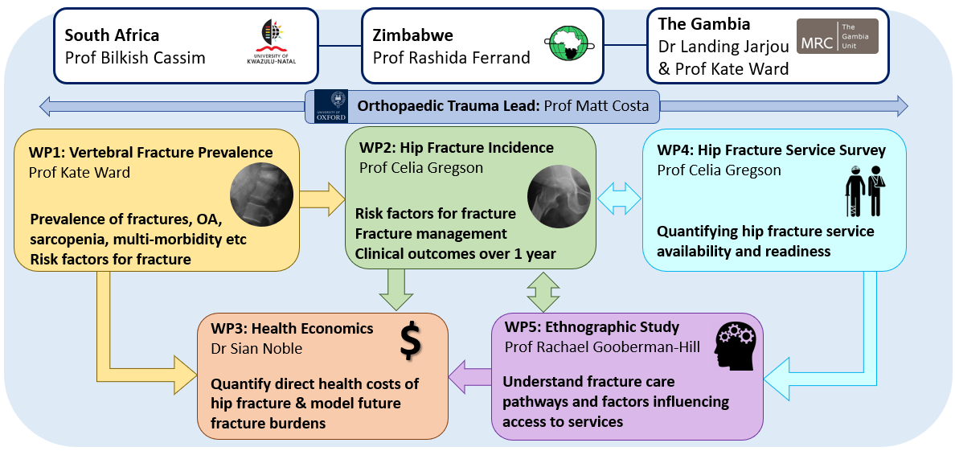
Five workpackages over 5 years (2020-25)

Slide 8
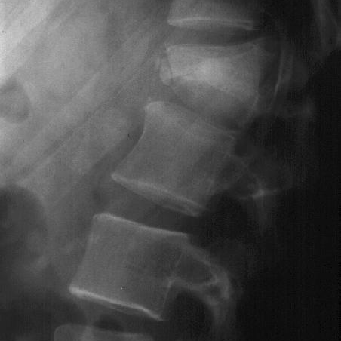
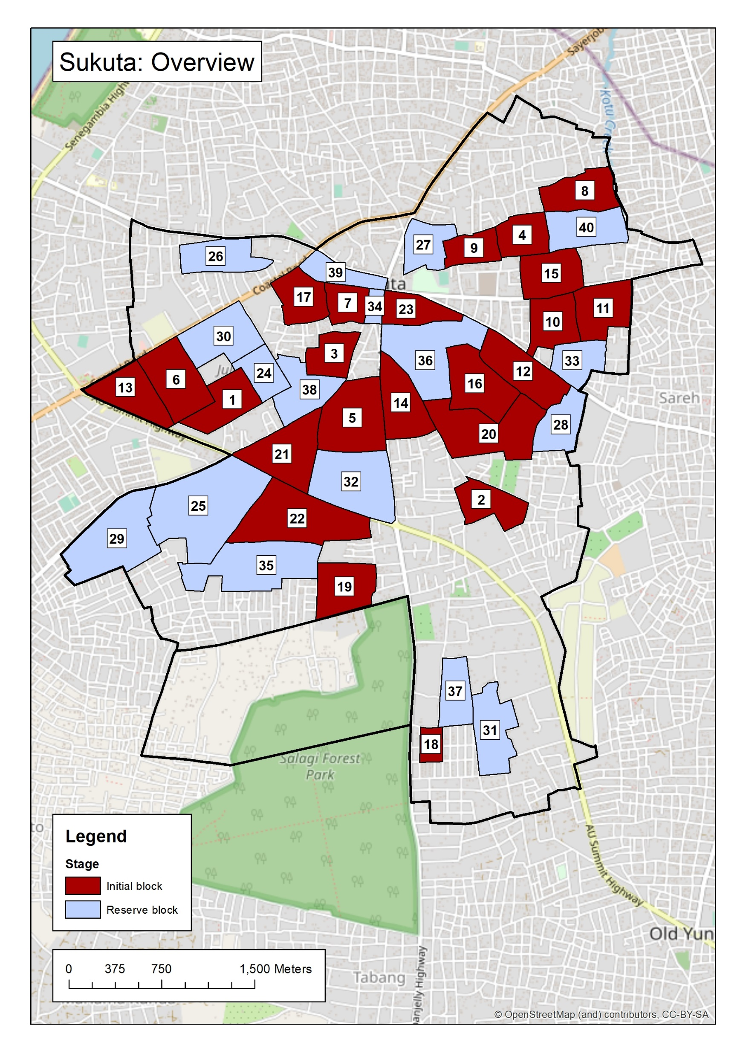
Workpackage 1
Cross-sectional study of vertebral fracture prevalence
WP1: Vertebral Fracture Prevalence
Prof Kate Ward
Aims
1. Quantify vertebral fracture prevalence
2. Determine clinical risk factors for vertebral fractures
3. Determine epidemiology of wider musculoskeletal morbidities
e.g., Osteoarthritis, sarcopenia, injurious falls & other morbidities
Prevalence of fractures, OA, sarcopenia, multi-morbidity etc
Risk factors for fracture
5030 men and women age ≥40 years
Recruitment started February 2022

Slide 9
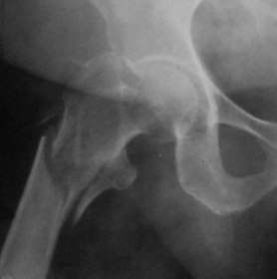
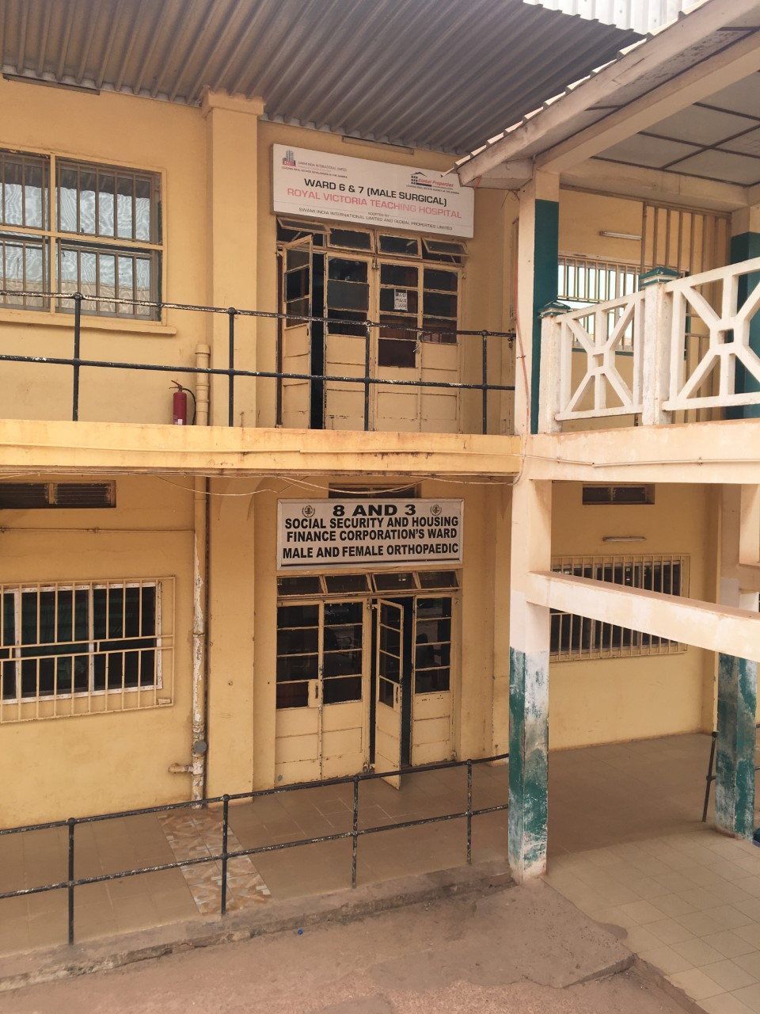
Workpackage 2
One-year cohort study of hip fractures
WP2: Hip Fracture Incidence
Prof Celia Gregson
Aims
1. Determine hip fracture incidence in men and women age ≥40 years
2. Understand clinical risk factors, mechanisms, and management for hip fractures
3. Establish outcomes after hip fracture over 1 year e.g., Length of stay, Readmission, Mortality, Disability, HRQOL
Risk factors for fracture
Fracture management
Clinical outcomes over 1 year
Recruitment started October 2021
Notes:
Prospective study of all hip fractures occurring in adults aged >40 years over one year, then followed-up for one year.
Fracture mechanisms (determining the burden due to fragility vs. trauma)
Management pathways (e.g., traction vs. operation)

Slide 10
Workpackage 3
Health Economic Study of Hip Fractures
$
WP3: Health Economics
Dr Sian Noble
Quantify direct health costs of hip fracture & model future fracture burdens
Aims
Determine direct healthcare costs attributable to hip fracture care
Establish predictors of healthcare costs
Determine the cost-effectiveness of different pathways of care
Model future health costs attributable to hip fracture
Recruitment started October 2021

Slide 11
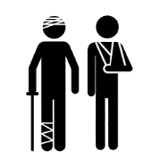
Workpackage 4
National fracture service surveys
WP4: Hip Fracture Service Survey
Prof Celia Gregson
Aims
To quantify current hip fracture services for each country, including;
  Types of facilities
  Fracture services (inpatient and outpatient)
  Referral patterns
  Medical/drug supplies
  Staffing (e.g., orthopaedic, general surgical)
  Equipment (e.g., traction, implants)
  Radiology
Quantifying hip fracture service availability and readiness
Country | No. facilities
The Gambia | 166 + 39*
South Africa | 315
Zimbabwe | 193
*39 traditional bone setters
Recruitment started December 2021

Slide 12

Workpackage 5
Ethnographic study of hip fracture services
Aims
To characterise hip fracture services by ethnographic study in both urban and rural environments, aiming to understand:
Pathways to and through fracture care, including how people with fractures do or do not make it into and through current services.
Factors that help or hinder the implementation of fracture treatment services. We will explore and characterise decision rationales and barriers and facilitators to care delivery.
WP5: Ethnographic Study
Prof Rachael Gooberman-Hill
Understand fracture care pathways and factors influencing access to services
40 case studies
(20 rural/ 20 urban)
Planned in each country
Recruitment starts March 2022
Notes:
40 case studies in each country, including hip fracture patients, family, friends, health care professionals (and Traditional Bone Setters in The Gambia)

Slide 13
Planned outputs and Conclusion
Model current and future fracture burdens
Develop fracture registries, linked with the Fragility Fracture Network
Calibration of fracture risk assessment tools (FRAX) for use in Africa
Characterisation of fracture services and opportunities for development
Open-access data resources e.g., protocols, image files, datasets
Spur inclusion of osteoporosis treatment as WHO Essential Medicine
Inform burden of comorbidities attributable to ageing in Africa
Aid management of HIV-associated musculoskeletal comorbidities
Inform policy and guidelines for fracture prevention and care
Grow multidisciplinary research capacity

Slide 14









Acknowledgements
Funders
Rashida Ferrand
Tsitsi Bandason
Tafadzwa Madanhire
Nyasha Buwu
Ted Manyanga
Munya Ndekwere
Prudance Mushayavabhu
Valentine Mandizvidza
Ruramayi Rukuni
Cynthia Mukwasi-Kahari
Farirayi Kowo-Nyakoko
Andrea Rehman
Katharina Kranzer
Kate Ward
Landing Jarjou
Kebba Marenah
Rachael Gooberman-Hill
Sarah Drew
Sian Noble
Nyasha Mafirakureva
Anya Burton
Sam Hawley
April Hartley
Mícheál Ó Breasail
Lackson Kasonka
Molly Chisenga
Hilda Banda Mabuda
Matt Costa
Simon Graham
James Masters
Bilkish Cassim
Farhanah Paruk
Mkhululi Lukhele
Lisa Micklesfield
https://www.bristol.ac.uk/translational-health-sciences/research/musculoskeletal/rheumatology/research/global-musculoskeletal-health/

