Slide 1
Sexually transmitted infections among youth in Zimbabwe – findings from STICH
Dr Chido Dziva Chikwari
Assistant Professor
London School of Hygiene and Tropical Medicine
Biomedical Research and Training Institute
Notes:
Add MRC and welcome logo and CHIEDZA logo

Slide 2
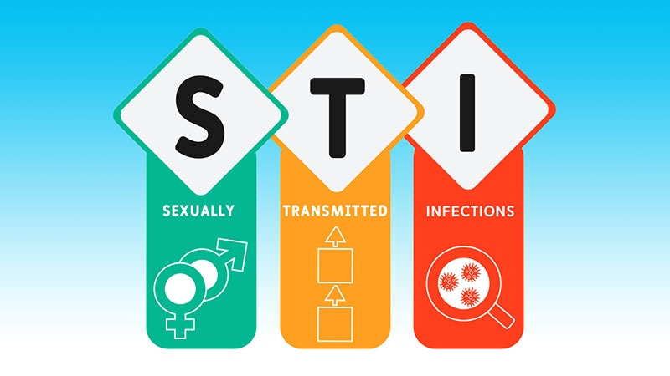
Background
In 2020, more than 370 million new STIs acquired globally
(>1 million/daily)
Syndromic management ineffective
Youth at high risk of STIs when compared to adults

Slide 3
STIs in CHIEDZA – STICH
To investigate the impact of providing community-based STI testing and comprehensive STI management on population prevalence of STIs among youth
Methods
GT/NG testing on GeneXpert – results and follow up in 1 week
TV testing (females) using OSUM test – same day results

Slide 4
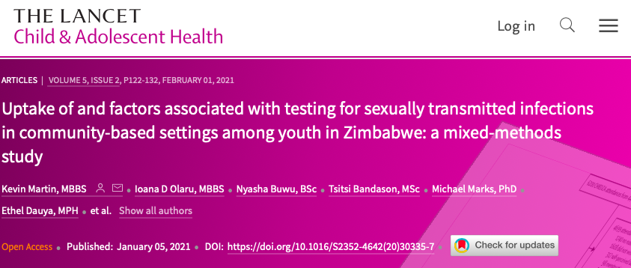
Formative work – Pilot study
Key findings
33% uptake
Barriers:
Stigma
Confidentiality concerns
Lack of information
Notes:
Lancet paper take home points included:
A chlamydia/gonorrhoea prevalence in women of 18.2% (15.9% CT, 3.3% NG)
Out of 218 women with CT or NG, only five received syndromic management
Barriers to testing included stigma and misperceptions surrounding testing, and uptake improved with time

Slide 5
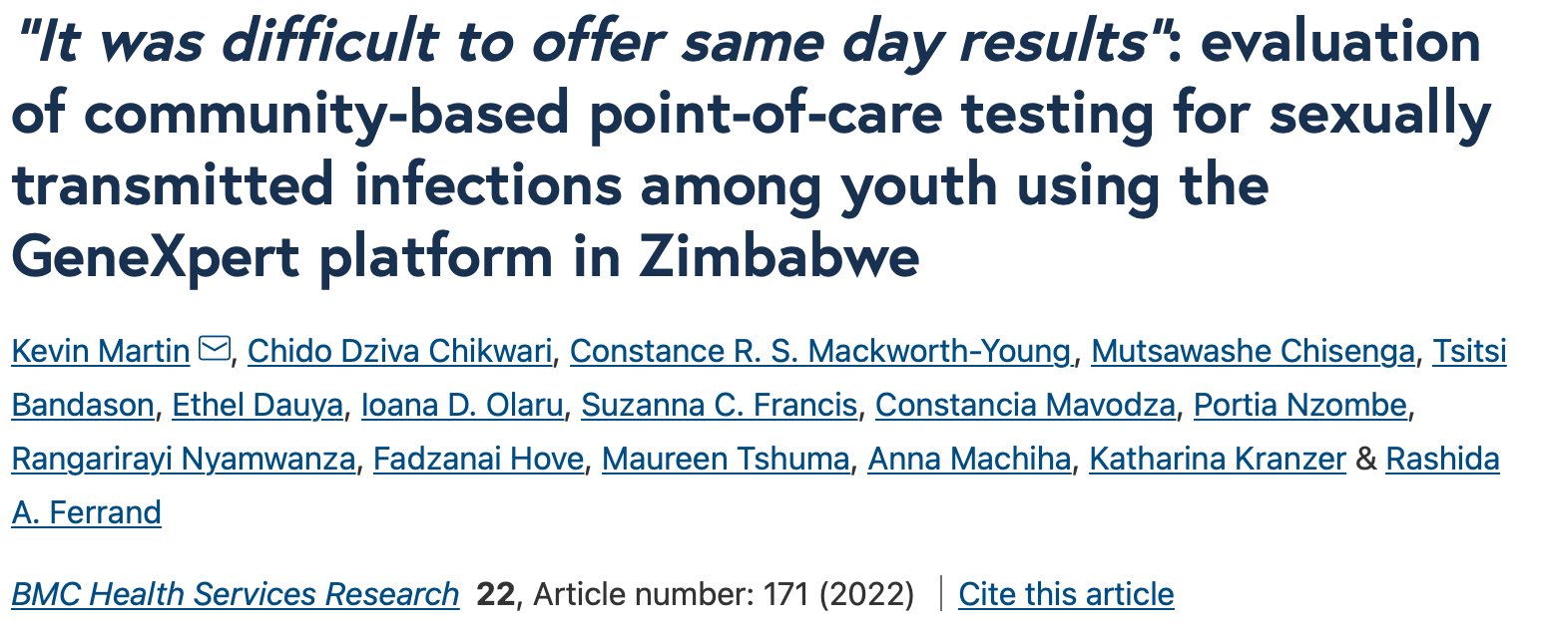
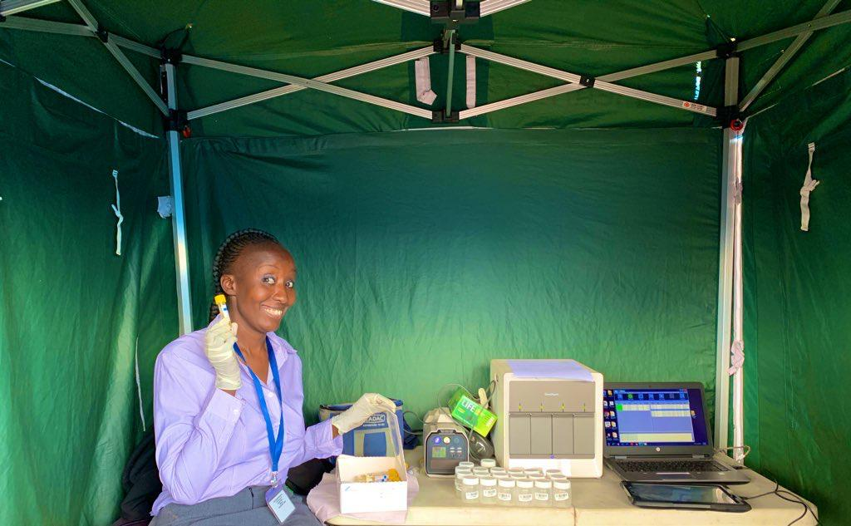
Formative work – Community testing
Key findings
On-site GeneXpert feasible
Barriers:
Limitations of device
Erratic power supply
Provider buy-in
Notes:
BMC paper:
Showed a high prevalence of chlamydia/gonorrhoea of 19.9%
Importantly, demonstrated the feasibility of implementing on-site testing in a difficult operational environment with intermittent electricity supply, non-laboratory staff and in youth, who are a population that have historically faced significant barriers to accessing healthcare
Some of the findings have informed this project proposal, such as the need to use a four-module GeneXpert machine to maintain necessary throughput, and addressing power supply issues

Slide 6
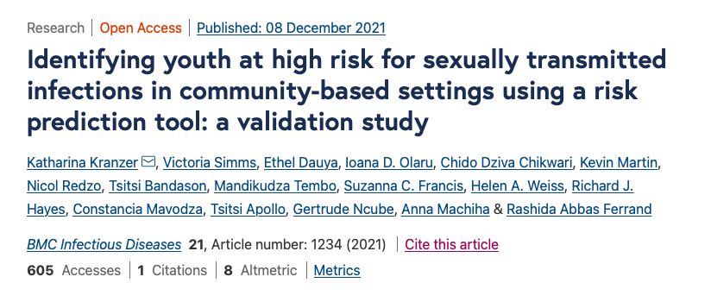
Formative work – Screening tool
Key findings
STIs prevalence even among clients with the lowest possible STI risk was high
Youth who reported that they had never had sex – 5.9% prevalence
Youth who reported one lifetime sexual partner – 13.9% prevalence

Slide 7
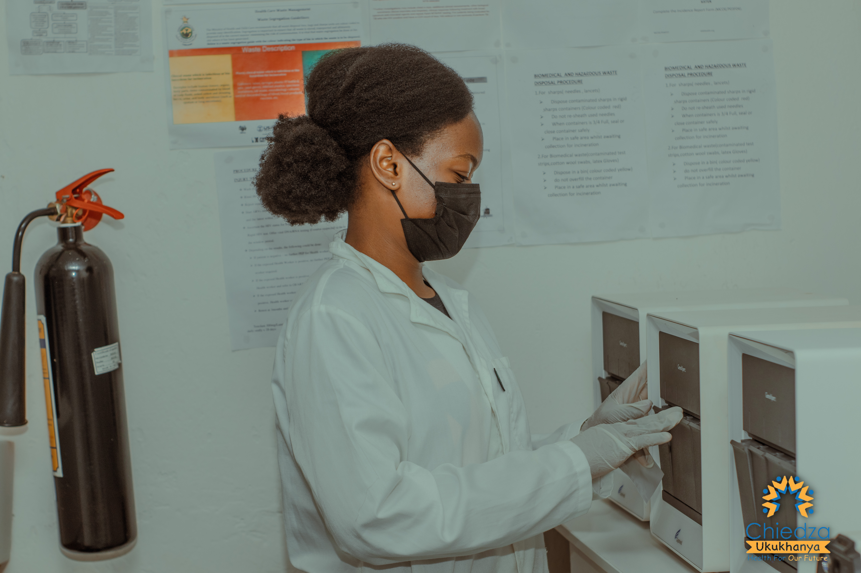
STICH intervention delivery
Community based unselected STI testing
CT/NG testing off site – laboratory
Intense and ongoing staff training
Information material for participants

Slide 8
Testing uptake
CT/NG testing
TV testing (females)
Eligible visits
10997
Eligible visits
7851
Not tested
1878
Not tested
1355
Total tests
9119 (82.9%)
Total tests
6496 (82.7%)

Slide 9
Prevalence
CT/NG Tests
Variable |  | Total Tests | Any +ve (%)
Overall |  | 9119 | 1348 (14.8)
Sex | Male | 2701 (29.6) | 243 (9.0)
 | Female | 6418 (70.4) | 1105 (17.2)
Age | 16-18 | 2745 (30.1) | 234 (8.5)
 | 19-21 | 3362 (36.9) | 562 (16.7)
 | 22-24 | 3012 (33.0) | 552 (18.3)
HIV Status | Unknown | 3055 (33.5) | 427 (13.9)
 | +ve | 413 (4.5) | 83 (20.0)
 | -ve | 5651 (62.0) | 427 (14.8)
TV Tests (females)
Variable |  | Total tests (%) | TV +ve (%)
Overall |  | 6496 | 444 (6.8)
Age | 16-18 | 1947 (30.0) | 96 (4.9)
 | 19-21 | 2296 (35.3) | 162 (7.1)
 | 22-24 | 2253 (34.7) | 186 (8.3)
HIV Status | Unknown | 2236 (34.4) | 136 (6.1)
 | +ve | 359 (5.5) | 53 (14.8)
 | -ve | 3901 (60.1) | 255 (6.5)
Syndromic STI management in CHIEDZA
4% (1044/26105)

Slide 10
Treatment uptake
444 TV positive females →440 (99.1%) treated
1348 CT/NG positive tests → 849 (63.0%) treated
Main reasons for not taking up treatment – no phone, number not reachable

Slide 11
Prevalence survey - Harare
Community prevalence - CT/NG/TV
Participants aged 18-24 years
Intervention and control clusters
Variable | Male |  | Female |  | Total
 | n | % | n | % | n | %
Tests | 805 |  | 1683 |  | 2488
Any Positive | 81 | 10.1% | 393 | 23.4% | 474 | 19.1%

Slide 12
Discussion
High prevalence of asymptomatic STIs -> females & youth living with HIV
High uptake of community based STI testing
Treatment uptake lower if participants must return for treatment
Impact on population prevalence of STIs? Partner notification?
What’s next?

Slide 13
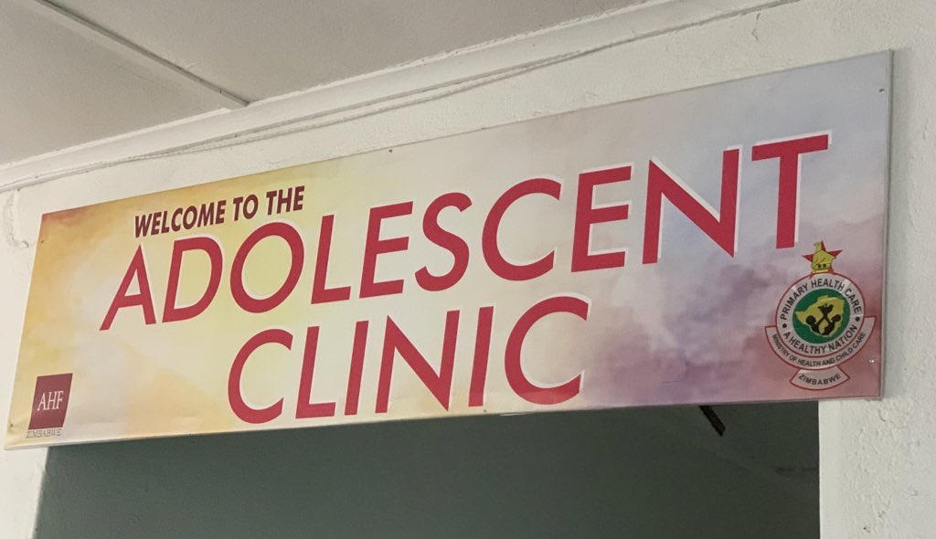
The PSYH study
A pilot study to evaluate the STI management cascade for youth (16-24 years) living with HIV and accessing treatment at Mpilo Hospital
Methods
CT/NG and TV (females) testing and treatment at HIV clinic
Key findings
Testing uptake 75.2%
300 participants recruited → 46 (15.3%) tested positive for at least one STI
Treatment uptake 80.4%

Slide 14
Thank you
Rashida Ferrand, Katharina Kranzer, Suzanna Francis, Ethel Dauya, Lovemore Sigwadhi, Tsitsi Bandason, Primrose Musiyandaka, Tinashe Mwaturura
MoHCC
BRTI
AIDS Healthcare Foundation – Mpilo
OPHID
Cepheid
Wellcome Trust & MRC
CHIEDZA Teams

