Slide 1





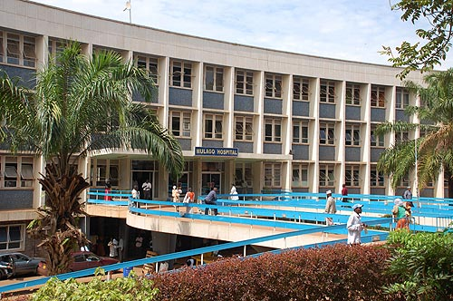

Integrated management cryptococcal and opportunistic infections to improve outcomes in advanced HIV disease.
(IMPROVE study)

Slide 2
IMPROVE: Integrated management cryptococcal and opportunistic infections to improve outcomes in advanced HIV disease.
Overview:
The persistent burden of advanced HIV disease
The final 25% in cryptococcal meningitis
IMPROVE opportunistic infection cohort study
IMPROVE TB prevention RCT
Future plans
Notes:
AHD which is defined as having a CD4 < 200 or any WHO stage ¾ disease
Despite test and treat initiatives, in 2015 approximately 30-40% of people presenting to HIV care had advanced disease (CD4 count < 200 cells/µL, Figure 1).
These data from South Africa, demonstrate that this population has remained relatively constant despite globally expanding ART access (Figure 2), as people cycle in and out of care.
Cryptococcal meningitis remains the most common cause of HIV-associated meningitis and mortality remains unacceptably high in SSA
KM plot here from ACTA trial which demonstrates mortality between 24 and 45% even in the context of clinical trials
This is in contrast to ~ 10% in high income settings.
Our preliminary data suggest that co-prevalent OIs – inc. BSI, CMV and TB - do occur in cryptococcal meningitis and may be associated with increased mortality

Slide 3
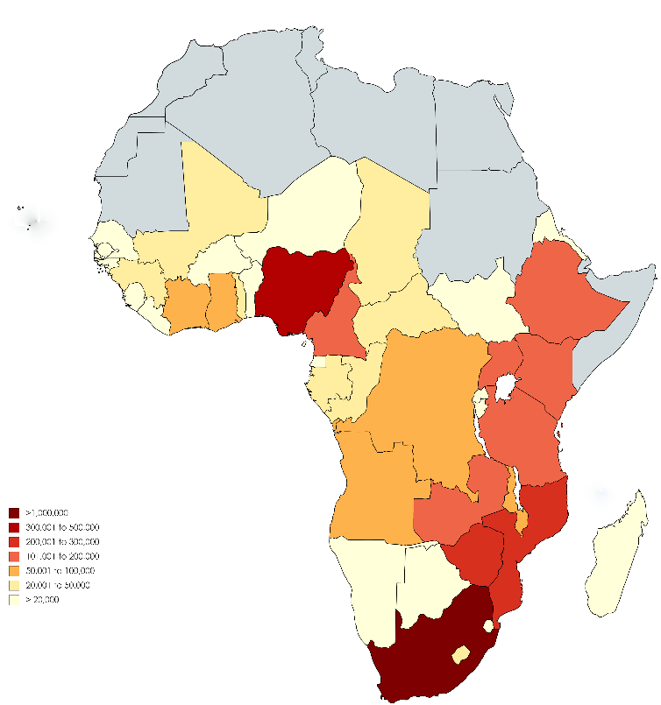
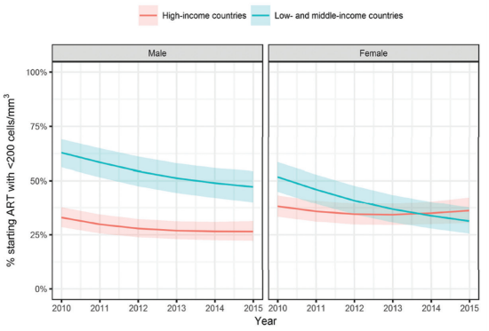
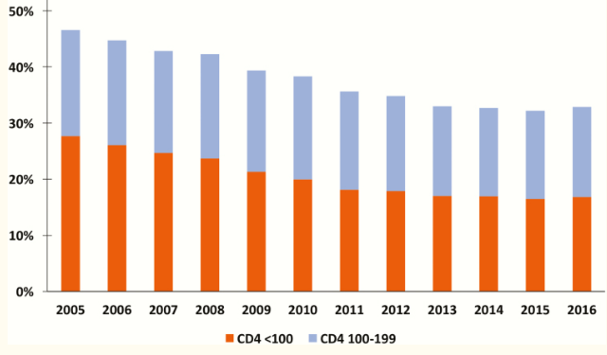
IMPROVE: Integrated management cryptococcal and opportunistic infections to improve outcomes in advanced HIV disease.
IDI Clinical meningitis research group
The persistent burden of Advanced HIV disease (CD4<200 cells/mcL)
Notes:
AHD which is defined as having a CD4 < 200 or any WHO stage ¾ disease
Despite test and treat initiatives, in 2015 approximately 30-40% of people presenting to HIV care had advanced disease (CD4 count < 200 cells/µL, Figure 1).
These data from South Africa, demonstrate that this population has remained relatively constant despite globally expanding ART access (Figure 2), as people cycle in and out of care.
Cryptococcal meningitis remains the most common cause of HIV-associated meningitis and mortality remains unacceptably high in SSA
KM plot here from ACTA trial which demonstrates mortality between 24 and 45% even in the context of clinical trials
This is in contrast to ~ 10% in high income settings.
Our preliminary data suggest that co-prevalent OIs – inc. BSI, CMV and TB - do occur in cryptococcal meningitis and may be associated with increased mortality

Slide 4
IMPROVE: Integrated management cryptococcal and opportunistic infections to improve outcomes in advanced HIV disease.
ART naive
Adult inpatients with advanced HIV disease
Cryptococcal meningitis
HIV-related deaths
Tuberculosis
ART < ~3 months
Severe bacterial infections
Failing on ART
?? CMV
Notes:
Patients with AHD typically fall into one of three ART groups – they may be presenting for the first time an
These patients undoubtedly present many clinical challenges for us
It is this cohort of patients – who continue to fill our wards – that unfortunately contribute to the majority of HIV related deaths globally, of which there were ~700,000 in 2020.
The three major causes of death amongst adults with AHD are CM, TB and SBIs; the role of CMV is less clear.
The current WHO guidelines recommend a combined screening and prevention OI package for adults with AHD including CrAg screening and Alere TB LAM testing for all AHD admissions, but the evidence base is limited and the diagnostics landscape evolving.

Slide 5
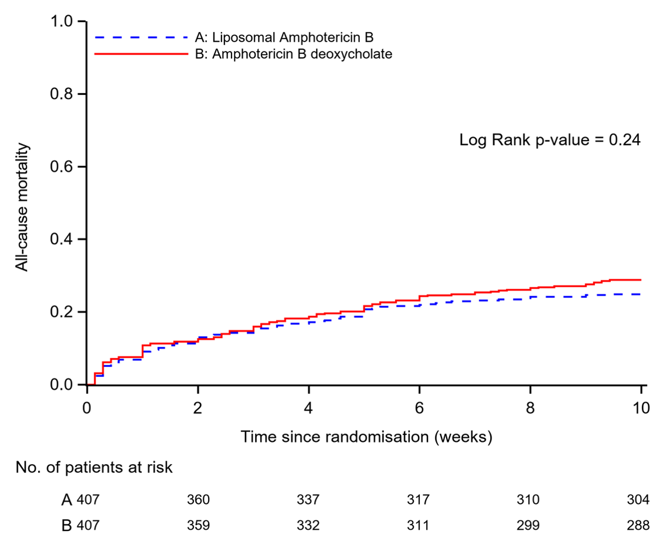
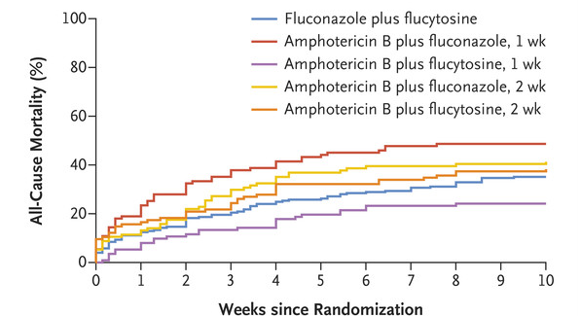
IMPROVE: Integrated management cryptococcal and opportunistic infections to improve outcomes in advanced HIV disease.
Cryptococcal meningitis remains the most common cause of HIV-associated meningitis.
250,000 incident cases annually.
In sub-Saharan Africa, case fatality remains between 24-45%, even in the context of clinical trials.
Our preliminary data suggests that co-prevalent opportunistic infections (OIs) occur in cryptococcal meningitis and may be associated with increased mortality:
  Active TB and latent TB infection (LTBI)
  CMV
  Blood stream infections
Early identification and treatment of OIs may improve patient outcomes, but data to inform design of an OI screening and prevention intervention are limited.
Notes:
The IMPROVE study uses CM as an anchor, from which to investigate the optimal OI screening and prevention strategy for inpatients with AHD in Uganda.

Slide 6
IMPROVE:
The importance of co-infections?
Bacteraemias:
Two retrospective analyses of cryptococcal cohorts (COAT and ACTA), co-prevalent bacteraemias diagnosed in 5-15%.
High proportion of multi-drug resistant infections.
OR 1.8, 95% CI 0.78–4.0, p = 0.17
CMV viraemia:
Retrospective COAT trial data clearly demonstrated that CMV viraemia in HIV-associated cryptococcal meningitis is common (52%, 58/111).
aHR=3.25; 95% CI 1.49-7.10; p 0.003.
Causal mechanism however unclear.
Notes:
I have highlighted some of the key data for you here:
Re bacteraemias:
There have been two retrospective analyses looking at bacteraemias in CM cohorts – ACTA and COAT.
Bacteraemias were found in between 5 – 15%, with a high proportion of drug resistant infections.
CMV
Again retrospective data from the COAT trial
Caleb Skipper’s analyses clearly demonstrated that CMV viraemia is common in CM
On multivariate analyses, there was a clear ass. between CMV viraemia and increased mortality aHR 3.25
However, what is not clear is the causal mechanism which underpins the ass. between CMV and mortality.
Is CMV a marker of more severe inflammation and immune dysfunction caused by AHD and CM or is it a sig. secondary pathogen in these patients?
Regarding active TB disease
As we all know, due to suboptimal TB diagnostics, data on TB-CM coinfection are limited
However novel urinary TB diagnostics have the potential to improve our diagnostic precision.
Early identification and treatment of OIs may improve patient outcomes, but data to inform design of an OI screening and prevention intervention are limited.
Therefore the overarching research question for my PhD is:
What are the co-prevalences of opportunistic infections in patients with cryptococcal meningitis, and can an enhanced, standardized OI screening and treatment package be delivered in the acute hospital setting?

Slide 7
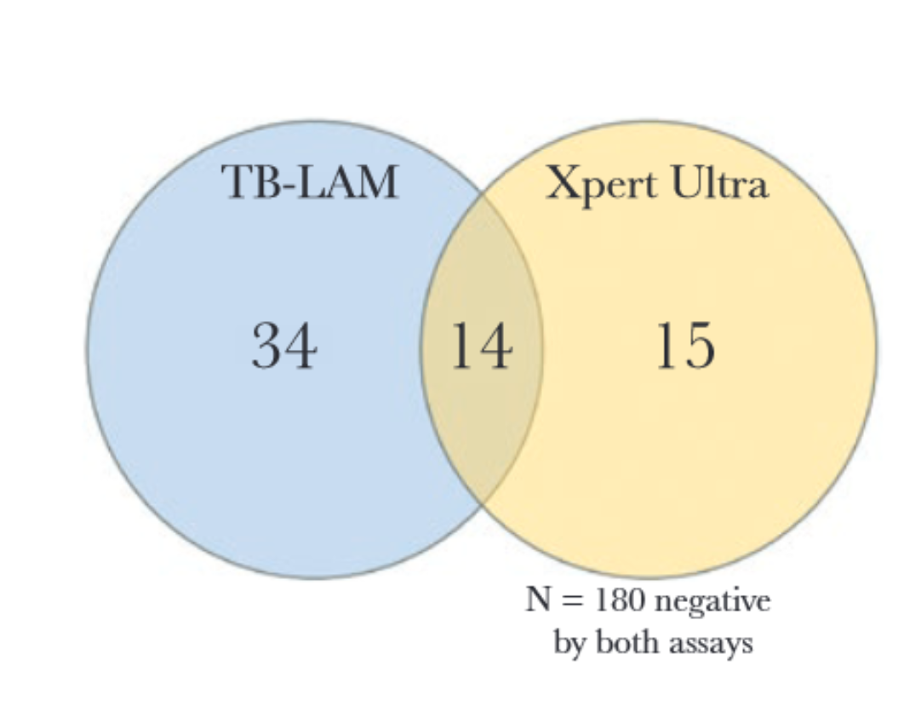
IMPROVE:
The importance of co-infections?
Tuberculosis
198 adults diagnosed with HIV-associated cryptococcal meningitis
Systematically screening for disseminated TB using:
  Alere LAM
  Urine Xpert Ultra MTB/RIF assay
22% had evidence of disseminated TB by either test.
Poor concordance between Alere LAM and Ultra.
Notes:
I have highlighted some of the key data for you here:
Re bacteraemias:
There have been two retrospective analyses looking at bacteraemias in CM cohorts – ACTA and COAT.
Bacteraemias were found in between 5 – 15%, with a high proportion of drug resistant infections.
CMV
Again retrospective data from the COAT trial
Caleb Skipper’s analyses clearly demonstrated that CMV viraemia is common in CM
On multivariate analyses, there was a clear ass. between CMV viraemia and increased mortality aHR 3.25
However, what is not clear is the causal mechanism which underpins the ass. between CMV and mortality.
Is CMV a marker of more severe inflammation and immune dysfunction caused by AHD and CM or is it a sig. secondary pathogen in these patients?
Regarding active TB disease
As we all know, due to suboptimal TB diagnostics, data on TB-CM coinfection are limited
However novel urinary TB diagnostics have the potential to improve our diagnostic precision.
Early identification and treatment of OIs may improve patient outcomes, but data to inform design of an OI screening and prevention intervention are limited.
Therefore the overarching research question for my PhD is:
What are the co-prevalences of opportunistic infections in patients with cryptococcal meningitis, and can an enhanced, standardized OI screening and treatment package be delivered in the acute hospital setting?

Slide 8
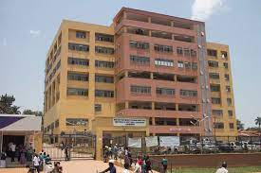
IMPROVE part 1:
Prospective opportunistic infection screening cohort
Research question:
What are the co-prevalences of key opportunistic infections (TB, bacteraemias and CMV) amongst patients with HIV-associated cryptococcal meningitis.
Study population:
450 Ugandan adults with HIV-associated cryptococcal meningitis
Intervention:
Standard of care + standardized, enhanced OI screening and treatment.
Notes:
Progress:
Recruitment started 18th August 2021
2 active sites
77 recruited
3rd site to open 04/2022

Slide 9
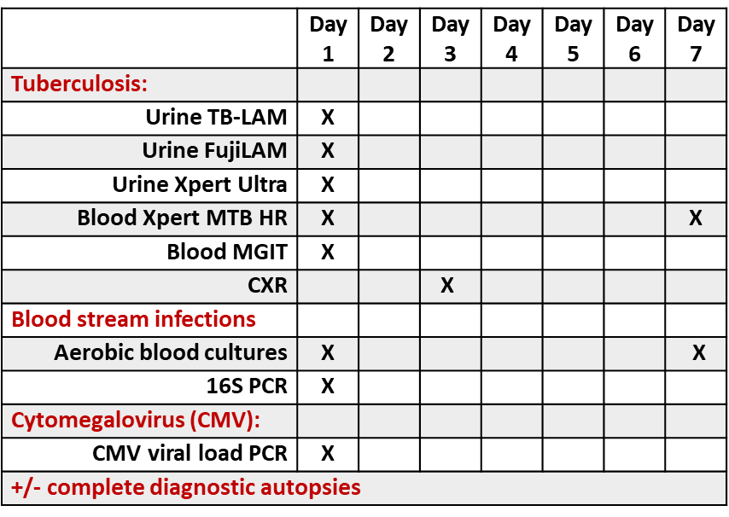
IMPROVE part 1:
Prospective opportunistic infection screening cohort
The standardized, enhanced OI screening and treatment package:
Progress:
77 recruited
Evidence of disseminated TB in 48% (37/77)
Baseline Cryptococcaemia by blood culture in 27% (20/74)
3 pathogenic BSI
Outputs:
Prospectively describe the burden of key co-prevalent OIs.
Comparative diagnostic yield analysis, and cost-consequence analysis for TB diagnostics.
To inform design of future OI screening and prevention package.
Notes:
Progress:
Recruitment started 18th August 2021
2 active sites
77 recruited
3rd site to open 04/2022

Slide 10
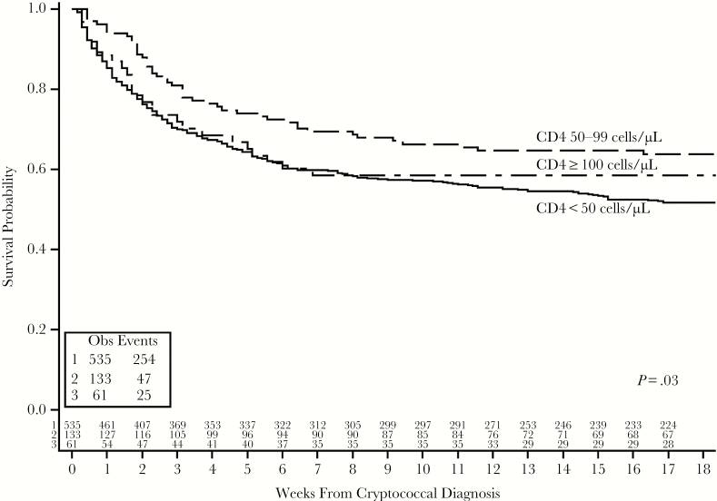
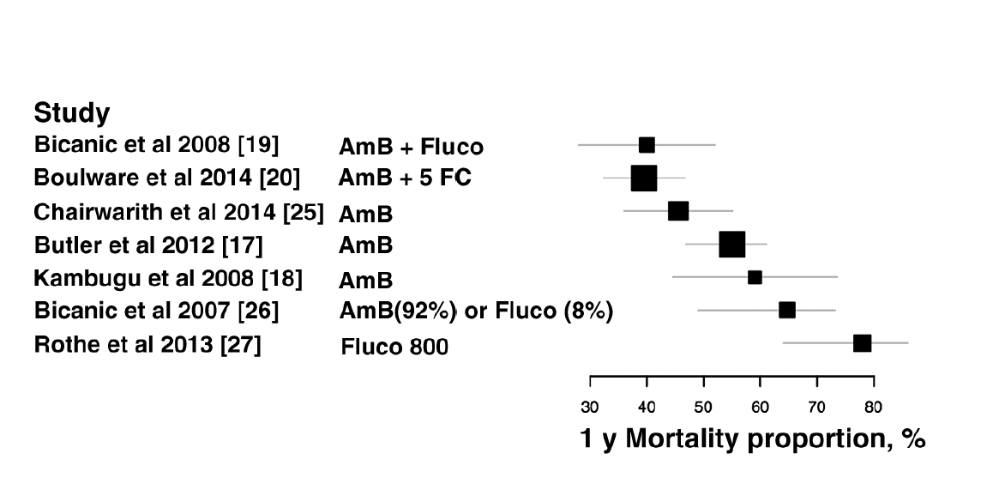
IMPROVE: Integrated management cryptococcal and opportunistic infections to improve outcomes in advanced HIV disease.
Mortality at one year 40 - 78% in resource limited settings.
Notes:
Progress:
Recruitment started 18th August 2021
2 active sites
75 recruited
3rd site to open 04/2022

Slide 11
IMPROVE part 2:
Nested 1HP randomised controlled trial
BRIEF-TB – 2019
Randomized, open-label, phase 3 noninferiority trial of 1HP vs. 9H
3000 HIV-positive adults
Primary end point = first TB diagnosis, or death from TB/unknown cause: 2% in the 1HP group vs. 2% in the 9H group.
Treatment completion: 97% in the 1HP group vs. 90% in the 9H group (p <0.001)
SAEs: 6% in the 1HP group vs. in 7% in the 9H group (p 0.07).
There is robust evidence that TPT significantly reduces TB-associated morbidity and mortality, irrespective of CD4 count and ART status.
Implementation of TPT for PLHIV has been suboptimal globally.
Barriers to implementation are complex inc. concerns about adherence, loss to follow-up, drug toxicity and drug resistance.
1HP as an ultra short course TPT option offer a potential breakthrough.
Notes:
We know that:
Cryptococcal meningitis remains the most common cause of HIV-associated meningitis and mortality remains unacceptably high in SSA
KM plot here from ACTA trial which demonstrates mortality between 24 and 45% even in the context of clinical trials
This is in contrast to ~ 10% in high income settings.
Our preliminary data suggest that co-prevalent OIs – inc. BSI, CMV and TB - do occur in cryptococcal meningitis and may be associated with increased mortality

Slide 12
IMPROVE part 2:
Nested 1HP randomised controlled trial
Study design: A nested randomised strategy trial to evaluate the safety and feasibility of two strategies for the delivery of 1HP TPT
Study population: 205 adults with AHD and cryptococcal meningitis.
Intervention: Inpatient initiation vs. outcome initiation of 1HP.
Notes:
We know that:
Cryptococcal meningitis remains the most common cause of HIV-associated meningitis and mortality remains unacceptably high in SSA
KM plot here from ACTA trial which demonstrates mortality between 24 and 45% even in the context of clinical trials
This is in contrast to ~ 10% in high income settings.
Our preliminary data suggest that co-prevalent OIs – inc. BSI, CMV and TB - do occur in cryptococcal meningitis and may be associated with increased mortality

Slide 13
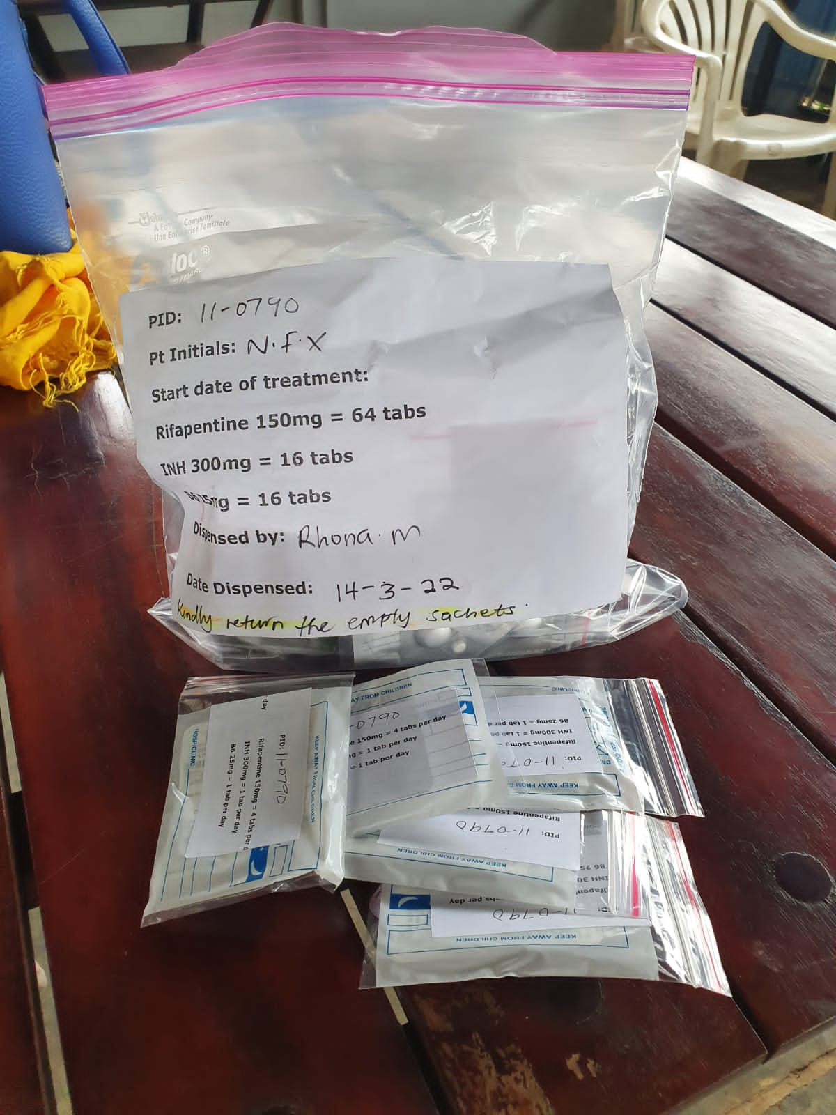
IMPROVE part 2:
Nested 1HP randomised controlled trial
Participants from IMPROVE prospective OI screening cohort
TB diagnostic work-up negative
Randomise for 1HP TPT (N=205)
Inpatient initiation of 1HP (week-2)
Outpatient initiation of 1HP (week-6)
Primary outcome: TB-disease free 1HP treatment completion at 18-weeks.
Secondary outcomes: 1HP treatment completion, 1HP discontinuation, adverse events, drug induced liver injury, incident TB, 18-week survival, RPT/DTG/FLU PK analyses.
Notes:
We know that:
Cryptococcal meningitis remains the most common cause of HIV-associated meningitis and mortality remains unacceptably high in SSA
KM plot here from ACTA trial which demonstrates mortality between 24 and 45% even in the context of clinical trials
This is in contrast to ~ 10% in high income settings.
Our preliminary data suggest that co-prevalent OIs – inc. BSI, CMV and TB - do occur in cryptococcal meningitis and may be associated with increased mortality

Slide 14
IMPROVE: Integrated management cryptococcal and opportunistic infections to improve outcomes in advanced HIV disease.
Possible benefits of early (inpatient) 1HP: | Potential harms of early (inpatient) 1HP:
1HP TPT prior to ART initiation may: Reduce TB-IRIS events Reduce Active TB Reduce late death in cryptococcosis due to TB Currently TPT is predominately provided in the outpatient setting. Inpatient provision may: Improve reach of the intervention i.e. clinicians providing 1HP as a to-take-away (TTA) medication prior to hospital discharge Reduce loss to follow-up within the LTBI treatment care cascade. | Drug-drug interactions (DDIs) with anti-fungals (rifapentine – fluconazole) DDIs with ART (DTG) Tolerability of increased pill burden during acute cryptococcosis Increased cryptococcal relapse due to DDIs +/- non-compliance Suboptimal diagnostics to definitively exclude TB in AHD and therein the risk of treating active TB disease with 1HP: TB treatment failure Development of drug resistance TB deaths
Notes:
Progress:
Recruitment started 18th August 2021
2 active sites
75 recruited
3rd site to open 04/2022

Slide 15
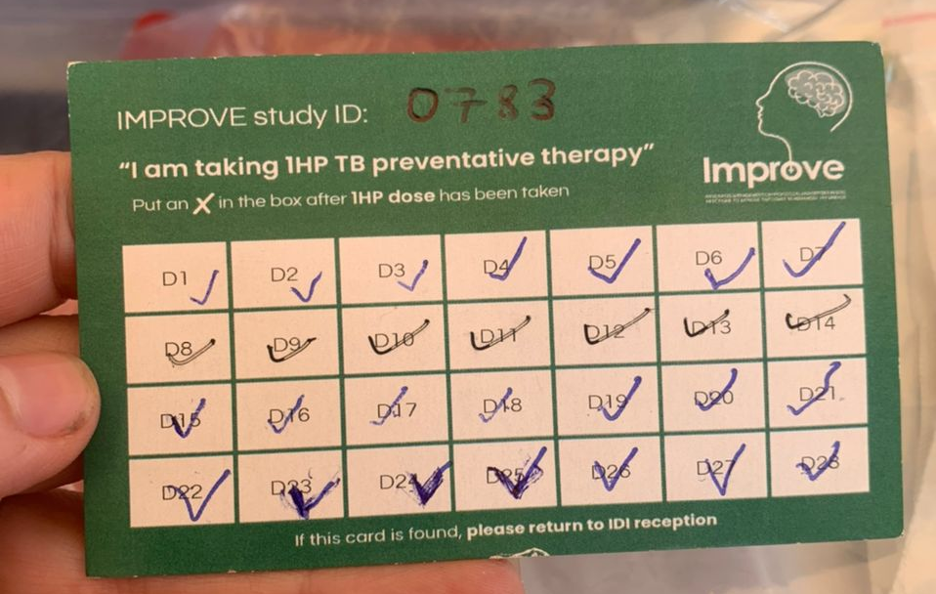
IMPROVE: Integrated management cryptococcal and opportunistic infections to improve outcomes in advanced HIV disease.
Preliminary feasibility and safety data to inform design of subsequent multi-component screening and prevention trial to reduce mortality amongst adults with AHD.
Hypothesis:
Inpatient initiation of 1HP TPT will be non-inferior to outpatient initiation 1HP TPT with respect to TB-disease free 1HP treatment completion; and inpatient 1HP TPT provision will be safe (≥ grade 3 adverse events) and feasible (adherence and tolerability) in patients with HIV-associated cryptococcal meningitis.
Progress:
Recruitment started 10th Jan
6 randomised to date

Slide 16
IMPROVE: Integrated management cryptococcal and opportunistic infections to improve outcomes in advanced HIV disease.
Next steps for year #2:
Mbarara site to open in April 2022
PK sub-study to commence Q2 2022
Costing sub-studies to commence Q2 2022
AMBITION bio-bank testing (plasma and CSF for CMV)

Slide 17
Collaborators:
Professor David Meya
Professor David Boulware
Professor Tom Harrison
Dr Fiona Cresswell
Dr Catriona Waitt
Huge thanks to so many including:
Wellcome Trust
LSTHM
Our patients and families
IDI clinical meningitis research team
Supervision:
Professor Joe Jarvis
Professor Katherine Fielding
Professor David Moore

Slide 18
Dr Jayne Ellis
Wellcome Global Health Research Clinical PhD Fellow
Infectious Diseases Institute, Kampala, Uganda, P.O. Box 22418
WhatsApp +256 701 553 752 jayne.ellis1@lshtm.ac.uk

