Slide 1





Transmission of respiratory pathogens in households from MDR TB to SARS-CoV-2
Wellcome Trust
Clinical PhD scientific meeting March 2022
Kate Gaskell
Kate.Gaskell@lshtm.ac.uk
@katekmg

Slide 2
Comparison of new and emerging SARS-CoV-2 variant transmissibility through active contact tracing (CONTACT)
Most estimates of Secondary attack rate (SAR) are:
in symptomatic PCR positive contacts through screening programmes
Testing driven through symptoms
Underestimates total number infected and transmissibility
Little comparative serology data
Secondary household attack rate amongst contacts of PCR positive SARS-CoV-2 index cases
Comparing ALPHA variant of concern (VOC) vrs non-VOC SARS-CoV-2
Whole genome sequenced Index patients diagnosed in two London Hospitals between
9th Nov – 31st Jan 2021
Household serosurvey
Notes:
Prevalence ratio
Illness severity

Slide 3
CONTACT
AIMS
Primary Aim
Evaluate transmissibility of Alpha VOC SARS-CoV-2 relative to circulating non-VOC SARS-CoV-2
Secondary objectives
Define proportion of VOC infected individuals with asymptomatic infection
sero-concordance within households
Does spike protein or receptor-binding domain serological markers distinguish between exposure to VOC and non-VOC amongst household contacts
Notes:
by defining the proportion of household contacts exposed to each virus with a detectable serological response

Slide 4
CONTACT
Statistical Plan
Sample size: 292 VOC HH: 292 non-VOC HH (1168 participants)
15% seroprevalence in non-VOC households
average cluster size of 2 (household size of 3; 2.4 in SE England)
provide 90% power to detect a 50% increase in seropositivity
multivariable random effects logistic regression model adjusted for clustering at the household level
Propensity score analysis
Serology Assay
Non-VOC & VOC SARS-CoV-2 using a multiplex chemiluminescence immunoassay (MSD, Rockville, MD).
anti-nucleocapsid IgG reactivity
Notes:
not anti-spike protein IgG to confirm previous SARS-CoV-2 infection to avoid any effect of vaccination status

Slide 5
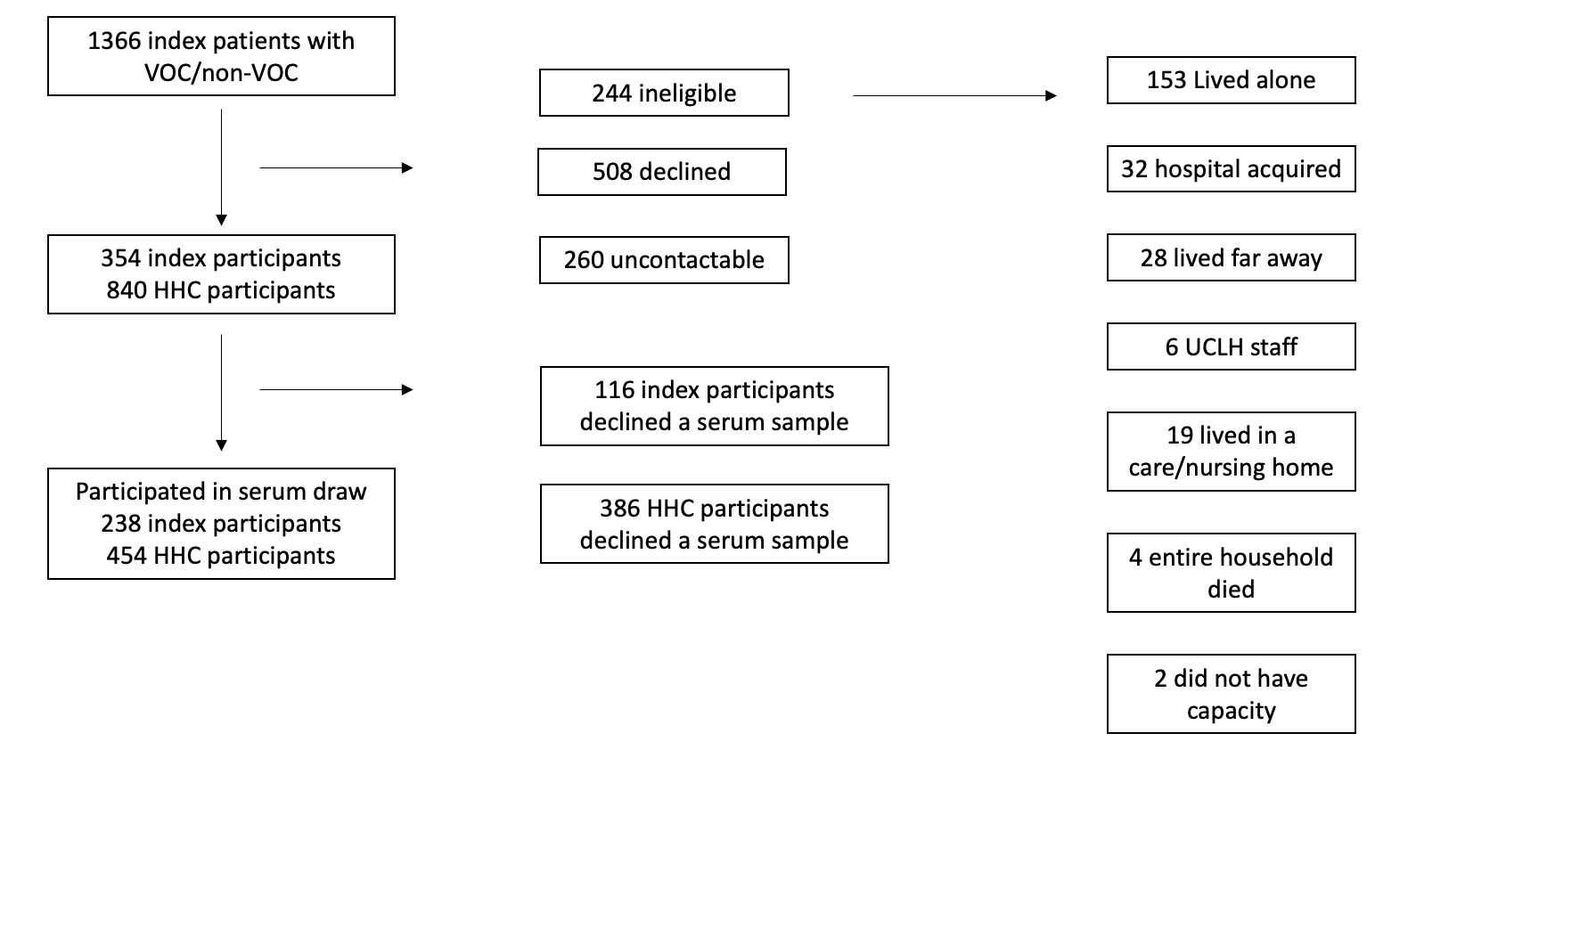
CONTACT
Recruitment Flow chart
Notes:
Prevalence ratio
Illness severity

Slide 6
Results
Index patients –188 VOC & 50 non-VOC
50% female
Median age 57 (IQR 45-59)
Median Household size 3 (IQR2-4)
IMD decile 3 (IQR 2-6)
Median symptom duration 7 days (IQR 3-10)
No difference between VOC & non-VOC groups
Difference in days of exposure to index case at home 4 vrs 7 days (p<0.001)
Difference in reporting COVID-19 diagnosis 47% vrs 67% (p <0.001)
Contacts – 352 VOC & 102 non-VOC
57% female
Median age 43 (IQR 24-60)
Notes:
Stratified by Indices VOC and non-VOC SARS-CoV-2 status for whom we have serum
64% hospitalised, 17% ICU admission & 1%mortality
Ethnicity
50% white 17% black 8% SE Asian 8% middle eastern
Prevalence ratio
Illness severity

Slide 7
CONTACT
Results
 | Non-VOC | VOC | Total
Seropositivity* | 61.8% (63/102) | 82.1% (289/352) | 77.5% (352/454)
Households with no seropositive HHC | 6% (3/50) | 0.5% (1/188)
*seropositivity to anti-nucleocapsid IgG antibody
Logistic regression modelling
3 things increased the odds of seropositivity
household index case with VOC vrs non-VOC OR 3.02 (95%CI 1.46-6.25)
index case spending >5 days in household OR 2.21 (95%CI 1.16-4.18)
increased proximity to case (caring) OR 2.39 (95%CI 1.10-5.23)
Notes:
Prevalence ratio
Illness severity

Slide 8
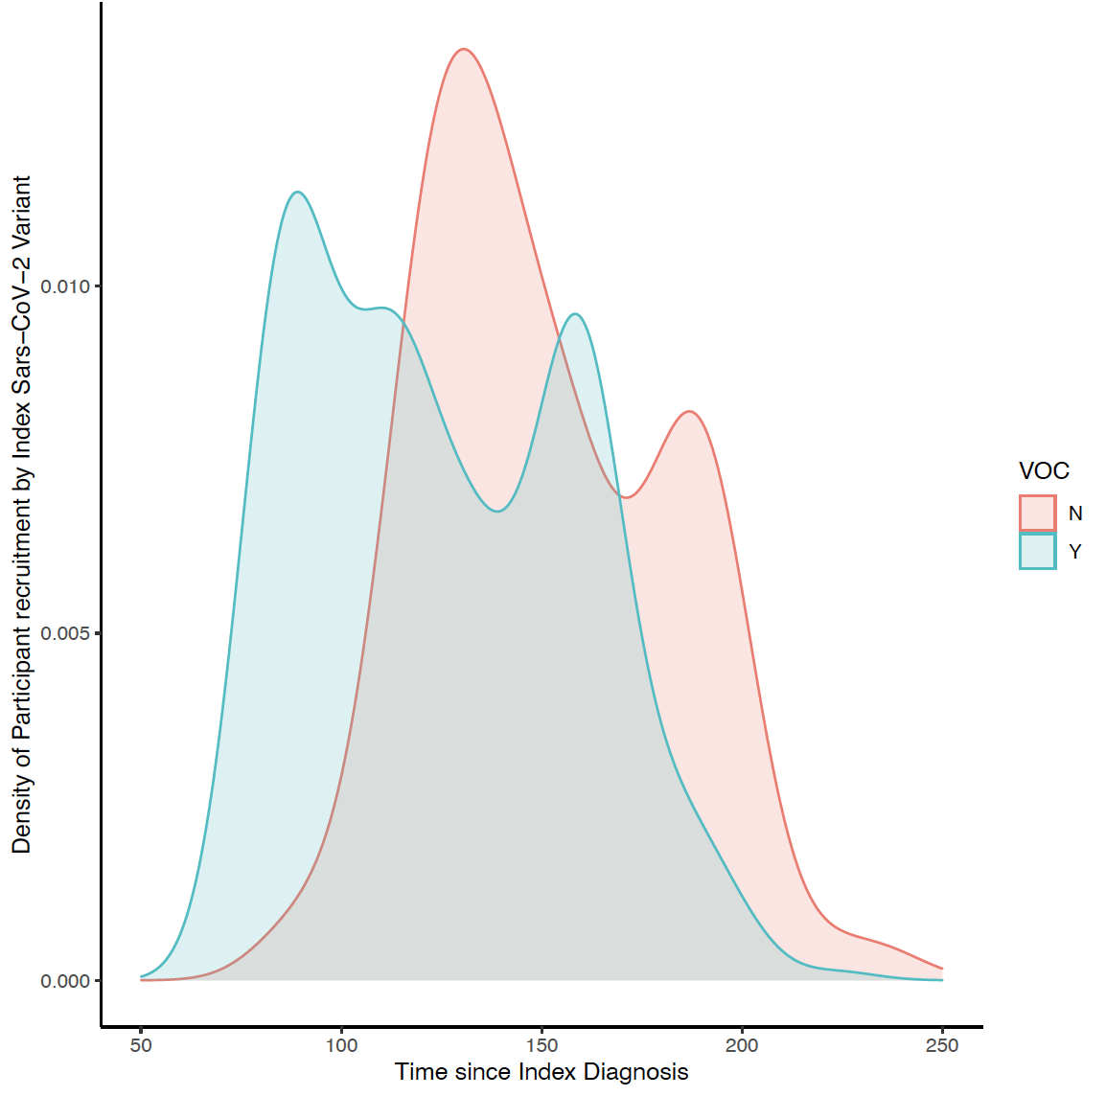
CONTACT
Limitations
Notes:
During well adhered to lockdown periods in UK which ended in May/June when our last serology samples
David Goldblatt’s work has shown that NC titres fall but slowly and not significantly over 6 months – these data back this up

Slide 9
Conclusions
Seroprevalence 77.5% overall in HHC
VOC households significantly higher seroprevalence indicating it is probably more transmissible within households
Almost all households had evidence of HHC seropositivity and likely transmission
Significant differences between groups of in household exposure time and COVID-19 diagnosis
Further work to explore this between groups needed with Propensity Score analysis

Slide 10
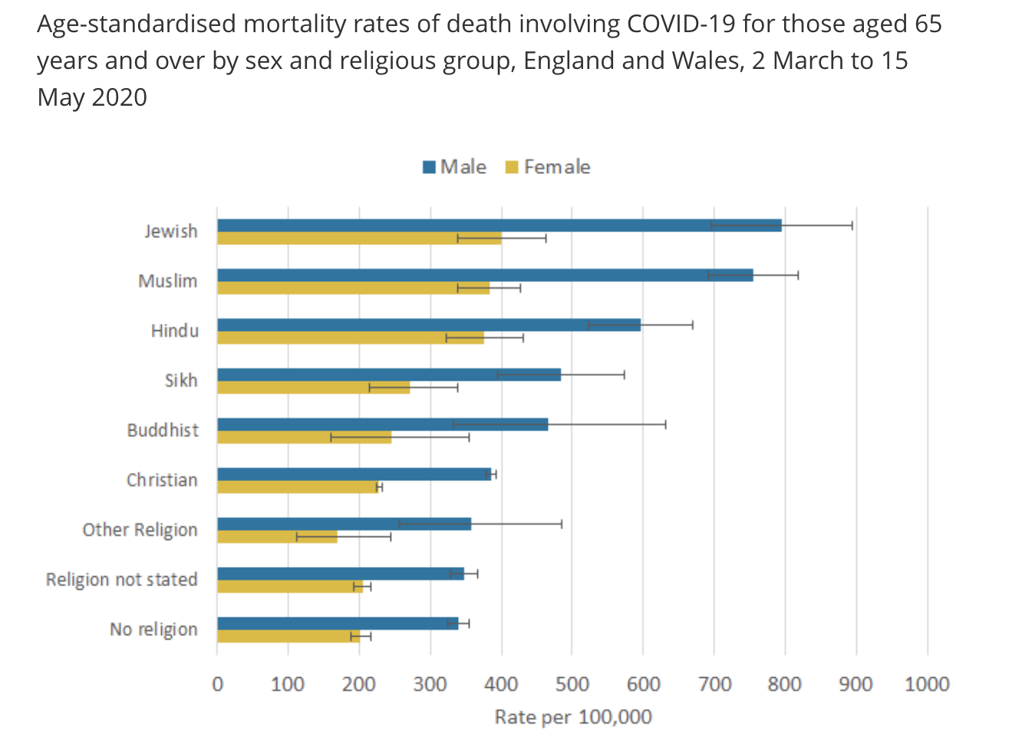
Background: North London Ultra Orthodox Jewish community
May 2020 request from London Jewish community to help understand their burden of disease & identify which (if any) activities were particularly associated with risk
PHE data highlighted higher risk of death in UK Jewish population
Notes:
Jewish community 0.5% of UK pop
Not just Socio economic status driving this. Complex factors between and within household transmission,
Michael Marks

Slide 11
Seroprevalence of SARS-CoV-2 in a strictly-Orthodox community in UK
AIMS & STUDY DESIGN
Using detailed data collection on households and their social interactions with serological testing of seasonal CoV and SARS-CoV-2 in a tightly-knit Jewish community
Cross sectional Serosurvey of households and their individuals
Notes:
NIHR £250 000 Grant
Qualitative sub study exploring access to information and opinions on strategies to control the epidemic
Mathematical transmission model of SARS-CoV-2 in the community

Slide 12
Sampling
Sampling using a comprehensive community list
Sampling at the level of the household, all consenting members
All age groups
Serology assay:
MSD, Rockville, MD assay
David Goldblatt’s UCL group
Samples tested with a multiplex serological assay for:
CoV-2 Nucleocapsid
CoV-2 Receptor binding domain
CoV-2 Spike protein
Seasonal Coronavirus
  229E s
  HKU1 s
  HL63 s
  OC43 s
Notes:
Transfusion data 15%
National HH size av is 2.3

Slide 13
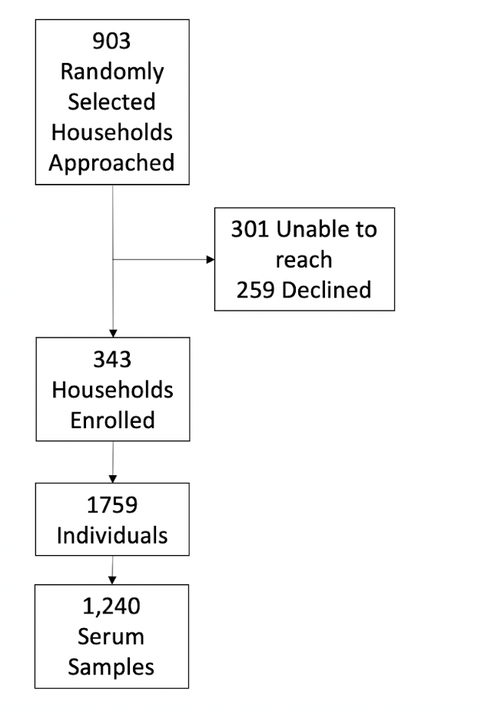
Enrollment & Results
52% participants female
Median age 14 (IQR 7-33)
58% <19 years old
44% in formal education
35% not in education or employment
Median Household size 5 (IQR 3-7)
Notes:
Transfusion data 15%
National HH size av is 2.3

Slide 14
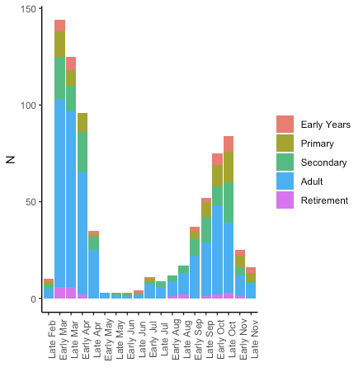
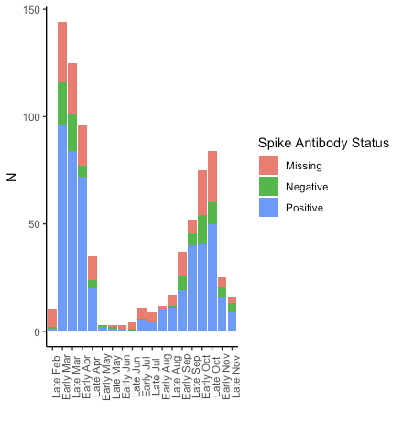
Self-Reported Illness & Seroprevalence
Notes:
Transfusion data 15%
National HH size av is 2.3

Slide 15
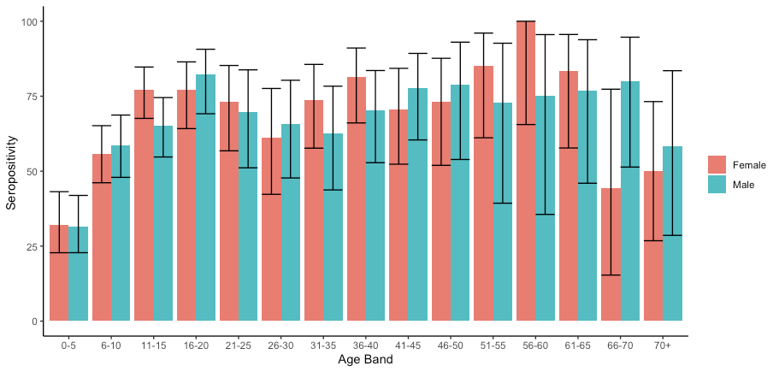
Seroprevalence
Notes:
Transfusion data 15%
National HH size av is 2.3

Slide 16
Seroprevalence
Antibody titre higher for anti-Spike SARS-CoV-2 antibodies than anti-Nucleocapsid across all age groups
0-4 yrs: 28% vrs 18%
5-10 yrs: 56% vrs 43%
11-18 yrs: 75% vrs 51%
19-66 yrs: 74% vrs 45%
>67 yrs: 55% vrs 45%
Logistic regression modelling
Increased risk of seropositivity in:
11-18 yr olds OR 1.70 (95%CI 0.89-3.27)
Males OR 1.62 (1.18-2.24)
Overcrowding & attending community events did not increase the risk of seropositivity
Notes:
Nc only data would underestimate pop prevalence
Spike and nc decline at different rates as shown in other work

Slide 17
Conclusions
Overall seroprevalence antibodies 65%
Lowest in children <5
Highest in secondary school aged children & working age adults
Slightly higher in men
No association household crowding / attendance at community events in this analysis
In keeping with broader UK data clear evidence high rates of infection in minority population
No evidence ‘herd immunity’

Slide 18
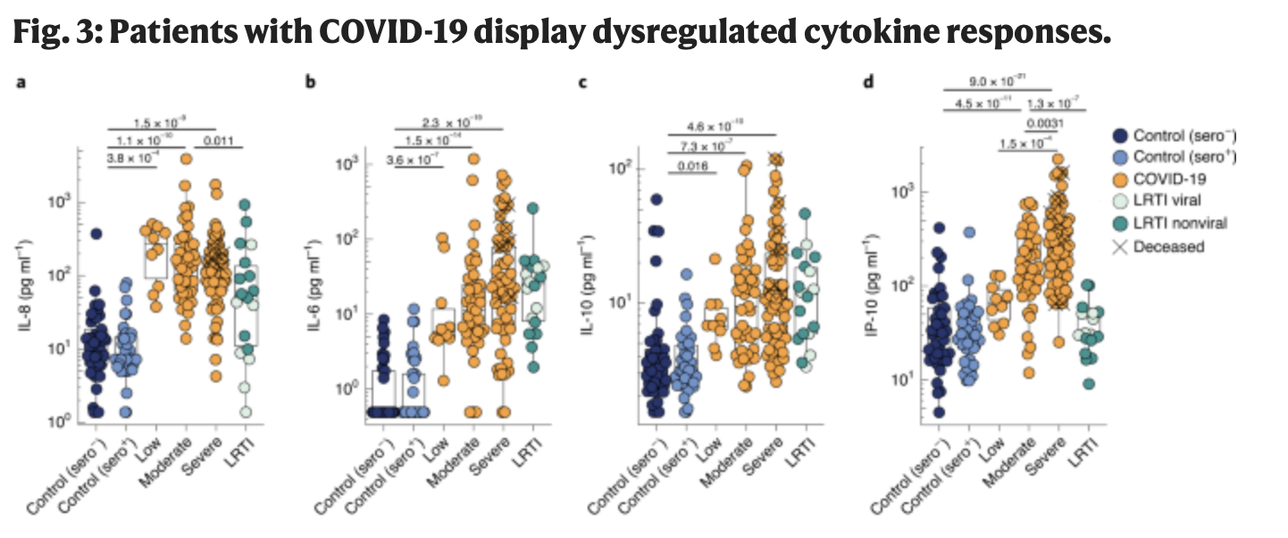
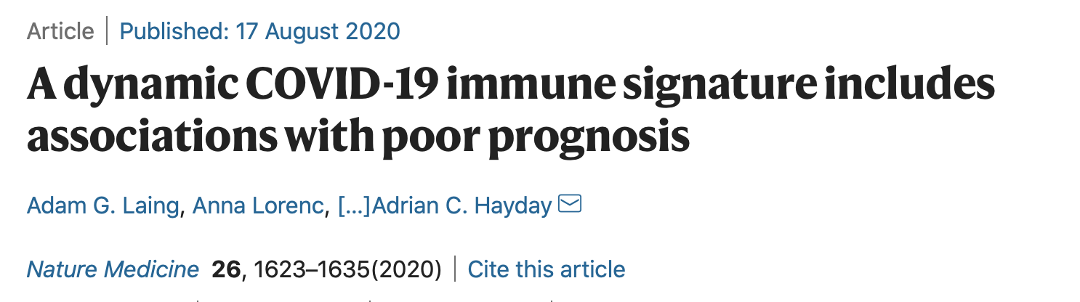
Markers of Severity Diagnostics for Evaluating COVID-19 MosDeco
Immune signature in COVID exposed community household population
- IL10 IL6 IP10
- MosDef multiplex panel (FIEBRE study) vrs commercial flow cytometry BioLegend panel
Notes:
Symptomatic vrs asymptomatic
Time from symptoms to blood sample
Children response vrs adult response
13 immune markers

Slide 19
MosDeco
AIM
Do markers of immune and endothelial activation vary between
symptomatic and asymptomatic SARS-CoV-2 seropositive and seronegative individuals within a community setting
OBJECTIVES
Cytokine profiles of symptomatic, asymptomatic and seronegative participants, comparison between symptomatic in wave 1 or 2 of the COVID-19 pandemic
Comparison of cytokine profiles in SARS-CoV-2 negative and positive groups
Comparison of childrens’ cytokine profiles from groups of SARS-CoV-2 negative, positive symptomatic and positive asymptomatic.
Exploration of the relationship between survey data on illness severity with cytokine profile.
Determine effect of time from symptomatic infection on immune profile

Slide 20
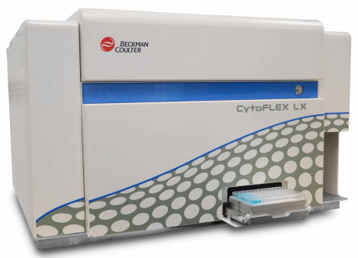
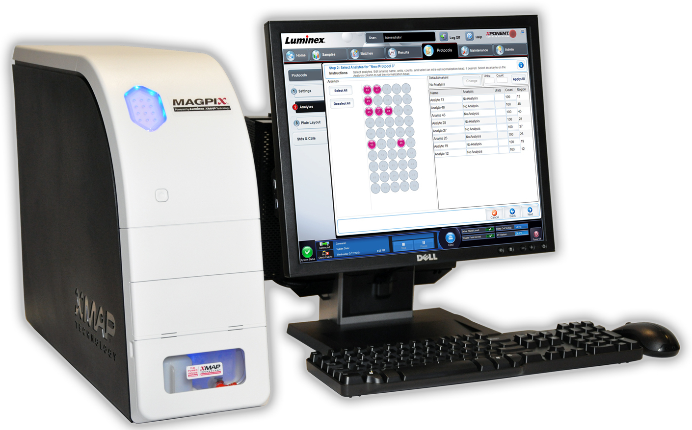
MosDeco
Flow cytometry
BioLegend LEGENDplex
Anti-Virus Response Panel
13-plex for $150 per sample
Th Cytokine Panel
12-plex for $140 per sample
Luminex
MosDef multiplex from FIEBRE study
Cost for 13-plex assay after MosDef optimisation
$320 per plate
$4 per sample
Notes:
Symptomatic vrs asymptomatic
Time from symptoms to blood sample
Children response vrs adult response

Slide 21
Ongoing work
CONTACT study
Propensity score model
Variables to include: IMD decile score, Time since index PCR diagnosis, Number of days of exposure to infectious index, Intensity of close contact, Index isolation from household
Two models – likely stratification model & co-variate adjustment model
MosDeco
Principle Components Analysis
Flow Cytometry validation work
MDR TB Household Contact prospective cohort in Peru
MDR TB Household Contact prospective cohort UK
Notes:
Prevalence ratio
Illness severity

Slide 22







Thank you
PhD Supervisors
Dave Moore
Chrissy h Roberts
CONTACT study
Katherine Fielding
Natalie El Kheir
Catherine Houlihan
Tommy Rampling
Mariyam Mirfenderensky
CONTACT field team
MosDeco
Abhishek Das
Tegwen Marlais
SARS-CoV-2 in an Orthodox community
Michael Marks
Roz Eggo
William Waites
Sham Lal
David Goldblatt
Marina Johnson
Adam Hunt
Neil Stone
Tracey Chandler
Ben Kasstan
Medical Advocacy and Referral Service (MARS)
UPCH team
Sonia Lopez
Jorge Coronel
Erika Sachun
Cesar Ugarte Gil
Tansy Edwards

