Slide 1
Surveillance of Plasmodium falciparum drug resistance within MATAMAL
David McGregor
Wellcome Trust Clinical PhD Research Fellow Year 1
Supervisors: Dr Anna Last, Prof. Taane Clark

Slide 2
Overview
1. Investigating phenotypic drug resistance
2. Evaluating rapid diagnostic test based surveillance

Slide 3
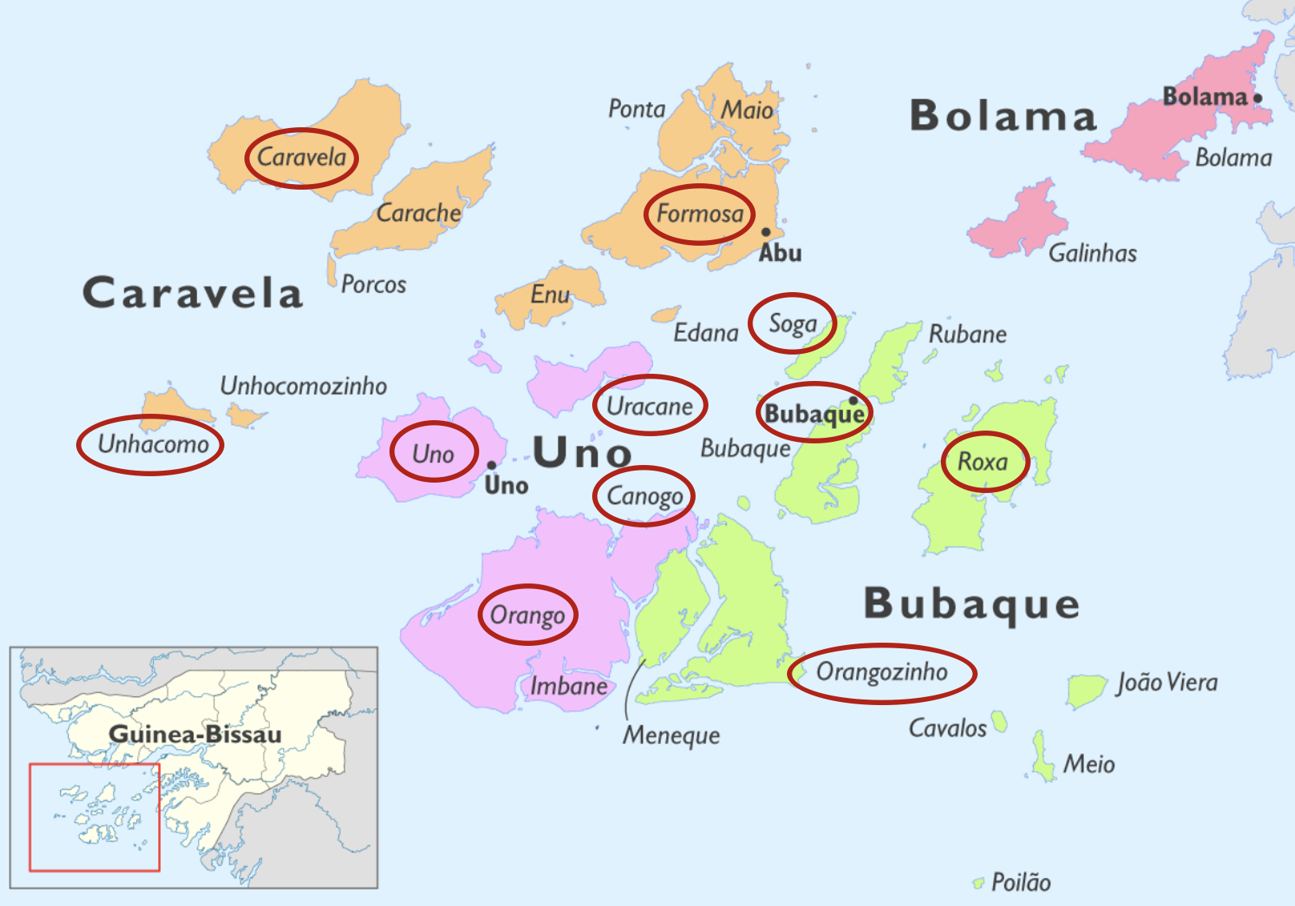
Phenotypic resistance
Therapeutic efficacy study
Determine efficacy of dihydroartemisinin-piperaquine and artemether-lumefantrine and in trial area
Open-label randomised study
Recruitment in two health clinics in trial area
First therapeutic efficacy study in this region

Slide 4
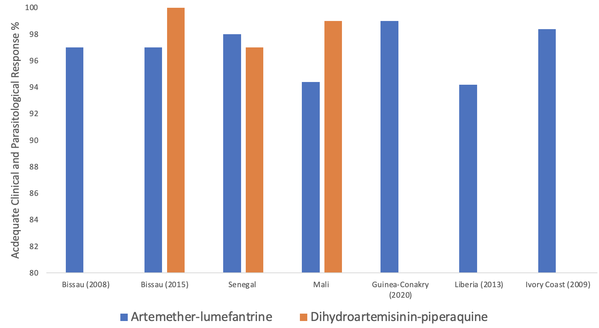
Phenotypic resistance
Artemether-lumefantrine (AL) and dihydroartemisinin-piperaquine (DP) efficacy
95%

Slide 5
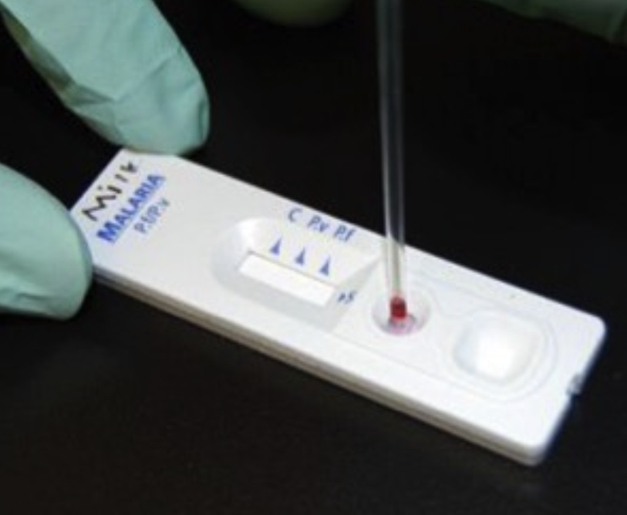
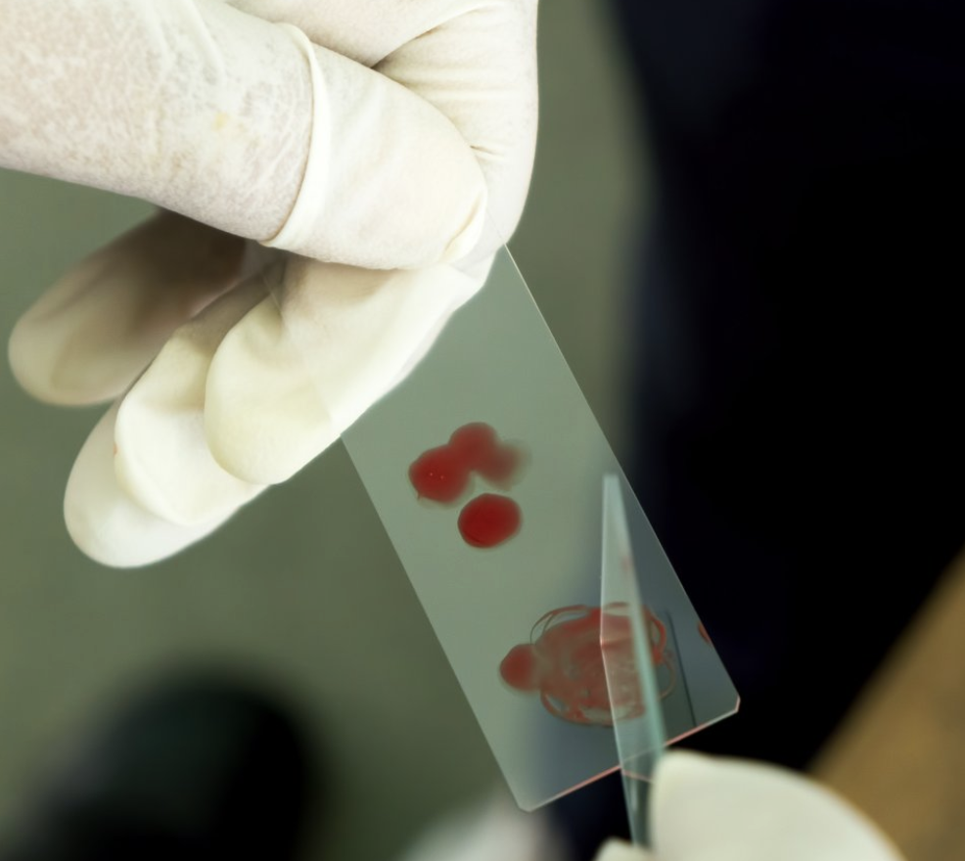
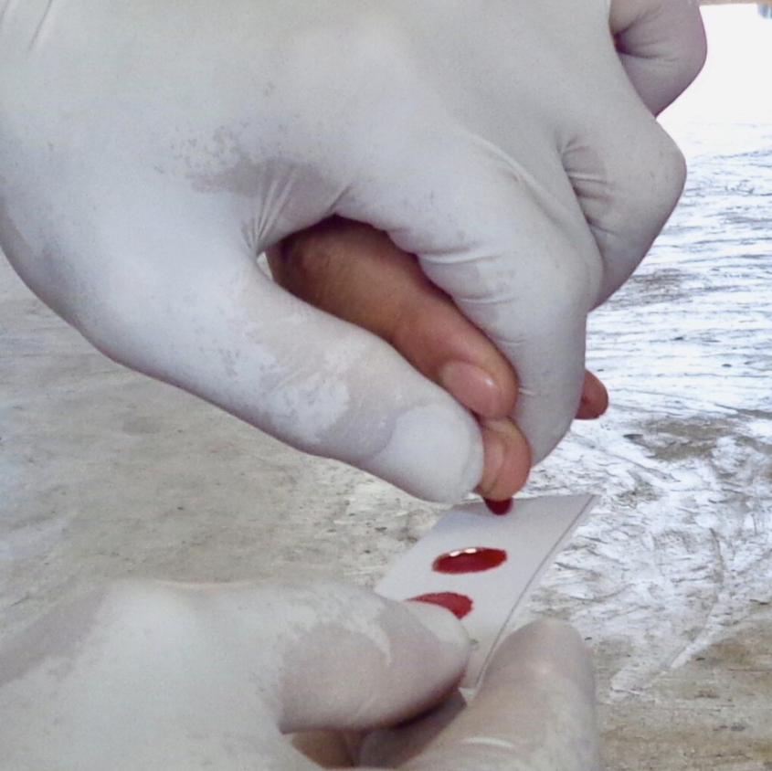
Phenotypic resistance
Hypothesis: the efficacy of AL and DP in the trial area is 95% or above
Standardised methodology (WHO, 2009):
Age from 6 months with uncomplicated P. falciparum malaria infection
Timing: during peak transmission season
Clinical examination and diagnostic assessment (RDT, microscopy, PCR)
Assessment on day 1, 2, 3, 7, 14, 28, and 42.
Sample size: 100 patients/arm
Estimated 3 months recruitment period (500+ presentations over two sites).
Notes:
seactn.org ameyawdebrah.com yourgenome.org

Slide 6
Phenotypic resistance
Additional features:
Genotyping: recrudescence vs reinfection (msp1, msp2, glurp)
Blood concentration of AL and DP
Liquid chromatography
Evaluate adverse events
Results shared with local public health authority

Slide 7
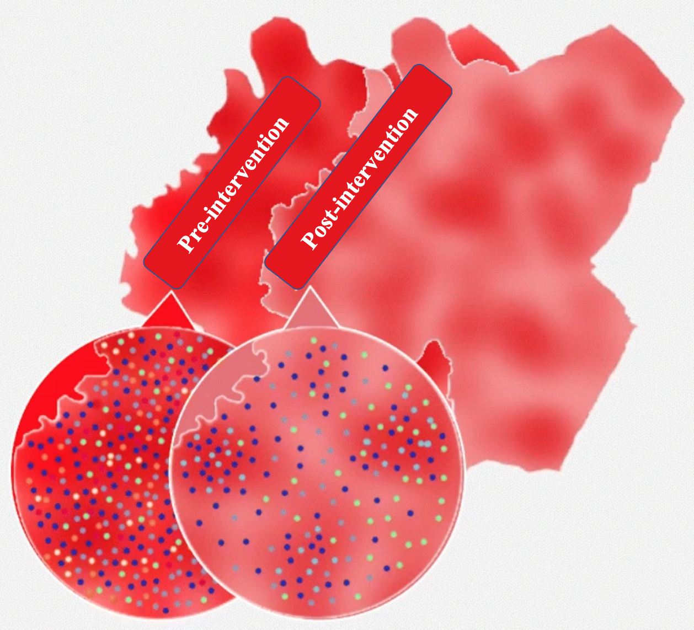
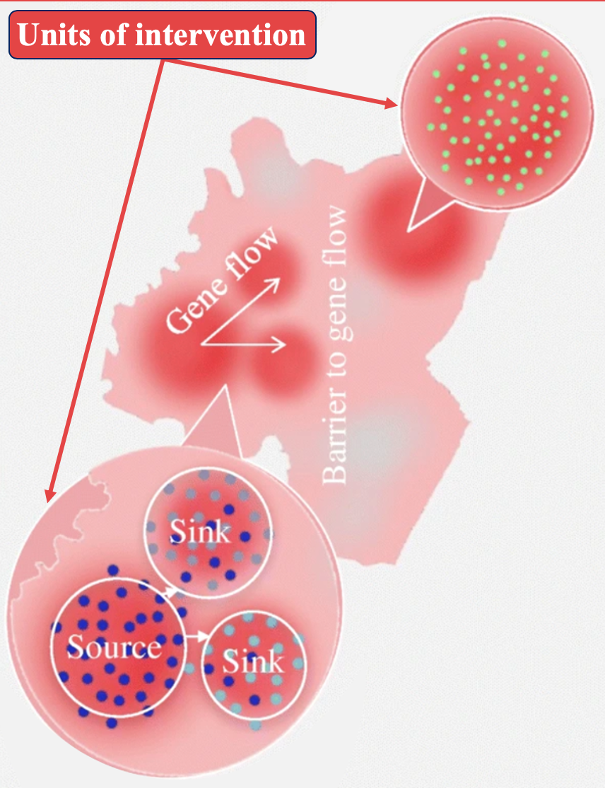
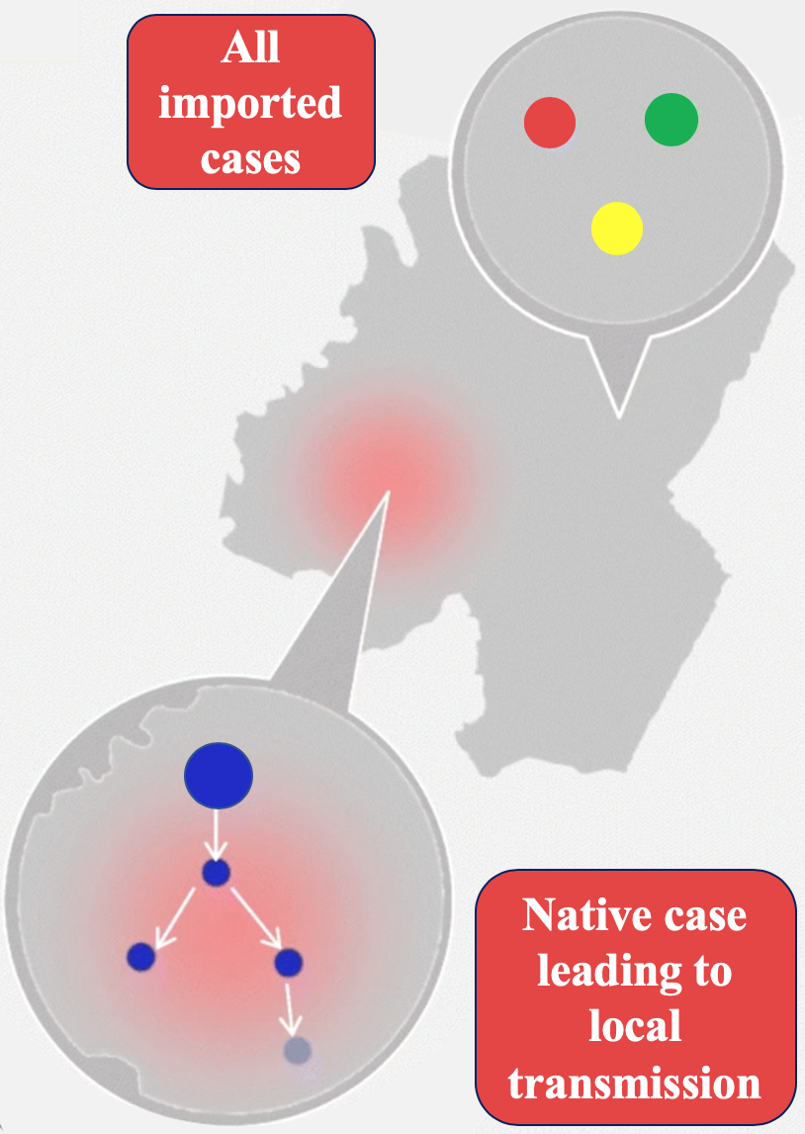
Rapid diagnostic test based surveillance
Background
1. Monitoring of drug resistance level after MATAMAL
MDA and SMC impact on resistance (Ndiaye et al, 2021)
2. Surveillance of parasite transmission and connectivity
Inform NMCP strategy and prioritise intervention timing and location (Neafsey et al, 2021)
3. Detection of imported cases
Low transmission setting

Slide 8
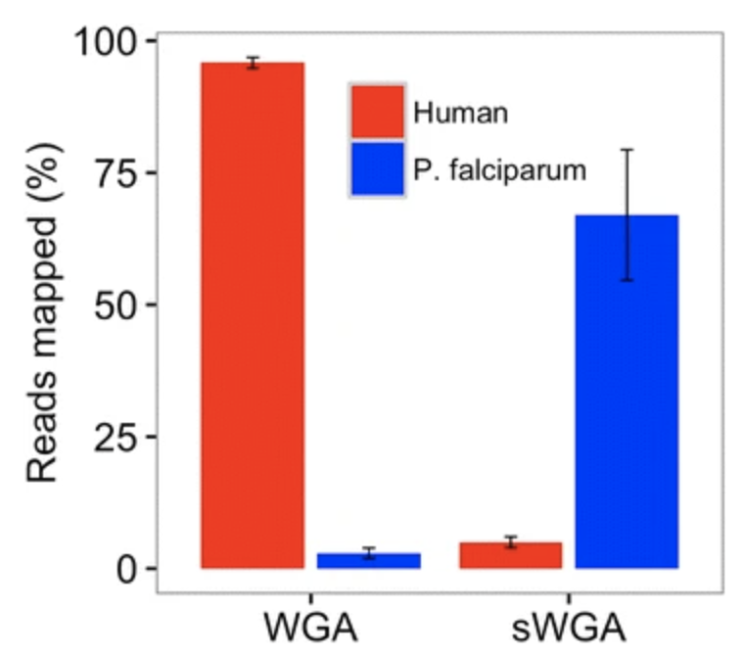
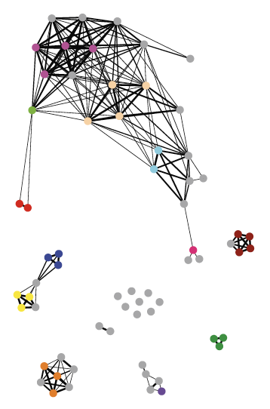
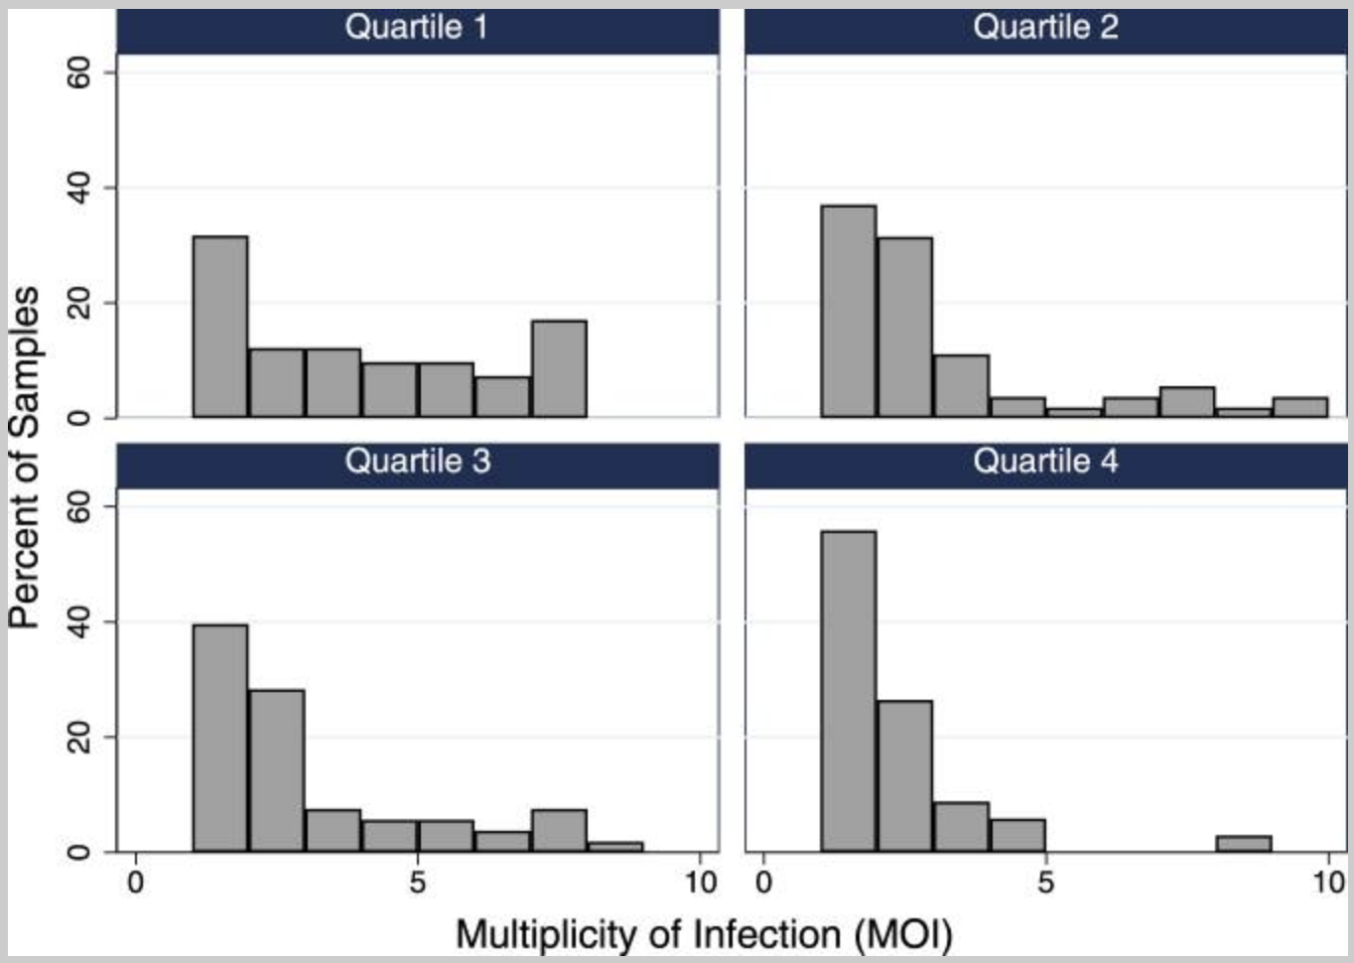
Rapid diagnostic test based surveillance
Approaches
Whole genome sequencing (Oyola et al, 2016)
Targeted amplicon sequencing (Boyce et al, 2018)
Single nucleotide polymorphism (SNP) genotyping (Daniels et al, 2015)
Oyola et al, 2016
Boyce et al, 2018
Daniels et al, 2015

Slide 9
Rapid diagnostic test based surveillance
Aim: determine if RDTs can be used for monitoring drug resistance and parasite population dynamics in the trial region
Hypothesis: RDT-based surveillance can accurately replicate markers of P. falciparum resistance, transmission, and connectivity as measured from dried blood spots.
Objectives
To determine the extent to which RDTs can replicate results for genomic data for P. falciparum obtained from dried blood spots.
To determine the extent to which RDTs can replicate serology data for P. falciparum from dried blood spots.
To determine training and logistical requirements for an RDT-based surveillance system

Slide 10
Rapid diagnostic test based surveillance
Study design: prospective collection of samples (dried blood spots and RDTs) from eleven health clinics in the trial area and mainland sites.
Timing: across peak and low transmission seasons
Participants: 6 months of age and above
Outcomes
Molecular markers of anti-malarial drug resistance
pfcrt1, pfpm2-3 (piperaquine), pfk13 (artemisinin), pfdhps (sulphadoxine)
Multiplicity of infection, fixation index, identity by descent
Serology markers of P. falciparum infection
Training and quality control requirements, and logistical requirements

Slide 11
Concluding remarks
Importance of monitoring drug resistance with complementary approaches in the context of mass drug administration.
There is an increasing need for transmission and connectivity surveillance to inform interventions and guide priorities.
Importance of sustainability and role of local public health teams.

Slide 12
Acknowledgements
Supervisors: Dr Anna Last and Prof. Taane Clark
Advisors: Prof. David Mabey, Dr Kevin Tetteh, Prof. Sanjeev Krishna, Dr Susana Campino, Dr John Bradley
Trial team: Dr Harry Hutchins, Sophie Moss, and Liz Pretorius
Laboratory expertise: Hristina Vasileva
Field Team and trial site investigators led by Eunice Texeira da Silva
Bissau Guinean Ministry of Health: Dr Paulo Djata, Director of the national malaria control programme
MRC The Gambia: Dr Mamadou Ousmane Ndiath and team in the molecular lab, Prof. Umberto D’Alessandro, and Prof. Alfred Amambua-Ngwa.
Bandim Health Project: Dr Amabelia Rodrigues
Funder: Wellcome Trust

