Slide 1

Characterising genomic markers for drug resistance in Plasmodium falciparum
Sophie Moss
Wellcome Trust Bloomsbury Centre Scientific Meeting 2022
Notes:
Hello, thanks for your attention at the end of a really interesting day
I am a PhD student working with MATAMAL and today I’d like to talk to you about characterizing genomic markers for drug resistance in P. falciparum.

Slide 2
Antimalarial resistance – the evolutionary arms race
1632
1844
1940
1944
1945
1947
1957
1967
1977
1985
1996
2008
Quinine
Quinine resistance
Primaquine
Primaquine resistance
Proguanil
Chloroquine resistance
Artemisinin
Mefloquine
Mefloquine resistance
Atovaquone
Artemisinin partial resistance
Proguanil resistance
SP
Atovaquone resistance
SP resistance
Chloroquine
WHO recommend monitoring molecular markers of drug resistance
Improved sequencing technology has led to a data explosion
Genomic surveillance has an increasingly important role
SP = Sulphadoxine-Pyrimethamine
Notes:
The plasmodium parasite is in a constant evolutionary arms race with our antimalarial drugs
This timeline shows the year in which some of our antimalarial drugs were introduced, and the year that the first case of antimalarial resistance to that drug was reported, which has been a major problem.
For example, the evolution of chloroquine resistance caused an increase in malaria mortality worldwide, and alternative drugs were produced, but unfortunately resistance to these drugs has evolved too.
The WHO now recommends monitoring molecular markers which are associated with drug resistance
As sequencing technology has been improved, there has been a complete explosion in sequencing data
And this has really led genomic surveillance to have an increasingly important role in monitoring drug resistance
It is particularly important to monitor the evolution of resistance when using antimalarial drugs on a mass scale, for example during MATAMAL
As you know, MATAMAL is a mass drug administration rtrial with DHA-PPQ and Ivermectin

Slide 3
My PhD Aims to investigate the impact of MATAMAL
Overall Aim: To investigate the impact of MATAMAL on the evolution of drug resistance and on the population structure and genetic variation of P.falciparum parasites in the Bijagós archipelago.
Notes:
My research aims to investigate the impact of this ongoing MDA trial on the evolution of drug resistance and on the population structure and genetic variation of P.falciparum parasites in the Bijagós, using dried blood spots collected during the transmission surveys as part of the MATAMAL trial.
To do this I am comparing genome sequence data from parasites collected both before and after the MATAMAL drug interventions, to understand how the MDA is impacting these parasites.

Slide 4
Genetic variation and population dynamics
Sample Selection
~2500 dried blood spots
Low DNA concentrations, 0.011 to 0.268ng/uL
48 with sufficient ng DNA for WGS
Samples were collected from before the MDA
qPCR for presence of Plasmodium
~2500 dried blood spots
Selective Whole Genome Amplification
145 samples
Whole Genome Sequencing
Novaseq 6000
Selection of Plasmodium positive samples with CT<30, 145 samples
DNA clean up using KAPA beads
145 samples
WGS data for 15 samples
Qubit for DNA concentration
145 samples
Qubit for DNA concentration
145 samples
Notes:
To understand the impact of MATAMAL, I need to know what we are starting with. So I first analysed samples from BEFORE the MDA, from two trials which happened in 2018 and 2019.
I have done DNA extraction and qPCR from samples collected during surveys
I then selected malaria positive samples which had a cycle threshold of less than 30 for further analysis,
DNA concentrations of these samples was very low, in the range of 0.011ng/uL to 0.268ng/uL, and most of that will of course be human DNA, which I am not sequencing.
So, I used selective whole genome amplification to amplify the Plasmodium DNA within the samples, which uses the temperature sensitive phi29 enzyme in a 16-hour long reaction.
I then cleaned-up these samples and after whole genome sequencing, I have 15 with whole genome sequencing data with a good level of coverage across the genome

Slide 5
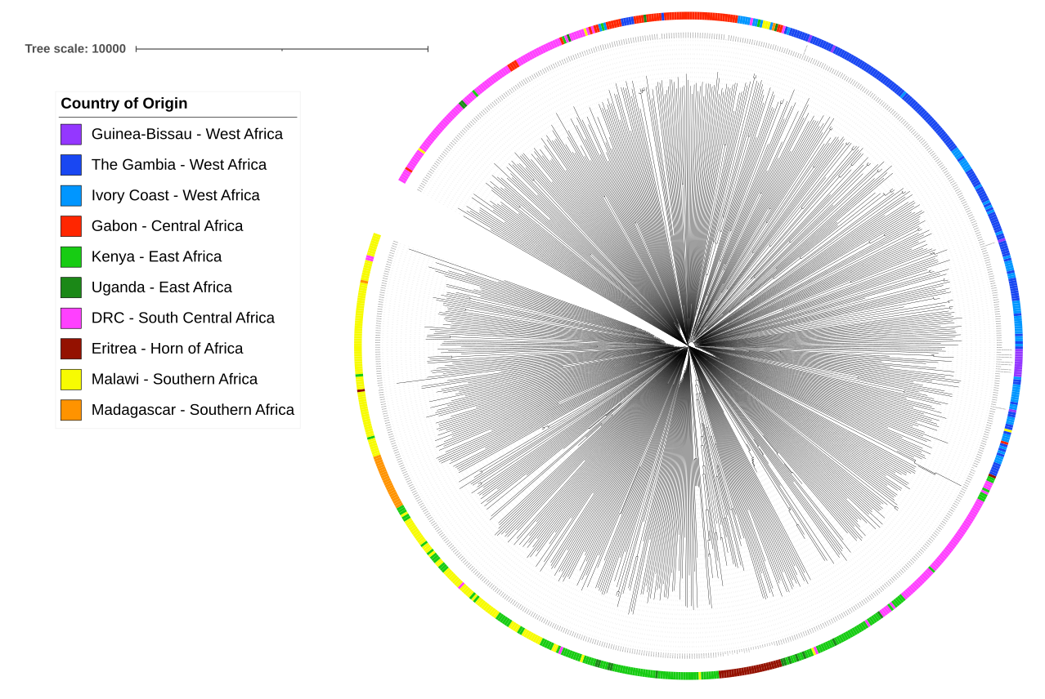
How do the Bijagós samples compare to samples from other countries?
Sequence Mapping
Variant Calling
Population Structure comparison using publicly available African WGS data
Notes:
I then did some applied genomic analysis to see how the Bijagos samples compare to parasites from other countries
I mapped these sequences to the reference plasmodium 3D7 genome and did variant calling using a bioinformatics pipeline
So I took the raw FastQ files for each sample, trimmed them and aligned them to the 3D7 genome.
I then called the variants in the sequence data, producing a VCF file for each sample
I then merged the VCFs to form a database which has all of the genotype calls for all of the variant positions across all of the samples
I converted that into a binary matrix where the reference allele is represented by a 0, the alternate by 1 and mixed calls by 0.5
I included other samples from west Africa in the binary matrix, which were publicly available through the MalariaGEN Pf3K project and other studies at LSHTM
And compared these to the Bijagos samples with principal components analysis and with a neighbour-joining tree which you can see here
You can see the that samples from Guinea-Bissau in purple are related most closely to the other samples from West Africa – The Gambia in dark blue and the Ivory coast in lighter blue
There is a lot of mixing between samples in West Africa, which indicates that there has been a lot of parasite transmission in the area, but you can still see reasonable distinction between the other regions of Africa

Slide 6
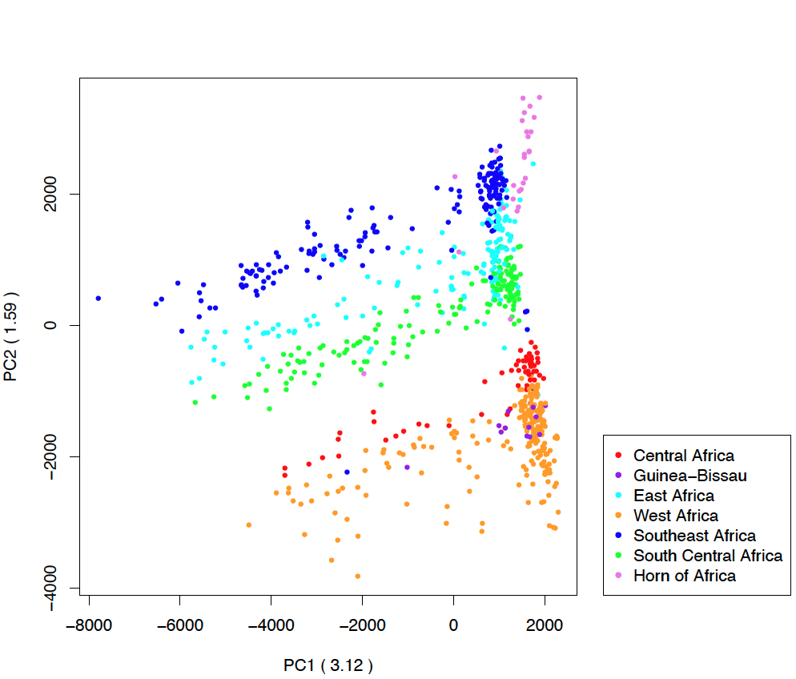
Samples cluster within West Africa as expected
Notes:
This is a PCA created using the same samples. Again you can see clustering of the Bijagos samples within West Africa, which is what we would expect, all good so far.
This demonstrates that the whole genome sequence data I have generated for these parasites fits as we would expect in a global context
And this is the first time that sequence data has been produced from parasites on the archipelago
So PC1 explains the major axis of variation, PC2 the second largest and so on, until all of the available variation is explained.
Typically PC1 discriminates between geographical regions, but in Africa the plasmodium populations have a lot of diversity and shared ancestry, so the regional effect is represented by PC2
A PCA summarises the major axes of variation in allele frequencies in the data, and then produces the coordinates of individuals along those axes.

Slide 7
Molecular markers of drug resistance to analyse
Gene | Targeted polymorphism(s)
Pfcrt | Genomic positions 72-76, and K76T
Pfmdr1 | N86Y, S1034C, N1042D, D1246Y
Pfdhfr | A16V, N51I, C59R, S108N, I164L
Pfdhps | I431V, S436A, A437G, K540E, A581G, A613S
Pfk13 | Whole gene
Pfexo | E415G
Pfap2µ | I592T
Pfcoronin | G50E, R100K, E107V
Pfubp1 | V3275F
Plasmepsins | Gene duplication
Notes:
I then wanted to see what the baseline resistance profile is for these samples, to existing antimalarial drugs.
These are the different markers that I want to look at, which have each been associated with resistance to one or more antimalarials.
So I first looked in my whole genome sequence data for these markers

Slide 8
Baseline drug resistance profile in the Bijagós
Gene | Target | % Reference Allele | % Alternate Allele | % Mixed Allele
Pfexo | E415G | 100 | 0 | 0
Pfcrt | K76T | 64 | 29 | 7
Pfmdr1 | N86Y | 92 | 8 | 0
 | Y184F | 38 | 54 | 7
Pfdhfr | N51I | 0 | 100 | 0
 | C59R | 7 | 93 | 0
 | S108N | 0 | 100 | 0
Pfdhps | G437C | 33 | 60 | 7
Notes:
There was good coverage of 7 of these drug resistance markers in the whole genome sequence data.
Three main points of interest on this slide:
Pfcrt K76T which is associated with resistance to chloroquine- split, 29% alternate allele, which is in line with parasites sequenced from mainland Guinea-Bissau.
Pfmdr1 N86Y is majority reference allele, which is associated with resistance to lumefantrine. This makes sense as the main treatments on the Bijagós are Artemether-Lumefantrine for uncomplicated malaria infection so we would expect selection pressure for N86Y
3. The three Pfdhfr mutations show a clear mutated profile with N51I and S108N at fixation. This indicates resistance to Sulphadoxine-pyrimethamine.
The caveat is that this is a small number of samples, it’s 15 infections of many.

Slide 9
Multiplex Amplicon PCR and Sequencing
Barcode
Primer
Target Gene in Sample 1
Target Gene in Sample 4
Target Gene in Sample 2
Target Gene in Sample 5
Target Gene in Sample 3
Target Gene in Sample 6
Notes:
To get a more detailed picture of the baseline resistance profile I am using multiplex amplicon sequencing
You can do this with samples which aren’t good enough for whole genome sequencing, but will be good enough for you just to amplify the small bits of the genome that you’re interested in
This uses primers which are designed like the diagram on the right
You have your primer sequence but then you have a barcode which is specific to the DNA sample you are amplifying,
The barcode system allows you to multiplex different PCR reactions together and to sequence different DNA samples in the same sequencing run, and then to work out which bits of sequence come from which DNA samples bioinformatically but demultiplexing the data afterwards
This is a low cost, high throughput method for molecular surveillance.

Slide 10
Multiplex Amplicon Sequencing - Results
Gene | SNP | Reference (Ref.) base | Alternative (Alt.) base | Ref. codon | Alt. codon | Ref. freq. (%) | Alt. Freq. (%) | Total Count
Pfdhfr | N51I | A | T | N | I | 0 | 100% | 4
Pfdhfr | C59R | RT | C | C | R | 0 | 100% | 3
Pfdhfr | S108N | G | A | S | N | 25% | 75% | 4
Pfdhps | S436A | C | T | S | A | 80% | 20% | 5
Pfdhps | A437G | G | C | A | G | 80% | 20% | 5
Notes:
So far, I have amplicon sequencing data for an additional 5 of the DNA samples.
And the presence of Pfdhfr N51I, C59R and S108N mutations and Pfdhps mutations S436A and A437G indicate intermediate level resistance to S-P.
So my next steps are to continue to grow this baseline profile, and then to compare the profile of antimalarial resistance of samples before MDA and those after MDA, to see if there has been any impact of this MDA on the markers of antimalarial resistance. In particular for DHA-PPQ, I’ll look at the frequency of the E415G mutation in the Pfexo gene, plasmepsin copy number, and a number of markers in CRT which may be associated with DHA-PPQ resistance.

Slide 11
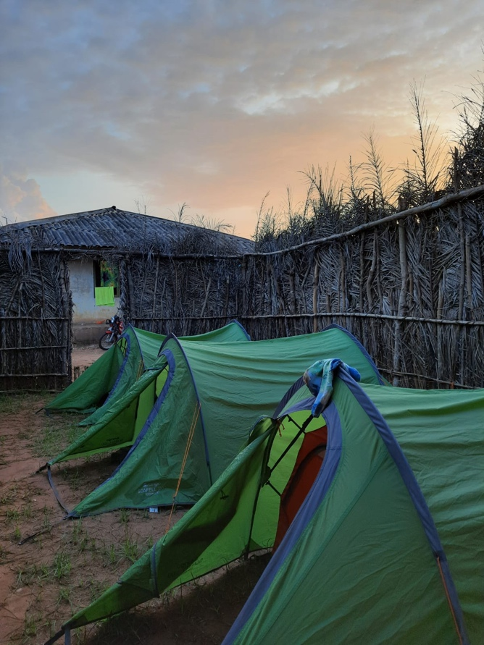
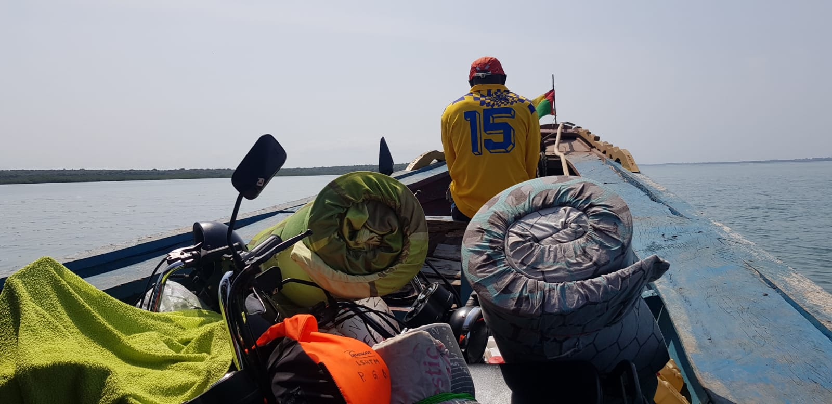
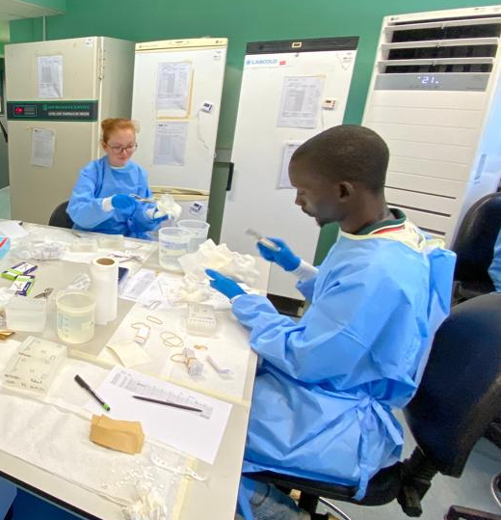
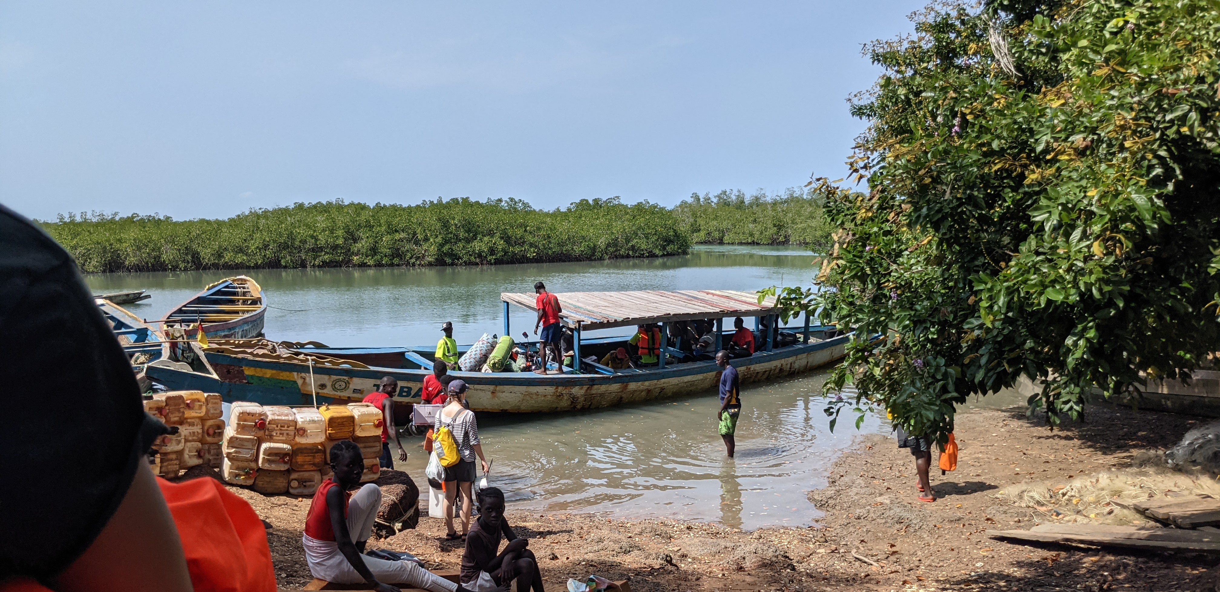
Compare to samples following Mass Drug Administration
Continue to generate baseline resistance profile for Bijagós samples
Compare to samples collected post-MDA

Slide 12








Acknowledgements
The Team:
MATAMAL Team at LSHTM and MRC The Gambia
MATAMAL Team in Guinea-Bissau
LSHTM: The Campino-Clark Group
SGUL: The Staines-Krishna Group
Supervisors:
Dr Anna Last
Professor Taane Clark
Professor Susana Campino
Professor Sanjeev Krishna
Advisory Committee:
Dr Alfred Amambua-Ngwa
Notes:
I’d like to acknowledge everybody in the team and the funders, without whom this project wouldn’t be possible
So thank you very much

