Slide 1
In silico classification of Plasmodium falciparum hypervariable multigene family
Hristina Vasileva
16th March 2022

Slide 2
MATAMAL intro slide
MSc Medical Microbiology (LSHTM)
MATAMAL
Molecular Biology Researcher
qPCR
Luminex
Troubleshooting
Development
Sample testing
Data QC/analysis
MRC Gambia/LSHTM London
Molecular Biology Researcher
qPCR
Luminex
Troubleshooting
Development
Sample testing
Data QC/analysis
MRC Gambia/LSHTM London
PhD: Characterization, development and use of hypervariable surface proteins as serological markers of exposure to P. falciparum infection in a massive drug administration intervention setting.
Notes:
Do I keep my background info of education?

Slide 3
Overview
Background
Analytical model for clustering sequence data
Results
Importance

Slide 4
P. falciparum: Hypervariable surface proteins
Proteins features
Expressed on the surface of infected red blood cells
Possessing antigenic properties
Subtelometic Variable Open Reading Frame
Scherf, A.,et. al (2008). Annual Review of Microbiology, 62(1), 445–470.
Notes:
Keep it short

Slide 5
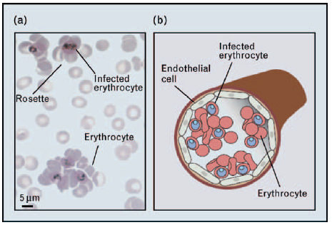
STEVOR protein family
Functions
Evasion of host immune response
Rosetting
Mediated binding of RBCs to the endothelial cells
Alternation of RBC rigidity
Merozoite attachment (some STEVORs)
Structure model
Rowe, J. A.,et. al (2009). Current Opinion in Hematology
SP: signal peptide
V1: variable domain 1
STEVOR (n≈30-40)
P: PEXEL motif
SC: semi-conserved
SP
V1
P
SC
TM
V2
TM
C
TM: trans-membrane
V2: variable domain 2
C: conserved
Notes:
Have been shown to bind to Glycoprotein C on RBCs and mediate resetting
Antibodies targeting STEVOR block merozoite attachment and erythrocyte invasion

Slide 6
Multi-copy gene family: Antigenic variance
Parasite population infection model
Gene family X1
X1.1
X1.2
X1.3
X1.4
Notes:
Allowing the pathogen to change it’s phenotypic apperiance
Evade antibody mediated host immunity by altering the parasite-encoded antigens that are exposed at the erythrocyte surface
Antigenic switching?
Expression is clonally variant
Expression undergoes switching
Switching rates vary amongst different variants
Classic immune evasion strategy

Slide 7
PhD Overview
Aim
To develop and use novel hypervariable recombinant proteins as serological markers to monitor exposure to P. falciparum infection.
Objectives
To develop a library of STEVOR recombinant variants to use as markers of naturally acquired immunity (NAI) to P. falciparum. (Luminex technology)
To investigate the potential impact of MDA on the profile of antibody responses to the STEVOR . (MATAMAL)
Study importance
Filling the knowledge gap associated with a largely neglected hypervariable family of clinical importance

Slide 8
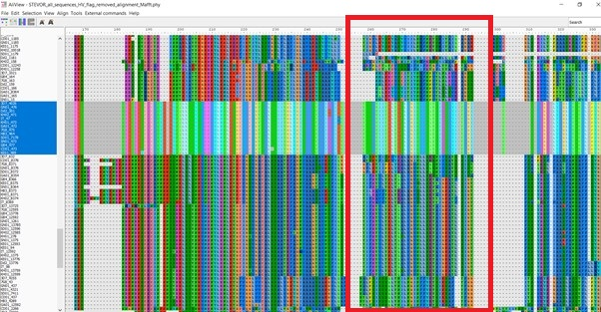
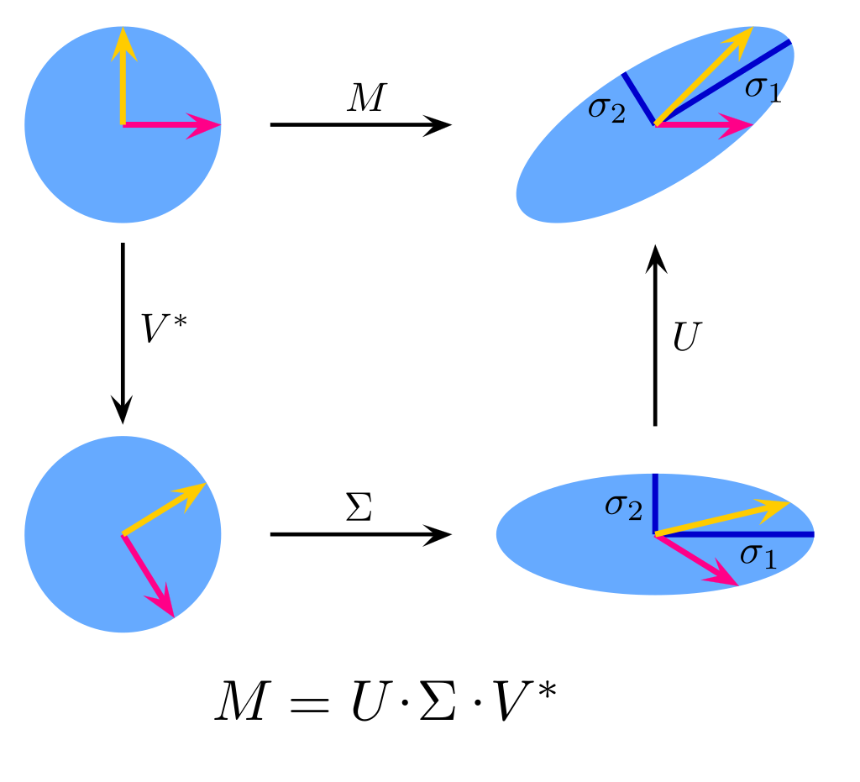
In silico model for protein classification
Model summary (R)
Sequence data base inspection (n=493)
Alignment (MUSCLE)
Domain sequences isolation (V2, SC and C)
Digitizing AA sequences
Each AA (21) create Boolean vector
Piling Boolean to matrix M
Singled value decomposition of M (SVD)
Euclidean distances sPC
Principle component analysis plots (PCA)
Sequence Clustering
Library selection
Isolating unique sequences
bo01ean
bo01ean
bo01ean
Notes:
This model observes the structure of the sequence matrix data without harming its structure.
Not connecting samples based on unverifiable assumptuions
PCA does not assume a specific structure of data
Finds direction of differences and presents them by using the axes
Rotating the matrix to calculate the distance between the sequences as points in space to present them in a point a to point b. The distance becomes a metric distance to plotted in 2D plots.

Slide 9
High level sequence variation
Key points
High level variation
Some unique variants
Defining variant groups
Key questions
Role in pathology?
Role in immune modulation?
Role in immune evasion?

Slide 10
Low level sequence variation

Slide 11
Conclusions
In silico model
Exploration of multilevel relationships between data points.
Reproducibility of analysis (100%)
Analysis of and AA or NA sequences data
Applicable to any organism
STEVOR V2 data
Complex variation of V2 domain sequences
Less variation as conservation level increases
Sequence plasmids available representing the breadth of STEVOR variability

Slide 12
Acknowledgments
Funding: Joint Global Trials Health Scheme (JGHTs)
Foreign, Commonwealth and Development Office (FCDO)
Medical Research Council (MRC)
National Institute for Health Research (NIHR)
Wellcome Trust foundation
MATAMAL
Harry Hutchins
Sophie Moss
David McGregor
Elizabeth Pretorius
Eurnice Texeira da Silva
Field team
Supervisors
Dr Kevin Tetteh
Dr Anna Last
MRC Unit The Gambia
Fatima Ceesay
Sarata Sambou
Aurelia Prom
Advisory Panel
Dr Lindsey Wu
Dr Ernest Diez Benavente
Dr John Bradley
LSHTM
Prof David Mabey
Prof Chris Drakeley
Elin Dumont
Katie Patterson
James Ashall
Sonal Shah

Slide 13
Thank you
for listening

