Slide 1

Exploring malaria transmission and sero-epidemiology on the Bijagos Archipelago in the context of MATAMAL
Harry Hutchins
MATAMAL Trial Manager
Clinical Research Fellow
March 2022

Slide 2
Contents
Background
Aims and objectives
Methods
Preliminary results
Future work

Slide 3
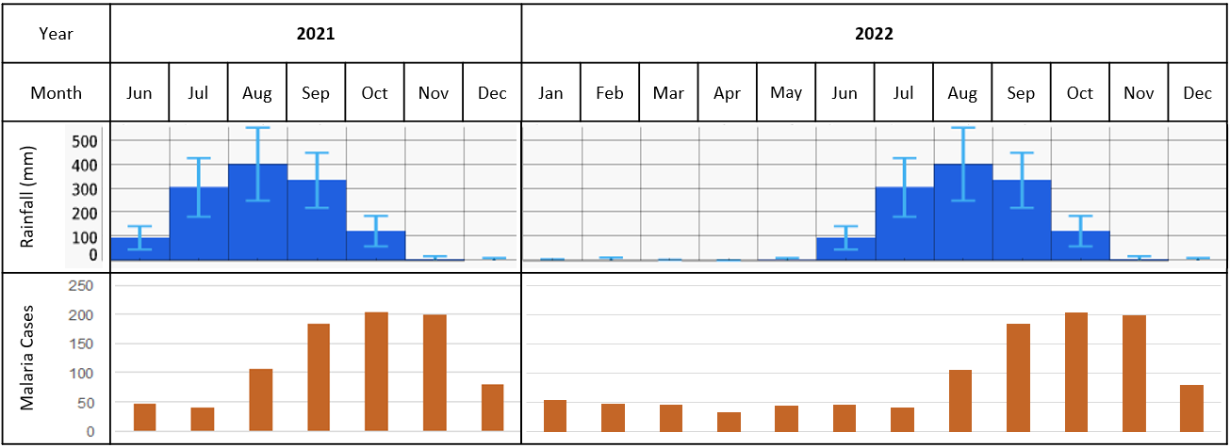
Background
Malaria remains a significant global health problem
MATAMAL is trialling new control tools on the Bijagos
Accurate surveillance is critical: programme and academic
Target + evaluate interventions
Guiding decision making
Reduce waste + harm
Especially in areas of low/seasonal transmission
Heterogenous, hotspots
Harder to identify
Microscopy, RDT, PCR lose sensitivity
Notes:
Surveillance is critical to map spread, identify areas of continuing transmission, target interventions…

Slide 4
Serology
Diagnostic identification of antibodies
Historical exposure, not only current infection
Increased sensitivity in low/seasonal transmission settings
Different antibodies = different half-lives = different exposure histories
Procedural benefits:
DBS
Recombinant antigens
Quantify response
Multiplex platforms (antigens + species)
Seroprevalence, sero-incidence, transmission, intervention evaluation, risk stratification, hotspot analysis…
Notes:
Horizontal combination of programmes: e.g. NTDs and malaria
Not perfect: must set up assays, not all antibodies are equal, initial cost and training, securing reagents, saturation in high-transmission

Slide 5

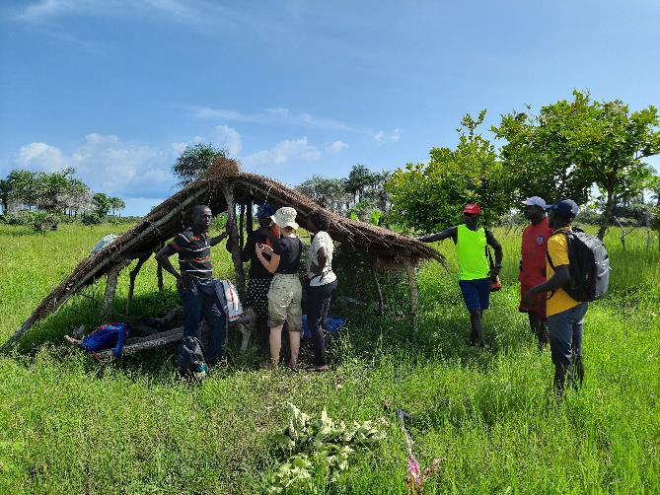


Setting
Notes:
Describe setting
Seasonal, low to moderate transmission (22.2% peak PCR prevalence)

Slide 6
PhD Aim and Objectives
To describe the impact of IVM/DP MDA over DP MDA alone on malaria transmission on the Bijagos Archipelago in the context of MATAMAL
To characterise seasonal variation in malaria transmission across the archipelago prior to MATAMAL
To evaluate the impact of IVM/DP MDA over DP-only MDA on malaria prevalence on the archipelago
To use a multiplex platform to explore the sero-epidemiological impact of MATAMAL on malaria transmission on the archipelago

Slide 7
1) Baseline Malaria Transmission
Describe the baseline seasonal variation in malaria transmission on the Bijagos
Serial population-based cluster-randomized cross-sectional surveys
RDT, qPCR and Luminex
Full analysis pending
1 island
404 participants
1 island
564 participants
1 island
487 participants
6 islands
2297 participants
16 islands
2335 participants
6 islands
1654 participants
Notes:
Lab results completed just before field work began

Slide 8
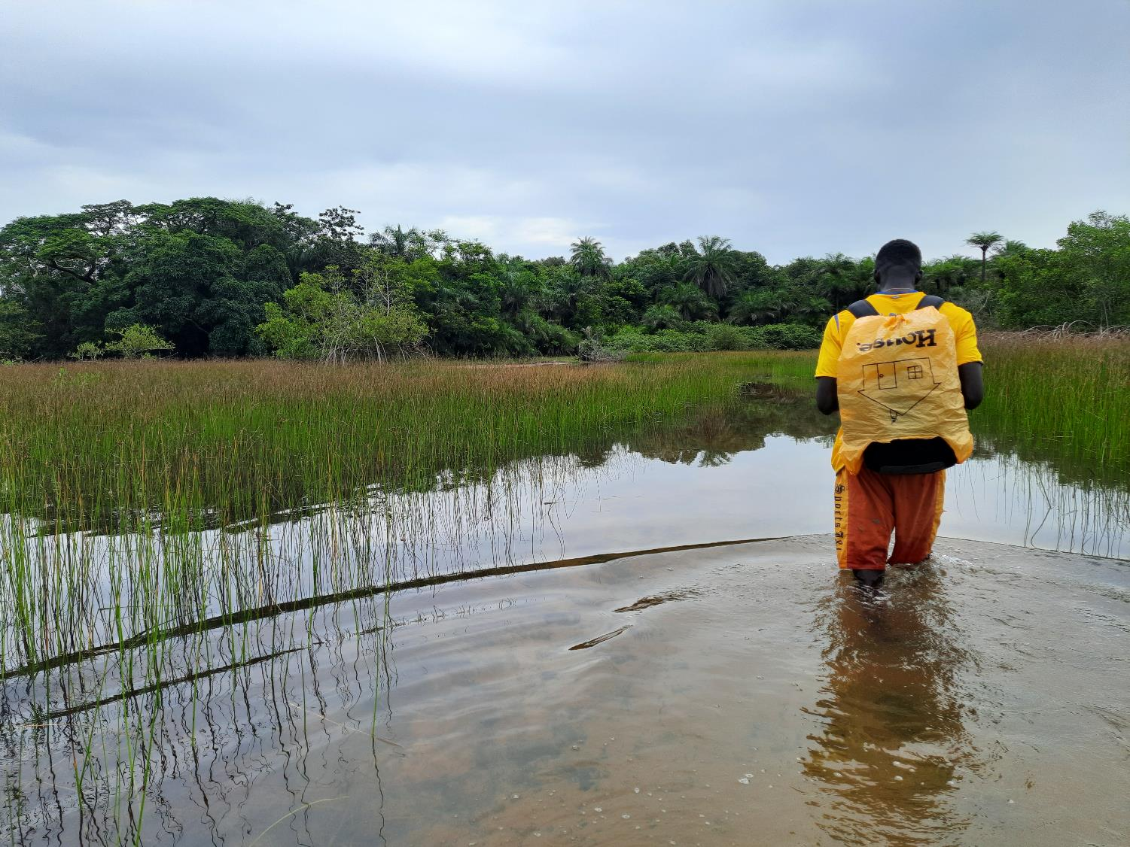
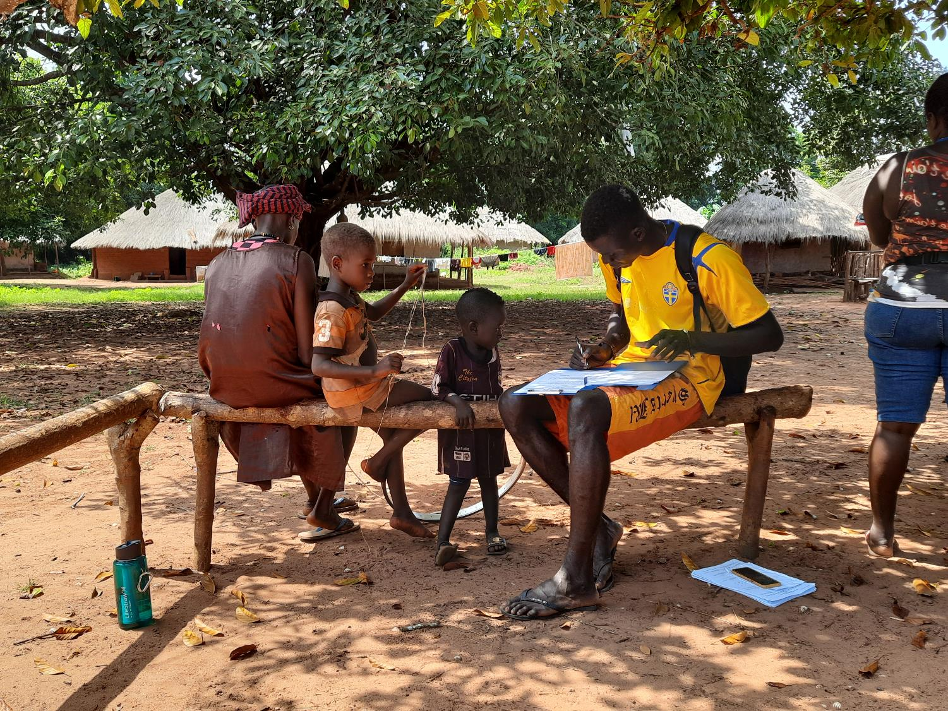



Data Collection

Slide 9
Archipelago Prevalence by Timepoint
Survey | Islands | Participants | Prevalence (%)
Survey | Islands | Participants | RDT | qPCR
Aug 2017 | 1 | 404 | 6.44 | 18.56
Nov 2017 | 6 | 1654 | 7.44 | 16.68
Jan 2018 | 1 | 564 | 4.44 | 8.51
Jul 2018 | 1 | 487 | 1.65 | 12.32
Nov 2018 | 6 | 2297 | 12.02 | 17.55
Nov 2019 | 16 | 2335 | 7.54 | 9.76
Notes:
SMC in rainy season 2019

Slide 10

Schematic Visualisation of Prevalence
Key | PCR prevalence
 | 0.00 – 0.09
 | 0.10 – 0.19
 | 0.20 – 0.29
 | ≥0.30
Notes:
Heterogeneity informed power calculations

Slide 11
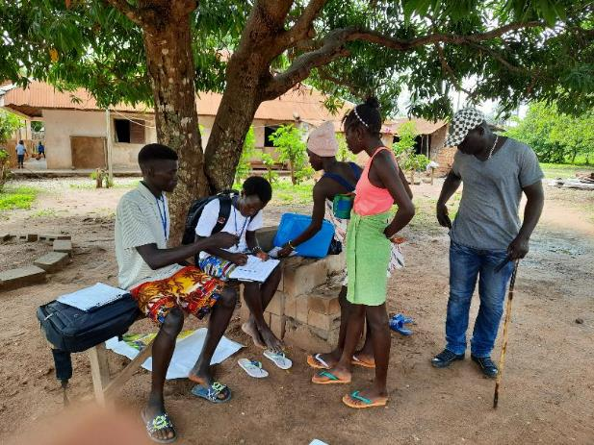
2) The Impact of MATAMAL
Difference in prevalence & incidence between trial arms
Prevalence
Incidence
Coverage
Peak transmission cross-sectional survey (all ages)
Rainy season cohort survey (5-14)
Passive clinical incidence data
Unblinding
Notes:
Monthly coverage: participants receiving 3 doses/total population (not eligible only)
Head count performed as numbers uncertain

Slide 12
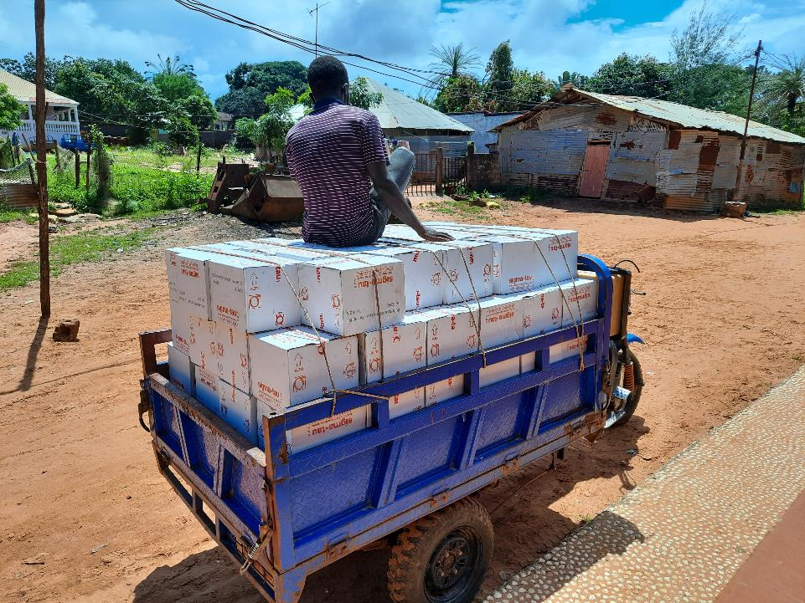
Interim Results – Coverage
Paper record forms → electronic data capture pending
Preliminary ad hoc estimations:
Coverage 70%
Refusals 2%
Absences 15%
Overall successful 1st year
Variation between months: problem-solving + experience
Heterogeneity due to population movement: participatory mapping in 2022

Slide 13
Interim Results - Surveys
Survey | Participants | Female (%) | Mean age
Cohort | 912 (2930 samples) | 49.2 | 8.8
X-sectional | 4433 | 56.4 | 25.7
Monthly decrease in cohort children sampled
9 febrile children

Slide 14
Objective 3 – MATAMAL Serology
Comparing malaria serology between trial arms
Categorical seroprevalence
Continuous MFI
Seroconversion rates
Antibody acquisition models with AUC
Identify which antigens most sensitively detect differences
Comparing after MDA1 and MDA2
Assumptions
Reduced seroprevalence and SCR in intervention arm
Short-term markers more sensitive
Long-term markers stable, except in youngest age group
Antigen | Half life
MSP1.19 | Long
AMA1 | Long
GLURP.R2 | Long
EBA175.RIII.V | Medium
EBA181.RIII.V | Medium
Etramp5.Ag1 | Short
Etramp4.Ag2 | Short
HSP40.Ag1 | Short
CSP | Short
SBP1 | Short
Hyp2 | Short
GEXP18 | Short
Rh2.2030 | Short
Rh4.1 | Short
Rh5.2 | Short
Notes:
Nil available yet, in process
These antigens in assay validated by Wu et al
Seropositive = 3sd above mean response from malaria-naïve samples. But, lose a lot of information
Seropositive: multi-level logistic regression with random effect for clustering
MFI: mixed effect linear regression
SCR: Cluster-level age-dependent changes in the seroprevalence of each antigen will be fitted to a reversible catalytic conversion model using maximum likelihood methods
EBA and Rh more associated with protection than exposure
Age-group subanalysis (1-4, 5-14, 15+)

Slide 15

Objective 3 – MATAMAL Serology
Seroprevalence as a diagnostic:
Correlate cluster-level seroprevalence with qPCR + clinical incidence
Sensitivity + specificity
Correlate continuous MFI data with qPCR
Identifying geospatial hotspots of transmission:
Collecting household GPS
Spatial scan statistic (seroprevalence, SCR, qPCR, incidence)
SaTScan to identify areas of above-average transmission
Serology as an indicator of clinical risk:
Cohort children: baseline and monthly samples
Survival analysis, followed up to time to:
  Asymptomatic parasitaemia
  Symptomatic malaria
  … Uninfected
Notes:
Spearman rank coefficient
Bernoulli and discrete Poisson models for spatial scan statistics
Cox regression for survival

Slide 16
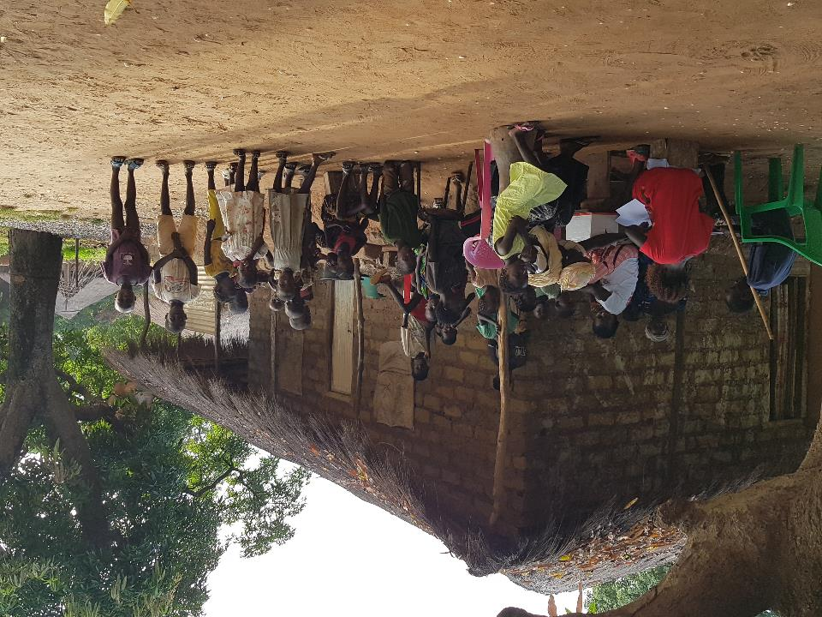
Progress and Future Work
Baseline serological analysis
Year 1 MDA and sample collection complete
Year 1 coverage data entry/analysis
Year 2 preparations progressing
Laboratory analysis → 1st year analysis

Slide 17
Summary
Malaria remains a significant public health problem
MATAMAL is trialling ivermectin for malaria control on the Bijagos Archipelago, Guinea-Bissau
Multiplex serological analysis has the potential to add a wealth of data in this and other settings
This PhD aims to evaluate local malaria transmission patterns before, during and after MATAMAL, with special interest in its sero-epidemiology
First indications are of good coverage and an effect on clinical incidence

Slide 18







Thanks
Thank you for your attention
Happy to take your questions
Harry.Hutchins@lshtm.ac.uk
Special thanks to:
Anna Last, Chris Drakeley, John Bradley
Eleanor Martins
MATAMAL PhD colleagues, MSc students and volunteers
MRC Gambia and Bandim Health Project
Eunice Teixeira da Silva, nha equipa garandi di MATAMAL na Guiné-Bissau
e no colaboradores
Funding: JGHT scheme (MRC, FCDO, NIHR, Wellcome)

