Slide 1
Ivermectin for Malaria Control: The MATAMAL Trial Bijagós Archipelago, Guinea Bissau
Anna Last
WT Bloomsbury Centre for Global Health Research Scientific Meeting
The Gambia, 16th March 2022
Notes:
Intro

Slide 2
MATAMAL
AIM
Evaluate the impact of ivermectin (IVM) with dihydroartemisinin-piperaquine (DP) MDA on malaria prevalence
DESIGN
Two arm cluster randomised placebo-controlled trial (24 clusters randomised 1:1)
STUDY POPULATION
~27,000 inhabitants meeting eligibility criteria on the Bijagos Archipelago.
PRIMARY OUTCOME
Pf PCR (all ages) prevalence after two years of intervention
estimated by cross-sectional survey during peak malaria
transmission season
PRIMARY ANALYSIS
ITT, cluster-adjusted Pf prevalence comparison between arms
Notes:
Comparison between arms.
Intention-to-treat, with participants analysed according to the arm to which they were randomised and adjustment for factors imbalanced between arms at baseline as appropriate.
The intervention effect on Pf prevalence (and other secondary binary outcomes) will be estimated as an odds ratio and 95% confidence interval, estimated using a random effects logistic regression, including cluster as a random effect.

Slide 3
Objectives
To evaluate the impact of three rounds of adjunctive IVM MDA to DP MDA on malaria (prevalence and incidence)
To evaluate the impact of three rounds of IVM MDA on Anopheles gambiae and co-endemic diseases (LF, STH, scabies, bed bugs and head lice)
To use real-time/reactive social science research to monitor and improve implementation of MDA to ensure high coverage
To conduct a cost-effectiveness analysis

Slide 4
Study Setting
Co-endemic for malaria, LF, STH, scabies
Stable, seasonal malaria transmission
Peak vector density August/September
An. gambiae s.s malaria vector
Peak clinical malaria cases October/November
Pf prevalence 22.2% (95% CI 18.7-26.0%)
High LLIN coverage (>90%) and use
Moderate IPTp coverage (~65%)
Diagnosis of symptomatic malaria and treatment with ACT
No indoor residual spraying (IRS)
No seasonal malaria chemoprophylaxis (SMC)
Notes:
Net coverage 92% (95% CI 86%-96%) (net use (reported) ~86%)
Transmission setting – similar to The Gambia
IPTp variably conducted – data so far from our survey suggests that on Bubaque, approx 65% women who had been pregnant in the last two years reported to have received a full course of sulfadox/pyrimethamine. Lower on other islands.

Slide 5
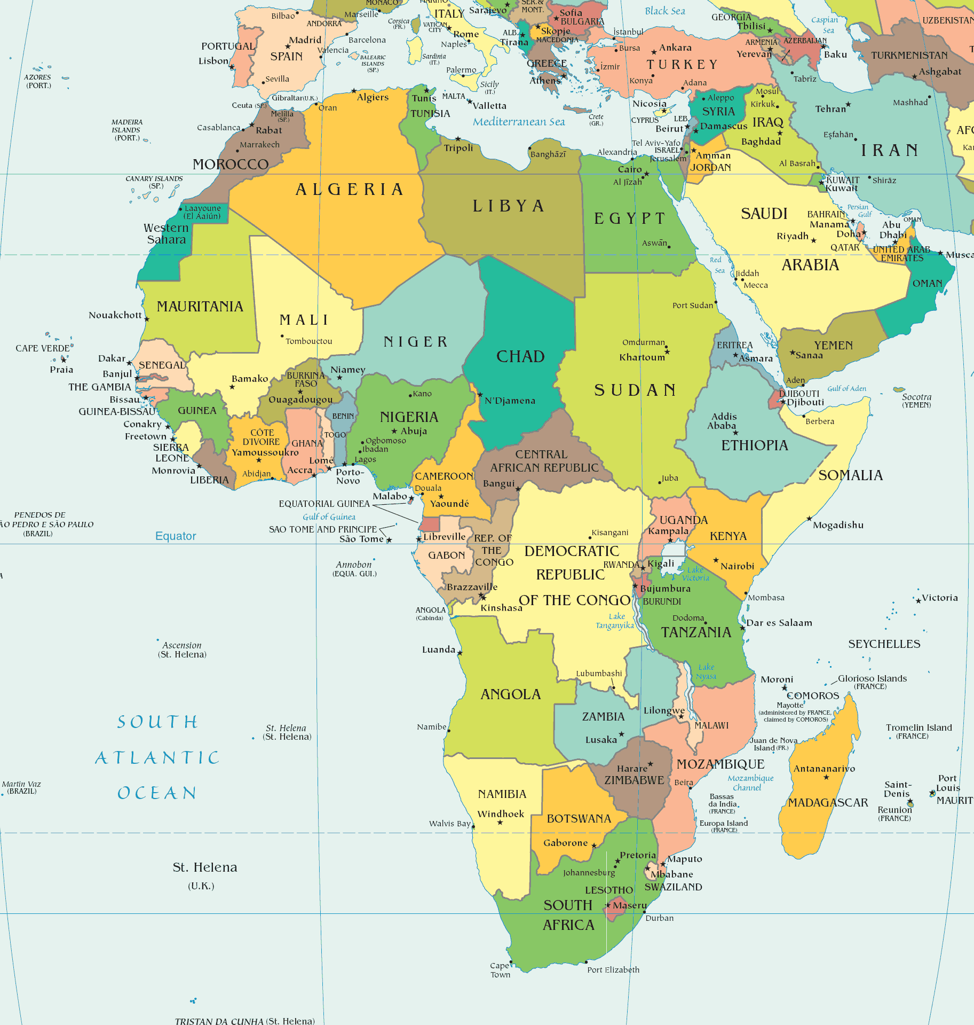
Bijagós Archipelago
Notes:
One of the poorest countries in the world. HDI 0.424 (178/188)
Ex-Portuguese colony (1879-1974); independence after a bloody guerilla war.
Political instability, with multiple political coups over the years.
Plagued by corruption and military-endorsed cocaine and people-trafficking.
In 2012 the only president to die of natural causes since 1974 died in a hospital in France; the army formed a transitional government and for some years,
Army mutinie
Since 2014, the first democratic presidential victory, donor interest has resurged, with investment.
Main export cashews

Slide 6
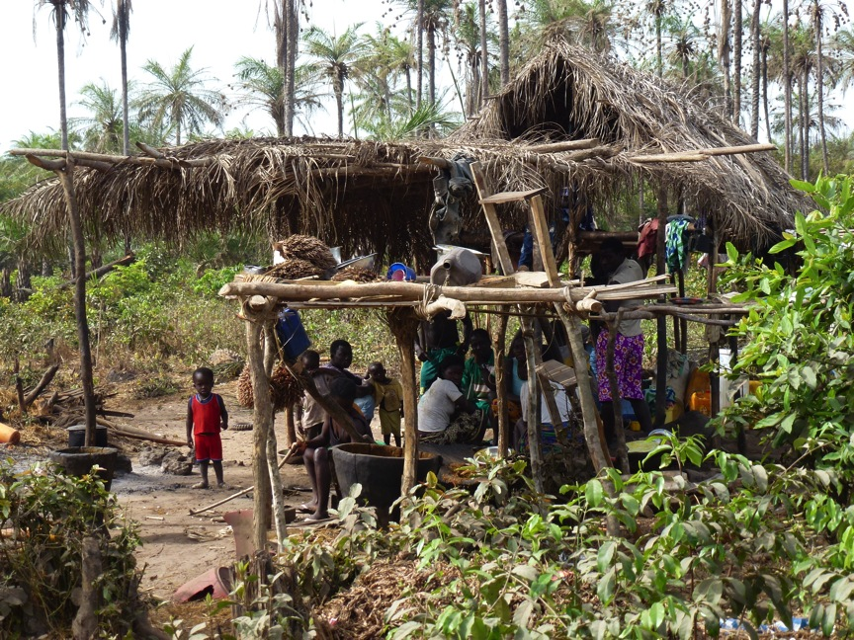
Notes:
Hunter-gatherers.
Remote.
Compared to other African populations, much less migratory.

Slide 7
Malaria Incidence

Slide 8
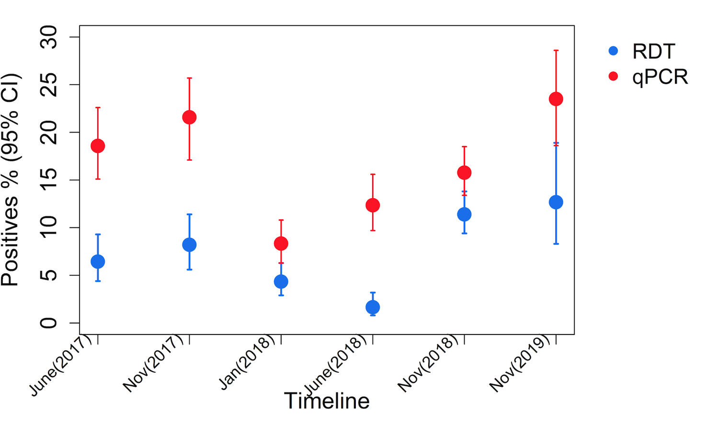
Malaria Prevalence

Slide 9
Impact of additive IVM on Pf prevalence
Time/months
Notes:
A mathematical model parameterised to simulate prevalence, seasonality, vector control and coverage (Figure) predicts PCR prevalence of 9% and 4% in year 1 and 7% and 1% in year 3 in the DP-Only and DP-IVM arms respectively (Table previous slide). The sample sizes described above are adequate to give sufficient power to detect a difference of this magnitude between the arms. The model assumes ideal conditions such as absence of population movement and no contamination of human or vector populations between control and intervention clusters. Figure 1: Impact of DP (navy blue) compared to DP+IVM300 (pink) on PCR prevalence. The green dots represent the timing of the MDA intervention and the green shaded areas are the proposed sampling periods. The grey dashed line shows the counterfactual of what prevalence would be with only LLINs and case management (no MDA). Coverage and DP efficacy assumptions are very conservative to ensure robust sample size calculations and consistency with prevalence reductions observed in other MDA trials: coverage is assumed to be 70% (DP: 70% of individuals aged ≥1 IVM: 70% of individuals aged ≥5) and DP efficacy is 75% - i.e. 75% of individuals agreeing to participate in the trial effectively complete the regimen and clear parasites.

Slide 10
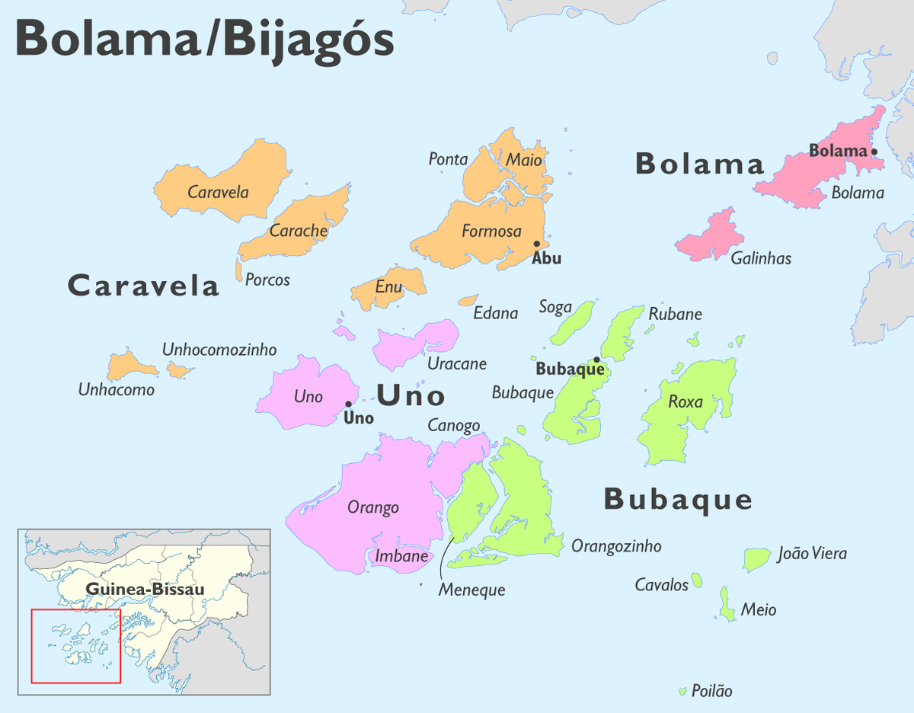
Notes:
Net coverage 92% (95% CI 86%-96%) (net use (reported) ~86%)
Transmission setting – similar to The Gambia
IPTp variably conducted – data so far from our survey suggests that on Bubaque, approx 65% women who had been pregnant in the last two years reported to have received a full course of sulfadox/pyrimethamine. Lower on other islands.

Slide 11
Intervention
DP plus IVM-Placebo (CONTROL) + PNLCP standard
DP plus IVM (INTERVENTION) + PNLCP standard
DP (Dihydroartemisinin-Piperaquine)
40/320mg and 20/160mg D/P per tablet once daily for three days
Alfasigma, Italy
IVM (Ivermectin)
300μg/kg to the nearest 6mg tablet once daily for three days
Laboratorio ELEA, Argentina
3 consecutive days, 3 consecutive months (July/August/September)
Notes:
The primary aim of the trial is to evaluate the impact of adjunctive IVM as part of an MDA strategy towards the elimination of malaria. Current PNLCP interventions in Guinea Bissau include distribution of LLINs every two years, IPTp and prompt diagnosis and treatment of symptomatic malaria cases with Artemisinin-based Combination Therapy (ACT). Indoor Residual Spraying (IRS) and Seasonal Malaria Chemoprevention (SMC) are not routinely employed in malaria control in Guinea Bissau. In addition to the above, each arm of the study will receive DP MDA for three days each month during the peak malaria season for two years during the trial. Both arms will also be subject to expanded case detection screening and treatment (CDSAT) using intensive community-based screening of all persons entering the cluster with RDT during the study period and treatment with ACT for RDT-positive cases (with an anticipated maximum of one RDT per entrant unless otherwise indicated by clinical symptoms). The intervention arm will additionally receive 300μg/kg IVM MDA daily for three days at the same time that DP MDA is given each month during the peak malaria season for two years during the trial. DP will be given in accordance with manufacturer’s guidelines (Sigma Tau Industrie Farmaceutiche Riunite SpA; 40/320mg and 20/160mg dihydroartemisinin/piperaquine per tablet) once daily for three days. IVM will be given according to body weight or height at a dose of 300μg/kg daily for three days to the nearest 3 or 6mg tablet according to package insert instructions (Laboratorio ELEA Industria Farmaceutica Argentina; 3 or 6mg tablets). The DP aims to clear Pf parasitaemia in humans and the IVM aims to decrease the survival of malaria vectors. The overall aim is to reduce re-infection during the peak transmission season. DP is known to be safe, well-tolerated and efficacious in clearing Pf infection [3]. It may be efficacious in prophylaxis against Pf infection for up to four weeks following treatment [3]. IVM at the proposed dose has a lethal effect on An. gambiae for up to 28 days, whilst being safe and well-tolerated at the proposed dose [4,5]. The combined effect of DP and IVM MDA is likely to result in a substantial reduction in malaria transmission (where reparameterising existing models [6] with the proposed IVM regimen has been predicted to boost the impact of DP in MDA by 50%), leading to acceleration towards malaria elimination in this setting.

Slide 12
Exclusion Criteria
DP
Women who are known to be in the first trimester of pregnancy and infants under the age of three months will
Concomitant prescribed medication that affects cardiac function or causes prolonged QTc
IVM
Children weighing less than 15kg or measuring less than 90cm, pregnant or breast feeding women and individuals who report travel to Loa loa endemic regions
Known hypersensitivity to either agent
Notes:
Although there is no evidence of adverse outcomes or congenital malformations in women who have been exposed to DP in the first trimester, as a matter of extra caution, women who are known to be in the first trimester of pregnancy or infants aged three months or under will not be given DP [7-12]. Individuals who receive treatment will be advised to take DP on an empty stomach as per manufacturer’s instructions. Children weighing less than 15kg or measuring less than 90cm (depending on whether weight- or height-based dosing is used in line with the product insert), pregnant or breast feeding women and individuals who report travel to Loa loa endemic areas (eg Central Africa) will not be treated with IVM. Similarly, though there is no evidence that inadvertent exposure of pregnant women to IVM and albendazole during MDA for LF is associated with adverse outcomes in pregnancy, women who are known to be pregnant or breast feeding will not be given IVM [13]. Loa loa is not known to be endemic in Guinea Bissau, however for extra vigilance, the absence of Loa loa will be confirmed by rapid assessment (RAPLOA) during the baseline cross-sectional survey (TDR guidelines for rapid assessment for Loa loa) [14].

Slide 13
24 Clusters
Bijagos Archipelago
DP MDA + PLACEBO MDA
12 CLUSTERS
DP MDA + IVM MDA
12 CLUSTERS
PRIMARY ENDPOINT ASSESSMENT
Sample: 200 per cluster (DBS for Pf PCR) November 2022
PRIMARY OUTCOME: Pf prevalence (all ages, PCR) after final MDA
SECONDARY OUTCOMES: Pf prevalence (all ages, PCR) after first MDA; incidence of clinical malaria through active and passive case detection; age-adjusted prevalence of serological markers of exposure to Pf; vector parity and density; prevalence of resistance to pyrethroids in mosquitoes; prevalence of resistance to ACT; MDA acceptability, feasibility, access and coverage estimates; prevalence of IVM-susceptible NTDs (scabies, strongy, LF), head lice and bed bugs; safety
QUADRUPLE MASKED
RECRUITMENT START DATE: June 2021
RECRUITMENT END DATE: April 2024
Notes:
Secondary Outcomes
Population-based Pf prevalence (all ages) after first intervention
Incidence of malaria through active case detection in children aged 5-14 years during peak malaria season
Age-adjusted prevalence of serological markers indicating recent exposure to Pf
Prevalence of serological markers of recent exposure to Anopheles
Prevalence of resistance to pyrethroids (and IVM?) in mosquitoes using molecular and bioassay methods
Prevalence of resistance of artemesinin-based combination therapy (ACT) in humans using molecular markers of resistance
MDA acceptability, feasibility, access and coverage estimates
Cost-effectiveness of adding IVM to DP MDA for malaria control
Prevalence of IVM-susceptible NTDs (scabies, strongyloides, LF), head lice and bed bug infestation
Safety of intervention (SAEs)

Slide 14
Intervention Delivery
Coverage, adherence and acceptability
Qualitative ethnographic and semi-quantitative work
Interviews and FGDs
Sustainability
Stakeholder assessment
Social science workstream to optimise delivery and maximise coverage
Public Engagement Small Grant working with ASCs documenting their experience of intervention delivery through PhotoVoice
Notes:
To evaluate and refine the intervention and its implementation MDA coverage, adherence and acceptability work will be conducted using a combination of qualitative ethnographic methodology and semi-quantitative study. In-depth interviews and focus group discussions will be undertaken to understand socio-cultural issues surrounding the intervention to estimate its acceptability and effectiveness. Community members, key informants and stakeholders will be involved in the process of developing the MDA strategy to increase efficacy and sustainability. A comprehensive stakeholder assessment will be conducted at inception, where formal and informal groups and organisations working closely with these communities will be identified. During the trial’s inception phase, prior to the intervention, we will attempt to address concerns and make recommendations to improve MDA implementation during the trial. A health economic evaluation will be undertaken, which will include a cost-effectiveness analysis.
Health Empowerment Theory (HET) will be used to explore the role of innovative approaches employing community engagement through health empowerment in sustainable malaria elimination [24]. These data will be used to inform and the MDA implementation strategy in the trial.

Slide 15
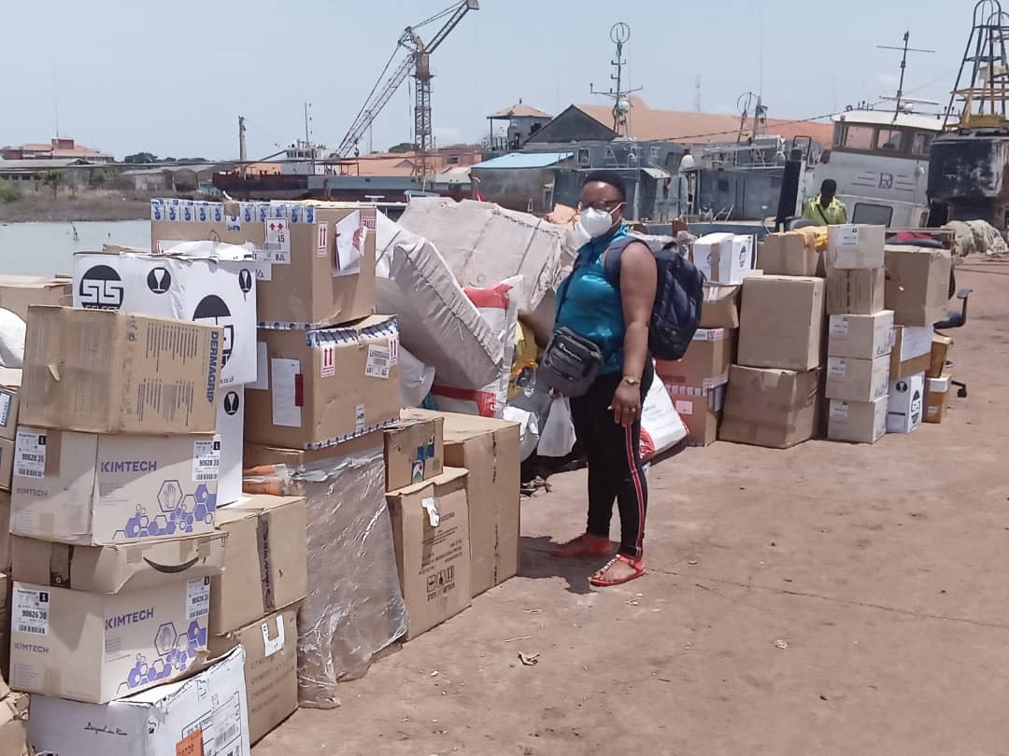

Slide 16
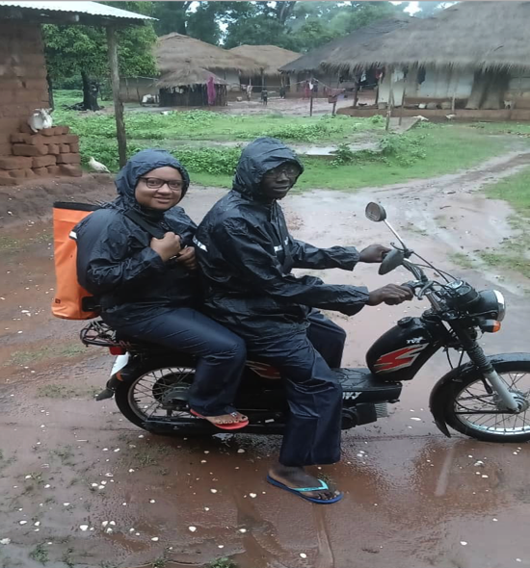
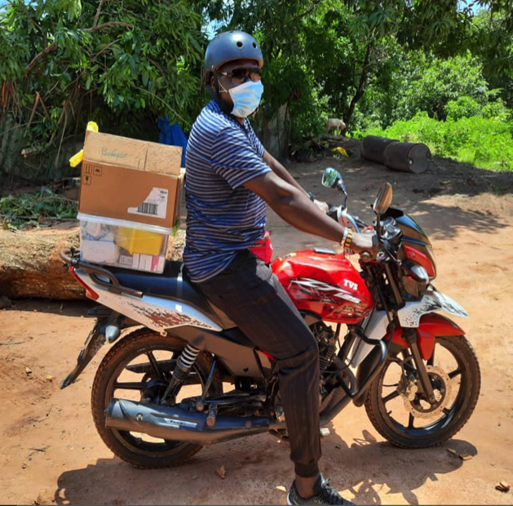
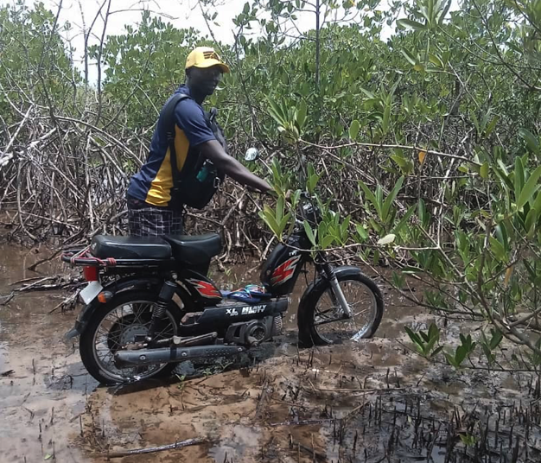
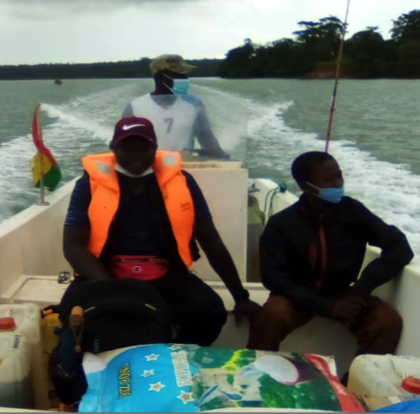

Slide 17
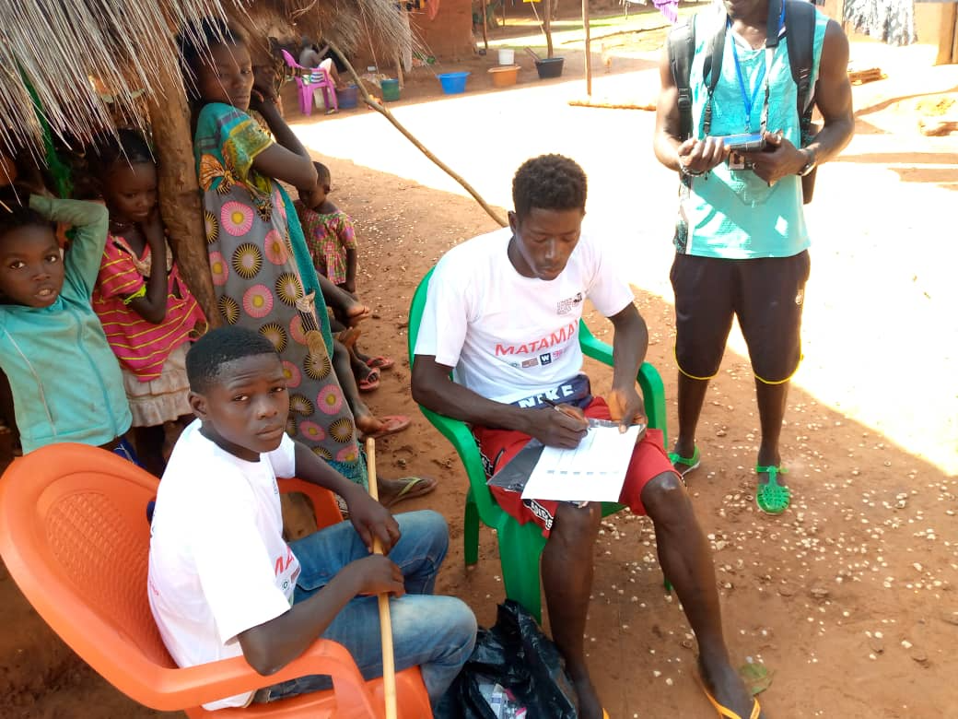

Slide 18
The MATAMAL Team

Slide 19
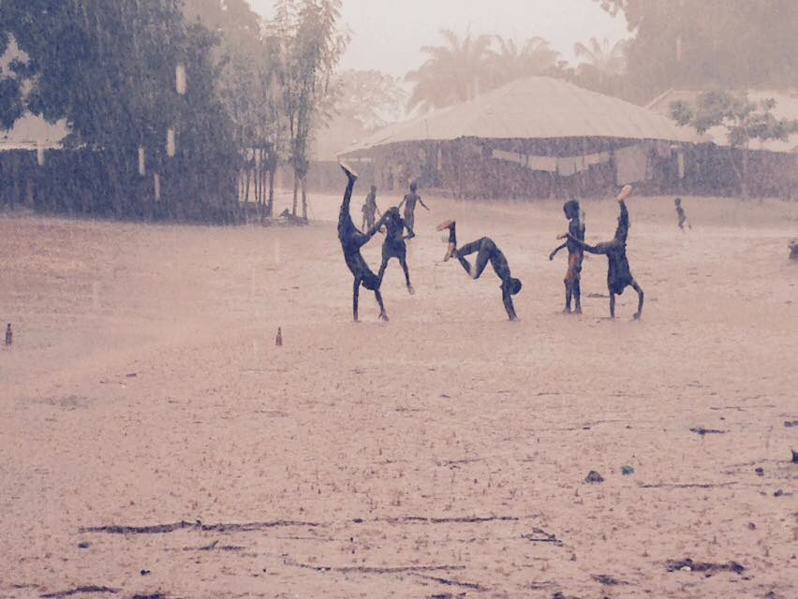
Acknowledgements
LSHTM: David Mabey, Chris Drakeley, Kevin Tetteh, John Bradley, James Logan, Taane Clark, Susana Campino, Hristina Vasileva, Harry Hutchins, Sophie Moss Liz Pretorius, Rob Jones, Eleanor Martins, MSc students
MRCG: Umberto d’Alessandro, Annette Erhart, Mamadou Ousmane Ndiath, Harouna Soumare, Fatima Ceesay, Patricia Ezedimbu-Michael, Karen Forrest, Marie-Rose Thorpe, John Correa, Omar Manneh
BHP: Amabelia Rodrigues, Cesario Martins, Kristian Holm-Buch, Carlos Cabral, JP Nanque
MINSAP: Paulo Djata, Luis Papique, Meno Nabicassa, Eunice Teixeira e Silva, Wilson Sa, Laercia de Caravalho
INEP: Hamadou Boiro, Samba Camara
Regiao Sanitaria dos Bijagos: Jose Nacutum
The MATAMAL team and survey participants

Slide 20
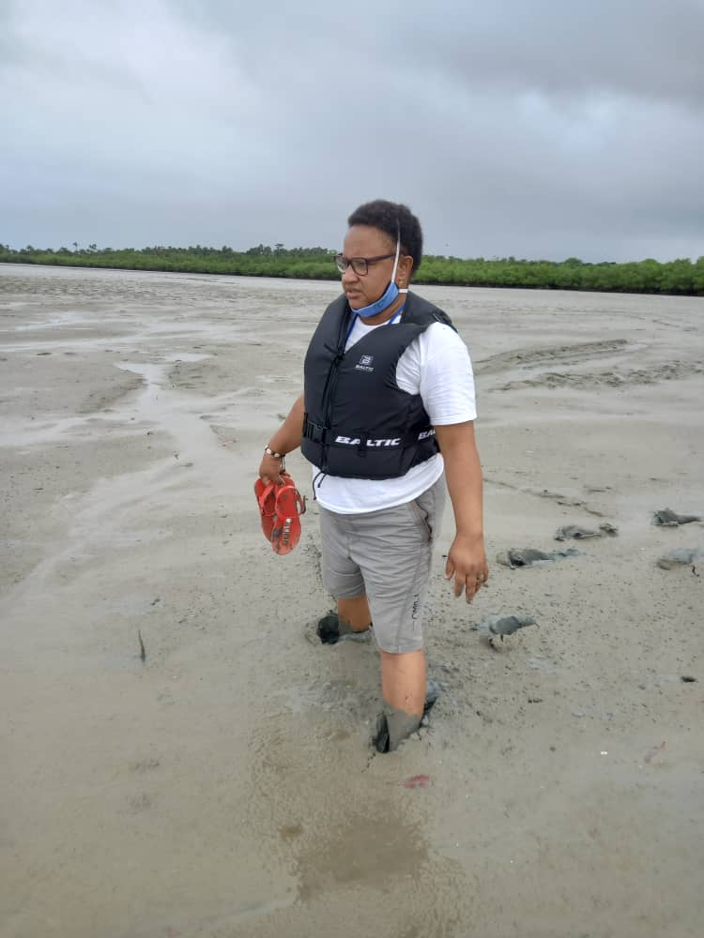

Slide 21
Notes:
Adjunctive Ivermectin MDA for malaria control: A cluster-randomised placebo-controlled trial (MATAMAL)

