Slide 1
Mass drug administration of ivermectin and dihydroartemisinin-piperaquine as an additional intervention for malaria elimination (MASSIV): results from The Gambia
Umberto D’Alessandro
MRC Unit The Gambia at the London School of Hygiene and Tropical Medicine

Slide 2
Study objectives
To evaluate the impact on malaria transmission of mass drug administration with ivermectin plus dihydroartemisinin-piperaquine (3 rounds per transmission season) in communities with high coverage of vector control interventions;
To evaluate the impact of mass drug administration with ivermectin in suppressing the vector population density;
To identify the most socially acceptable and sustainable way of achieving and maintaining high coverage of mass drug administration with ivermectin and dihydroartemisinin-piperaquine, and of embedding it within local communities and stakeholders
To determine the cost and cost-effectiveness of this intervention compared to standard malaria control measures

Slide 3
Cluster-randomized trial
Fried egg design
2 arms
Intervention: IVM+DP
Control: standard interventions
16 villages/arm
At least 3Km apart

Slide 4
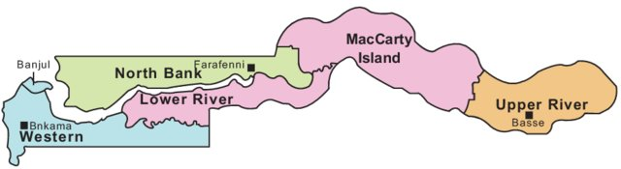
Study villages
Control villages

Slide 5
Study timelines
Nov 2017
Aug-Sept-Oct 2018
Nov 2018
Jul-Aug-Sept 2019
Nov 2019
Dec 2019
End of field
activities
Entomological collections
Entomological collections
Passive case detection
Year 1:
MDA IVM+DP
3 monthly rounds
Year 2:
MDA IVM+DP
3 monthly rounds
Year 0:
Malaria prevalence
Survey
Year 1:
Malaria prevalence
Survey
Year 2:
Malaria prevalence
survey

Slide 6
Trial profile
Villages screened: 47
Villages excluded : 15
(prevalence <7.0%)
Villages included: 32
Intervention: 16
N=4939
Control: 16
N=5699
Survey 2018
N=2166
Survey 2018
N=2252
Survey 2019
N=2722
Survey 2019
N=2529

Slide 7
Malaria prevalence by village and study arm; baseline (2017)
%
Intervention
Control
16.1%
18.1%

Slide 8
MDA coverage by round and year
%
2018
2019

Slide 9
Malaria prevalence by study arm, year and age group
 | 2018 |  |  |  | 2019
Age Group | Intervention | Control | OR [95%CI] | P value | Intervention | Control | OR [95%CI] | p value
< 5 | 12.8 % (41/321) | 6.3 % (22/348) | 2.11 [0.90, 4.94] | 0.085 | 4.0 % (19/477) | 11.0 % (56/511) | 0.35 [0.13, 0.93] | 0.035
5-14 | 9.0% (61/680) | 14.7 % (109/744) | 0.48 [0.24, 0.95] | 0.037 | 4.9 % (46/948) | 12.3 % (109/883) | 0.31 [0.14, 0.69] | 0.0040
≥ 15 | 11.2 % (106/947) | 16.5 % (175/1060) | 0.59 [0.34, 1.03] | 0.064 | 6.0 % (72/1200) | 14.1 % (159/1130) | 0.34 [0.18, 0.64] | 0.0010
All ages | 11.3 % (245/2166) | 14.4 % (324/2252) | 0.63 [0.36, 1.10] | 0.107 | 5.1 % (140/2722) | 12.8 % (324/2529) | 0.30 [0.16, 0.59] | <0.0001
Age in years, LLIN use, Open eaves, Traveling, Antimalarial use,
Baseline prevalence
Adjusted OR: 0.28 [0.14,0.56]
p=0.000

Slide 10
Incidence of clinical malaria (2019)
Age group | Control (IR) | Intervention (IR) | IRR (95%CI) | p-value
< 5 | 0·32 (18/5700) | 0·20 (10/4940) | 0·58 (0·18, 1·88) | 0·36
5-14 | 1·37 (144/10507) | 0·30 (27/9106) | 0·22 (0·09, 0·54) | 0·0010
≥ 15 | 0·98 (151/15481) | 0·19 (25/13417) | 0·18 (0·09, 0·38) | <0·0001
All ages | 1·10 (348/31686) | 0·24 (65/27460) | 0·21 (0·10, 0·43) | <0·0001
~80% decrease of clinical malaria

Slide 11
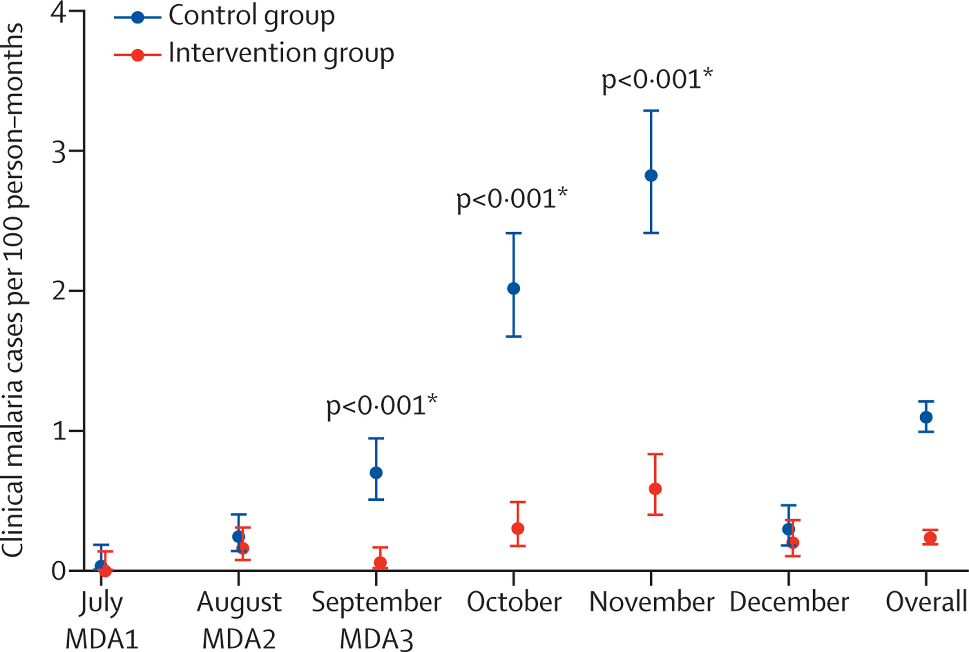
Incidence of clinical malaria by month and study group

Slide 12
Vector parity by year and study group
 | 2018 |  |  |  | 2019
 | Control | Intervention | OR (95% CI) | p-value | Control | Intervention | OR (95% CI) | p-value
MDA 1 | 297/518 (57·3 %) | 190/364 (52·2 %) | 0·98 (0·52, 1·87) | 0·951 | 131/186 (70·4%) | 72/94 (76·6 %) | 1·37 (0·77, 2·42) | 0·284
MDA 2 | 442/634 (69·7 %) | 262/391 (67·0 %) | 1·00 (0·58, 1·71) | 0·987 | 81/105 (77·1%) | 107/155 (69·0 %) | 0·78 (0·43, 1·41) | 0·405
MDA 3 | 130/157 (82·8 %) | 52/80 (65·0 %) | 0·31 (0·16, 0·61) | <0·001 | 238/259 (91·9%) | 229/252 (90·9%) | 0·87 (0·47, 1·62) | 0·661
Survey 1 | 30/41 (73·2 %) | 17/20 (85·0 %) | 1·75 (0·23, 13.47) | 0·591 | 83/95 (87·4%) | 28/32 (87·5 %) | 0·59 (0·14, 2·46) | 0·469
Survey 2 | 1/2 (50·0 %) | 0/0 (· %) | -- | -- | 19/19 (100v0%) | 5/7 (71·4 %) | -- | --
Overall | 900/1352 (66·6%) | 521/855 (60·9%) | 0·85 (0·62, 1·17) | 0·322 | 552/664 (83·1%) | 441/540 (81·7%) | 0·90 (0·66, 1·25) | 0·537

Slide 13
Vector density, sporozoite rate (CDC-LTC) and EIR by year and study group
 | 2018 |  |  |  | 2019
 | Control | Intervention | OR (95% CI) | p-value | Control | Intervention | OR (95% CI) | p-value
Vector density | 1·6 (1572/1002) | 0·7 (562/858) | 0·49 (0.9, 1.29) | 0·150 | 3·4 (3088/912) | 1·4 (1914/1344) | 0·36 (0·21, 0·64) | <0·0001
Sporozoite rate | 2/456 (0·4%) | 4/202 (2·0%) | 4·58 (0·83, 25·24) | 0·080 | 37/3047 (1·2%) | 14/1902 (0·7%) | 0·60 (0·32, 1·12) | 0·109
EIR (95% CI) | 0·58 (0·08, 3·86) | 1·35 (0·61, 8·68) | 2·34 (0·41,42·42) | 0·23 | 11·7 (6·72, 16·91) | 3·00 (1·76, 5·14) | 0·26 (0·13, 0·51)

Slide 14
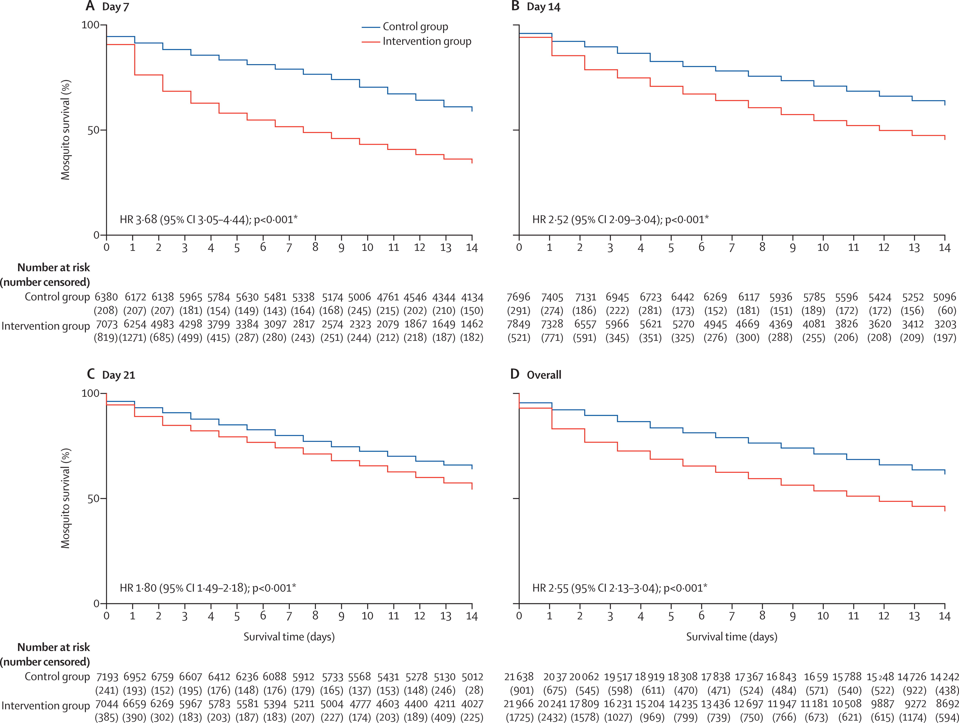
Mosquito survival over 14 days after feeding on blood from treated individual (by day post treatment)

Slide 15
Conclusions
Intervention safe and well tolerated
Significant reduction of both malaria prevalence and incidence of clinical malaria
Mosquitoes fed on blood from treated individuals had higher mortality, even after 21 days post treatment
Effect on mosquito density but not on parity (entomology primary end point)
MDA with DP and IVM can further reduce residual transmission
Not possible to disentangle the effect of IVM from that of DP

Slide 16







Acknowledgments (Funding: JGHTS)
Gambia
  Jane Achan
  Edgard Dabira
  Harouna Soumare
  Dr Conteh Bakary
  Julia Mwesigwa
  Balla Kandeh (NMCP)
  Dr Mamadou Ndiath
  Fatima Ceesay
  David Nwakanma
  Nuredin Mohammed
  Nurses and Fieldworkers
  Lab technicians and Entomology team
  Basse Regional Health team and health facilities staff
  Leaders and residents study communities
UK
  John Bradley
  Chris Drakeley
  Steve Lindsay
  Hannah Slater
Institutions
Belgium
  Koen Peeters and colleagues
The Netherlands
  Teun Bousema
  Menno Smit
  Henk Broekhuizen

