Slide 1
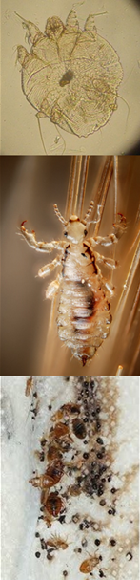
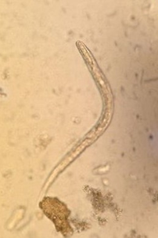


Off-Target Impacts of Ivermectin-MDA conducted for the Elimination of Malaria
Christian Kositz
(year 3 PhD) MRC The Gambia
and LSHTM

Slide 2
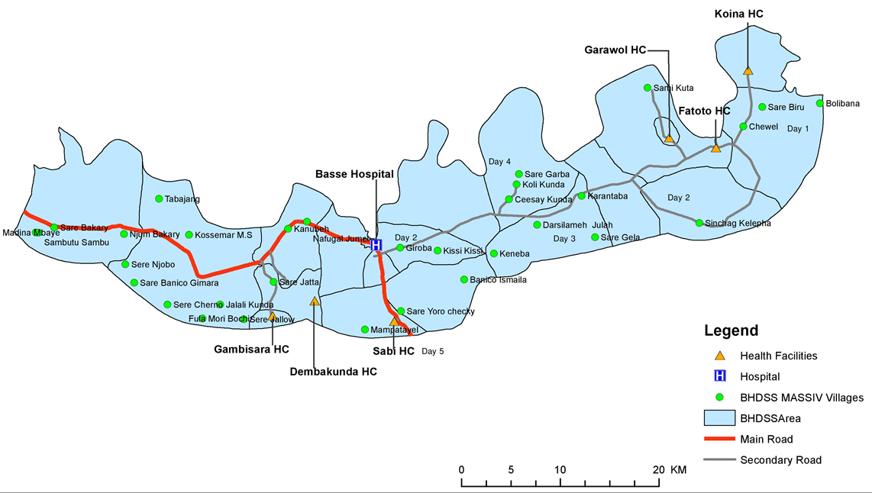
Background – MASSIV Trial – Eastern Gambia
Mass drug administration for malaria (dihydroartemisin-piperaquine) and malaria vector control (ivermectin) in 32 villages (= 32 clusters) with 16 per arm (intervention and control)
Ivermectin
300 mcg/kg/bodyweight for 3 days per month for 3 months (July – September)
  weight ≤ 15 kg
  Pregnancy or breast feeding

Slide 3
Why look at off target effects?
Ivermectin is effective against many ectoparasites (scabies, headlice, bedbugs) and several soil-transmitted helminths (Ascaris lumbricoides (98-100%), especially Strongyloides stercoralis (83-96%), less against Trichuris trichiura (11-88%) or hookworms (0-33%)
Pre-2019 burden of these parasites (ecto- and entoparasites) in Upper River Region in The Gambia was unknown or patchy
Higher than usual dose of ivermectin and repeated doses
  Effect of this intervention on some parasites is unclear (e.g. hookworms)
Notes:
Specifically strongyloides, as Albendazol is not particularly effective against Strongy
Hookworm generally not responsive to single dose

Slide 4
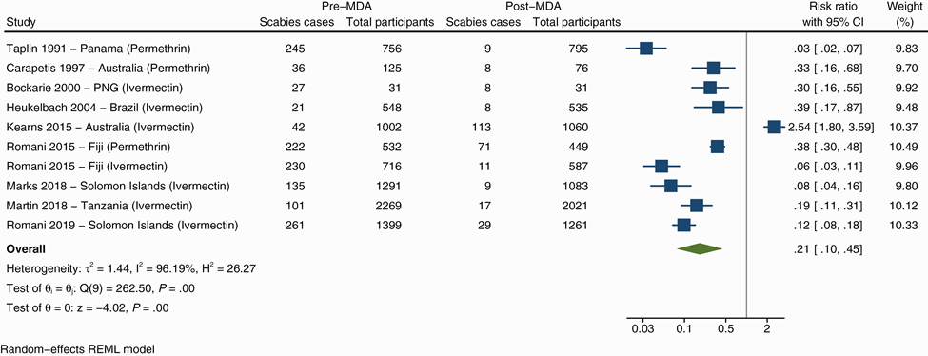
Existing evidence of ivermectin MDA for scabies
Lake SJ et al. (2022) Mass drug administration for the control of scabies: a systematic review and meta-analysis
Notes:
Differnt dosing schedules and an alternative agent for excluded people; one study with no effect in indiginous australians with lots of movement and not on an island and not scabies specific

Slide 5
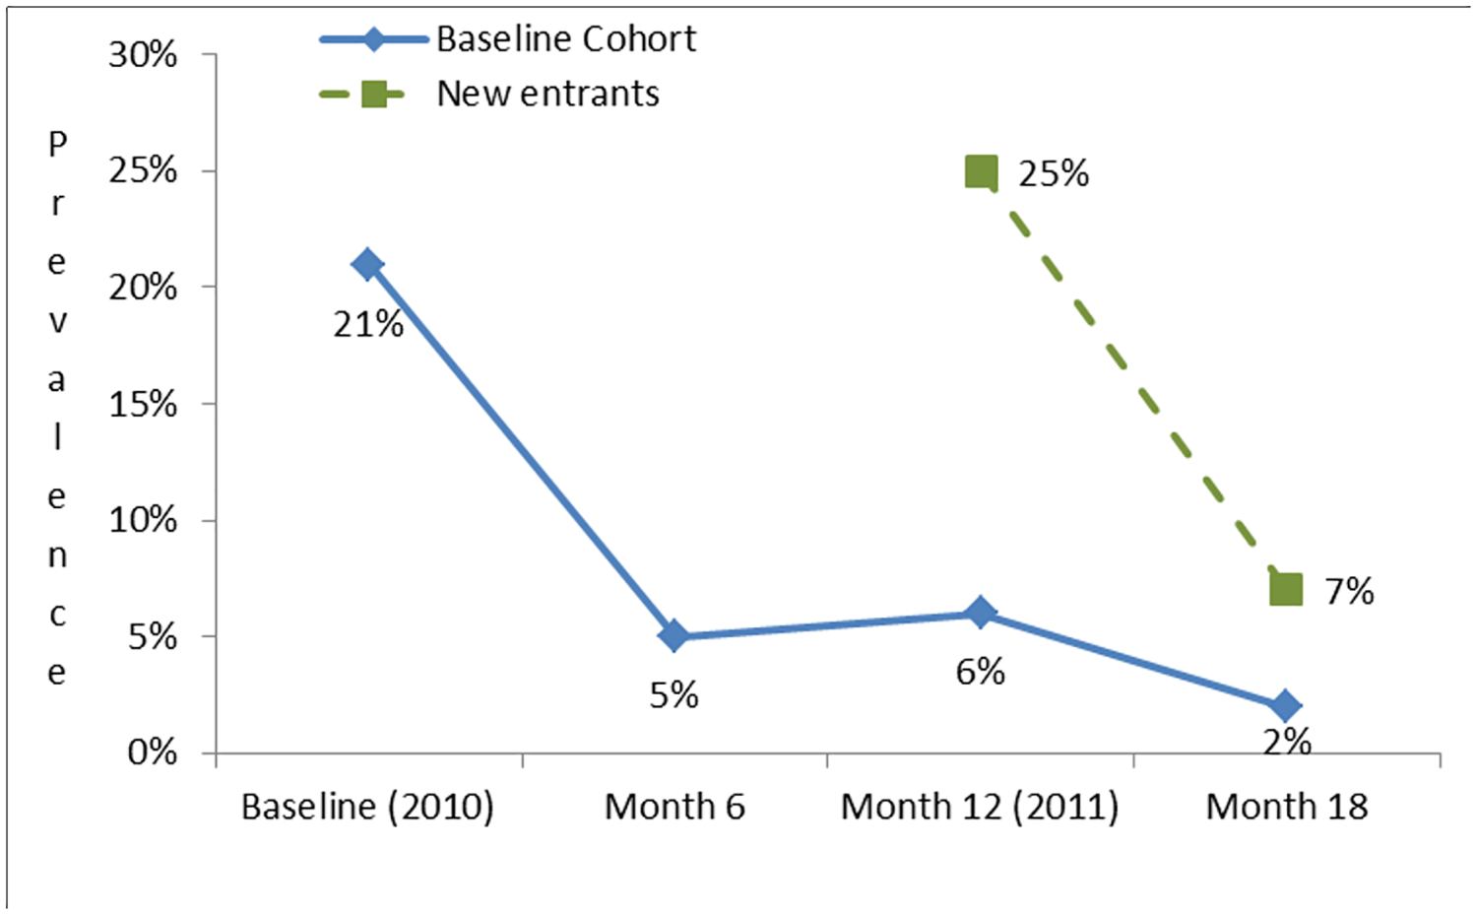
Existing evidence of ivermectin MDA for Strongyloides stercoralis
Kearns TM, et al. (2017) Strongyloides seroprevalence before and after an ivermectin mass drug administration in a remote Australian Aboriginal community.

Slide 6
Timeline
3 Surveys for ectoparasites and soil transmitted helminths (STH)
June 2019 before 2019 MASSIV MDA (July 15 to Sept 30)
  only ectoparasites (Spoilers: no bedbugs or headlice found)
November 2019 after 2019 MASSIV MDA (scabies and STH)
November 2021 follow up (scabies and STH)
  originally planned for 2020
Ectoparasites Survey June 2019 (mid June to mid July)
MASSIV MDA (July 15 to Sept 30)
Scabies Survey November 2019
Scabies Survey November 2021
MASSIV MDA (July 15 to Sept 30)
STH Survey November 2019
STH Survey November 2021

Slide 7
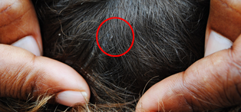
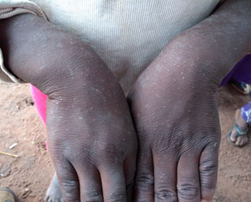
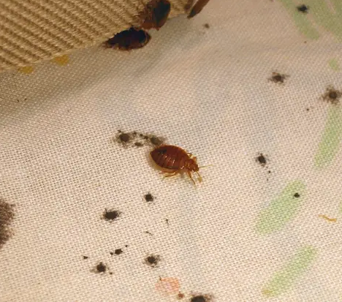
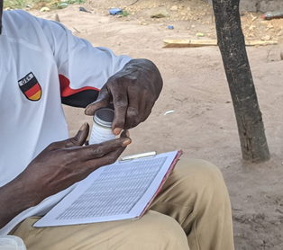
Methods:
Sample size:
Estimated 15% prevalence for each disease group
30 children per cluster/village (32) => 960 children age 3 - 14
  Simple randomization (~1300 children)
  Same children selected for 2019 surveys
  New selection in 2021 (movement, change in age)
Ectoparasites:
Physical examination for headlice
Physical examination of sleeping quarters
Physical examination for scabies using the 2018 IACS criteria
Soil-transmitted helminths
Stool collection from the participants (almond sized sample)
  mothers collected from their children
  adolescents themselves (or under parent supervision)
In house qualitative PCR of the stool samples
  Singleplex for S. stercoralis
  Multiplex for A. lumbricoides, N. americanus, Ancylostoma duodenale, Trichuris trichiura

Slide 8
Results: Prevalence of Scabies
Scabies | Prevalence N(%)
Agegroup | Jun-19 | Nov-19 | Nov-21
3 - 6 | 226/461 (49%) | 175/387 (45.2%) | 179/359 (49.8%)
7 – 10 | 160/393 (40.7%) | 152/387 (39%) | 168/356 (47.1%)
11 – 14 | 92/242 (38%) | 92/278 (33.1%) | 78/207 (37.6%)
Sex
Female | 217/552 (39.3%) | 205/535 (38.3%) | 175/456 (38.4%)
Male | 261/544 (47.9%) | 214/517 (41.4%) | 250/466 (53.6%)
Arm
Control | 273/567 (48.2%) | 237/576 (41.2%) | 180/464 (38.8%)
Intervention | 205/529 (38.8%) | 182/476 (38.2%) | 245/458 (53.2%)
OR (95%CI) | 0.64 (0.43 - 0.95) | 0.88 (0.66 – 1.8) | 1.94 (1.1 – 3.43)
Total | 478/1096 (43.6%) | 419/1052 (39.8%) | 425/922 (46.1%)

Slide 9
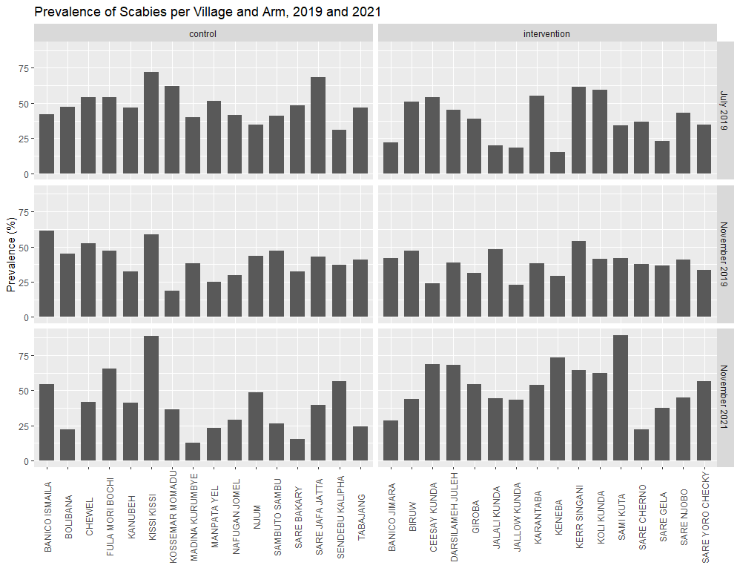
Results: Prevalence of Scabies
Notes:
Consistent with most data from ethiopia and the pacific we havent seen any evidence for an epidemic

Slide 10
Results: STH
Nov-19 | Participants | Strongyloides | Ascaris | Necator | STH total
Agegroup |  | Prevalence STH N (%)
3 – 6 | 356 (37.2%) | 50 (14.04%) | 12 (3.4%) | 17 (4.8%) | 73 (20.5%)
7 – 10 | 372 (38.8%) | 57 (15.3%) | 20 (5.4%) | 16 (4.3%) | 84 (22.6%)
11 – 14 | 230 (24%) | 20 (8.7%) | 7 (3%) | 13 (5.7%) | 36 (15.7%)
Sex
Female | 480 (50.1%) | 63 (13.1%) | 18 (3.8%) | 20 (4.2%) | 93 (19%)
Male | 478 (49.9%) | 64 (13.3%) | 21 (4.4%) | 26 (5.4%) | 100 (20.9%)
Arm
Control | 518 (54.1%) | 87 (16.9%) | 22 (4.4%) | 26 (5%) | 121 (23.4%)
Intervention | 440 (45.9%) | 40 (9.1%) | 17 (4%) | 20 (4.6%) | 72 (16.4%)
OR |  | 0.39 (0.16 – 0.94) | 0.91 (0.47 – 1.72) | 0.85 (0.36 – 2.0) | 0.62 (0.33 – 1.19)
Total | 958 | 127 (13.3%) | 39 (4.1%) | 46 (4.8%) | 193 (20.2%)

Slide 11
Explanations for Scabies results
Within study reservoirs not treated with ivermectin (children < 15kg, pregnant or breast feeding women), absent villagers (visiting, travelling, hiding, not participating)
External reservoirs: schools, new inhabitants
Intervention coverage might be sufficient for malaria but insufficient for scabies
Notes:
Results different from existing data

Slide 12
Explanations for STH results
Apparent effect on Strongyloides:
Have we measured at the right time point?
  S. stercoralis prepatent period 2 – 4 weeks (up to 8)
  Larval stage “less susceptible” to ivermectin (rumour? data?)
  Follow up data from November 2021 outstanding (ETA 04/2022)
One single village strongly influenced the ivermectin effect (contained 20% of Strongyloides in the intervention arm) => underestimated effect
  Other STH:
  Sample size too small?
    N. americanus effect still unclear unfortunately
    No apparent effect on A. lumbricoides

Slide 13
Conclusion
No effect on scabies seen;
  higher coverage needed
  addition of treatment for non-eligible ivermectin groups
Evidence of an effect on Strongyloides
Ivermectin for malaria vector control is likely to have off target effects and studies should look out for them
  Ectoparasites comparatively cheap
  Soil-transmitted helminths are more resource intensive
  Potential environmental impact (dung beetles)
  Potentially adds to cost-effectiveness of the intervention

Slide 14


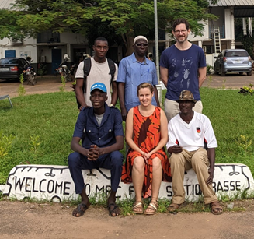
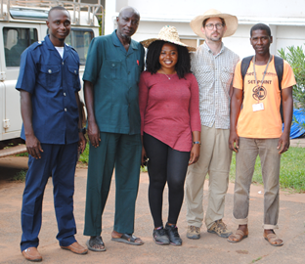
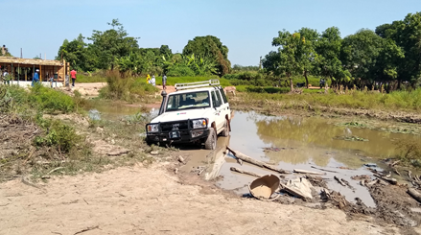
Acknowledgements
Fieldwork:
Omar Jallow
Dullo Baldeh
Ebrima Manneh
Muhammed Gissay
Mariama Drammeh
Franca Conradis-Jansen
Wassa Njie
Dembo KM Fatty
Muhammed Baldeh
Edwin Armitage
Alagie Darboe
Labwork:
Hristina Vasileva
Joanna Houghton
James Ashall
Logistics:
Rasheed Salaudeen
Ikumapayi Usman Nurudeen
John Correa
Abdoulie Sillah
Institutions and Funders:
Supervisors:
Michael Marks
John Bradley
Umberto D’Alessandro

