Slide 1
Evaluation of novel diagnostic tests for TB
Assoc. Prof Jayne Sutherland
Head, TB research group
MRC Unit The Gambia at LSHTM
Wellcome Trust - Bloomsbury Centre scientific meeting
16th March 2022
E: Jayne.Sutherland@lshtm.ac.uk
T: @Sutherland_TB

Slide 2
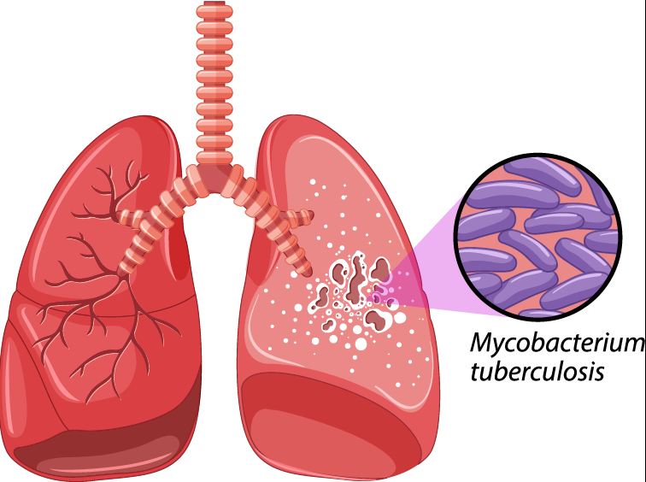
TB studies at MRCG
TB case-contact platform recruits index cases and exposed contacts
  Analysis at all stages of infection and disease
Infection
Progression
Asymptomatic
disease
Clinical
Disease
Post
Treatment
The TB Spectrum
TBVAC
R4K
ENDx-TB
TBCC
M72_{ES01}
Mask study
SUB-TB
Triage-TB
ENDxTB
R4K
TB-Sequel
ENDxTB
NAC HDT
Protection
Infection
Sub-clinical
Diagnostics
PTLD
Household
Contact
Household
Contact
Prevalence
survey
Index TB
Incident TB
Tx response
Relapse
PTLD

Slide 3
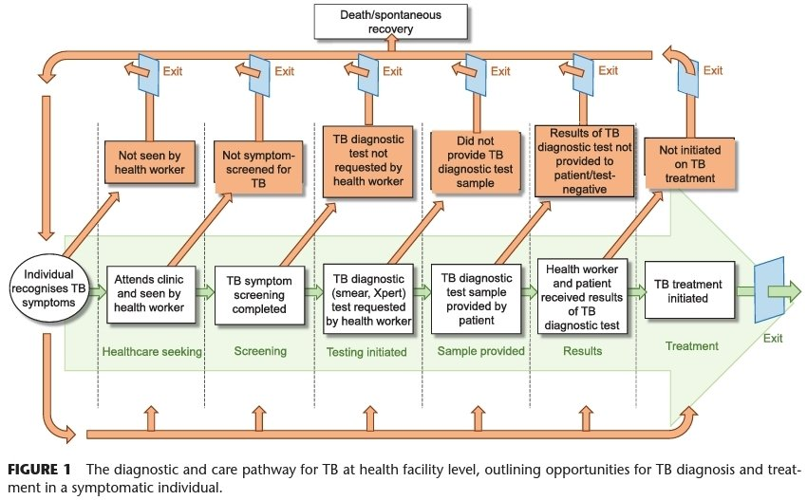
Diagnosis of TB
In 2020, 10 million people fell ill with TB
  Only 6 million were detected and officially notified
  Significant impact with COVID
Meta-analysis showed no screening for 33-96% of symptomatic individuals¹
  Better screening tools and interventions to improve the efficiency of TB screening and diagnosis pathways in health facilities are urgently needed
1. Divala et al., PHA, 2022

Slide 4



ENDxTB study
Aim:
Head-to-head evaluation of prognostic and diagnostic tests for TB at different levels of the health system
  Focus on triage tests for use at point of care
Participants:
1200 Symptomatic adults
600 Symptomatic children
1800 Exposed contacts
  Followed for 12 months
% of patients
Diagnostic Test
15
Level 1
Urban
Culture
GeneXpert
25
Level 2
District hospital
Microscopy
60
Level 3
Rural clinic,
limited infrastructure
Point-of-care
Gambia
(MRCG)
Vietnam
(OUCRU)
Uganda
(MAK)
South Africa
(SUN, SATVI)
Adapted from Batz et al., MSF StopTB, 2011

Slide 5
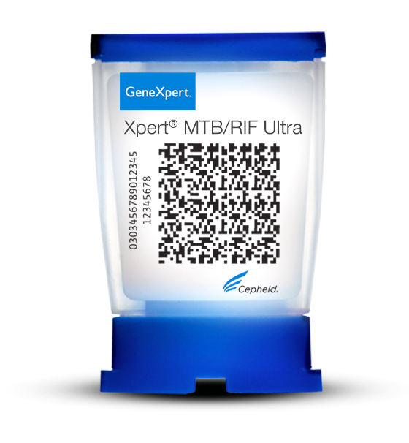
Integrated testing: TB, COVID, Host
Symptom screen clinical exam
CXR
HIV
Presenting at primary health care facility
Gold standard tests
(sputum)
Research test
(fingerstick blood)
COVID-19
(NPS)
GeneXpert Ultra
MGIT culture
3-gene host-response
MBT lateral flow test
SARS-CoV-2 Xpress
MTB/RIF Ultra
TB HR RUO
Xpress SARS-CoV-2
Other tests
26-plex pathogen panel (Seegene)
COVID serology
PAXgene RNA
TB HR RUO
SARS-CoV-2

Slide 6
Cepheid Xpert MTB-HR prototype
GeneXpert-MTB-HR quantifies relative mRNA levels of Sweeney 3-gene signature¹
  DUSP3 & GBP5 (pro-inflammatory)
  KLF2 (anti-inflammatory)
Shown to have good classification following analysis of stored PAXgene samples from HIV+ individuals from South Africa and Peru²
Performance in another retrospective study in Brazil failed to reach the target product profile (TPP) criteria for a triage test³.
First prospective evaluations ongoing
  Requires 100ul of fingerstick blood with results in <1 hour
Xpert MTB HR
TB HR RUO
Sweeney et al., Lancet Respir Med, 2016
Södersten et al., JCM, 2021
Moreira et al., EClinicalMedicine, 2021

Slide 7
Test performance
TB Score
GBP5
100
100
80
80
GeneXpert Ultra
87% Sensitivity (CI, 77-93%)
94% Specificity (CI, 88-97%)
60
60
Sensitivity%
40
40
20
All AUC 0.94 (CI 0.9-1.0)
20
All AUC 0.94 (CI, 0.9-1.0)
HIV- AUC 0.94 (CI, 0.9-1.0)
HIV- AUC 0.94 (CI, 0.9-1.0)
0
0
0
20
40
60
80
100
0
20
40
60
80
100
100% - Specificity%
Site | Sensitivity % | Specificity %
Gambia | 94 | 91 (CI, 87-96)
S. Africa | 95 | 69 (CI, 31-100)
Uganda | 93 | 78 (CI, 67-89)
Vietnam | 92 | 83 (CI, 57-100)
Full cohort | 91 | 86 (CI, 75-97)
TPP for a triage test
Sutherland et al., CID, 2021

Slide 8
Conclusions
Cepheid MTB-HR prototype is the first test to reach WHO TPP for a triage test for TB regardless of geographical location and HIV status
GBP5 alone results in similar accuracy and suggests the potential for further simplification of the test
  GBP5 also part of a promising signature for childhood TB diagnosis¹
A fast and accurate, non-sputum-based point-of-care triage test for TB would have a major impact on combating the TB burden worldwide.
Gjøen JE et al, Sci Rep. 2017

Slide 9
ENDx-TB consortium
SUN
Gerhard Walzl
Fanie Malherbe
Bronwyn Smith
Gian van der Spuy
Kim Stanley
Jane Shaw
Alicia Chetram
Tracy Richardson
Marika Finn
Andriette Hiemstra
Novel Chegou
Helena Kuivaniemi
Gerard Tromp
Susanne Tonsing
Elizma Smit
Balie Carstens
MRCG at LSHTM
Jayne Sutherland
Olumuyiwa Owolabi
Amie Secka
Georgetta Daffeh
Awa Gindeh
Joseph Mendy
Binta Sarr
Abi-Janet Riley
Alhaji Jobe
Monica Davies
Kairaba Kanyi
Momodou Jallow
Salieu Barry
Ousainou Cham
Esin Nkereuwem
SATVI
Thomas Scriba
Mark Hatherill
Kate Hadley
Justin Shenje
Stanley Kimbung
Humphrey Mulenga
Rachel Oelofse
Nicole Bilek
MAK
Harriet Mayanja-Kizza
Mary Nsereko
AnnRitah Namuganga
Sophie Nalukwago
Joseph Akol
Dorcas Lamunu
Michael Ordie
LUMC
Paul Corstjens
Annemieke Geluk
Elisa Tjon Kon Fat
Louise Pierneef
Anouk van Hooij
OUCRU
Guy Thwaites
Thuong Nguyen
Van Le
Son Vo Thanh
Hau Nguyen Thi
Ha Vu Thi Ngoc
Ngoc Le Hong
LINQ
Claudia Schacht
Julia Büech
Malte Streitz
CSU
John Belisle
Karen Dobos
LSHTM
Hazel Dockrell
Catalysis
Jill Winter
FIND
Morten Ruhwald
Emmanuel Moreau
Adam Penn-Nicholson

Slide 10











Sites & Funders

