Slide 1
CHILDHOOD TB & LUNG HEALTH FOLLOWING TREATMENT
Esin Nkereuwem MBBCh, MSc, FWACP (PAED)
Clinical Research Fellow
Vaccines and Immunity Theme, MRCG at LSHTM/
PhD Student
Clinical Research Department, LSHTM

Slide 2
Global state of childhood TB
In 2020:
1.1 million new childhood TB cases¹
Large case detection gap
194,000 childhood TB deaths¹
96% of childhood TB deaths – in children who did not access treatment²
>85% of first TB episode achieve treatment success³
>60 million lives saved (2000-2019)³

Slide 3
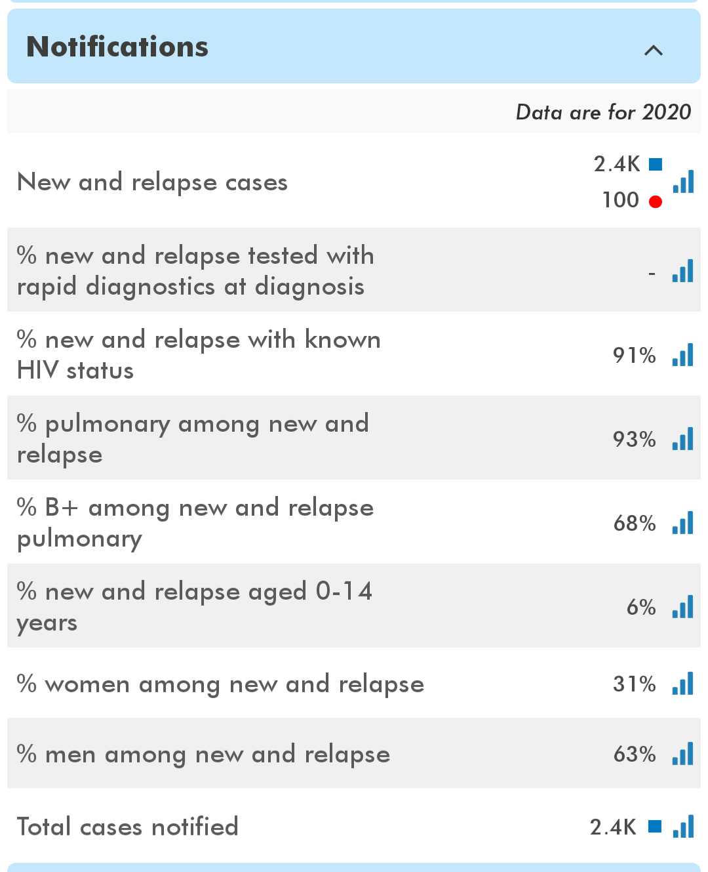
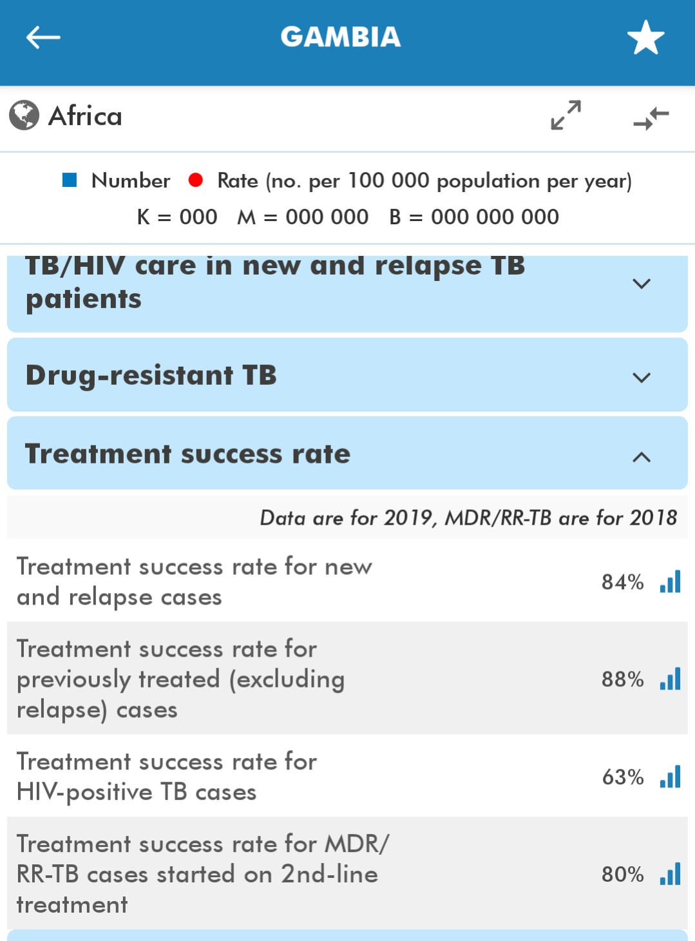
Childhood TB in The Gambia

Slide 4
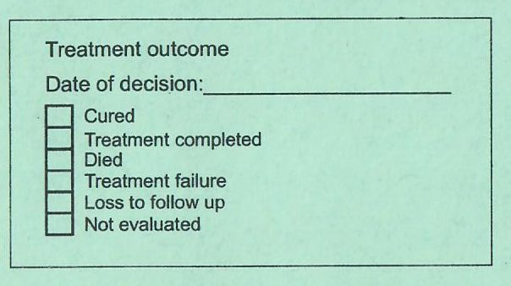
TB treatment outcomes

Slide 5
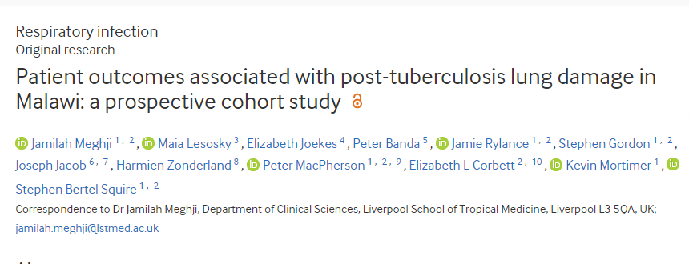
PTB-survivors have a high burden of
Post-TB lung damage
Adverse patient outcomes including accelerated lung function decline
Ongoing respiratory-related health seeking
Persistent chest symptoms
Difficulty working in the year after treatment completion

Slide 6
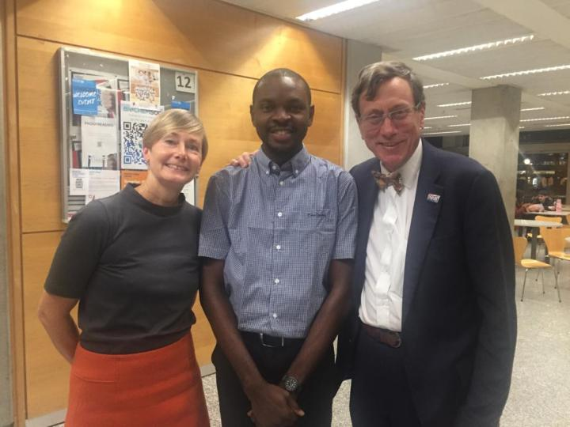
Childhood TB Sequel 1
Imperial College Spirometry Training
Childhood TB Sequel 1
Childhood TB Sequel 2 – Evaluating the sequelae of pulmonary tuberculosis in Gambian children
2019
2020
2021
2022
2023
2024
2025
PhD enrolment at LSHTM
ISSF Fellowship objectives
1. Establish paediatric spirometry capability
2. Describe characteristics of paediatric post-TB lung disease
PhD objectives
1. Describe long-term adverse lung outcomes associated with PTB in children
2. Describe the evolution of these sequelae
3. Determine the epidemiological risk factors associated with these sequelae

Slide 7
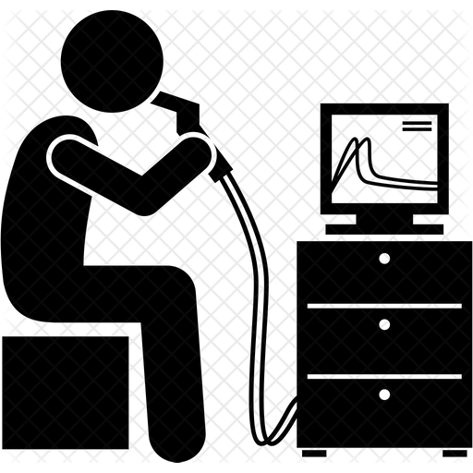
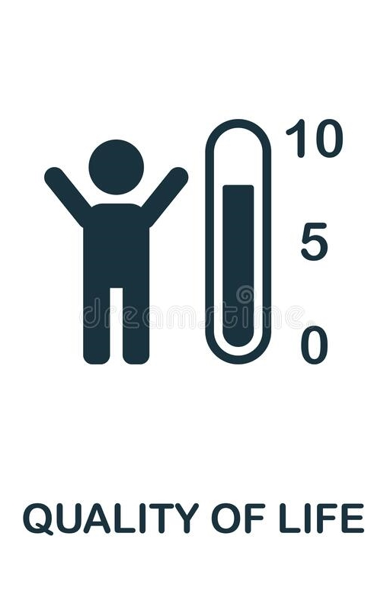
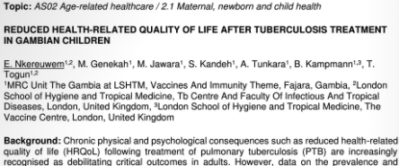
Childhood TB Sequel 1..
Post-TB
Increased mortality
Lung complications
Psychological impact
Recurrent TB
Socio-economic impact
Stigma
Post-TB
Increased mortality
Lung complications
Psychological impact
Recurrent TB
Socio-economic impact
Stigma

Slide 8
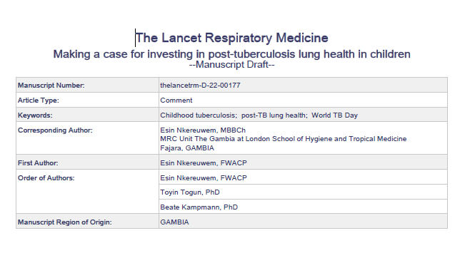
Highlights the deficiency of the current classification of TB treatment outcomes
Proposes a revision which includes post-treatment review to assess for sequelae
Highlights the need for investment to address all aspects of tuberculosis care, including research into post-TB lung health, especially in children who have a long life-course ahead of them

Slide 9
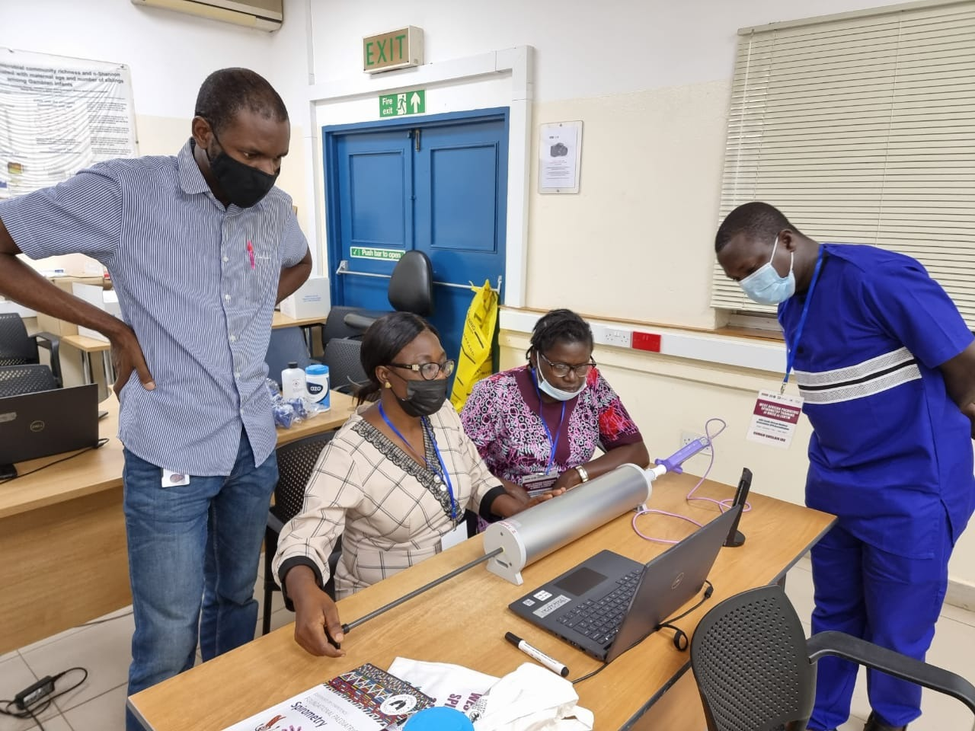
Childhood TB Sequel 2
Imperial College Spirometry Training
West African Paediatric Spirometry Training
GCRF Post-TB lung health in children
Childhood TB Sequel 1
Childhood TB Sequel 2 – Evaluating the sequelae of pulmonary tuberculosis in Gambian children
2019
2020
2021
2022
2023
2024
2025
PhD enrolment at LSHTM
ISSF Fellowship objectives
1. Establish paediatric spirometry capability
2. Describe characteristics of paediatric post-TB lung disease
PhD objectives
1. Describe long-term adverse lung outcomes associated with PTB in children
2. Describe the evolution of these sequelae
3. Determine the epidemiological risk factors associated with these sequelae

Slide 10
Acknowledgements
Supervisors
Prof Beate Kampmann
Dr Toyin Togun
TB Research Team – MRCG
Research support teams
Prof Andy Bush (Royal Brompton Hospital)
Sr Lindsay Zurba (Education for Health Africa)
Children and their parents (participants)
Funders

