Slide 1
Artificial Intelligence Supported Diabetic Retinopathy Screening In Tanzania
Dr Charles Cleland
Clinical Research Fellow
PhD Student, LSHTM
Notes:
Spend 30 seconds giving my personal history – detail time in Tanzania, I know collaborators well, published on the topic.

Slide 2
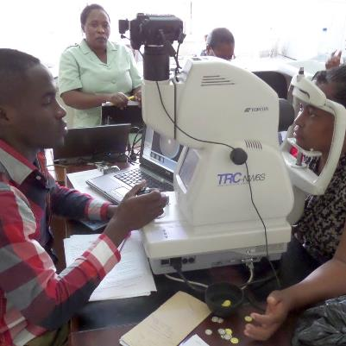
Background
Severe Proliferative DR with Retinal Detachment
Retinal Photography for DR Screening

Slide 3
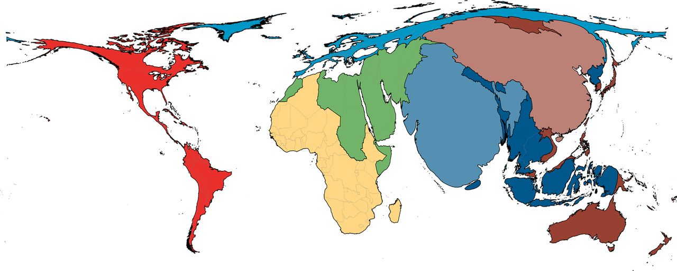
Diabetic Retinopathy Screening: Challenges
Human resources
Training
Quality control
Poor follow-up
Blindness
Ophthalmologists

Slide 4
Diabetics screened
for DR
Referred from
screening
Attend eye
clinic
Current DR screening pathway

Slide 5
Research Question
Does AI supported DR screening increase the proportion with true referable DR attending secondary ophthalmology clinic after screening – for assessment and treatment ?
Laser Treatment

Slide 6
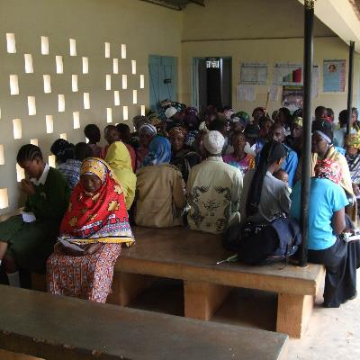
Study Design

Slide 7
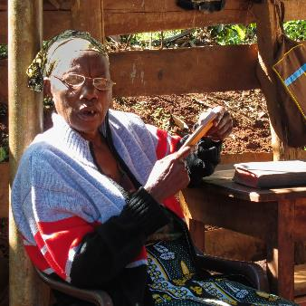
Potential for Translation and Impact
Reduce sight loss from diabetic retinopathy
Tanzanian Ministry of Health and DR-NET

Slide 8
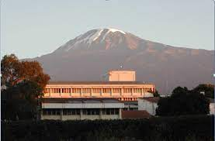
Acknowledgments
Matthew Burton
Cova Bascaran
David Macleod
William Makupa
Bernadetha Shilio
Frank Sandi
Tara Mtuy
Pearse Keane
Alastair Denniston
Adnan Tufail
Cathy Egan
Olvera Abraham

