Slide 1
Physical and mental multimorbidity prevalence in healthcare workers
Dr Vicky Simms
MRC International Statistics and Epidemiology Group
Faculty of Epidemiology and Population Health
@vickysimms_epi

Slide 2
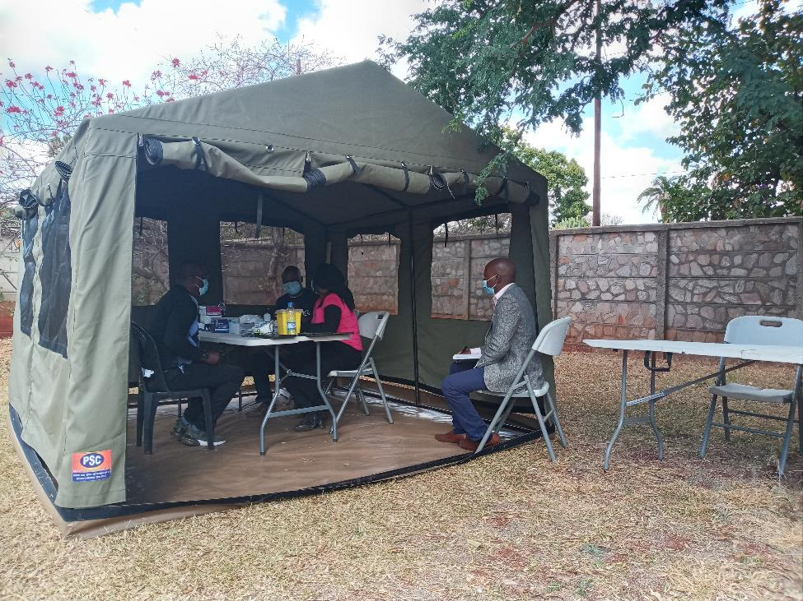
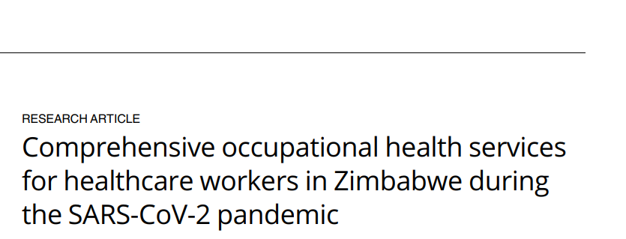
ICAROZ occupational health screening
Hospitals and clinics
All staff eligible
Screening and referral
July 2020 -

Slide 3
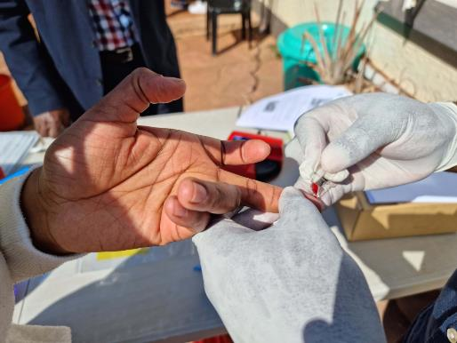
Screening
Condition | Definition | Measured
Diabetes | HBA1c>6.5% or previous diagnosis | Fingerprick and POC test
Hypertension | BP≥140/90 or previous diagnosis | 3 measurements
HIV | Positive test result or previous diagnosis | Blood based by nurse or OMT
Depression/anxiety | Shona Symptom Questionnaire (SSQ) ≥8/14 | Self-complete on paper
Notes:
SSQ – developed and validated in Zimbabwe, 14 items each yes/no

Slide 4
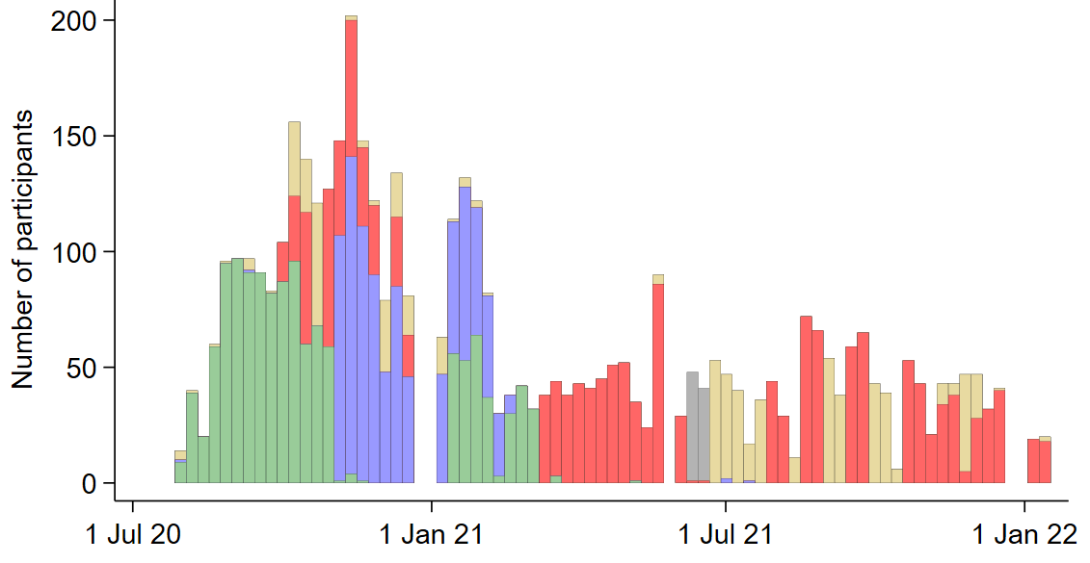
Enrolment over time

Slide 5
Client characteristics
 |  | Age ≤30 | Age 31-40 | Age >40 | Total
N |  | 1178 | 1774 | 1606 | 4558
Occupation (163 missing) | Clinical | 72.9% | 66.3% | 59.7% | 65.7%
 | Non-clinical | 27.1% | 33.7% | 40.3% | 34.3%
Sex | Male | 21.1% | 16.7% | 22.7% | 19.3%
Education | Post-secondary | 39.9% | 61.9% | 46.8% | 50.9%
BMI | <25 | 61.5% | 29.6% | 26.6% | 36.8%
 | 25-<30 | 24.1% | 36.5% | 31.3% | 31.5%
 | 30+ | 14.4% | 33.8% | 42.1% | 31.7%

Slide 6
Prevalence of 3 conditions
Condition | Prevalence | Prevalence of newly diagnosed | Proportion uncontrolled of previously diagnosed
Diabetes | 8.1% | 5.7% | 67.8%
Hyper-tension | 38.9% | 26.6% | 64.7%
HIV | 9.7% | 0.2% | -

Slide 7
Multimorbidity by age
Age ≤30
Age >40
Diabetes
Diabetes
76%
28%
3%
1%
8%
HIV
42%
1%
7%
2%
5%
HIV
15%
1%
9%
Hypertension
Hypertension

Slide 8
Hypertension by age and HIV status
HIV
No HIV
Notes:
HIV is protective against hypertension

Slide 9
Diabetes by age and HIV status
HIV
No HIV

Slide 10
Depression/anxiety by age and HIV status
HIV
No HIV
18 – 29 30 – 39 40 – 49 50 – 59 60 – 77
Age

Slide 11
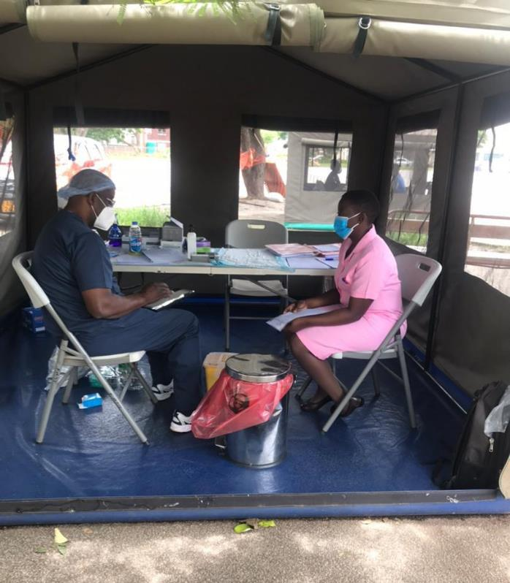
Mental health
“I had that anxiety and I also was failing to sleep; at times I would actually go on my bed and I would be tossing and turning till it was the early morning hours like 4 o’clock and that is when I would start feeling sleepy.” (nurse, female, 59)
“When I would finish work and head for home, I was disgruntled a lot, I would be thinking I work around people with the virus so if I get home, I could infect my family. This made me think excessively.” (painter, male, 63)

Slide 12
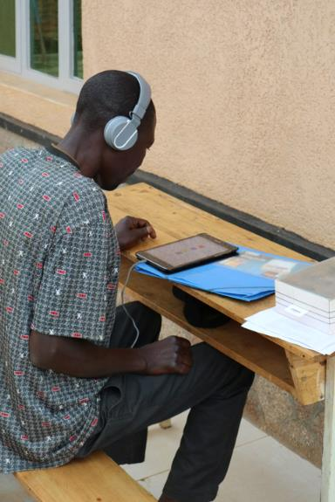
Mental health
Depression/anxiety by data collection method
Paper: July 2020-Oct 2021 (N=4136)
Audio: Oct 2021-Jan 2022 (N=412)
Claire Cullen
mbrg.bsg.ox.ac.uk
Notes:
SSQ 8+ on paper: 12.0% (95% CI 11.0-13.0) (496/4136) 27 Jul 2020 – 7 Oct 2021
SSQ 8+ on audio: 21.1% (95% CI 17.3-25.4) (87/412). 11 Oct 2021-11 Jan 2022
Cluster-randomised trial, unit=day. Started 19 Feb

Slide 13
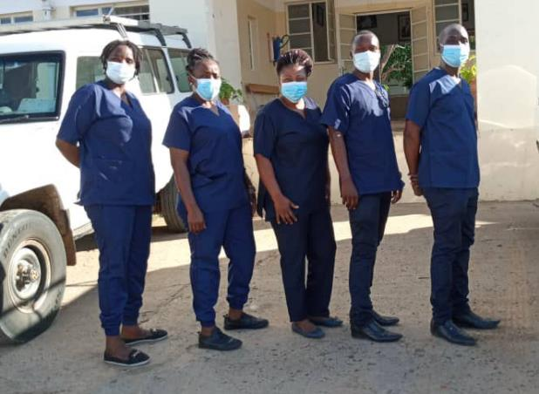
Acknowledgements
ICAROZ team
Katharina Kranzer
Edson Marambire
Bridget Kanengoni
Farrie Nzvere
Nicol Redzo
Rudo Chingono
Hannah Rickman

Slide 14
Conclusions
High burden of multimorbidity in older adults (>40)
HIV appears protective against diabetes and hypertension
Healthy worker effect
Better care
Mental health symptom collection needs privacy

