Slide 1
Multi-level perspectives on health system resilience
Insights from childhood vaccination delivery system responses to compound crises in Lebanon
Sharif Ismail
Clinical Research Training Fellow
15th March 2022

Slide 2
Acknowledgements
Supervisors:
Jo Borghi, Sadie Bell (LSHTM)
Karl Blanchet (UNIGE Geneva)
Advisory committee:
Andrada Tomoia-Cotisel (RAND Corp – US)
Diane Duclos (LSHTM)
Karin Diaconu (QMU Edinburgh)
Collaborators:
Fouad M. Fouad and Aya Noubani (AUB, Lebanon)
Janet Seeley (LSHTM/MRC-U)
Reinhard Mechler (IIASA, Austria)
Walter Lam (Natl Univ Singapore)
Zaid Chalabi (UCL)
In-country support:
Randa Hamadeh and Wafaa Kanaan, MoPH
Methodological support/advice:
David Anderson, George P. Richardson (U. Albany, US), Rachel Cassidy (LSHTM)

Slide 3
The classical definition of resilience
“The capacity of a health system to absorb, adapt or transform when exposed to a shock…and still retain the same control over its structure and functions”
Blanchet K, Nam SL, Ramalingam B, Pozo-Martin F. Governance and capacity to manage resilience of health systems: towards a new conceptual framework. International journal of health policy and management. 2017;6(8):431

Slide 4
The classical definition of resilience
“The capacity of a health system to absorb, adapt or transform when exposed to a shock…and still retain the same control over its structure and functions”
Blanchet K, Nam SL, Ramalingam B, Pozo-Martin F. Governance and capacity to manage resilience of health systems: towards a new conceptual framework. International journal of health policy and management. 2017;6(8):431

Slide 5
Three focal questions for the project
How do vaccination delivery systems respond to shocks in humanitarian settings and what does this tell us about resilience?
How might we go about measuring system resilience in a meaningful way?
What could be done to help reinforce systems against the effects of future shocks in these contexts?

Slide 6
The study settings: population displacement
Source: UNHCR data hub
Notes:
Why look at these questions in these settings?

Slide 7
The study settings: outcomes
Influx
Compound crisis

Slide 8
Shock-related dynamics: bird’s-eye view
Qualitative system dynamics modelling: causal loop diagram developed from 38 stakeholder interviews, analysed using purposive text analysis
Notes:
Shock “entry points” into the system at different points – need to bear in mind multi-level impacts

Slide 9
Zooming in: facility-level dynamics
Notes:
Law of unintended consequences – also seen at multiple scales

Slide 10
Zooming in: facility-level dynamics

Slide 11
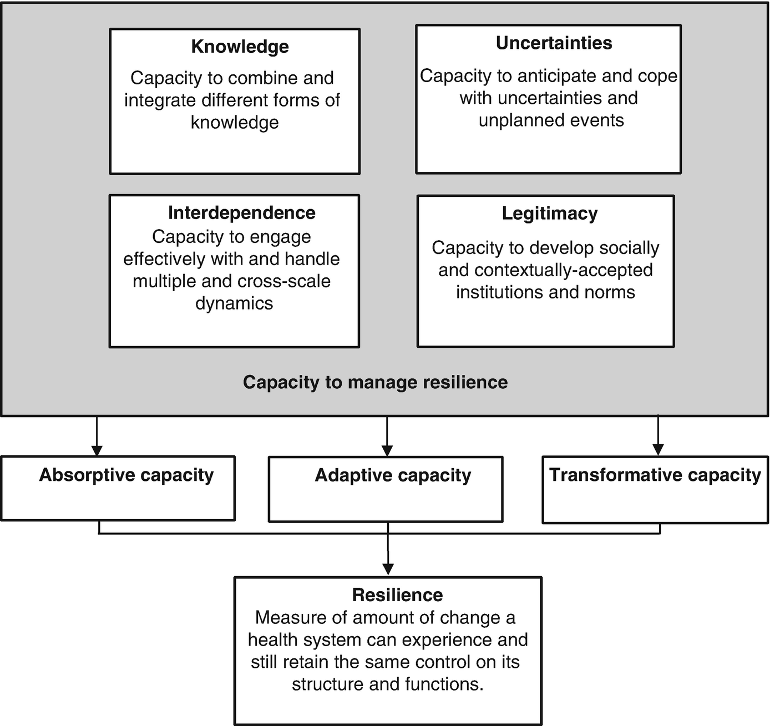
Zooming out: resilience governance
Blanchet K, Nam SL, Ramalingam B, Pozo-Martin F. Governance and capacity to manage resilience of health systems: towards a new conceptual framework. International journal of health policy and management. 2017;6(8):431.
Framework analysis triangulating findings from (i) 30 key informant interviews; (ii) meeting minutes spanning the period 2013-21; and (iii) strategy and operational documents.

Slide 12
Zooming out: resilience governance
Inputs matter for governance effectiveness: predictable funding inflows; stability in project cycle lengths; workforce retention
Decentralisation can be a blessing and a curse
Shocks can fundamentally re-shape sectoral power dynamics (in ways that could promote better long-term health outcomes including UHC)

Slide 13
Intervening to support system resilience
Realist-informed systematic review: spanning peer-reviewed and grey literature on childhood vaccination delivery in protracted crisis settings
Resilience mode | Intervention | Mechanism(s) for change
Absorptive | Changed service hours; workforce redeployment
Adaptive | Service supply: campaigns, SIAs, mobile health teams | Multi-modal, but mainly collaterals
 | Service integration: polio-routine imms; nutrition-routine imms | Resource pooling; collaterals; networking
 | Financing: P4P, private sector engagement, direct disbursement | Material and HR availability; speed of funding deployment
 | Workforce: surge technical capacity | HR availability; networking
Transformative | Governance: civil-military engagement | Material and HR availability
 | Integrated: multi-dimensional community mobilisation initiatives | New workforce capacities; networking; improved situational awareness; trust

Slide 14
What is all this telling us?
Shock responses are contingent on existing vulnerabilities, and play out at multiple levels within the vaccination delivery system
Shocks can interact in unexpected ways to create new vulnerabilities or possibly tip systems over into new resilience states
Assessing system resilience likely depends on a combination of “hard” metrics, systems insights, and service-specific outcome measures
Intervention at multiple levels likely needed to boost vaccination delivery system resilience, but ground-up trust-building key in crisis settings

Slide 15
Final thought: the weight of language
“I started to get annoyed by the word resilience…at one point of time, resilience was a positive term in the Lebanese context. Now you are getting your knocks on the head in more frequent situations that you are no longer able to experience recovery in a way. This is only human, we cannot be supermen and women – after you get 2, 3, 4, 5 knocks same day or some moment, it is no more resilience it is either you die or you don’t die, it is survivorship”

Slide 16
Annexes

Slide 17
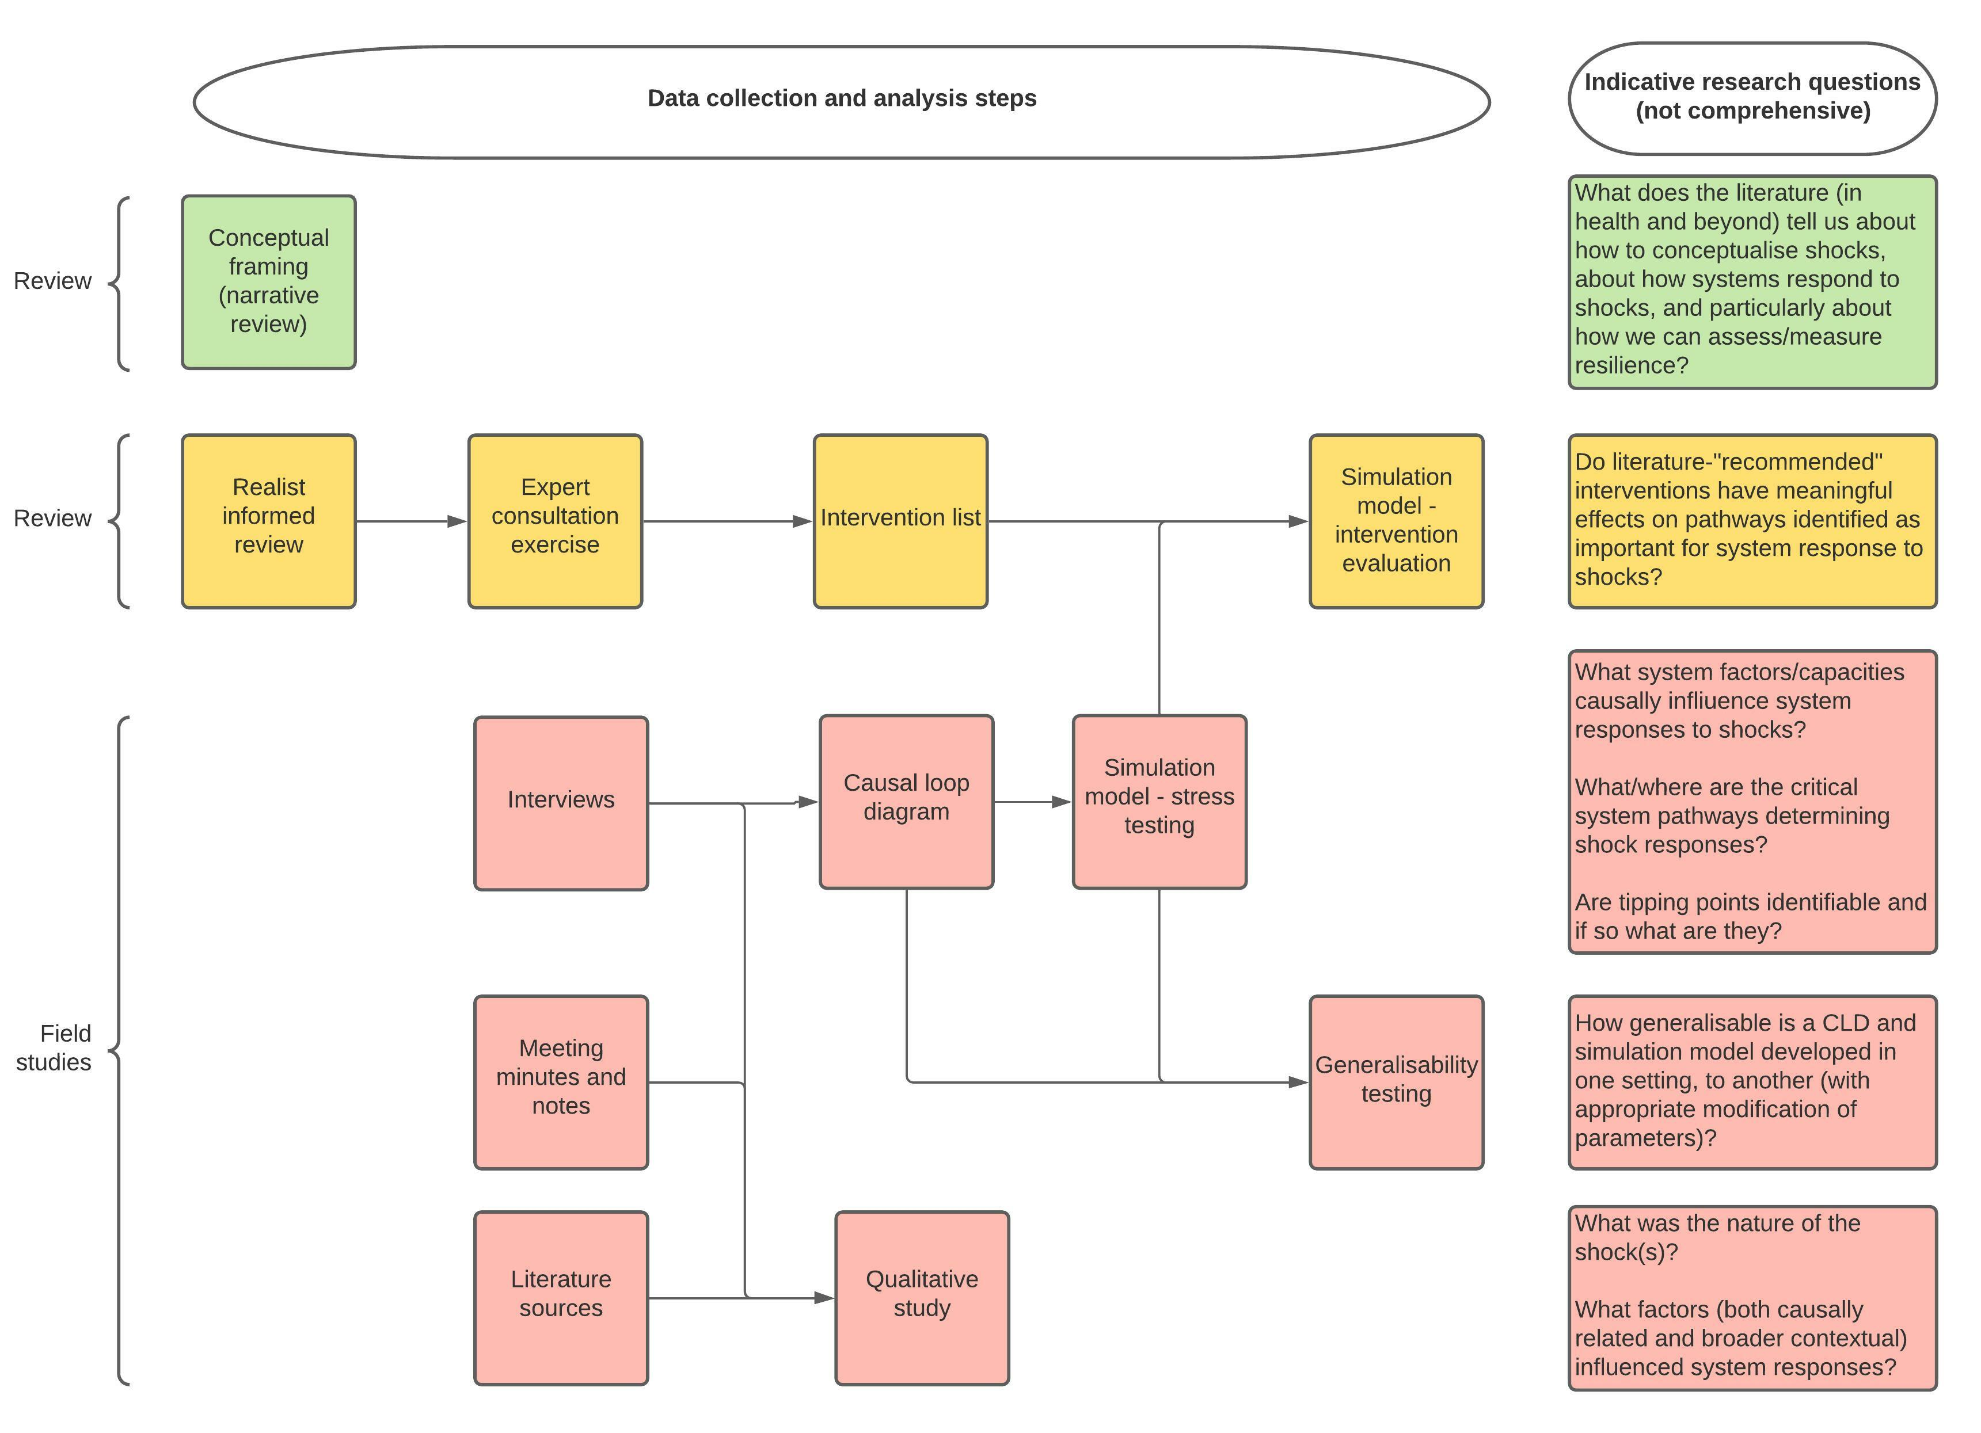

Slide 18
Classifying shocks
Shock | Scope (geo) | Scope (temp) | Demand? | Supply?
(Syrian) refugee influx | National but regional variations (border regions most affected initially) | Years (5+) | Yes | Yes but delayed and surge rather than decline
COVID | National | Months/years | Yes | Yes
Beirut blast | Local but with national implications | Days/weeks | Geographically focused | Yes – with national knock-on effects
Economic crisis | National but regional variations | Years – but marked deterioration recently | Yes | Yes – but delayed

Slide 19
Notional vaccination delivery organogram
Donors
Technical agencies
Supra-national
MOPH
MOSA
National
Partner NGOs
Regional tier structures…
Regional
PHC network
SDCs
Private clinics
Dispensaries
Local

Slide 20
Systematic review approach

Slide 21
Systematic review findings

