Slide 1


Impact of extreme heat on maternal and fetal physiology
Dr Ana Bonell, MBChB, MSc, DTMH, MRCP, FRCA
PhD candidate, Wellcome Trust Global Health Clinical Fellow
London School of Hygiene and Tropical Medicine
MRCG@LSHTM
Ana.bonell@lshtm.ac.uk
@BonellAna

Slide 2
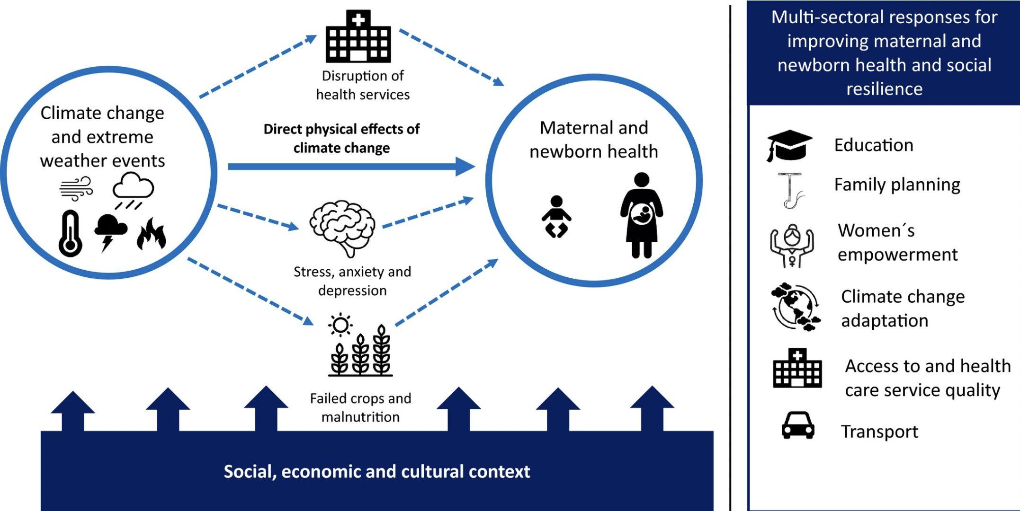
Climate change impacts

Slide 3
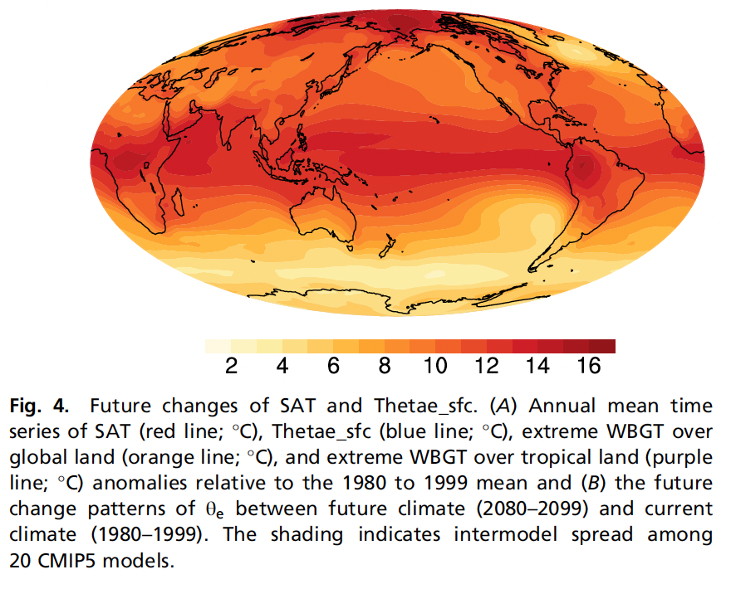
Inequality in impacts
Notes:
Clear inequality in where the impact will be felt and inequality by gender with a recognition that women are more vulnerable for the following reasons:
Caring responsibilities; lack of empowerment in terms of land ownership/ability to earn money; difficulty in safe migration – risk of exploitation and violence

Slide 4
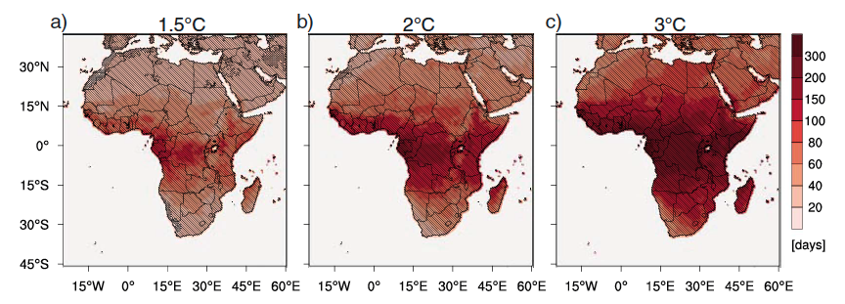
Predictions for Africa – heatwave days per year
Notes:
Gives number of days of heatwaves in different climate models

Slide 5
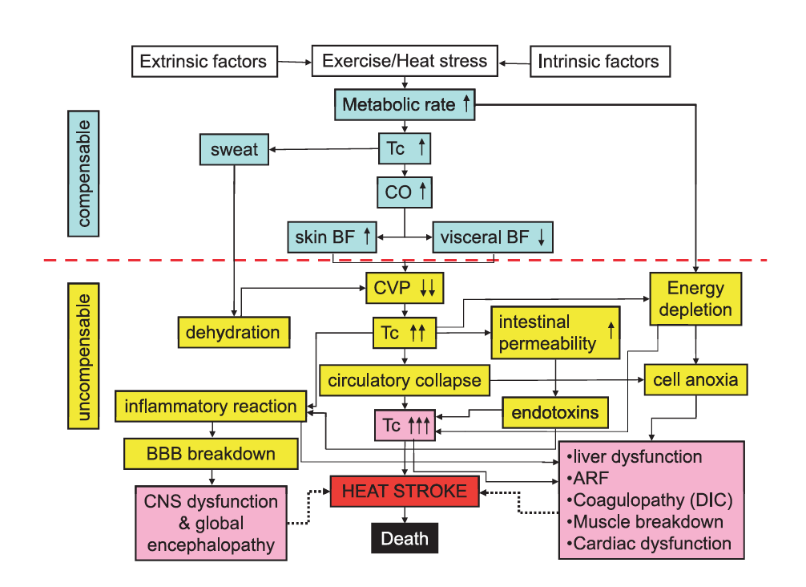
Compensable and uncompensable heat load

Slide 6
Compensable and uncompensable heat load
Notes:
Our study is exploring – mainly change in blood flow. But will also look at change in inflammatory markers. Hydration status beginning and end of day. Change in blood glucose as factors that may contribute to impact of heat stress on pregnancy

Slide 7
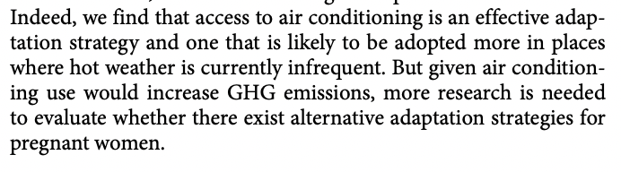
Effective interventions?
Notes:
This study for USA with 56 million births of 25,000 infants born earlier as a result of heat exposure.
Their conclusion is highly problematic.

Slide 8
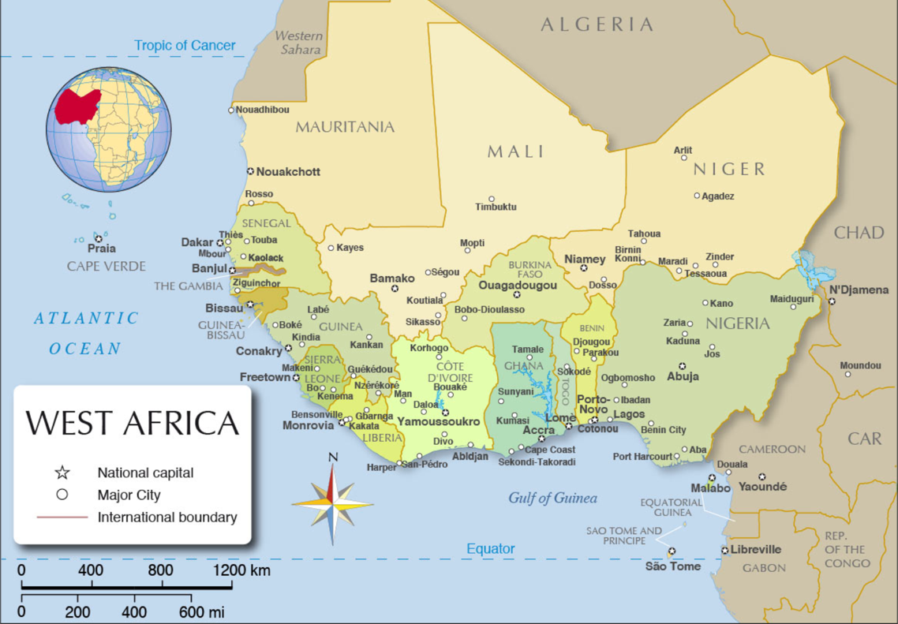
Study Setting
Notes:
Our observational cohort study

Slide 9
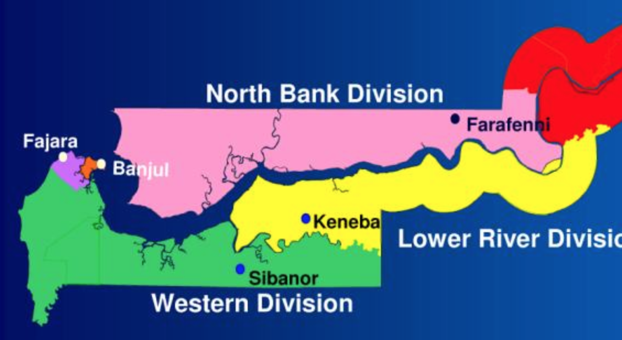
Study setting
MRC field station Keneba:
Rural field station
34 villages
750km²
Subsistence farming
Notes:
Targetted pregnant women who have to complete manual tasks during their usual day. Anyone who does some gardening or goes to the field. Included pulling up water from wells and also washing clothes.

Slide 10
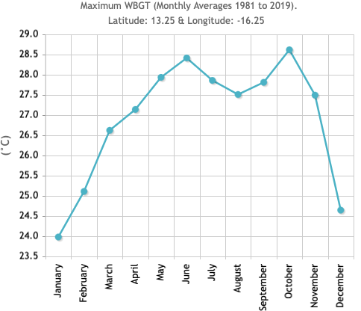
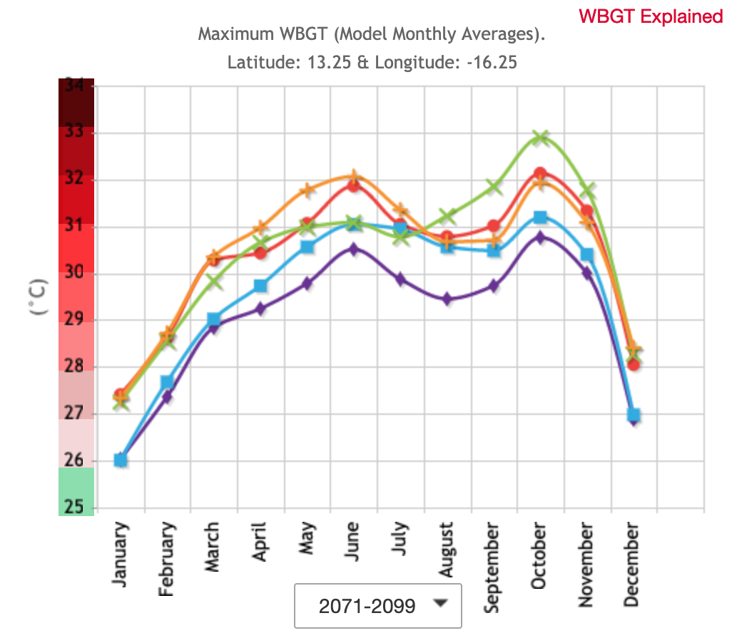
Why here?
Notes:
Natural heat chamber

Slide 11
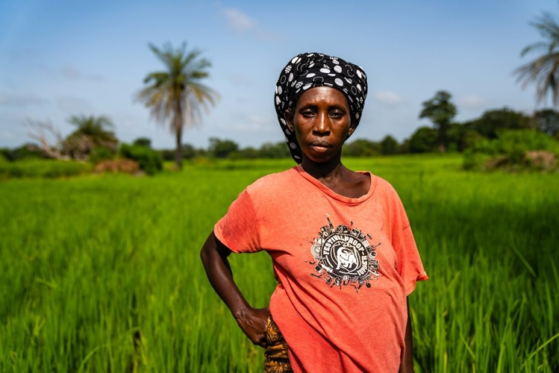
Why this population?
Neglected population
↑ risk with ↑ population and ↑ temperature
Active in tasks of daily living
Notes:
Limited options to escape the heat

Slide 12
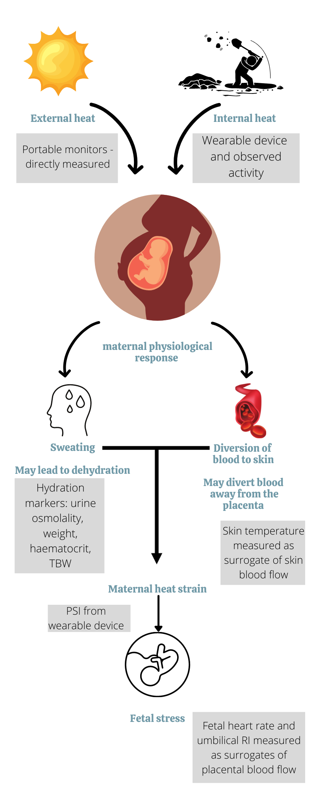
Testing the hypotheses for adverse birth outcomes
Dehydration
Rise in core temperature
Reduction in blood flow to the placenta
Heat shock proteins
Inflammation activation
Notes:
What do we already know about the underlying pathophysiology?

Slide 13
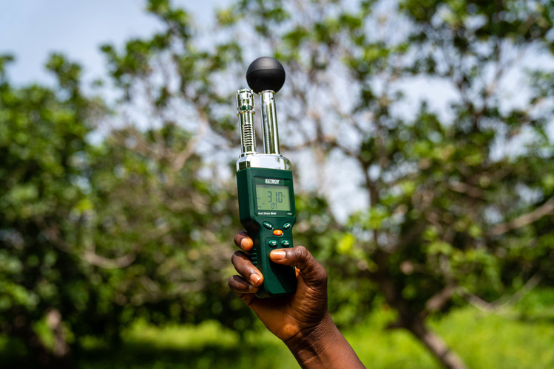
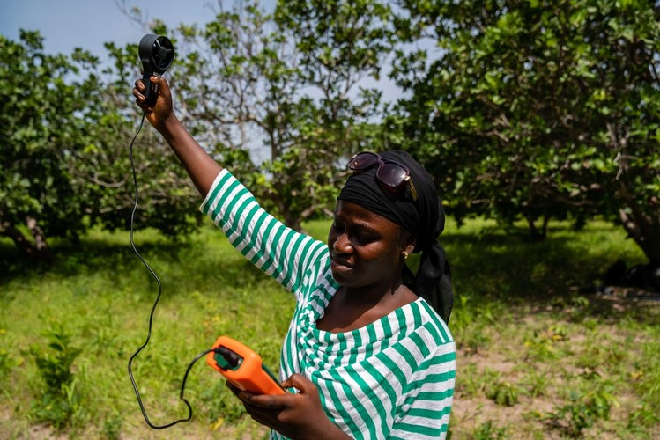
Exposure
Notes:
Exposure – directly measured air temperature/relative humidity/solar radiation (black globe temp)/wind speed

Slide 14
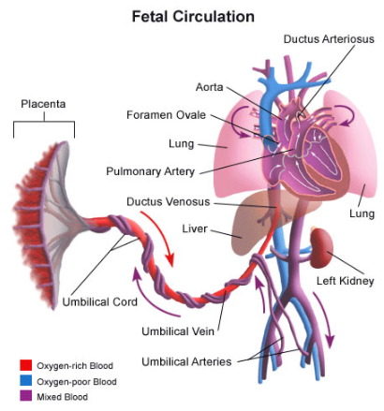
Outcome: fetoplacental circulation
Umbilical artery Doppler
  Reflects placental function
  Measure of “Utero-placental insufficiency”
Notes:
The baby’s heart pumps oxygen-poor blood through the 2 umbilical arteries to the placenta (note: ARTERY with oxygen POOR blood).
The placenta needs to have low resistance: wide open vessels to facilitate and maximise bloodflow through the placenta for the baby (maximum oxygen, nutrients).
In case of placental insufficiency: rigid blood vessels, high resistance, this shows in the Doppler.

Slide 15
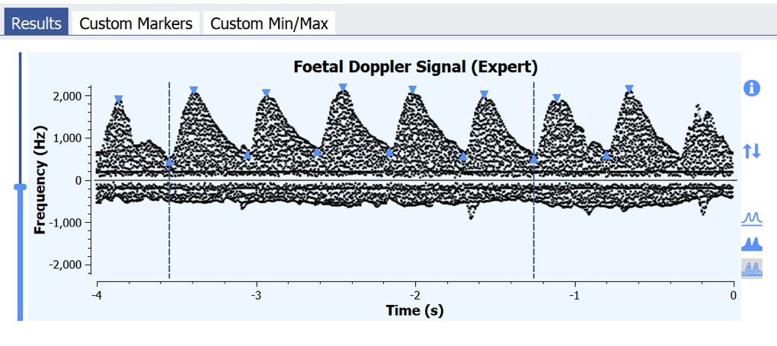
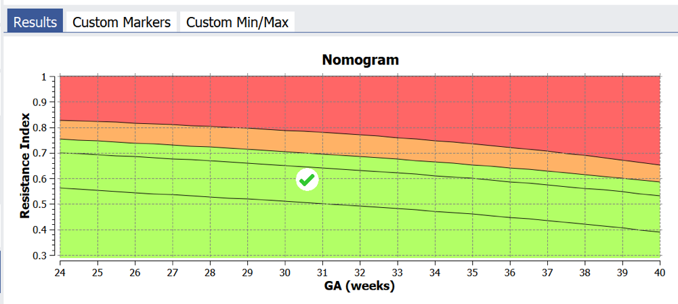
Outcome measures
UmbiFlow – portable cheap fetal doppler, developed in SA for identifying low risk pregnancies at risk of stillbirth
Umbilical artery Resistance Index (RI)
Or
Fetal Heart Rate

Slide 16
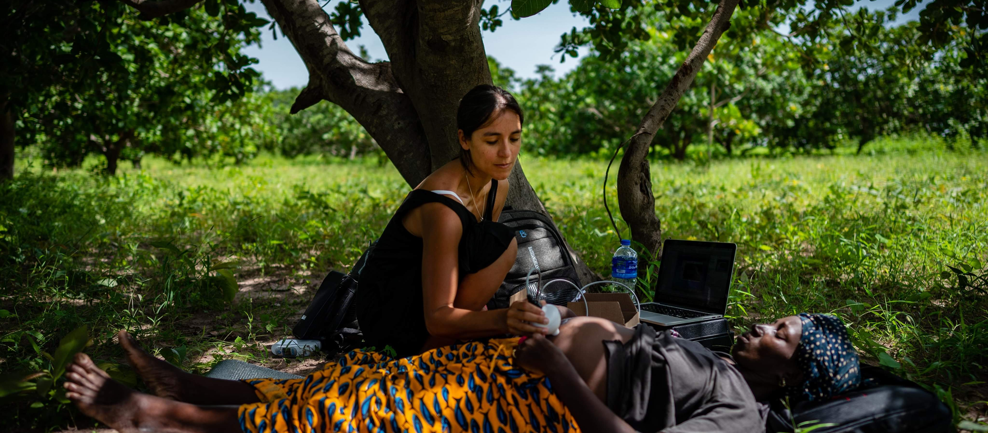
Outcome measurement

Slide 17
92 participants
 | Median (IQR) or Mean +/- SD
Gravida | 4 (2-7)
Parity | 3 (1-5.25)
Gestational Age at visit (weeks) | 28.5 (23.6-32.9)
Height | 162.9 +/- 5.6
Weight | 61.9 (55.8-97.3)
BMI | 23.0 (21.3-25.9)
MUAC | 27.0 (25.1-29.7)
Percentage fat mass (%) | 28.7 (25.8-33.8)
 | Count (%)
Normal birth | 53/91 (58%) | Missing n=1
SGA | 24/91 (26%) | Missing n=1
Preterm | 12/92 (13%) | Missing n=0
LBW | 12/91 (13%) | Missing n=1
Stillbirth/intrapartum death | 3/92 (3%) | Missing n=0
Notes:
Check this/change this

Slide 18
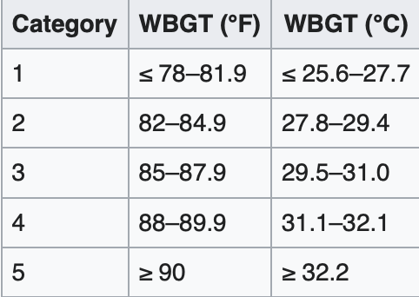
Exposure WBGT

Slide 19
Exposure UTCI
MH = moderate heat stress
SH = severe heat stress
VSH = very severe heat stress
EH = extreme heat stress
No day where there was no heat stress by UTCI

Slide 20
Estimated METs

Slide 21
Correlation matrix

Slide 22
Association of UTCI and heat strain

Slide 23
Change in maternal tymp and skin temperature
Change in mean maternal tympanic temperature
Change in mean maternal skin temperature
Notes:
Mean change in maternal temperature as measured by tympanic thermometers

Slide 24
Impact on fetus
41/122 (33.6%) episodes of fetal stress
21/122 (17%) experienced fetal heart rates >160 or < 115 bpm.
22/40 (55%) experienced an increase in RI from baseline
Notes:
Change in fetal heart rate at baseline, middle and end of day (can see that the whole mean is shifted up and where at baseline all HR were within normal range, when working there are several cases about 160)

Slide 25
Multilevel model
Model A – fetal heart rate
 | Estimate | 95% CI | P value
Intercept | 94.86 | 78.39;111.34
UTCI | 1.23 | 0.90;1.56 | <0.001
PSI | 0.71 | -0.01;1.44 | 0.05
osmolality | 0.001 | -0.01;0.01 | 0.80
Hb | 0.17 | -0.71;1.04 | 0.71
APO | -0.83 | -3.77;2.11 | 0.58
TBW | 0.06 | -0.26;0.37 | 0.72
Model B – fetal stress
 | Odds ratio | 95% CI | P value
Intercept | 0.00 | 0.00;0.28
UTCI | 1.17 | 1.05;1.29 | 0.01
PSI | 1.20 | 0.99;1.46 | 0.06
Gestational age | 1.12 | 1.02;1.22 | 0.02
Osmolality | 1.00 | 1.00;1.00 | 0.61
Haematocrit | 0.97 | 0.87;1.07 | 0.49
TBW | 0.93 | 0.83;1.05 | 0.27

Slide 26
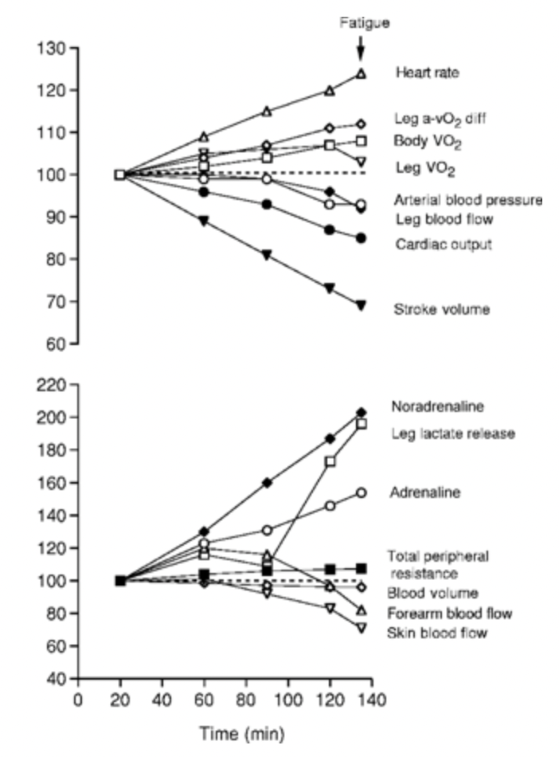
Change in RI and heat stress
Notes:
Really interested here in 2 things – is there a relationship between RI (blood velocity) and heat stress? Is there a difference in this response in those that have an adverse pregnancy outcome?

Slide 27
Response to heat by pregnancy outcome

Slide 28
Simulation-based power calculation

Slide 29
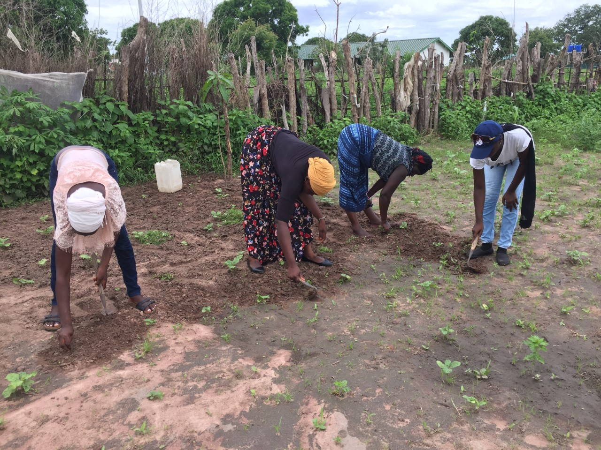
Lived experience: climate change impacts
“What we normally farm, in the last three years, we don’t gain much.”
“ for the previous three years, the amount of rain we received was not like normal”

Slide 30
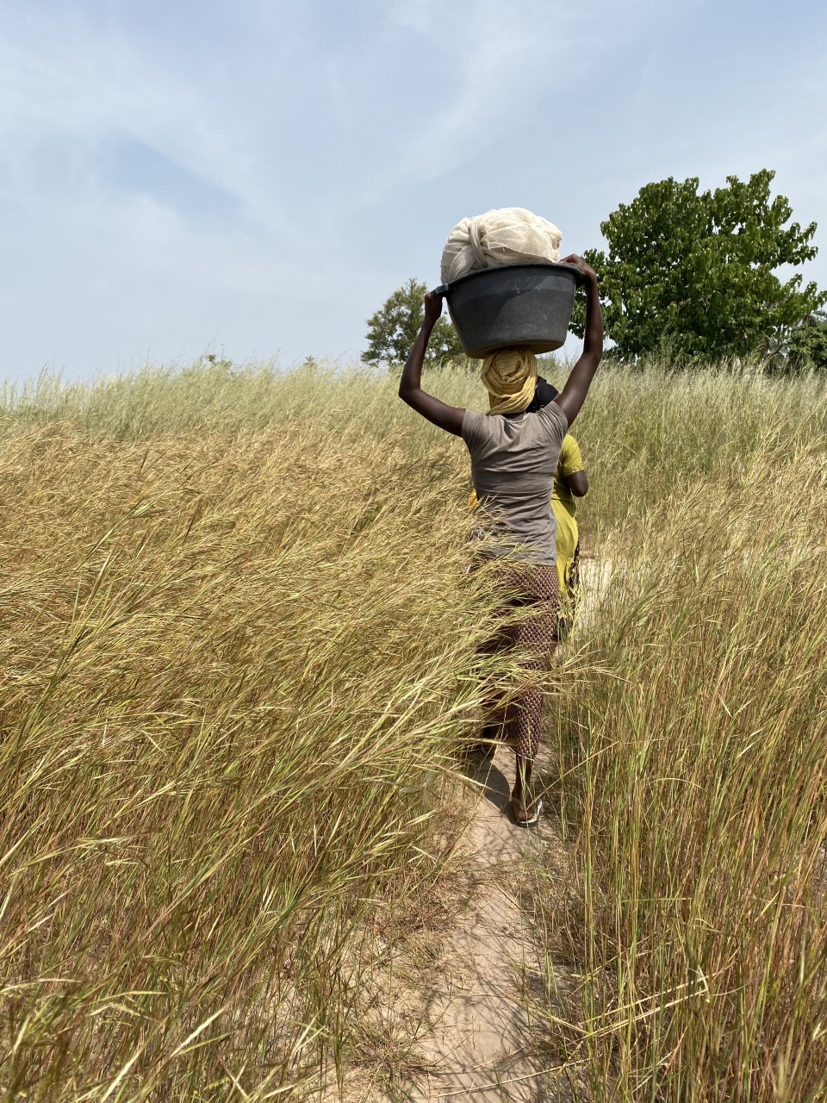
Lived experience: heat in pregnancy
“When it is very hot..I feel like my body is burning.”
“When the sun is really hot, it makes you feel tired, and dizzy."

Slide 31
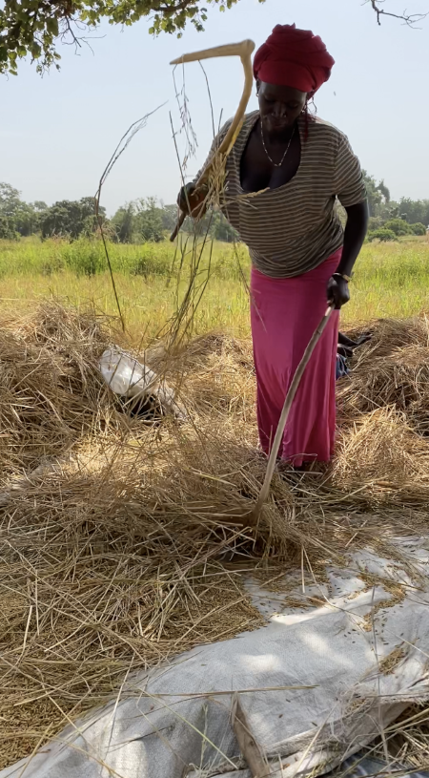
Lived experience: managing the heat
“When it is hot, and I notice I’m tired and hot, I will use that water and drink, and sit under that tree for a while. In that time, I realize that the baby is free and comfortable, that’s the time I will go and continue with my work.” - Aisha, age 30.

Slide 32
Summary
Large at-risk population
Already exposed to extreme heat – going to get much worse
Pregnant subsistence farmers do experience heat strain
Evidence of physiological stress transferred to the fetus
Biomarker analysis to come
Long-term implications unclear – but lots of future work planned

Slide 33
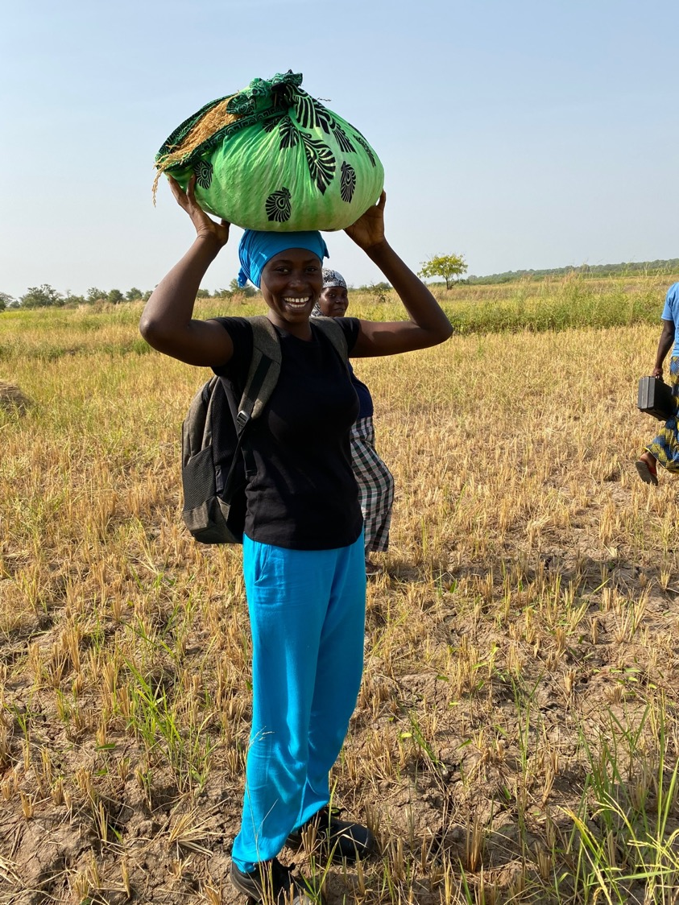

Thank you
All Keneba staff
Bakary Sonko
Lamin Jobarteh
Tida Samateh
Tida Saidy
Jainaba Badjie
Kebba Bajo
Fatou Sosseh
Yahya Sallah
Ebrima Danso
All MRC drivers
Amazing participants in West Kiang
MRCG healthcare workers
Shantelle Spencer
Gregor Eichhorn
Supervisors/advisory board
Prof Andrew Prentice
Prof Andy Haines
Dr Neil Maxwell
Dr Ana Vicedo-Cabreras
Dr Jane Hirst
Dr Kris Murray

