Slide 1


What next for management of cryptococcal meningitis?
The AMBITION-CM Trial and Beyond…..
Joe Jarvis
NIHR Global Health Professor
London School of Hygiene and Tropical Medicine & Botswana Harvard AIDS Institute Partnership
Notes:
Thank you very much for inviting me to talk about the Ambition trial today.

Slide 2









ACKNOWLEDGEMENTS ALL PARTICIPANTS AND CAREGIVERS ALL ROUTINE CARE STAFF LSHTM Joe Jarvis Nabila Youssouf Philippa Griffin Sophia Hafeez SGUL Tom Harrison Angela Loyse Sile Molloy LSTM Shabbar Jaffar David Lalloo Duolao Wang Tao Chen Louis Niessen Tinevimbo Shiri Erik van Widenfelt University of Liverpool William Hope Kat Stott Institut Pasteur Olivier Lortholary Francoise Dromer Timothee Boyer-Chammard Alexandre Alanio Aude Sturny-Leclere | Botswana Harvard AIDS Institute Partnership Mosepele Mosepele Tshepo Leeme Keatlaretse Siamisang Nametso Tlhako Katlego Tsholo Kwana Lechiile Charles Muthoga Tawe Leabaneng Norah Mawoko Tshepiso Mbangiwa Ponego Ponatshego Ikanyeng Rulaganyang Kaelo Seatla Jack Goodall James Milburn Refilwe Mmipi MLW Blantyre Henry Mwandumba Melanie Alufandika-Moyo Henry Mzinganjira Eltas Dziwani Ebbie Gondwe Wezzie Chimang’anga Christopher Kukacha Ajisa Ahmadu Steve Kateta Reya Shah Madalitso Chasweka Evelyn Kossam Auvrey Kadzilimbile John Ndaferankhande Bright Lipenga Agnes Zambasa Maureen Ndalama Andrea Singini | UNC Project Lilongwe Mina Hosseinipour Cecilia Kanyama Chimwemwe Chawinga Timothy Kachitosi Emily Kumwenda Laureen Kafantenganji Chimwemwe Maya Janet Zambezi Wilberforce Mhango Abineli Mbewe Tapiwa Munthali Lusungu Msumba Mussah Kazembe Towera Banda Simon Nicholas Tarsizio Chikaonda Gladys Chitulo Nelecy Chome Anthomy Stambuli Beauty Kamanga Chimwemwe Mphande Lusayo Simwinga Mary Gwin Masia Ian Kumwenda Doris Ngoma Gerald Tegha IDI Mbarara Conrad Muzoora Edwin Nuwagira Samuel Jjunu Michael Ssemusu Joan Rukundo Irene Rwomushana Leo Atwine Davis Muganzi Peter Buzaare James Mwesigye Ninsiima Emily Ankunda Rodgers Samson Kariisa Christine Inyakuwa Gavin Stead | University of Cape Town Graeme Meinjtes Charlotte Schutz Kyla Comins Achita Singh Lee-Ann Davids Siphokazi Hlungulu Mkhanyiseli Mpalali Ida Oliphant Tania Morar Masina Nomawethu Rene Goliath Tom Crede Jonathon Naude Deborah Maughan Trevor Mnguni Linda Boloko Hloni Bookholane Loraine Swanepoel Sonya Koekemoer Regina Hoffmann Samantha April Henriette Kyepa Sumaiyya Moosa Sumaya Sayed Muki Shey Abulele Bekiswa University of Zimbabwe Chiratidzo Ndhlovu Admire Hlupeni Constantin Mutata Prosper Kufa Tawanda Zinyandu Taddy Mwarumba Edward Mahaka Shepherd Mudzingwa Kathryn Boyd Takudzwa Mtisi Columbus Moyo Secrecy Gondo | IDI Kampala David Meya David Boulware Darlisha Williams Joshua Rhein Edward Mpoza Lillian Tugume Enock Kagimu Morris Rutakingirwa John Kasibante Kenneth Ssebambulidde Laura Nsangi Jane Ndyetukira Abdu Musubire Jane Gakuru Alisat Sadiq Cynthia Ahimbisibwe Carol Olivie Namuju Jane Francis Ndyetukira Florence Kugonza Eva Laker Rhona Muyise Andrew Luswata Lule John Kisembo Daniel Kiiza Richard Kwizera Andrew Akampurira Tonny Luggya Tadeo Kiiza Asmus Tukundane Michael Okirwoth Fiona Cresswell DSMB Andrew Nunn Sayoki Mfinanga Rob Peck Bill Powderly Trial Steering Committee John Perfect Andrew Kambugu Saidi Kapigi Doug Wilson
Notes:
I’m presenting the study on behalf of a very large consortium of investigators from across southern and east Africa and Europe, whose incredibly hard work during the last five years, in particularly challenges circumstances over the past two years, have made this possible. There are too many people to thank individually now, but I should mention my co-PI, Professor Tom Harrison who is chairing this session. Thanks also to our funders, the EDCTP, Wellcome Trust, Medical Research Council, UK Government official development assistance, and Swedish International Development AID, and Gilead for donating the study drug.

Slide 3
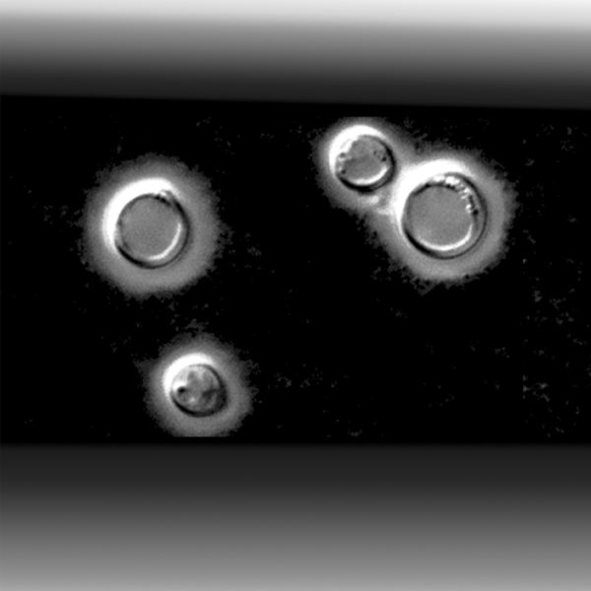

Slide 4

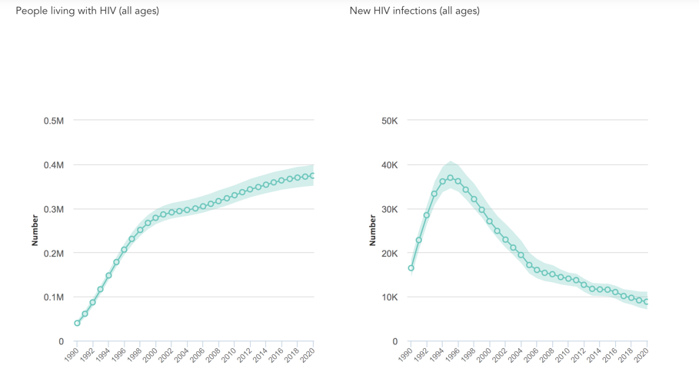
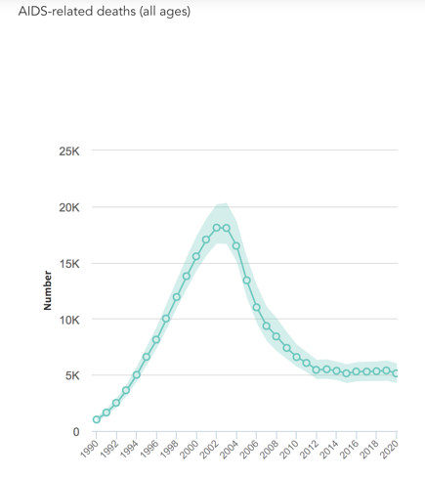
Botswana HIV Data - 2020

Slide 5
Epidemiology of CNS infections in high HIV-prevalence settings
Notes:
These are more recent data from some of our studies in Botswana, really confirming the same findings...
TB less – lack of diagnostics…
5

Slide 6
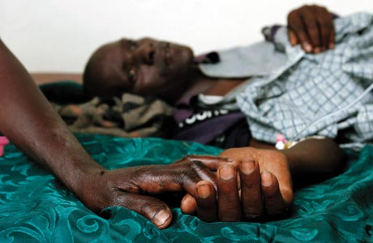
HIV-associated Cryptococcal Meningitis
36% acute mortality in Vietnam
Day et al. NEJM 2013;368:1291-302
41% acute mortality in Africa and Asia
Beardsley et al. NEJM 2016;374:542-54
15% of all HIV-related mortality
Rajasingham et al. Lancet ID 2017; pii: S1473-3099(17)30243-8
Notes:
This audience needs little background to the clinical need behind the trial. Cryptococcal meningitis remains the leading cause of adult meningitis in most of central, southern, and east Africa, and treatment outcomes with the 14-day amphotericin B deoxycholate based regimens that remain the mainstay of therapy in most of the region are terrible, with 10-week mortality rates of approximately 40% reported in recent trials, and even higher mortality in routine care settings.

Slide 7
Background to the AMBITION-cm Trial
HIV-associated cryptococcal meningitis remains the second leading cause of AIDS-related mortality¹
Conventional treatment with amphotericin B (AmB) is associated with significant drug-related toxicities²
ACTA trial demonstrated shorter, 7 day courses of AmB can be given with flucytosine (5FC)³
Liposomal amphotericin (AmBisome, LAmB) is less toxic, has a long half-life and effectively penetrates the central nervous system⁴
Phase 2 study demonstrated that a single, high dose of LAmB (10mg/kg) was non-inferior to 14 daily doses (3mg/kg) at clearing Cryptococcus from the cerebrospinal fluid and was well tolerated⁵
¹Rajasingham R, Lancet Infect Dis, 2017. ²Bicanic T, Antimicrob Agents Chemother, 2015. ³Molloy S, N Eng J Med, 2018. ⁴Groll AH, Clin Infect Dis, 2019. ⁵Jarvis J, Clin Infect Dis, 2018
Notes:
But what about liposomal amphotericin B? [READ SLIDE]

Slide 8
AmBisome
10mg/kg LAmB single dose
AND
5FC 100mg/kg/day for 14 days
AND
FLU 1200mg/day for 14 days
Control
1mg/kg AmB for 7 days
AND
5FC 100mg/kg/day for 7 days
THEN
FLU 1200mg/day for 7 days
Primary outcome
All-cause mortality at 10 weeks (non-inferiority)
Secondary outcomes
All-cause mortality at 2, 4 and 16 weeks (non-inferiority)
All-cause mortality at 10 weeks (superiority)
Early fungicidal activity
Safety
Notes:
Today I’ll briefly run through the highlighted outcomes.

Slide 9
WP-1: Clinical Trial
WP-2: Economic Analysis
WP-3: Scientific Substudies
WP-4: Network Development
WP-5: Training & Capacity Building
WP-6: Project Management
Notes:
As well as the clinical trial we…..[READ]

Slide 10







Kampala and Mbarara, Uganda
Infectious Diseases Institute
Lilongwe, Malawi
UNC Project
Blantyre, Malawi
Malawi-Liverpool Wellcome Trust Clinical Research Programme
Harare, Zimbabwe
University of Zimbabwe
Gaborone, Botswana
Botswana-Harvard Partnership and University of Botswana
Cape Town, South Africa
University of Cape Town
342
844 participants recruited
110
124
73
85
110
Notes:
The phase 3 trial recruited individuals from 8 hospitals across 7 cities in 5 countries in southern and eastern Africa.

Slide 11
All-cause mortality at 10 weeks: Non-inferiority, unadjusted analysis
 | AmBisome (N=407) | Control (N=407) | Risk difference (%)
Intention-to-treat
No. of deaths | 101 24.8% (95% CI 20.7 to 29.3) | 117 28.7% (95% CI 24.4 to 33.4) | -3.93% (90% CI -9.0 to 1.2)
Per protocol
No. of deaths | 95 24.5% (95% CI 20.3 to 29.1) | 113 28.5% (95% CI 24.1 to 33.3) | -4.05% (90% CI -9.3 to 1.1)
95% CI
ITT: -10.0 to 2.2
PP: -10.2 to 2.1
Notes:
Here we present the primary outcome data of all-cause mortality at 10-weeks. Within the intention to treat analysis there were 101 deaths in the AmBisome arm, giving a mortality risk of 24.8%. There were 117 deaths in the control arm, a mortality risk of 28.7%. The risk difference in the AmBisome arm compared to the control arm was -3.9% and the upper bound of the 90% confidence interval, which equates to a one-sided 95% confidence interval for the non-inferiority analysis was 1.2%, well below the pre-specified 10% non-inferiority margin. The results were similar in the per-protocol analysis. The upper bound of the two-sided 95% confidence intervals were also well below the 10% non-inferiority margin in both intention-to-treat and per-protocol analyses.

Slide 12
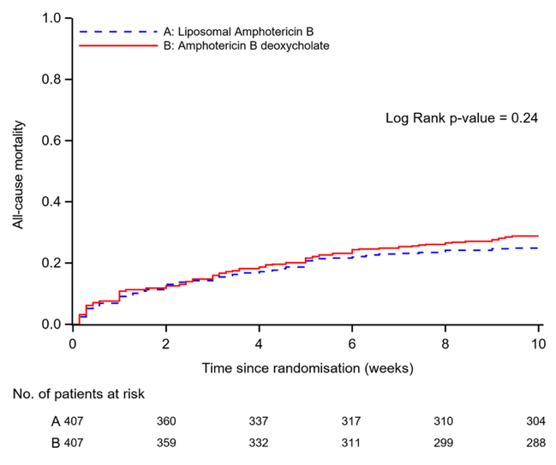
Notes:
These primary outcome data are visualised here. The risk difference of each analysis is shown with the two-sided 90% confidence intervals. Across all analyses: intention-to-treat, per-protocol, unadjusted, and adjusted, the upper bound of the confidence intervals is well below the pre-specified non-inferiority margin of 10%.

Slide 13
Safety: Safety population
Safety Parameter | AmBisome (N=420) | Control (N=422) | P value
Total number of Grade 3 or 4 adverse events | 382 | 579 | <0.001
Any adverse event – no. of participants (%) Grade 3 Grade 4 | 173 (41%) 91 (22%) | 225 (53%) 127 (30%) | <0.001 0.005
Anemia – no. of participants (%) Grade 3 Grade 4 | 44 (10%) 12 (3%) | 108 (26%) 62 (15%) | <0.001 <0.001
Mean change in haemoglobin level to day 7 – g/dl | -0.3 | -1.9 | <0.001
Received a blood transfusion – no. of participants (%) | 32 (8%) | 76 (18%) | <0.001
Creatinine increase – no. of participants (%) Grade 3 Grade 4 | 17 (4%) 5 (1%) | 22 (5%) 3 (1%) | 0.42 0.505
Mean % change in creatinine level to day 7 | 20.2% | 49.7% | <0.001
Hypokalaemia – no. of participants (%) Grade 3 Grade 4 | 6 (2%) 0 (0%) | 27 (6%) 3 (1%) | <0.001 0.25
Thrombophlebitis requiring antibiotics - no. of participants (%) | 8 (2%) | 28 (7%) | <0.001
Neutropenia – no. of participants (%) Grade 3 Grade 4 | 27 (6%) 20 (5%) | 21 (5%) 16 (4%) | 0.36 0.49
Thrombocytopenia– no. of participants (%) Grade 3 Grade 4 | 9 (2%) 4 (1%) | 17 (4%) 6 (1%) | 0.11 0.75
Elevated ALT – no. of participants (%) Grade 3 Grade 4 | 6 (1%) 1 (0.2%) | 4 (1%) 1 (0.2%) | 0.52 1.0
Notes:
Finally, the safety data for all individuals who were randomised and received any study drug.

Slide 14
Safety: Safety population
Safety Parameter | AmBisome (N=420) | Control (N=422) | P value
Total number of Grade 3 or 4 adverse events | 382 | 579 | <0.001
Any adverse event – no. of participants (%) Grade 3 Grade 4 | 173 (41%) 91 (22%) | 225 (53%) 127 (30%) | <0.001 0.005
Anemia – no. of participants (%) Grade 3 Grade 4 | 44 (10%) 12 (3%) | 108 (26%) 62 (15%) | <0.001 <0.001
Mean change in haemoglobin level to day 7 – g/dl | -0.3 | -1.9 | <0.001
Received a blood transfusion – no. of participants (%) | 32 (8%) | 76 (18%) | <0.001
Creatinine increase – no. of participants (%) Grade 3 Grade 4 | 17 (4%) 5 (1%) | 22 (5%) 3 (1%) | 0.42 0.505
Mean % change in creatinine level to day 7 | 20.2% | 49.7% | <0.001
Hypokalaemia – no. of participants (%) Grade 3 Grade 4 | 6 (2%) 0 (0%) | 27 (6%) 3 (1%) | <0.001 0.25
Thrombophlebitis requiring antibiotics - no. of participants (%) | 8 (2%) | 28 (7%) | <0.001
Neutropenia – no. of participants (%) Grade 3 Grade 4 | 27 (6%) 20 (5%) | 21 (5%) 16 (4%) | 0.36 0.49
Thrombocytopenia– no. of participants (%) Grade 3 Grade 4 | 9 (2%) 4 (1%) | 17 (4%) 6 (1%) | 0.11 0.75
Elevated ALT – no. of participants (%) Grade 3 Grade 4 | 6 (1%) 1 (0.2%) | 4 (1%) 1 (0.2%) | 0.52 1.0
Notes:
Within the first 21 days after randomisation, grade 3 or 4 adverse events occurred more frequently in the control arm.

Slide 15
Safety: Safety population
Safety Parameter | AmBisome (N=420) | Control (N=422) | P value
Total number of Grade 3 or 4 adverse events | 382 | 579 | <0.001
Any adverse event – no. of participants (%) Grade 3 Grade 4 | 173 (41%) 91 (22%) | 225 (53%) 127 (30%) | <0.001 0.005
Anemia – no. of participants (%) Grade 3 Grade 4 | 44 (10%) 12 (3%) | 108 (26%) 62 (15%) | <0.001 <0.001
Mean change in haemoglobin level to day 7 – g/dl | -0.3 | -1.9 | <0.001
Received a blood transfusion – no. of participants (%) | 32 (8%) | 76 (18%) | <0.001
Creatinine increase – no. of participants (%) Grade 3 Grade 4 | 17 (4%) 5 (1%) | 22 (5%) 3 (1%) | 0.42 0.505
Mean % change in creatinine level to day 7 | 20.2% | 49.7% | <0.001
Hypokalaemia – no. of participants (%) Grade 3 Grade 4 | 6 (2%) 0 (0%) | 27 (6%) 3 (1%) | <0.001 0.25
Thrombophlebitis requiring antibiotics - no. of participants (%) | 8 (2%) | 28 (7%) | <0.001
Neutropenia – no. of participants (%) Grade 3 Grade 4 | 27 (6%) 20 (5%) | 21 (5%) 16 (4%) | 0.36 0.49
Thrombocytopenia– no. of participants (%) Grade 3 Grade 4 | 9 (2%) 4 (1%) | 17 (4%) 6 (1%) | 0.11 0.75
Elevated ALT – no. of participants (%) Grade 3 Grade 4 | 6 (1%) 1 (0.2%) | 4 (1%) 1 (0.2%) | 0.52 1.0
Notes:
Grade 3 or 4 anaemia was significantly less frequent in the AmBisome arm, occurring in 13% of participants compared to 41% in the control arm. The mean decrease in hemoglobin over the first week was 0.3g/dL in the AmBisome arm and 1.9g/dL in the control arm. 8% of participants in the AmBisome arm received a blood transfusion compared to 18% of participants in the control arm.

Slide 16
Safety: Safety population
Safety Parameter | AmBisome (N=420) | Control (N=422) | P value
Total number of Grade 3 or 4 adverse events | 382 | 579 | <0.001
Any adverse event – no. of participants (%) Grade 3 Grade 4 | 173 (41%) 91 (22%) | 225 (53%) 127 (30%) | <0.001 0.005
Anemia – no. of participants (%) Grade 3 Grade 4 | 44 (10%) 12 (3%) | 108 (26%) 62 (15%) | <0.001 <0.001
Mean change in haemoglobin level to day 7 – g/dl | -0.3 | -1.9 | <0.001
Received a blood transfusion – no. of participants (%) | 32 (8%) | 76 (18%) | <0.001
Creatinine increase – no. of participants (%) Grade 3 Grade 4 | 17 (4%) 5 (1%) | 22 (5%) 3 (1%) | 0.42 0.505
Mean % change in creatinine level to day 7 | 20.2% | 49.7% | <0.001
Hypokalaemia – no. of participants (%) Grade 3 Grade 4 | 6 (2%) 0 (0%) | 27 (6%) 3 (1%) | <0.001 0.25
Thrombophlebitis requiring antibiotics - no. of participants (%) | 8 (2%) | 28 (7%) | <0.001
Neutropenia – no. of participants (%) Grade 3 Grade 4 | 27 (6%) 20 (5%) | 21 (5%) 16 (4%) | 0.36 0.49
Thrombocytopenia– no. of participants (%) Grade 3 Grade 4 | 9 (2%) 4 (1%) | 17 (4%) 6 (1%) | 0.11 0.75
Elevated ALT – no. of participants (%) Grade 3 Grade 4 | 6 (1%) 1 (0.2%) | 4 (1%) 1 (0.2%) | 0.52 1.0
Notes:
A grade 3 or 4 increase in creatinine was relatively uncommon, developing in 5% of participants in the AmBisome arm compared to 6% in the control arm. The mean increase in creatinine from baseline to day 7 was 20.2% in the Ambisome arm and 49.7% in the control arm. Hypokalaemia was also more common in the control arm.

Slide 17
Safety: Safety population
Safety Parameter | AmBisome (N=420) | Control (N=422) | P value
Total number of Grade 3 or 4 adverse events | 382 | 579 | <0.001
Any adverse event – no. of participants (%) Grade 3 Grade 4 | 173 (41%) 91 (22%) | 225 (53%) 127 (30%) | <0.001 0.005
Anemia – no. of participants (%) Grade 3 Grade 4 | 44 (10%) 12 (3%) | 108 (26%) 62 (15%) | <0.001 <0.001
Mean change in haemoglobin level to day 7 – g/dl | -0.3 | -1.9 | <0.001
Received a blood transfusion – no. of participants (%) | 32 (8%) | 76 (18%) | <0.001
Creatinine increase – no. of participants (%) Grade 3 Grade 4 | 17 (4%) 5 (1%) | 22 (5%) 3 (1%) | 0.42 0.505
Mean % change in creatinine level to day 7 | 20.2% | 49.7% | <0.001
Hypokalaemia – no. of participants (%) Grade 3 Grade 4 | 6 (2%) 0 (0%) | 27 (6%) 3 (1%) | <0.001 0.25
Thrombophlebitis requiring antibiotics - no. of participants (%) | 8 (2%) | 28 (7%) | <0.001
Neutropenia – no. of participants (%) Grade 3 Grade 4 | 27 (6%) 20 (5%) | 21 (5%) 16 (4%) | 0.36 0.49
Thrombocytopenia– no. of participants (%) Grade 3 Grade 4 | 9 (2%) 4 (1%) | 17 (4%) 6 (1%) | 0.11 0.75
Elevated ALT – no. of participants (%) Grade 3 Grade 4 | 6 (1%) 1 (0.2%) | 4 (1%) 1 (0.2%) | 0.52 1.0
Notes:
Thrombophlebitis requiring antibiotic therapy occurred in 2% of AmBisome participants and 7% of control participants.

Slide 18
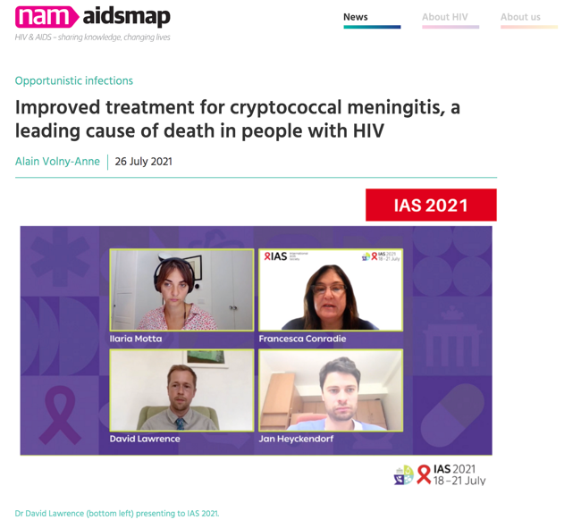
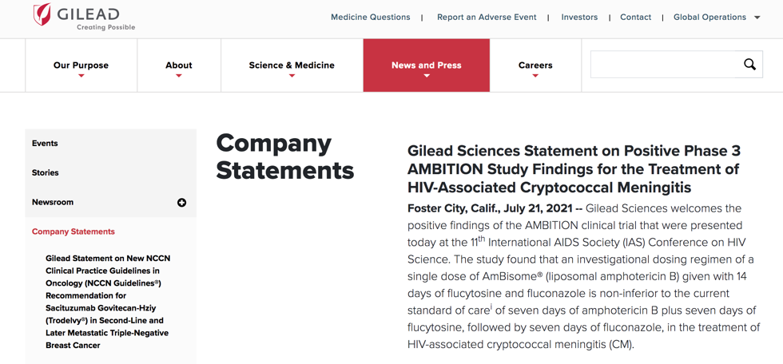
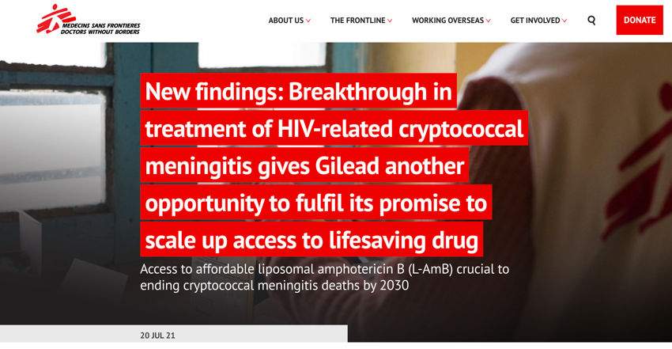

Slide 20
What next for the treatment of cryptococcal meningitis?
Implement findings from the AMBITION-cm trial
Further reduce mortality in patients with cryptococcal meningitis
Prevent cryptococcal meningitis in patients with advanced HIV disease
Apply what we have learnt in cryptococcal meningitis to other HIV-associated fungal infections
Reduce the burden of advanced HIV-disease in mature ART programmes
Notes:
This was the largest cryptococcal meningitis trial conducted to date and has demonstrated that single, high-dose AmBisome given with flucytosine and fluconazole was non-inferior to the current WHO recommended standard of care in averting all-cause mortality at 10 weeks. The AmBisome regimen effectively cleared cryptococcus from the CSF and was associated with a significant reduction in adverse events. This regimen offers a practical, easier-to-administer and better tolerated treatment for HIV-associated cryptococcal meningitis in Africa with the potential to reduce the length of hospital admissions. We are currently completing the cost-effectiveness analysis of the study which we hope will provide additional evidence to support widespread implementation of this regimen and highlight further the urgent need to broaden access to AmBisome and flucytosine.

Slide 21
What next for the treatment of cryptococcal meningitis?
Implement findings from the AMBITION-cm trial
Health economic analysis
Qualitative work exploring acceptability and feasibility of the single-dose regimen (Dr David Lawrence)
CDC collaborative award awarded under CK21-2106 Global Fungal Disease Surveillance and Capacity. : Implementing Short-course Treatment Regimens for HIV-associated Cryptococcal Meningitis in sub-Saharan Africa (5 years, starting September 2021)
NIHR Global Health Group on HIV-associated fungal infections (4 years, starting August 2022)
Notes:
This was the largest cryptococcal meningitis trial conducted to date and has demonstrated that single, high-dose AmBisome given with flucytosine and fluconazole was non-inferior to the current WHO recommended standard of care in averting all-cause mortality at 10 weeks. The AmBisome regimen effectively cleared cryptococcus from the CSF and was associated with a significant reduction in adverse events. This regimen offers a practical, easier-to-administer and better tolerated treatment for HIV-associated cryptococcal meningitis in Africa with the potential to reduce the length of hospital admissions. We are currently completing the cost-effectiveness analysis of the study which we hope will provide additional evidence to support widespread implementation of this regimen and highlight further the urgent need to broaden access to AmBisome and flucytosine.

Slide 24

Global Health Research Group on HIV-associated Fungal Infections
Aim: to improve the diagnosis and treatment of HIV-associated fungal infections and ensure that these improvements are made widely available to the underserved populations most commonly affected to reduce the significant morbidity and mortality caused by these neglected diseases.
Six discrete work packages:
1. Implementation of novel short-course therapies for HIV-associated CM and talaromycosis.
2. Expanding screening, early diagnosis and treatment strategies for HIV-associated fungal infections.
3. Developing platforms for novel PCP diagnostics and treatments.
4. Economic evaluation of new interventions to reduce mortality from HIV-associated fungal infections.
5. Training and capacity strengthening to build expertise in HIV-associated fungal infections in Africa and Asia.
6. Patient and community engagement.

Slide 25

Guinea
DRC
Mozambique

Slide 26


What next for the treatment of cryptococcal meningitis?
Further reduce mortality in patients with cryptococcal meningitis
Identity and manage concurrent opportunistic infections (Dr Jayne Ellis, Wellcome PhD Fellow, Uganda)
Enhance understanding of immune response to cryptococcal infection to develop effective adjuvant therapies
Host transcriptomics (Dr James Scriven, UK, MRC CARP award)
T-cell immunology, HLA and NK typing (Kathy Fortunate Boyd, Zimbabwe, NIHR funded PhD)
Genome wide association study (Dr Ronan Doyle, UK, NIHR funded post doc)
Development of novel formulations od liposomal amphotericin and flucytosine (Dr Yiwei Tian, MRC DPFS Outline Application; DNDi through NIHR GHG)
Notes:
This was the largest cryptococcal meningitis trial conducted to date and has demonstrated that single, high-dose AmBisome given with flucytosine and fluconazole was non-inferior to the current WHO recommended standard of care in averting all-cause mortality at 10 weeks. The AmBisome regimen effectively cleared cryptococcus from the CSF and was associated with a significant reduction in adverse events. This regimen offers a practical, easier-to-administer and better tolerated treatment for HIV-associated cryptococcal meningitis in Africa with the potential to reduce the length of hospital admissions. We are currently completing the cost-effectiveness analysis of the study which we hope will provide additional evidence to support widespread implementation of this regimen and highlight further the urgent need to broaden access to AmBisome and flucytosine.

Slide 27
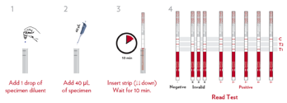
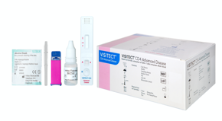


What next for the treatment of cryptococcal meningitis?
Prevent cryptococcal meningitis in patients with advanced HIV disease
Optimise cryptococcal antigen screen and treat strategies through:
Testing and implementing improved semi-quantitative cryptococcal antigen assays
Enhancing identification and management of advanced HIV disease with new point of care CD4 tests
Trialing combination treatments in patients with asymptomatic cryptococcal antigenaemia
Notes:
This was the largest cryptococcal meningitis trial conducted to date and has demonstrated that single, high-dose AmBisome given with flucytosine and fluconazole was non-inferior to the current WHO recommended standard of care in averting all-cause mortality at 10 weeks. The AmBisome regimen effectively cleared cryptococcus from the CSF and was associated with a significant reduction in adverse events. This regimen offers a practical, easier-to-administer and better tolerated treatment for HIV-associated cryptococcal meningitis in Africa with the potential to reduce the length of hospital admissions. We are currently completing the cost-effectiveness analysis of the study which we hope will provide additional evidence to support widespread implementation of this regimen and highlight further the urgent need to broaden access to AmBisome and flucytosine.

Slide 28
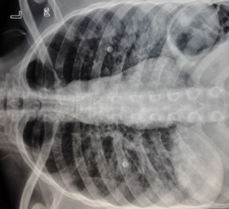
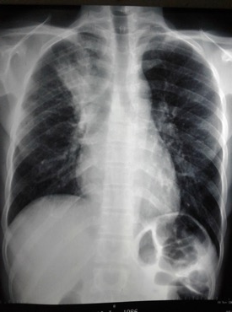
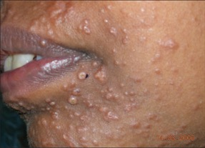
What next for the treatment of cryptococcal meningitis?
Apply what we have learnt in cryptococcal meningitis to other HIV-associated fungal infections
Emergomycosis
PCP
Talaromycosis
Histoplasmosis
Notes:
This was the largest cryptococcal meningitis trial conducted to date and has demonstrated that single, high-dose AmBisome given with flucytosine and fluconazole was non-inferior to the current WHO recommended standard of care in averting all-cause mortality at 10 weeks. The AmBisome regimen effectively cleared cryptococcus from the CSF and was associated with a significant reduction in adverse events. This regimen offers a practical, easier-to-administer and better tolerated treatment for HIV-associated cryptococcal meningitis in Africa with the potential to reduce the length of hospital admissions. We are currently completing the cost-effectiveness analysis of the study which we hope will provide additional evidence to support widespread implementation of this regimen and highlight further the urgent need to broaden access to AmBisome and flucytosine.

Slide 29
Conclusion
Single, high-dose AmBisome given with flucytosine and fluconazole was non-inferior to the current WHO recommended standard of care for HIV-associated cryptococcal meningitis.
The AmBisome regimen was associated with a significant reduction in adverse events including significantly lower rates of anaemia, a reduced need for blood transfusions and a significantly smaller increase in creatinine.
This regimen offers a practical, easier-to-administer and better tolerated treatment for HIV-associated cryptococcal meningitis in Africa.
There is an urgent need to broaden access to AmBisome and flucytosine.
Notes:
This was the largest cryptococcal meningitis trial conducted to date and has demonstrated that single, high-dose AmBisome given with flucytosine and fluconazole was non-inferior to the current WHO recommended standard of care in averting all-cause mortality at 10 weeks. The AmBisome regimen effectively cleared cryptococcus from the CSF and was associated with a significant reduction in adverse events. This regimen offers a practical, easier-to-administer and better tolerated treatment for HIV-associated cryptococcal meningitis in Africa with the potential to reduce the length of hospital admissions. We are currently completing the cost-effectiveness analysis of the study which we hope will provide additional evidence to support widespread implementation of this regimen and highlight further the urgent need to broaden access to AmBisome and flucytosine.

