Slide 1


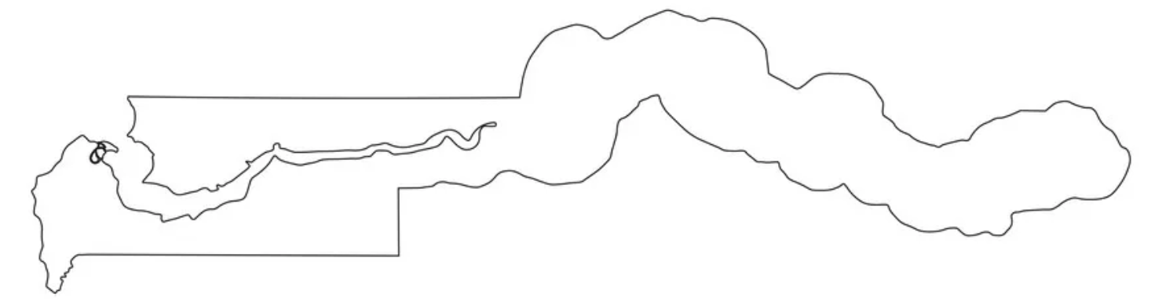
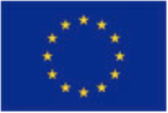
Personalised risk assessment in febrile illness to optimise real-life management
Diagnosis and management of febrile illness using RNA personalized molecular signature diagnosis
CADAMEM
Childhood acute respiratory tract infections, diarrhoea and malaria – epidemiology and management
Dr Effua Usuf, DIAMONDS Site PI, The Gambia
Wellcome Trust – Bloomsbury Centre for Global Health Research Scientific Meeting, March 2022
MRC Gambia @ LSHTM

Slide 2
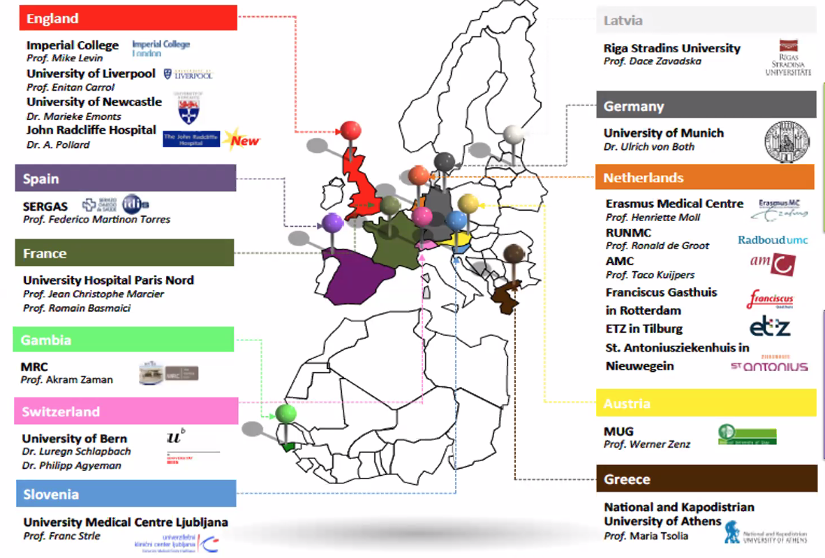
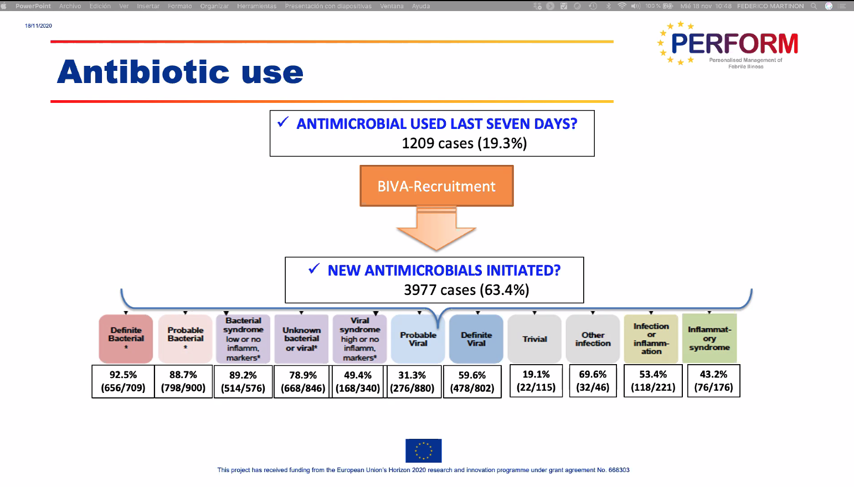
Key aims:
To improve diagnosis and management of febrile patients, by application of ‘omics’ approaches to multinational cohorts
To identify, validate and evaluate new discriminators of bacterial and viral infection

Slide 3

MRC-Gambia@LSTHM:
Two key PERFROM site studies
CADAMEM
-Gambia
Recruitment of 500 febrile children
(>1month 18years) from outpatients
Dec 2016-2019
Retrospective routine clinical data from >350,000 outpatient visits (<5yrs) at six sites, 2009-2018
Clinical phenotype analyses
Aetiology (MicroPathology Ltd)
  Cultures, Luminex respiratory panel
Paxgene samples for RNA transcriptomics
  Validation of prior signatures
  Diagnostic development (bacterial vs. viral)
Clinical phenotypes
Management of key clinical syndromes inc. antibiotics, ORS, zinc
Use of the malaria RDT
Trends over 10 years, since introduction of pneumococcal and rotavirus vaccines, and routine RDT use

Slide 4
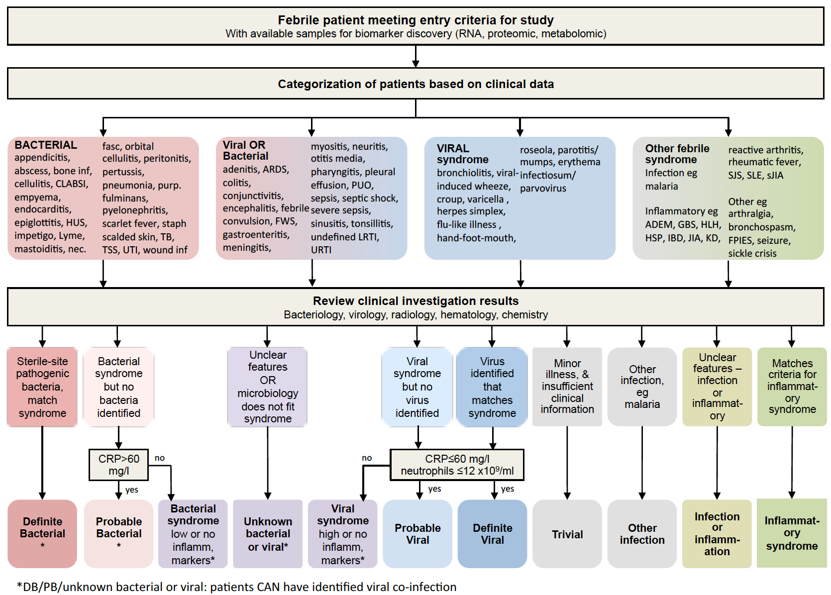
Strength of PERFORM:
Systematic and detailed phenotyping of patients on spectrum of ‘definite bacterial’ to ‘definite viral’ infection; using aetiology work up and CRP.
Allows key biomarker work:
Protein biomarkers
RNA signatures
Diagnostic development and external validation of prior biomarkers
Notes:
‘Unique gold standard patient phenotyping to establish biomarker discovery and validation cohorts’

Slide 5
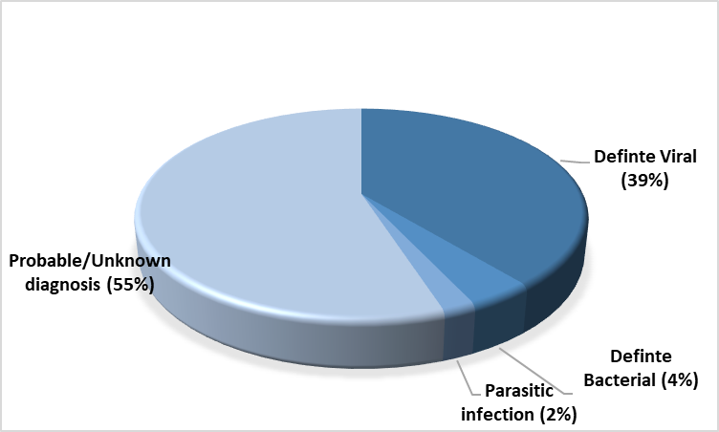
The Gambia site results
Low blood culture positivity: 12/501 (2.4%)
Low malaria (RDT) positivity: 11/460 (2.4%)
Urine culture positivity 17/141 (12.1%)
High proportion with respiratory viruses (68%)
77 (15.6%) clinically diagnosed with pneumonia;13 (2.6%) with undefined LRTI
55% undifferentiated
High frequency of antibiotic prescriptions (79.4%)
Characteristics | N(%)
Age (years)
<2 | 163(32.5)
2-4 | 190(37.9)
≥ 5 | 148(29.5%)
Female | 237(47.3%)
Weight (kg) Median (IQR) | 12.3(9.7-16.25)
Admitted | 22(4.4%)

Slide 6
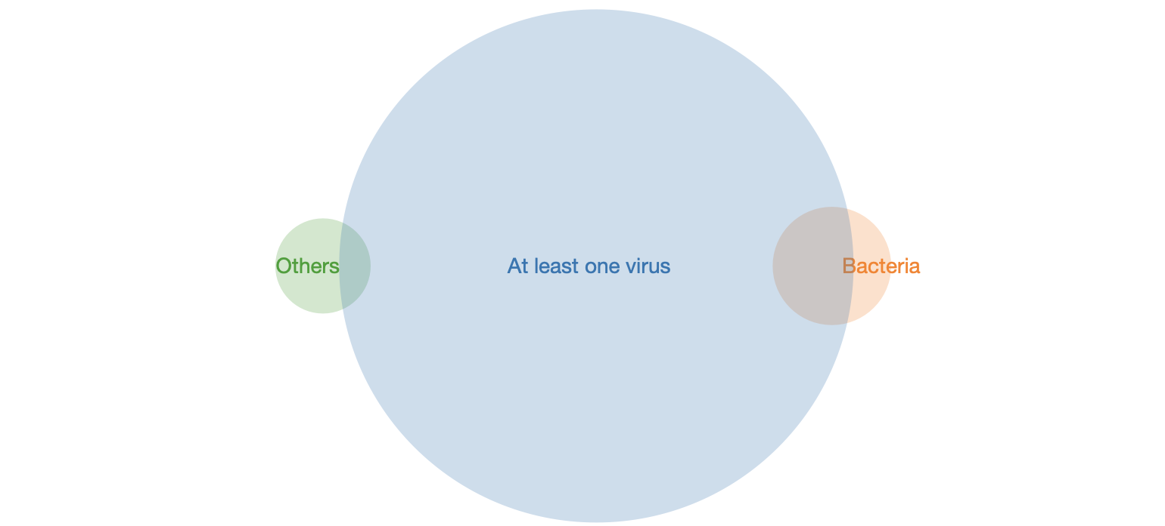
PERFORM: Co-infections
PATHOGENS DETECTED AMONG FEBRILE CHILDREN PRESENTING TO OUTPATIENT DEPARTMENT IN URBAN GAMBIA
Authors: Effua Usuf¹, Marie Voice², Fatou Secka³, Isatou Sarr¹, M.A. Zaman³, Kalifa Bojang¹, Anna Roca¹ and the PERFORM Consortium
¹ MRC Unit The Gambia at the London School of Hygiene & Tropical Medicine ² Micropathology, University of Warwick ³ Liverpool School of Tropical Medicine
Urine:
Coliform spp; E.Coli
Blood: Salmonella spp*,
S. Pneumoniae, Acinetobacter, E.Cloacae, proteus spp, P.aeruginosa, S. matophila, bacillus
Coagulase -ve staph, micrococcus(4)
*& stool
Blood: Malaria
Stool: E. histolytica
At least one virus
Pharyngeal swab:
Influenza A, Influenza B, RSV, Adenovirus, Parainfluenza virus,
Blood: HIV (2)

Slide 7
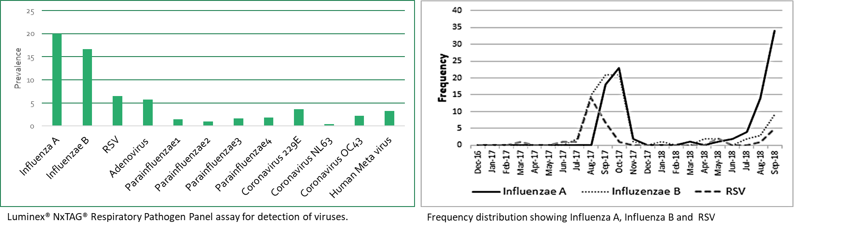
PERFORM: Viral infections

Slide 8
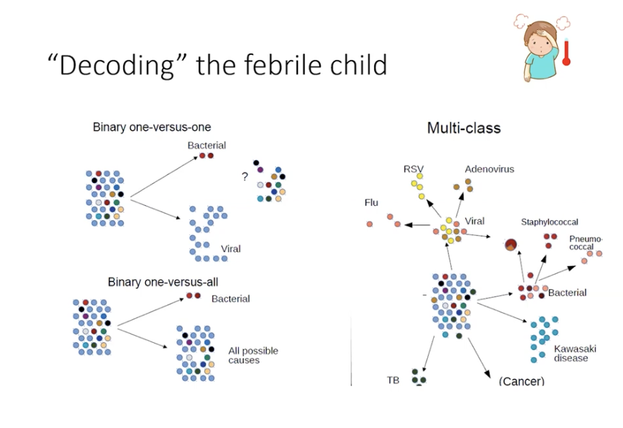
Key aims:
To establish a transcriptomic library of RNA data to establish a novel taxonomy of infections and inflammatory disease
To identify a minimal transcript signature for a Personalised Molecular Signature Diagnosis (PMSD) diagnostic
Notes:
From a binary bacterial-viral approach to developing a multi-class signature

Slide 9
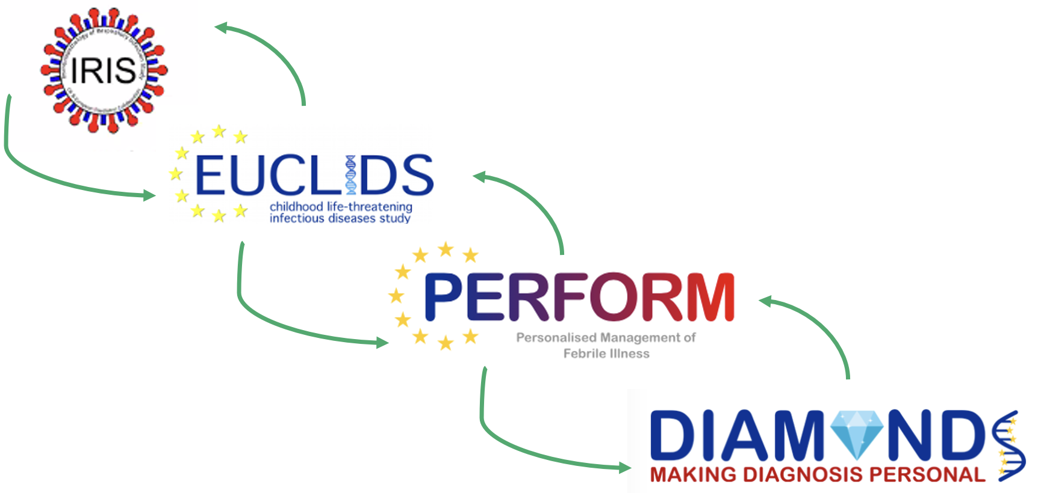
Recruitment in the Gambia
150 febrile adults are being recruited from outpatients
Similar aetiological work up to PERFORM
Same clinical phenotyping process
Adding the only African cohort to the IRIS-EUCLIDS-PERFORM-DIAMONDS combined transcriptomic library

Slide 10
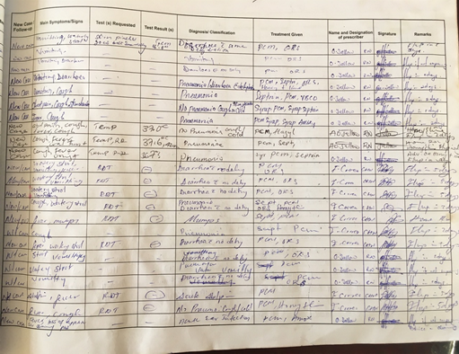
CADAMEM: childhood acute respiratory tract
infections, diarrhoea and malaria – epidemiology and management
Key questions
Of all outpatient presentations, what proportions of children <5 presented with respiratory tract infections, undifferentiated fever and malaria, and diarrhoea over 10 years (2009-2018)?
What are the trends in the use and documentation of RDT results, and administration of antimicrobials?
Is routine outpatient diagnosis management data suitable and useful for these and future analyses (e.g. evaluation of IMCI guidelines)

Slide 11
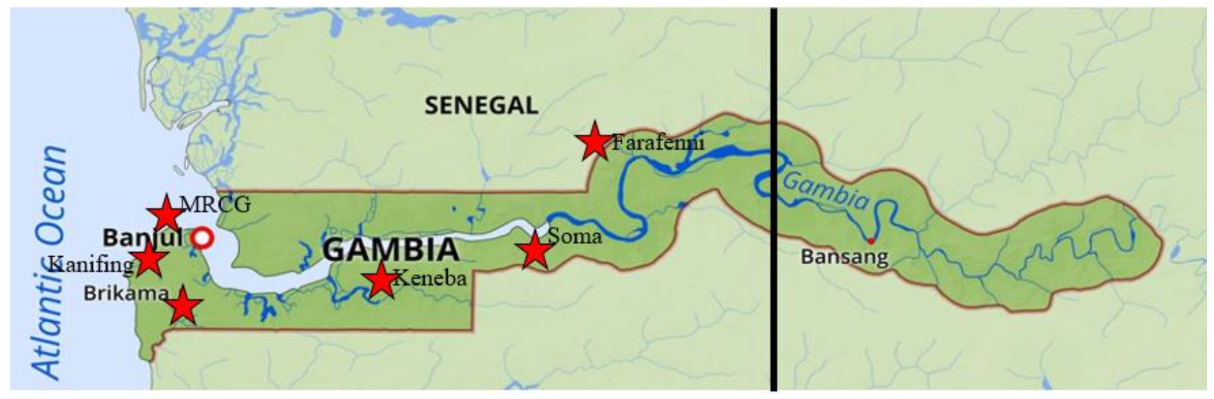
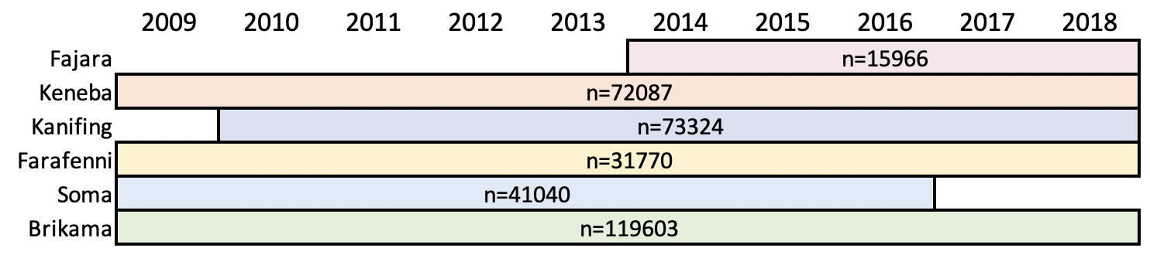
CADAMEM – >350,000 outpatient presentations (all) <5 years

Slide 12
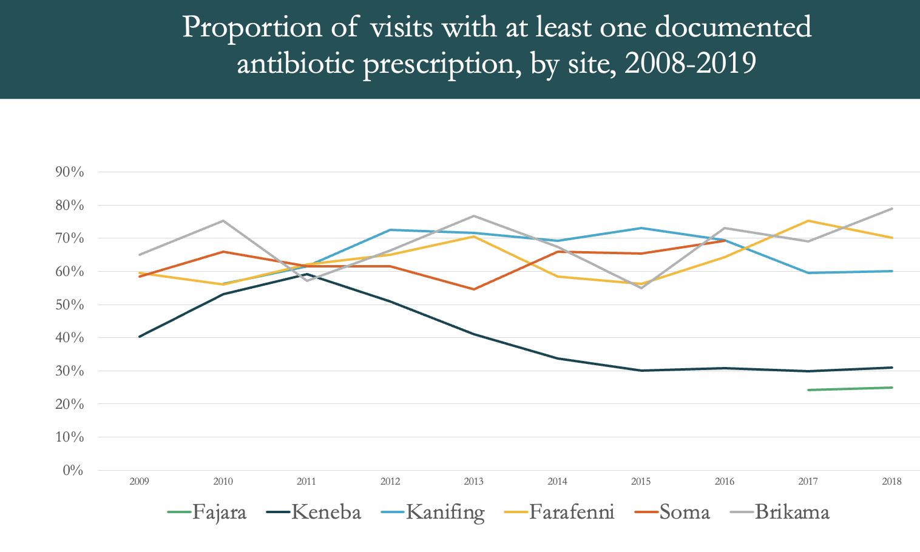

Slide 13
PERFORM team: MRCG@LSHTM

Slide 14


