Slide 1
Understanding Gram-negative infections and antimicrobial resistance in Zimbabwe
Ioana Olaru
Clinical Research Department
Faculty of Tropical & Infectious Diseases
Biomedical Research and Training Institute

Slide 2
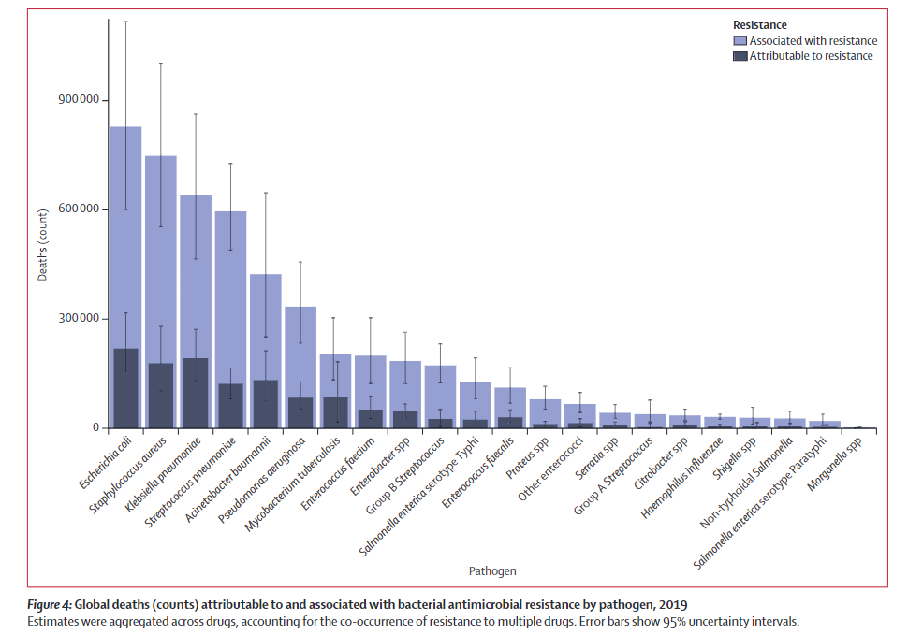
Global burden of bacterial AMR
↓
mortality
Murray et al. Lancet 2022

Slide 3
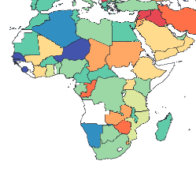
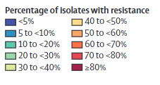
3rd gen. cephalosporin-resistant E. coli
RAW DATA
MODELLED ESTIMATES
How to get representative data?
Murray et al. Lancet 2022

Slide 4
Current challenges
High number of deaths related to AMR
Understanding of populations at risk
Access to diagnostics and treatment
Guidelines informed by local prevalence data
Representative data
Studies from LMICs
Improve access to testing
Tests that can be used in lower level laboratories

Slide 5
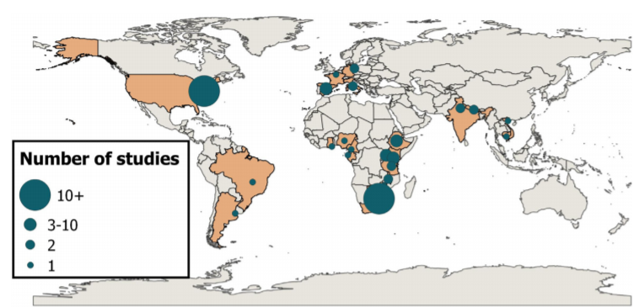
AMR in people with HIV
Olaru et al. Clin Microbiol Infect, 2021

Slide 6
AMR in people with HIV
Penicillin non-susceptibility in Streptococcus pneumoniae
22 studies
Methicillin resistance in Staphylococcus aureus
43 studies
Cephalosporin resistance in Enterobacterales
8 studies (4/8 carriage)
Olaru et al. Clin Microbiol Infect, 2021

Slide 7
Antimicrobial Resistance in Gram-negative bacteria from Urinary Specimens (ARGUS)
Notes:
Ioana Diana Olaru1, Nicholas Feasey2, Rashida A. Ferrand1, Janice A. Martin3, David
Mabey1, Heidi Hopkins1, Sekesai Mtapuri-Zinyowera4, Prosper Chonzi5, Katharina Kranzer

Slide 8
ARGUS study sites
Adults with symptoms of urinary tract infections at primary clinics in Harare
10 primary care clinics
Recruitment between June 2018 and July 2020
1 urine sample collected for culture

Slide 9
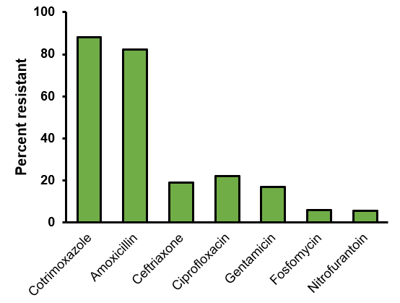
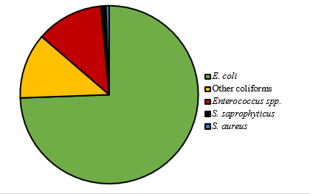
Prevalence of AMR
1164 participants recruited
64% female
15% pregnant women
36% HIV+
337 (29%) positive urine cultures
Recommended for treatment in Zimbabwean guidelines:
amoxicillin and fluoroquinolones

Slide 10
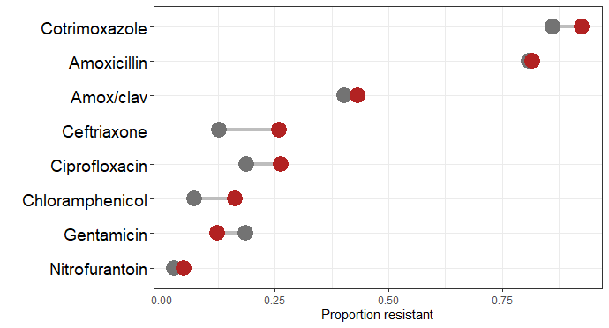
Resistance and HIV
Ceftriaxone resistance
26% in people living with HIV vs. 13% in HIV –ve individuals
aOR 2.13 (95%CI 1.1-4.3)

Slide 11
Alternative culture media
Evaluated tests: InTray COLOREX Screen and ESBL & Compact Dry
Chormogenic pre-prepared media
Shelf life of 6-18 months
Compact Dry: stored at room temperature
Intray COLOREX Screen & Compact Dry: bacterial identification based on the colony colour
Intray COLOREX ESBL: bacterial identification + detection of resistance to third generation cephalosporins

Slide 12
Alternative culture media
Brilliance UTI agar (reference)
Urine samples from 414 participants tested in parallel with the 3 systems
 | Sensitivity (95% CI) | Specificity (95% CI)
InTray Screen | 89 (82-96) | 98 (97-100)
Compact Dry | 95 (91-100) | 100 (99-100)
InTray COLOREX Screen
ESBL detection
Reduced time to resistance detection to 1 day (or less)
Sensitivity 96%
Specificity 100%
Compact Dry EC
Olaru et al. Eur J Clin Microbiol Infect Dis, 2021

Slide 13
Neonatal sepsis
Patients: 216 neonates with suspected sepsis
Site: Harare Central Hospital
Study duration: February 2020 – July 2020
recruitment interrupted by COVID-19 lockdown
Chimhini et al Pediatr Infect Dis J 2021

Slide 14
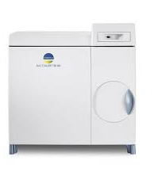
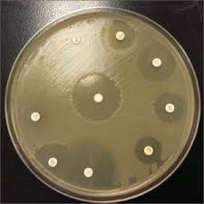
Neonatal sepsis
NOVEL METHOD
Automated incubation
Inoculation on InTrays (Screen & ESBL)
Reading after 24h incubation at 37°C
(early reading at 6-7h)
Blood culture
Turnaround time ~30-48h
Positive
Turnaround time ~72h
Gram stain
Identification of GNB by API 20E
Inoculation on conventional media*
216 neonates
56 postive blood cultures
54 positive with K. pneumoniae all with resistance to ceftriaxone
Conventional AST by disc diffusion
REFERENCE METHOD
Chimhini et al Pediatr Infect Dis J 2021

Slide 15
Conclusions
High prevalence of resistance to drugs recommended by the guidelines
AMR for E. coli higher among patients with HIV
Alternative culture media can be used to expand diagnostics
Facilitate diagnostics in lower level laboratories
Decrease turnaround times

Slide 16
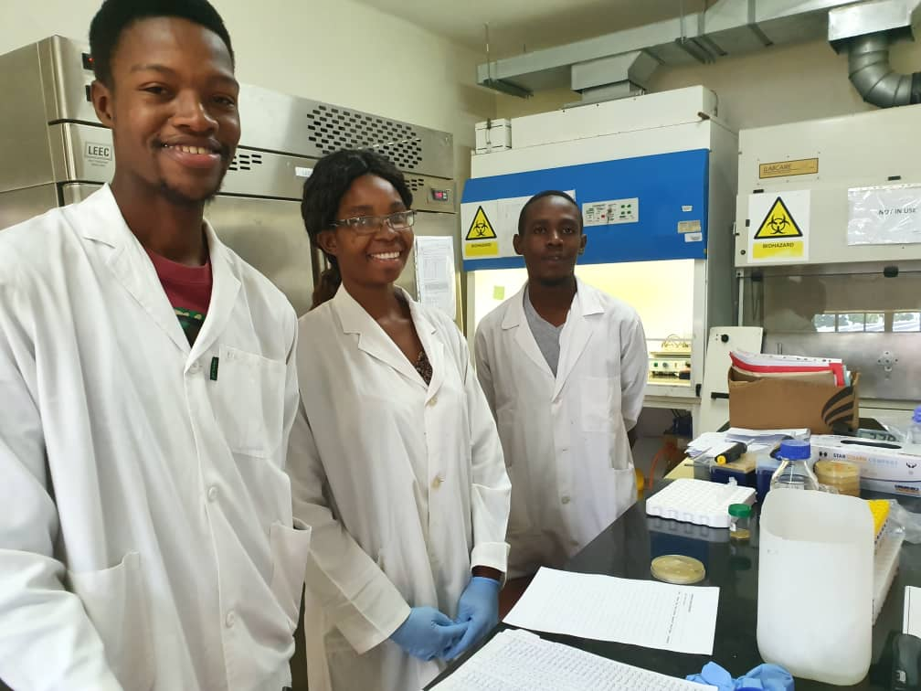
Acknowledgements
PhD Supervisors
Katharina Kranzer
Shunmay Yeung
Rashida Ferrand
LSHTM
David Mabey
Heidi Hopkins
Richard Stabler
BRTI
Forget Makoga
Mutsawashe Chisenga
Beauty Makamure
Rudo Chingono
Harare City Health
Prosper Chonzi
Kudzai Masunda
Doctors and nurses from the Polyclinics

