Slide 1
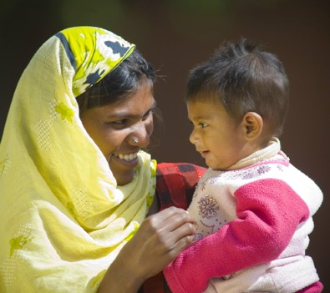
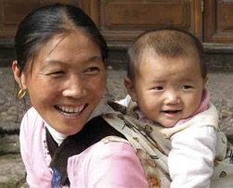
Improving neonatal surgical outcomes in low- and middle-income countries
Wellcome Trust Bloomsbury Centre for Global Health Meeting, March 2022
Naomi Wright, Paediatric Surgery Registrar & Clinical PhD Fellow in Global Health

Slide 2
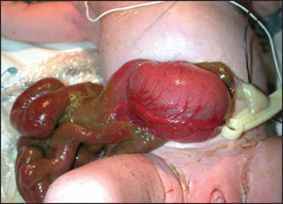
Outline
Global PaedSurg study results:
- mortality from gastrointestinal congenital
anomalies in low-, middle-, and high-income
countries, globally
- recommendations for improved neonatal surgical
outcomes
Gastroschisis Interventional Study
- improving survival in practice

Slide 3
Background
Global mortality in children < 5 years has fallen from 12.6 million in 1990 to 5.2 million today.
Global neonatal mortality has fallen at a slower rate from 4.7 million in 1990 to 2.4 million today.
Hence, 46% of under 5 deaths now occur in the neonatal period.
2015 Lancet Newborn Series was published, and Every Newborn Action Plans introduced into LMICs across the globe.
Surgical care for neonates not mentioned!

Slide 4
Background
Surgical mortality amongst neonates in LMICs has been estimated at around 18-42%
This compares to a 1-4% surgical mortality in older children (>1 year) and adults
However, neonates have yet to be a major focus of global surgery efforts either
= surgical neonates are falling through the cracks

Slide 5
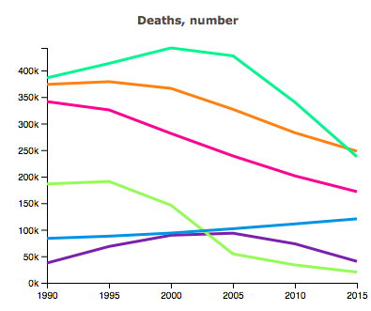
Background
Congenital anomalies:
= 5th leading cause of death in < 5s
= >1/2 million annual deaths
= 97% deaths are in LMICs
Increasing burden
Gastrointestinal congenital anomalies are often fatal without emergency neonatal surgical care
= likely contribute a large proportion
of the mortality
GBD, IHME data: www.healthdata.org

Slide 6
Aim
To compare management and outcomes from
gastrointestinal congenital anomalies
in low-, middle-, and high-income countries, globally.
Notes:
Hence, we aimed to collect prospective data and compare the outcomes of a selection of common gastrointestinal congenital anomalies between low-, middle-, and high-income countries globally.
We decided to focus on gastrointestinal congenital anomalies because they are a particularly understudied group and most are fatal in the neonatal period without access to emergency neonatal surgical care.

Slide 7
Methodology
Prospective data collection on seven congenital anomalies:
1) Oesophageal atresia
2) Congenital diaphragmatic hernia
3) Intestinal atresia
4) Gastroschisis
5) Exomphalos
6) Anorectal malformation
7) Hirschsprung’s disease
Over a minimum 1-month period, Oct 2018 – April 2019
Primary outcome: all-cause, in-hospital mortality
Statistics: multivariable penalised regression analysis (risk ratio, 95% CIs)
Notes:
The seven conditions included in the study were oesophageal atresia, congenital diaphragmatic hernia, intestinal atresia, gastroschisis, exomphalos, anorectal malformation and Hirschsprung’s disease – a collection of the commonest gastrointestinal congenital anomalies.
Data was collected by children’s surgical teams providing surgical care for these conditions in hospitals across the globe over a minimum of 1 month between Oct 2018 and April 2019.
The primary outcome was all-cause in-hospital mortality.
We used multilevel multivariable analysis to identify factors associated with mortality.

Slide 8
Methodology
1374 Collaborators, 264 hospitals, 74 countries, 12 languages
3849 patients
Notes:
In total, over 1300 collaborators from 264 hospitals, in 74 countries contributed data in 12 languages from across the globe on 3849 patients.

Slide 9
Outcomes
 | MORTALITY
 | High-income countries | Middle-income countries | Low-income countries
Gastroschisis (n=453) | 1.4% | 31.9% | 90.0%
Oesophageal atresia (n=560) | 7.2% | 29.4% | 85.7%
CDH (n=448) | 14.2% | 38.5% | n/a
Intestinal atresia (n=681) | 3.3% | 21.4% | 60.0%
Anorectal malformation (n=991) | 1.7% | 12.1% | 20.0%
Hirschsprung’s Disease (n=517) | 1.9% | 6.6% | 11.8%
Exomphalos (n= 325) | 17.1% | 20.3% | 28.6%
P<0.05
Notes:
We identified significant differences in mortality for all the study conditions between low, middle and high-income countries.
Gastroschisis had the highest disparity in mortality at 1% in high income countries, compared to 90% in low income countries and 32% in middle income countries.

Slide 10
Outcomes
 | MORTALITY
 | High-income countries | Middle-income countries | Low-income countries
Gastroschisis (n=453) | 1.4% | 31.9% | 90.0%
Oesophageal atresia (n=560) | 7.2% | 29.4% | 85.7%
CDH (n=448) | 14.2% | 38.5% | n/a
Intestinal atresia (n=681) | 3.3% | 21.4% | 60.0%
Anorectal malformation (n=991) | 1.7% | 12.1% | 20.0%
Hirschsprung’s Disease (n=517) | 1.9% | 6.6% | 11.8%
Exomphalos (n= 325) | 17.1% | 20.3% | 28.6%
P<0.05
Notes:
Followed by oesophageal atresia.

Slide 11
Outcomes
 | MORTALITY
 | High-income countries | Middle-income countries | Low-income countries
Gastroschisis (n=453) | 1.4% | 31.9% | 90.0%
Oesophageal atresia (n=560) | 7.2% | 29.4% | 85.7%
CDH (n=448) | 14.2% | 38.5% | n/a
Intestinal atresia (n=681) | 3.3% | 21.4% | 60.0%
Anorectal malformation (n=991) | 1.7% | 12.1% | 20.0%
Hirschsprung’s Disease (n=517) | 1.9% | 6.6% | 11.8%
Exomphalos (n= 325) | 17.1% | 20.3% | 28.6%
P<0.05
Notes:
Congenital diaphragmatic hernia

Slide 12
Outcomes
 | MORTALITY
 | High-income countries | Middle-income countries | Low-income countries
Gastroschisis (n=453) | 1.4% | 31.9% | 90.0%
Oesophageal atresia (n=560) | 7.2% | 29.4% | 85.7%
CDH (n=448) | 14.2% | 38.5% | n/a
Intestinal atresia (n=681) | 3.3% | 21.4% | 60.0%
Anorectal malformation (n=991) | 1.7% | 12.1% | 20.0%
Hirschsprung’s Disease (n=517) | 1.9% | 6.6% | 11.8%
Exomphalos (n= 325) | 17.1% | 20.3% | 28.6%
P<0.05
Notes:
And intestinal atresia.

Slide 13
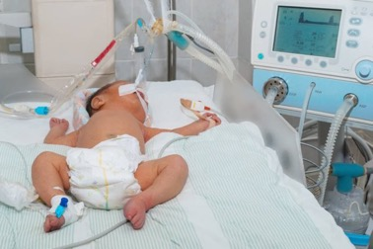
Factors associated with higher mortality
Country income category:
LIC vs HIC, 2.78 (1.88-4.11), MIC vs HIC, 2.11 (1.59-2.79)
Sepsis at presentation: 1.20 (1.04-1.40)
ASA score: 4-5, 1.82 (1.4-2.35) or 3, 1.58 (1.30-1.92) vs 1-2
No surgical safety checklist: 1.39 (1.02-1.90)
No physician anaesthetist: 1.57 (1.05-2.34)
Ventilation needed but unavailable: 1.96 (1.41-2.71)
Parenteral nutrition needed but unavailable: 1.35 (1.05-1.74)
Notes:
We identified many factors significantly associated with mortality – a summary of which is presented here.
Low and middle income country status were the factors associated with highest risk of mortality.
The other factors can be considered in terms of 3 key time points – at presentation, at surgical intervention, and in the perioperative period.
Higher mortality was associated with sepsis at presentation (hence poorer clinical condition on arrival)
Similarly, being sicker i.e. having a higher ASA score at the time of primary surgical intervention was associated with a higher mortality. As did not using a surgical safety checklist and not having a physician anaesthetist present at the primary intervention.
During the perioperative period, not having neonatal ventilation and parenteral nutrition available when needed increased mortality.

Slide 14
Factors associated with lower mortality
Receiving parenteral nutrition: 0.61 (0.47-0.79)
Use of a PICC line (peripherally inserted central catheter): 0.65 (0.5-0.86)
Use of a percutaneous central line: 0.69 (0.48-1.00)
Notes:
Indeed, receiving parenteral nutrition, and a peripherally or percutaneously inserted central line were associated with lower mortality.

Slide 15
Conclusion
Unacceptable disparities in mortality exist for common gastrointestinal congenital anomalies between low, middle and high-income countries.
Sustainable Development Goal 3.2 to ‘end preventable deaths in neonates and children <5 by 2030’ is not achievable without urgent action.
Focus should be on:
Antenatal diagnosis and delivery at a paediatric surgery centre
Improving district level resuscitation and timely, safe transfer
Perioperative care at the tertiary level:
Surgical safety checklist, IV access, parenteral nutrition & ventilation
Notes:
In conclusion:
Unacceptable disparities in mortality exist for common gastrointestinal congenital anomalies between low, middle and high-income countries, globally.
Rapid action is required through a coalition of stakeholders to improve timely access to quality neonatal surgical care.
Action should focus on:
Improving antenatal diagnosis and delivery at a paediatric surgery centre to avoid clinical deterioration prior to arrival.
Improving recognition, stabilisation and early transfer of surgical neonates born in, or referred to, district hospitals.
And improving perioperative care at paediatric surgery centres, primarily through the provision of basic Neonatal Intensive Care Unit (NICU) resources including ventilation, peripheral or percutaneous central IV access and parenteral nutrition for neonates and use of a surgical safety checklist.

Slide 16
Local Action
Multi-disciplinary team meetings including the paediatric surgical teams, neonatal/paediatric teams and obstetric/ultrasonographer teams
Outreach teaching to referring hospitals
Discussion re setting up or improving
referral pathways and communication
between the paediatric surgery centre and
referring facilities
Notes:
To read and discuss as per the slide

Slide 17
National Action
Local multi-disciplinary team members can approach:
- Local MP/ government representative
- Regional health minister
- Minister of Health for the country
Incorporate into the National Health Plan (or National Surgical, Obstetric and Anaesthetic Plan if being developed)
Increase training numbers for paediatric surgery, paediatric anaesthesia, paediatric nursing and antenatal ultrasonographers
Share the study results in the local newspapers/press to raise awareness amongst the population
Notes:
To read and discuss as per the slide

Slide 18
International Action
Need to incorporate into WHO guidelines:
- Every Newborn Action Plans
- Newborn Care Guidelines
- Congenital anomaly registries
Need to include congenital anomalies within national and international population health surveys
Need to raise awareness amongst major global health funders
Need to incorporate into international organisation activities such as UNICEF
Need to develop an action plan within GICS Congenital Anomalies Working Group
Notes:
To read and discuss as per the slide

Slide 19
Gastroschisis Interventional Study
Wellcome Trust Clinical PhD in Global Health
Multi-Centre Clinical Interventional Study
7 hospitals:
Ghana, Zambia, Malawi, Tanzania
Aim:
Reduce mortality in neonates
born with gastroschisis

Slide 20
Methodology
2-year pre-post clinical interventional study
Prospective data collection 2018 – 2020
Implementation of a new interventional care bundle, May to December 2019
(4-weeks at each centre)

Slide 21
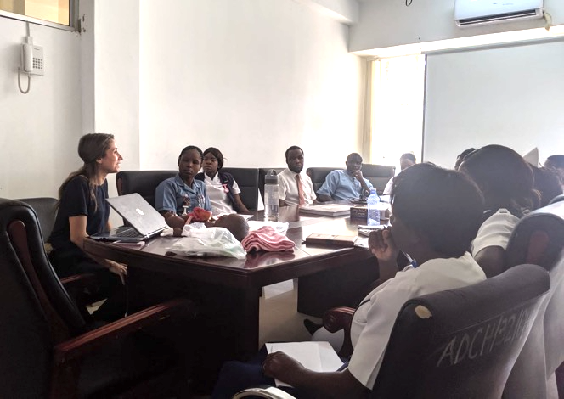
Evidence-Based Care Bundle
Core and adaptable components
Determined by evidence from a systematic review and qualitative study
AND
Local expertise/ team consensus

Slide 22
Interventional Bundle
Gastroschisis protocol for referring hospitals

Slide 23
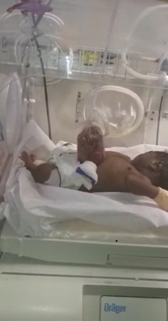
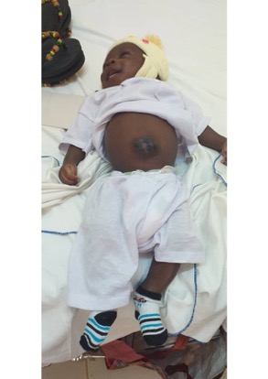
Interventional Bundle
2) Gastroschisis protocol at the tertiary centre
Early resuscitation, cotside reduction & closure, nutrition

Slide 24
Outcomes
All multi-disciplinary team members trained at the 7 study centres
26 Outreach Gastroschisis Training Days undertaken for referring district hospitals & health centres
= over 2000 healthcare professionals trained
Neonatal surgery referral pathways established
= increased no. of cases referred

Slide 25
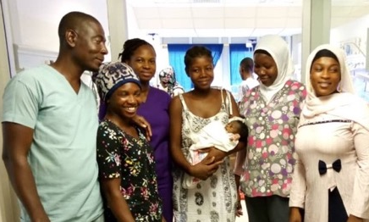
Outcomes
Baseline: 97% mortality (108/111)
Pre-intervention: 80% mortality (some interventions implemented during this phase by local teams)
Post-intervention: - 65% mortality
P=0.047
68 neonates with gastroschisis survived during the 2-year study
compared to 3 neonates in the 2-years prior to the study

Slide 26
Challenges
Lack of antenatal diagnosis - challenge for the future (unfeasible to tackle in this study)
Some improvement in referrals/ condition on arrival - need to keep spreading the word.
Referrals limited by transport availability
Sepsis within tertiary hospital

Slide 27
Sincerest Thank You
All team members in the Global PaedSurg Research Collaboration
and Gastroschisis Interventional Study
To the Wellcome Trust, Bloomsbury Centre for Global Health and all involved at King’s Centre for Global Health and Health Partnerships, King’s College London, London, UK
Notes:
Thank you very much to all members of the Global PaedSurg Research Collaboration, the funders and everyone involved.

Slide 28
References
Global PaedSurg website:
www.globalpaedsurg.com
Global PaedSurg published protocol:
https://bmjopen.bmj.com/content/bmjopen/9/8/e030452.full.pdf
Global PaedSurg published results in The Lancet:
https://authors.elsevier.com/sd/article/S0140-6736(21)00767-4
Gastroschisis Interventional Study Protocol, Wellcome Open:
https://wellcomeopenresearch.org/articles/4-46
Notes:
You can read more on the website. In the blog section there are videos on Gastroschisis Care in LMICs and other information/opportunities.
The study protocol is published in BMJ Open.
The main study results are published in The Lancet.

Slide 29
Thank you for listening
paedsurg.research@gmail.com
@GlobalPaedSurg #GlobalPaedSurg @PaedsSurgeon @GICSurgery @BAPS_IAC
www.globalpaedsurg.com
Notes:
Thank you for listening, any questions?

