Slide 1
Vaccine Confidence in Pregnant Women and Around COVID-19 in The Gambia
Penda Johm, PhD Candidate LSHTM
Wellcome Trust Scientific Meeting
14 March 2022

Slide 2

VACCINE CONFIDENCE
Trust in vaccines
Trust in vaccinators and/or vaccine providers
Trust in vaccine decision and policy makers
Larson, H.J., Schulz, W.S., Tucker, J.D. and Smith, D.M., 2015. Measuring vaccine confidence: introducing a global vaccine confidence index. PLoS currents, 7.
Notes:
Trust in the effectiveness and safety of vaccines and in the system that delivers them, including the reliability and competence of the health services and health professionals and having trust in the motivations of the policy makers who decide which vaccines are needed and when they are needed.
These trusting relationships are important because in accepting vaccination, the public relies on the integrity, competence, and good faith of public health and government authorities to recommend appropriate vaccines, of private-sector actors to manufacture effective and uncontaminated products, and of health providers to administer them safely. Trust fundamentally depends on perceptions of competence and motive.

Slide 3
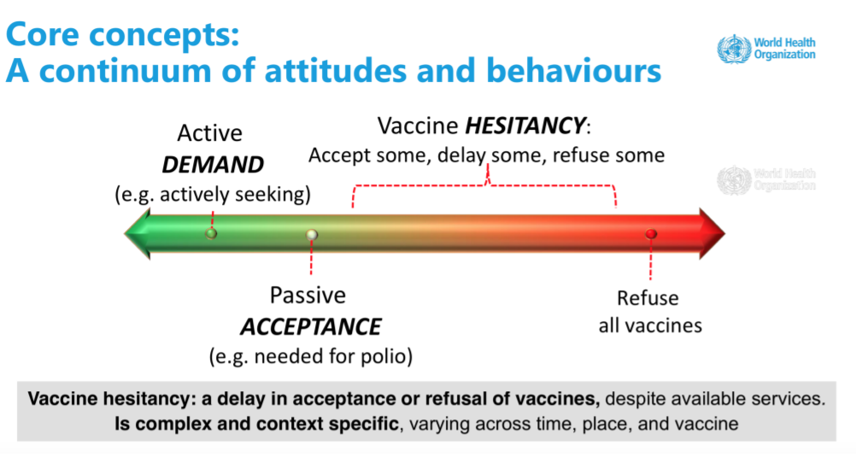
Notes:
Vaccine confidence falls within a continuum of attitudes and behaviours. In this continuum, confidence refers to trust in the effectiveness and safety of vaccines, the system that delivers them – including the reliability of the health professional – and/or the motivations of policymakers who make determinations about vaccines.
Within this range of total acceptance to complete refusal are vaccine hesitant individuals. Vaccine-hesitant individuals hold varying degrees of indecision, doubts, or concerns about specific vaccines or all vaccines. Some may take up all vaccines but remain concerned about them. Some may refuse or delay certain vaccines but not others. And others may refuse all vaccines outright.

Slide 4
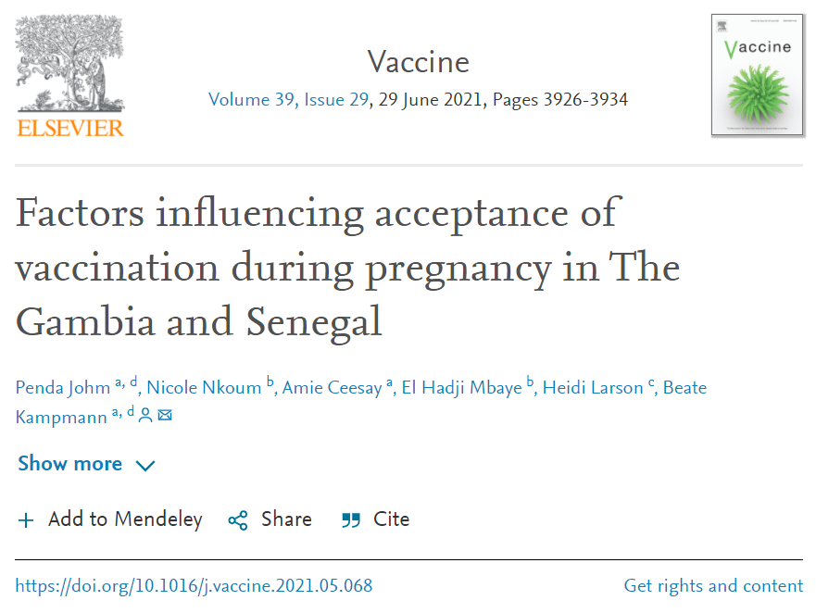
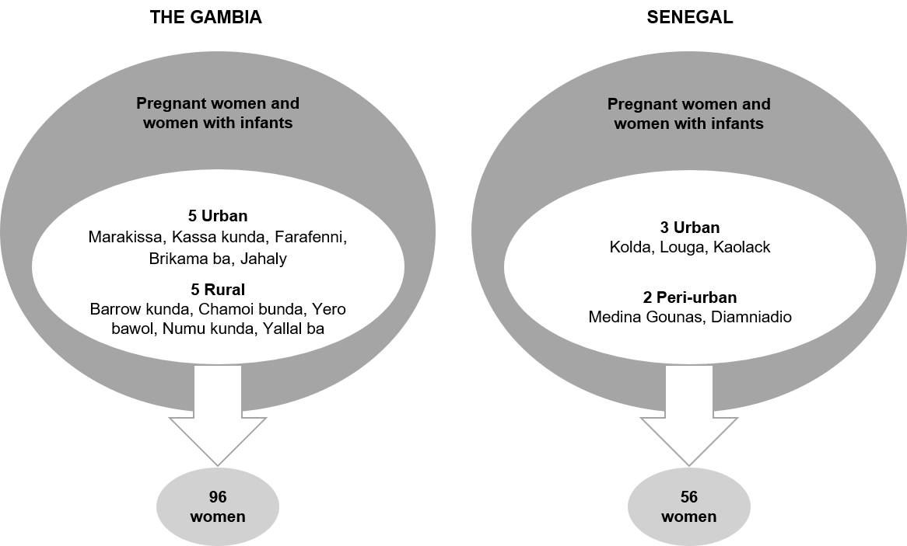

Slide 5
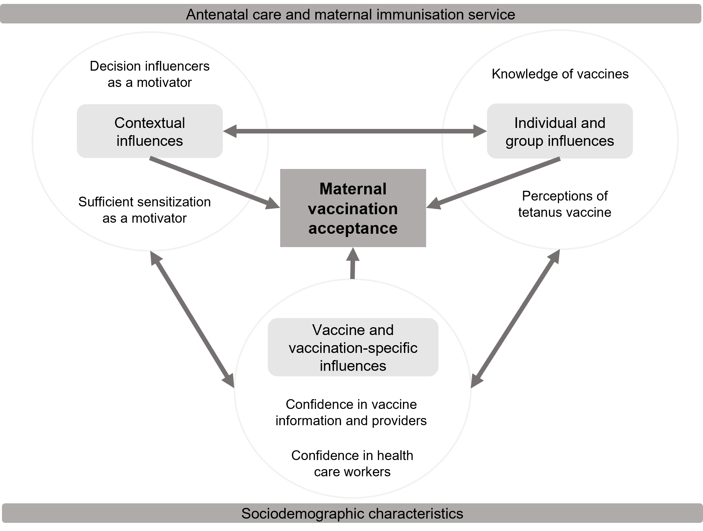

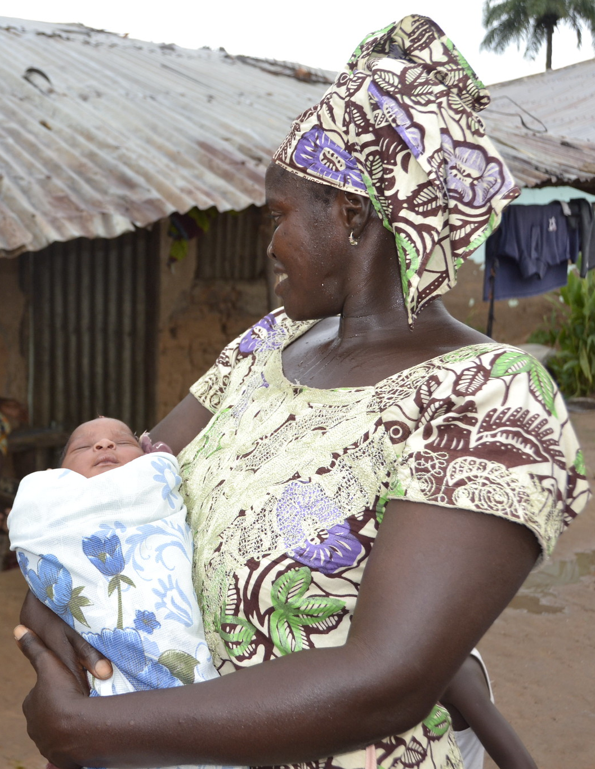
Notes:
Women had been encouraged by HCWs to attend ANC and receive all their required doses of TT during pregnancy to prevent them and their child from contracting tetanus. Perceived side effects such a dizziness, swollen arm and nausea were mentioned; however, they did not deter tetanus vaccine uptake.
During a FGD conducted in rural Gambia (Numu kunda), participants pointed out that a woman should always ask her husband for permission before going for ANC, which is where she receives maternal vaccines. This rule was said to be found in both their religion and tradition, wherein a married woman has limited autonomy as she belongs to her husband.

Slide 6
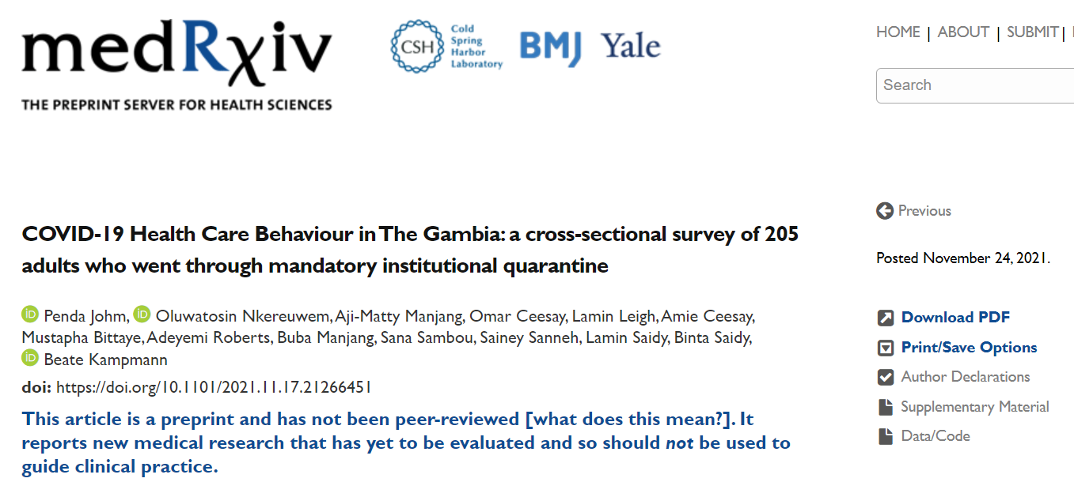

Slide 7

STUDY AIM AND OBJECTIVES
Explored the experiences of individuals in The Gambia who completed the government mandated institutional quarantine.
Knowledge and perceptions of COVID-19
COVID-19 Health Care Behaviour
COVID-19 Related Stigma
Perceptions of quarantine experience
Notes:
1) The initial questions probed our participants knowledge base
2) We assessed the way participants had sought health care for themselves before and during quarantine
3) Participants were asked questions about stigma regarding their experience before, during and after going into quarantine. Attitudes towards COVID-19 related stigma were measured using a Likert scale, wherein respondents rated their levels of agreement with different statements.
4) Participants were also asked to evaluate their quarantine experience

Slide 8
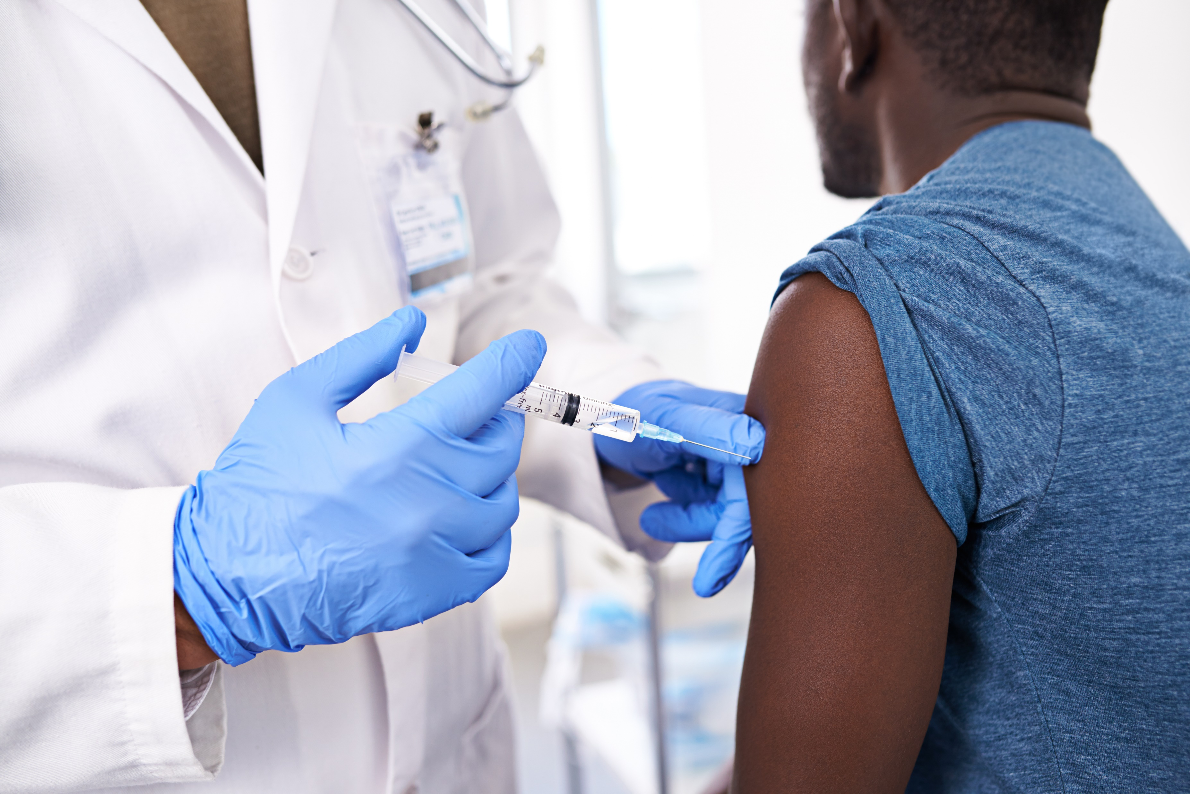

Slide 9
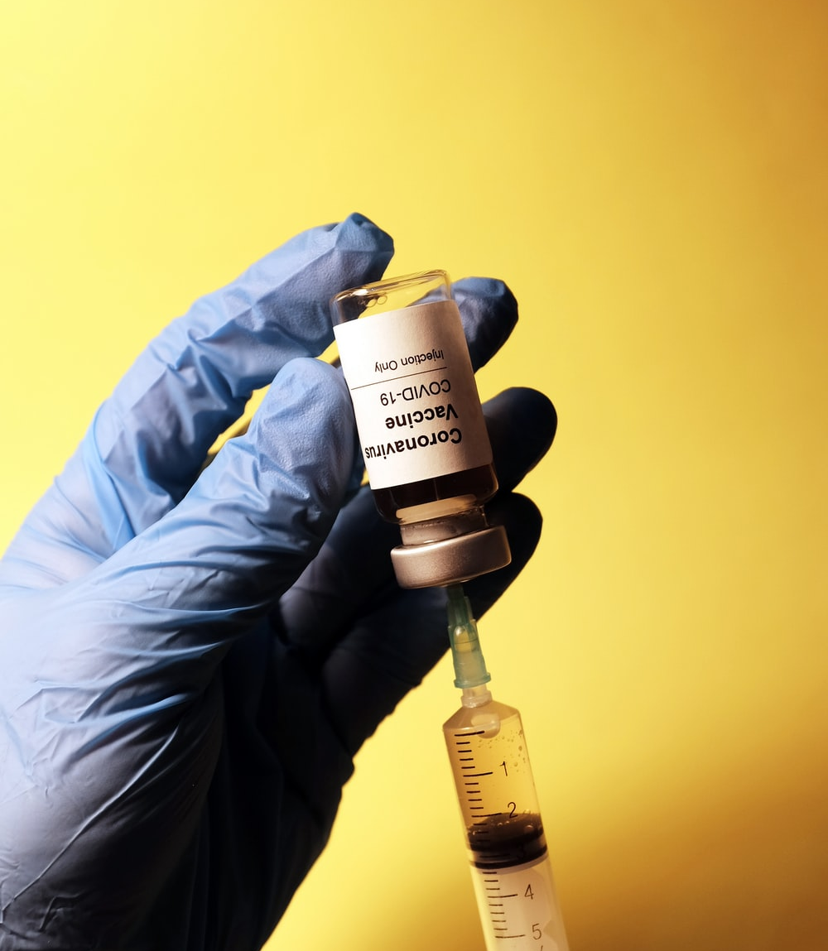
PARTICIPATION IN COVID-19 VACCINE TRIAL
“It is not safe for me, and there is
no consensus about the disease
and its vaccine prevention protocol.”
Efficacy concerns
Safety concerns
Healthy
Rumours
Sceptical
Risk perceptions
Preventive measures better
Fear of vaccination
Trust issues
Fear of vaccine trials
“Let them test it on themselves
first before me. I do not believe
or trust that the injection will not
infect me with the disease.”
Notes:
One of the key strengths of this study was carrying out interviews via mobile phone call guided by our REDCap questionnaire displayed on tablets. This method seemed most appropriate over traditional face-to-face interviewing due to the rise of new cases at the time and government COVID-19 preventive mandates such as social/physical distancing. Our chosen method ensured we generated rapid first-hand evidence and helped us save on travel costs. Another key strength of our study was conducting interviews soon after participants left quarantine to minimise their recall bias after changing environment.
It is important to note that our study population does not represent the diverse demographics of The Gambia and not every person who went through institutional quarantine was included. Most of our participants were Gambian males who were more likely to travel than women during the pandemic and therefore were more frequently identified for institutional quarantine. Secondly, our chosen method of phone call surveys reduced our opportunity to take note of participants’ nonverbal communication.

Slide 10



ACKNOWLEDGMENTS
Stakeholders, collaborators and sponsors
  The Gambia Ministry of Health (MoH)
  Study participants and communities
  Study funders, data collectors and supervisors
  MRCG@LSHTM support departments
    RSO, Data Management, Purchasing, Transport

