Slide 1



Impact of early KMC versus standard care on survival of mild-moderately unstable neonates <2000g in The Gambia: A RCT
Wellcome Trust Clinical PhD Programme Scientific Meeting
14th March 2022
Dr Helen Brotherton
Consultant Paediatrician/Neonatologist (NHS Fife)
Doctoral student, LSHTM (2016 – 2022)
Wellcome Trust Research Training Fellow (2016-2021)
Supervisors: Prof. Joy Lawn, Prof. Anna Roca, Prof. Simon Cousens
Credit: L Leeson. LSHTM

Slide 2
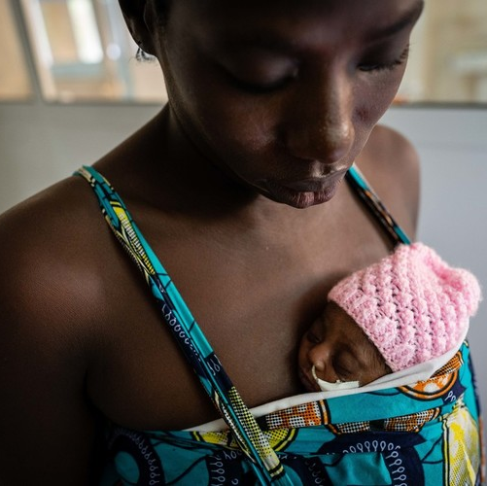
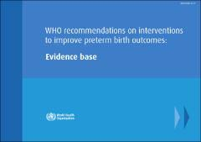
Kangaroo mother care:
Evidence gap prior to stability for vulnerable newborns
Outcomes at discharge or term corrected age:¹ | RR
Mortality (n=1736, 8 trials) | 0.60 95% CI 0.39-0.92
Nosocomial infection / sepsis (n=1463, 8 trials) | 0.35 95% CI 0.22-0.54
Hypothermia (N=989, 9 trials) | 0.28 95% CI 0.16-0.49
Exclusive breast feeding at discharge (n=1453, 6 trials) | 1.16 (95% CI 1.07 – 1.25
Credit: L Leeson. LSHTM
Notes:
Neonatal mortality remains unacceptably high and, of all the 2.5 million neonates who die every year, premature and low birth weight neonates are the most vulnerable with the highest mortality rates and greatest contribution to U5 nmortality rates
KMC is an evidence based package of care – consisting of skin to skin contact, exclusive breastfeeding, early hospital discharge and close follow up. There is strong evidence for use in unstable newborns <= 2 kg, with Cochrane review 2016 reporting 40% mortality reduction compared to standard care, but evidence gap exists for use before stabilisation has occurred, especially in first 24h after birth

Slide 3
PhD objectives and structure
Notes:
Investigating the clinical and survival effects of KMC prior to stability was the focus of my (recently defended) PhD thesis and today I will share the results of

Slide 4
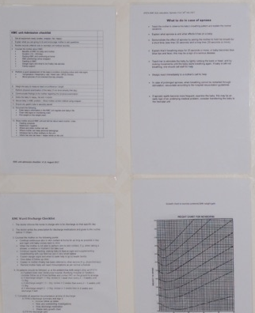
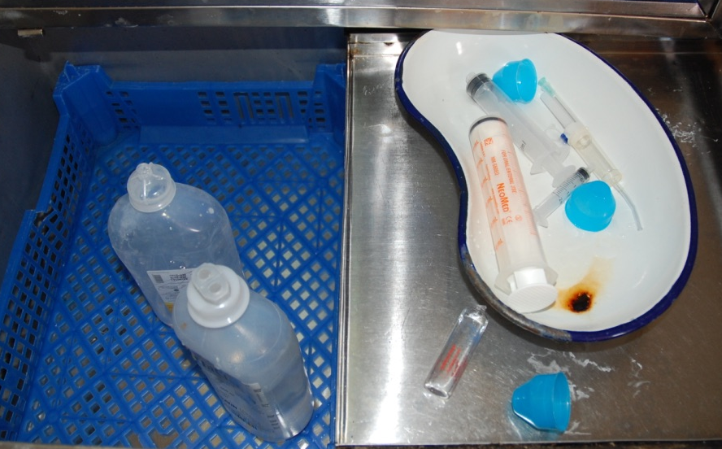


Extensive preparation of research site (EFSTH) for eKMC trial
Unblinded trial, risk of performance bias
Implementation of standardised SSNC guidelines
Known high HAI risk
Infections as 2ary outcome
NNU environmental surveillance & IPC surveys
Recommended care
Definition of intervention & control procedures
Continuous KMC established as standard care for stable neonates <2000g
Notes:
Just to note – prior to the start of the eKMC trial extensive preparation was needed to ensure
1 – The risk of performance bias was minimized as the trial was non-blinded and required co-developing and implementating standardized SSNC guidelines
2 – Environmental surveillance and IPC surveys to monitor changes to HAI risk during trial period
3 – implementation of the intervention, which involved setting up KMC as standard care for all neonates <2000g to be in line with WHO recommendations, then further implementation of KMC for unstable neonates by reconfiguring NNU to have a trial area, including adult beds and facilities for safe and respectful. This was done in collaboration and partnership with GG MoH, UNICEF The Gambia and EFSTH, the trial site

Slide 5
eKMC trial design & participants (May 2018 – Mar 2020)
Mild-moderately unstable neonates <2kg & <24h old
Individually randomised trial
Randomisation of mother (1:1)
  Stratified by neonatal wt (1.2kg)
Non-blinded
Objective 1ary outcome: Mortality at 28d
Efforts to avoid bias
Sample size = 392 (30% red. of 48% CFR)
Excluded if:
Triplet, Seizures, Major congenital defect, Jaundice
Stable, Severely unstable
No study bed or willing caregiver within 24h of screening
Brotherton et al, Trials, 2020
Notes:
Methods to prevent subversion of sequencing
Nature of intervention – unblinded to participants/families / HCW providing clinical care and research team

Slide 6
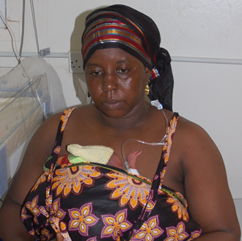
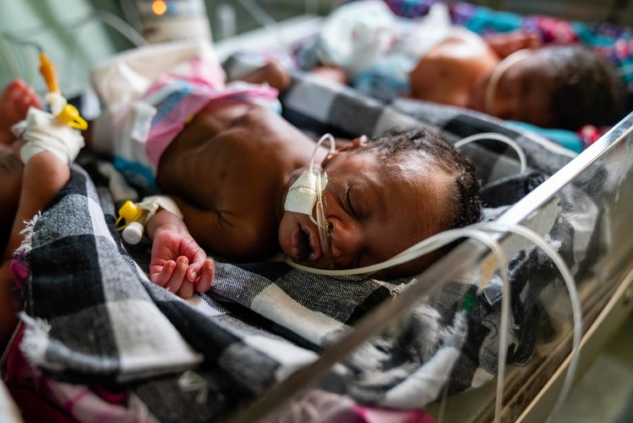
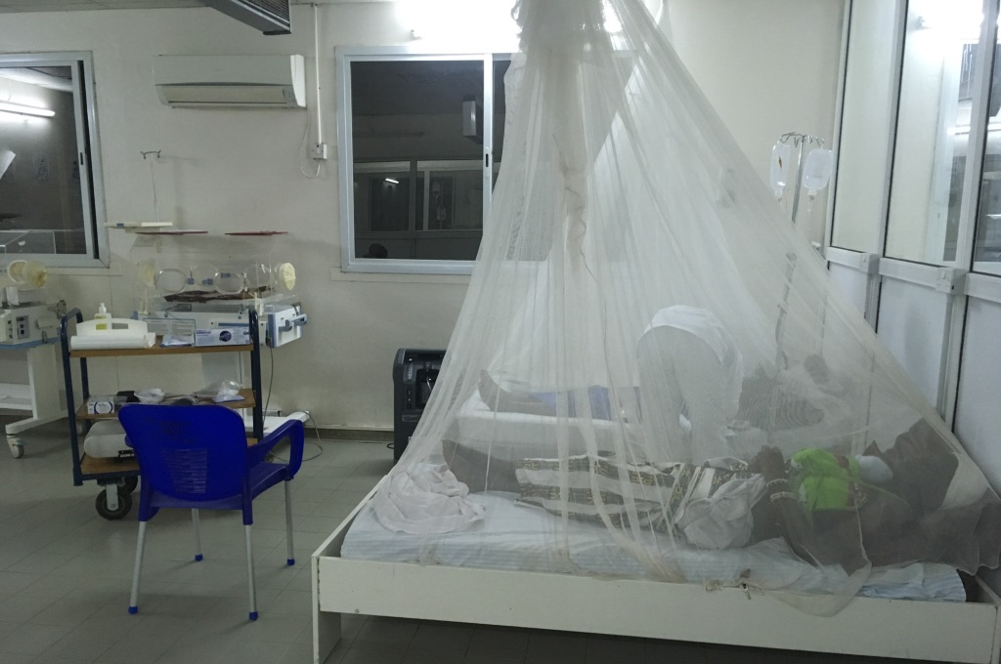
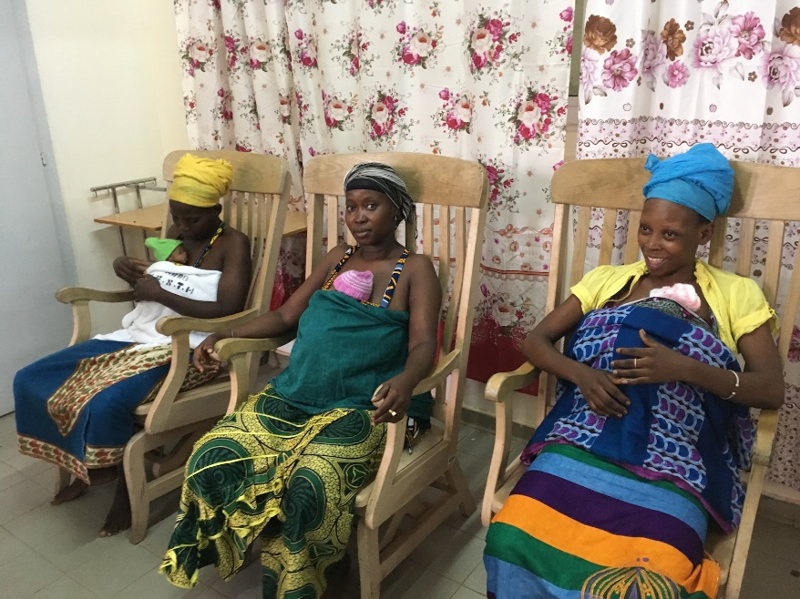
eKMC trial intervention & control procedures
Continuous skin-to-skin contact started <24h admission
Standard care + KMC >24h admission when stable
Brotherton et al, Trials, 2020
Notes:
The intervention was continuous skin-to-ckin contat started within 24h of admission, aiming for 18h/d, provided alongside other treatments (with the exception of bCPAP) and was provided on the NNU
Once stability criteria were met, baby was no longer needing IV fluids/oxygen, they were transferred to tge KMC unit to continue with continuous KMC as a stable newborn
Control arm – received care on radiant warmer or incubator until stability criteria were met and >24h of admission . Either started intermittent KMC on NNU or continuous KMC after transfer to KMC unit

Slide 7
eKMC trial screening, enrolment & follow-up
Brotherton et al, EClinicalMedicine, 2021
Notes:
So, we screened 1107 neonates < or equal to 2 kg and recruited 279. 75% of neonates could not be recruited, most commonly due to being severely unstable or dying during or before the screening process. This highlights the incredibly vulnerable condition of many of these newborns.
Another key barrier to recruitment was the lack of a caregiver (mother or other relative) who was available AND willing to do KMC, if required.
- Approx 140 were in each arm and we had excecllent FU rates with only 2 neonates LTFU at 28 days and no withdrawals

Slide 8
eKMC participants baseline characteristics
Baseline characteristics
Weight = 1436g / 1459g
Gest. Age = 32w / 33w
Twins = 32% / 30% (17% enrolled)
13h old at enrolment
Antibiotics (87% vs 91%)
Oxygen (89%)
IV fluids (89% vs 83%)
  2 btwn arm differences
  More intervention arm were stable
  More control arm had prophylaxis for apnea of prematurity
Brotherton et al, EClinicalMedicine, 2021
Notes:
Intervention and control groups had comparable baseline characteristics with the exception that more intervention arm were stable at baseline and differences in proportion who received prophylaxis for apnea of prematurity. Our participants had median 32 – 33 weeks gestation, around 1.4 kg birth weight and high rate of twins recruited (both born of multiple gestation pregnancy and both twins enrolled to trial)
Nearly 90% in both arms were on oxygen, Iv antibiotics and iv fluids at baseline – reflecting the unstable conditions

Slide 9
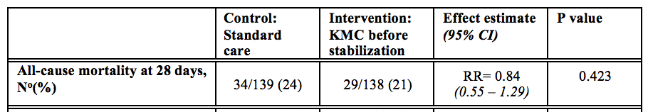
Primary outcome result
Adjusted for twin status, weight & gestational age (RR0.93, 95% CI 0.63 – 1.36, p=0.699)
Sensitivity analysis excluding ineligible at baseline
(RR1.04, 95% CI 0.65 – 1.65. 24% vs 23%, n=253)
Brotherton et al, EClinicalMedicine, 2021
Notes:
We did not find any evidence of reduction in mortality with the intervention. 24% of control arm died, compared to 21% of the intervention arm, on the unadjusted intention to treat analysis.
Adjusting for twin status/admission weight and gestational age showed similar result
The sensitivity analysis excluding neonates who either stabilized or became severely unstable between screening and baseline showed no difference in mortality between arms

Slide 10
Secondary outcome results
No effect on 2ary outcomes with adjusted, unadjusted or sensitivity analysis
Sub-group analyses:
45% reduced risk of hypothermia for <1200g
(RR 0.55, 95% CI 0.33 – 0.91, 69% vs 39%)
Test of interaction. p=0.008
Brotherton et al, EClinicalMedicine, 2021
Notes:
We did not find evidence of any effect of the intervention on any of the secondary outcomes on either the adjusted, unadjusted or sensitivity analysis excluding stable/severely unstable at baseline.
However, the results do give some insights into SSNC provided during the trial
38 – 40% of cohort were hypothermic at 24h – temperature control is often taken as a proxy for the quality of newborn care and the fact that 38% of the intervention arm were hypothermic despite receiving KMC, suggests either the quality of KMC was suboptimal or that not enough was provided
98% of cohort were exclusively breastfed at discharge, which is to be commended, yet mean weight gain per day was only 10 – 12g/d over the first 28d, which is sub-optimal and indicates that quality of feeding support could be improved (worth noting that human breast milk, parenteral nutrition were not available)
Pre-specified sub-group analyses showed statistically significant evidence of interaction for only admission weight <1200g and 45% reduced risk of hypothermia at 24h for smallest neonates <1200g. N=64)
25% of cohort were <1200g & 11% <1kg – relatively

Slide 11
Safety of KMC prior to stability
33% (46/138) stopped early KMC
Severe instability or apnea needing resuscitation most common
Non-fatal SAEs in 21%
No difference btwn arms
No SAE related to intervention
Life threatening = apnea needing resuscitation, severe instability, critical illness
Risk of disability = severe jaundice, suspected/confirmed meningitis
VULNERABLE POPULATION
CONTINUOUS PULSE OXIMETRY MONITORING DURING KMC PRIOR TO STABILITY
Notes:
Safety was closely monitored by the DSMB and sponsor, with all SAEs also reviewed by local safety monitor and myself as PI.
Non-fatal SAEs occurred in 21% of cohort, most commonly life threatening events such as apnoea needing resuscitation, or severe instability
There was no between arm difference in SAEs and none were deemed related to the intervention
Of the intervention arm – 33% temporarily stopped early KMC, due to meeting protocol criteria – most commonly being severely unstable and requiring closer observation and CPAP. This highlights the vulnerable population and need for close clinical monitoring for KMC prior to stability especially when on oxygen.

Slide 12
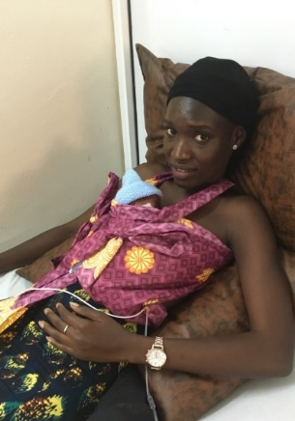
Low fidelity of the intervention (6.7h/day)
Limitations in measurement of KMC duration
Brotherton et al, EClinicalMedicine, 2021
Notes:
Of note – we had low fidelity of the intervention compared to what we aimed for in the trial protocol
86% of participants in intervention arm started KMC within 24h of admission, with median time 12h. The control arm started at 4 days – which was as intended
But the the median daily duration of skin to skin contact in intervention arm for duration of admission was only 6.7 h/day compared to intended 18h/day
This highlights practicalities of implementation in pragmatic setting and is an important area for future research

Slide 13
iKMC trial: KMC (2h after birth) reduces mortality by 25%
WHO MULTICENTRE TRIALª
3211 neonates randomised (1 – 1.8kg)
25% relative reduction in risk of death
(16% - 12%; RR 0.75, 95% CI 0.64 – 0.89, p=0.001)
iKMC stopped early by DSMB
Greatest effect size in India (growth restriction)
Heterogeneous effect size in Africa
OMWaNA trial^{b} (Uganda; MRCU at UVRI at LSHTM) recruitment ongoing until mid 2022
a) iKMC study group, 2021; b) Medvedev et al 2020
Notes:
So we did not identify a mortality effect of early KMC in unstable neonates. But this does not mean that there is no effect of the intervention.
The iKMC trial, published in May 2021, reported a 25% reduction in 28d mortality for neonates 1 – 1.8kg, from a multicentre WHO trial conducted in India and 4 sites in Africa.
The iKMC trial was stopped early by the DSMB due to efficacy and WHO are preparing updated guidelines for when to use KMC.
However, important questions still exist, especially whether KMC prior to stability has context specific effects - the greatest effect size was seen in Indian site, where 40% of neonates were recruited and generally have high rates of growth restriction. A heterogeneous effect size was seen in African sites (although it wasn’t powered to detect differences by site)
The OMWaNA trial in Uganda is due to finish this year and wil lprovide additional dta for effect of KMC prior to stability in pragmatic level 2 African settings

Slide 14
Why no mortality effect in eKMC trial?
Sample size too small to detect difference
Mortality halved (48% - 24%)
Varying population & contexts of care
<1kg; % SGA; baseline stability
Differences in trial interventions
Timing of KMC onset (15h vs 1.5h of age)
KMC "Dose" or daily duration (6.7h/d vs 16.9h/d)
KMC provider (female relative vs mother)
Higher level & quality of care in iKMC trial (“Mother-Neonatal ICUs)
70% of target sample size recruited
80% power at trial onset (30% effect size)
Notes:
Considering the eKMC trial result sin the light of the iKMC findings – why did we not find evidence of mortality effect?
There are several important potential reasons
1 – despite having adequate power at trial onset, based on pre-trial mortality – our sample size was too small to detect a difference. This was primarily due to a halving in control arm mortality (which I will consider in more detail as part of obj. 3), but also impacted by smaller than intended sample size deu to recruitment issues, including COVID-19 pandemic
2 – There were important differences in the intervention delivered during eKMC and iKMC trials
- Timing of onset (12h from admission; 15h of age in eKMC – 1.5h of age in iKMC) - ? Window of opportunity for maximum effect
- ”dose” or daily duration (6.7h in eKMC vs 16.9h/d in iKMC) – although the optimal dose for mortality effect is not yet known, Cochrane resview identified mortality effect only in trials >20h/d
- KMC provider (mix of mother / female relative in eKMC – mother in iKMC) – As KMC is a package of care, with nutrition an important aspect and known benefits of breast milk feeding, it is plausible that the quality of KMC provided by non-mothers is different to mothers in terms of promoting breast milk. Data on this is not yet available
3 – High rate of late onset infections with nosocomial risk at site
4 – Different populations & contexts of care

Slide 15
Exploration of changes to mortality during eKMC trial
Before / after comparison of case-fatality rates:
21% rel. reduction in CFR for all neonates (35% – 28%)
24% rel. reduction in CFR for <2000g (48% - 36%)
Comparison of clinically similar neonates recruited vs. not recruited:
Generalised linear model
Adjusted for twin status, admission age, in-born
29% relative risk reduction in CFR for eKMC participants
(RR 0.71, 95% CI 0.53 – 0.96, p=0.026)
Trial participants:
Pulse oximetry
Clinical scrutiny to management/QoC
Access to investigations
a) Okomo et al, Int Child Health, 2015
Notes:
Understanding changes to mortality during trial period really critical to our lack of evidence

Slide 16
Summary
eKMC trial identified no evidence of mortality effect prior to stability
Mortality gains possible through providing currently recommended high quality SSNC
Quantified direct benefits from trial participation & close clinical monitoring (29% relative risk reduction)
Insights into feasibility, safety & implementation of KMC prior to stability in pragmatic low resource setting

Slide 17
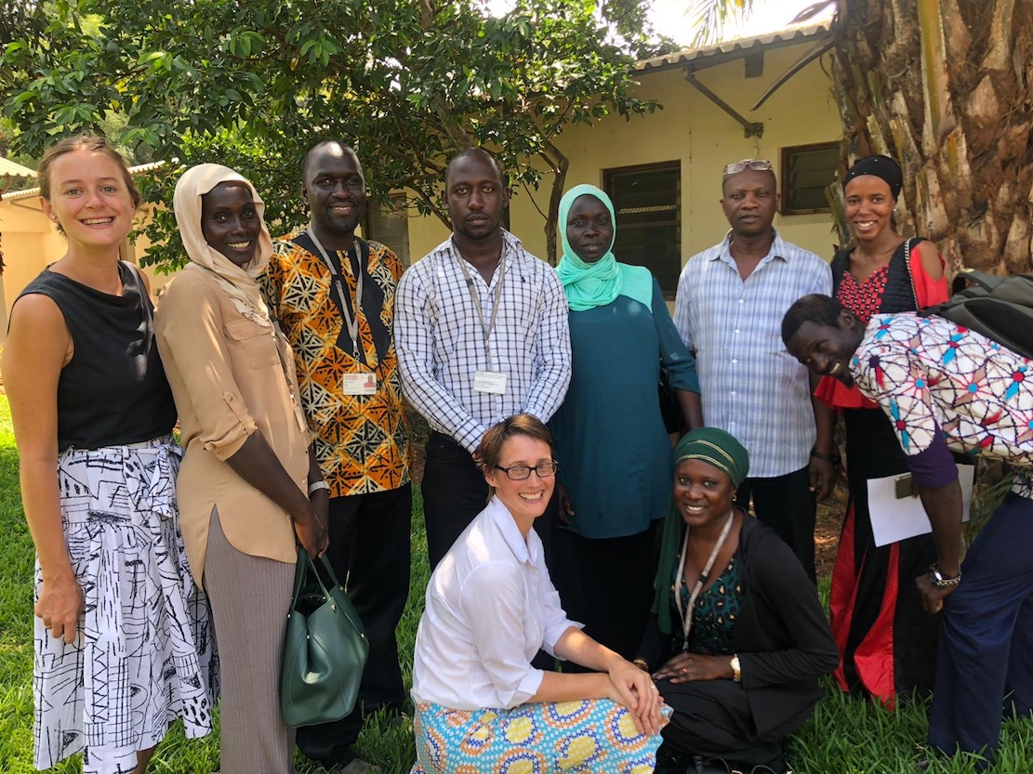

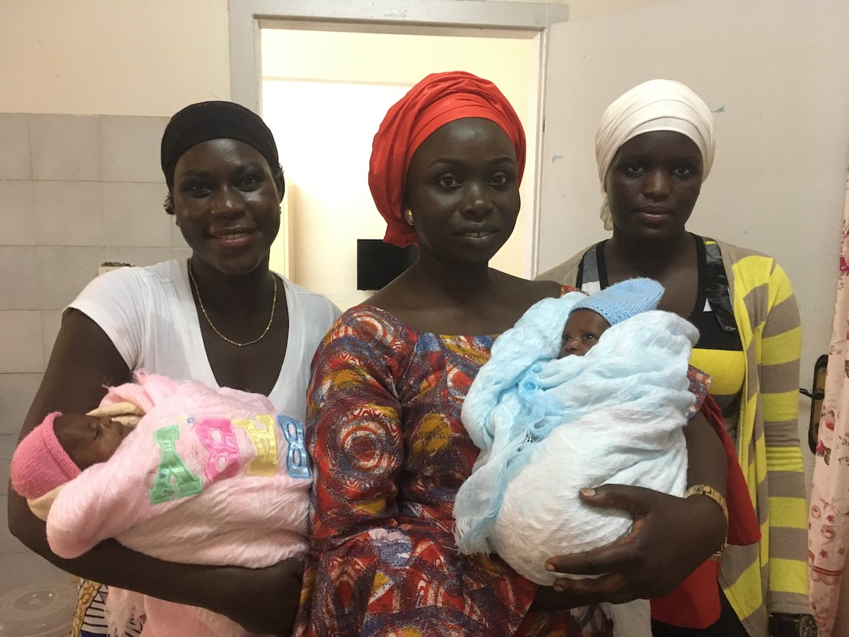

Acknowledgements
MRCG at LSHTM:
eKMC team: A.Gai, B.Kebba & nurses
Data: Y.Njie, B.Saidy, J.Jones
Lab: S.Darboe, M.Jallow, B.Ceesay, D.Cham
RSO: MR.Thorpe, A.Jallow
Stats; D.Jeffries, AK Mohammad
Transport / facilities / Biobank
CTSO: V.Thomas-Njie, G.Sey,
LSHTM: C.Tann, A. Seale, L.Penn-Kakana, S.Yeung
TSC: E.Mason, E.Carroll, C.Ezeaka, J.Crawley, B. Abatan,
D.Elbourne
DSMB: E.Allen, PA.Hardy, C.Enweronu-Laryea, M.Ota
EFSTH: R.Paulinho, nurses, doctors, SMAC lab
Gambian Gov. MoH: AL.Samateh, F.Camara, F.Fatty
UNICEF The Gambia: M.Janneh
Participants, mothers & families

