Slide 1

Routes of Transmission of Infection in Neonates
Dr Uduak Okomo MBBCH, MSc, FWACP, PhD
Clinical Assistant Professor
Vaccines & Immunity Theme
MRC Unit The Gambia at the London School of Hygiene & Tropical Medicine
Wellcome Trust - Bloomsbury Centre for Global Health Research Scientific Meeting
Monday 14th March 2022

Slide 2
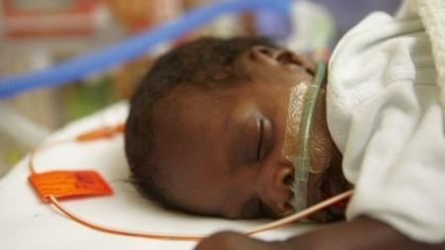
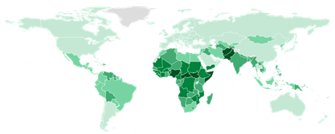
2.4 million
global neonatal deaths annually
Main causes of neonatal deaths
PRETERM BIRTH
BIRTH COMPLICATIONS
NEONATAL INFECTIONS
CONGENITAL MALFORMATIONS
NEONATAL JAUNDICE
Aetiology
Transmission Pathways
Notes:
The neonatal period is the most vulnerable time in a child’s life.
In 2020, 2.4. million newborns died in the first 28 days after birth

Slide 3
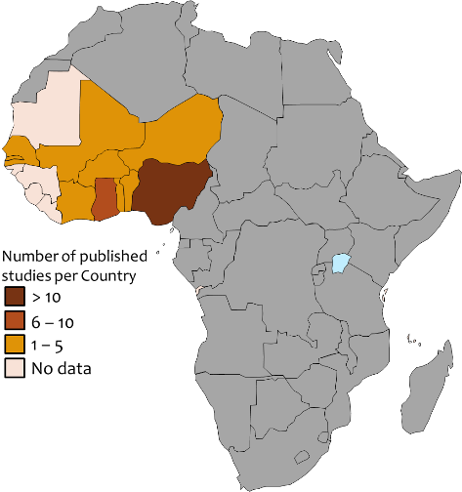
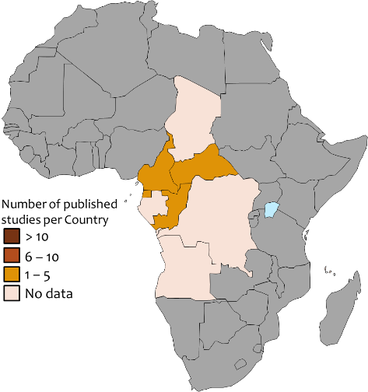
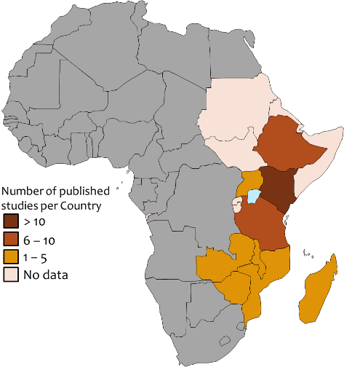
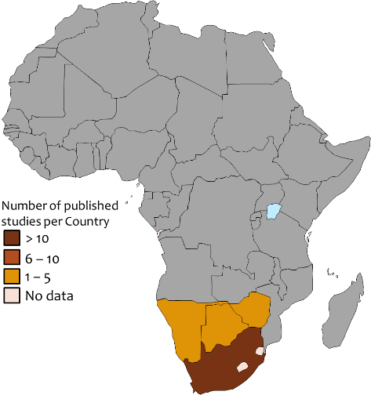
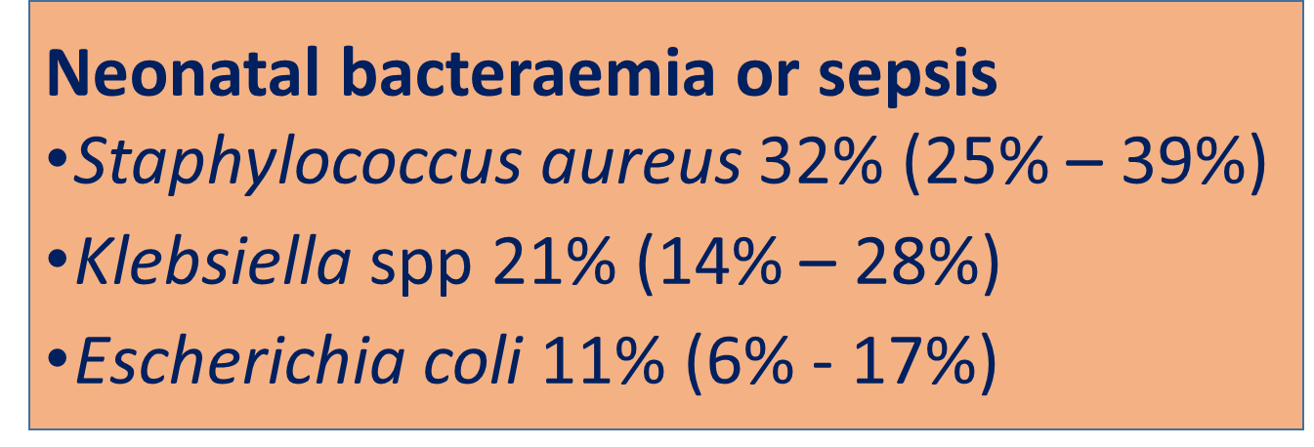
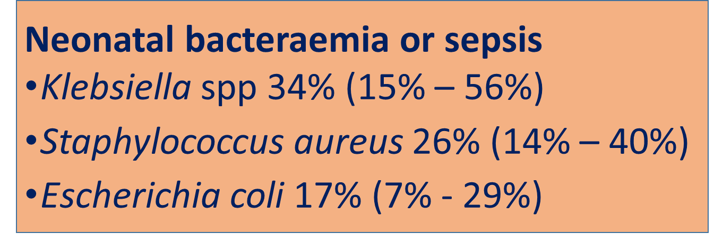
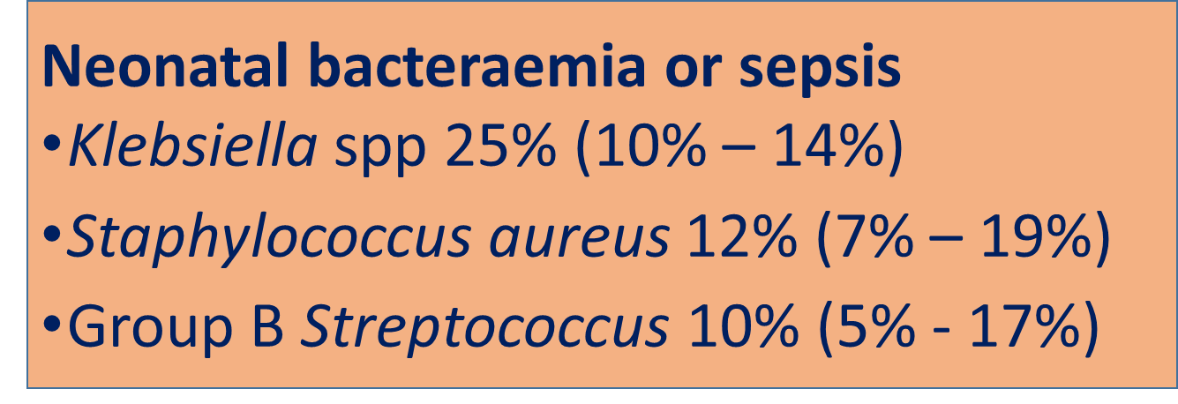
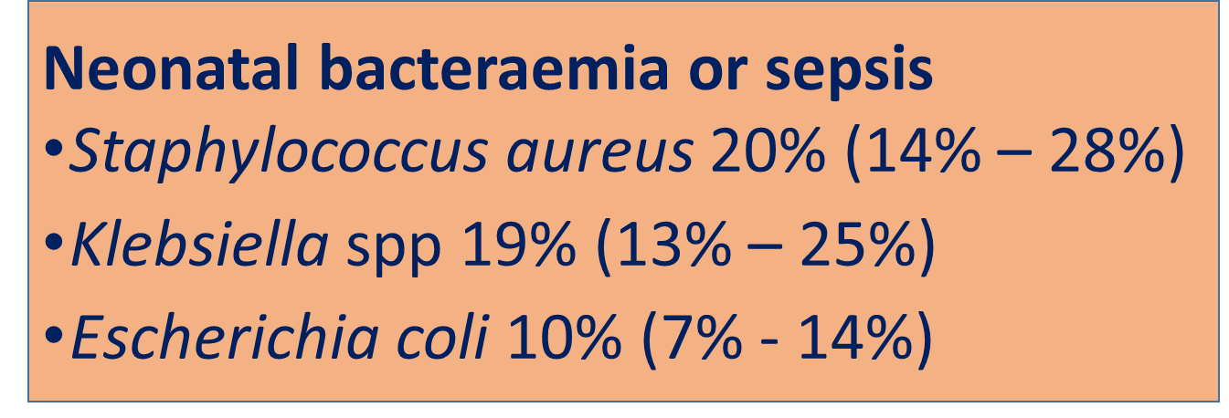
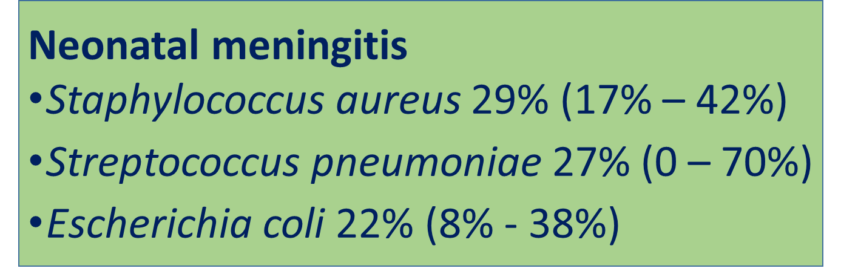
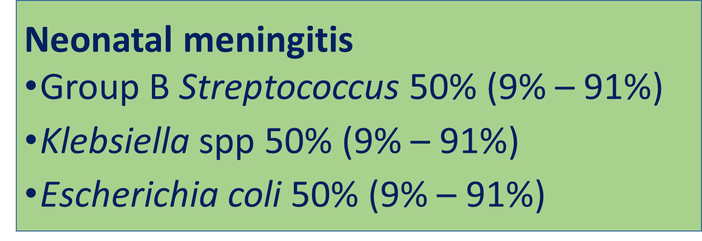
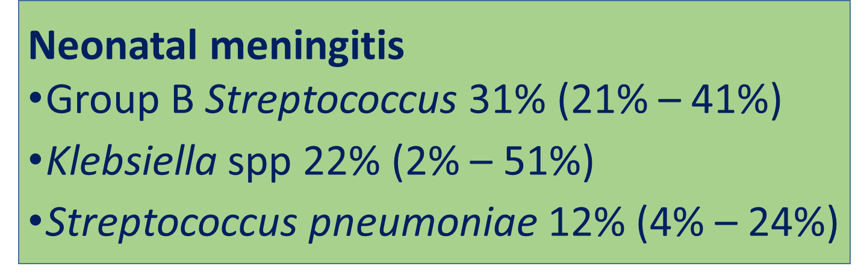
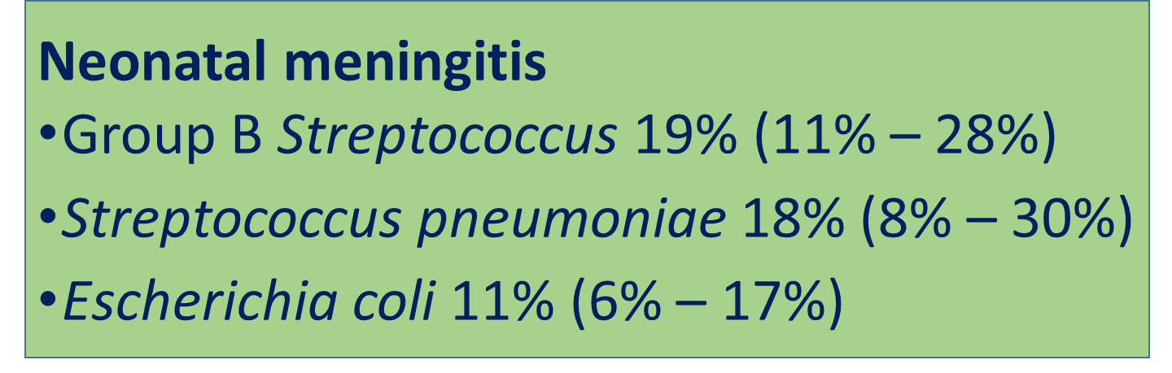
Aetiology of neonatal sepsis and meningitis in sub-Saharan Africa, by sub-region
82 studies (2008 – 2018); 52465 neonates; 19 countries
West Africa
Central Africa
Eastern Africa
Southern Africa
Notes:
Overall, S.aureus, Klebsiella and E.coli are the main causes of neonatal sepsis
While GBS, S. pneumonia S.aureus are the main causes of neonatal meningitis.
As you can see on the maps, we also observed sub-regional geographic variations in the distribution of specific bacterial pathogens between regions, and what is not shown is that there are differences within regions.

Slide 4




Sources of infections among newborns
Notes:
The fetus and newborn are exposed to multiple sources of infection.
Each year, millions of vulnerable newborns require inpatient care yet are at a major risk from hospital-acquired infections; yet many cases and deaths are missed. There is an urgent need for better detection including ward and laboratory integration plus innovation for diagnostics.
Detection of infection sources is often overlooked - important especially given the emergence of AMR
The risk of hospital-acquired infection is particularly high for babies born in or admitted to hospital in low-resource settings, and is associated with overcrowding and understaffing, as well as weak infection control protocols

Slide 5
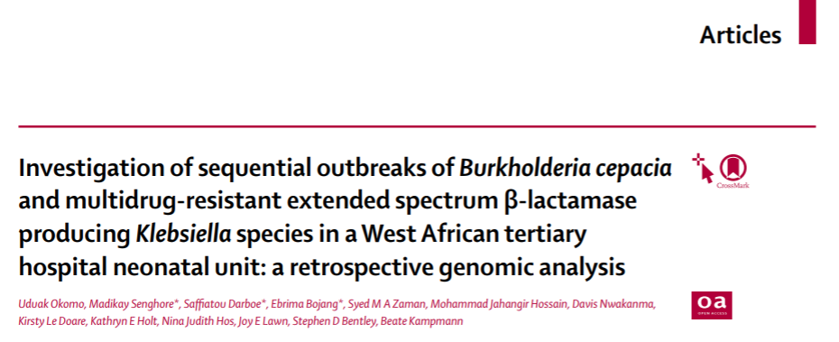
Hospital Transmission:
A Genomic Analysis of Hospital-Acquired Neonatal Sepsis Outbreaks

Slide 6
Hospital-acquired neonatal infections: - Endemic Infections & Outbreaks
High CFR (~50%)
Extrinsic contamination of IV fluids and antibiotics
Suboptimal infection prevention & control (*poor hand hygiene)
Notes:
Between March & December 2016, we had sequential outbreaks at the neonatal ward of Gambia’s largest and only teaching hospital and the pathogens involved were: Burkholderia cepacia and then MDR ESBL Klebsiellae
Our limited clinical outcome data demonstrate high case fatalities among newborns in both outbreaks (~50% for the Klebsiella)
Investigations into both outbreaks revealed suboptimal infection prevention & control (*poor hand hygiene), and pointed to extrinsic contamination of IV fluids and antibiotics as from samples of intravenous fluids in use on the neonatal ward, all had the same antibiogram as those from the cases.

Slide 7
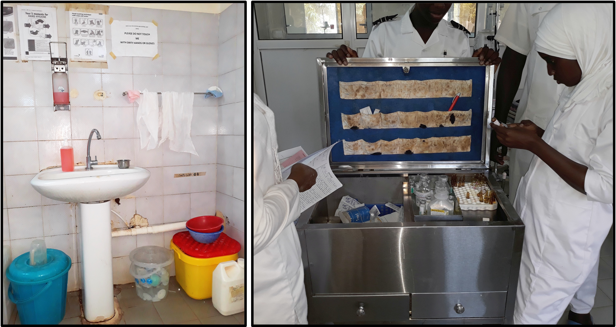
Outbreak Investigation
Source: Intravenous antibiotics and fluids (in-use)
Lapses in nursing procedures, Suboptimal hand hygiene
Notes:
Investigations into both outbreaks revealed suboptimal infection prevention & control (*poor hand hygiene), and pointed to extrinsic contamination of IV fluids and antibiotics as from samples of intravenous fluids in use on the neonatal ward, all had the same antibiogram as those from the cases.

Slide 8
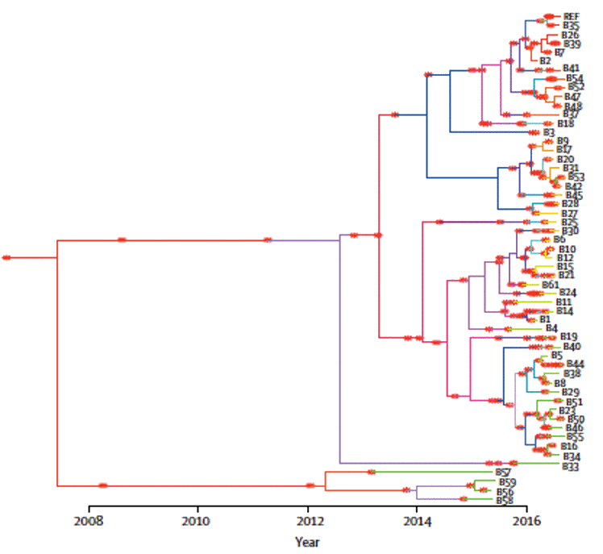
Results: Burkholderia cepacia
A
B
Notes:
We sequenced the B cepacia patient isolates B1–B49, as well as six environmental B cepacia isolates (B50–B55).
We also sequenced five historical isolates (B56–B60) from five newborns with sepsis in the same neonatal ward between May and August, 2015.
Figure A shows the phylogeny of all Burkholderia cepacia isolates annotated with patient age, sex, and a timeline of when isolates were collected. The historical isolates from 2015 formed a monophyletic clade, and the outbreak isolates from 2016 formed four subclades (I–IV) with short branches.
Figure B shows the Time-dated phylogeny of B cepacia outbreak isolates, including archived bacterial strains. The data suggest B cepacia was probably an endemic contaminant in the neonatal ward over several years (possibly as far back as 8 years) , and there might have been at least four separate introductions in the ward and the hospital at large, which eventually gave rise to outbreaks.

Slide 9
Results: Klebsiella species
A) Klebsiella quasipneumoniae subspecies similipneumoniae (ST1535)
B) Klebsiella pneumoniae (ST 39)
Notes:
The genomic analysis of the K. pneumoniae outbreak included isolates from 39 patients and one environmental sample (K46).
Our data revealed the suspected K pneumoniae outbreak to be contemporaneous outbreaks due to two related but distinct species
Sequence type 1535 (ST1535) K. quasipneumoniae subspecies similipneumoniae (n = 33) [capsule locus type KL114] previously unreported locally, and
Sequence type (ST) 39 K. pneumoniae (n = 7) [capsule locus type KL23]
Figures A and B show the phylogeny of the Klebsiella quasipneumoniae subspecies similipneumoniae and Klebsiella pneumoniae outbreak isolates respectively, annotated with patient age, sex, a timeline of when isolates were collected, and antibiotic resistance patterns
Each genotype consisted of closely related variants of the same strain:
ST1535 isolates differed from one another by mean 0.8 core genome SNPs (95% CI 0.70-0.93, range 0-5 SNPs) and the
ST39 isolates differed from one another by mean 0.5 SNPs (95% CI 0.24-0.71, range 0-1 SNPs)
The low sequence diversity suggests each of these clusters has a very recent common ancestor, consistent with the short time frame; however, precise dating was not possible due to the low diversity.
All Klebsiella isolates were ESBL producing and resistant to gentamicin, ciprofloxacin, ceftazidime,cefuroxime, and cefepime, but sensitive to meropenem and imipenem.
We also observed appreciable concordance between the multi-drug phenotypic resistance pattern and the genotypic resistance, except for chloramphenicol, to which strains were classed as susceptible despite the presence of the catB4 resistance allele.
Both STs harboured multiple bla genes conferring resistance to beta-lactams, including the ESBL CTX-M-15, which was conserved in all strains.
The combination of virulence genes differed between the two strain clusters.
The acquired siderophore yersiniabactin (allele ybt 15, ICEKp11) was present in ST1535 strains but absent in ST39.
The colibactin genotoxin and other acquired siderophores were absent from both outbreak strains.

Slide 10
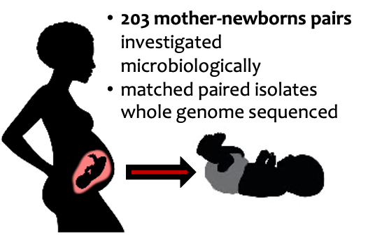
Maternal Transmission:
Maternal colonisation and invasive neonatal infection in The Gambia, West Africa: a genomic analysis of vertical transmission (Submitted)

Slide 11
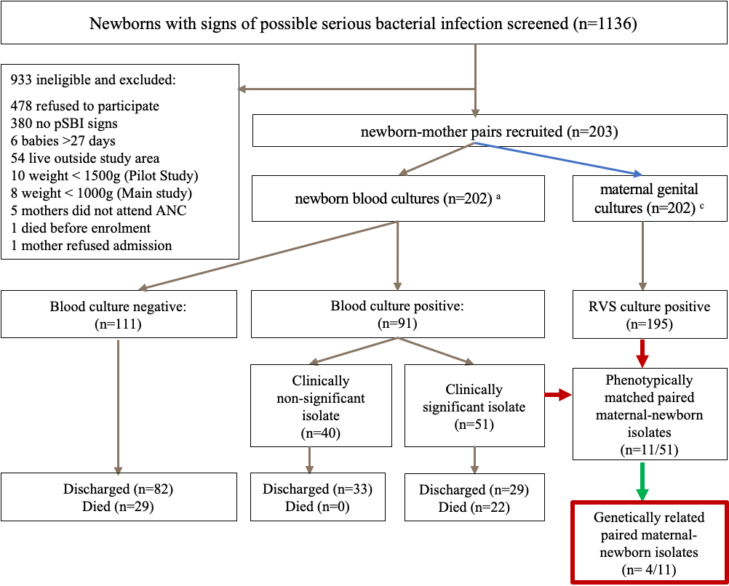
Lack of strong evidence to support vertical transmission of pathogenic bacteria from mother-to-neonate
Notes:
Ongoing surveillance of antimicrobial prescribing patterns, and studies to understand these differences, are important to design interventions to change prescribing practices. In addition, the appropriateness and relevance of national and global prescribing guidelines needs to be reassessed.
Address Data gaps – many countries little or no data
More consistency in reporting – less data wastage
Use of standardised reporting guidelines – STROBE NI (Fitchett et al. Lancet Infect Dis 2016)

Slide 12

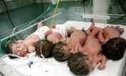
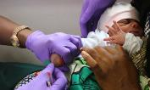


Implications for policy and practice
PREVENTION
CARE
DETECTION
RESPONSE
SYSTEMS
Environmental and hand hygiene
Better care both to prevent and treat infections
More cultures and other diagnostics
Improved laboratory support and rapid response
Policy & Guideline development, Audit
Notes:
Gram-negative bacterial infections are increasingly common in neonatal units, especially multidrug-resistant Klebsiella spp, which are implicated in outbreaks.
Our study highlights the emerging threat of previously unreported strains of multidrug-resistant Klebsiella species in this neonatal unit.
K. quasipneumoniae is often misidentified as K. pneumoniae by routine clinical microbiological diagnostics and are difficult to distinguish without genome data
Using whole-genome sequencing to the infection-control investigation allowed us to classify the Klebsiella infections as nosocomial outbreaks and not community-acquired infections and enabled more precise identification of bacterial species and transmission pathways than with standard microbiological techniques.
Genome-based surveillance studies can improve identification of circulating pathogen strains, characterisation of antimicrobial resistance, and help understand probable infection acquisition routes during outbreaks in newborn units in low-resource settings.
Our data provide evidence for the need to regularly monitor endemic transmission of bacteria within the hospital setting, identify the introduction of resistant strains from the community, and improve clinical practices to reduce or prevent the spread of infection and resistance.
In the future, the required sequencing technologies might become more rapidly available, also in LMIC with the aim to rapidly identify healthcare-associated infection transmission dynamics and inform infection control efforts.
--------------------------------------------------------------------------------------------------------------
Additional info:
The K. pneumoniae outbreak coincided with the peak admission period (September to December) in the neonatal ward during which cot occupancy increases 100-fold.
High-rates of neonatal gastro-intestinal colonisation with ESBL-producing K. pneumoniae and high stool bacterial loads provide a reservoir for spread from baby to baby via the hands of mothers and staff. and some of the cases might have occurred due to cross-contamination from intestinally-colonised babies.
Our study has important implications for preventing newborn deaths from hospital acquired infections in LMIC where even the supportive treatments administered may be leading to infection transmission.

Slide 13
Transforming care for small and sick newborns…
Acknowledgements
Prof Beate Kampmann
Prof Joy Lawn
Dr Edem Akpalu
Dr Kirsty Le Doare
Prof Anna Roca
Prof Simon Cousens
Dr Alexander Jarde
Prof Mike Sharland
Prof Stephen Bentley
Dr Madikay Senghore
Mrs Saffiatou Darboe
Dr Ebrima Bojang
Dr Syed MA Zaman
Dr Jahangir Hossain
Dr Davis Nwakanma
Prof Kathryn Holt
Dr Nina Hos
Mr Shiekh Jarjue
Ms Abigail Ayorinde
Dr Saikou Y. Bah
Dr Abdul Karim Sesy
Dr Abdou Gai
Dr Mary Grey-Johnson
Dr Tida Dibbasey
Notes:
To conclude, as we move faster to end preventable newborn deaths by 2030 we need to focus on transforming care for small and sick newborns, especially those with serious infections.
Next generation sequencing can be used to compliment traditional microbiological methods for pathogen and AMR surveillance.
Let me end by acknowledging my colleagues and co-authors.

