Slide 1
Nutrition Research in MRCG –
A very brief overview
Talk title
New Horizons in Life-Course Nutrition
Andrew Prentice
MRC Unit The Gambia at the London School of Hygiene & Tropical Medicine
Andrew Prentice
Wellcome Fellows Meeting, 14th March 2022

Slide 2
Our emphasis is on discovery science
Basic
Clinical
Applied
Policy
Translation
Ultimate Translational Goal
To help generate ‘next generation’
nutritional and planetary health interventions

Slide 3
Nutrition – Our 3 Key Challenges

Slide 4
Nutrition focus areas: 4 sub-programmes
Early Growth and Development (EGD)
ENID
HERO-G
BRIGHT
MILQ
eMILQ
INDiGO
Iron, Infection and Anemia (IIA)
Iron-babies
IDeA 1,3 & 3
MillNETi
MillNETi women
Nutritional Genetics and Epigenetics (NGE)
Hotspots
GiA
Obesity/POMC
Thyroid/PAX8
EDEN
Nutrition-Related Chronic Diseases (NRCDs)
PRIMORDIAL
EPI-Tension
MAfricaEE
FracturesE3
RCT
Observational
International multi-centre

Slide 5
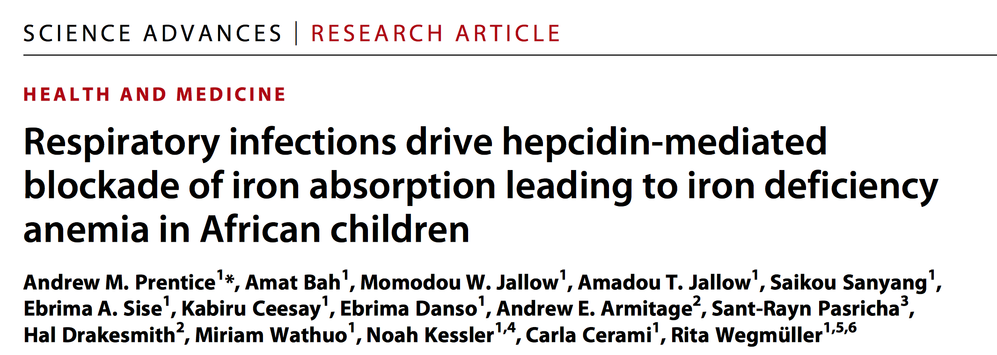
High levels of anemia in rural Gambian children
Keneba biobank n = 4500+
IDeA 3
RCT of:
Haem iron
Anti-inflammatories
BOYS
GIRLS

Slide 6
Joint Global Health Trials grant: ‘Iron babies’
Critically low circulating iron levels in breast-fed infants
RCT
of
early
iron

Slide 7
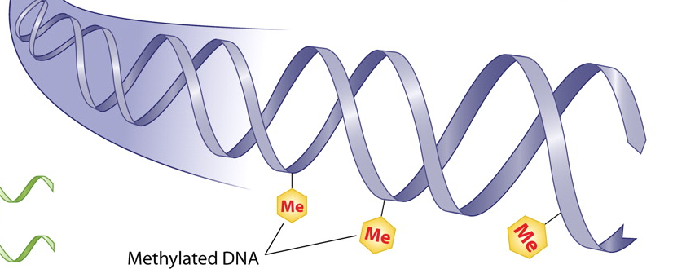
What are the mechanisms behind DOHaD?
When are the critical windows?
Can these inform interventions that can
break the intergenerational cycle of malnutrition?

Slide 8
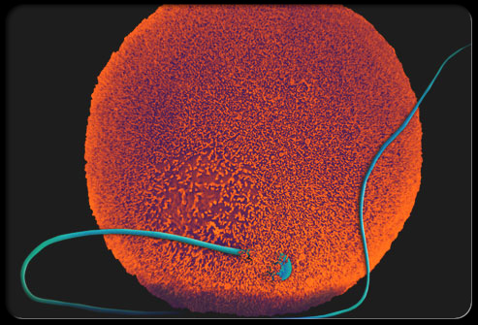
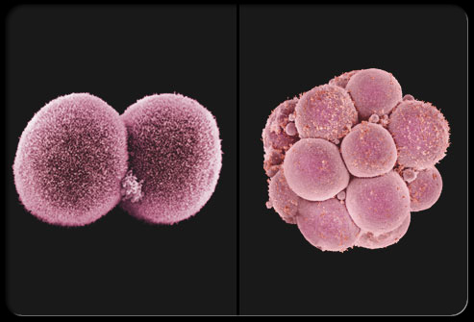
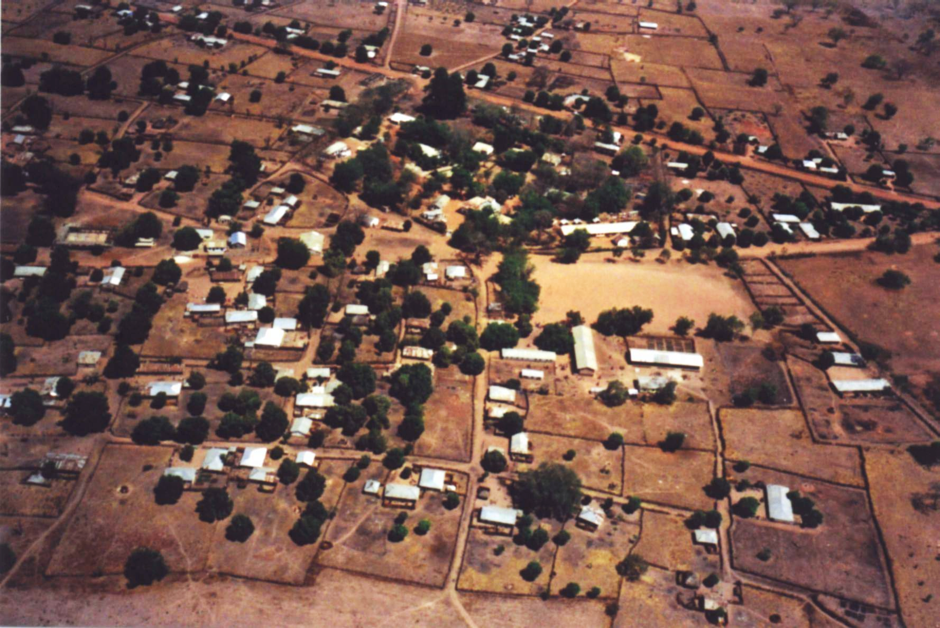
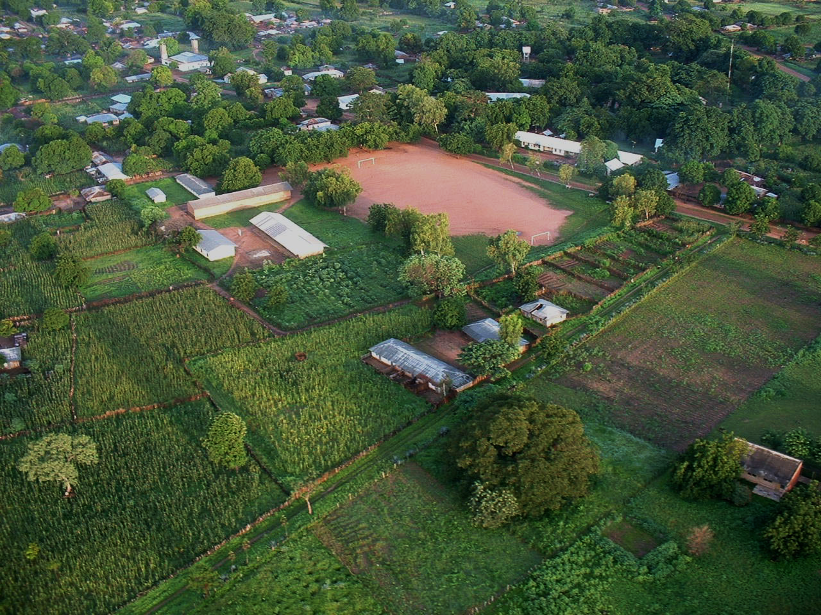
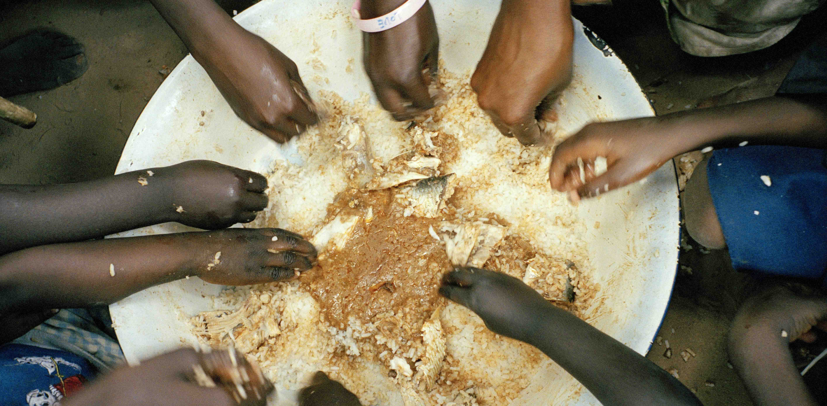
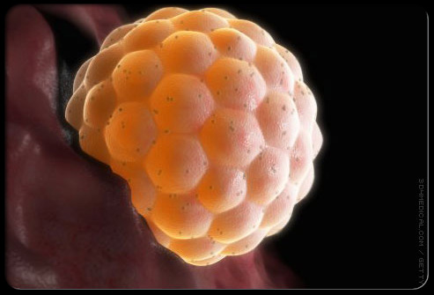
Metastable epialleles:
A device for studying
the very early embryo
Seasonality
Experiment of Nature

Slide 9
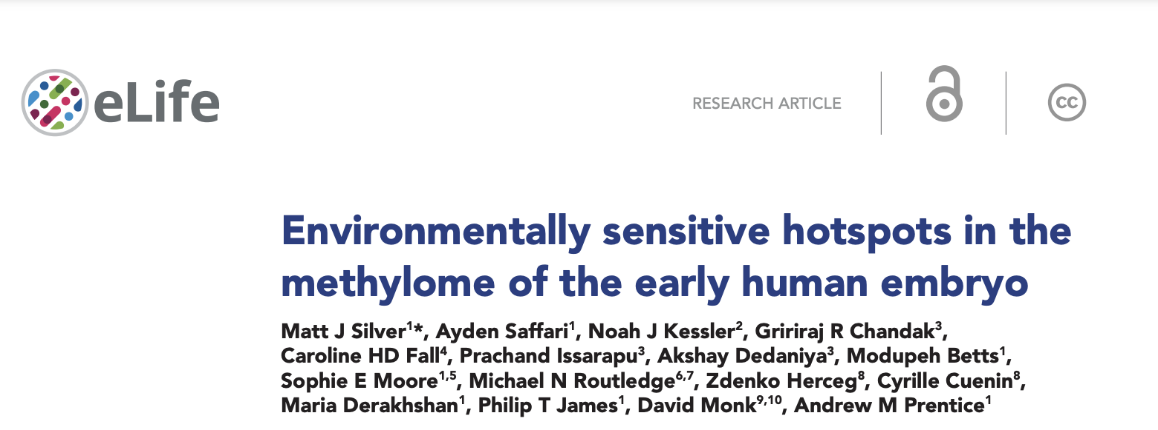
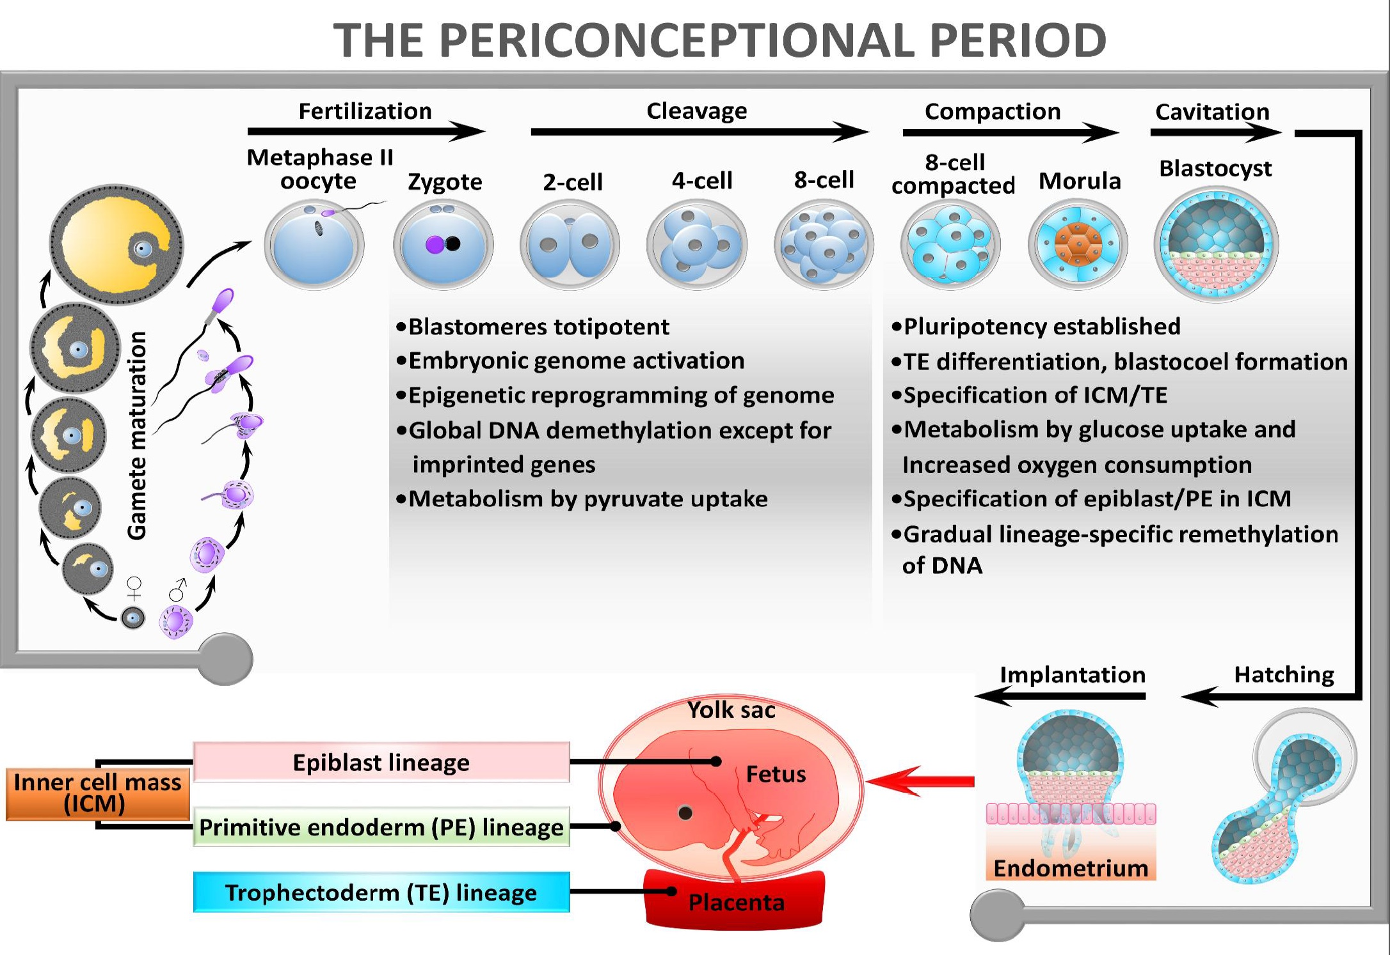
SENSE the environment
RECORD the information
ADAPT the phenotype

Slide 10
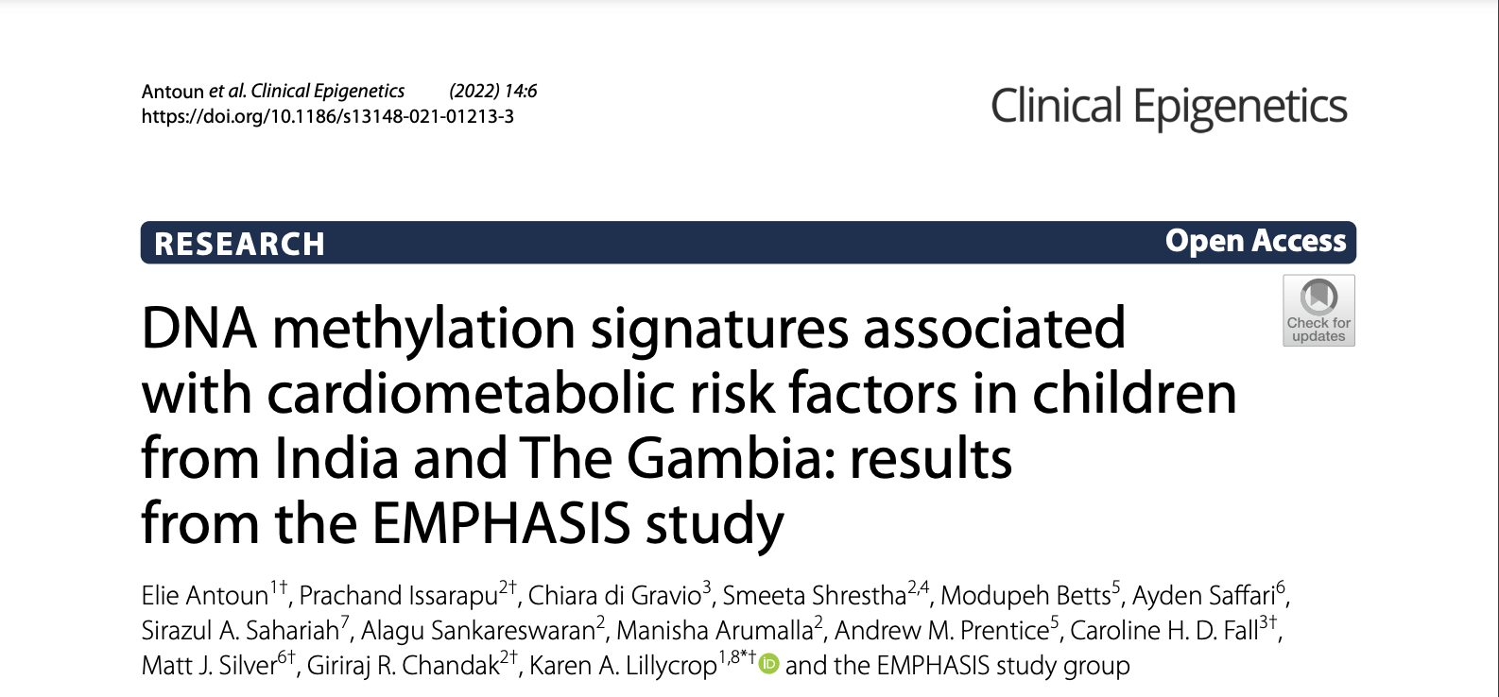
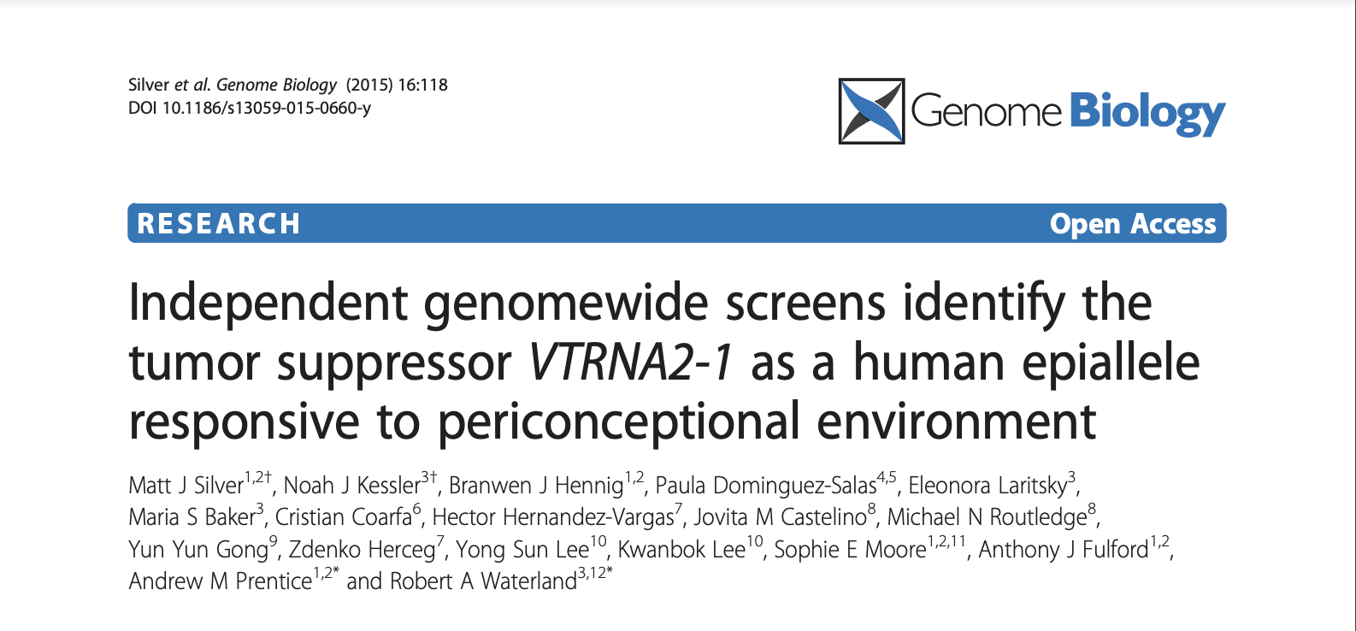
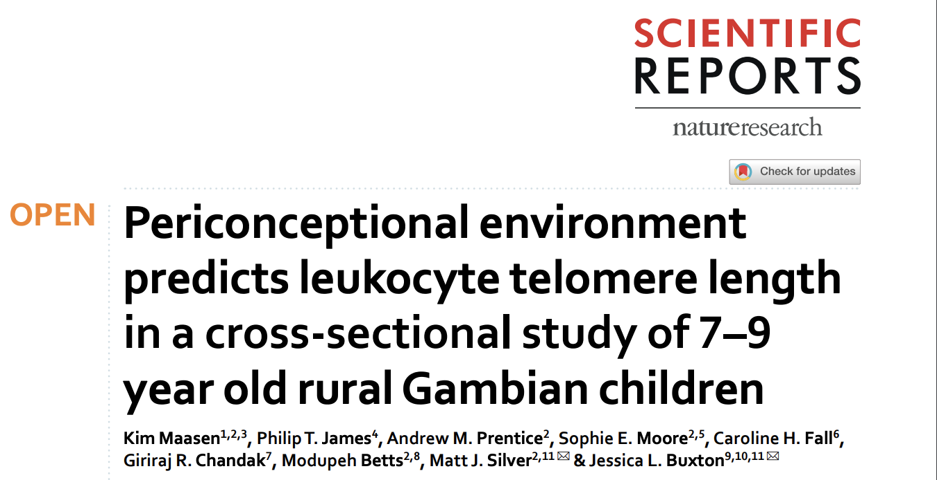
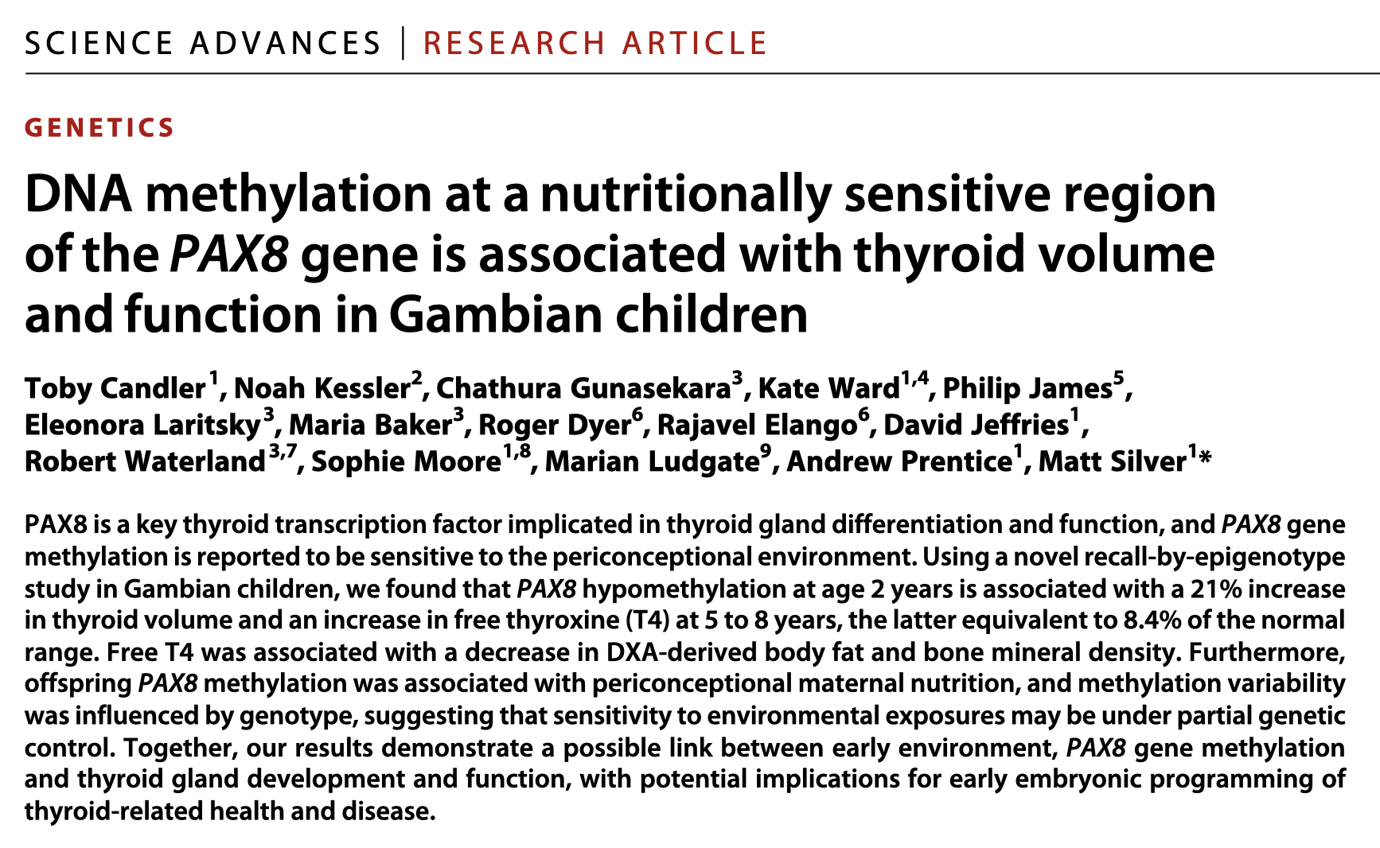
Strong evidence of relevance to health outcomes

Slide 11

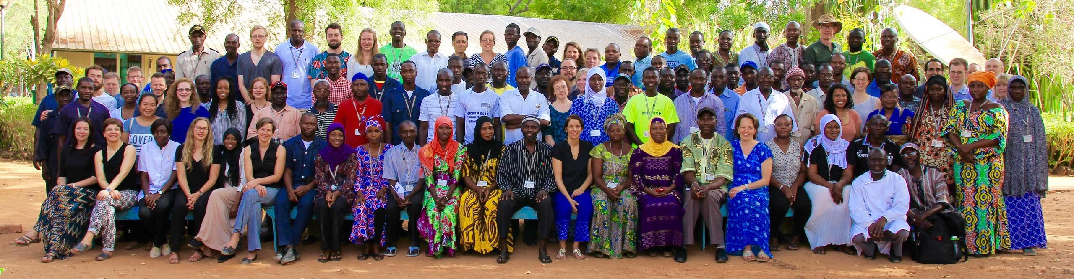






Slide 12
