Slide 1
Beta-haemolytic streptococcal carriage and infection in The Gambia: clinical epidemiology, transmission dynamics and household modelling
Dr Edwin Armitage
MRC Unit The Gambia at the London School of Hygiene & Tropical Medicine
14th March 2022

Slide 2
Talk structure
Brief Introduction
Background
SpyCATS study design
SpyCATS early results
Other ongoing work

Slide 3
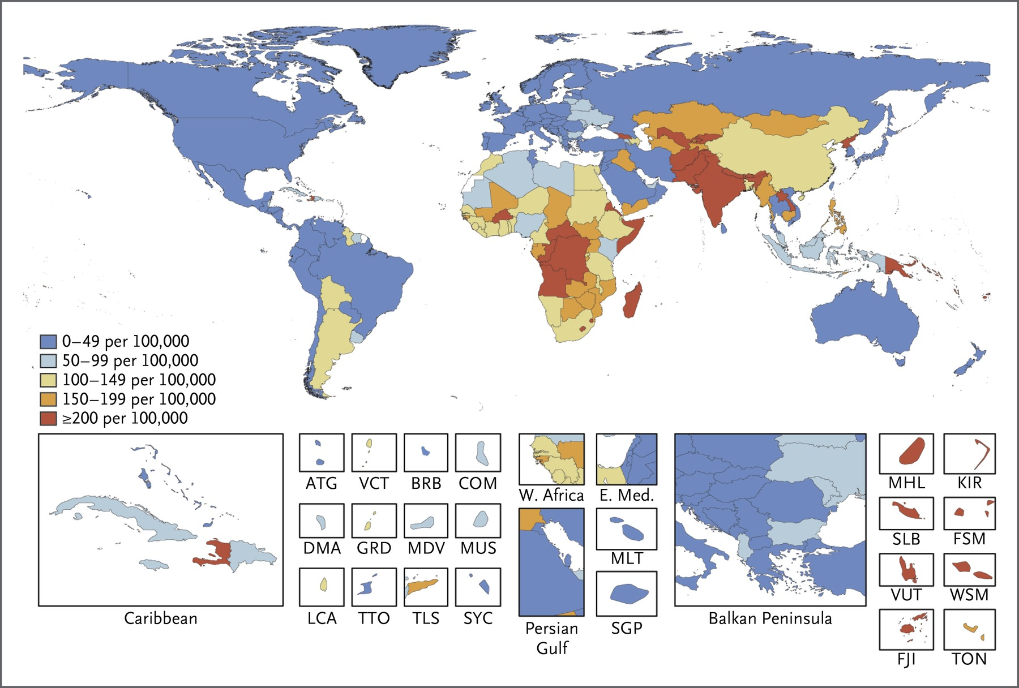
Streptococcus pyogenes (StrepA)
Pharyngeal carriage
Skin carriage
?
?
Pharyngeal infection
Skin infection
616m
111m
Immune complications
Invasive disease
RIP
165k
1m
1.8m
Watkins et al. 2017
Rheumatic Heart Disease
RIP
320k
34m

Slide 4
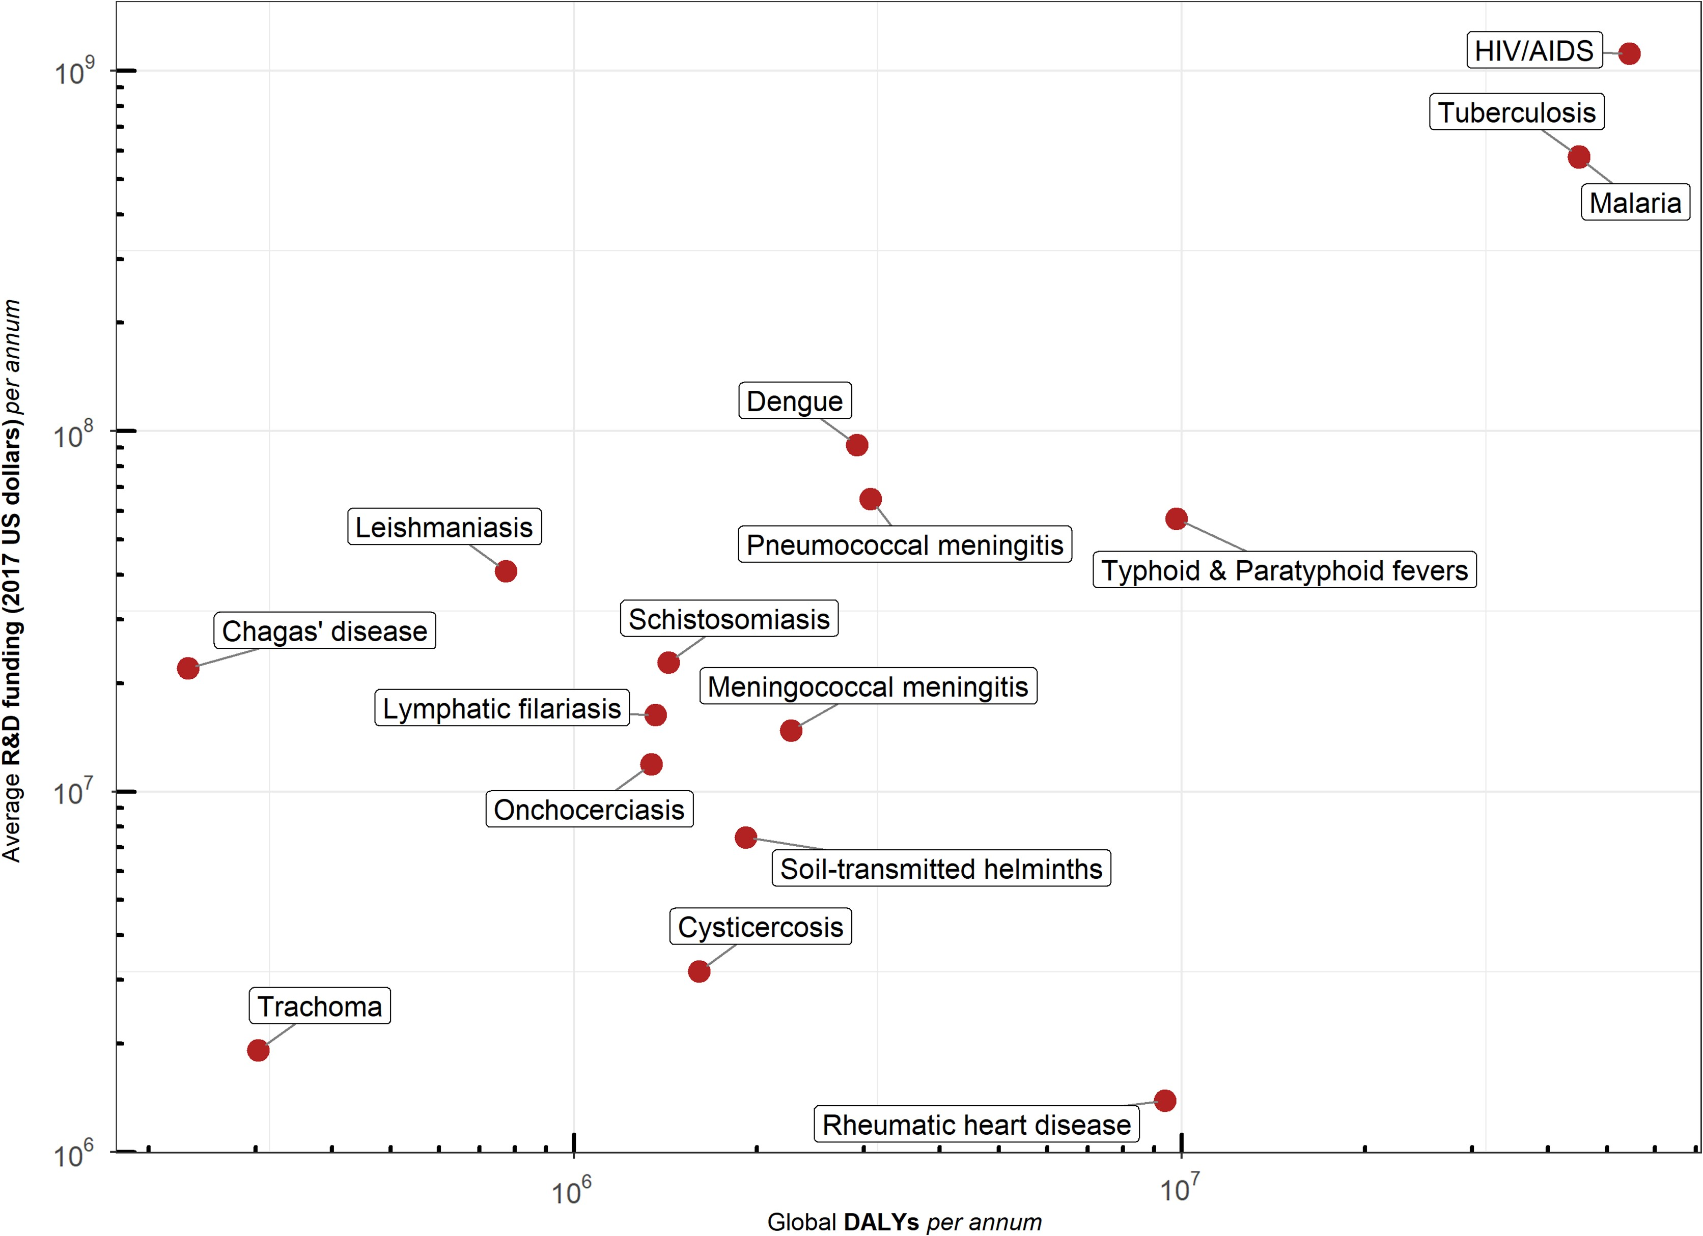
RHD: most neglected of the neglected
Macleod et al., 2019.

Slide 5
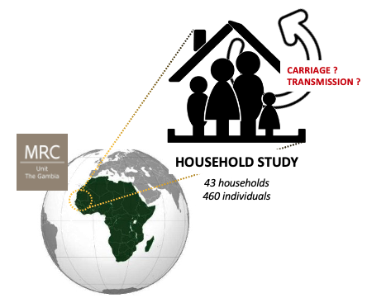
SpyCATS
Streptococcus pyogenes Carriage Acquisition, persistence and Transmission dynamics within households in The Gambia: a longitudinal cohort Study
Rainy season
Rainy season
0
3
6
9
12
Suspected StrepA
pharyngitis or pyoderma
New StrepA pharyngeal or skin carriage
Weekly pharyngeal and skin swabs for 6 weeks
Months
1
2
4
5
7
8
10
11
2021-2022
Study Cohort :
43 households
460 individuals
Swabs:
Pharynx
and skin
Data:
Clinical, demographic and social mixing
Subgroup 1:
Incident disease
Subgroup 2:
Carriage incidence and duration
Subgroup 3:
Higher resolution carriage incidence and duration
Notes:
SpyCats stands for « Streptococcus pyogenes Carriage, Acquisition, persistence and Transmission dynamics within households in The Gambia »
This is a prospective longitudinal observational cohort study hold in Sukuta, that started in August last year.
The study involves 45 households, comprizing 400 participants from 0 to 85 years old.
You can see here the study desing and sampling schedule :
The households are monitored monthly for a period of 12 months.
Each month, we collect from each participant throat and normal skin swabs as well as blood and saliva.
Serum samples are taken at the first and last visit and DBS is collected each month.
We also collect environmental swabs from places frequently touched by family members.

Slide 6
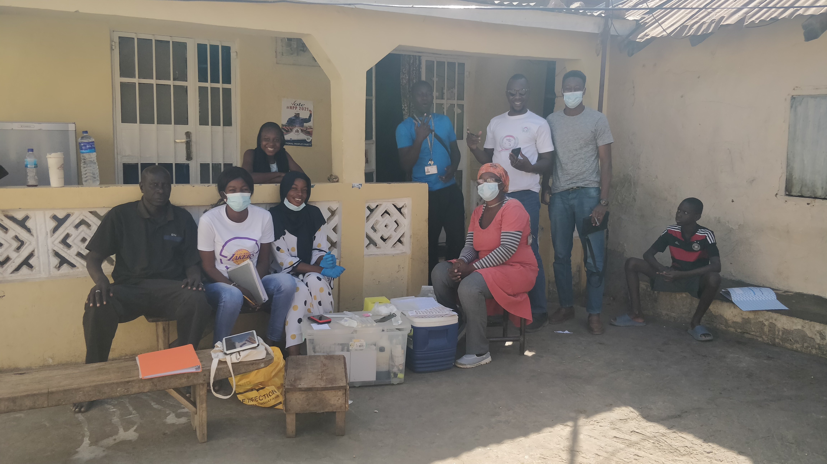

Slide 7
SpyCATS progress
Visits and swabs collected so far
MV0
MV1
MV2
MV3
MV4
MV5
MV6
UVs
WVs
TOTAL
OPS
337
319
257
248
256
268
268
55
272
2,280
NSS
335
318
257
247
257
266
267
37
1,984
WS
29
12
9
6
2
4
3
18
13
96
Isolates:
StrepA
139
StrepC
45
StrepG
137

Slide 8
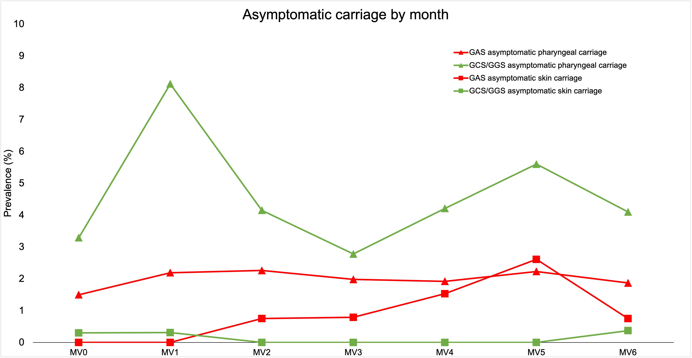
Carriage prevalence
Outcome: Monthly carriage prevalence

Slide 9
Incidence
Outcome: Carriage Incidence (MV0-MV5)
StrepA pharyngeal carriage: 29 cases per 100 person-years
StrepC pharyngeal carriage: 14 cases per 100 person-years
StrepG pharyngeal carriage: 48 cases per 100 person-years
StrepA skin carriage: 8 cases per 100 person-years
Outcome: Disease Incidence (MV0-MV5)
StrepA pharyngitis: 7 cases per 100 person-years
StrepA pyoderma: 45 cases per 100 person-years

Slide 10
Household transmission patterns

Slide 11
Impact of contacts on swab positivity
MV0-MV4 | Any positive swab (OR¹, p value) | Any positive OPS (OR¹, p value) | Any positive NSS (OR¹, p value) | Any positive WS (OR¹, p value)
Non-household contacts² | 1.23 (p=0.209) | 1.03 (p=0.800) | 1.52 (p=0.192) | 1.50 (p=0.060)
Non-household physical contacts² | 1.28 (p=0.063) | 1.08 (p=0.616) | 1.51 (p=0.210) | 1.53 (p=0.049)
Non-household non-physical contacts² | 0.43 (p=0.335) | 0.37 (p=0.329) | 1.88 (p=0.686) | 0.23(p=0.633)
Household size | 1.02 (p=0.012) | 1.03 (p=0.003) | 1.02 (p=0.518) | 0.99 (p=0.5678)
¹Adjusted for age and sex; ²Average number of contacts over all visits

Slide 12
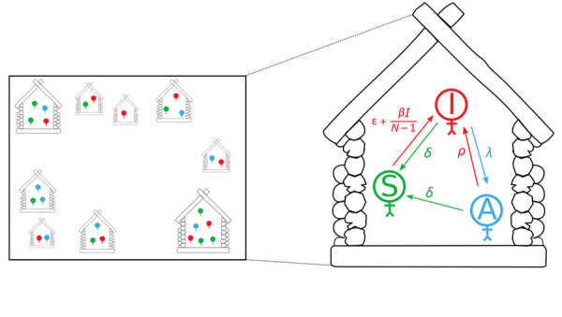
Other ongoing and planned work
Household members:
Susceptible (S, green) Infectious (I, red) Asymptomatic (A, blue)
SpyCATS
PharynGAS
Whole genome sequencing
Household modelling
Holmes, A., Tildesley, M. J., Solomon, A. W., Mabey, D., Sokana, O., Marks, M., & Dyson, L. (2020).
Modeling Treatment Strategies to Inform Yaws Eradication. Emerging infectious diseases, 26(11), 2685–2693.

Slide 13
Thank you
Supervisors:
Michael Marks
Thushan de Silva
Adam Kucharski
Collaborators/MSSG
study group:
Beate Kampmann
Claire Turner
Abdul Sesay
Alex Keeley
Gabrielle de Crombrugghe
Annette Erhart
Pierre Smeesters
Sona Jabang
Ya Jankey Jagne
Any questions?
Study team:
Musukoi Jammeh
Belali Keita
Amie Samba
Amat Bittaye
Haddy Ceesay
Isatou Ceesay
Bunja Samateh
Fatoumata Darboe
Fama Manneh-Dibba
Lawrence Mendy
Wally Njie
Elina Senghore
Fatoumatta Camara
Aja Binta Bah
Abdoulie Jarju
Aji Fatou Touray
Fatoumata Cole

