Slide 1
Integrated Approaches to Neglected Tropical Diseases of the Skin
Michael Marks
London School of Hygiene & Tropical Medicine

Slide 2
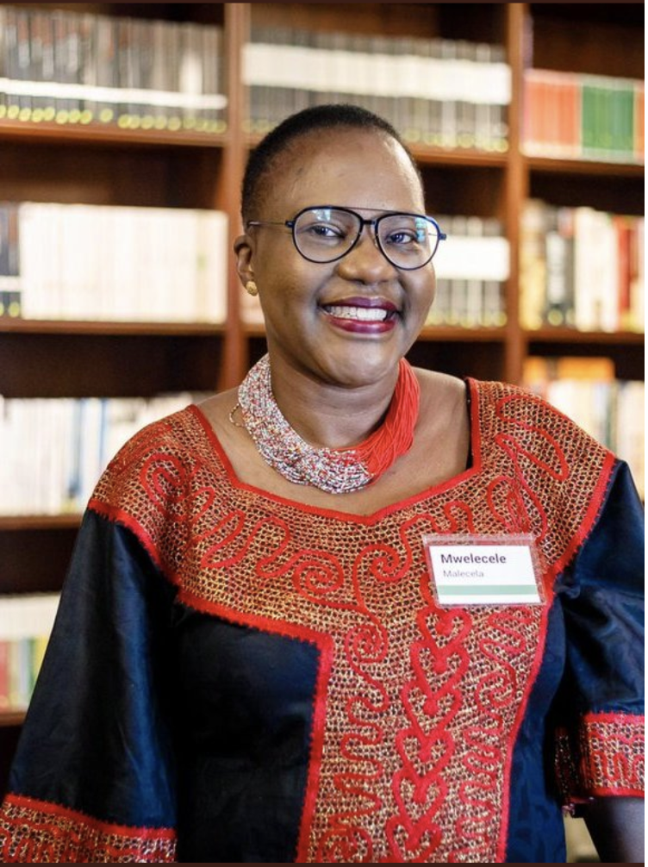

Slide 3
Outline
NTDs & Skin-NTDs
Liberia burden estimation survey
Integrated Skin NTD Studies in Ghana & Ethiopia

Slide 4
Outline
NTDs & Skin-NTDs
Liberia burden estimation survey
Integrated Skin NTD Studies in Ghana & Ethiopia

Slide 5
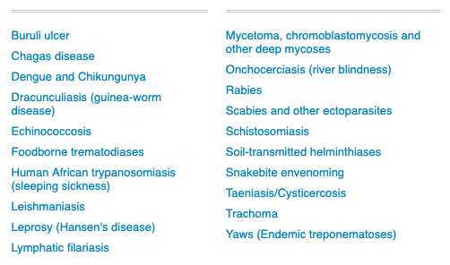
PC-NTDs
AKA MDA Diseases
Prominent Skin Manifestations
AKA Skin-NTDS

Slide 6
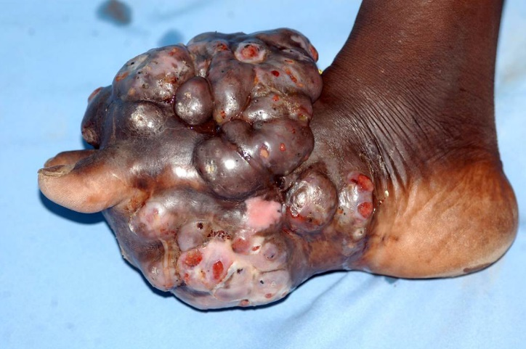
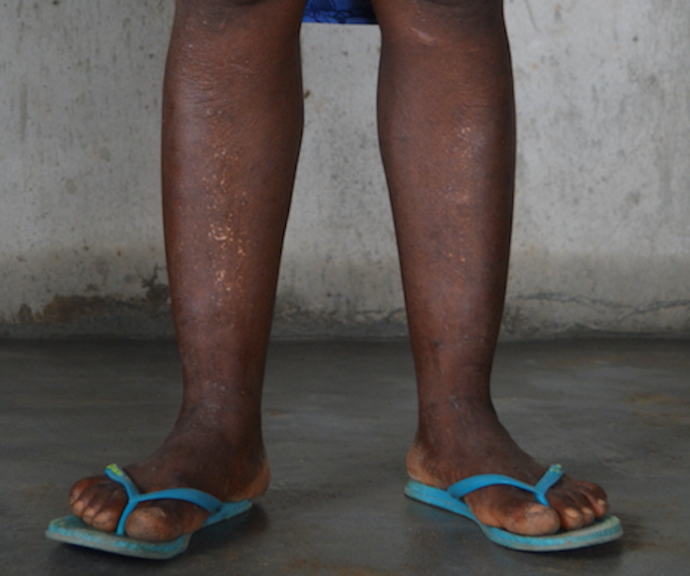
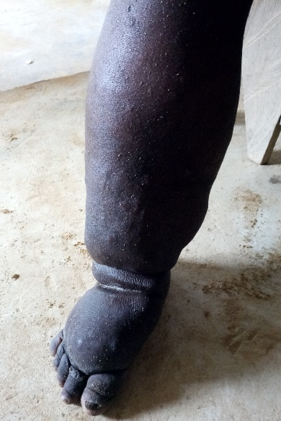
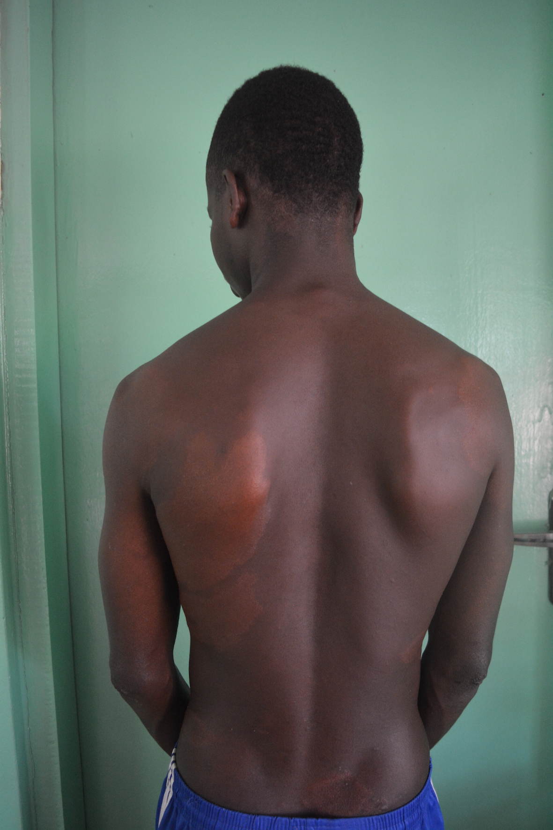
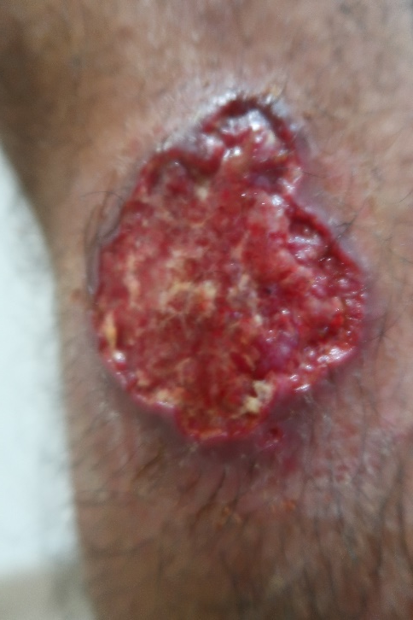
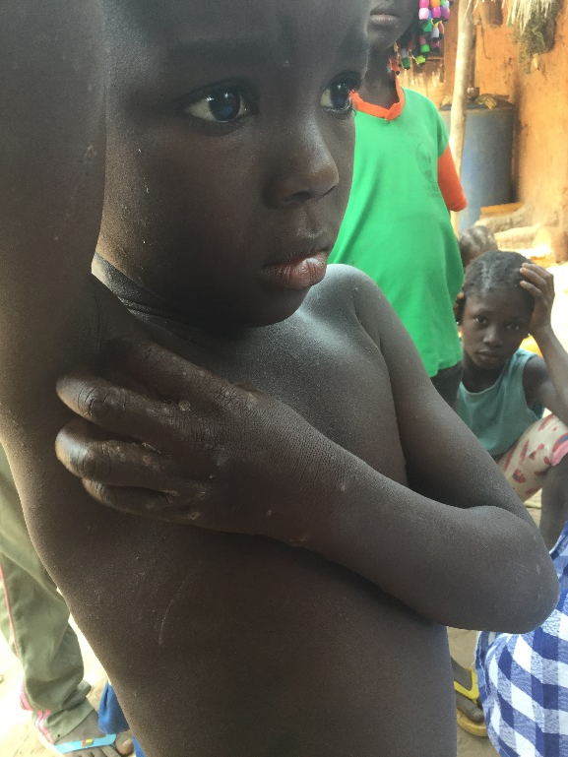
Buruli ulcer
Mycetoma
Onchocerciasis
Yaws
LF
Leishmaniasis
Scabies
Leprosy

Slide 7
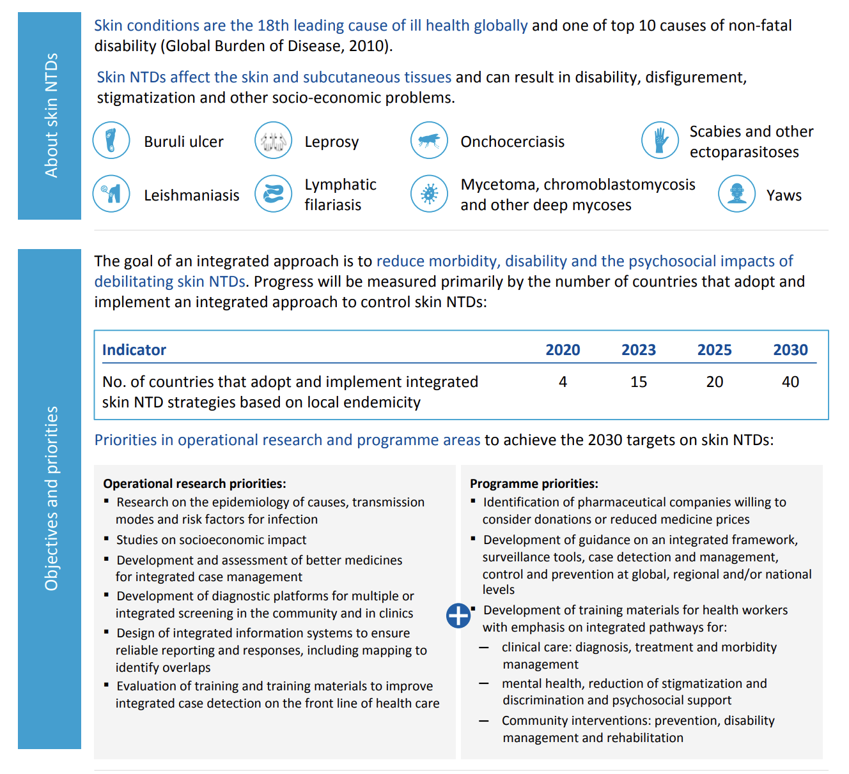
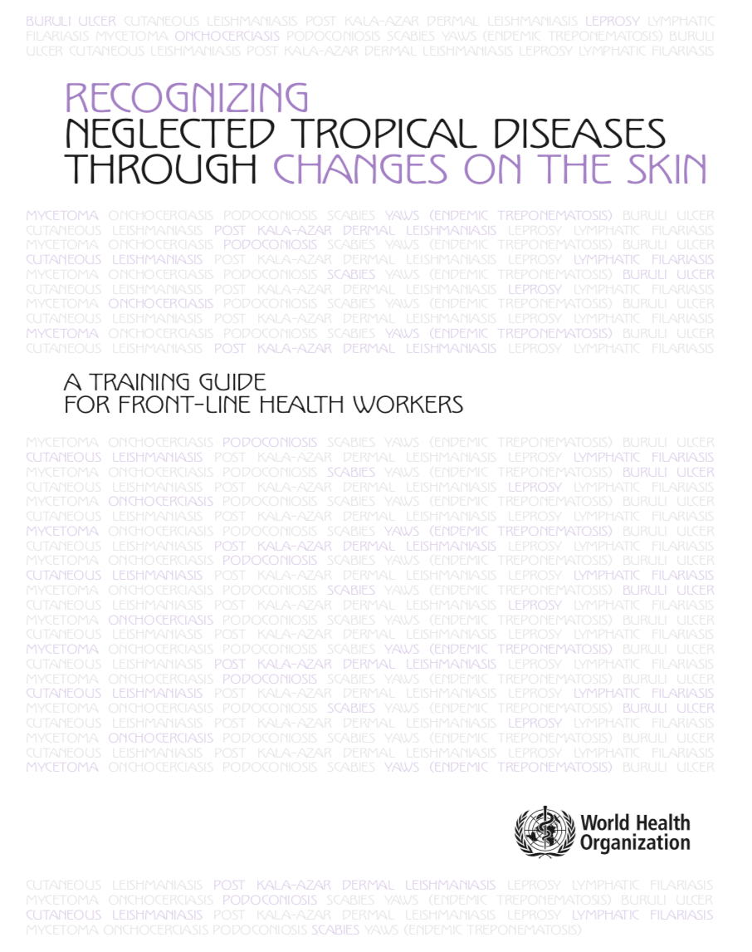
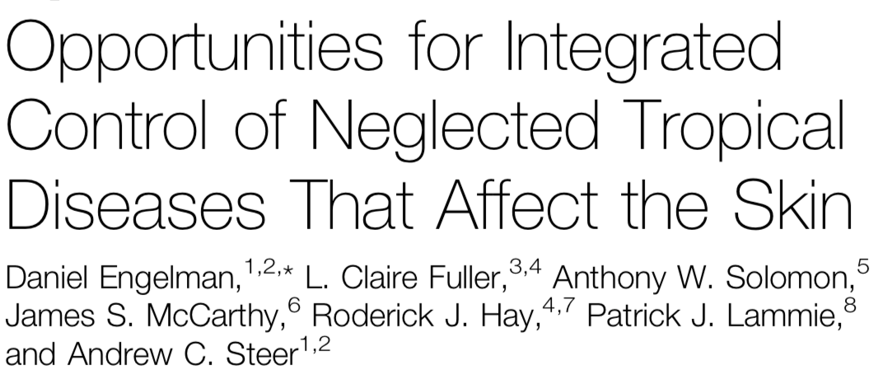
2015
2016
2017
2018
2021

Slide 8
Outline
NTDs & Skin-NTDs
Liberia burden estimation survey
Integrated Skin NTD Studies in Ghana & Ethiopia

Slide 9
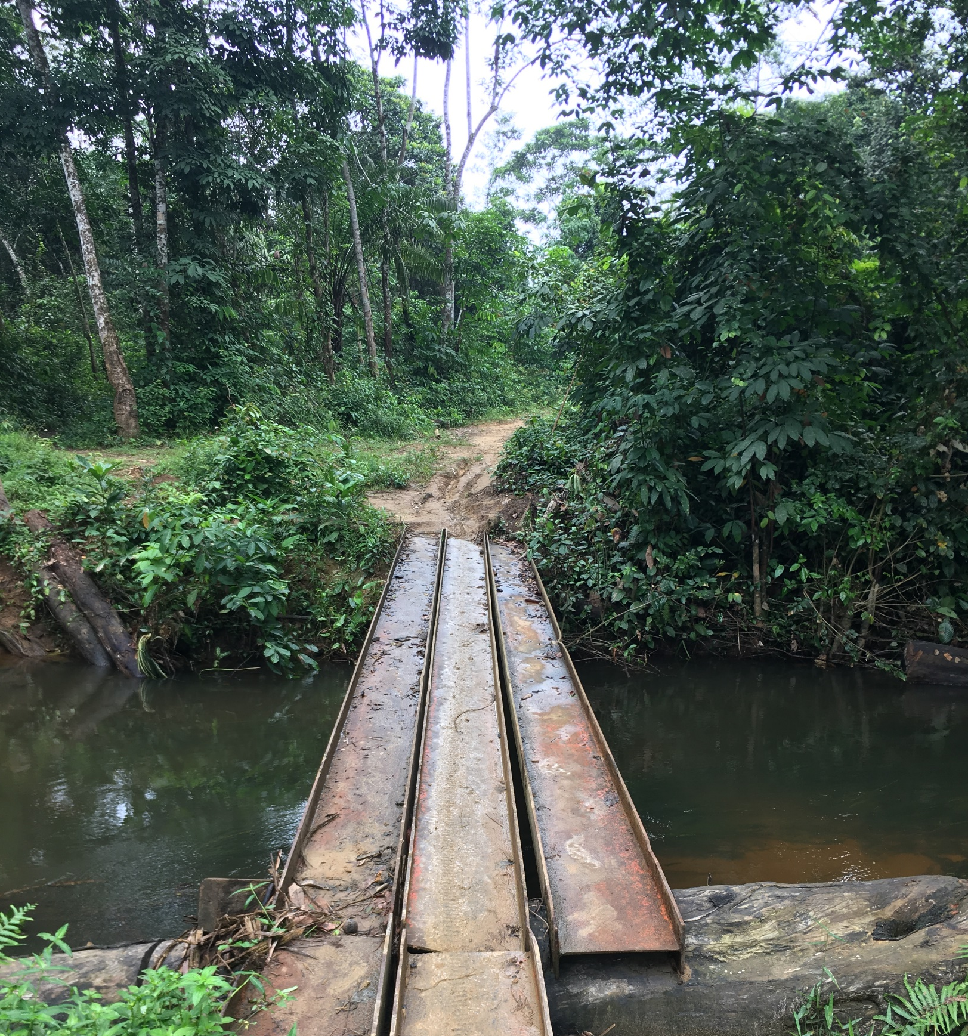
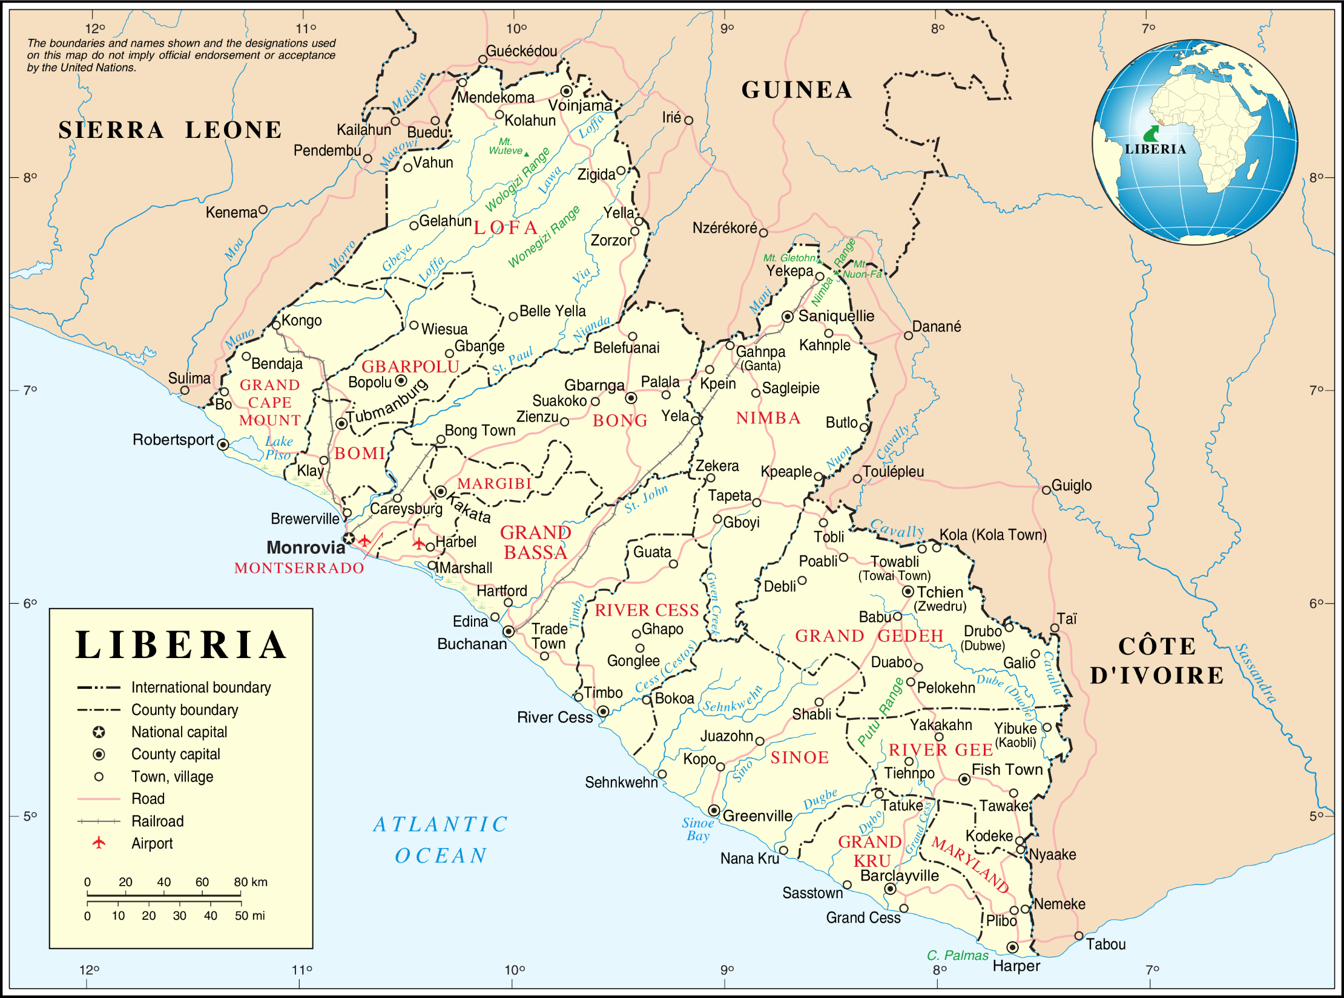
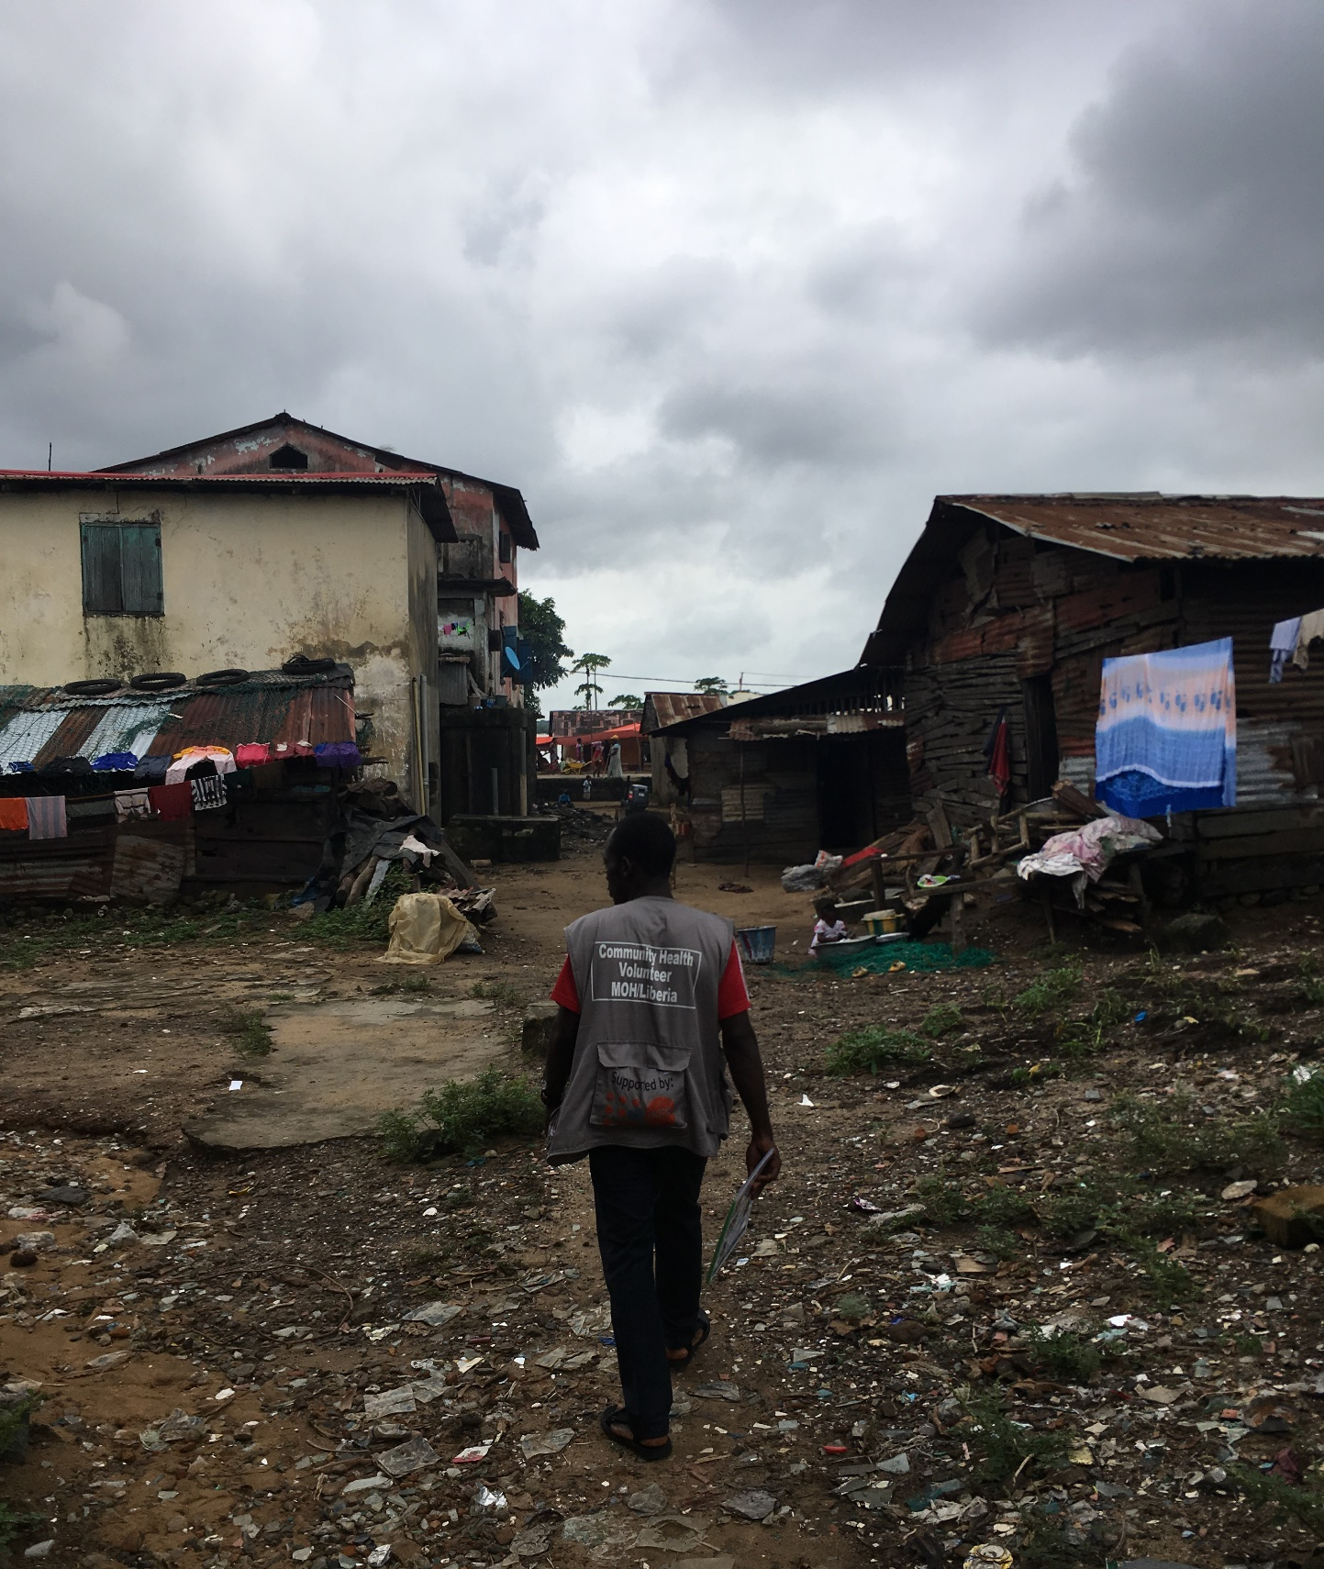
Integrated skin-NTD burden estimation strategy in Maryland County, Liberia

Slide 10
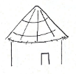
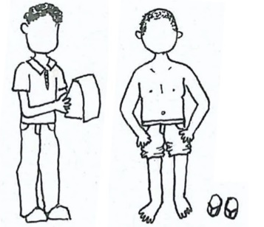
Cluster 1
Cluster 2
Cluster 3
Cluster 4
etc etc…
Cluster 92
Community sensitisation in every cluster
Stage 1 Screening
CHW census and screening in every cluster
(92 CHWs)
QC survey
Stage 2 Verification
Mobile verification of all cases
(Trained physician assistants)
QC survey
Estimated sample size = 59,724

Slide 11
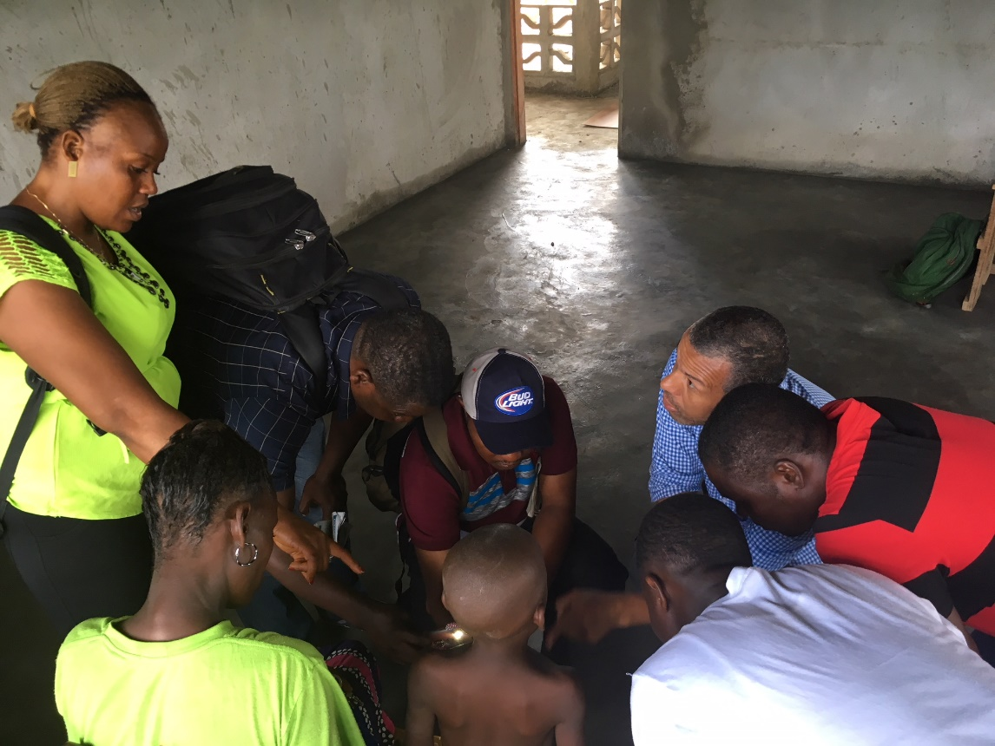
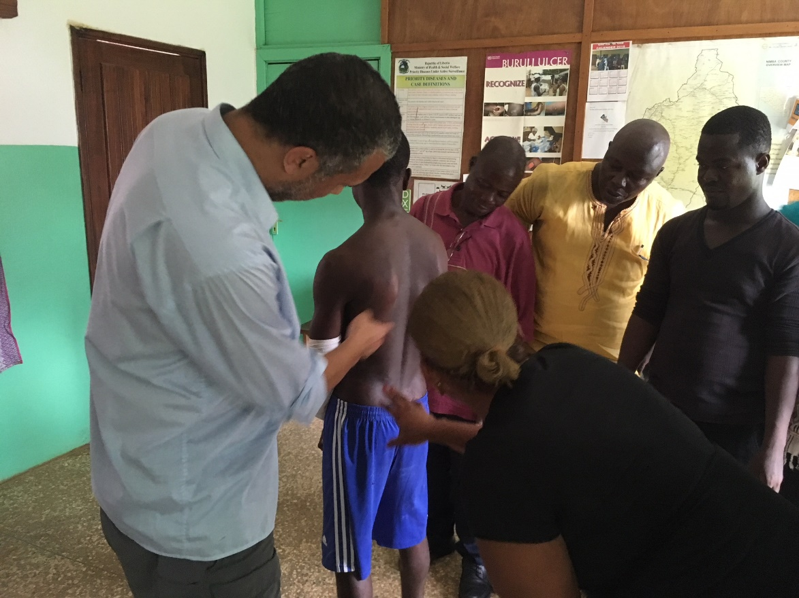
Stage 0: Training mid-level health workers
5-day clinical training programme developed for skin-NTD verifiers at national skin-NTD referral centre.
Recruited experienced health workers with physician assistant qualifications.
Step 1
Basic dermatology and common skin diseases.
Step 2
Practical training in clinical diagnosis of skin-NTDs.
Step 3
Case management.

Slide 12
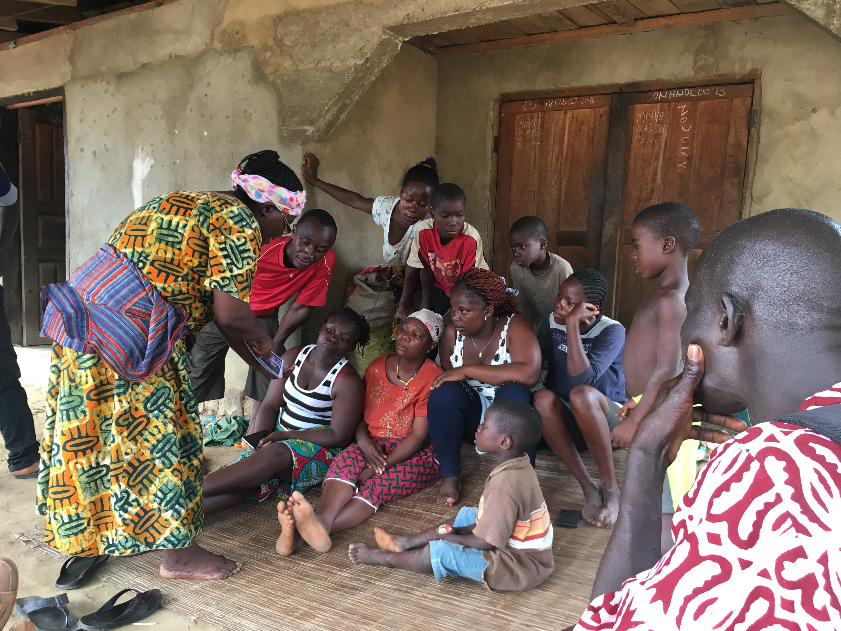
Stage 1: Screening
92 community health workers randomly selected
Collect GPS and electronic data with $35 mobile phones (3-days training)
Complete full census of community
(300-1700 people)
Show pictures of skin-NTDs to every household & Generate case list of suspected skin-NTDs

Slide 13
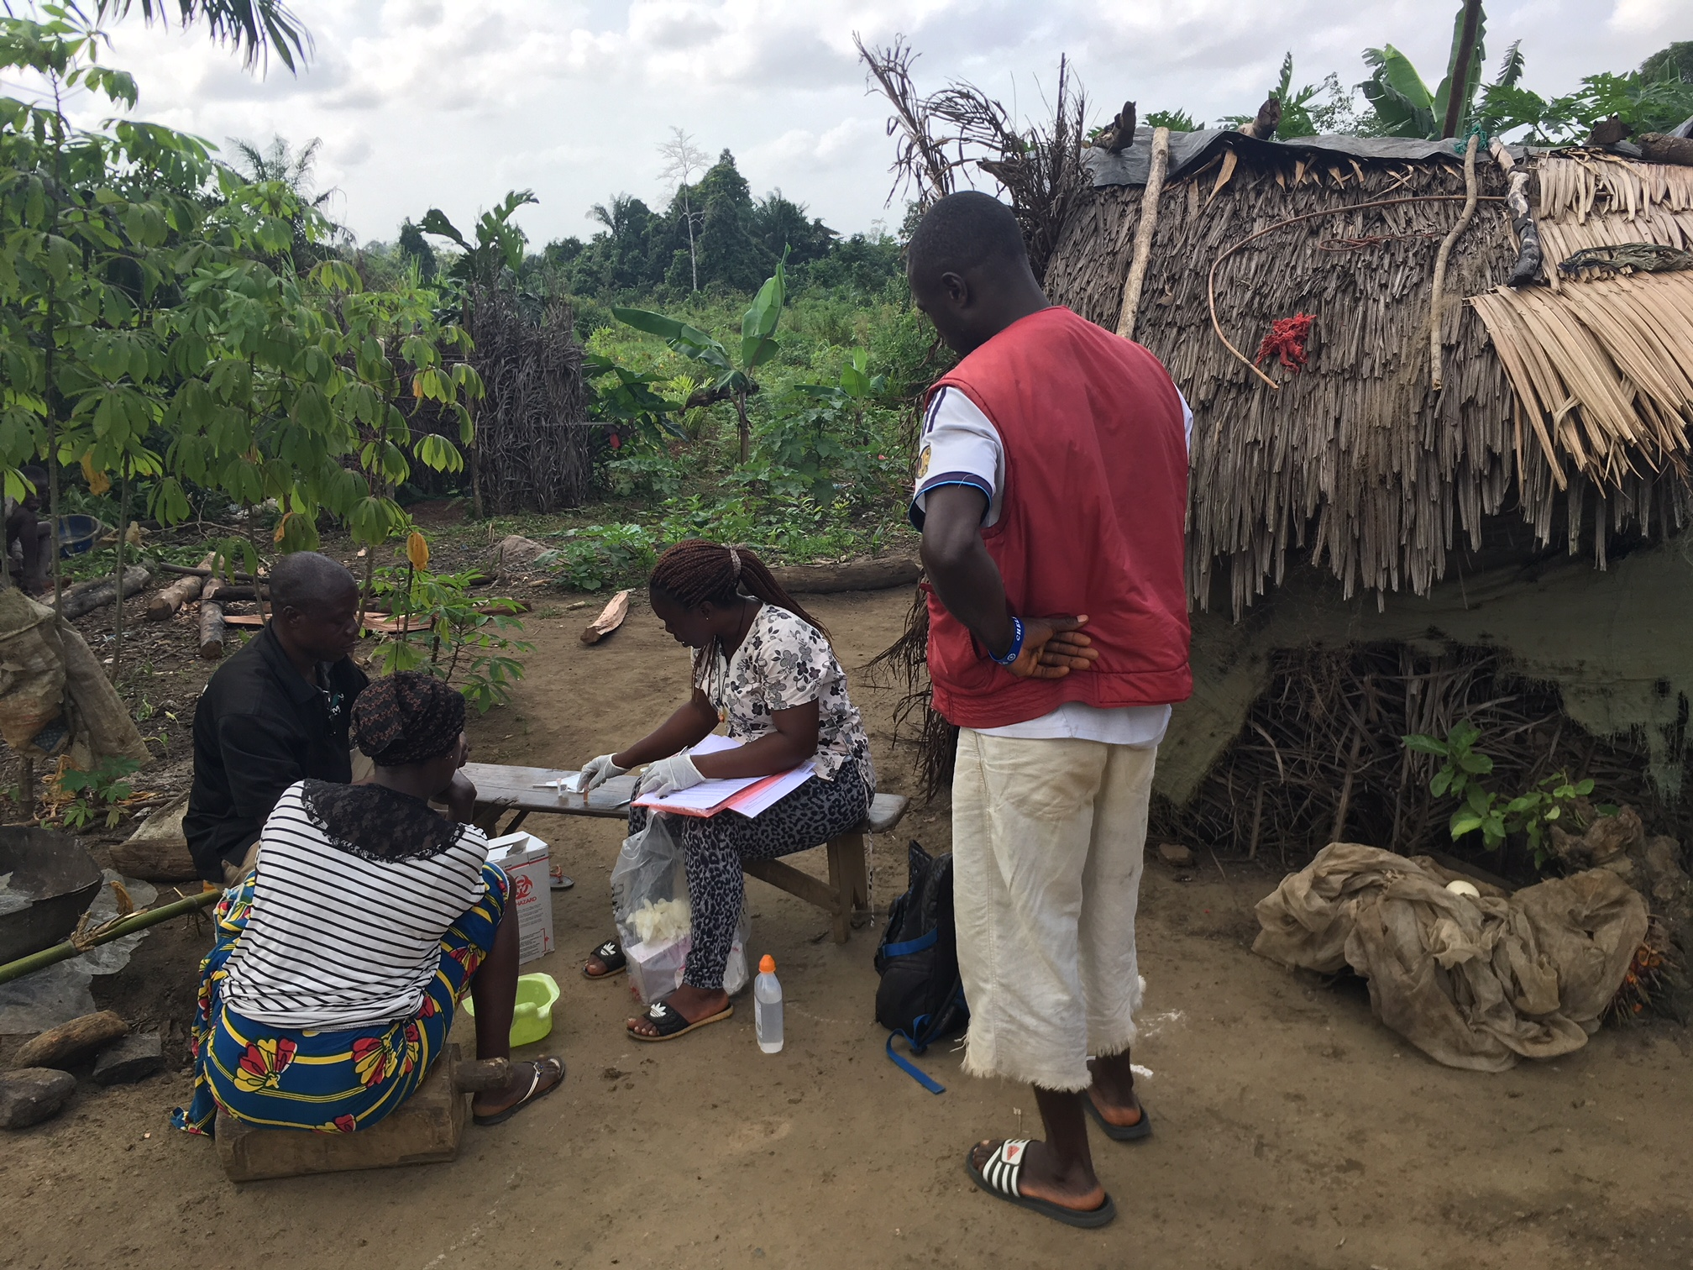
Stage 2: Case Verification
7 physician assistants trained to diagnose skin-NTDs
Verification team travel door-to-door to follow-up every suspected case
Diagnose skin-NTDs in patients’ home and collect samples.

Slide 14
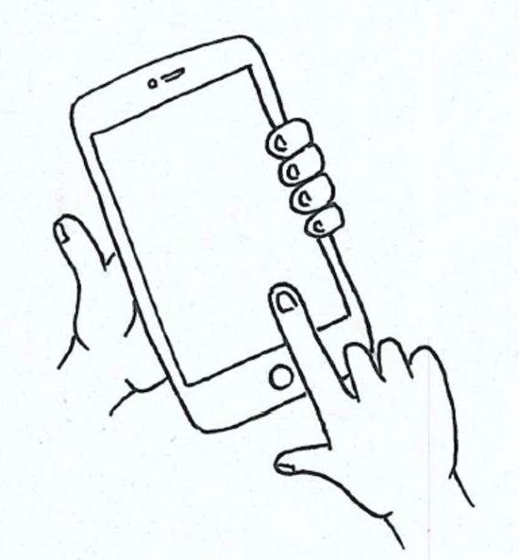
Quality Control Stages
Stage 1 QC
Local health worker randomly visit 10% of households
(2-days training):
Check CHW coverage
Perform full skin examinations
Stage 2 QC
National programme staff confirm clinical diagnoses in patients’ homes.
Electronic data capture
Electronic validation of data input and GPS.

Slide 15
4 month duration
56,825 enumerated and screened
3,140 suspected cases referred
Quality control of CHW screening
High CHW community coverage rates
95% reported CHW visit during QC checks.
87% household ID re-capture rate during QC.
Stage 1: Screening Results

Slide 16
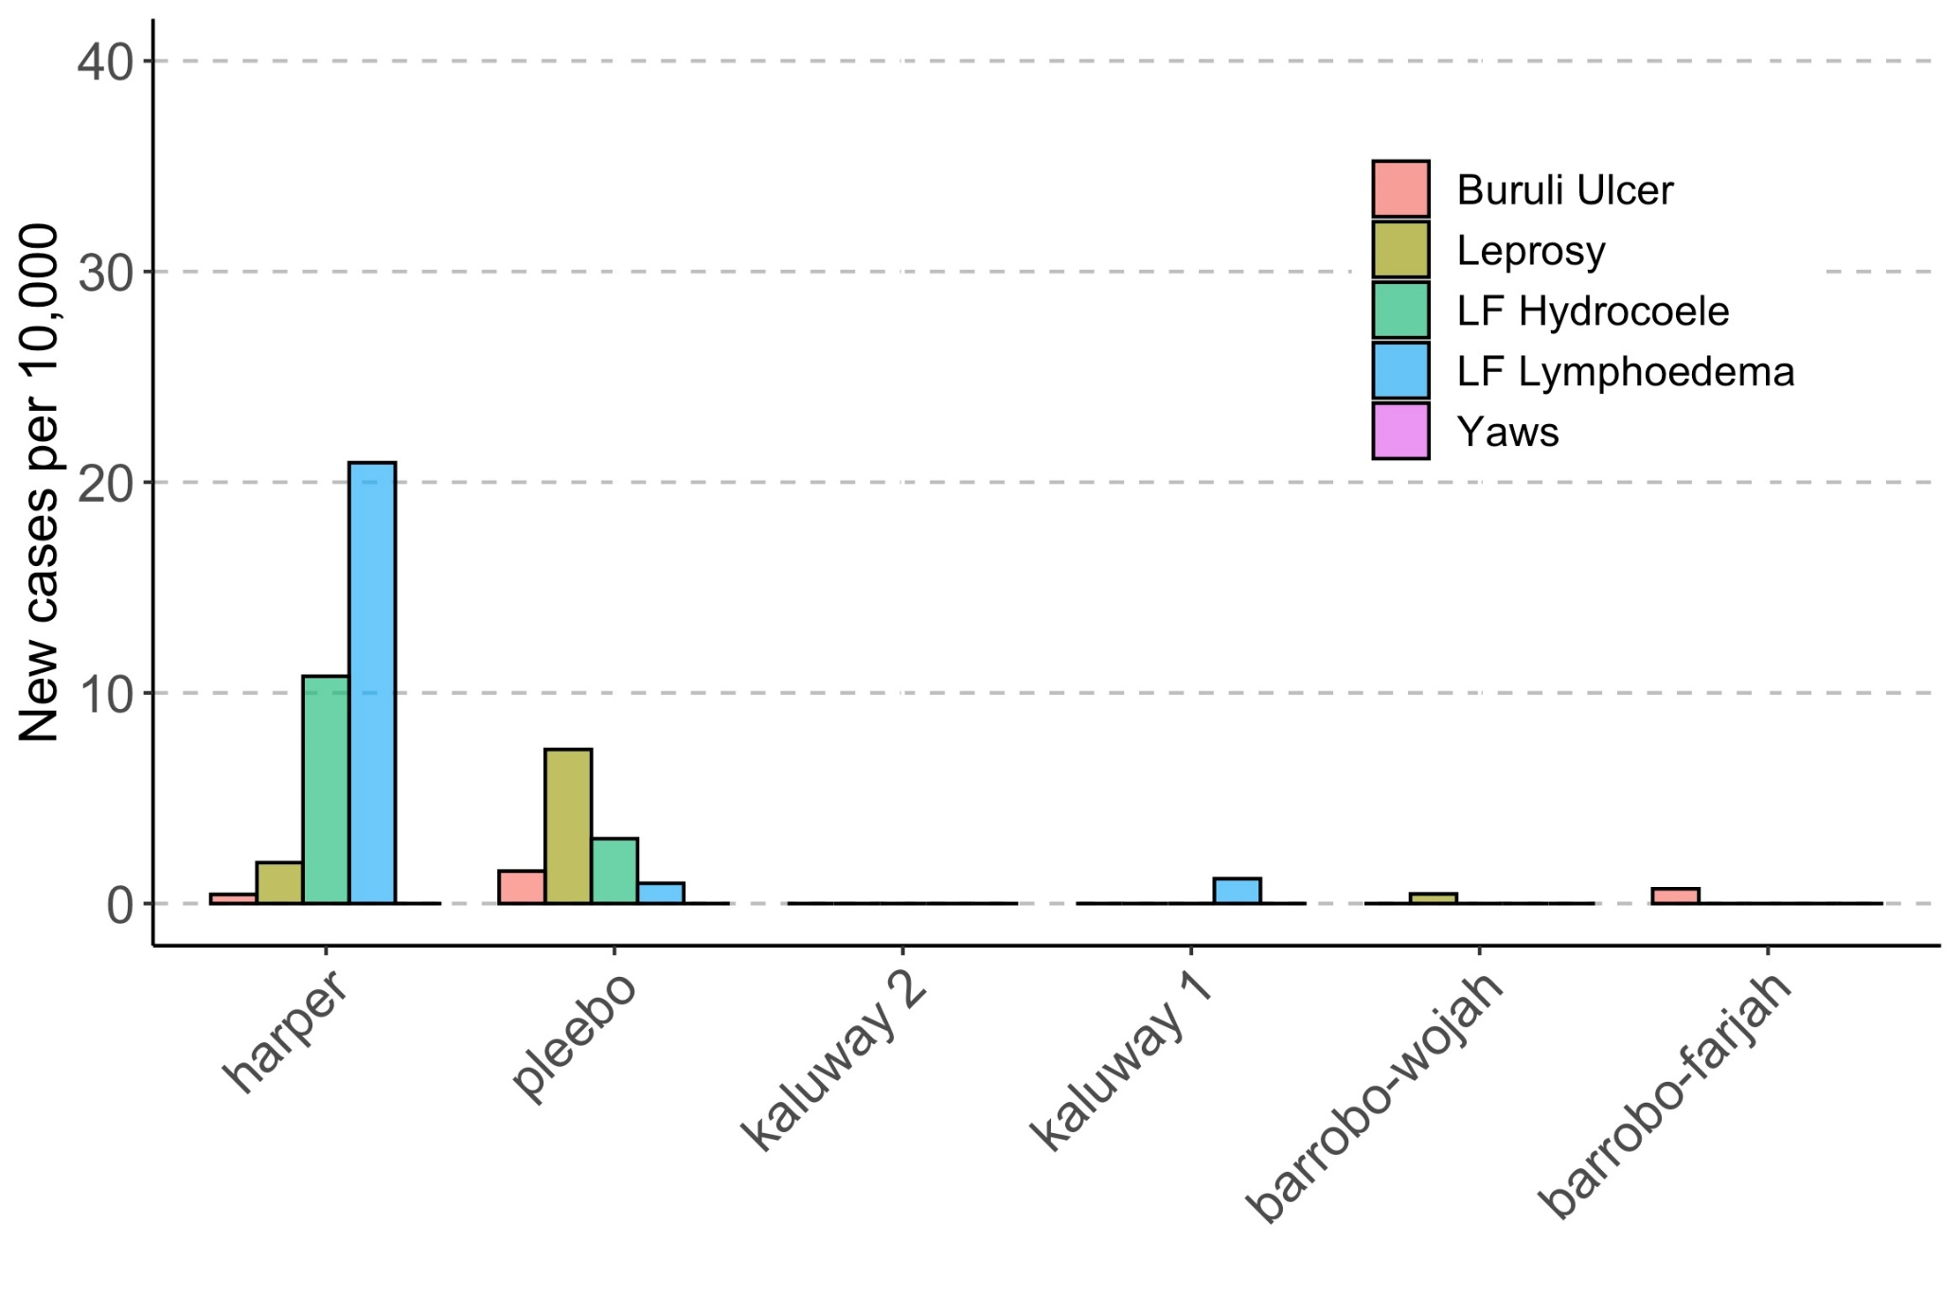
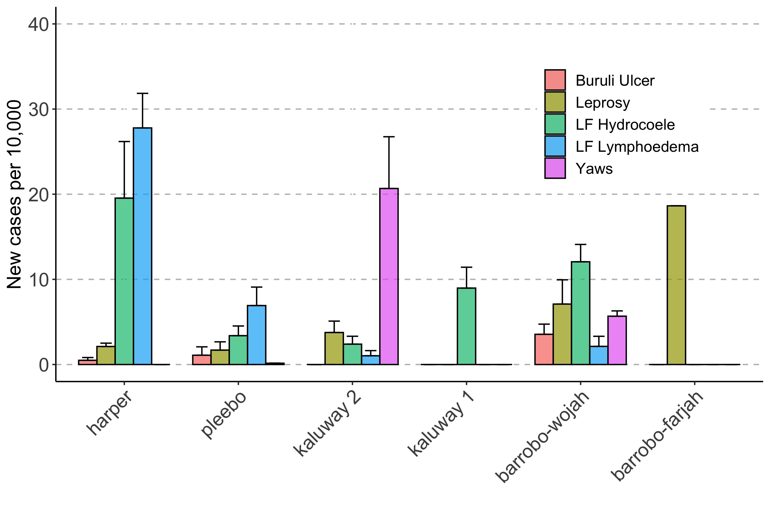
Stage 2: Verification Results
Routine data: New case detection rate
Maryland Jan-Dec 2017
Survey cases: Previously
unknown to the health system

Slide 17
Stage 2: Verification Results
>85% of referrals diagnosed were not skin-NTDs.
Implementation considerations:
Treatment provision (not cheap e.g. benzyl benzoate in Liberia is $4 per 100ml).
Implications of not treating ~90% of suspected cases.
 | Ulcers | Scabies | Fungal Infection | Scrotal Hernia | Non-LF hydrocele | Hernia | Oedema | Unknown | Nothing
Total cases - % of all diagnoses | 65 - 2.5% | 316 - 12.0% | 471 - 17.9% | 279 - 10.6% | 15 - 0.6% | 217 - 8.3% | 17 - 0.6% | 58 - 2.2% | 359 - 13.7%

Slide 18
Outline
NTDs & Skin-NTDs
Liberia burden estimation survey
Integrated Skin NTD Studies in Ghana & Ethiopia

Slide 20
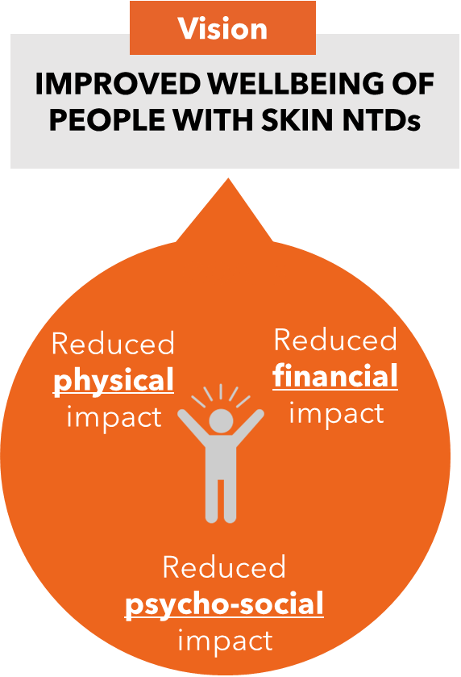
AIM: Improve outcomes for people with SSSDs by strengthening the care cascade through scalable strategies for earlier detection, improving management to reduce disability and counteracting stigma and discrimination
Ghana
Cross-SSSDs: Co-develop and evaluate tailored, integrated strategies
for early diagnosis, adherence support and stigma reduction
Ethiopia
BU: Evaluate the performance of strategies to improve healing
CL: Validate person-centred outcome measures to optimise care and inform evidence for treatment
Promote inter-sectoral collaboration and build capacity

Slide 21
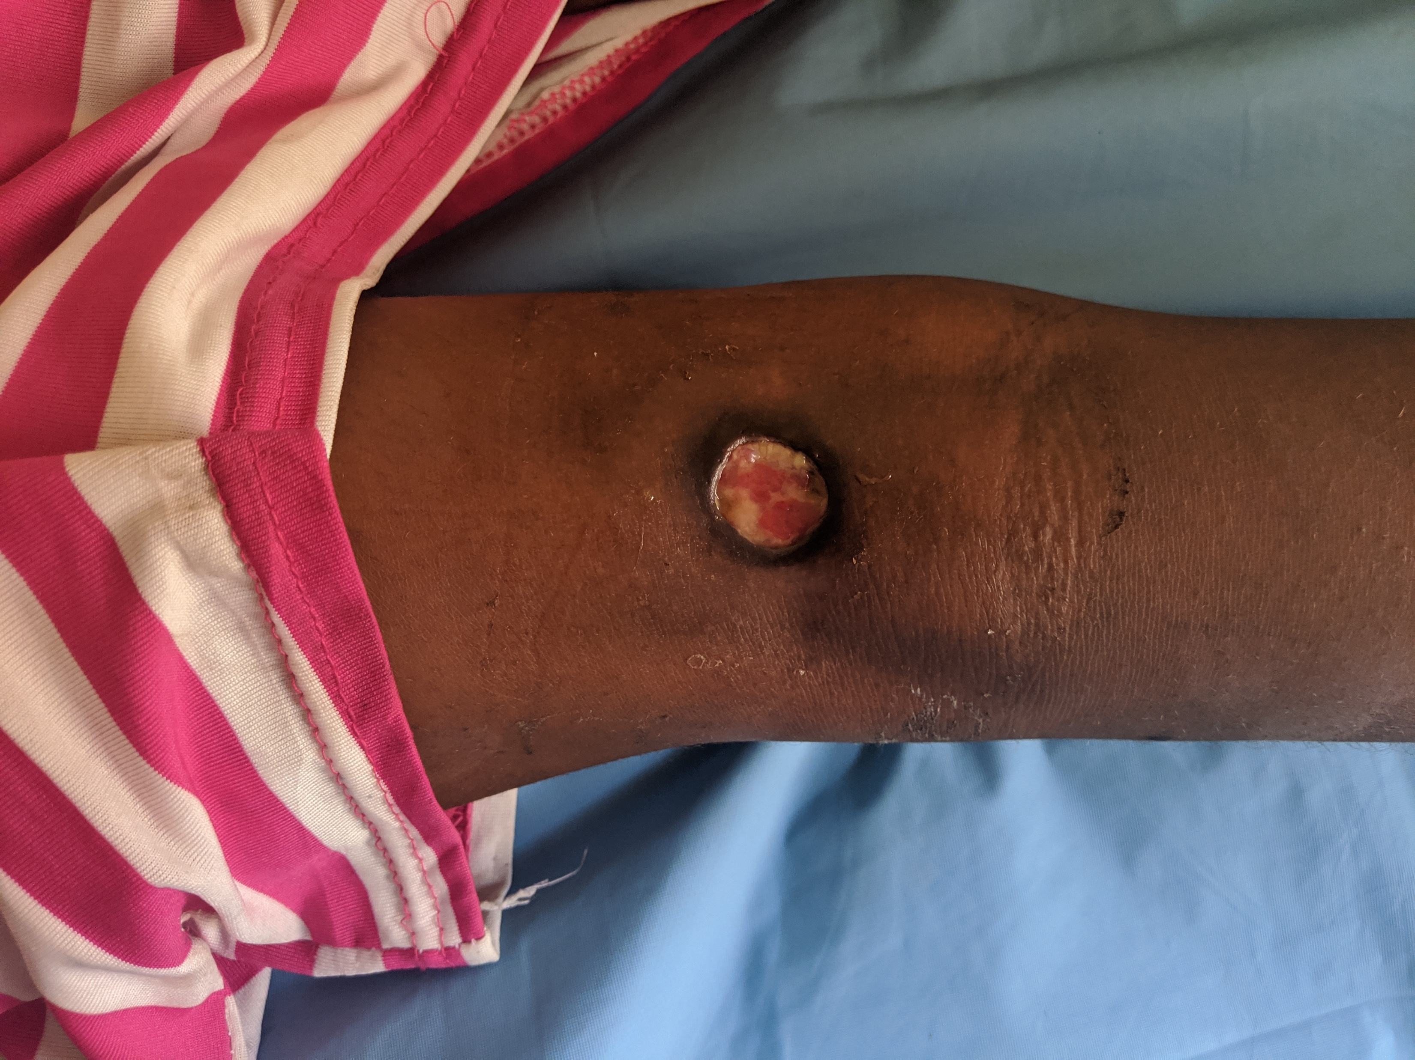
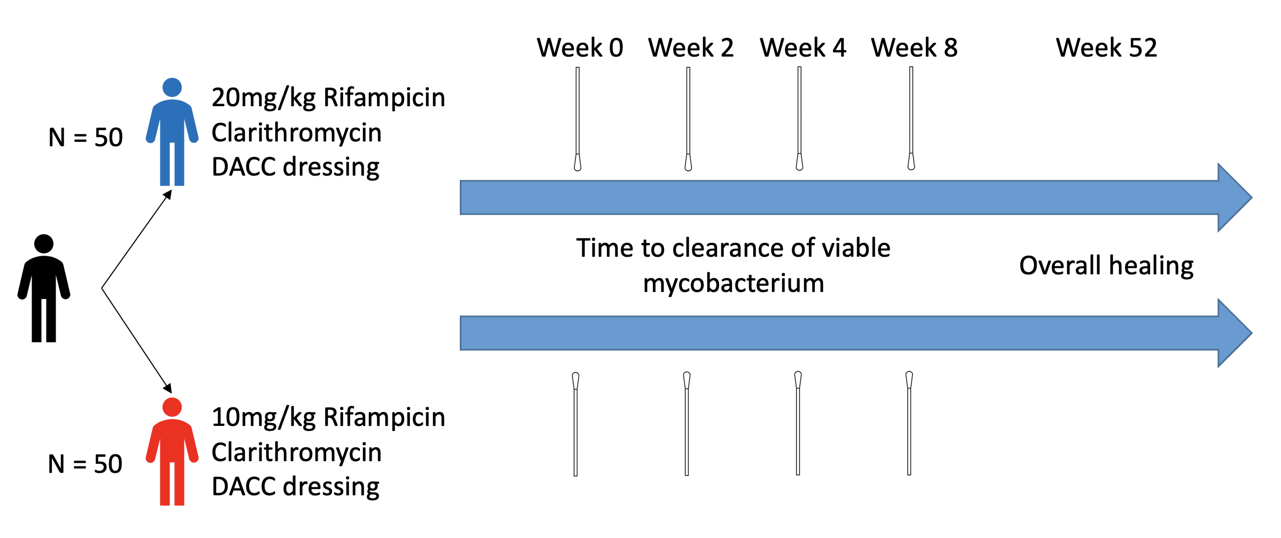
Promote inter-sectoral collaboration and build capacity
Ghana
Ethiopia
BU: Improving healing
3. Cross-SSSDs: Co-develop and evaluate tailored, integrated strategies for early diagnosis, adherence support and stigma reduction
CL: Validate person-centred outcome measures
Aim: Shorten treatment duration and reduce time to wound healing in patients with Buruli ulcer
Design: Prospective individually randomised trial at 3 Buruli Ulcer treatment centres in Ghana

Slide 22
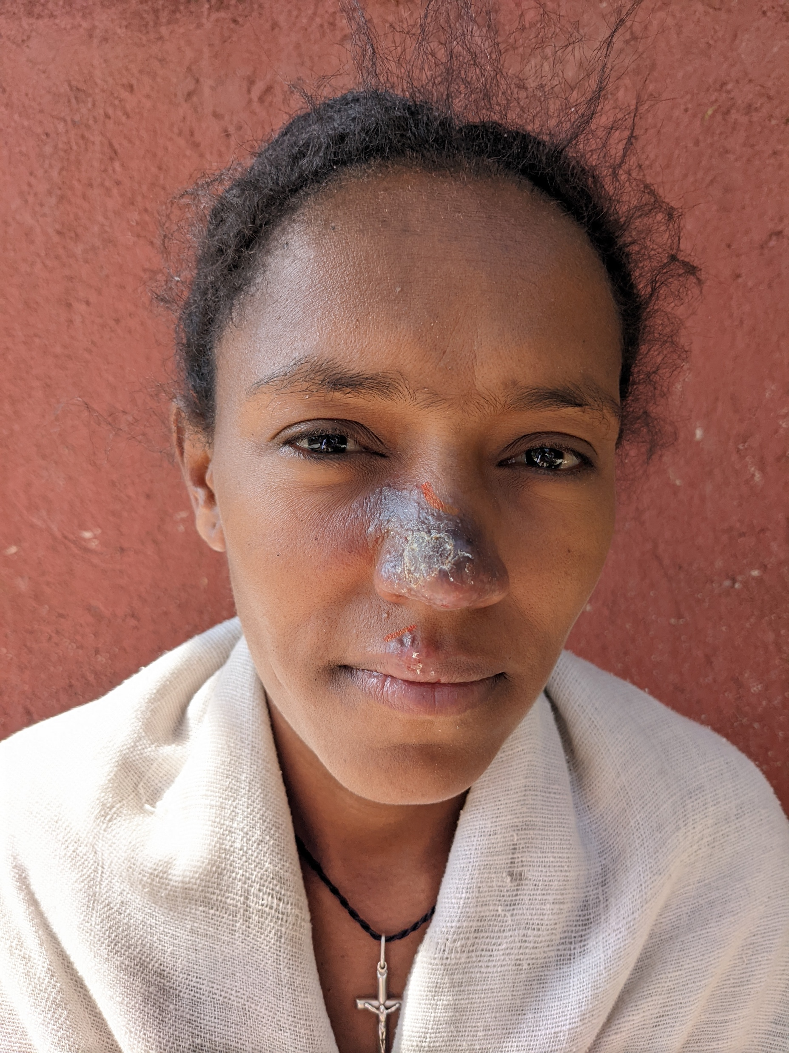
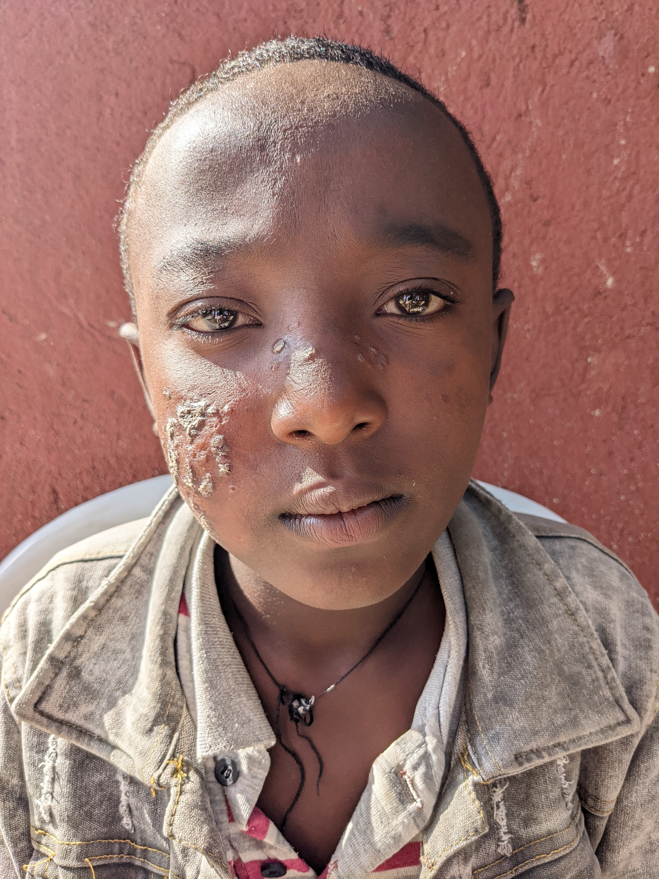
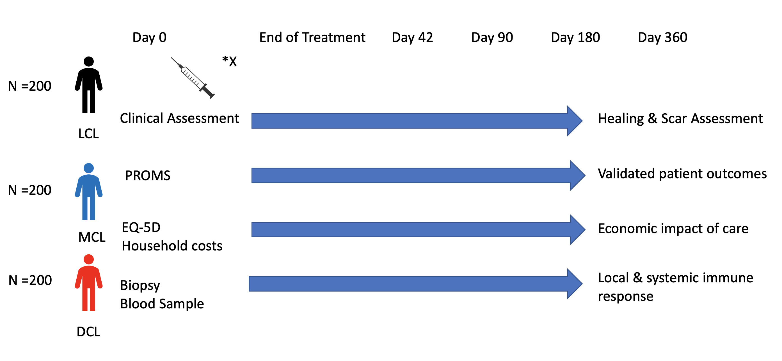
Promote inter-sectoral collaboration and build capacity
Ghana
Ethiopia
BU: Improving healing
3. Cross-SSSDs: Co-develop and evaluate tailored, integrated strategies for early diagnosis, adherence support and stigma reduction
CL: Validate person-centred outcome measures
Aim: Validate patient centred clinical outcomes for CL caused by L. aethiopica and identify clinical predictors of outcome
Design: Prospective cohort study at two CL treatment centres in Ethiopia

Slide 23
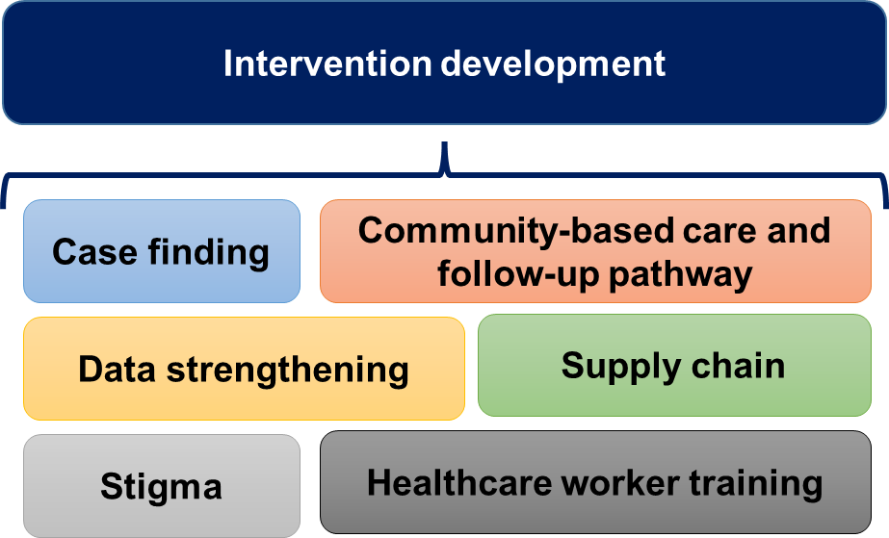
Promote inter-sectoral collaboration and build capacity
Ghana
3. Cross-SSSDs: Co-develop and evaluate tailored, integrated strategies for early diagnosis, adherence support and stigma reduction
Ethiopia
BU: Improving healing
CL: Validate person-centred outcome measures
Aim: develop, pilot and evaluate the feasibility, cost-effectiveness and impact of comprehensive integrated SSSD interventions on the number of people with SSSDs who are diagnosed, linked to the health system and complete treatment in Ethiopia and Ghana.

Slide 24
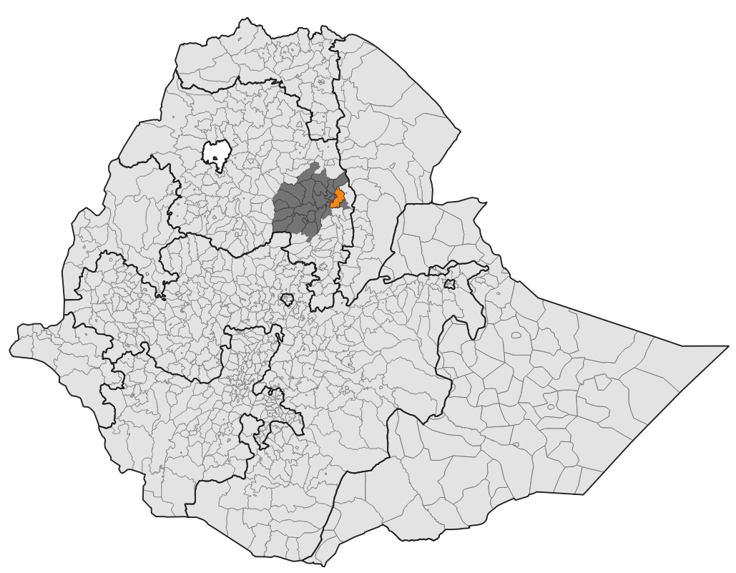
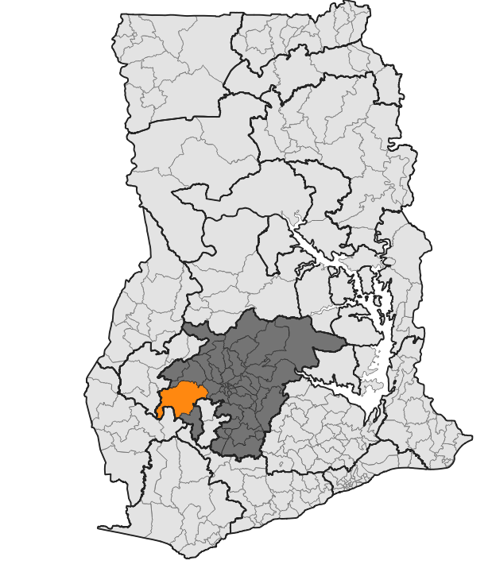
Cross-SSSDs: Co-develop and evaluate tailored, integrated strategies for early diagnosis, adherence support and stigma reduction
Kalu (South Wollo Zone, Amhara)
Population: ~200,000
Environment: lowland and highland zones, varying from subhumid to semiarid
Livelihoods: mixed farming
9 health facilities, 33 health posts
Endemic SSSDs: CL, leprosy
Neither setting has experience of formal health interventions for SSSDs
Atwima Mponua (Ashanti Region)
Population: ~170,000
Environment: wet semi-equatorial forest
Livelihoods: agriculture, forestry, fishing
10 health centres, 6 CHPS
Endemic SSSDs: BU, yaws, leprosy
Notes:
Community-based Health Planning and Services

Slide 25
What are we aiming for?
High level outcomes
Pre-diagnosis*
Formal diagnosis
Treatment and support
More people seeking early care for skin conditions from an appropriate person
Timely and accurate diagnosis received by individual following initial contact with health facility
Individuals complete effective treatment (regaining normal function)
! All without incurring catastrophic expenditure !
Initial symptoms

Slide 26
Integrated case-finding and management:
Formative Research Overview
Health records review
Assessment of routine reporting data on skin NTDs at both facility and district level.
In depth interviews
With stakeholders (local& national) delivering health, social or local care services related to these diseases, and with community members who have experience with these skin diseases
Health systems review
Mixed
Methods
Service availability and readiness surveys (conducted at health centres, posts and CHPS) and medicines surveys (conducted at pharmacies and drug sellers)
Focus group discussions
Observations
With different groups of community members exploring: knowledge and views on skin diseases; experiences of living with skin diseases; experiences of providing care or services
In a small number of health facilities, patients, organisations and members of the local care system were selected to follow more closely through in-person observations
Notes:
We have collected information from a range of individuals in the formal and informal health sectors and the communities, as well as from the variety of stakeholders within Ghana involved in skin-health focused care provision.
Project activities
Focus group discussions – Discussions with different groups of community members exploring: knowledge and views on skin diseases; experiences of living with skin diseases; experiences of providing care or services
In-depth interviews – Interviews with local and national stakeholders delivering health, social or local care services related to these diseases, and with community members who have experience with these skin diseases
Participant observations – In a small number of health facilities, patients, organisations and members of the local care system were selected to follow more closely through in-person observations
Health system survey – comprehensive service availability and readiness surveys (conducted at health posts and CHPS) and medicines surveys (conducted at pharmacies and drug sellers) supplement the interviews and observations conducted with the health and local care providers.
Routine health records review – assessment of routine reporting data on skin NTDs at both facility and district level.

Slide 27
Problems we didn’t see
We didn’t see any evidence for……..
Substantial stigma impacting upon people’s choice to seek care
Firmly held causal beliefs strongly dictating people’s choice of care
Strongly held beliefs that allopathic medicine was ineffective for treating these conditions
No knowledge or understanding of these skin NTDs within communities
Limited faith in existing diagnostics

Slide 28
Pre-diagnosis*
Formal diagnosis
Treatment and support
More people seeking early care for skin conditions from an appropriate person
Timely and accurate diagnosis received by individual following initial contact with health facility
Individuals complete effective treatment (regaining normal function)
! All without incurring catastrophic expenditure !
1. People know (from report and/or experience) that seeking diagnosis, treatment and care from a health facility can be expensive and take a long time
2. Healthcare landscape is complicated!
3. Community awareness of many skin conditions (presentation, causation, next steps) is limited
1. Staff at most levels of the health system do not have the knowledge, skills and confidence re what tests to do, when, and how.
2. Molecular diagnosis is only available from expert reference labs outside the district, leading to logistical (samples → lab) and communication (result → patient) bottlenecks
1. Firstline drugs for many conditions are not rapidly available at the facility level
2. Medicines, dressings and wound care are often unavailable at all levels of the health system, or are available but individual doesn’t have health insurance
3. Skills gaps around respectful care and appropriate communication

Slide 29
Promote inter-sectoral collaboration and build capacity
Ghana
3. Cross-SSSDs: Co-develop and evaluate tailored, integrated strategies for early diagnosis, adherence support and stigma reduction
Ethiopia
BU: Improving healing
CL: Validate person-centred outcome measures
Implementation of a scalable package deliverable by MOH
Process evaluation
Population SSSD survey
Cost effectiveness

Slide 30
Conclusions
NTDs increasingly moving away from vertical programmes
Aligned with UHC
Reflected in 2030 NTD roadmap
Skin involvement is the most common feature of NTDs but most of what we see won’t be NTDs
Work is an entry point for ‘healthy-skin for all’
Not enough ‘experts’ to deliver care > broader, decenteralised, whole community based approach

Slide 31
London School of Hygiene and Tropical Medicine
Steve Walker
Michael Marks
Rachel Pullan
Katherine Halliday
Joseph Timothy
Saba Lambert
Sinead Langan
David Mabey
Charles Opondo
Liz Allen
Jennifer Palmer
Catherine Pitt
Iris Mosweu
Maria Zuurmond
Vanessa Yardley
Ruth Canter
Tara Mtuy
Armauer Hansen Research Institute
Enalamaw Gadisa
Kidist Bobosha
Yohannes hailemichael
Abebaw Yeshambel
Tekelu Cherkose
Abay Woday
ALERT Hospital
Shimelis Nigusse
Addis Ababa University
Mirgissa Kaba
Fewzia Shikur
Amel Mohammed
Kibur Engdawork
Kumasi Centre for Collaborative Research in Tropical Medicine
Richard Phillips
Yaw Amoako
Jacob Novignon
Ruth Tuwor
Lucy Owesu
Abigail Agbanyo
Michael Oppong
Joseph Tuffour
Noguchi Memorial Institute for Medical Research
Dorothy Yeboah-Manu
Collins Ahorlu
Eric Koka
Adwoa Asante-Poku
Daniel Okyere
Edmund Kwaku Richard Akuffo
Mr. Ishaque Mintah Siam
Emmanuel Afeh
Liberia Ministry of Health
Emerson Rogers
Karsor Kollie
Tarnue Mulbah
Zeela Zaizay
Romeo Giddings
Abednego Wright
Amos Ballah
Stanley Duwor
Johnson Geekor
William Govergo
Tina Hampaye
Emmanuel Johnson
Lawrence Kollie

