Slide 1
Vaccines trials in Pregnancy in Uganda
Prof. Kirsty Le Doare
14th March 2022

Slide 2
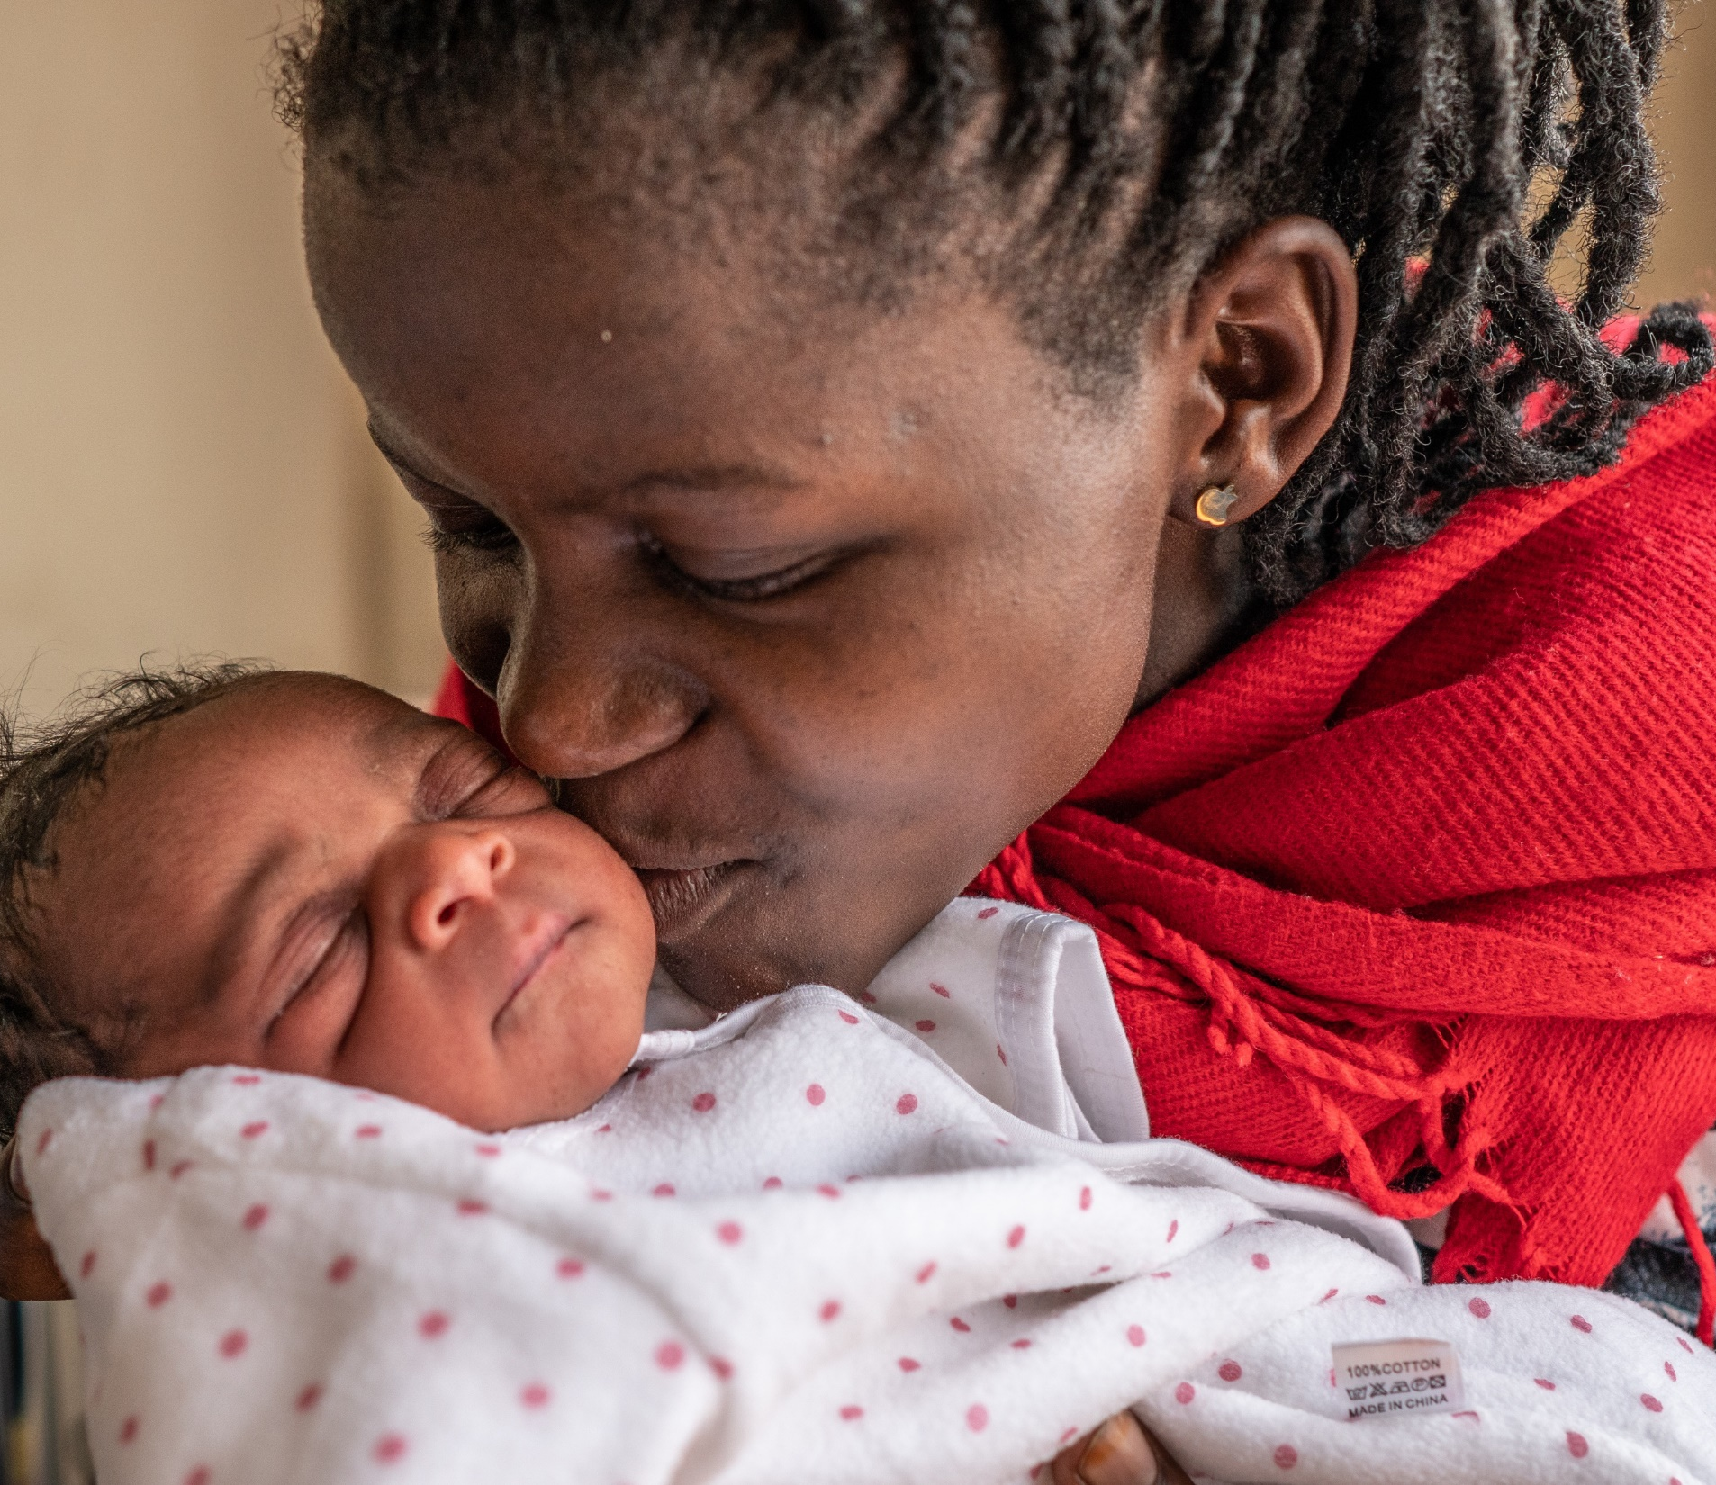
Preparation for maternal vaccine studies
Pregnancy is associated with complications (stillbirth, premature birth etc) that must be differentiated from vaccine associated adverse events.
Safe conduct of vaccine trials requires detailed information about background rates of adverse obstetric, maternal, neonatal and infant outcomes.
These are used to detect safety signals during trials and after implementation.

Slide 3
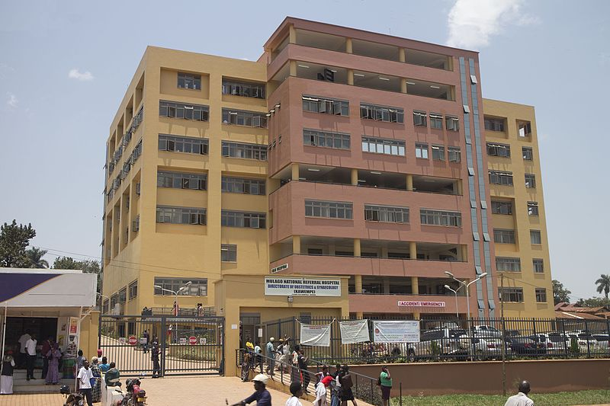
Kawempe Hospital
Recognized as a National referral hospital in 2019
High volume MCH facility
Opportunity to contribute to:
  Clinical care
  Training (undergraduate and postgraduate)
  Research
However – paper based records were a major obstacle/challenge!

Slide 4
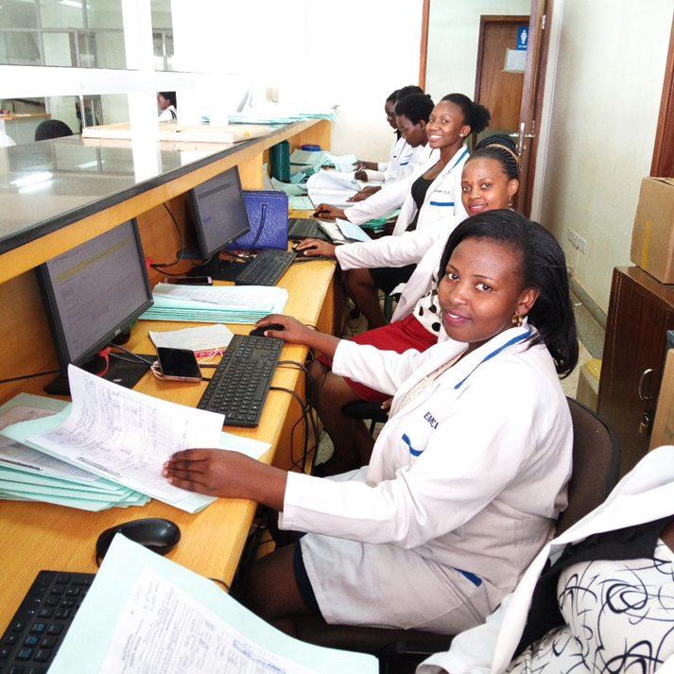
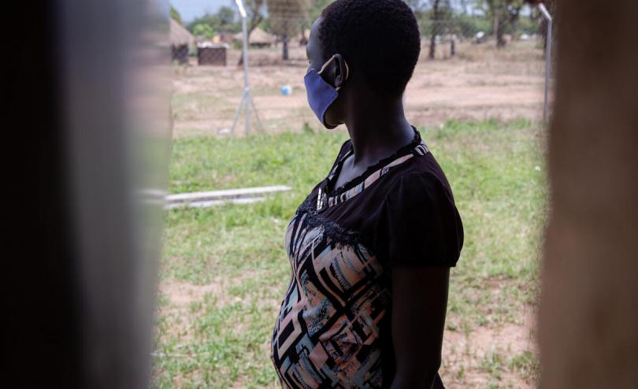
The Uganda Maternal Vaccines platform
Establishing background rates of adverse pregnancy, neonatal and infant outcomes
Harnessing EMR Pregnancy registries to monitor safety signals from vaccines
Conducting Phase II trials of TdaP and GBS vaccines in women living with HIV and uninfected controls
Working with our communities to build and maintain vaccine confidence

Slide 5
Establishing background rates of pregnancy outcomes
Screened
3947
Recruited
3315
Kawempe
1381
Elsewhere
376
Delivered
1757
Withdrawn consent 5

Slide 6
Adverse outcomes of pregnancy (n=1757)
Outcome | Number Recorded
Preterm birth (USS) | 136 (7.7)
Stillbirths | 52 (3.0)
Low birthweight (<2500g) | 175 (10.0)
Neonatal admissions | 175 (10.3)
Hypertensive disorders* | 462
Neonatal deaths | 26 (1.5)
Antepartum haemorrhage | 5 (0.1)
HIV Positive | 159 (4.8)
Postpartum haemorrhage | 29 (1.65)
Spontaneous abortions | 29 (0.7)
Maternal deaths | 2 (0.06)
*forms completed not individual participants
These outcomes have not undergone expert case file review or assessment for whether they meet
the GAIA Case Definitions

Slide 7
Pregnancy registry using electronic medical records Jul’ 20 - Jan’ 22
Monthly
1st ANC visits > 800
2+ ANC visits >1800
Deliveries > 2,000
Deliveries: 35,843
Still births
1,958
Live births
32,660
Fresh Still birth: 910
Macerated
still birth: 1,048
Deaths
Maternal
123
Neonatal
1,687

Slide 8
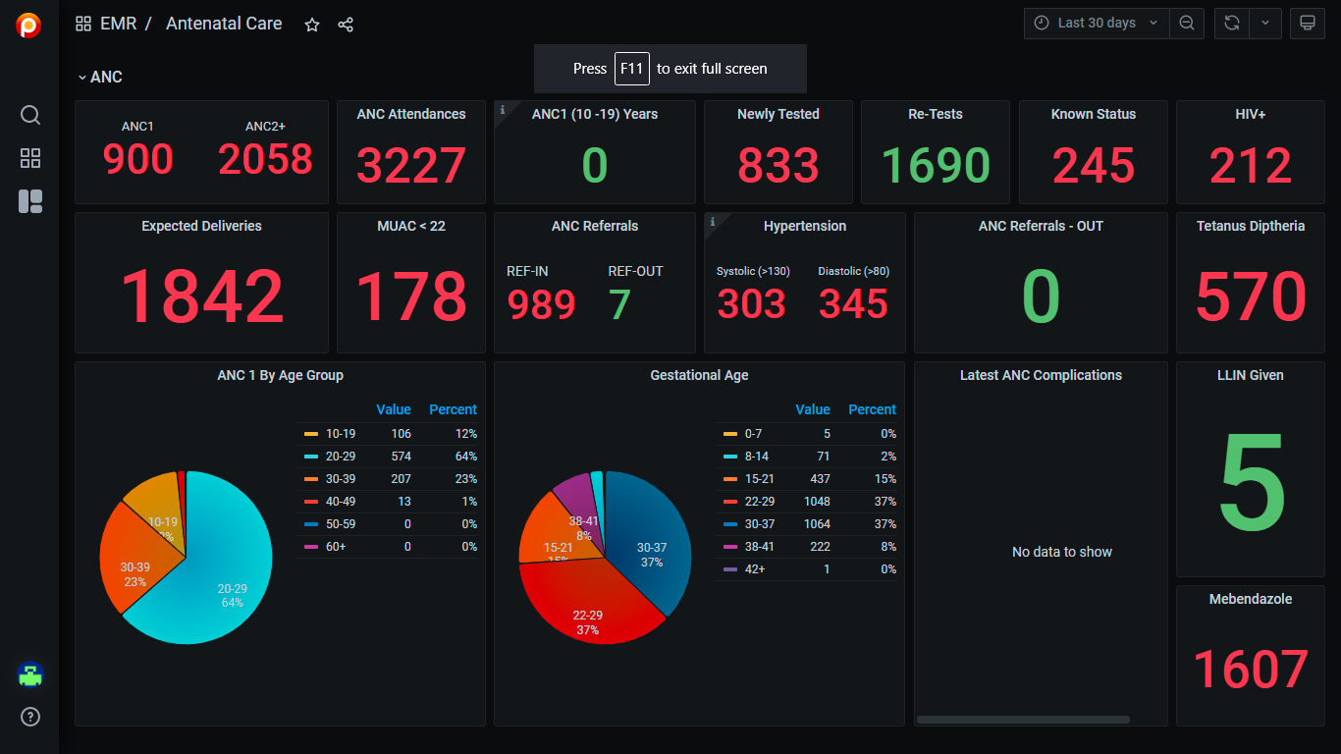

Slide 9
Multivalent GBS vaccine clinical trials
Prior studies of other GBS CPS conjugate vaccines: safe & immunogenic in pregnant women
  Over 1000 pregnant women have received any GBS vaccine with no safety signals
  Also safe in HIV +ve pregnant women, but with reduced immunogenicity
Vaccines for LMIC (esp. Africa) should be investigated in the populations they are meant to protect
Pfizer GBS vaccine aimed at prevention of GBS disease due to 6 serotypes with CRM197 carrier protein
Minervax GBS protein-vaccine aimed at prevention of GBS disease due to 4 conserved proteins with alum adjuvant

Slide 10
SAEs
Preeclampsia | Fetal Malposition
non-reassuring fetal status | Prolonged active labour
Preterm Delivery | Pre Labour rapture of membranes
Prematurity | Oligohydramnios
Respiratory distress syndrome | Meconium aspiration syndrome
Urinary tract infection | Obstructed labour
Septicaemia | Transient tachypnea of the newborn
Polydactyly | Neonatal sepsis
PPROM | Postpartum Psychosis
Premature Rapture of membranes | Puerperal sepsis
Prolonged pregnancy | Hypoxic ischemic encephalopathy
NB: Non assessed as having a causal relationship to study vaccine

Slide 11
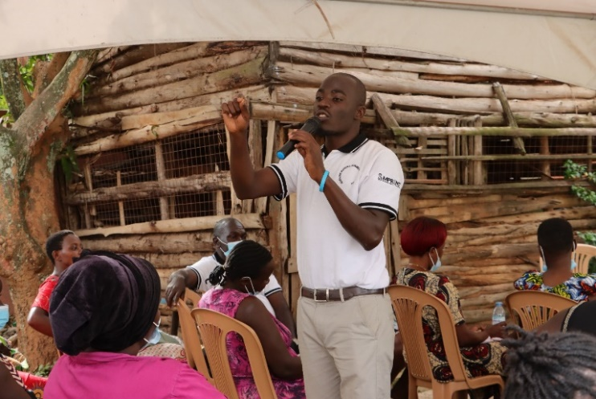
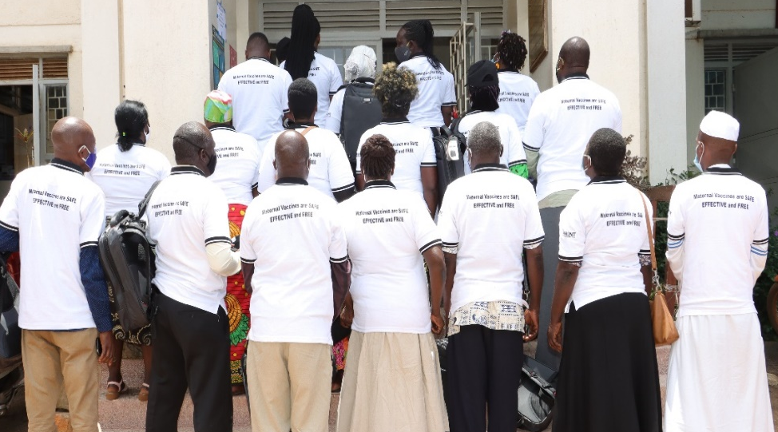
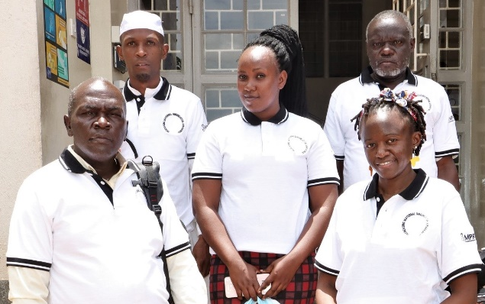
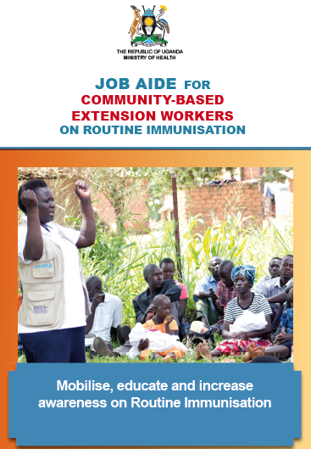
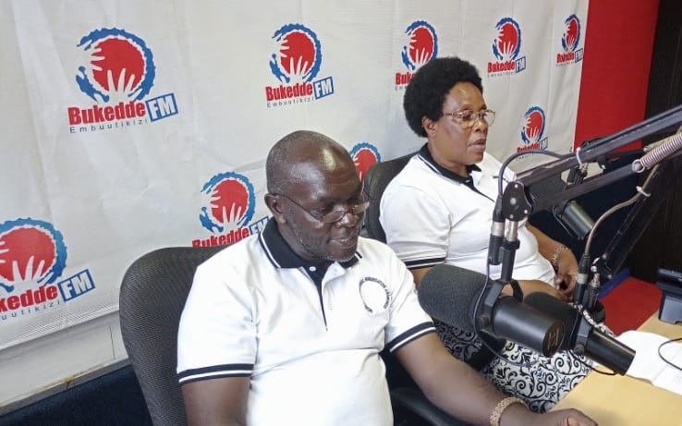
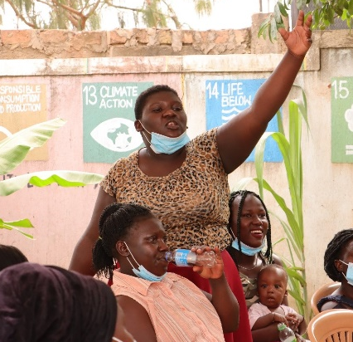
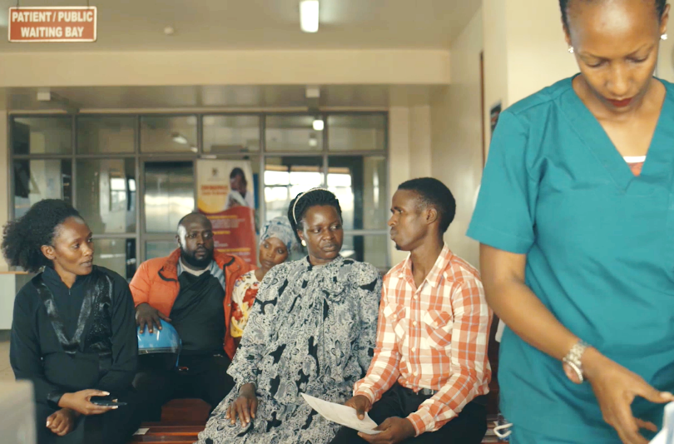
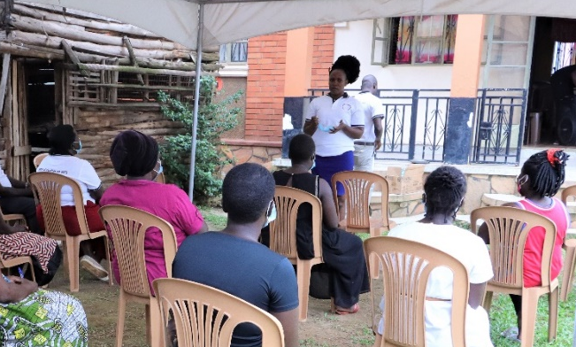
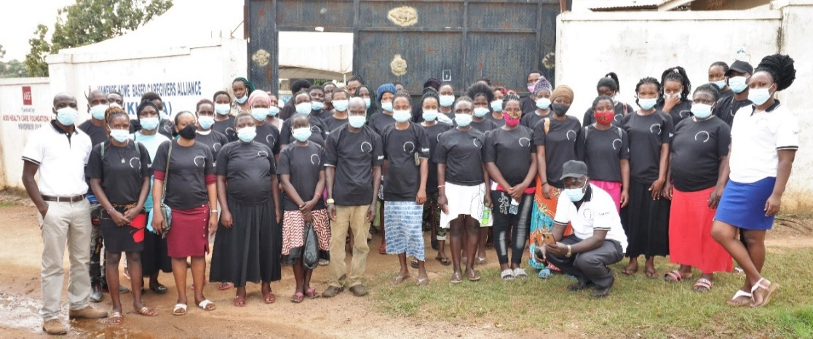
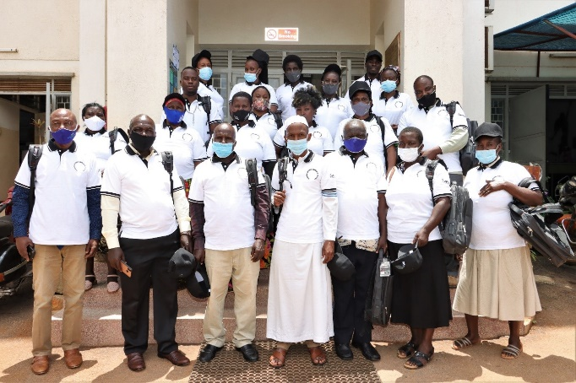
Working with our communities

Slide 12
Next steps
Completion of trials anticipated by end of 2023
Development of Phase III/IV site capacity
Roll out pregnancy registry country-wide

Slide 13

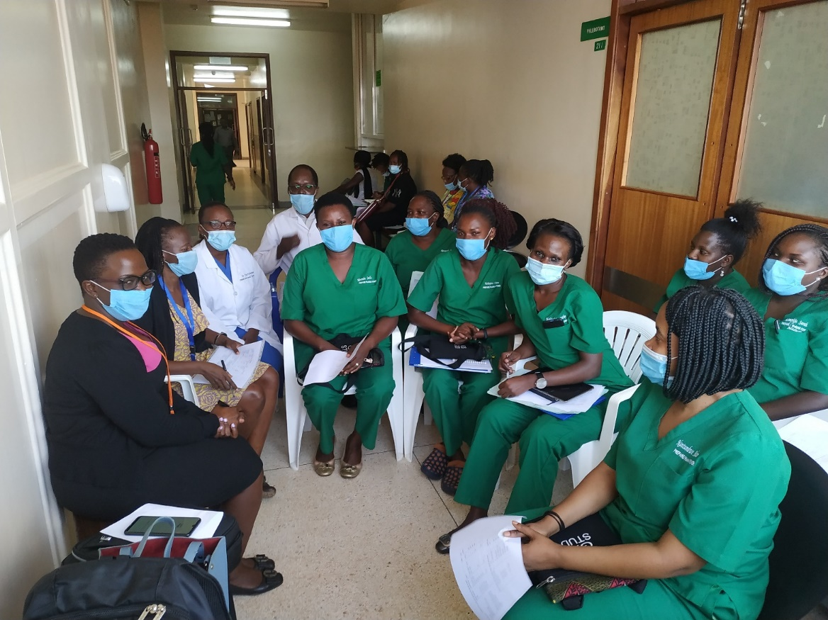




Thank you

