Slide 1
Gut dysfunction, inflammation and mortality in malnutrition
Jonathan Sturgeon (year 3 PhD), Harare, Zimbabwe
Zvitambo Institute for Maternal and Child Health Research
Wellcome Fellows meeting 14th Mar 2022

Slide 2
Increased infective mortality in Severe Acute Malnutrition
Gut dysfunction (enteropathy) in SAM:
Loss of barrier function
  Disrupted tight junction
  Endothelial breaks
Mucus reduced
Histological changes
  Villus blunting
  Crypt hyperplasia
  Lymphocytic infiltrate
Increased translocation of gut contents across endothelium

Slide 3
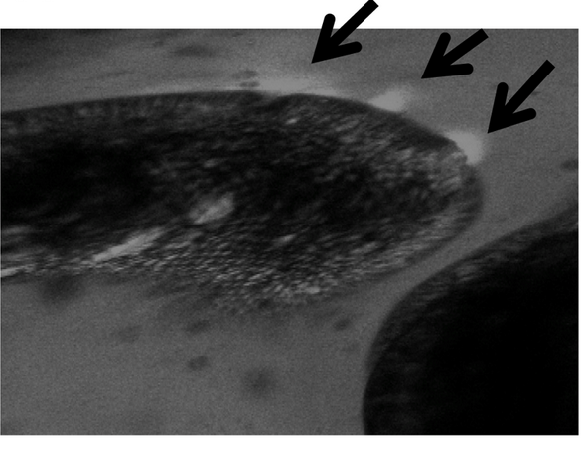
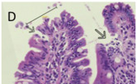
Increased infective mortality in SAM
Gut dysfunction (enteropathy) in SAM:
Loss of barrier function
  Disrupted tight junction
  Endothelial breaks
Mucous reduced
Histological changes
  Villus blunting
  Crypt hyperplasia
  Lymphocytic infiltrate
Increased translocation of gut contents across endothelium
Amadi. et al 2017

Slide 4
Increased infective mortality in SAM

Slide 5
Enteropathy, inflammation, and mortality in SAM
Enteropathy
Aim 1.
Examine the enteropathy -> translocation pathway -> inflammation pathway in children with SAM, and determine its association with mortality
Translocation of bacterial products
Inflammation

Slide 6
Enteropathy, inflammation, and mortality in SAM
Enteropathy
Translocation of bacterial products
Inflammation

Slide 7
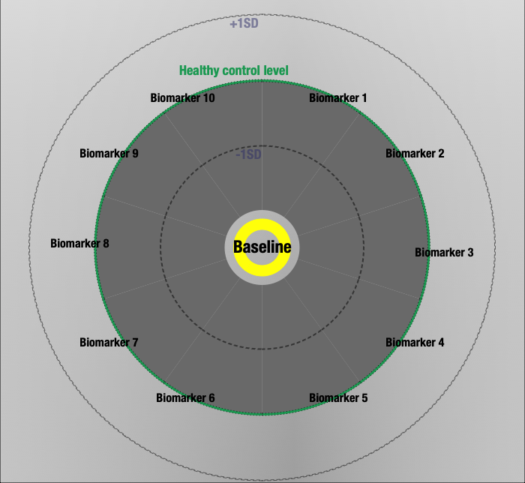
Enteropathy, inflammation, and mortality in SAM
Biomarker levels are shown as a wedge of the pie
Biomarkers have been logged
Healthy control level level is shown at the green circle
Wedge length is the SAM child result compared with healthy control result

Slide 8
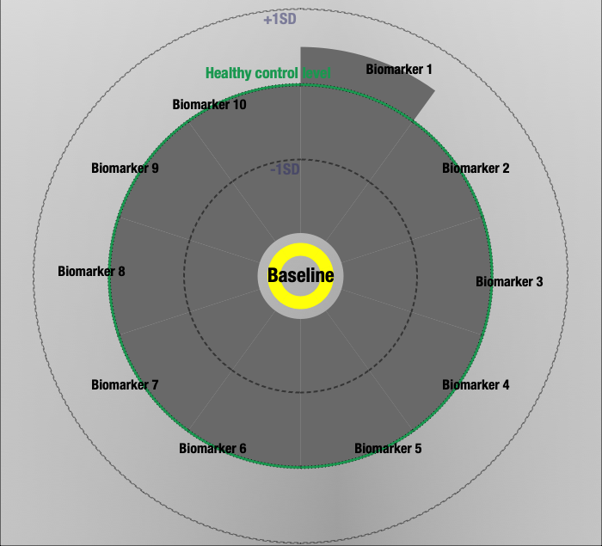
Enteropathy, inflammation, and mortality in SAM
Biomarker levels are shown as a wedge of the pie
Biomarkers have been logged
Healthy control level level is shown at the green circle
Wedge length is the SAM child result compared with healthy control result
If wedge is larger, the SAM result is higher than the healthy result
  Biomarker 1 has on average increased by ~0.5SD across the group

Slide 9
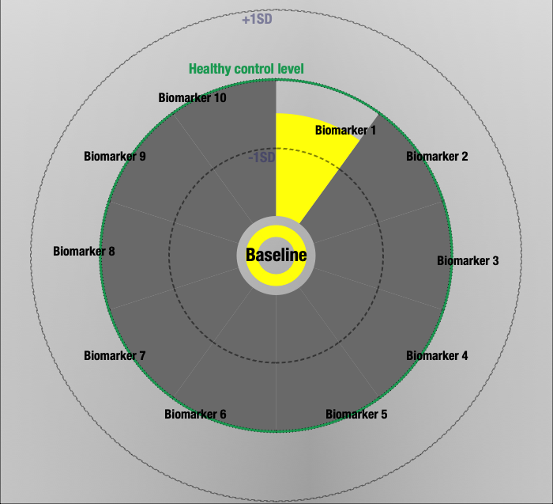
Enteropathy, inflammation, and mortality in SAM
Biomarker levels are shown as a wedge of the pie
Biomarkers have been logged
Healthy control level level is shown at the green circle
Wedge length is the SAM child result compared with healthy control result
If wedge is smaller, the SAM result is higher than the healthy result
  Biomarker 1 has on average decreased by ~0.5SD across the group
Result is shaded if the result is statistically different (p<0.05)

Slide 10
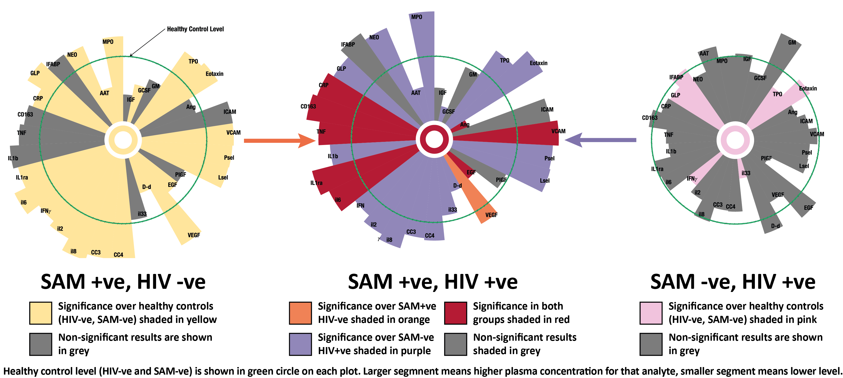
Enteropathy, inflammation, and mortality in SAM

Slide 11
Enteropathy, inflammation, and mortality in SAM
In children with SAM at baseline over controls:
Systemic inflammatory factors increased
Stool inflammatory markers increased
Growth factors reduced

Slide 12
Enteropathy, inflammation, and mortality in SAM
Enteropathy
Translocation of bacterial products
Inflammation

Slide 13
Enteropathy, inflammation, and mortality in SAM
Enteropathy
BUT:
Currently awaiting the translocation results (lactulose-mannitol testing), and completing LPS testing
Now have results from Zimbabwe and Zambia for remainder
Translocation of bacterial products
Inflammation

Slide 14
Enteropathy, inflammation, and mortality in SAM
Principal Component Analysis (PCA)
Enteropathy
Enteropathy component
Translocation of bacterial products
No results yet
Inflammation
Inflammation component
STATQUEST explanation of PCA: https://www.youtube.com/watch?v=FgakZw6K1QQ

Slide 15
Enteropathy, inflammation, and mortality in SAM
Principal Component Analysis (PCA)
Enteropathy
Enteropathy component
Translocation of bacterial products
No results yet
Inflammation
Inflammation component
STATQUEST explanation of PCA: https://www.youtube.com/watch?v=FgakZw6K1QQ

Slide 16
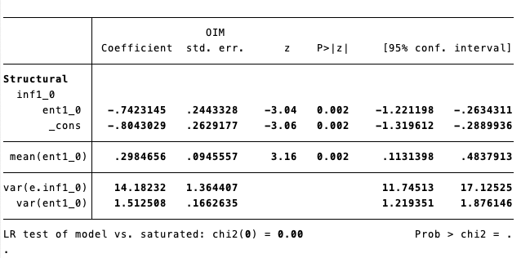
Enteropathy, inflammation, and mortality in SAM
Principal Component Analysis (PCA)
Enteropathy
Enteropathy component
Translocation of bacterial products
No results yet
Negative??
Inflammation
-0.74
Inflammation component
STATQUEST explanation of PCA: https://www.youtube.com/watch?v=FgakZw6K1QQ

Slide 17
Enteropathy, inflammation, and mortality in SAM
Principal Component Analysis (PCA)
Enteropathy
Translocation of bacterial products
Inflammation

Slide 18
Enteropathy, inflammation, and mortality in SAM
Principal Component Analysis (PCA)
Enteropathy
Translocation of bacterial products
Inflammation

Slide 19
Enteropathy, inflammation, and mortality in SAM
Principal Component Analysis (PCA)
Enteropathy
Component 1: pro inflammatory
Component 2: growth factors
Component 3: Mixed – mainly inflammatory markers
Translocation of bacterial products
Inflammation

Slide 20
Enteropathy, inflammation, and mortality in SAM
Principal Component Analysis (PCA)
Enteropathy
Translocation of bacterial products
Inflammation

Slide 21
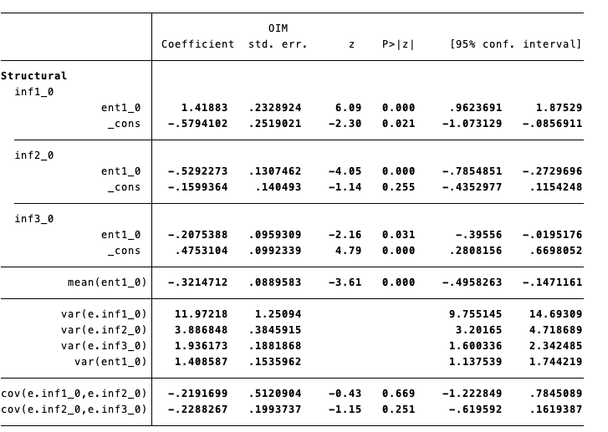
Enteropathy, inflammation, and mortality in SAM
Principal Component Analysis (PCA)
Enteropathy
Translocation of bacterial products
Inflammation

Slide 22
Enteropathy, inflammation, and mortality in SAM
Principal Component Analysis (PCA)
Enteropathy
Translocation of bacterial products
Inflammation

Slide 23
Enteropathy, inflammation, and mortality in SAM
Principal Component Analysis (PCA)
Enteropathy
Translocation of bacterial products
Inflammation

Slide 24
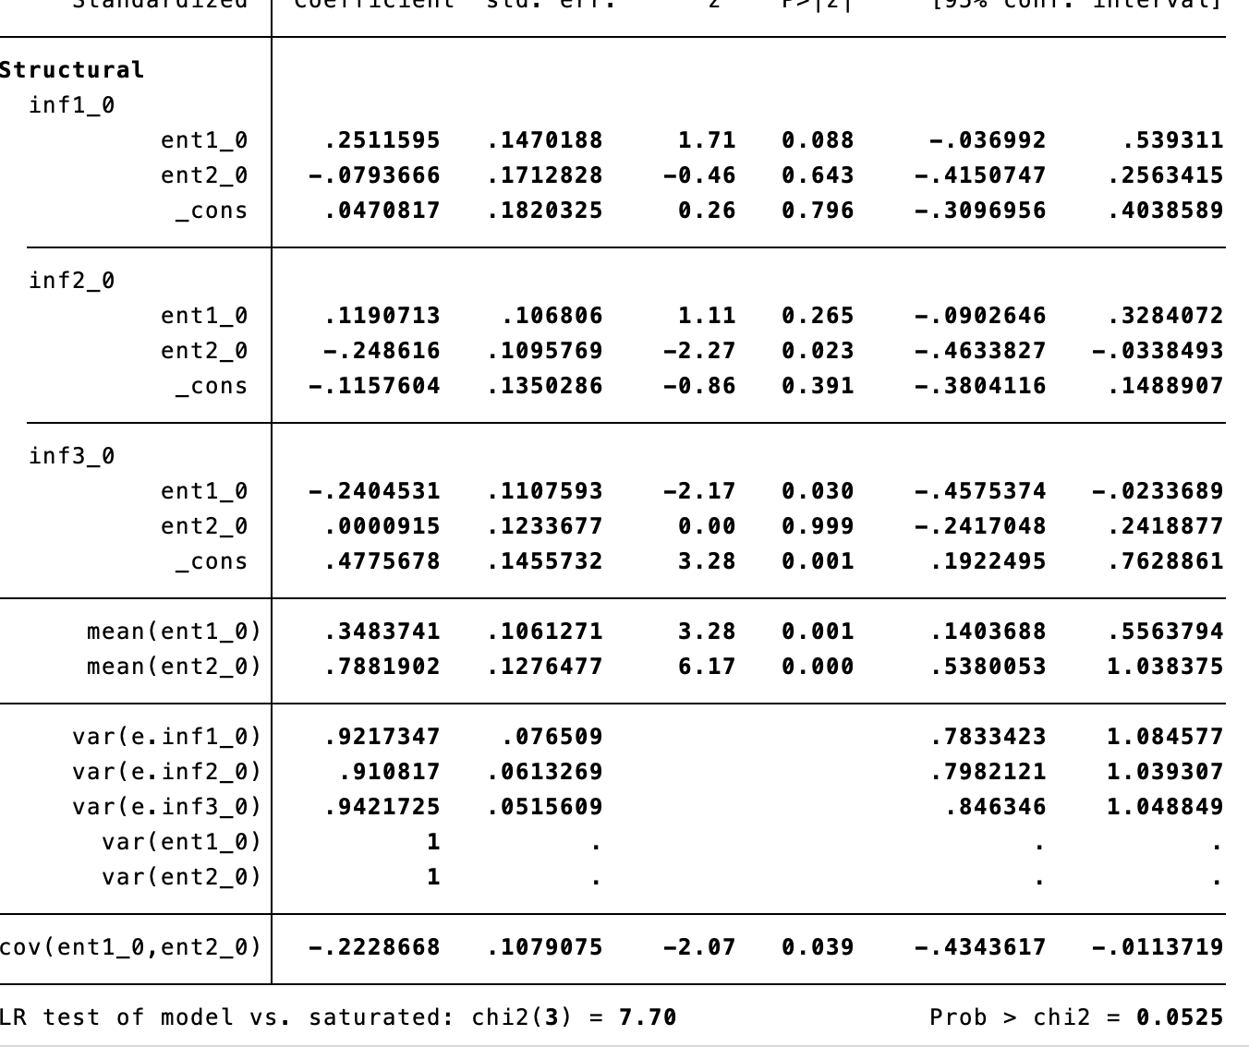
Enteropathy, inflammation, and mortality in SAM
Principal Component Analysis (PCA)
Enteropathy
Translocation of bacterial products
Inflammation

Slide 25
Enteropathy, inflammation, and mortality in SAM
Principal Component Analysis (PCA)
Enteropathy
Associated with a poorer outcome
Higher Enteropathy Component 1:
  Higher: Neo, AAT, MPO
  Lower: IGFBP3, IFABP
Lower Inflammatory Component 2:
  Lower Growth factors:
  EGF, Ang, GCSF, VEGF
  Higher inflammatory factors:
    V-CAM, IL1-ra, (CRP, CD163, sCD14)
Translocation of bacterial products
Inflammation

Slide 26
Enteropathy, inflammation, and mortality in SAM
Principal Component Analysis (PCA)
Enteropathy
Associated with a poorer outcome
Enteropathy Component 1:
  Higher: Neo, AAT, MPO
  Lower: IGFBP3, IFABP
Inflammatory Component 2:
  Lower Growth factors:
  EGF, Ang, GCSF, VEGF
  Higher inflammatory factors:
    V-CAM, IL1-ra, (CRP, CD163, sCD14)
Translocation of bacterial products
Inflammation

Slide 27
Longitudinal data

Slide 28
Longitudinal data
Inflammatory component 1 stays persistently high over time
Inflammatory component 2 (growth factors) increases towards the healthy control level over time
Inflammatory component 3 higher than health at baseline, then stays higher

Slide 30
Relationship between inflammatory markers and growth over time
But complete case for timepoints 0,1,5,6
So n= 35

Slide 31
If we impute missing values, both Inf 1 and Inf 3 are related to changes in WHZ over time

Slide 32
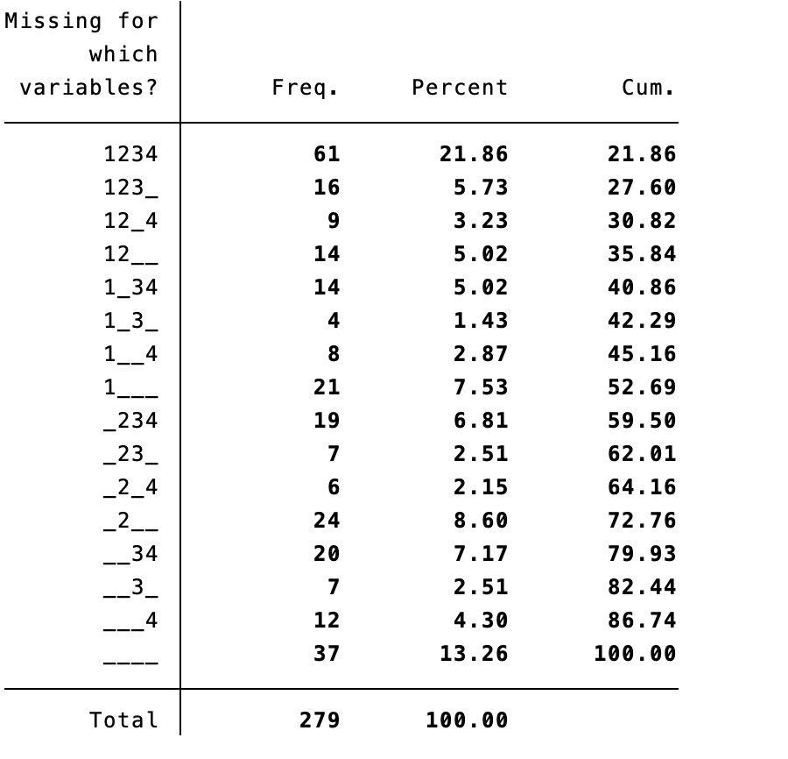
If we impute missing values, both Inf 1 and Inf 3 are related to changes in WHZ over time

Slide 33
TAME trial
Aim 2: Does altering the enteropathy in children with SAM affect the inflammatory changes seen?

Slide 34
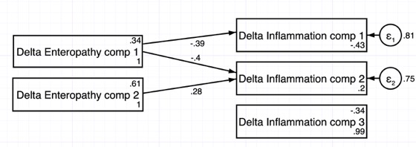
TAME trial:
Enteropathy-inflammation pathway: Structural Equation Modelling
Change over the 14 days
Delta = D14 result – D0 result

Slide 35
TAME trial:
Changes due to novel investigatory medical products treating enteropathy:
?

Slide 36
Conclusions (so far…)
In children with SAM:
Markers of enteropathy are correlated with markers of inflammation
Both inflammatory markers and enteropathy markers are independently correlated with a poor outcome
The pro-inflammatory markers in these children do not seem to resolve to healthy control levels in survivors of SAM, despite a resolution of malnutrition phenotype
Improvements in enteropathy markers are correlated with improvements in inflammation markers by D14 of inpatient stay
  Could medicines for enteropathy help improve inflammatory markers??

Slide 37
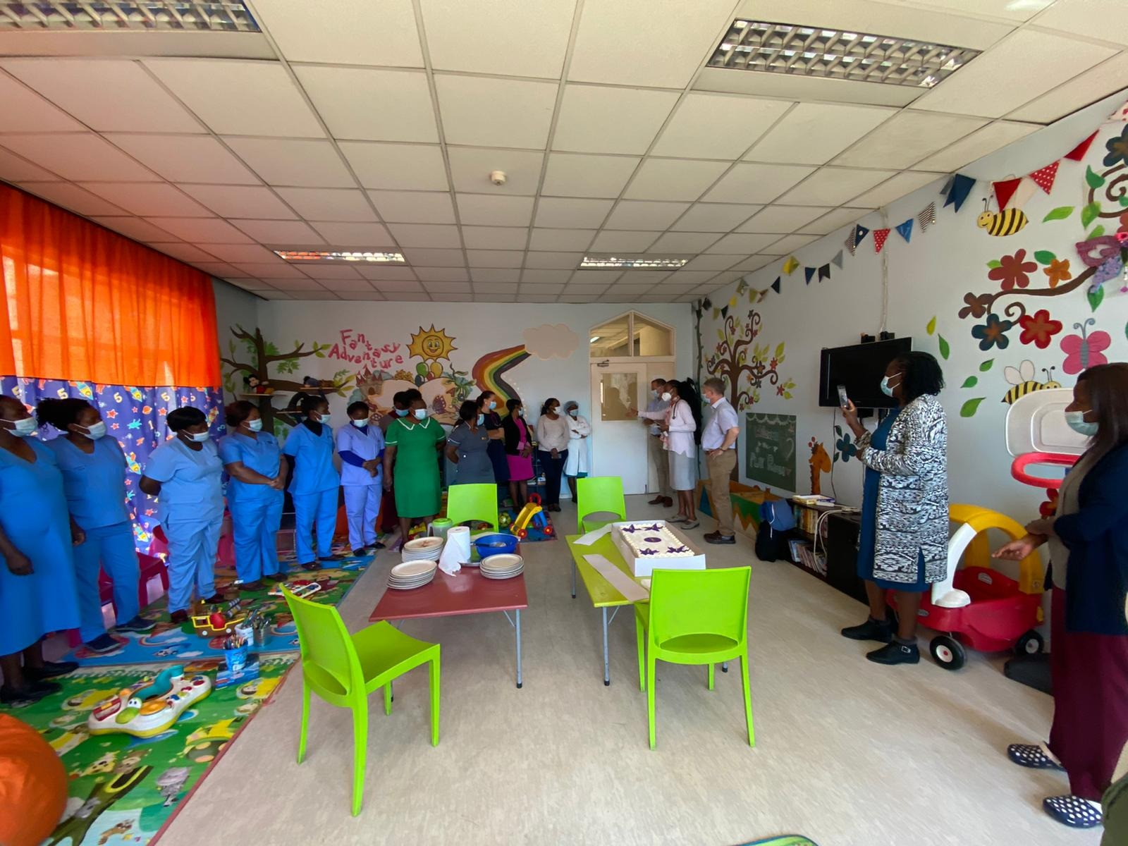
Cherlynn Dumbura and Joice Tome

