Slide 1
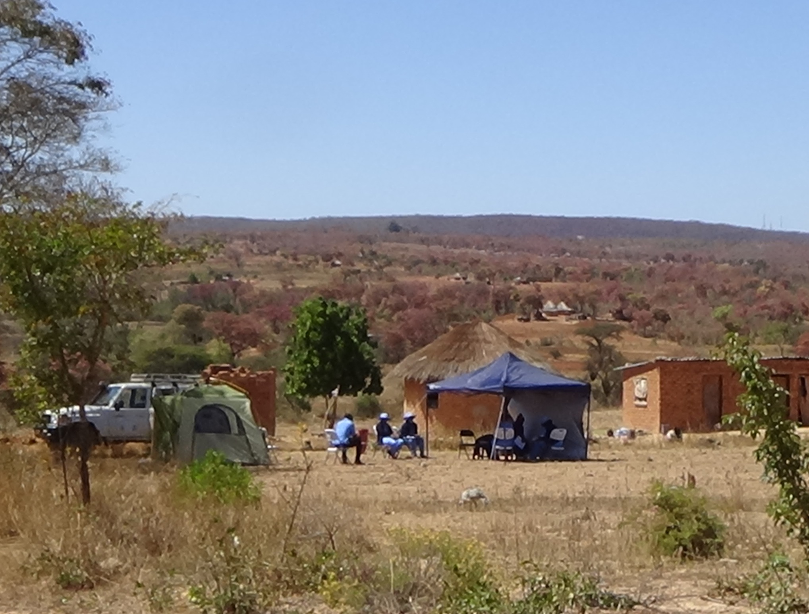



Characterising school-age growth, cognitive and physical function in rural Zimbabwe
Joe Piper
Queen Mary University of London
Zvitambo Institute for Maternal and Child Health Research, Harare, Zimbabwe
Notes:
Our main brand colour is R:0 G:103 B:120

Slide 2
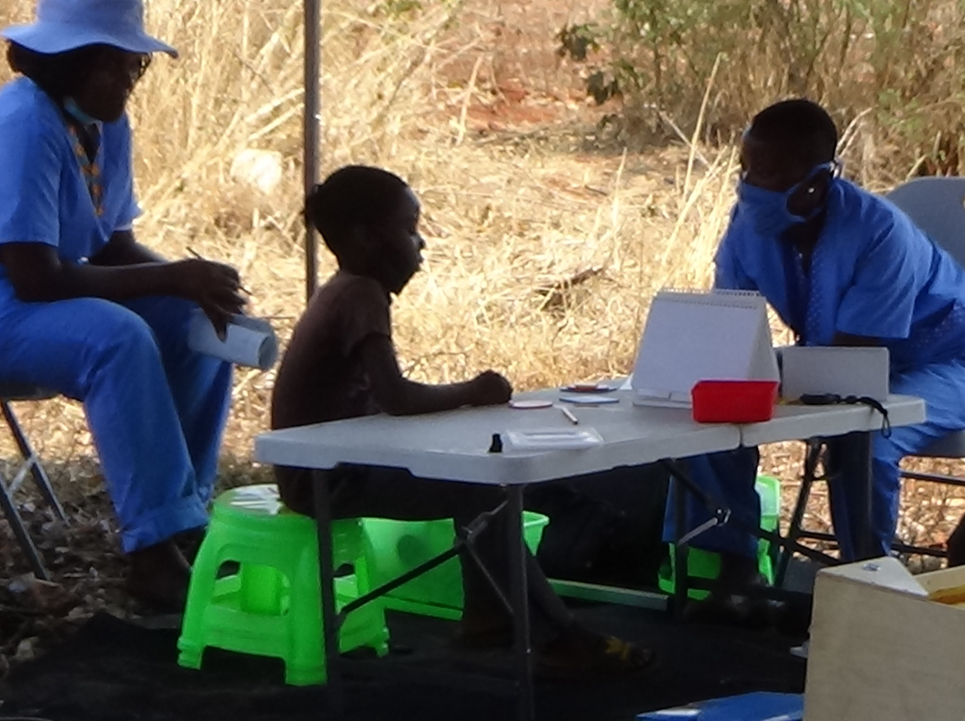
Overview
Introduction: Life course, SHINE trial
Methods: SAHARAN toolbox
Results: Growth, physical & cognitive function
Future plans

Slide 3
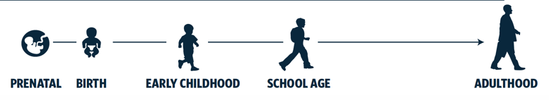



The Life Course Approach: 250 million children ‘failing to thrive’
Brain / body
SAHARAN toolbox
Function
Protective factors
SHINE WASH & IYCF intervention
Healthy
Stunted
Risk factors
Generational effects
Life course
ADOLESCENCE
MIDDLE AGE
OLD AGE
Child Health for All, 6th Ed, Saloonje, Piper et al.
Height and body-mass index trajectories of school-aged children and adolescents from 1985 to 2019 in 200 countries and territories: a pooled analysis of 2181 population-based studies with 65 million participants, NCD Risk Factor Collaboration, Lancet Nov 2020
Notes:
Whether wasted, stunted, or not thriving physically, “stunted” in growth and development
Hence measure at school age

Slide 4
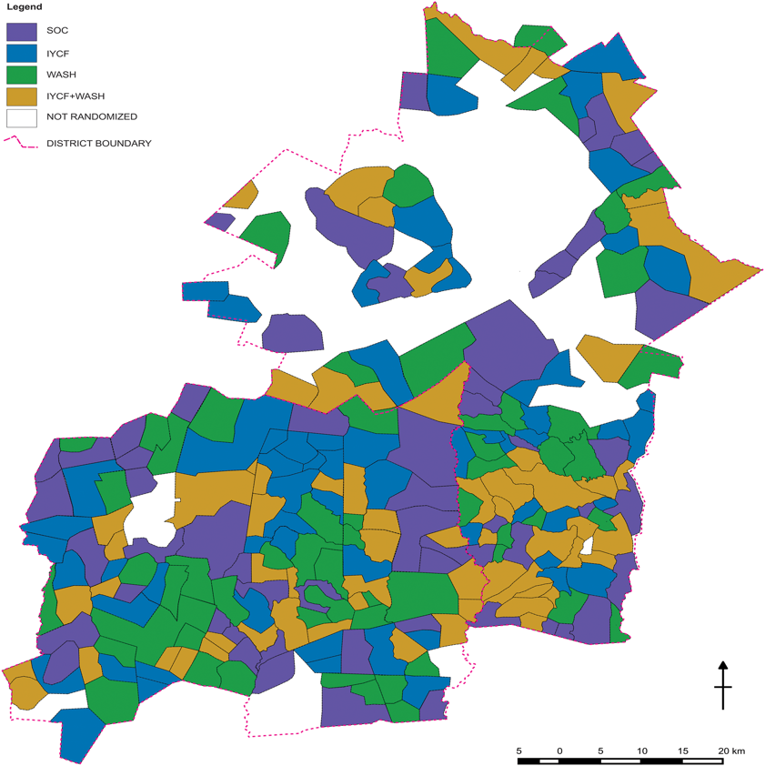
SHINE: independent and combined effects of IYCF and WASH in Zimbabwe
15% children born to HIV-positive mothers “HIV-exposed uninfected” (CHEU)
IYCF
WASH
IYCF &
WASH
SoC
4 to 6+ visits / day [620 visits]
1000 HIV unexposed (CHUU) = 250 in each arm
→ detect a difference of 0.2 SD for the intervention
300 CHEU
Detect a difference of 0.2 SD c.f. CHUU (0.35 SD for intervention on CHEU)

Slide 5
3. SAHARAN Development: The school-aged health, activity, resilience, anthropometry and neurocognitive assessment toolbox
Academic
WRAT
Executive Function
Plus EF
Socio-emotional SDQ
Functional screening
WG
Caregiver Questionnaire
Demographics
SES
Child adversity
CPRS (nurture)
EPDS (maternal depression)
Food insecurity (HFIAS, HDDS & H-FOOD)
Water insecurity (H-WISE, H-WATER, access)
MICS Child discipline
Gender norms & social support
HIV counselling & testing
Cognitive function
K-ABC2
Fine motor
Finger tap
Quality of Growth
BIA (Lean mass index)
Skinfolds, Knee-heel length
Anthropometry
Physical function
Grip strength, broad jump
Bleep test, Hb, BP, HR
Piper et al. Characterising school-age health and function in rural Zimbabwe using the SAHARAN toolbox,(PloS One under review)
Notes:
Figure 1: The SAHARAN toolbox: a holistic 4 hour assessment with simultaneous caregiver questionnaire. All SAHARAN tests have been previously applied in low and middle income settings: [K-ABC2 Kaufmann Assessment Battery for Children 2nd Edition, EGRA Early Grade Reading assessment, MICS FLM: Multi-indicator Cluster Survey Foundational Learning Module, CBCL: Child behavior checklist, WG: Washington Group Child functioning module, RSCM rapid sequential continuous movements, BIA bio-impedance analysis, BP: Blood pressure, Hb: Hemoglobin: HR Heart rate, HFIAS: Household Food Insecurity Assessment Scale, HDDS: Household Dietary Diversity Score, H-FOOD: Holistic food scale, H-WISE: Household water insecurity experience scale, H-WATER, holistic water.

Slide 6
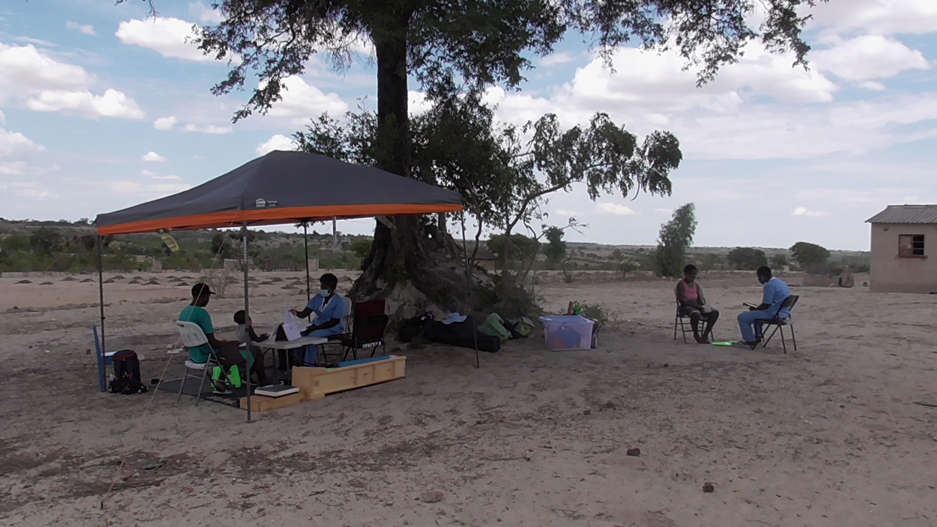

Slide 7
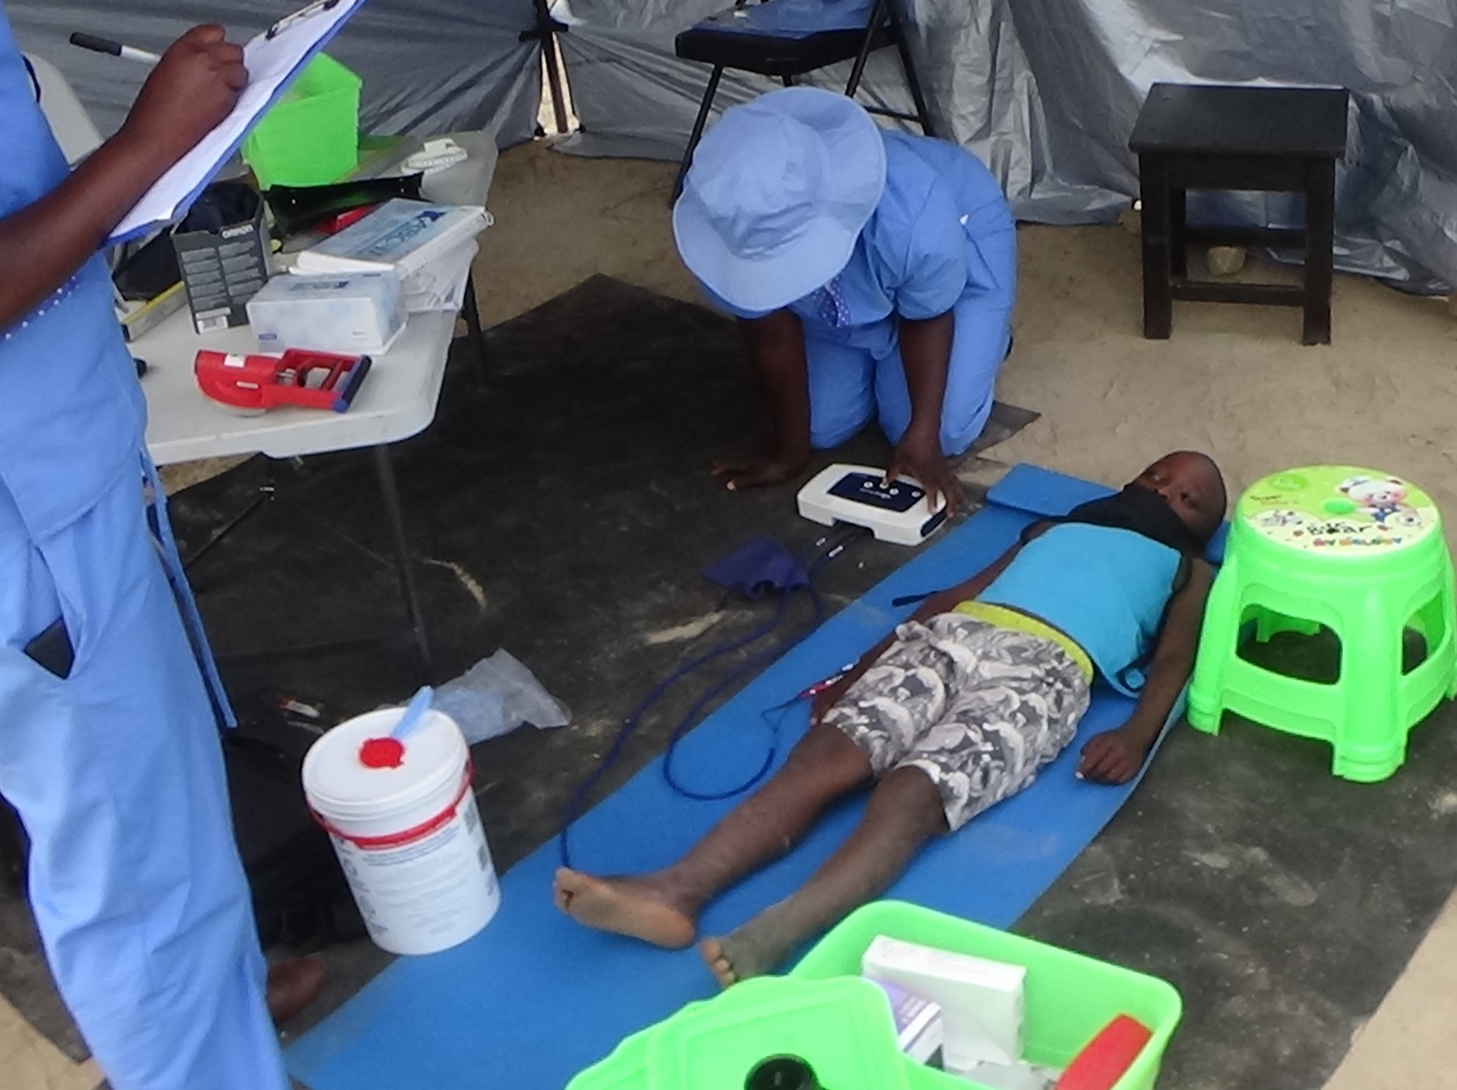
Body composition: Bioimpedance analysis (BIA)
321 girls, 298 boys
Age 7 years,
160 CHEU
Quality of Growth
BIA (Lean mass index)
Skinfolds, Knee-heel length
Anthropometry
Notes:
Plan to compare with 2 year old data

Slide 8
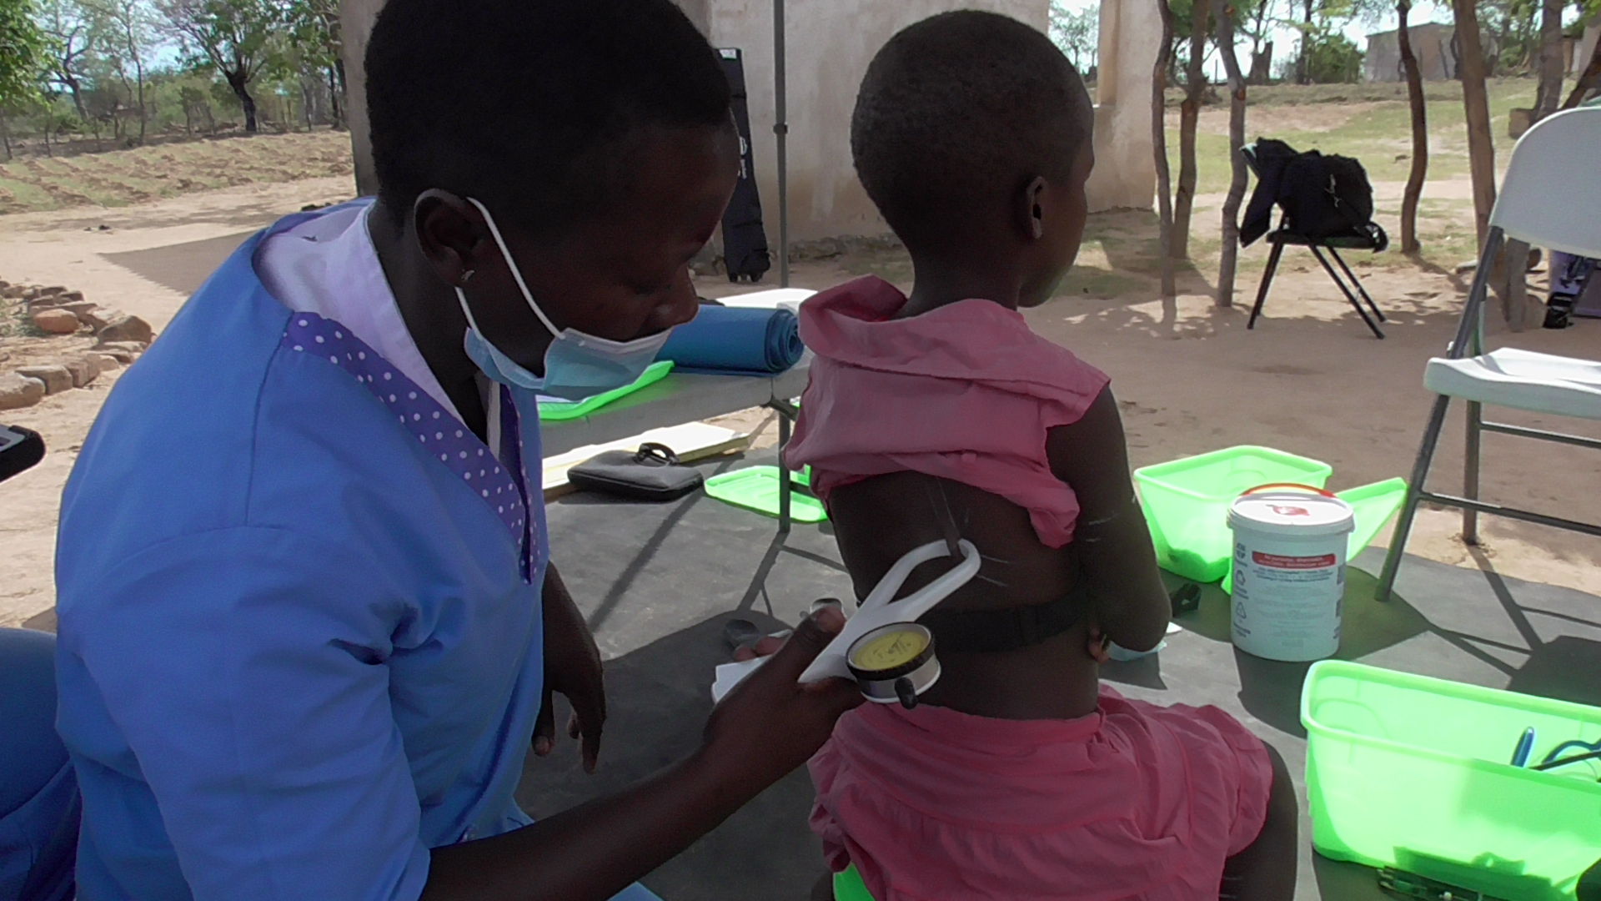
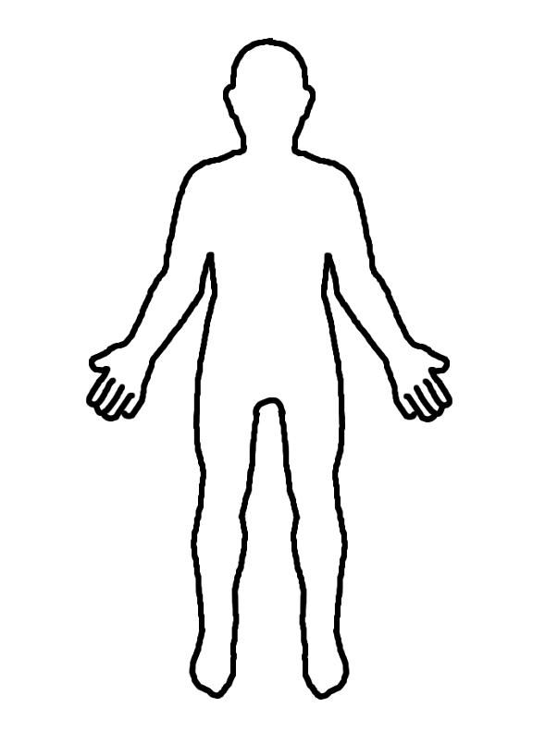
Skinfold thickness: measures fat mass
Eur J Clin Nutr. 2012 May;66(5):613-21. .
Percentile curves for skinfold thickness in 7- to 14-year-old children and adolescents from Jena, Germany
Notes:
1 large child 36.6Kg

Slide 9
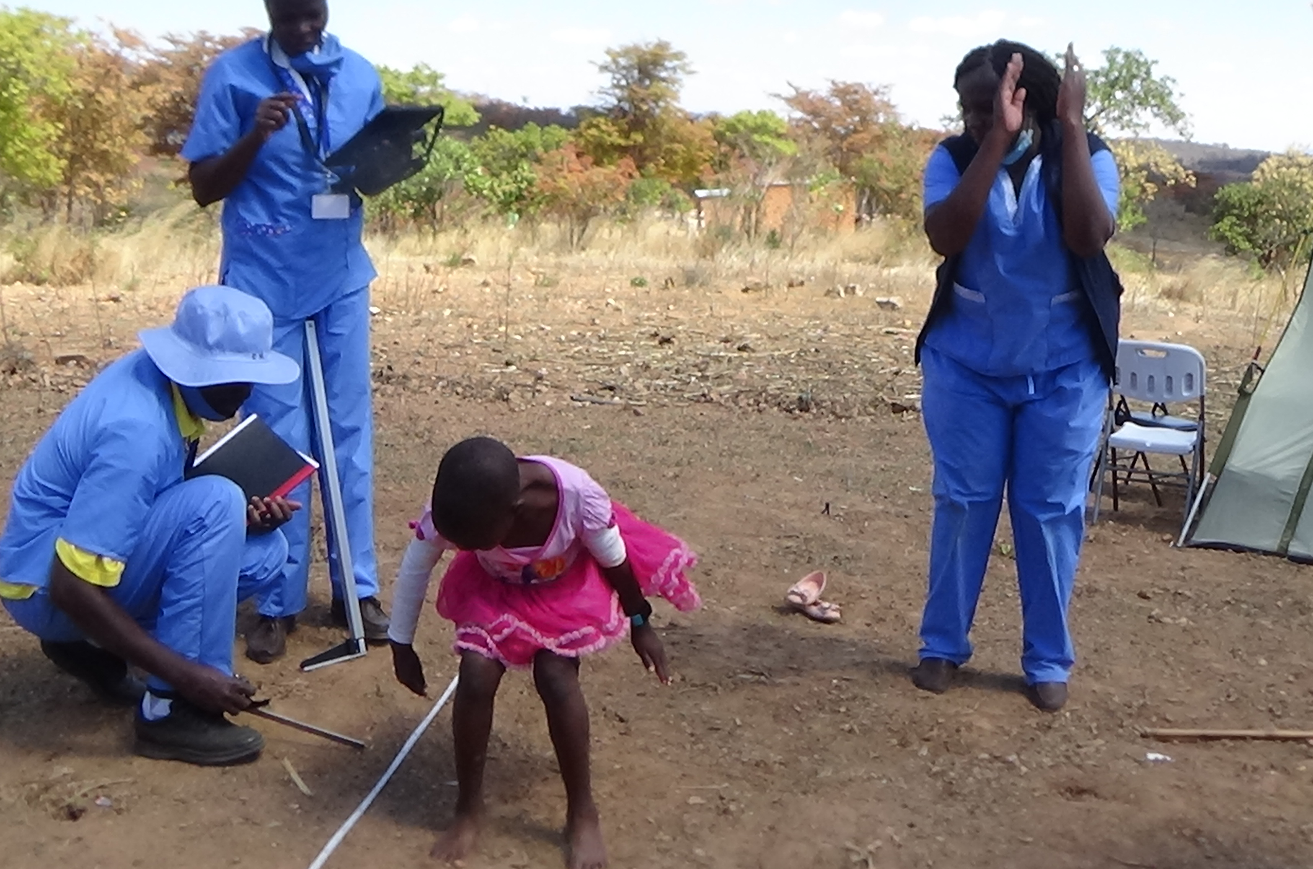
i) Broad jump
Physical function
Grip strength, broad jump
Beep test, Hb, BP, HR
Field-based fitness assessment in young people: the ALPHA health-related fitness test battery for children and adolescents. Ruiz et al. Br J Sports Med, 45, 518-24 (2011)

Slide 10
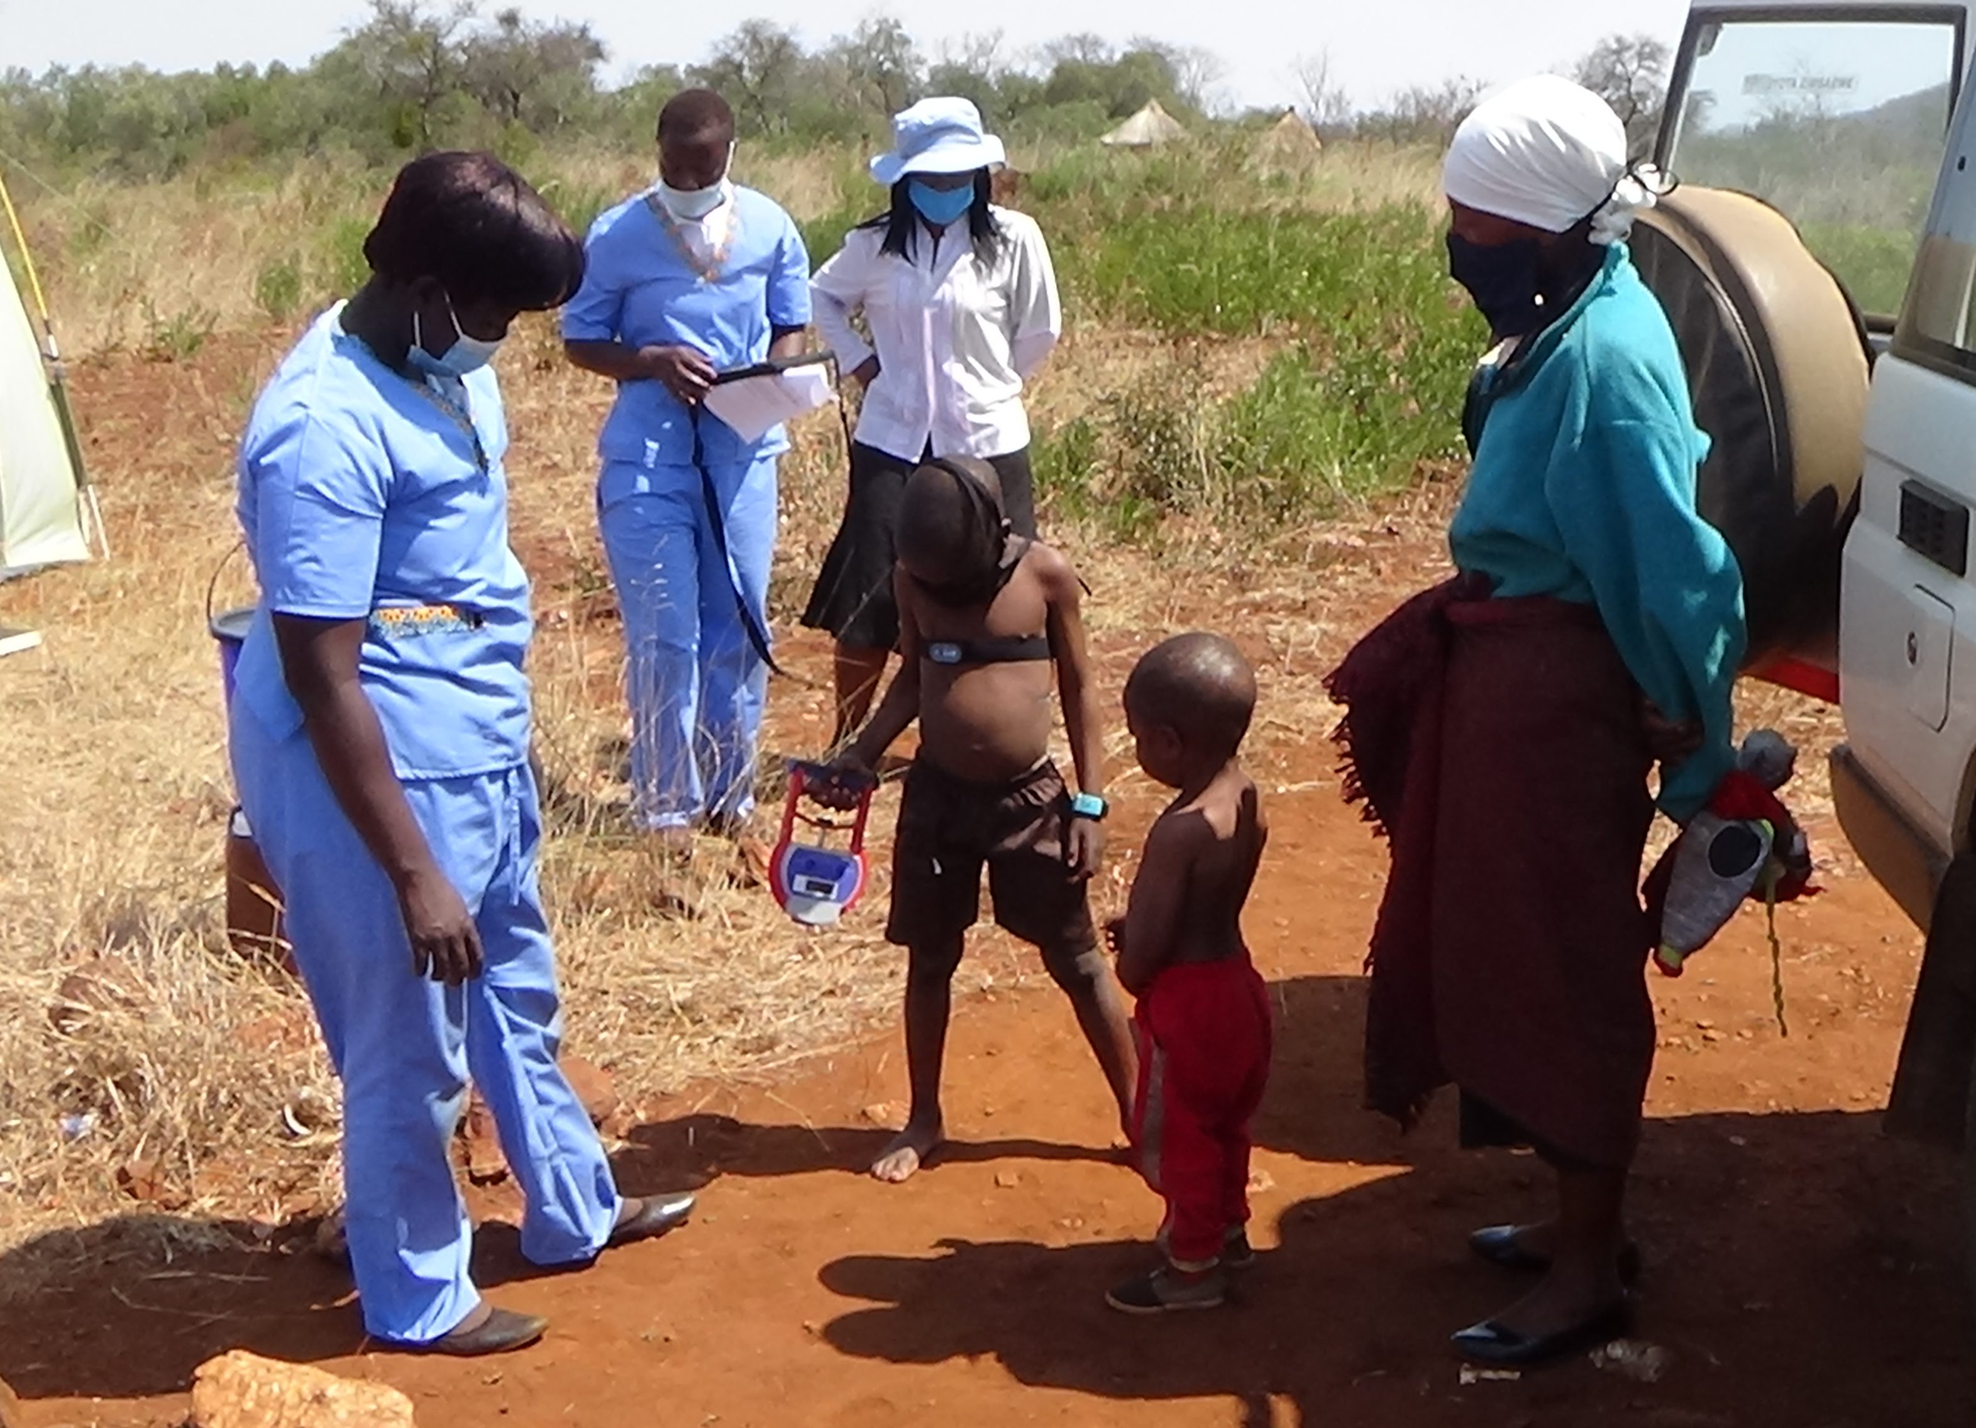
ii) Grip strength
Hogrel, JY., Decostre, V., Alberti, C. et al. Stature is an essential predictor of muscle strength in children. BMC Musculoskelet Disord 13, 176 (2012)
Field-based fitness assessment in young people: the ALPHA health-related fitness test battery for children and adolescents. Ruiz et al. Br J Sports Med, 45, 518-24 (2011)
UNPUBLISHED DATA – DO NOT COPY OR DISTRIBUTE

Slide 11
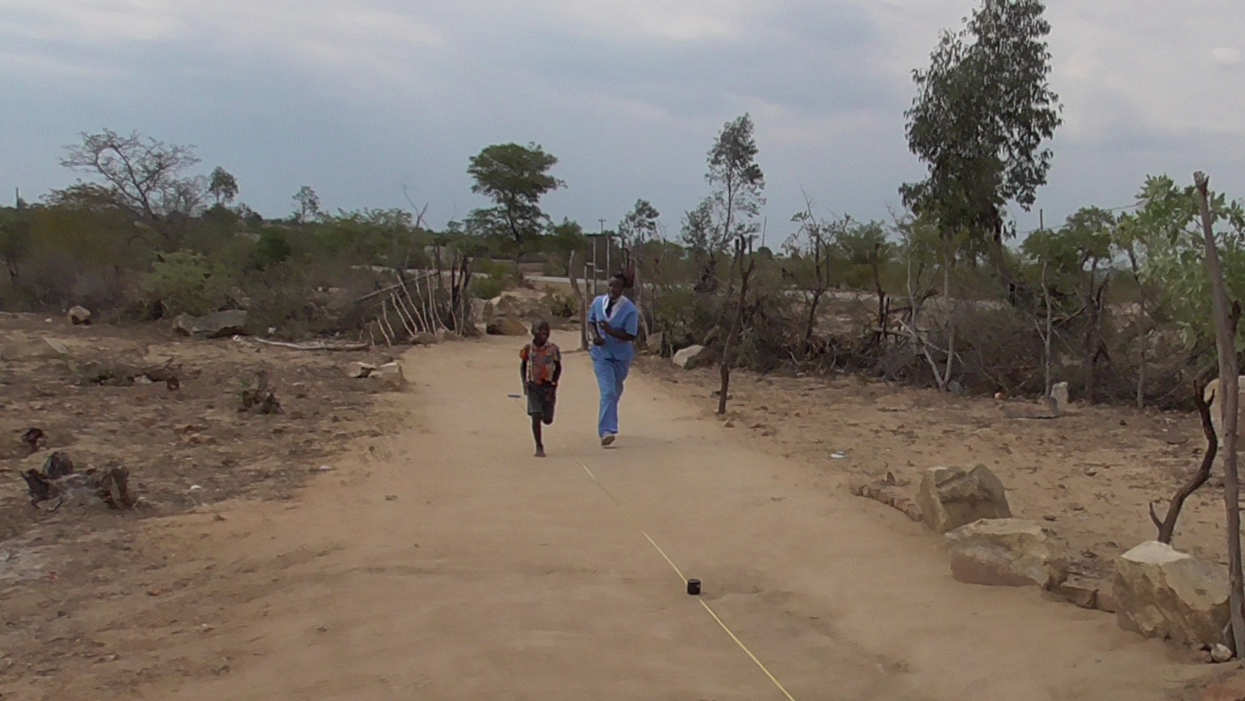
Field-based fitness assessment in young people: the ALPHA health-related fitness test battery for children and adolescents. Ruiz et al. Br J Sports Med, 45, 518-24 (2011)

Slide 12
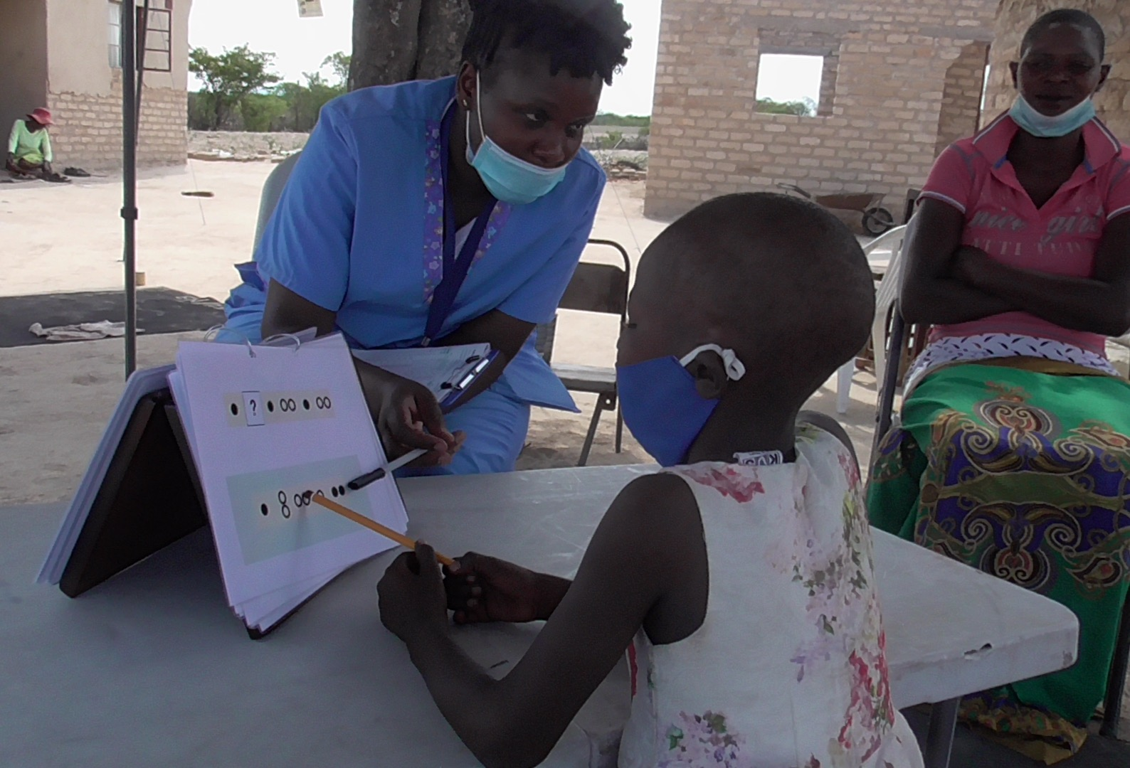
Academic
Literacy
Numeracy
Socio-emotional SDQ
4.3 Cognitive function
Executive function
Plus-EF
Functional screening
WG
Cognitive function
KABC-II
Fine motor Finger tapping

Slide 13
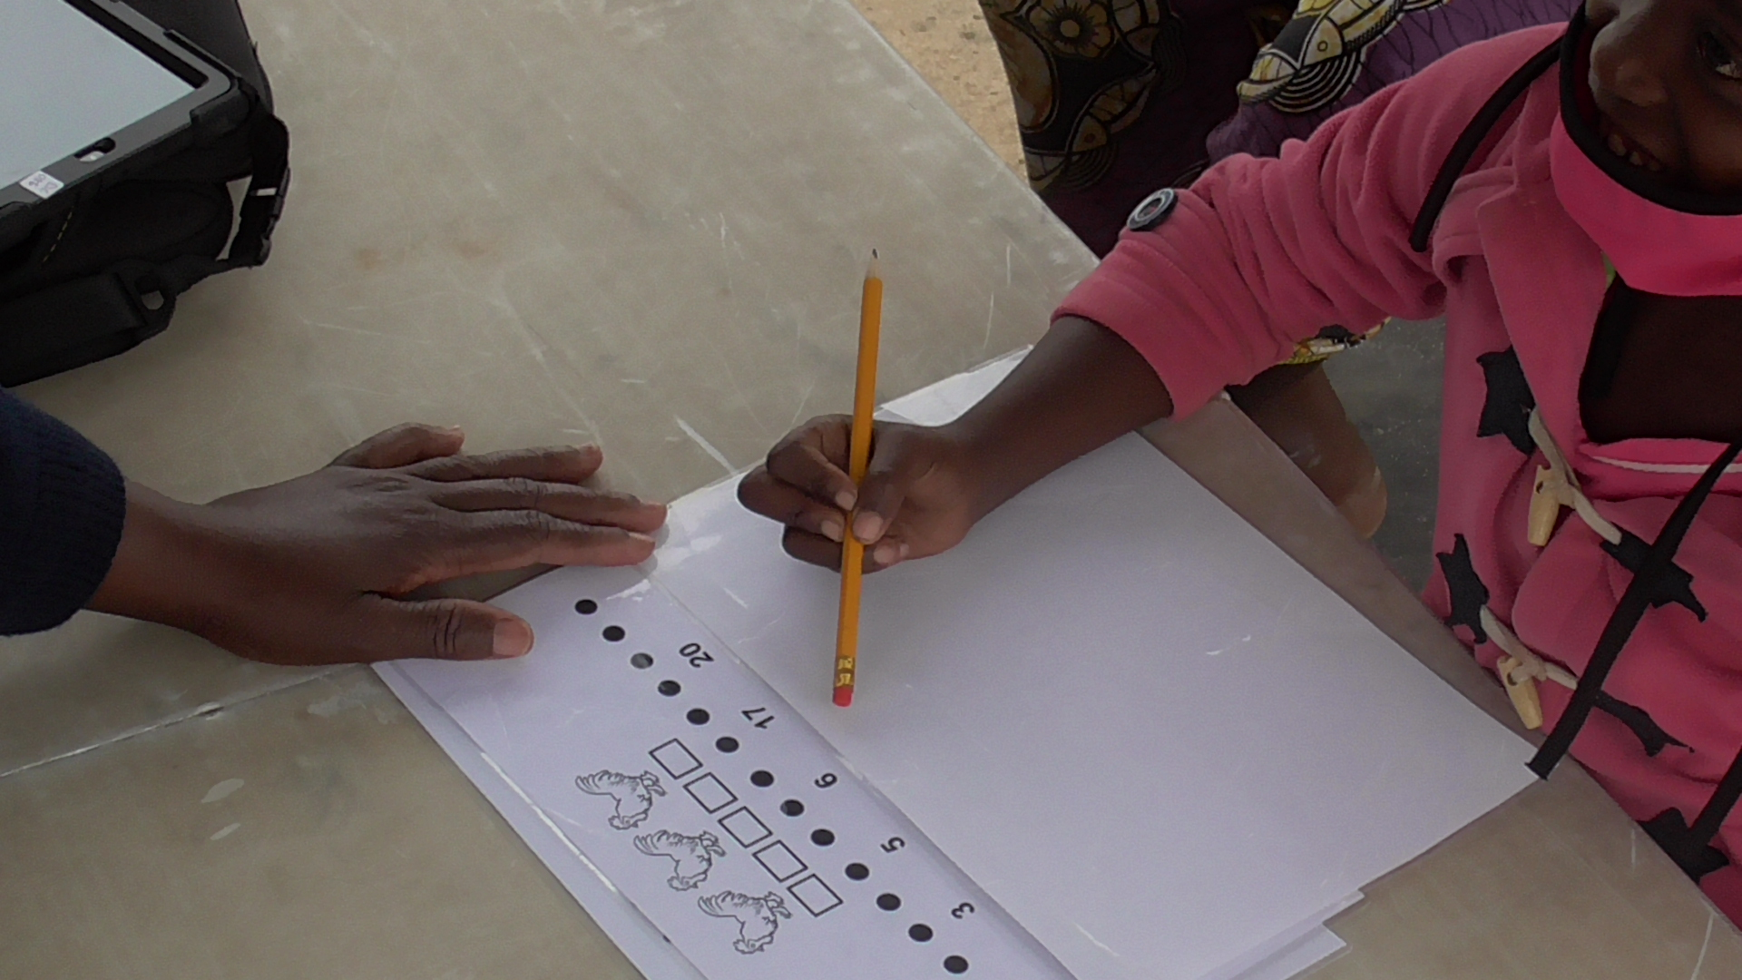
Sigt effects: Schooling, child socioemotional score

Slide 14
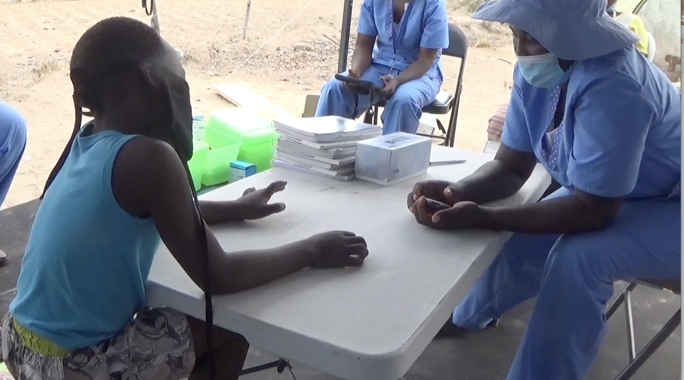

Slide 15
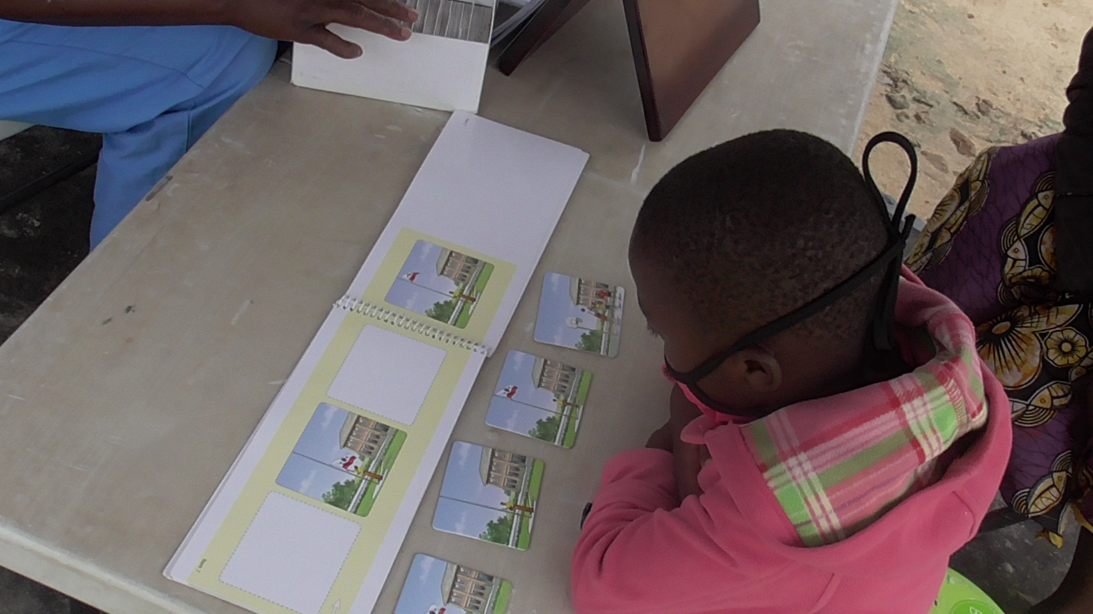
Piper et al. Adaptation of the Kaufman Assessment Battery for Children—2nd edition (KABC-II) to assess school-age neurodevelopment in rural Zimbabwe
(manuscript in preparation)

Slide 16
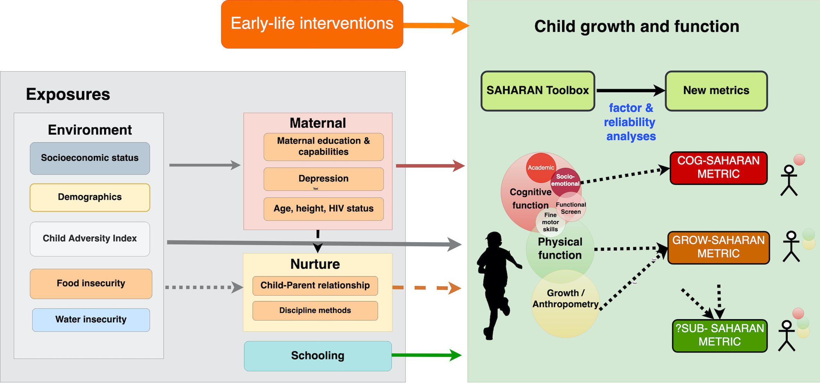
Early-life growth
Future plans
16

Slide 17
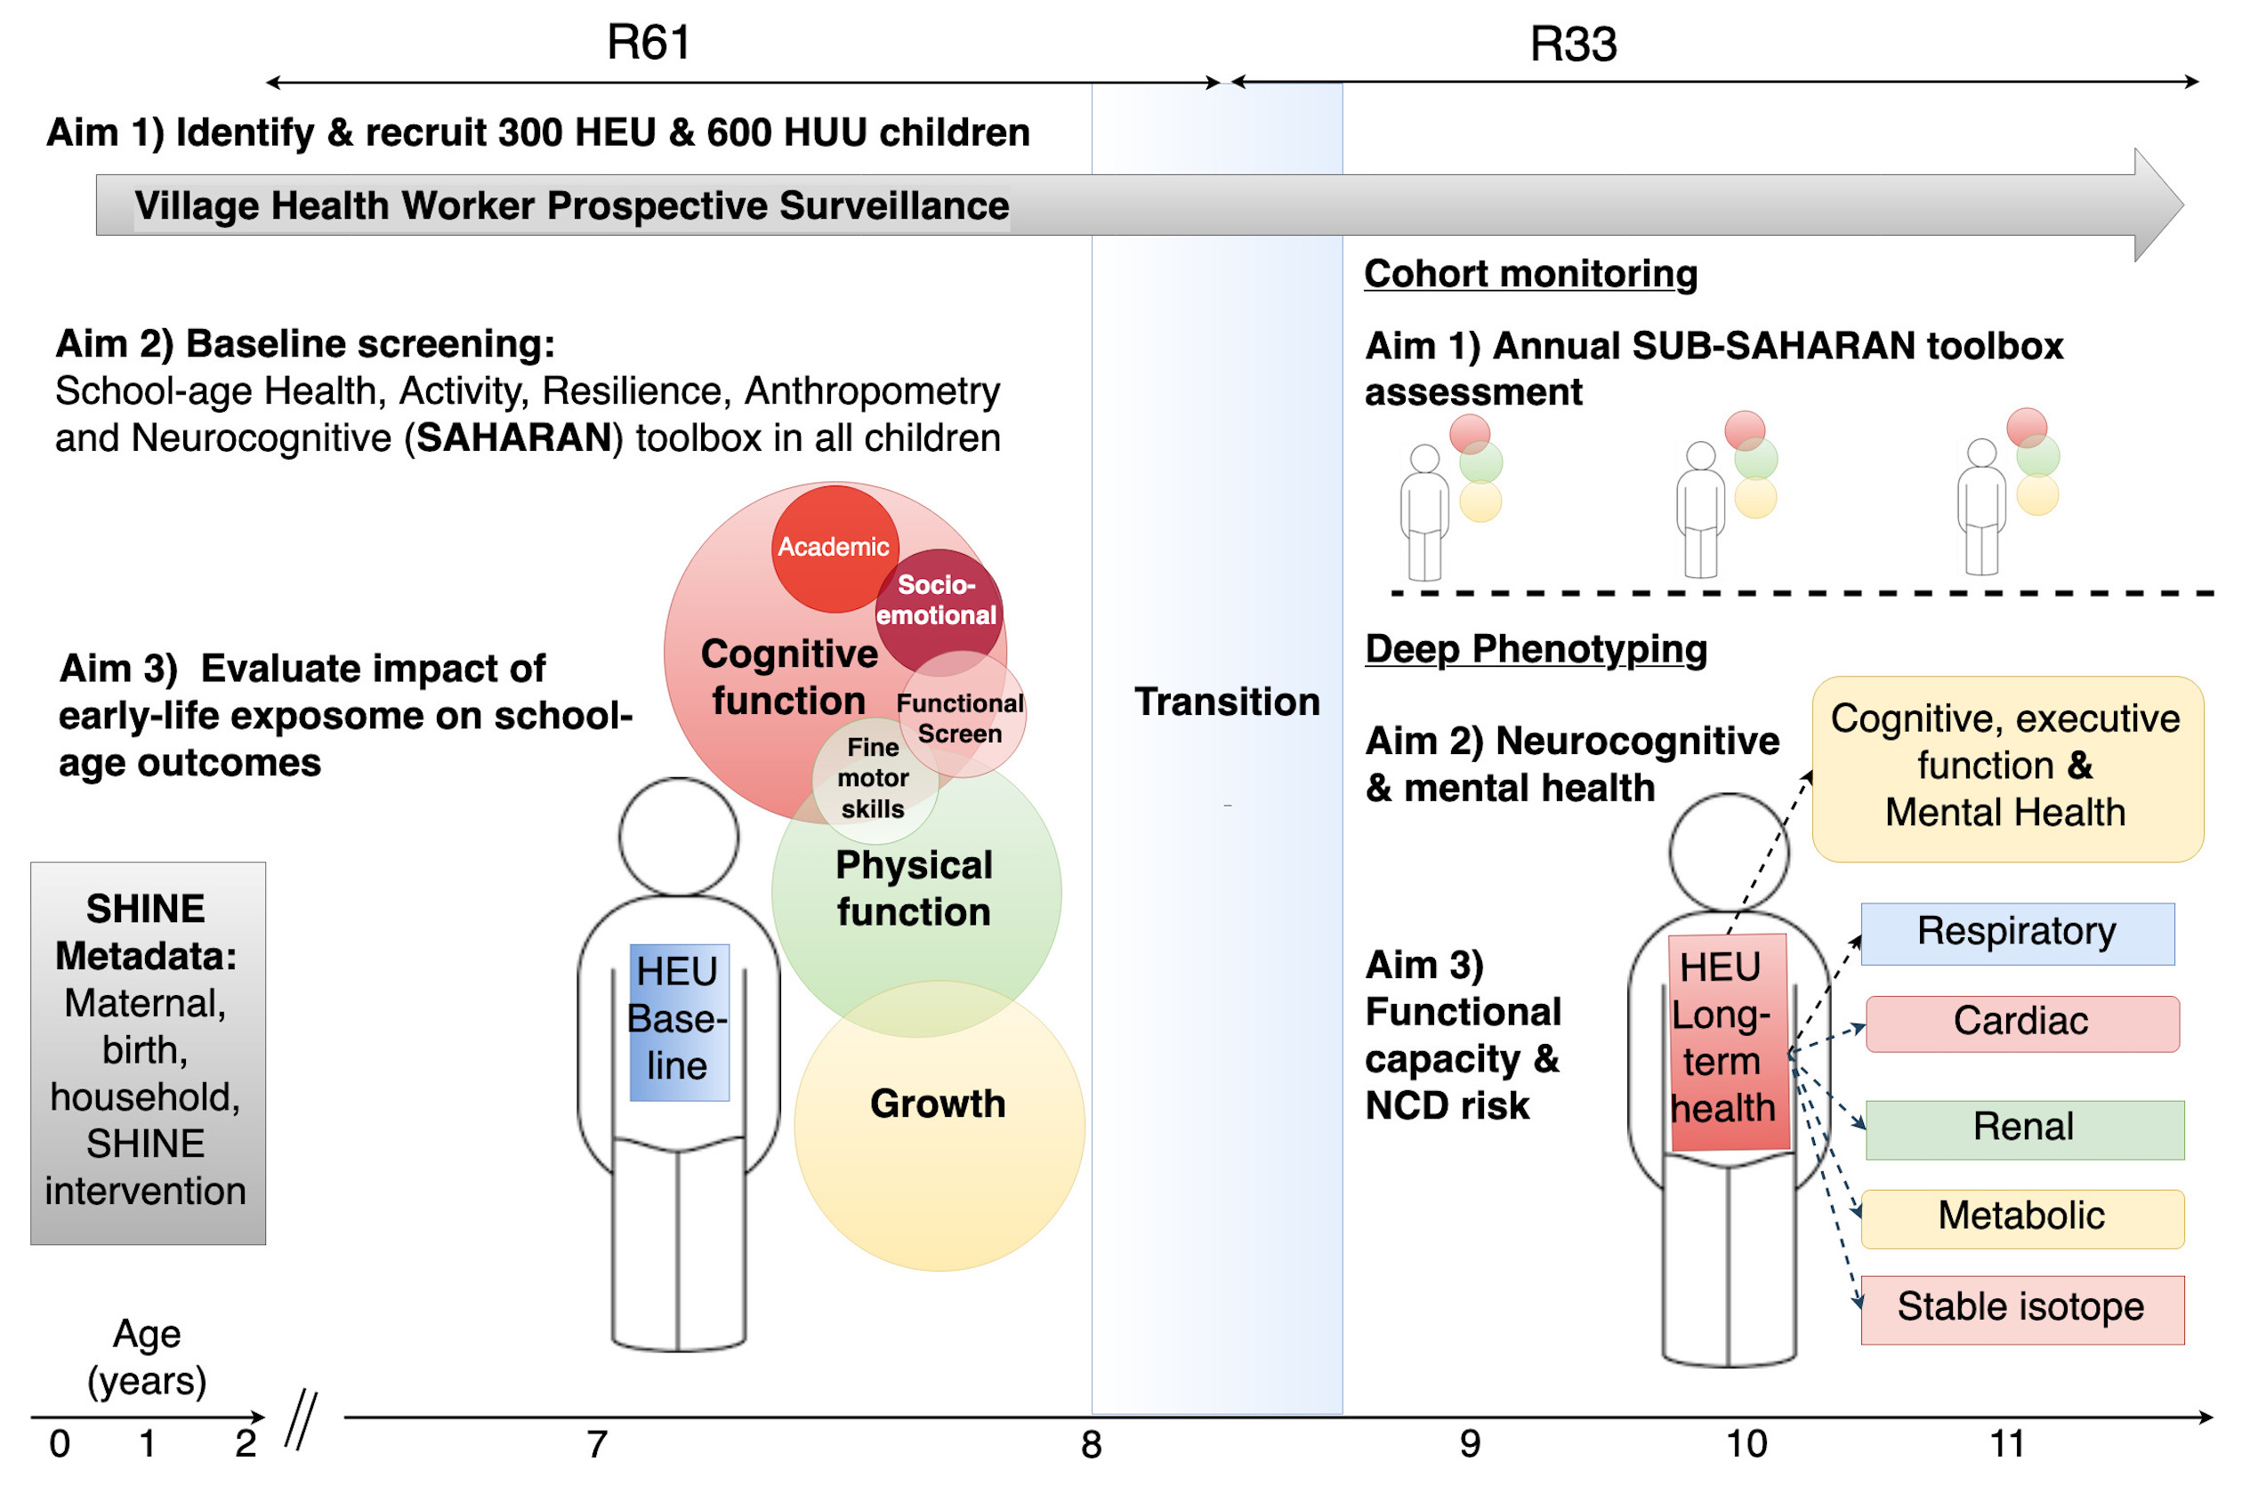

Slide 18
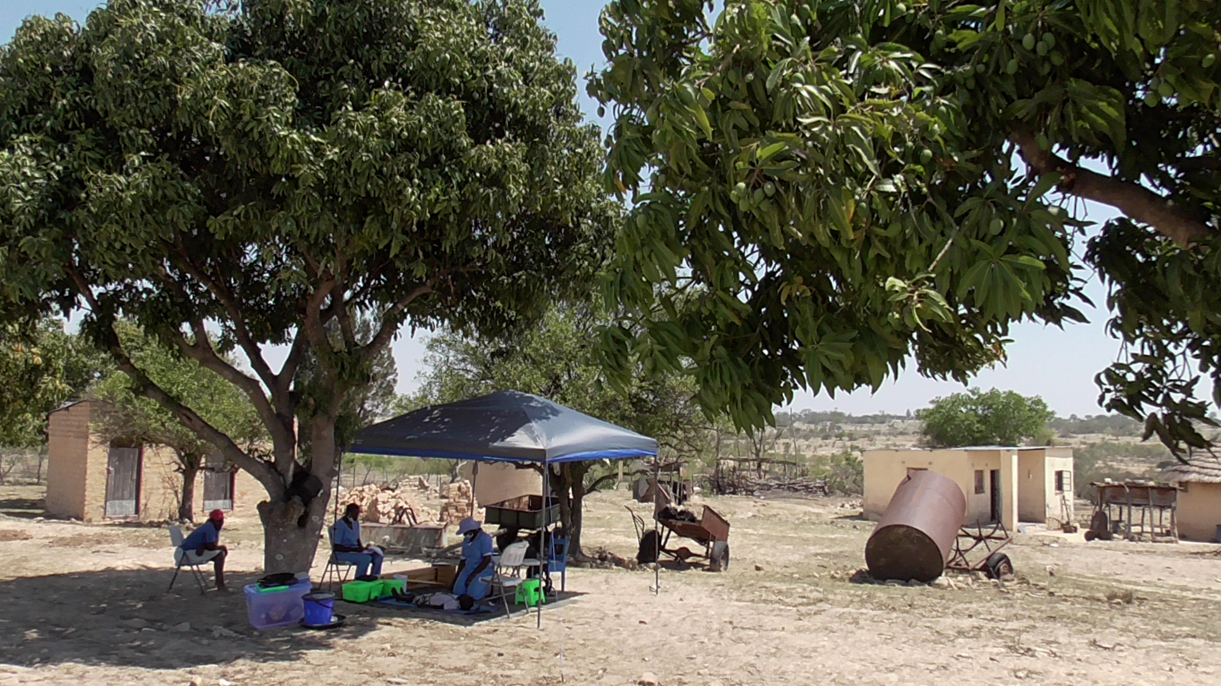
Summary
SAHARAN Toolbox
Body composition, growth and physical function:
Strong link of function to growth
  LMI, birthweight, LAZ at 18 months for physical function
  HAZ for physical & cognitive function
Future
Field-ready Metrics
HIV- exposed children
Early-life associations
Impact of SHINE nutrition & WASH interventions
Contemporary associations & adversity

Slide 19
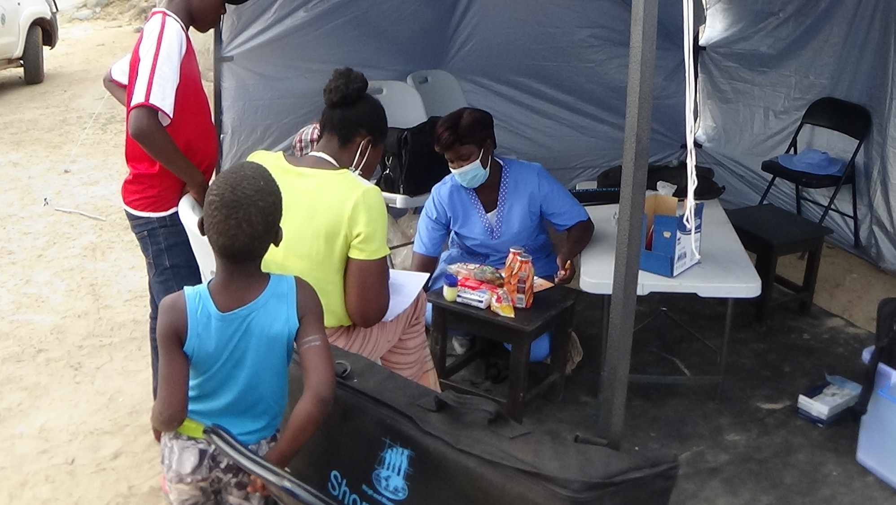
Acknowledgements
Zvitambo field team: Clever Mazhanga, Eunice Munyama, Gloria Mapako, Idah Mapurisa, Tsitsi Mashedze, Kundai Sibanda, Maria Kuona, Dzidzai Matemvi, Thomizodwa Mashiri, Dzie Chidhanguro, Peter Maparango, Kundai Sibanda, Dzidzai, Maria Kuona, Thombizodwa
Zvitambo Harare office: Stephen Moyo, Robert Ntozini, Bernard Chasekwa, Virginia Sauramba Eddington Mpofu, Lisa Langhaug, Batsi Mutasa, Naume Tavengwa, Laura Smith
Supervisor: Andrew Prendergast
Previous PI: Jean Humphrey
Body composition: Jonathan Wells
Physical function: Marko Kerac & Carlos Eternod-Grijalva
Cognitive function: Melissa Gladstone, Fahmida Tofail, Tamsen Rochat, Alan & Nadeen Kaufmann, Jaya Chandna
Funders: Wellcome, Thrasher, NIH, IMMANA
Partners: DHE, PHE, Zimbabwean Ministry of Health and Child Care
Notes:
Plot kernel density

Slide 21
