Slide 1




Integration of point-of-care diagnostics for sexually transmitted infections in antenatal care in Zimbabwe
Dr Kevin Martin
Wellcome Trust Clinical PhD Fellow (Year 1)
Clinical Research Department

Slide 2
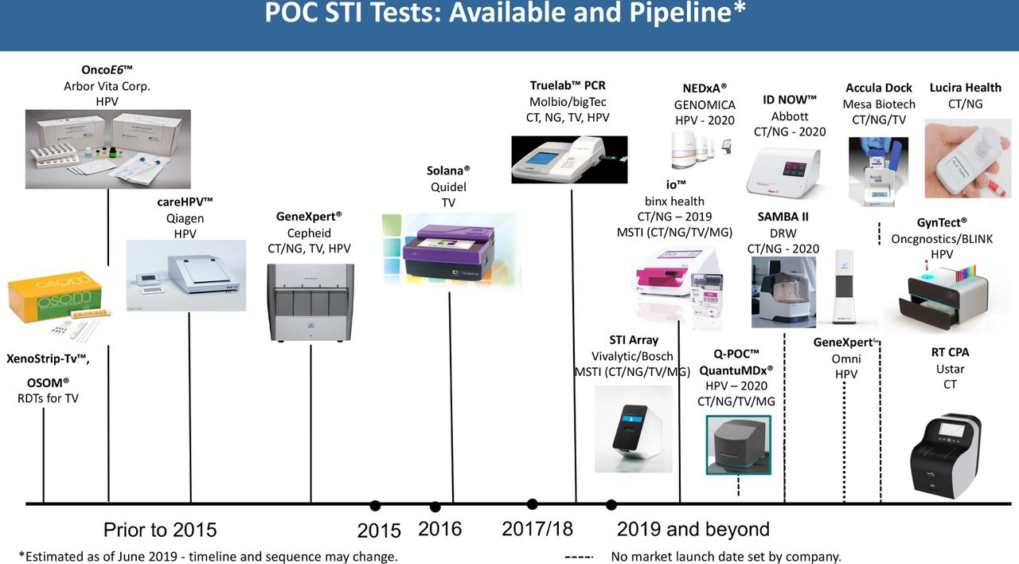
Background
High STI prevalence
STIs are associated with poor birth outcomes
Syndromic management is ineffective for STI control
Point-of-care platforms developed
Increasing reports of ceftriaxone-resistant gonorrhoea

Slide 3
Research gaps
Epidemiology
Prevalence of STIs in antenatal care in Zimbabwe
  Chlamydia, gonorrhoea, trichomoniasis, hepatitis B
Risk factors for infection in this population
Prevalence of antimicrobial resistance (AMR) in gonorrhoea in Zimbabwe
Implementation
Point-of-care STI testing
  Uptake and yield
  Acceptability and feasibility
  Cost-effectiveness
Gonococcal Surveillance
  Enhanced gonococcal antimicrobial surveillance programme (EGASP) in Zimbabwe

Slide 4
Aims & Objectives
Aim: To implement and evaluate a strategy for integration of point-of-care diagnostics for STIs into antenatal care settings in Harare, Zimbabwe.
The objectives are to:
Determine the uptake, prevalence and yield of chlamydia, gonorrhoea, trichomoniasis, syphilis and hepatitis B testing, and risk factors for infection among women attending for antenatal care
Conduct a mixed-methods process evaluation to assess the acceptability and feasibility of this intervention
Estimate the cost and cost-effectiveness of point-of-care STI testing
Investigate the prevalence of antimicrobial resistance for Neisseria gonorrhoeae in this population to inform the development of an enhanced gonococcal antimicrobial surveillance programme

Slide 5
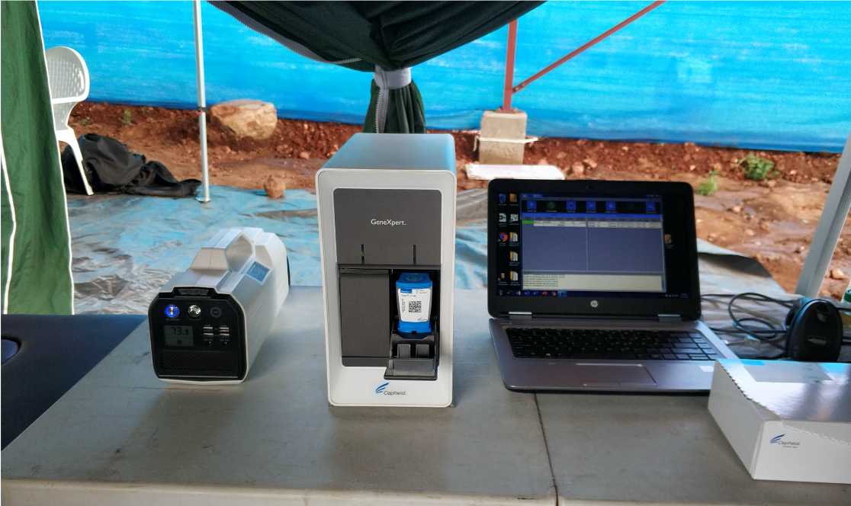
Methods: Overview
Prospective interventional study
Primary healthcare centres
  3 in Harare
Testing over 9 months
  3 months per PHC
Sample size:
  1000 pregnant women
  140 men with urethral discharge

Slide 6
Methods: Study visit
Written informed consent
Collection of 2 vaginal swab samples and fingerprick blood sample
Xpert CT/NG
OSOM Trichomonas Rapid test
SD BIOLINE HIV/Syphilis Duo
Determine HBsAg2 rapid test
Collection of data on sociodemographic factors, sexual behaviour and other STI risk factors
Participant informed of results
STI negative
Health promotion advice
90 minutes
Cervical swab collection
NG positive
STI positive
Hep B positive
Hep B viral load and ALT testing with referral to specialist
Treatment or referral as per guidelines
Birth dose vaccines for babies

Slide 7
Methods:
Data
collection
Month
0
1
2
3
4
5
6
7
8
9
12
15
18
Objective 1: Prevalence, uptake and yield of testing
CT/NG/TV/Hep B/HIV/Syphilis testing:
Vaginal swabs
Fingerprick blood samples
Birth outcome data from participants and delivery books
Collection of data on sociodemographic factors, pregnancy history and STI risk factors
Objective 2:
Process evaluation
IDI/ FGDs
IDI/
FGDs
IDI/
FGDs
IDI/ FGDs
Implementation data:
Structured observation
Real-time feedback from staff and patients
Routine monitoring data
Context diaries to record external events
Objective 3:
Cost and cost-effectiveness
Cost data:
Direct and indirect patient costs
Health system costs: consumables, staff costs, transport
Objective 4:
Prevalence of AMR in NG
Cervical swab from pregnant women if NG positive
Urethral swab from men with urethral discharge
→ Determination of MICs of ceftriaxone, cefixime, azithromycin, and ciprofloxacin on cultured NG isolates

Slide 8
Methods: Analysis
Objective 1:
STI prevalence, uptake and yield of testing
Multivariate logistic regression to assess:
  Factors associated with presence of STIs
  Relationship between STI diagnosis and birth outcome
Objective 2:
Process evaluation
Implementation
  Fidelity
  Coverage
Mechanisms of Impact
Context
Objective 3:
Cost and cost-effectiveness
Unit costs per patient diagnosed and treated
Simple static model to estimate cost per DALY averted

Slide 9
Next steps
Ethical approvals
Research team recruitment and training
Formative work to tailor testing strategy
Implementation of testing alongside process evaluation
Generation of data to:
  Guide the use of point-of-care tests for STIs in resource-limited settings
  Guide national STI management guidelines in Zimbabwe
  Inform the development of an EGASP in Zimbabwe

Slide 10


Acknowledgements
Supervisors:
  Prof Rashida Ferrand
  Prof Katharina Kranzer
  Dr Michael Marks

