Slide 1
TB Immunoreactivity Surveillance in Malawi (TIMASAMALA)
Identifying spatial areas of high TB risk in Blantyre
Hannah Rickman
Wellcome Trust - Bloomsbury Centre for Global Health Research Scientific Meeting 2022

Slide 2
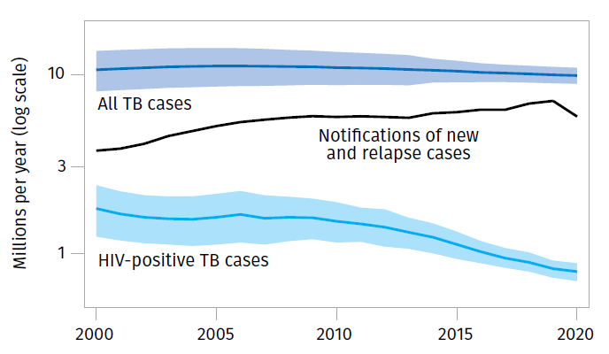
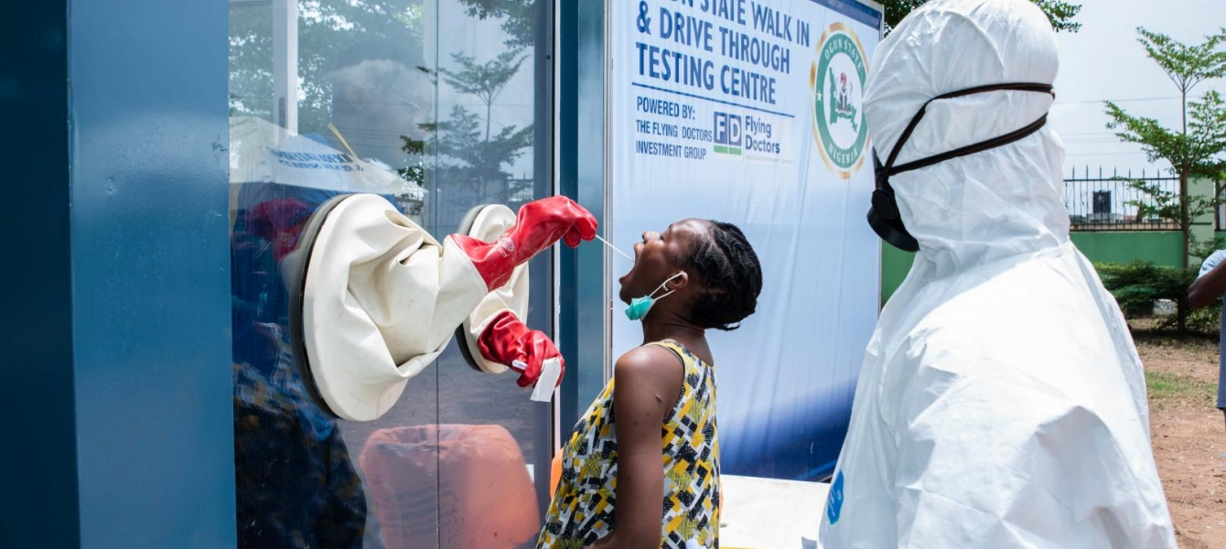
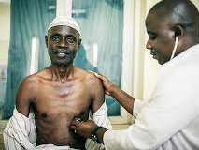
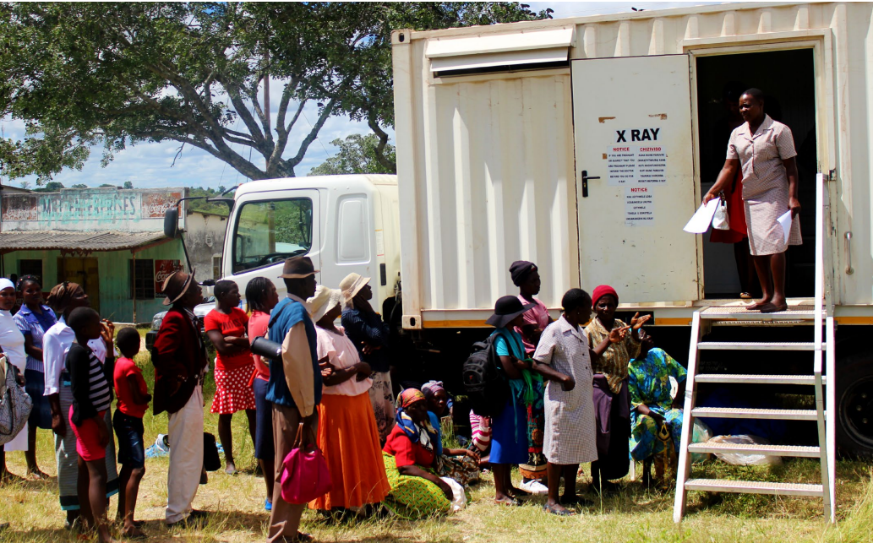
Importance of TB surveillance
Notes:
Measure the effect of an intervention or disruption
Identify high risk spatial areas for targeted interventions
Identify high risk groups
Plot trends over time
Compare countries and areas
Measure progress towards goals

Slide 3
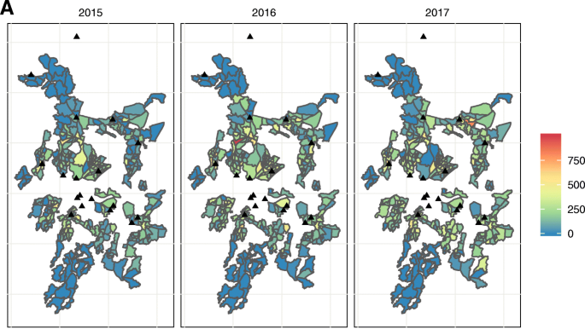
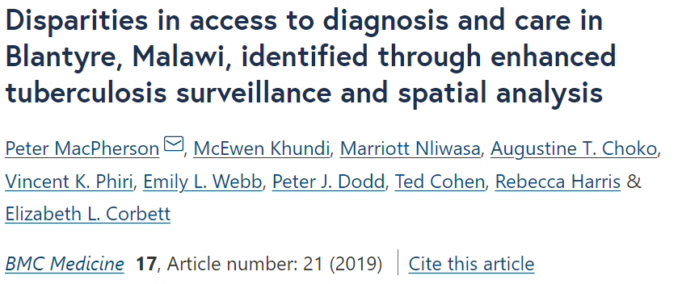
Case notifications in Blantyre
TB case notifications are lower in areas which are:
Poorer
Have more men
Are further from clinics

Slide 4
How should we measure TB epidemiology?
Time -- increased impact of cofactors -- increased chance of mobility
TB transmission
TB infection
TB disease
Diagnosis
Notification
Case notification data
Data sources
TB disease prevalence survey

Slide 5
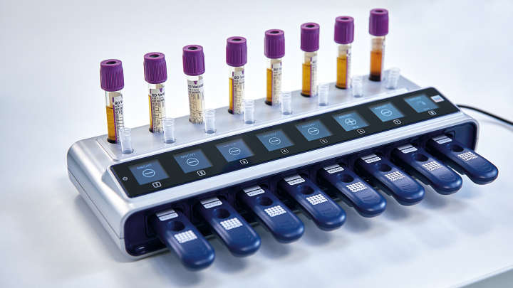
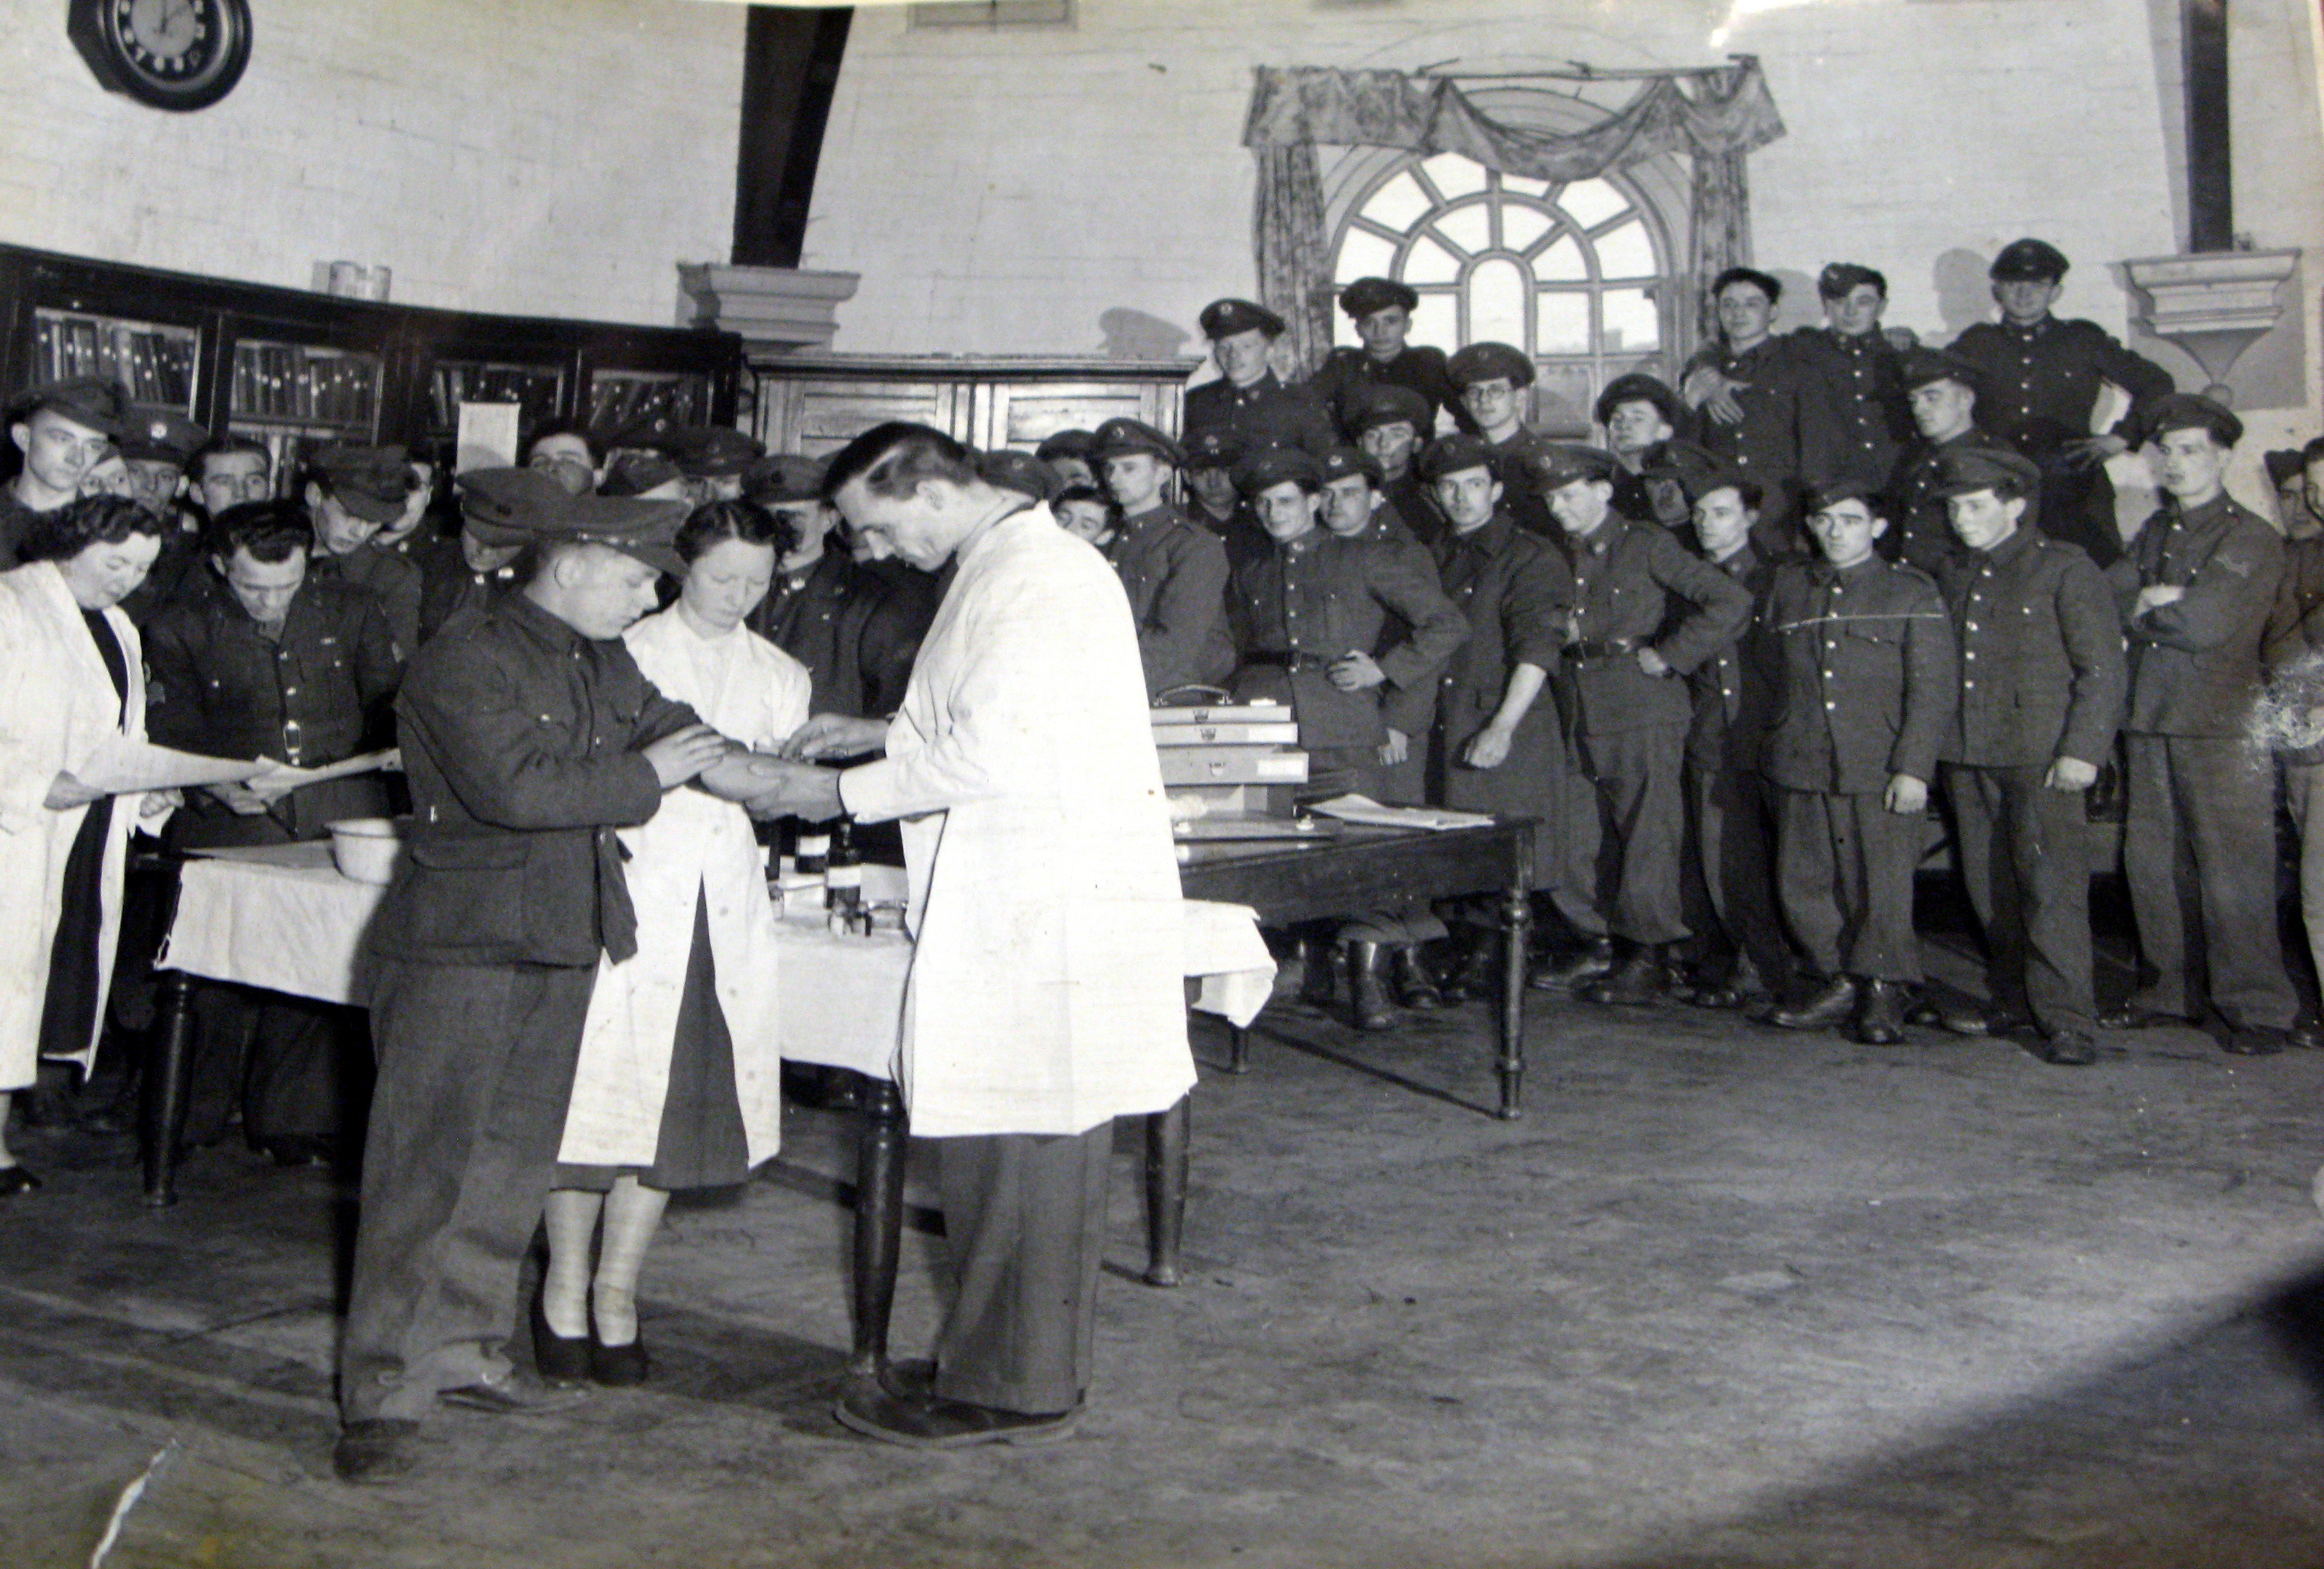
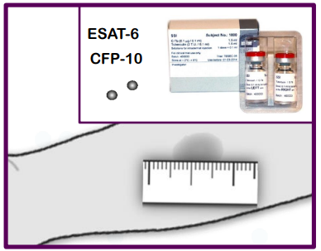
How should we measure TB epidemiology?
Time -- increased impact of cofactors -- increased chance of mobility
TB transmission
TB infection
TB disease
Diagnosis
Notification
Case notification data
Data sources
TB disease prevalence survey
TB infection prevalence survey

Slide 6
Objectives
To evaluate the safety, acceptability and utility of TB immunoreactivity surveillance to detect spatial variation in TB infection risk in urban Blantyre
To determine the annual risk of TB infection (ARTI) amongst young children in Blantyre, and explore the individual- and area-level risk factors for infection
To test the hypothesis that urban areas with high case notifications have higher rates of TB infection amongst children under 5
To identify high-risk areas within Blantyre for future spatially-targeted TB case-finding and prevention interventions
Notes:
, and to investigate whether predictive power is improved using modelling based on markers of undernotification

Slide 7
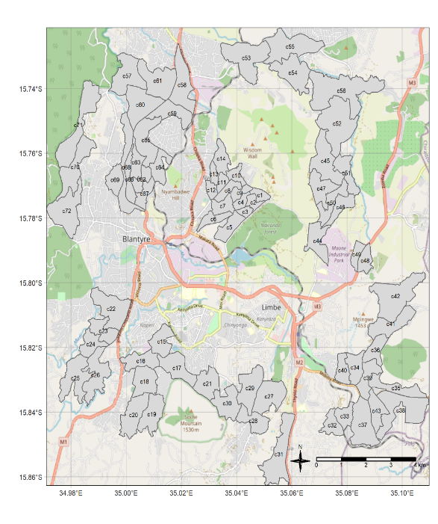
TIMASAMALA: TB Immunoreactivity Surveillance in Malawi
Testing 6,000 U5s in Blantyre for TB immunoreactivity
QIAReach IGRA +/- C-Tb
Recruiting from:
Cross-sectional household sample
Convenience sampling in PHCs
Notes:
Clear benefits to diagnosing and treating TB exposure
Infection reflects recent exposure
Results less affected by reversion
?More reflective of local risk

Slide 8
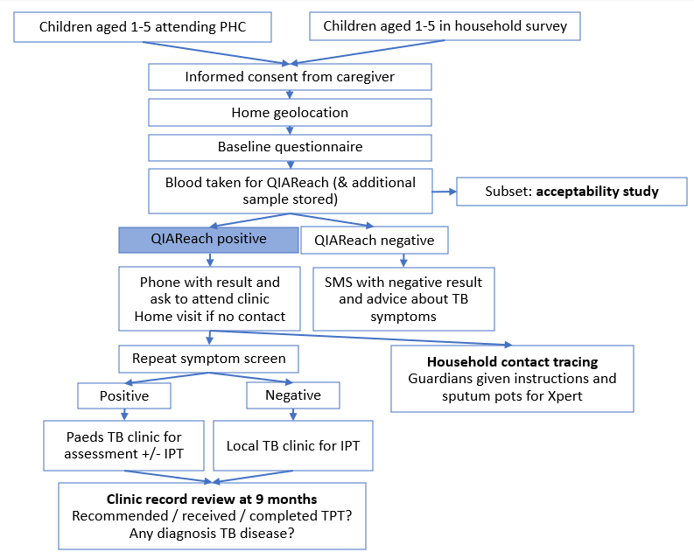
TIMASAMALA: TB Immunoreactivity Surveillance in Malawi (2)

Slide 9
How to interpret survey results?
ARTI = 1−(1−Prevalence) ^{1/mean age}
Assumptions
Rate of infection is constant over calendar time
Rate of infection is constant with age
Everyone infected will have a positive test
Positive test stay positive for life
All false!

Slide 10
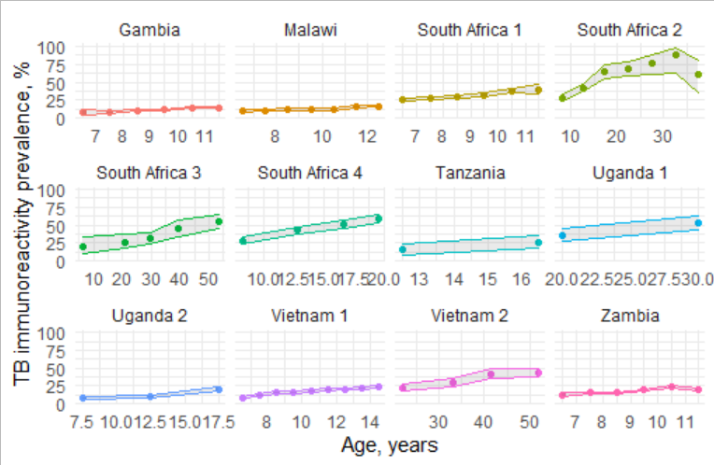
Age-dependent trends in infection risk
Estimates of:
Age-dependent trends
+ Secular trends + Reversion
→ Simulation

Slide 11
Acknowledgements
…and many others for formal and informal input, support and advice

