Slide 1

Podoconiosis as a doctoral training vehicle.
Professor Gail Davey
Centre for Global Health Research
Brighton & Sussex Medical School

Slide 2

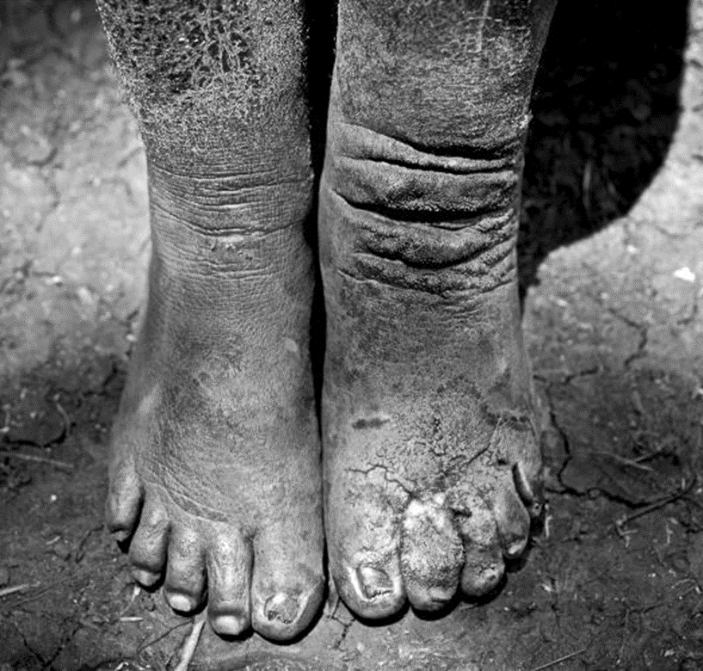
Podoconiosis:
a non-infectious tropical disease characterized by steadily progressive foot and leg swelling;
the ‘lesser-known’ form of tropical lymphoedema
A gene x environment x behaviour condition.
Find out more at –
https://openwho.org/courses/NTDs-podoconiosis-EN
www.podo.org
Credit: Alex Kumar

Slide 3
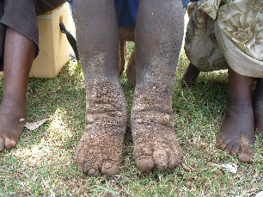
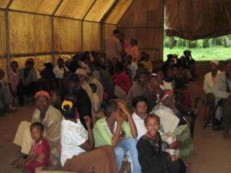
Nineteen years ago in Ethiopia
Invited to review NGO after application to British Embassy for small grant.
Realised my ignorance!
Rich, but ignored literature (aetiology, natural history, distribution, management) from EW Price in the 1970s and 1980s.
Term ‘podoconiosis’ coined 1980s.
Very little research since then.

Slide 4
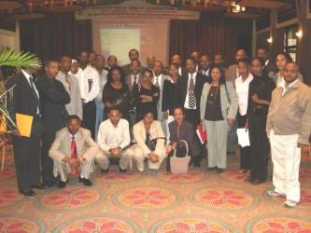
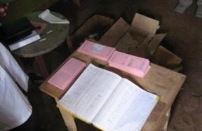
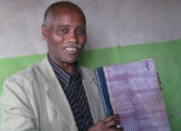
Plan for Research: Capacity Building
School of Public Health, AAU: scores of MPH students needing projects
Develop capacity to study endemic disease
Mossy Foot Association:
Highly organised, though paper-based, treatment clinics
Develop capacity to host and contribute to relevant research, act as ‘gatekeepers’

Slide 5
Podoconiosis Research
Epidemiology
Behavioural Sciences
Genetics
Ethics
Economics
Geology
Mineralogy
Health Systems
Histopathology
Ophthalmology
Microbiology
Public Health
Mental Health
Clinical Medicine

Slide 6
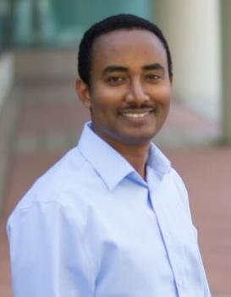
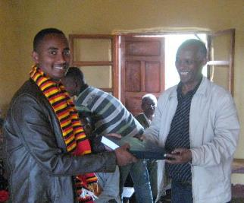
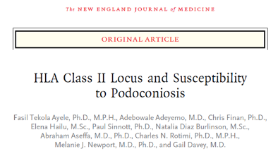
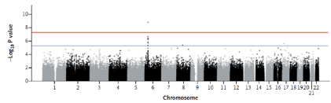
Aetiology: Genetic susceptibility
Genomewide scan of 194 cases and 203 controls, and family based testing, demonstrated association between podoconiosis and SNPs in the HLA Class II locus.
Fasil Tekola-Ayele

Slide 7
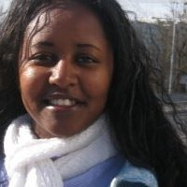
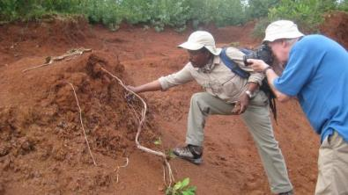
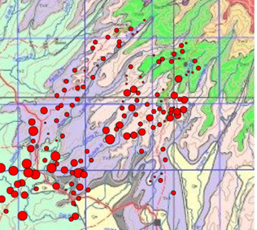
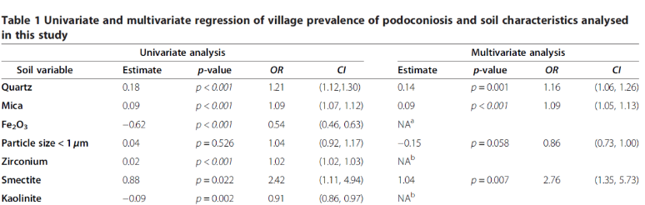
Aetiology: Geology & Mineralogy
Yordanos Belayneh Molla

Slide 8
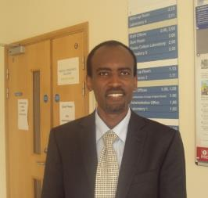
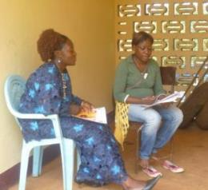
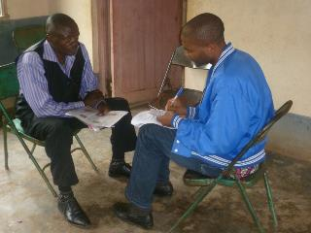
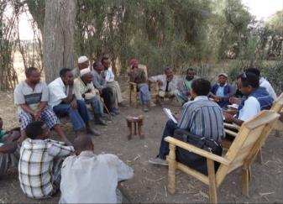
Rapid Ethical Appraisal
“a brief qualitative intervention designed to map the ethical terrain of the research setting prior to a research team recruiting participants”
Adamu Addissie Nuramo

Slide 9
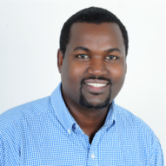

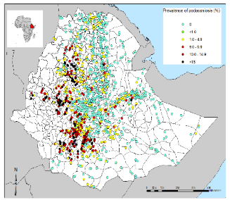
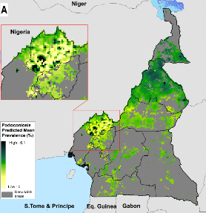
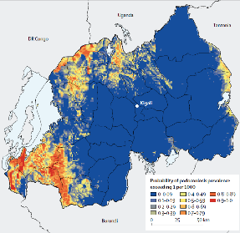
Mapping
Wellcome-funded PHATIC fellowship followed by Intermediate fellowship. Prolific mapping, enabling understanding of environmental determinants and estimation of disease and economic burdens.
Kebede Deribe
Ethiopia (PhD)
Cameroon (PDRF)
Rwanda - PDRF
Kenya - PDRF

Slide 10
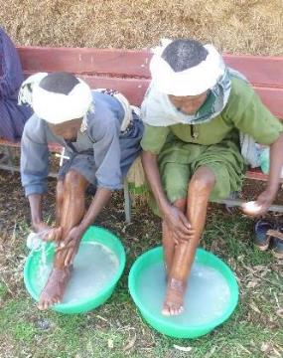
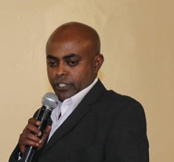
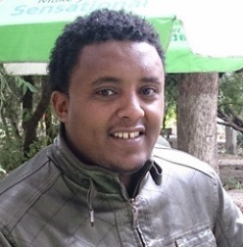
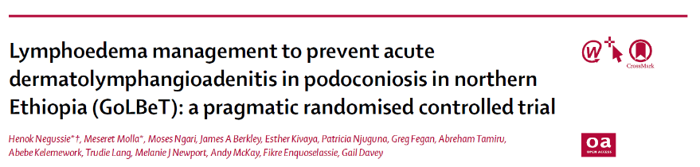
Lymphoedema Management Trial
MRC/WT/DfID-funded trial of lymphoedema management ‘package’ (foot hygiene, skin care, exercise, elevation, and use of socks and shoes). Key outcome: reduction in incidence of ‘acute episodes’..
Henok Negussie
Meseret Molla Kassahun

Slide 11
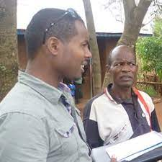
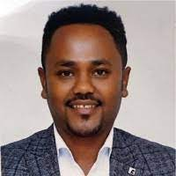
Sociology and behavioural sciences
NIH-funded work on footwear use for primary prevention of podoconiosis.
H3Africa- funded work on improving health education interventions using a mental model approach with rural youth.
Abebayehu Tora
Kibur Engdawork

Slide 12
NIHR Global Health Unit on NTDs at BSMS, Phase 1
Country | Area | Name
Ethiopia | Integration of mental health and limb care across NTDs and into the state health system | Dr Oumer Ali
Ethiopia | Improving the diagnosis of tropical lymphoedema | Abdi Samuel
Ethiopia | Understanding immune responses in podoconiosis | Mikias Negash
Ethiopia | Efficacy of Ethiopian plant extracts for lower limb care in in vitro models. | Dr Dereje Negussie
UK | Linking soils and human health: geospatial analysis of podoconiosis occurrence and cause in Ethiopia and Cameroon. | Harriet Gislam

Slide 13
NIHR Social Sciences for Severely Stigmatising Skin Diseases (5S) Foundation
Country | Area | Name
Rwanda | Efficacy of Ethiopian plant extracts for lower limb care in in vitro models. | Jean Paul Bikorimana
Ethiopia | Intersectionality of Gender, Rurality and Disability: The Lived Experiences of Women with Podoconiosis as Primary Caregivers in Rural Areas of Western Ethiopia | Bikila Ayele Suyum
Ethiopia | Communication Intervention for Behavior Change: Community Conversations to Improve Well-Being and Reduce Stigma against Podoconiosis Patients | Tseganesh Mulugeta
UK | Linking soils and human health: geospatial analysis of podoconiosis occurrence and cause in Ethiopia and Cameroon. | Corinna Thellmann

Slide 14

Country | Area | Individual
Ethiopia | Implementation science | TBA
Ethiopia | Geospatial mapping | TBA
Rwanda | Mental health and health economics | Nadia Hitimana
Rwanda | Integration into CHW workstream | Gashegu Misbah
UK | Health economics | TBA

Slide 15













With thanks to…

