Slide 1
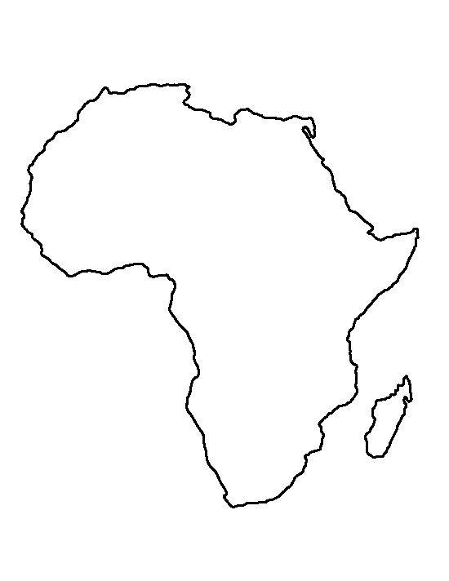


Dr Fortunate Machingura CeSHHAR
17 March 2022
Wellcome Trust Collaborative Award in Science (PI Cowan)
Differentiated prevention and care to support virtual elimination of HIV transmission attributable to sex work in southern Africa

Slide 2
Presentation outline
Background and Research questions
Formative work
AMETHIST trial
Parallel regional work
Next Steps

Slide 3
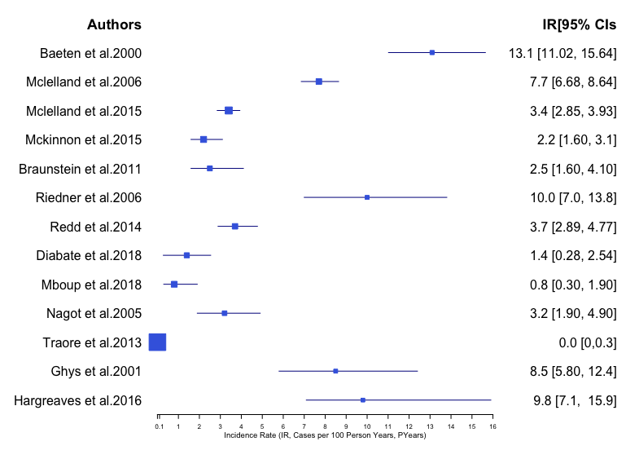
Globally individuals who sell sex bear a disproportionate burden of HIV
Global AIDS Update 2021
In 2020 female sex workers were at 26 times greater risk of acquiring HIV that women in the general population
FSW will become increasingly important to include in interventions as generalised epidemics in Africa come under epidemic control
Zimbabwe: estimated 40,00 FSW; 53% of FSW are HIV infected
Notes:
As all of you are already well aware individuals who sell sex bear a disproportionate burden of HIV – last years UNAIDS Global AIDS Report estimated that female sex workers were at 26 times greater risk for acquiring HIV than adult women more generally.
In a systematic review of HIV incidence among female sex workers from Africa presented at IAS in 2020 you can see incidence varied by region and study time period – with incidence higher in East Africa than West Africa. There was only one measure from southern Africa – Zimbabwe – 10% per annum (20 times that estimated in the general population).
While the overall proportion of women who sell sex in the population is small – between 0.2% and 5% of population the burden they bear is very heavy.
There is less information about the additional risks of selling among trans or males compared to their general population counterparts - figures are largely conflated with non-sex working individuals – regardless they are also at greatly increased risk.
So what puts sex workers at such high risk of acquiring HIV - high partner numbers, inability to negotiate condom use with clients or regular partners, concomitant STIs as well a host of individual and structural factors that combine to mitigate against their wellbeing. Additionally men who report paying for sex in SSA are 1.5 times more likely to be HIV infected than men who don’t.
In addition to their disproportionate burden of HIV individuals selling sex also bear a disproportion of AIDS related stigma and discrimination.

Slide 4
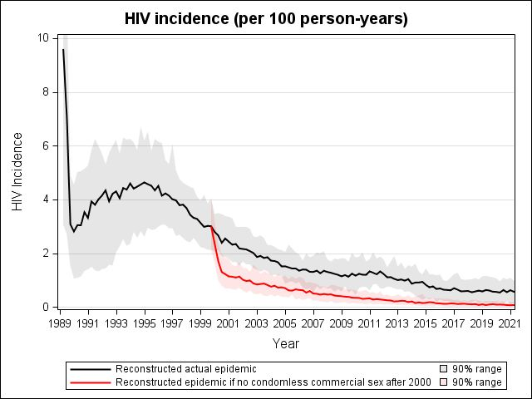
Differentiated prevention and care (AMETHIST) to support virtual elimination of infectious HIV among sex workers in southern Africa
UNAIDS goal of eliminating HIV by 2030 is unachievable (and unaffordable) without more effective targeting of prevention and care
COLLABORATION GOAL
To virtually eliminate population level transmission and acquisition of HIV that occurs as a result of commercial sex transactions

Slide 5
Research guiding ‘Sisters’ programme scale up
National FSW implementation–research platform in Zimbabwe ‘Sisters with a Voice’
2009
2010 - 2012
2013
2014 -2015
2016 –2018
2019 –2021
36 sites,
youth program, 29,110 FSW got clinic services
DREAMS, PrEP, Self Help Groups, microplanning 26,782 FSW got clinical services
86 sites, 38,895 FSW got clinical services
5 sites
322 FSW got clinic services
16 sites, 3,394 FSW got clinical services
36 sites, 6,105 FSW got clinic services
Formative
work
RDS – care cascade + qualitative research
SAPPH-IRe trial, stigma analyses
Program data to estimate HIV incidence in FSW
SAPPH-IRe trial, migration, national size estimation, DREAMS Impact evaluation, mapping 16-19 yr AGSS, recency testing, modelling
AMETHIST, MeSH,
sex work life course
Programme providing platform for implementation research

Slide 6
Our Research Questions
RQ2 Impact evaluation
Is AMETHIST effective at increasing coverage, uptake and engagement with prevention and care?
RQ4: Transferability:
Can AMETHIST be
translated cost
effectively to other
African settings?
RQ1 Formative research
What characteristics predict engagement in HIV prevention and care among FSW?
RQ3 Modelling
What uptake of AMETHIST will lead to virtual elimination of transmission through sex work?
Is it cost effective?

Slide 7
Studies to better understand life course of sex worker and their engagement with prevention and care services
RQ1 Formative research
What characteristics predict engagement in HIV prevention and care among FSW?
Impact evaluation of the AMETHIST intervention (Adapted microplanning) in 22 sites across Zimbabwe
RQ2 Impact evaluation
Is AMETHIST effective at increasing coverage, uptake and engagement with prevention and care?
Modelling population level impact and cost effectiveness of effective sex worker programming
RQ3 Modelling
What uptake of AMETHIST will lead to virtual elimination of transmission through sex work?
Is it cost effective?
Malawi & South Africa
  Studies to understand context of sex work in different settings and determine likely transferability of AMETHIST
RQ4: Transferability:
Can AMETHIST be translated cost effectively to other African settings?

Slide 8
Our Research Questions
RQ2 Impact evaluation
Is AMETHIST effective at increasing coverage, uptake and engagement with prevention and care?
RQ4: Transferability:
Can AMETHIST be
translated cost
effectively to other
African settings?
RQ1 Formative research
What characteristics predict engagement in HIV prevention and care among FSW?
RQ3 Modelling
What uptake of AMETHIST will lead to virtual elimination of transmission through sex work?
Is it cost effective?

Slide 9
..understand what’s happening in the lives of SWs + Secondary data analysis to understand life course, transitions into and out of SW – longitudinal life narratives

Slide 10
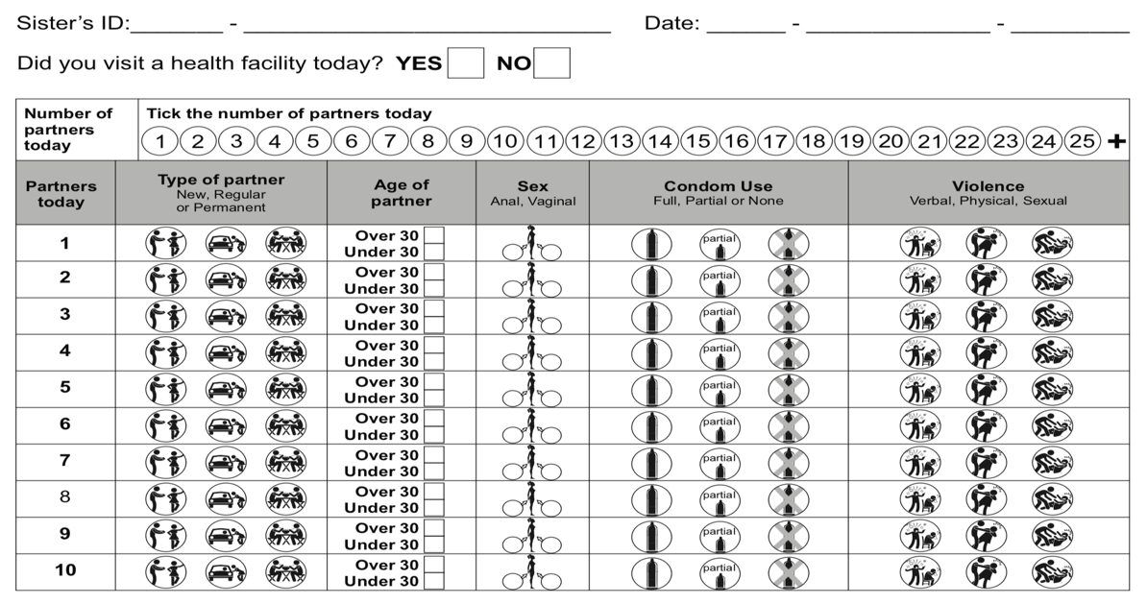
..understand partnerships, experience of violence, condom use + Secondary analyses of programme data -
Longitudinal diary study
Transitions into and out of sex work and how these affect service engagement
  Partnership patterns and associated risks (particularly in terms of service engagement)
  Condom use

Slide 11
.. ..one of the first tracing studies of SWs lost to care in Africa to understand what happens to women who drop out.
Primary outcome =
Secondary outcome =
Some women attend Sisters repeatedly – others disengage
We are unsure the extent to which this reflects
  Unmet need for services
  An opportunity programme improvement
  Women leaving sex work
  Implications for their risk and engagement with services
We initiated tracing of women who had visited the programme previously but subsequently become “lost to follow up”
Number of FSW in need of Sisters services because they remain active in sex work
Number of FSW traced by phone or personal contact
Number of women who access Sisters services within 3 months of being traced
Number of women in need of Sisters clinical services because they remain active in sex work

Slide 12
Our Research Questions
RQ2 Impact evaluation
Is AMETHIST effective at increasing coverage, uptake and engagement with prevention and care?
RQ4: Transferability:
Can AMETHIST be
translated cost
effectively to other
African settings?
RQ1 Formative research
What characteristics predict engagement in HIV prevention and care among FSW?
RQ3 Modelling
What uptake of AMETHIST will lead to virtual elimination of transmission through sex work?
Is it cost effective?

Slide 13
Differentiated prevention and care (AMETHIST) to support virtual elimination of infectious HIV among sex workers in southern Africa
Self help groups
Regular, risk differentiated peer support (microplanning) that nudges individuals and their networks to stay safe
Strengthened solidarity and space (self-help groups) to support service engagement and develop positive norms
SW data microplanner programme strengthened programme response

Slide 14
Design, Cluster Definition and selection,
Cluster Randomised Trial
Cluster: population of female sex workers working in a geographic location (usually a town or business centre) where there is a government health clinic providing dedicated FSW services through the Sisters programme.
22 clusters selected to reflect range of setting types, sufficient distance to avoid contamination
1:1 randomization using restriction at a public meeting 27th Jan 2019

Slide 15
Intervention…complex biobehavioural survey….composite outcome
Intervention arm only: 11 clusters
Microplanning + SHG
  Regular risk-differentiated, individualized support for Sisters engagement
  Biweekly peer-led, community Self Help Groups
Map hotspots
Microplanning
Form SHG
RDS survey data
200 x 22 FSWs HIV Ab, HIV VL, HIV RITA, HIV DRL, STI, TDF levels Y chromosome, Questionnaire, program data
Impact at FSW population level in both HIV+ and HIV- FSW
1⁰ Outcome – composite outcome (RDS)
  % of all FSW who are at risk of HIV acquisition/transmission*
  *FSW reporting condomless sex in past month & HIV+ VL>1000c/mL or HIV- not on PrEP.
Randomise
Year 0
Year 1
Year 2
Year 3
Country-wide: all 22 clusters
Comprehensive SRH services
Programme monitoring
Process evaluation
  Facility-level: weekly clinic for FSW at Govt health facility
  Community-level: peer-led mobilisation for services
  Real time data capture data guided programming
  In-depth, theory-based process evaluation

Slide 16
RDS survey (n=4444) data collection and lab methods
Questionnaire delivered using ACASI
  Sex behavior
  SRH
  Mental health
  QoL
  Substance use
  Social cohesion
  Stigma
  Violence
  Programme engagement
  PrEP Values and Preferences – including DCE
  CV19 vaccination
Laboratories
Finger-prick blood sample point of care test
  HIV – national algorithm
  Syphilis
Dried blood spot
  Viral Load
  PrEP Tenofovir diphosphate levels
  Recent HIV infectioj
  ART Levels
  ART resistance
Self-administered vaginal swab
  NG, CT, TV
  Y-Chromosome

Slide 17
Primary endpoint
The proportion of all FSW who are at risk of either HIV acquisition or HIV transmission

Slide 18
Our Research Questions
RQ2 Impact evaluation
Is AMETHIST effective at increasing coverage, uptake and engagement with prevention and care?
RQ4: Transferability:
Can AMETHIST be
translated cost
effectively to other
African settings?
RQ1 Formative research
What characteristics predict engagement in HIV prevention and care among FSW?
RQ3 Modelling
What uptake of AMETHIST will lead to virtual elimination of transmission through sex work?
Is it cost effective?

Slide 19
Our Research Questions
RQ2 Impact evaluation
Is AMETHIST effective at increasing coverage, uptake and engagement with prevention and care?
RQ4: Transferability:
Can AMETHIST be
translated cost
effectively to other
African settings?
RQ1 Formative research
What characteristics predict engagement in HIV prevention and care among FSW?
RQ3 Modelling
What uptake of AMETHIST will lead to virtual elimination of transmission through sex work?
Is it cost effective?

Slide 20
Parallel work in Malawi and SA
To understand sex worker life course in those settings
To investigate the potential additional impact of sex work programming enhanced by the AMETHIST intervention in those settings
Notes:
Zimbabwe and some other countries in the region have had a programme for some time, many countries do not have nationally scaled programmes. However, modelling will be more straightforward to explain if done in the context of a situation with no existing programme until 2022.
This presentation will focus on the first

Slide 21







AMETHIST/Sex Work Post Doc, PhD and MSc Fellows
PostDoc Fellows
Fortunate Machingura (University of Oxford / LSTM)
Sanni Ali (LSHTM)
PhD
Sungai Chabata (Erasmus)
Galven Maringwa (LSTM)
Gracious Jamali (LSTM)
Primrose Matambanadzo (LSTM)
Doreen (LSTM)
Collin Mangena (LSTM)
Lindiwe (LSTM)
Harriet (LSHTM)
Sibongile Mtetwa (Leeds)
MSc
Memory Makamba (AU)
Sithembile Musemburi (Wits)

Slide 22
PI, Co-PIs and Co-Investigators
Frances Cowan (PI)
Fortunate Machingura
James Hargreaves
Andrew Phillips
Joanna Busza
Maryam Shahmanesh
Nicola Desmond
Brian Rice
Richard Steen
Loveleen Bansi- Matharu
Rachel Baggaley
Owen Mugurungi
Amon Mpofu
Memory Makamba
Sungai Chabata
Sanni Ali
Jasper Maguma
Galven Maringwa
Sarah Boudin
Thomas Hartney
T. Triantifolas
Tatenda Kujeke
Gracious Jamali
Primrose Matambanadzo
Memory Makamba
Sithembile
Sithembiso Dube
Lilian Chinyanganya
Florence
Rumbidzo Makandwa
Miniyenkosi Majoli
Albert Takaruza
Albert Nyamugunduru
Jeff Dirawo
Edward K
Wezzie Lora
Doren
Natsayi
Gumede
Carina
James Chirombe
DSMB
Nancy Padian
Katherine fielding
Helen Ward

Slide 23








Slide 24









