Slide 1






Y-Check: Evaluating the effectiveness of adolescent health check-ups
Dr. Aoife Doyle
Faculty of Epidemiology and Population Health, LSHTM, UK
Biomedical Research and Training Institute, Harare, Zimbabwe

Slide 2
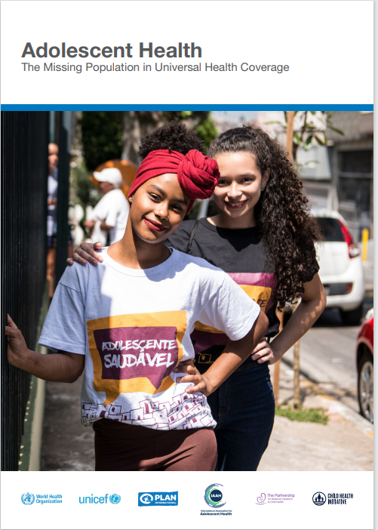
Adolescent health and well-being
In Adolescence, health-related behaviours adopted that will have substantial positive or negative impacts on short- and long- term health, educational attainment and employment prospects.
However, few adolescents have any contact with health services
→ missed opportunity for early detection of health problems, health promotion, and the development of healthy health-seeking behaviours.

Slide 3
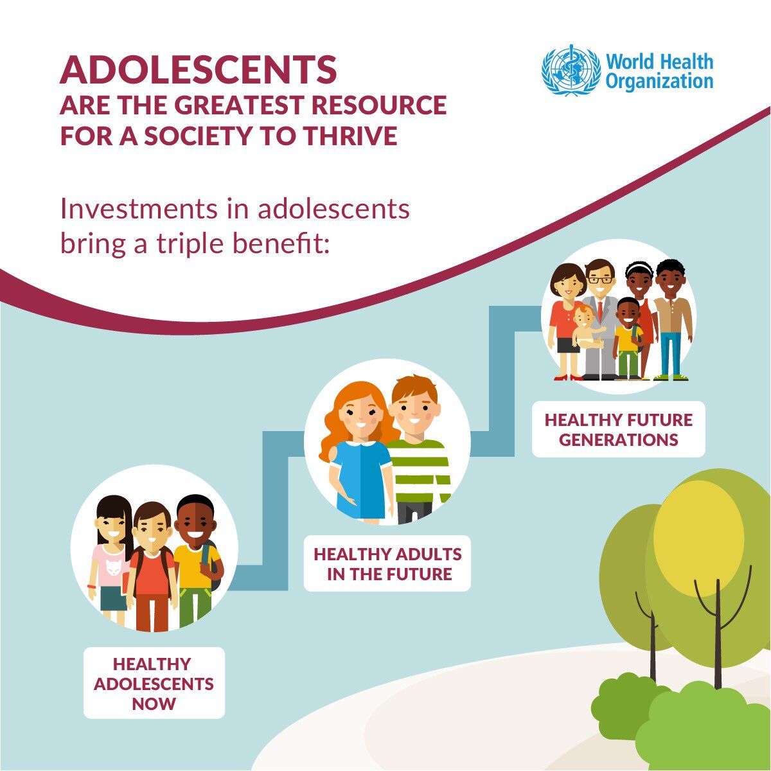
Triple dividend for human development

Slide 4

Novel adolescent check-up strategy
Aim
To develop and evaluate the effectiveness and cost-effectiveness of a novel adolescent health check-up visit strategy to provide access to adolescent-friendly promotive, preventive and curative health care

Slide 5
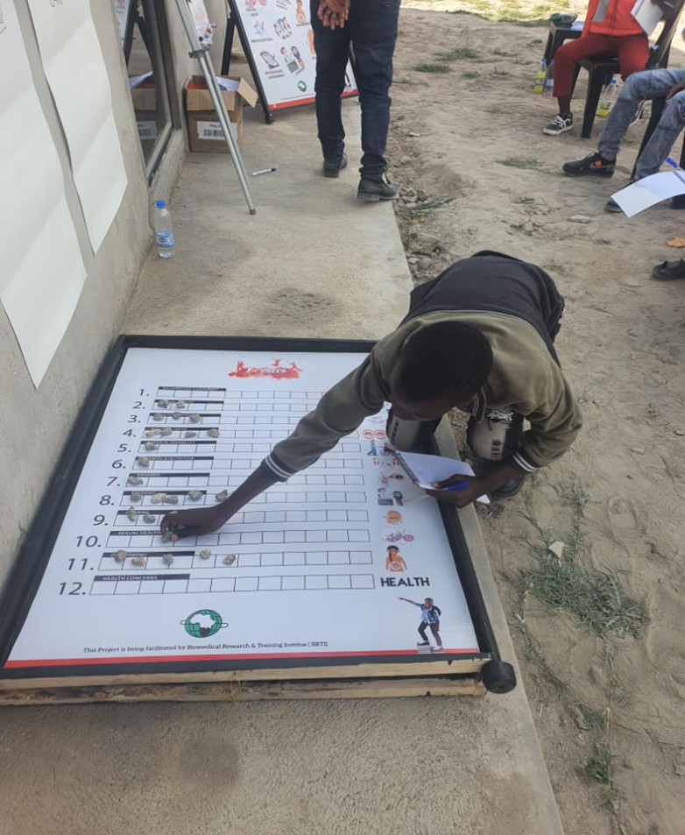
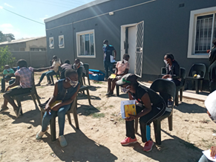
Formative work in Zimbabwe (2020)
WHO-led 12-month multi-country study (PI David Ross; Fondation Botnar)
Chitungwiza (386k population, 30km South of Harare)
IDI and participatory workshops with adolescents (10-14y, 15-19 y) and key stakeholders
Facilitators and Barriers to attending check- up visit
  Cost, usually only attend services when ill, parental approval, religious beliefs
Preferences for delivery of intervention
  Schools (10-14y); Community (15-19y)
Content of check-up visit : SRH, mental health, mouth and teeth, hearing, anaemia, immunisation
Rudo Chingono, Constance Mackworth-Young, et al, Journal of Adolescent Health, 2021

Slide 6
UKRI Future Leaders Fellowship (2021-25)
Phase 1 (yr1-2)
Develop and pilot test Y-Check
-Youth & community engagement and support
-Screening tools, clinical protocols and referral pathways
-Digital platform development
Phase 2
(yr 2-3)
Y-Check Implementation and evidence generation
Phase 3
(yr3-4)
Knowledge dissemination and translation
Outputs
Novel intervention
Evidence on cost-effectiveness in urban Zimbabwean settings
Proposals for follow-on studies

Slide 7

Implementation and evaluation
Implementation
Evaluation
  Client-centered integrated check up visits for males and females at two time-points during adolescence
    Y-Check 1- Schools (4 schools, Grade 5, 10-13 y, n=1000)
    Y-Check 2- Schools and Community settings (2 schools, Form 3, 16-19 y, n=1000)
  Conditions to be screened for context specific and aligned with policy
  Cohort follow-up at 4 months and 12 months – health and educational outcomes
  Primary outcome:
  % who screen positive for at least one condition and receive appropriate on-the-spot care or complete appropriate referral within 4 months.
  Process evaluation
  Cost-effectiveness analysis
Notes:
Screening criteria: (i) Identified need (ii) accurate and acceptable test (iii) locally accessible effective intervention

Slide 8
Check-up visit format and content
Nurse review
Physical examination & laboratory tests
Screening questionnaire
Health promotion, counselling, treatment and/or referral
Psychosocial issues
Drug, alcohol, tobacco use
Mental health
Epilepsy
Immunisation
Growth, nutrition, and physical activity
Oral health
Eyesight & Hearing
Physical impairment
Blood pressure (Y-Check 2 only)
Voluntary male circumcision
Menstrual Hygiene Management
Sexual and reproductive health and HIV prevention (Y-Check 2 only)

Slide 9
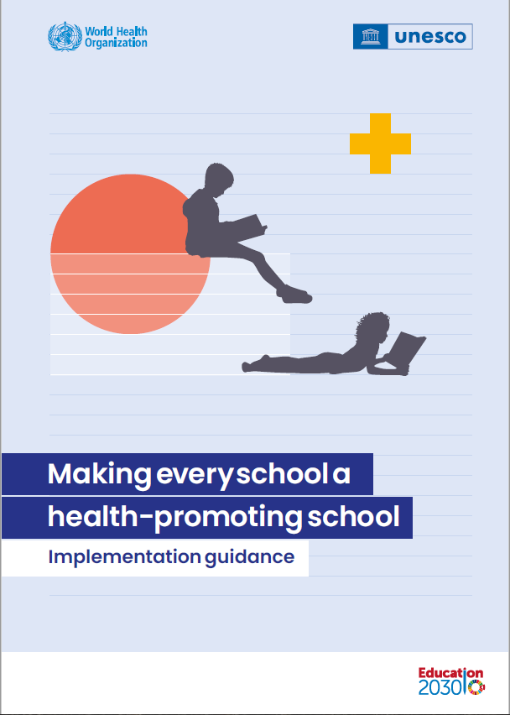

Global context: Check-up visits & school health services
  Obtaining evidence on check-ups is a top World Health Organization (WHO) priority for adolescent health research
  → develop recommendations for preventive and promotive contacts with the health system
  Y-Check Phase 2 in Tanzania and Ghana with funding from Fondation Botnar (2022-2024)
  WHO, Geneva
  Biomedical Research and Training Institute, Zimbabwe
  Mwanza Intervention Trials Unit/ National Institute for Medical Research, Mwanza, Tanzania.
  University of Ghana School of Public Health, Ghana
  LSHTM
New 2021 guidance from WHO

Slide 10

Acknowledgements
Ministry of Health and Child Care
Ministry of Primary and Secondary Education
Y-Check team (Farrie Nzvere, Salome Manyau, Chelsea Mazonde, Mcnelson Zulu, Cuthbert Sekanevana, Prosper Usika, Tendai Murwira, Chipo Mazarura, Chipo Nyamayaro, Faith Kandiye, Raphel Nyahwedegwe)
BRTI (Rashida Ferrand, Ethel Dauya, Tsitsi Bandason, Chido Dziva Chikwari, Vicky Simms, Constance Mackworth-Young, Rudo Chingono, Mandi Tembo)
WHO ( Prerna Banati, Valentina Baltag, David Ross)
LSHTM (Helen Weiss, Giulia Grecco, Sarah Bernays)
MITU (Saidi Kapiga, Mussa Nsanya, Gerry Mshana, Yovitha Sedekia)
University of Ghana (Benedict Woebong , Franklin Glozah,Philip Adongo, Eric Koka, Hannah Taylor-Abdulai)
UKRI and Fondation Botnar

