Slide 1
Pertussis vaccines: Old and New challenges
Dr Anja Saso
Wellcome-Trust Annual meeting: March 2022
Vaccine-induced systemic and mucosal immunity to Bordetella pertussis in infancy: bringing B- and T-cell responses together

Slide 2
Outline
Background
International pertussis consortium and the Gambian pertussis study (GaPs)
PhD Aims
Methods
Preliminary results

Slide 3
Background

Slide 4
Isn’t whooping cough old news?
Whooping cough is caused by gram –ve bacteria Bordetella pertussis
Two types of vaccine exist worldwide
  1940/50s: Whole cell (wP) = inactivated (killed) whole bacterium
  1990s: Acellular pertussis (aP) = subunit vaccine of 1-5 antigens
https://www.canada.ca/en/public-health/services/publications/healthy-living/vaccine-preventable-disease-surveillance-report-december-31-2015.html#a71

Slide 5
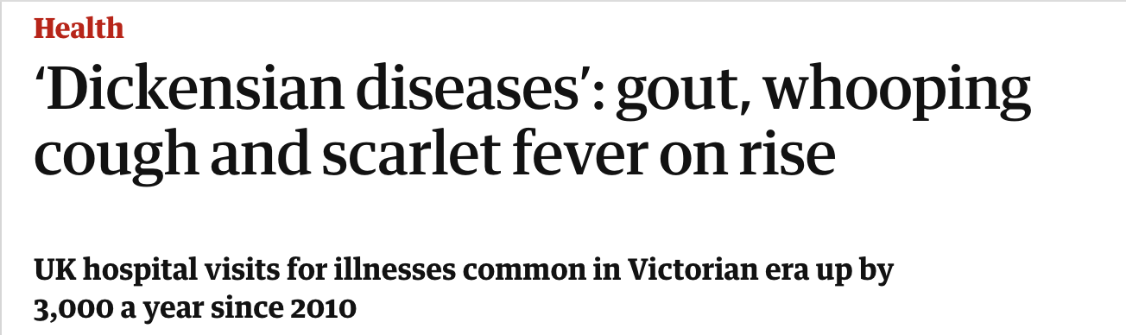
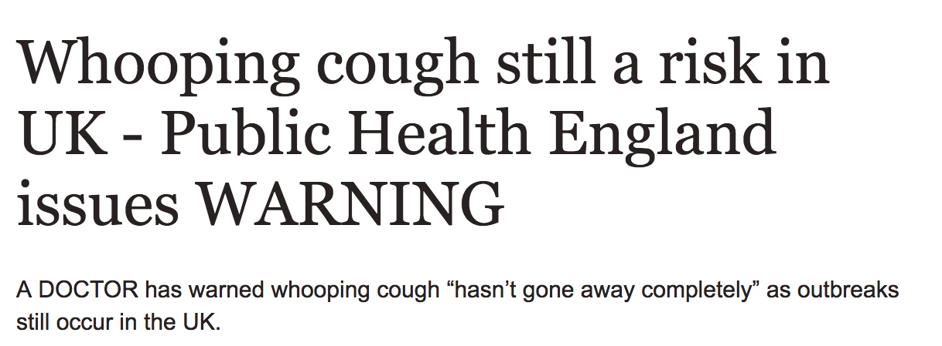
Sadly not…
Remains an important cause of vaccine preventable morbidity and mortality globally
Recent WHO model estimated 24.1m pertussis cases with 160 700 deaths in children < 5 years worldwide
  Largest proportion in SS Africa and children < 1year
Recent outbreaks even in areas with high vaccine coverage
Yeung et al 2017

Slide 6
What are the reasons for this?
Low-to-middle income countries – poor coverage, conflicting health priorities, limited resources, suboptimal diagnosis/awareness?
Increased surveillance
Improvement in detection, awareness and reporting
Vaccine-driven evolution of circulating strains
Suboptimal and/or waning vaccine-acquired immunity
  Particularly switch from wP to aP vaccines

Slide 7

Both protect against severe disease…
  aP vaccine
  Less reactogenic?
  vs.
  Shorter duration of protection?
  Less effective against infection/colonisation in upper airway?
wP vaccine
  More reactogenic?
  vs.
  Longer duration of protection?
  Clears bacteria from colonising upper airway
….But neither are as good as natural immunity

Slide 8
What are the underlying immunological mechanisms?
  No correlate of protection against pertussis disease or following vaccination ?anti-PT antibody
  Both vaccines induce robust serum antibody responses
  BUT cell-mediated immunity is also important
    CD4+ T-helper cells may mediate differences in vaccine efficacy
  Skewing of CD4+ T-helper (Th) cell subsets
    Th1/Th17 post wP and natural infection vs. Th2 dominance post aP
    Persists even if subsequent aP boosters given in adolescence/ adulthood
Antunes 2018

Slide 9
Mucosal antibody and cytokines
Limited evidence in infants, especially Sub-Saharan Africa
Relationship between vaccine responses and mucosal microbiome
GAPS IN KNOWLEDGE
Role of other T helper cell subsets beyond Th1/2/17 in humans
Nature and role of functional antibody
Relationship between B and T cell mediated immunity
Contextualise with animal and human infection and vaccine challenge models

Slide 10
The opportunity
PERISCOPE (PERtussIS Correlates Of Protection Europe) is an EU/IMI funded multinational consortium
Collaboration between academic, private and public bodies

Slide 11
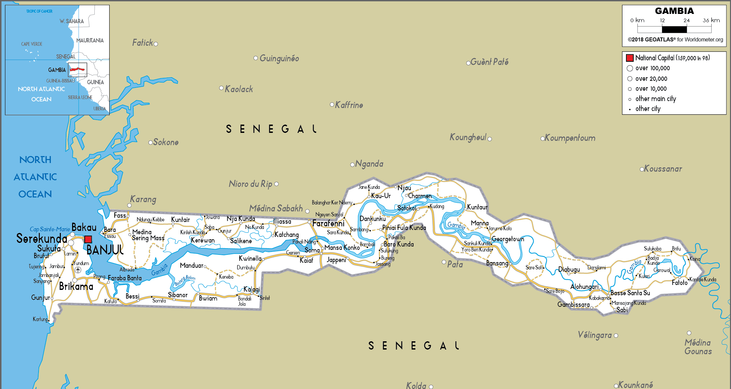
African arm: Gambian Pertussis Study (GaPs)
Phase IV double blinded randomised control trial
Comparing immunogenicity of aP vs. wP primary immunisation in Gambian infants up to 9 months of age
Also exploring impact of pertussis immunisation in pregnancy – not my primary focus
Primary end-point
  anti-pertussis-toxin (PT) antibody concentrations at 5 and 9 months of life
My PhD project is nested within the GaPs study.

Slide 12
PhD hypothesis and aim

Slide 13
Broad hypothesis
Differences between cell-mediated responses induced by aP vs. wP vaccines may underlie differences in:
  How these vaccines protect against infection/colonisation
  Duration of their protection
Mediated by B-cell dependent and independent mechanisms

Slide 14
Specific objective
Is there a difference in T-helper-cell and B-cell responses
induced in the blood and upper airway following aP compared to wP primary immunisation?

Slide 15
Methodology and a flavour of the results!

Slide 16
Study design and PhD time points
Primary immunisation schedule
Blood and mucosal sample collection
+7
+28

Slide 17

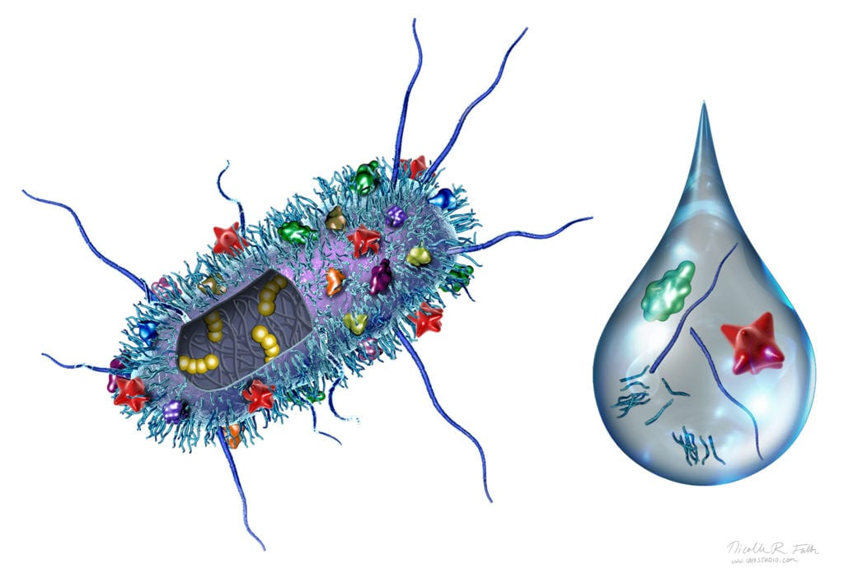
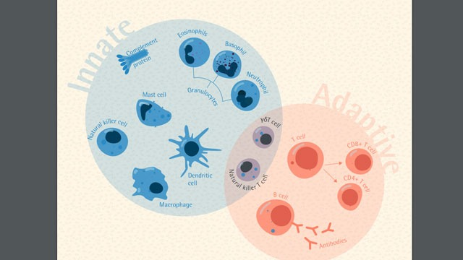
Host immune readouts
Differences in vaccine-induced:
Protection against infection
Longevity of protection
Pathogen (Bordetella)
wP vs. aP
Mucosal samples
Nasopharyngeal Microbiome
Peripheral blood samples
Innate system (Periscope)
T-cells:
Th1
Th2
Th17
Tfh
Treg
Mucosal immunity:
-Pertussis-specific IgG/A,
-Functional antibodies
-Cytokines
B-memory cells
Antibodies (Periscope)

Slide 18
Systemic T-cell responses
Whole blood 48-hour stimulation with pertussis antigens and readout of cytokine profile in culture supernatant → Th1/Th2/Th17
Flow cytometric readout using cryopreserved Peripheral blood mononuclear cells (PBMCs) → Th17/T-regulatory/T-follicular helper cells
Exploratory: T-cell transcriptomics → gene expression profiles
  Single-cell RNA sequencing at RUMC, The Netherlands

Slide 19
How do you analyse the data?
Ex vivo panel: to determine total pool of T-follicular helper (Tfh) cells
    characterise according to subtype or activation status
Infant day 7 post completion of primary imm
Indication of Tfh1/2/17 subtype
Indication of activated vs. quiescent state

Slide 20
2) AIM/ICS Panel: to characterise T-regulatory, T-follicular helper, Th17 cell populations
    Following overnight stimulation with pertussis peptide pool
    Pertussis specificity determined by activation-induced markers (AIM)
MARKER | FUNCTION
Live/dead (viability dye) | Dump channel – to exclude dead cells and monocytes (which can express CD4)
CD14
CD4 | T-helper cell phenotype
OX40 | Activation-induced markers (AIM)
CD25
CD45RO | T-follicular helper cells
CXCR5
CXCR3
CCR6
CD154 | T-regulatory cells
CD137
FoxP3 | T-regulatory cells
IL-17A/F | Secreted by Th17 cells
CD69 | Homing to tissues
CD103 | Homing to tissues

Slide 21
Activated (antigen—specific OX40+ CD25+) Th-cells increase following vaccination…
Baseline pre immunisation
Day 28 post completion of primary immunisation
*Gated on live single CD4+ CD14- cells
…what is their phenotype/function: Tfh/Th17/T-regulatory cells?
…are there differences according to mother/infant vaccine groups?

Slide 22
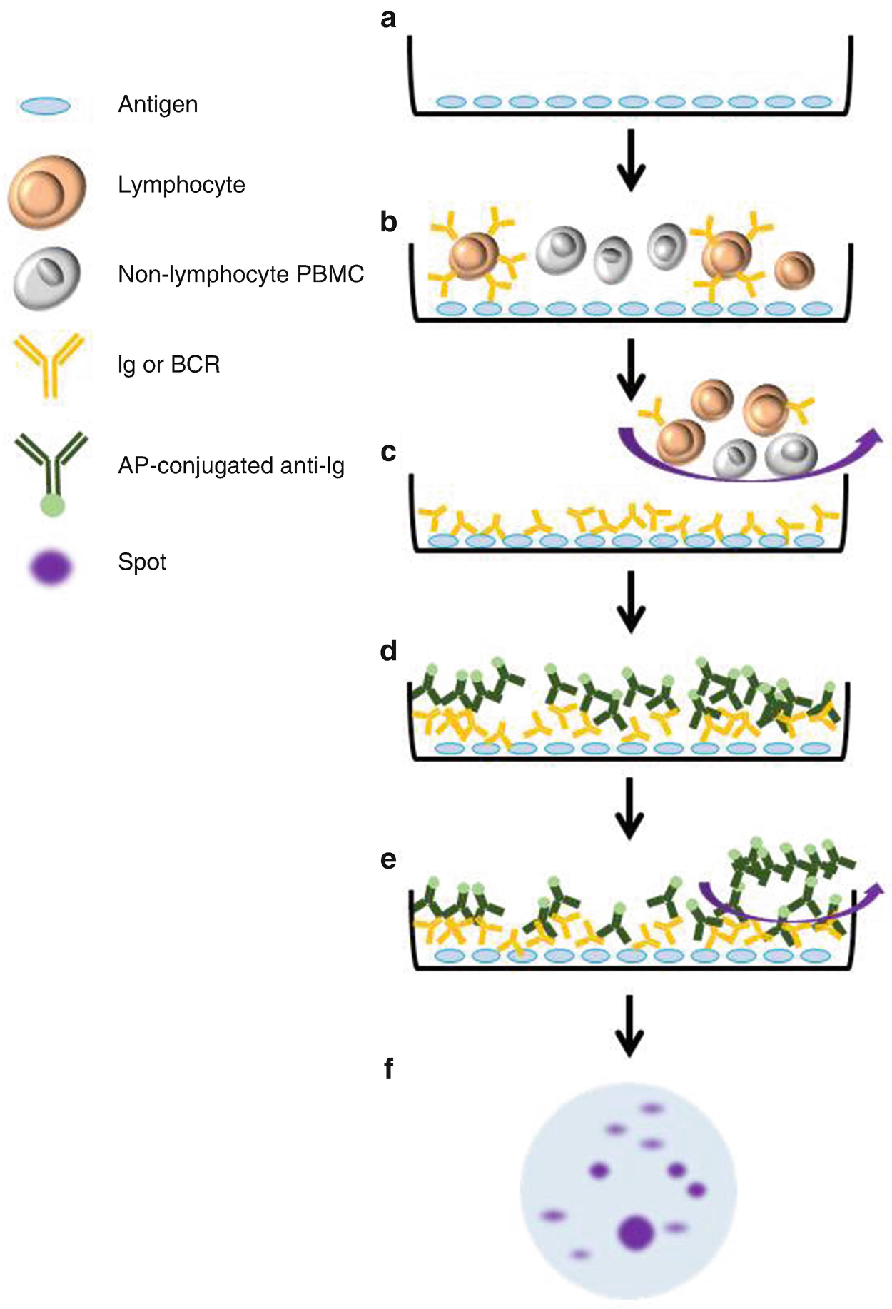
B-memory cell ELISpots
Initial cell stimulation/culture for 5 days with R848/IL2/IL10/CpG
V05
Hwai H et al (2018) https://doi.org/10.1007/978-1-4939-8567-8_11

Slide 23
B-memory cell responses
Preliminary semi
blinded data
Difference in PT- and TT-specific IgG+ memory B-cells at 1-month following immunisation between infant vaccine groups
PT, Pertussis Toxin; FHA, Filamentous Haemagglutinin; TT, tetanus toxoid; SFC, spot-forming cells

Slide 24
Host immune readouts
Differences in vaccine-induced:
Protection against infection
Longevity of protection
Pathogen (Bordetella)
wP vs. aP
Mucosal samples
Nasopharyngeal Microbiome
Peripheral blood samples
Innate system (Periscope)
T-cells:
Th1
Th2
Th17
Tfh
Treg
Mucosal immunity:
-Pertussis-specific IgG/A,
-Functional antibodies
-Cytokines
B-memory cells
Antibodies (Periscope)

Slide 25
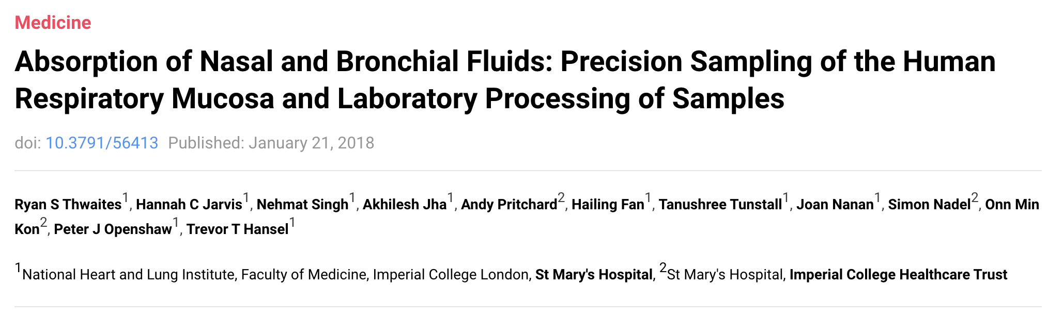
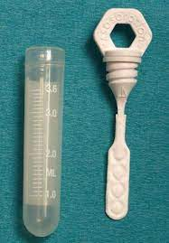
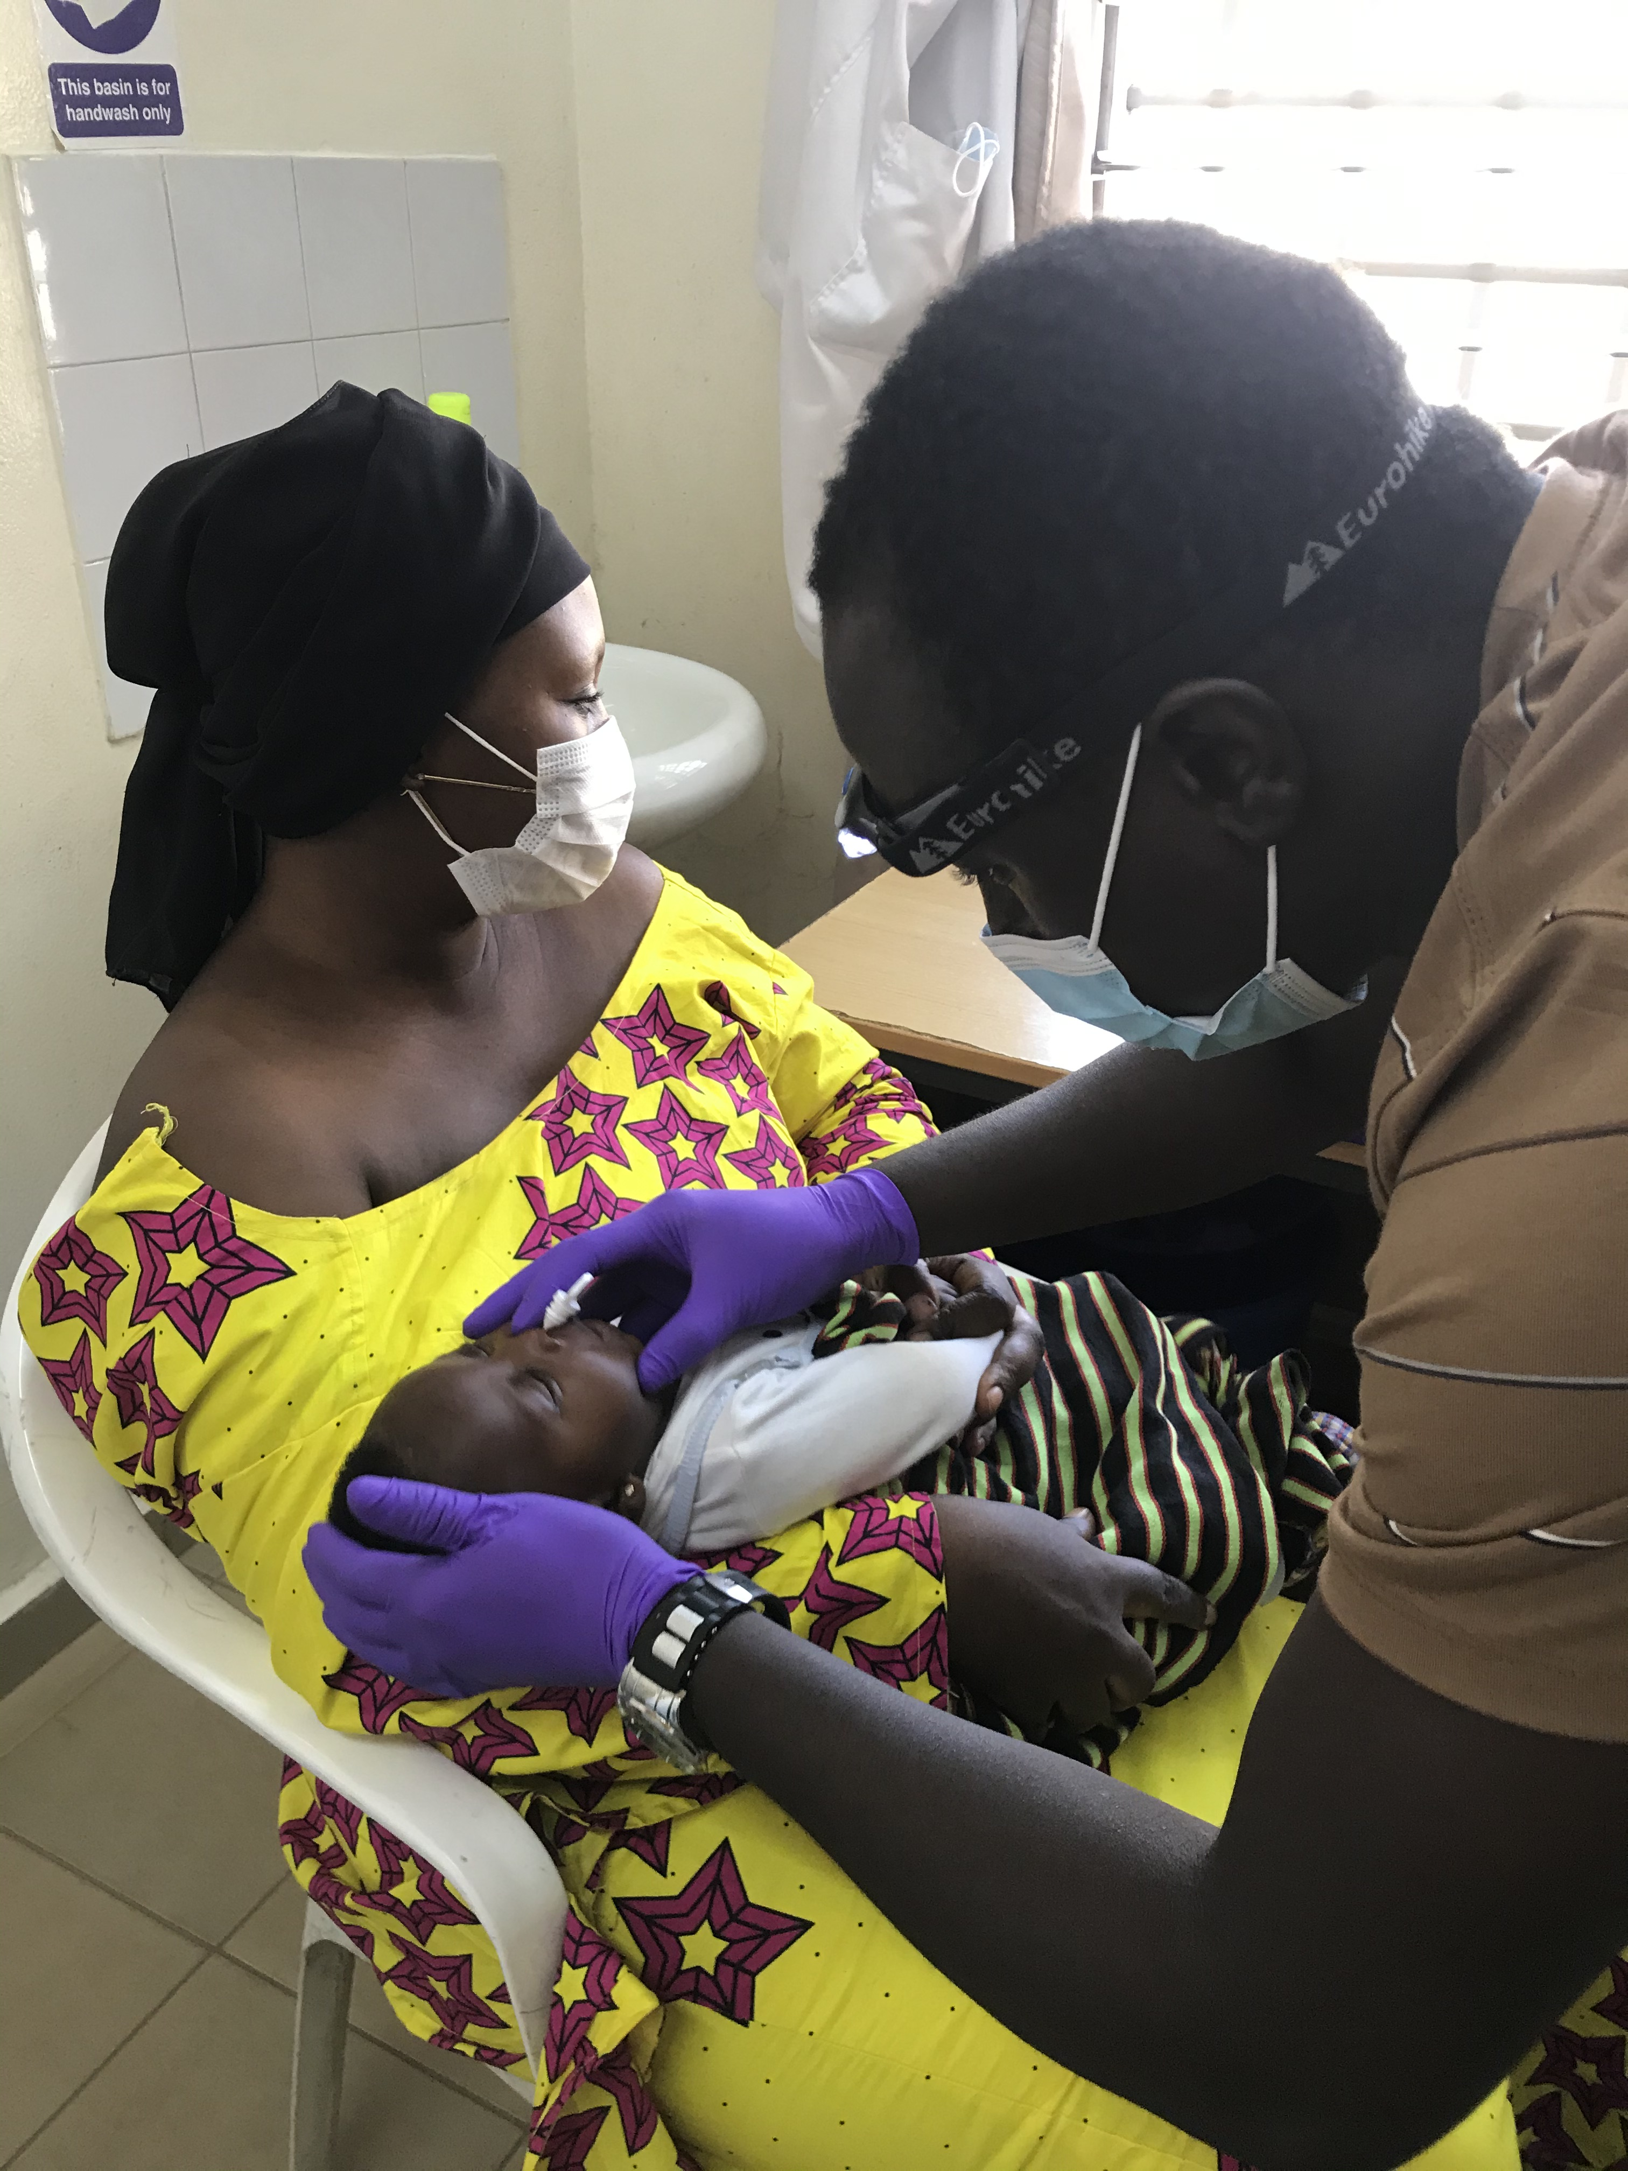
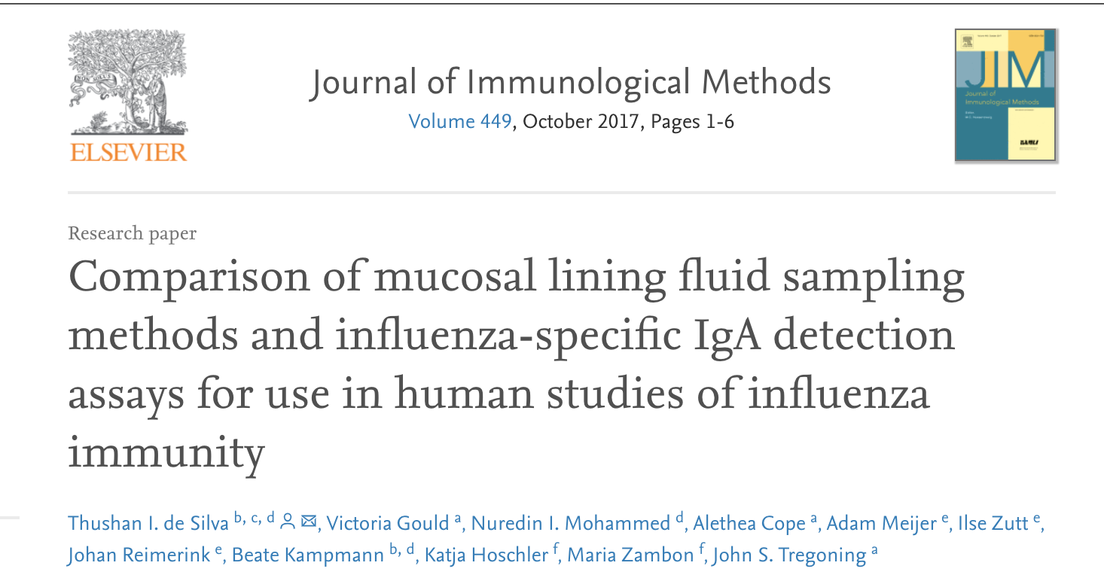
1. Mucosal lining fluid (MLF)
Unique ‘Nasosorption’ device
Photo with consent

Slide 26
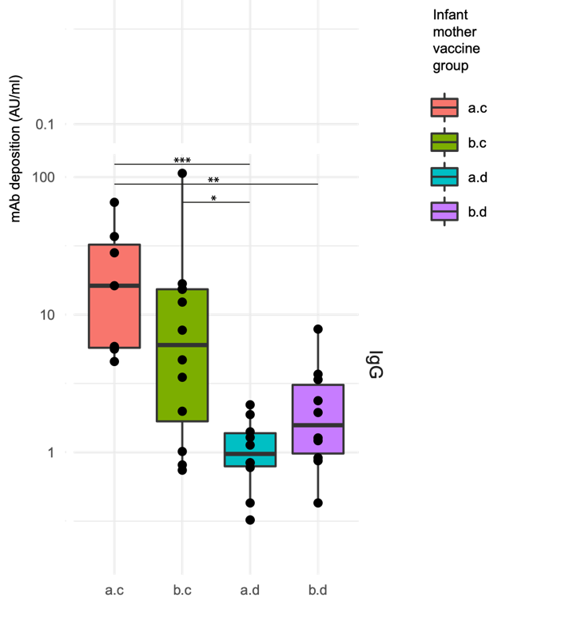
Mucosal responses (1)
Pertussis-specific IgG antibody deposition level at baseline (pre-vaccination)
Preliminary semi-blinded data
Mothers received pertussis vaccine in pregnancy?
Detection of vaccine-induced IgG derived transplacentally or in breast milk?
Run in collaboration with RUMC, The Netherlands
Wilcoxon signed rank test, *p<0.05 **p<0.01 *** p<0.001
Notes:
Fluoroscently labeled antibodies detected by flow cytometry

Slide 27
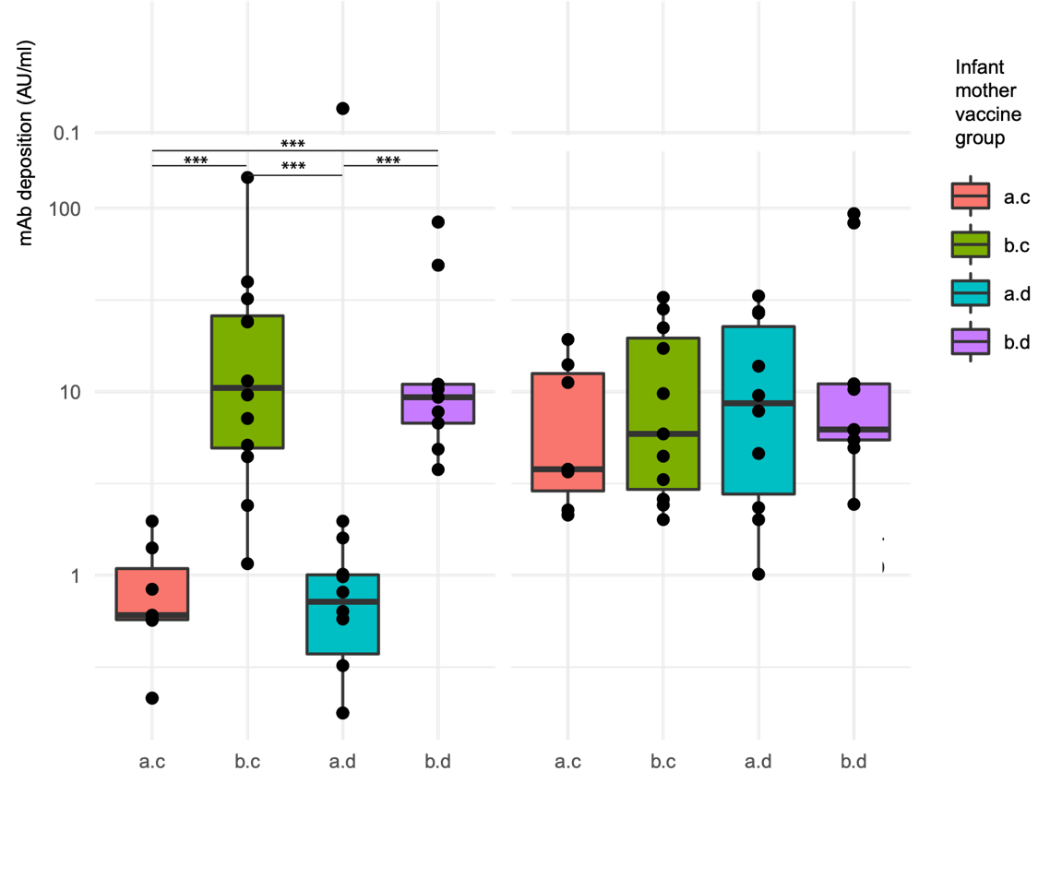
Mucosal responses (2)
Pertussis-specific IgG antibody deposition level at V05 (1-month post-vaccination)
No difference between vaccine groups
Reflects similar pattern to antibody levels in blood?
Is there waning by V06 (5-6 months post-vaccination?)
Is there a difference in IgG sub-class?
Preliminary semi- blinded data
Run in collaboration with RUMC, The Netherlands

Slide 28
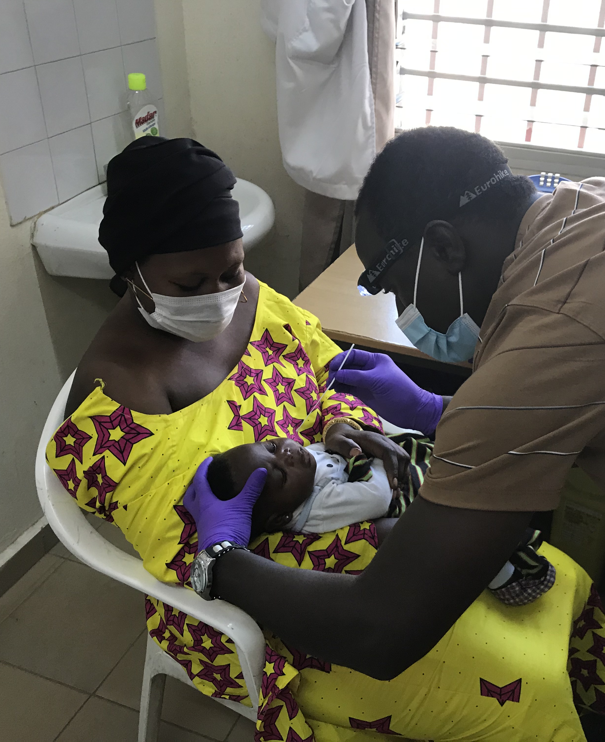

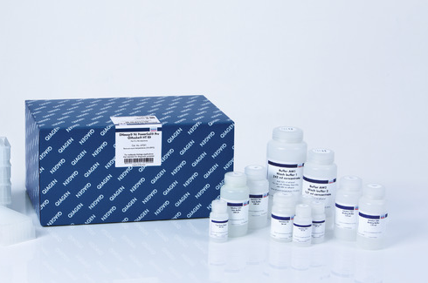
2. Mucosal colonisation
Nasopharyngeal swab (NPS) sampling
DNA extraction
Photo with consent
Qiagen DNeasy PowerSoil Kit
Multiplex qPCR to quantify colonisation by Bordetella pertussis and parapertussis
Target genes: IS481, BP283, pIS1001, hIS1001
Amplification of the 16S rRNA gene by PCR
Amplicon sequencing using the Illumina MiSeq platform
To characterise nasopharyngeal microbiome

Slide 29
The future
Hypothesis generating for future studies
Inform testing of novel pertussis vaccines
Novel correlate of protection – ? Composite
Design of next-generation of pertussis vaccines
  Delivery: intranasal vaccines
  Formulation: streamline T cell response
  Needs to be combined with epitope mapping
Novel methodological approach to the development of effective vaccines in the future
Novel tools to measure and analyse vaccine-induced systemic and mucosal responses

Slide 30



Acknowledgements
My supervisors
Prof Beate Kampmann
Dr Sophie Roetynck
Dr Thushan de Silva
GaPs lab team
Haddi Jobe
Biran Gaye
Modou Fofana
Aru-Kumba Baldeh
Karamo Konteh
Amadou Faal
Elishia Roberts
GaPs field team led by
Ebrima Kanteh
Mike Okoye
MRCG Infant Immunology
Ed Clarke
Jankey Jagne Ya
MRCG genomics team
Sheikh Jarju
Abdul Sesay
Jarra Manneh
Bakary Sanyang
Lamin Sillah
MRCG RSO, Logistics, Procurement, Biomed teams
Giana Yaya
Njilan Johnson
Omar-Sheikh
LSHTM
David Mabey & WT
Christina Albertsen
Ed Parker
PERISCOPE
Dimitri Diavatopolous and team
Andrew Preston
Pascal Blanc
Imperial College
Ryan Thwaites
Le Jolla Institute
Ricardo da Silva Antunes
Funders
Wellcome-Trust
Bactivac
HicVac
And all the GaPs mothers and babies : )

Slide 31
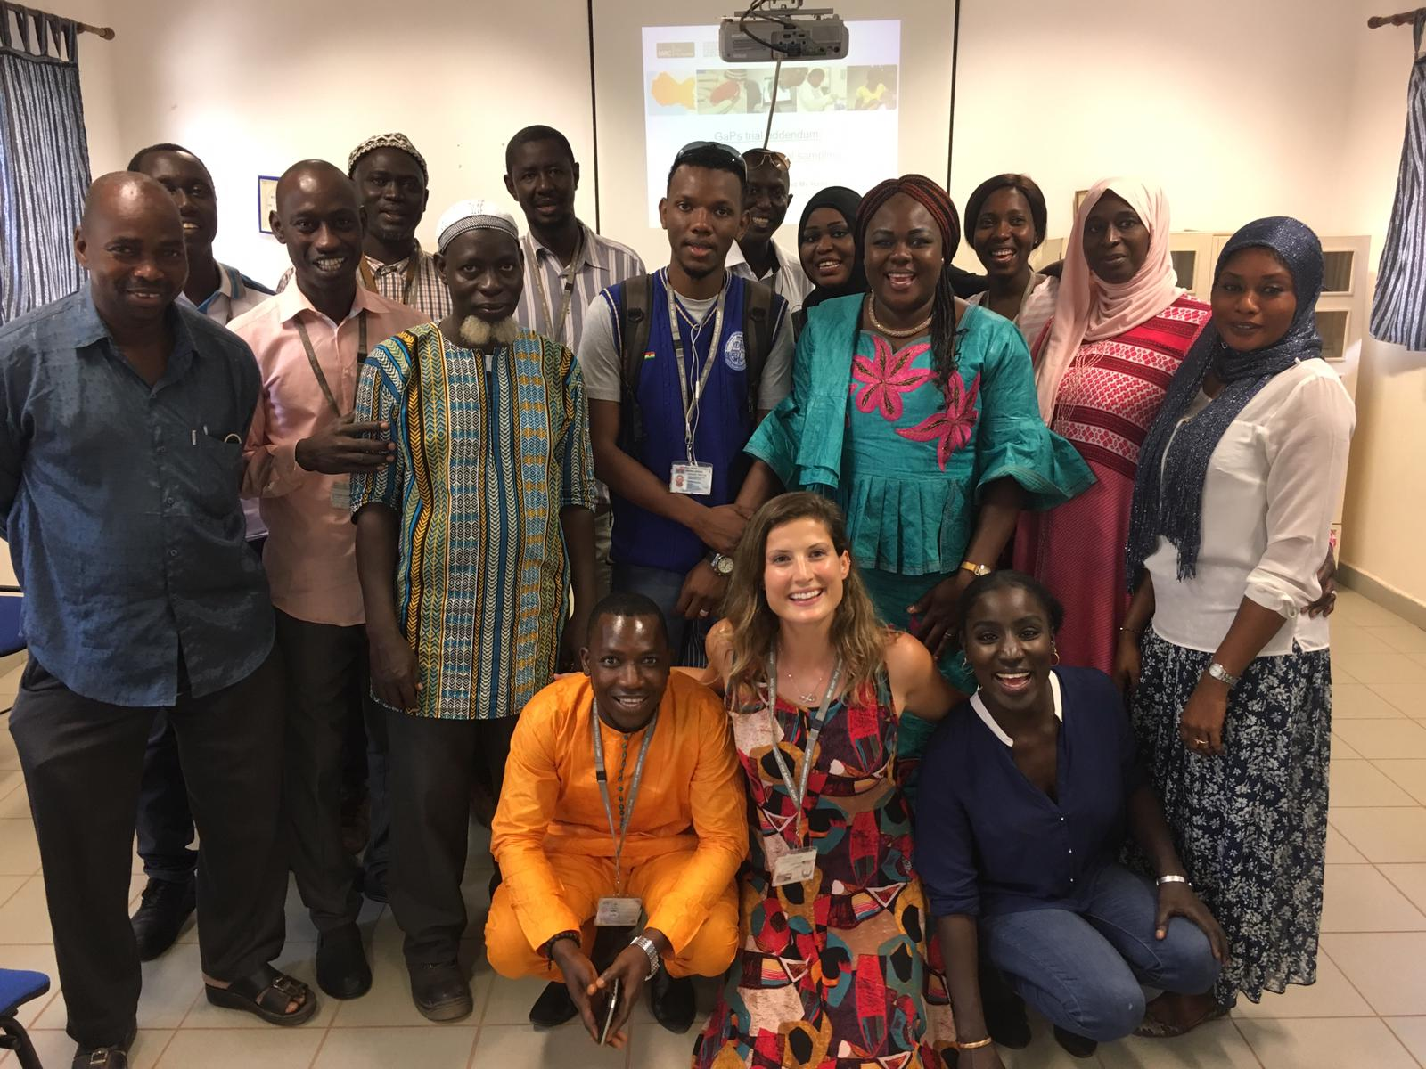

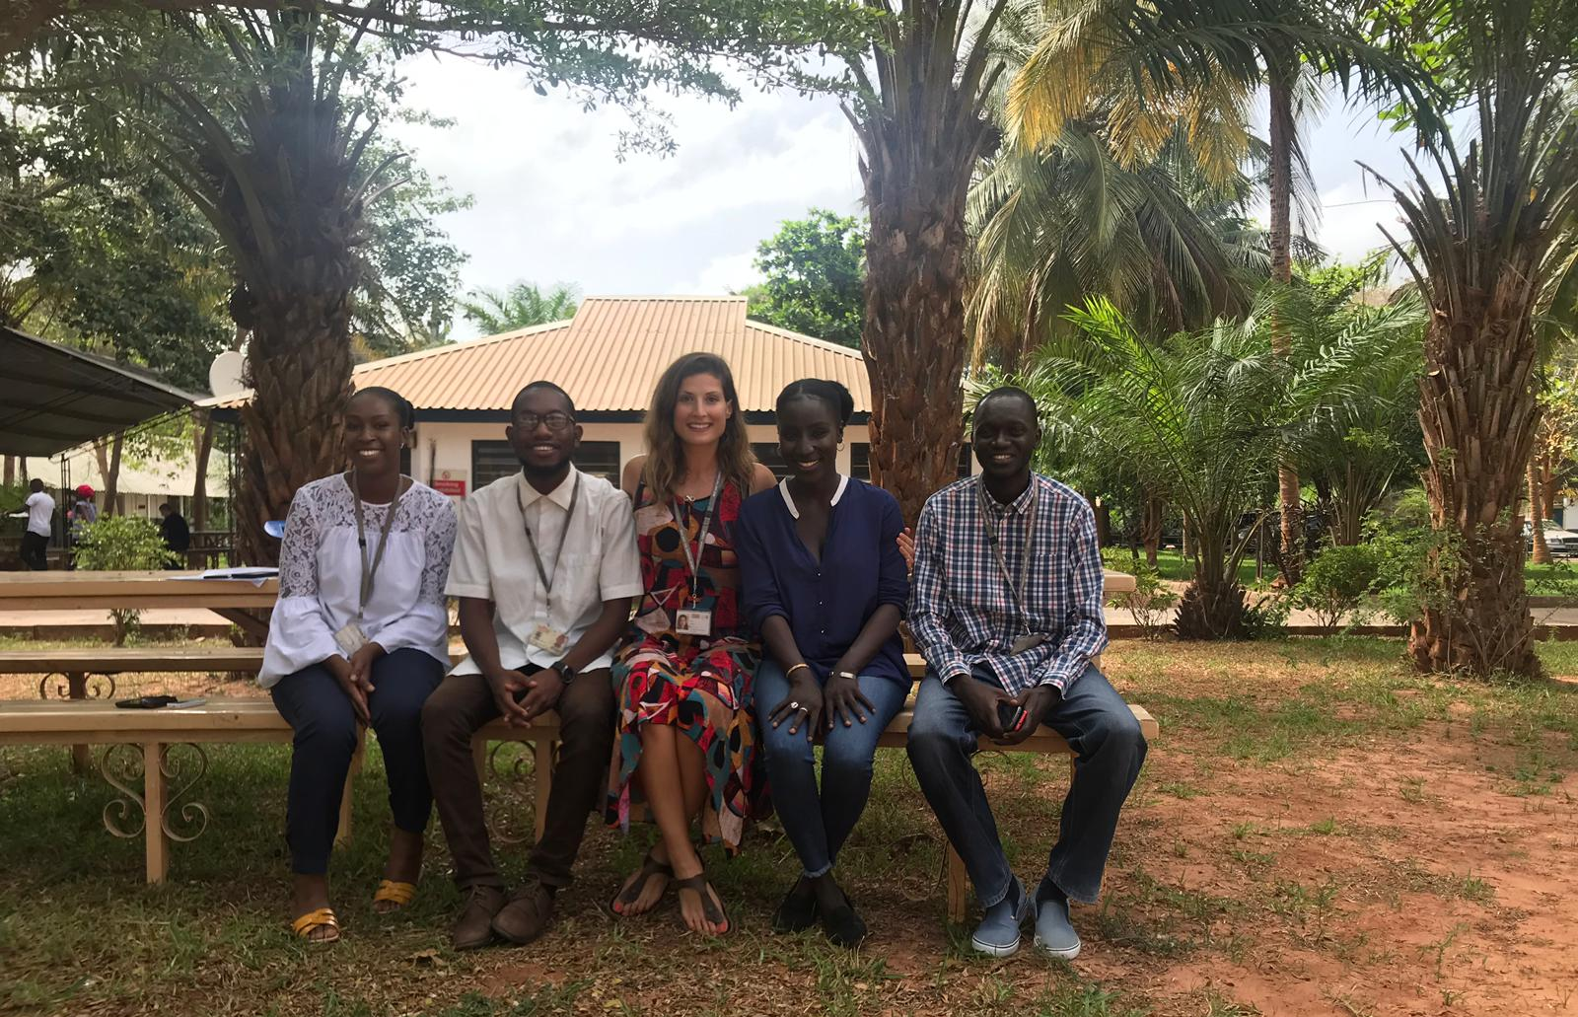
Thank you!
Questions??

Slide 32

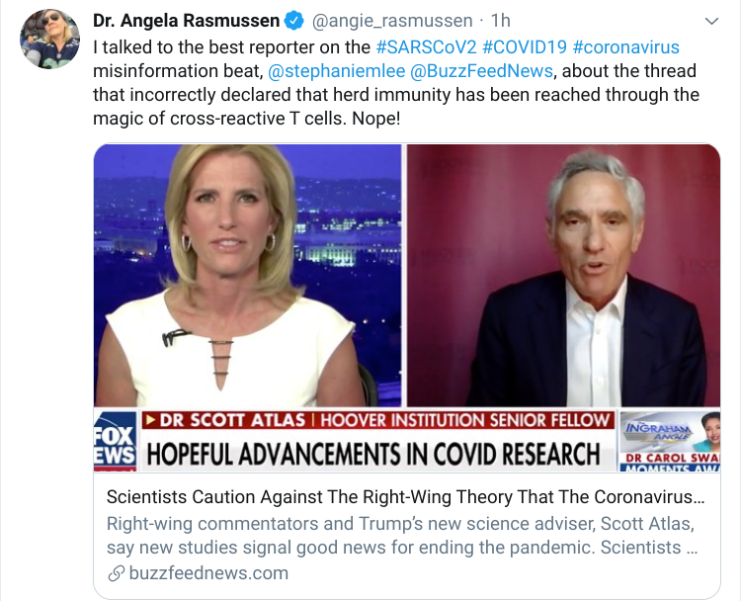
Final thoughts
What a great time to be working in vaccinology!
Even T cells are being politicised!

