Slide 1

Towards understanding natural immunity to Group A Streptococcus in The Gambia: Does humoral immunity to candidate-vaccine antigens protect from colonisation and disease?
Dr Alex Keeley – Wellcome Trust PhD fellow – Year 1
@AlexJKeeley

Slide 2
Outline:
Background information – setting the (vac) scene
Serological responses to Strep A colonisation
Opportunities provided by SpyCATS longitudinal household study
Luminex 4-plex assay development
Next steps

Slide 3

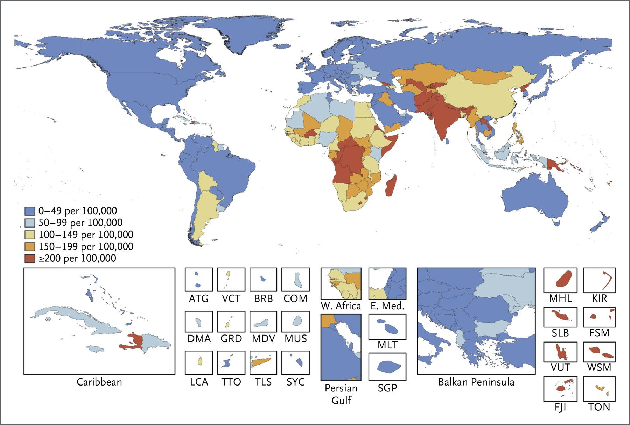
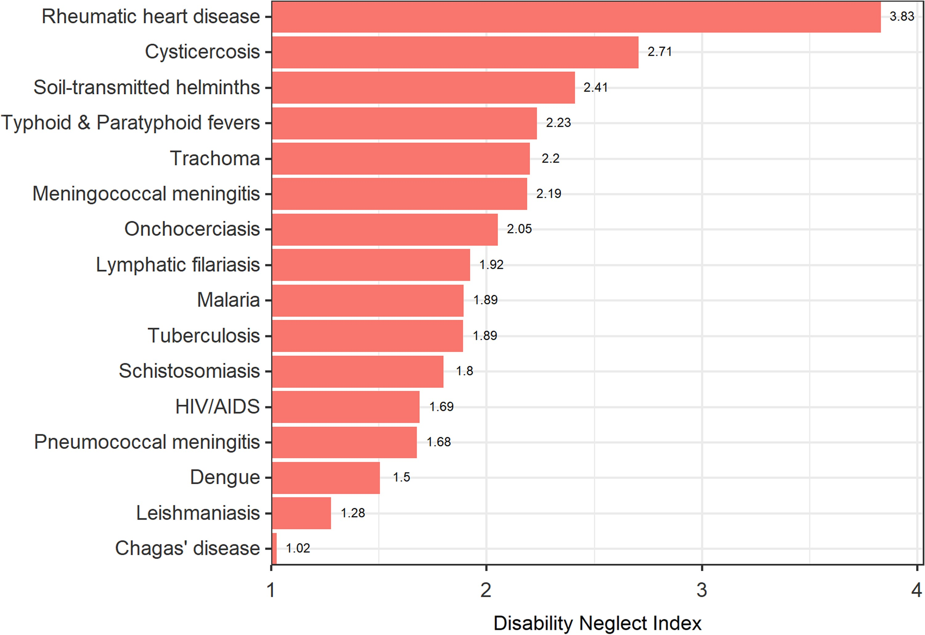
VACCINE
A safe and effective vaccine against Strep A is major global health priority

Slide 4
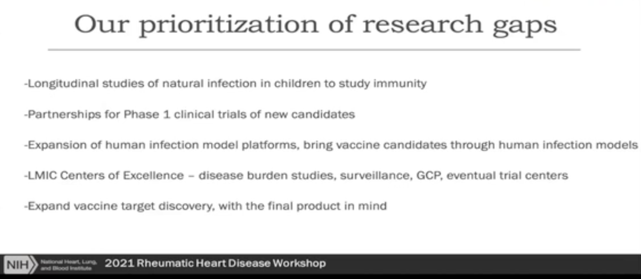
VACCINE
Knowledge gaps:
Natural immunity to non-invasive infection
Role of mucosa in protective immunity
Correlates of protection

Slide 5


VACCINE
A safe and effective vaccine against Strep A is major global health priority
M protein
vaccine
Conserved
antigen
vaccine
VS
Vaccines Institute for Global Health

Slide 6
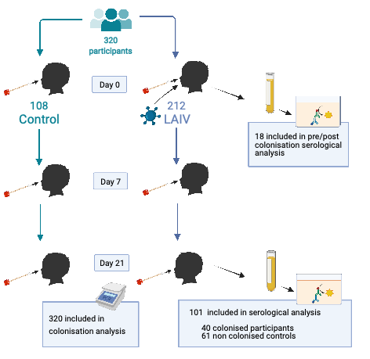
Serological response to colonisation
Children aged 2-4 in Sukuta, The Gambia
Randomised 2:1 to receive LAIV or control (no LAIV)
Post hoc: qPCR to SpeB from NP swab
Serum collected baseline and day 21 (LAIV group only)

Slide 7
Positive at any time point
Incident acquisition

Slide 10


Hypothesis 1: Higher magnitude serum antibody titres to conserved StrepA antigens will lead to protection from StrepA colonisation and disease caused by all strains.
Month
0
3
6
9
12
1
2
4
5
7
8
10
11
Swabs:
Throat and skin
Environment
Microbiology:
New Strep A colonisation
Confirmed Strep A disease
Serum:
Immunology:
Dried blood spot:
Oral fluid:
Hypothesis 2: Strep A humoral immune responses following infection will differ between colonisation and disease, between pharyngeal and skin infection, according to age, infecting strain and infection history.
IgG titre
Strep A episode
High titre
Antibody
Fold-change
Strep A disease incidence
Low titre

Slide 11
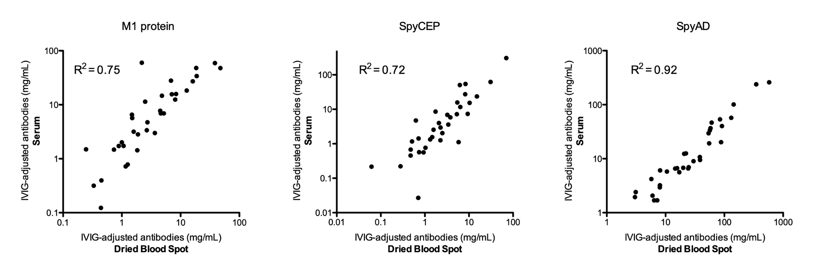
Month
0
3
6
9
12
1
2
4
5
7
8
10
11
Swabs:
Throat and skin
Environment
Microbiology:
New Strep A colonisation
Confirmed Strep A disease
Serum:
Immunology:
Dried blood spot:
Oral fluid:

Slide 12
Aim 1: Measure IgG to conserved vaccine antigens via Luminex multiplex assay
Vaccines Institute for Global Health
Manuscript coming soon:
“We describe the in depth characterisation of a 4-plex assay to quantify IgG in human sera to four vaccine antigens using the Luminex platform. We have demonstrated that the assay is highly specific, precise, repeatable and performs linearly across a large concentration range with low limits of quantification for each antigen. “

Slide 13
Next steps:
Incorporate M-proteins into Luminex assay
Develop ELISA / Luminex to measure IgA from oral fluid
Move to MRCG
Measure antibodies to vaccine antigens from SpyCATS cohort
Analysis to interrogate hypotheses and identify correlate of protection
Whole genome sequencing to genotype isolates to investigate strain specific antibody dynamics
Functional immune assays to explore serological correlate of protection

Slide 14





Supervisors:
Beate Kampmann
Thushan de Silva
Claire Turner
MSSG study group / key collaborators:
Saikou Bah
Annete Erhart
Abdul Sesay
Sona Jabang
Edwin Armitage
Gabreille de Crombrugghe
Ya Jankey Jagne
Elina Senghore
Michael Marks
Martina Carducci
Luisa Massai
Omar Rossi
Danillo Gomes
Pierre Smeesters
Allie Shaw
Lilith Whittles
Any questions?
Vaccines Institute for Global Health

