Slide 1
Supporting governments through genomic surveillance in West Africa
Abdul Karim Sesay
Genomics Strategic Core Platform, MRC Unit The Gambia @ LSHTM
Wellcome Trust - Bloomsbury Centre for Global Health
Research Scientific Meeting
17th March 2022

Slide 2
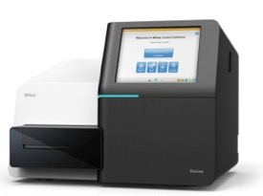
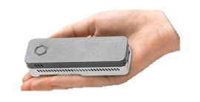
Genomics
DNA sequencing and the capacity to investigate the genome of host and pathogen populations have become an essential part of biomedical research, unlocking unique information about why some individuals or populations develop disease while others do not and how pathogens evolve to cause disease and counteract medical interventions
There is exponential growth in the interest and implementation of genomics research in Africa. However, most of the sequencing of samples collected in Africa is done outside of the continent.

Slide 3
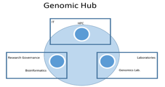
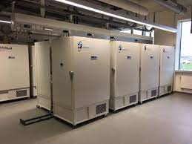
Establishing a Genomics Hub in the Unit
Genomics Platform
Biobank
MB and genomics
Data management and Computation
Archived samples
Current projects
Sequencing core
Data management
High performance
Molecular equipment
Quality control
1^{st, 2nd and 3rd} Generation sequencers
Infrastructure
Computing
Access
Platform Staffs
Project Staffs
MPhil and PhD Students
Interns
Fellows

Slide 4








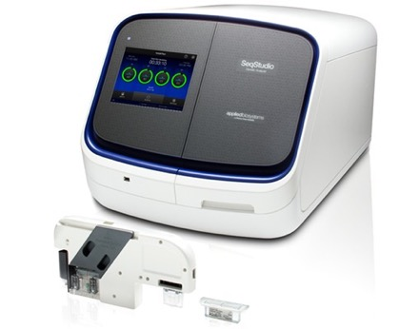
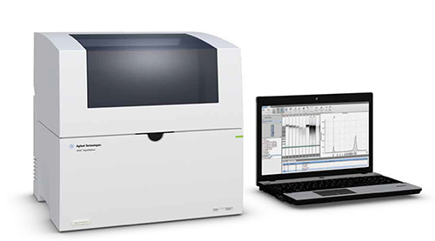
Platform investments at MRC Unit The Gambia at LSHTM
Iscan PromethION Nanostring system Opentron robots
Glomax MK1C (x3) Voltrax Megaruptor Bluepippin HT

Slide 5
West African Platform Networking and Training Opportunities
CLIMB WANETAM Workshop, The Gambia
Crick African Network Workshop, The Gambia
PAMGEN Malaria Genomics Workshop, The Gambia
WAGHA meeting, Senegal
WANETAM Research Design and Strategy, The Gambia
WANETAM and CLIMB TB Genomics Workshop, The Gambia

Slide 6
Covid-19 pandemic – a pathogen genomics opportunity
Providing confirmation of the presence of the virus. Monitor viral genome mutations that might affect the performance of medical countermeasures, including the current diagnostic tests and vaccines.
Africa Covid -19 Sequencing in Numbers (GSAID, January 2020)
An urgent need for the rapid scale-up of genomic surveillance efforts
A need for urgent funding of genomic surveillance in Africa
Additional role
Establishing Covid-19 detection at NPHL
Secondment to The Gambia MOH & NPHL
Covid-19 Response and Surveillance team

Slide 7


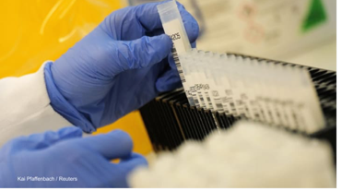
Sequencing capacity building in our sub-region
One example of a success story is Gambia. Dr. Abdul Karim Sesay, …largely supported by the United Kingdom. Gambia has uploaded 430 sequenced genomes to the global database but plans to upload another 470 this week, which amounts to about 19% of its positive samples.
In a Washington Post article published in December, the country ranked 6th globally for the percentage of positive COVID-19 samples sequenced. But as a small country with a relatively low number of cases, it has a numbers advantage.
Sesay is an advocate for decentralizing genome sequencing . He is working to strengthen labs in Mali, Guinea Bissau, Senegal, and Burkina Faso.
This is important, he says, because even if Gambia sequences a high portion of its positive samples, these efforts could mean little if neighboring countries aren’t doing the same due to the region’s porous borders.

Slide 8
MRCG at LSHTM genomics capacity building model
Phase 1
Training and Support
Phase 2
Coaching and Mentoring
Genomics Hub
Centre of Excellence
Phase 3
Monitoring and Evaluation

Slide 9
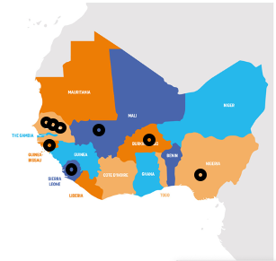
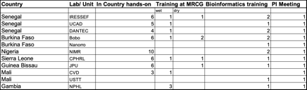
Building sequencing capacity to enhance surveillance of COVID-19 pandemic in the sub-region

Slide 10
Impact and Future Direction
Recognition
Public Health policies
Knowledge transfer: training, mentoring
Publications
Future Directions
Site visits and in-country training
WANETAM 3 work package
Increase collaboration: Regional, LSHTM, Networks
Human Genome Sequencing Network in the region
Emerging disease, zoonosis
Joint grants, publications and knowledge transfer

Slide 11
Genomics Core Facility Team
Abdoulie Kanteh
Jarra Manneh
Bakary Sayang
Mariama Kujabi
Dabiri Damilare
Sainabou Ndure
Sambou Suso
Michelle Katsvanga

