Slide 1
Integrating mental health in multimorbidity care: the ASSET study in Ethiopia
Dr Charlotte Hanlon
NIHR Global Health Research
Global Health Research Unit on Health System Strengthening
in Sub-Saharan Africa (ASSET)

Slide 2
Aim of ASSET
To develop/adapt, implement and evaluate health system strengthening interventions to achieve person-centred, integrated, continuing care for people with chronic conditions in primary health care
→ Focus on how mental health fits into person-centred care

Slide 3
Why integrate mental and physical health?
Undetected and unaddressed emotional needs associated with:
Repeated health centre attendance, help-seeking, out-of-pocket costs
Increased disability
Poorer quality of life
Reduced adherence to medications
Reduced healthy behaviours
Poorer prognosis

Slide 4
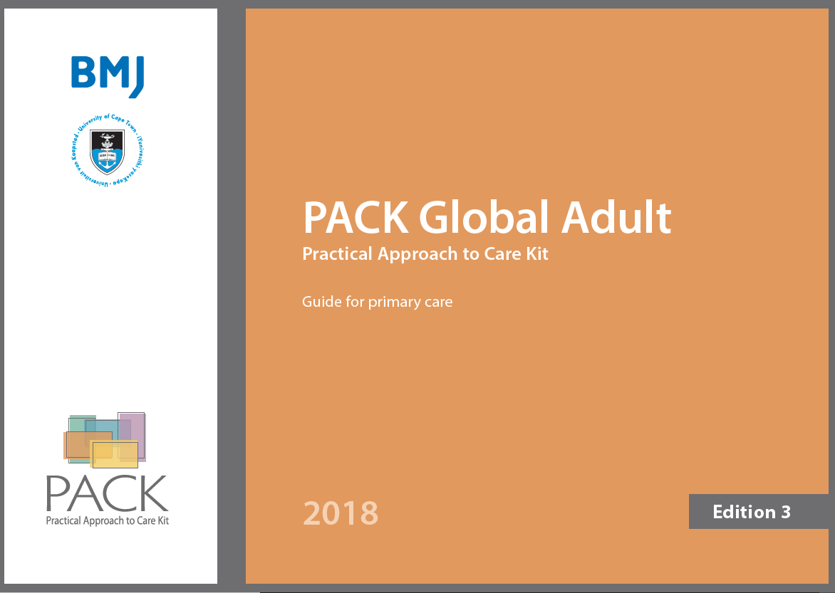
Integrated primary care for multimorbidity
Evidence-aligned, symptom-led, person centred, horizontally integrated
BMJ Global Health Series (2018); Lara Fairall

Slide 5
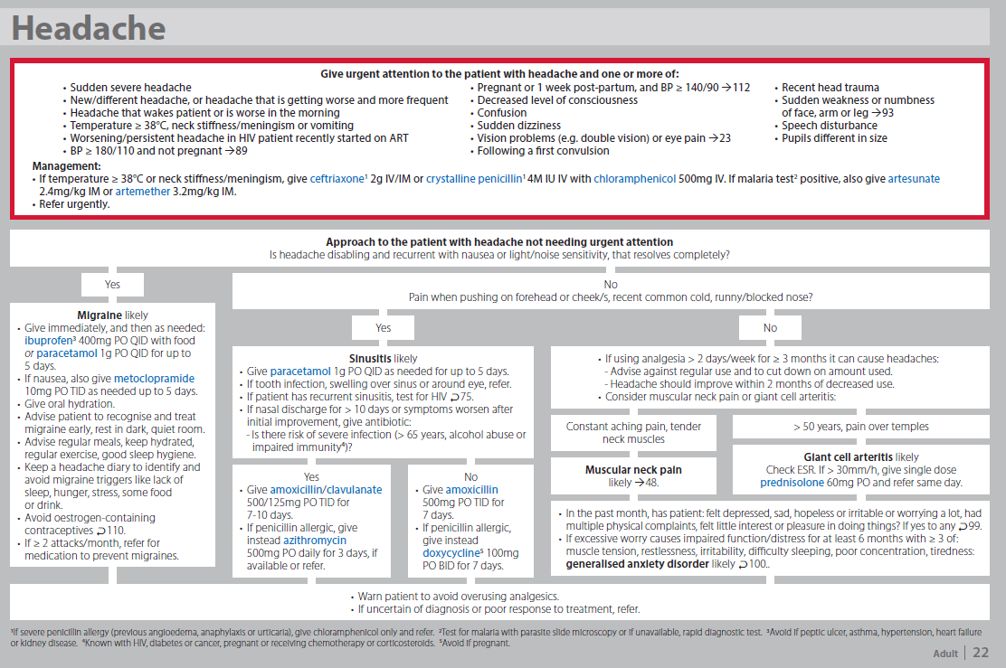

Slide 7
Diagnostic phase After implementing EPHCG, what are the system bottlenecks?

Slide 8
Cross-sectional, facility-based study
Consultation with PHC worker
Structured questionnaires
Clinical assessment
Data extracted from clinical notes:
Presenting complaint
Diagnosis
Investigation
Medications
Advice & follow-up
Socio-demographics
Clinical history
IUALTD
COPD screen
ASSIST
Cigarettes, coffee
PHQ-9, GAD-7
WHODAS-12
Healthcare contacts
Blood pressure
FBS or HbA1c
Spirometry
Anthropometry

Slide 9
Measurement
Culturally validated measure
Stringent definition of ‘case’ of depression
5 or more (optimal cut-off for major depression)
+
If said yes to any of the problems, how difficult have these problems made it for you to do your work, take care of things at home or get along with other people?
Very difficult/ extremely difficult

Slide 10
Survey participants
Characteristics
Male | 55.3%
Non-literate/ no education | 44.9%
Rural residence | 75.6%
Age (years) 18-30 31-50 51-70 71-90 | 27.7% 44.9% 24.1% 3.3%
N=1786 consecutive attendees,
8 primary care health centres

Slide 11
(1) Prevalence
 | Prevalence (n=1786)
 | n | %
Hypertension | 275 | 15.6%
Diabetes mellitus | 139 | 7.1%
Chronic lung disease | 260 | 14.6%
Depression | 304 | 16.4%

Slide 12
(2) Multimorbidity
 | Hypertension N=275 | Diabetes Mellitus N=139 | Chronic lung disease N=260 | Depression N=304 | Overweight/ obese N=181 | Under-weight N=394 | Risky alcohol use N=74 | Risky khat use N=254
Hypertension |  | 16.9% | 16.4% | 17.2% | 27.4% | 10.7% | 5.0% | 14.0%
Diabetes | 37.0% |  | 22.5% | 17.4% | 33.7% | 15.7% | 4.9% | 16.9%
Chronic lung disease | 17.5% | 11.0% |  | 21.1% | 15.8% | 29.3% | 4.4% | 18.6%
Depression | 16.3% | 7.6% | 18.7% |  | 10.8% | 23.0% | 6.5% | 21.9%
Overweight/ obese | 41.6% | 23.4% | 22.3% | 17.2% |  |  | 1.3% | 22.0%
Risky alcohol use | 19.2% | 8.8% | 15.8% | 26.6% | 3.4% | 25.8% |  | 11.9%%
Risky khat use | 14.2% | 7.9% | 17.6% | 24.5% | 6.9% | 13.1% | 3.1%

Slide 13
(3) Detection
 | New cases (n=1786) | Detection by PHC worker
Raised blood pressure | 9.3% (n=168) | 10.9% (17/168)
Diabetes mellitus | 2.2% (n=46) | 0% (0/46)
Chronic lung disease | 8.3% (n=138) | 0.7% (2/138)
Depression | 5.6% (n=100) | 6.7% (8/100)

Slide 14
(4) Control
 | Known cases (n=1786) | Control
Hypertension | 6.3% (n=107) | 68.4% (82/107)
Diabetes mellitus | 5.0% (n=93) | 51.5% (51/93)
Chronic lung disease | 6.3% (n=122) | 81.3% (100/122)
Depression | 10.9% (n=204) | 47.8% (98/204)

Slide 15
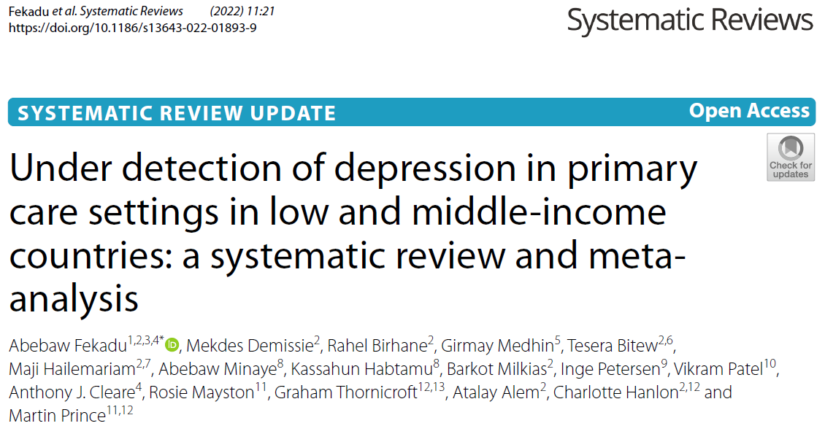
Nothing new!
12 studies
Pooled detection 3.9% for mild; 7.0% for severe depression

Slide 16
But why?
Tekola et al. Transcultural Psych; 2021
Bitew et al. BMC Psych; 2020
Selamu et al. HRH; 2019
Patient & community
Health worker
Health system
Low awareness in patient
Lack needed communication skills
No private space
Time pressures
No referral pathways
Alternative attributions
Stigma
Lack of knowledge
Lack of acceptable and feasible interventions
Not reinforced by HMIS
Emotional labour
Not expected to discuss at health centre
Own problems or burnout
Different manifestations
Inadequate supervision
Not confident

Slide 17
What to do?
Screening?
Patient & community
Health worker
Health system
Low awareness in patient
Lack needed communication skills
No private space
Time pressures
No referral pathways
Alternative attributions
Stigma
Lack of knowledge
Lack of acceptable and feasible interventions
Not reinforced by HMIS
Emotional labour
Not expected to discuss at health centre
Own problems or burnout
Different manifestations
Inadequate supervision
Not confident

Slide 18
Improved functioning and quality of life in people with
NCDs and mental health conditions
Chronic care app
Peer support
Clinical communication skills
Information leaflet
Cradle VSA
QI training
Increase detection & referral & monitoring for hypertension
Person-centred care:
Self-management
Informed
Motivated
Increased detection of NCD & mental health conditions
Better quality of care for NCDs/MHCs
Data to improve continuing care and engagement over time

Slide 19
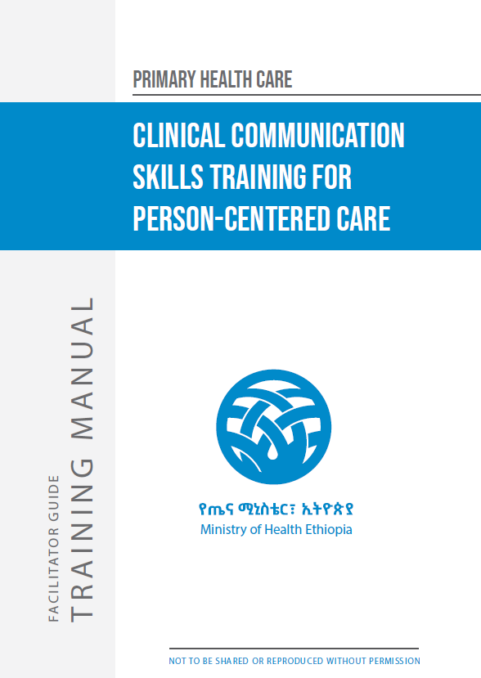
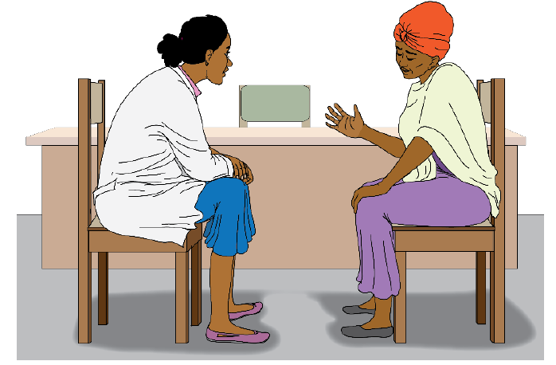
Adapted from Petersen et al.

Slide 20
Clinical Communication Skills for PCC
Session 1
Why do we need a new way of working?
Golden minute
Prepare
Relationship-building
whY?
Session 2
Gathering holistic information
Ideas
Concerns
Expectations
Handling social problems
Session 3
Dealing with emotions
Recognise
Empathy/engage
Affirm & respect
Develop a plan
Handling stress in health work
Session 4
Informing and motivating
Ask
Alert
Assess
Assist
Arrange

Slide 21
% of OPD attendees with diagnosis of depression

Slide 22
Other initiatives…
Social contact – people with depression involved in training health workers
IDEAS project
Brief problem-solving therapy
Chronic care app
Health worker app

Slide 23
Summary
Depression detection in routine services is a bottleneck to care
Uncritical application of screening instruments will not solve the problem
Person-centred care for chronic conditions requires attention to depression and mental health
Health workers need a new way of working to achieve this
System strengthening interventions to achieve person-centred care can increase the quality of all care, and create conditions for detection

Slide 24
Thank you
This research was funded by the National Institute of Health Research (NIHR) Global Health Research Unit on Health System Strengthening in Sub-Saharan Africa, King’s College London (GHRU 16/136/54) using UK aid from the UK Government.
The views expressed in this publication are those of the presenter and not necessarily those of the NIHR or the Department of Health and Social Care.

Slide 25
ASSET Integrated PHC team
Martin Prince
Charlotte Hanlon
Lara Fairall
Inge Petersen
Atalay Alem
Abebaw Fekadu
Girmay Medhin
Tewodros Haile
Alemayehu Bekele
Tigist Eshetu
Hanna Negussie
Sewit Timotewos
Amanuel Belay
Medhanit Getachew

Slide 26
Global Health Research Unit on Health System Strengthening in Sub-Saharan Africa (ASSET), NIHR Global Health Research
The work presented in this presentation is funded by the National Institute of Health Research (NIHR) Global Health Research Unit on Health System Strengthening in Sub-Saharan Africa, King’s College London (GHRU 16/136/54) using UK aid from the UK Government to support global health research. The views expressed in these materials are those of the author(s) and not necessarily those of the NIHR or the Department of Health and Social Care.

Slide 27
